Slide 1


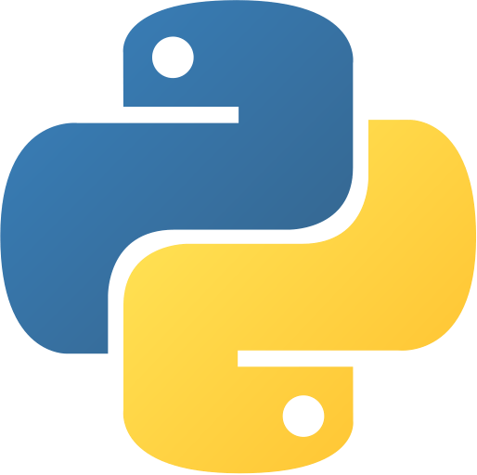
McGill
Students’
Trading Society
PYTHON FOR FINANCE
tradingsociety.wixsite.com/msts

Slide 2
AGENDA
WHAT WILL YOU LEARN?
1. Data Access : Accessing stock data in python
5. Interview Questions & Conclusion
2. Basic Visualizations: Plotting Price, Volume & more
3. Data Manipulation : Wealth Indexes
4. Portfolio Creation : Creating our stock portfolio
Notes:
Before we get started:
Hopefully everyone has installed python and anaconda (send out links to those who have not)
We’re going to be going through with Jupyter, please use it

Slide 3
BUILDING YOUR PORTFOLIO
ASSET ALLOCATION
Asset Allocation relates to the structure of your portfolio.
Asset classes include equities, fixed income, commodities, real assets, etc.
Asset types are not to be confused with instruments (futures and options on stocks are still exposure to stocks!)
WHY DO PEOPLE WANT TO BE IN DIFFERENT ASSET CLASSES?
To protect their downsides through different economic cycles.
Typically, when the economy is doing well, yields on bonds are lower and returns on equities are higher
On the other hand, when the economy is doing poorly, credit dries up which leads to higher yields and lower bond prices.
Depending on a macro investor’s current outlook of the economy, he is going to be allocated into assets differently.
Notes:
Check if people have python installed by going into the terminal and typing python

Slide 4
BUILDING YOUR PORTFOLIO
SECURITY SELECTION
Security selection is about selecting which specific assets compose your allocation to a given asset class.
For example, in your equities portion of the portfolio, you may choose to pick your own stocks as you feel these have the highest expected return to risk tradeoff.
It’s also important to think about how your equities relate to each other, as we will see, the correlation and variance of returns matter when we are looking for the best risk adjusted returns overall
When looking to optimize portfolios on a mean-variance basis, we look to maximize the ratio of return to risk
Ray Dalio’s All Weather Portfolio is a good example of a diversified portfolio.
Notes:
Check if people have python installed by going into the terminal and typing python

Slide 5
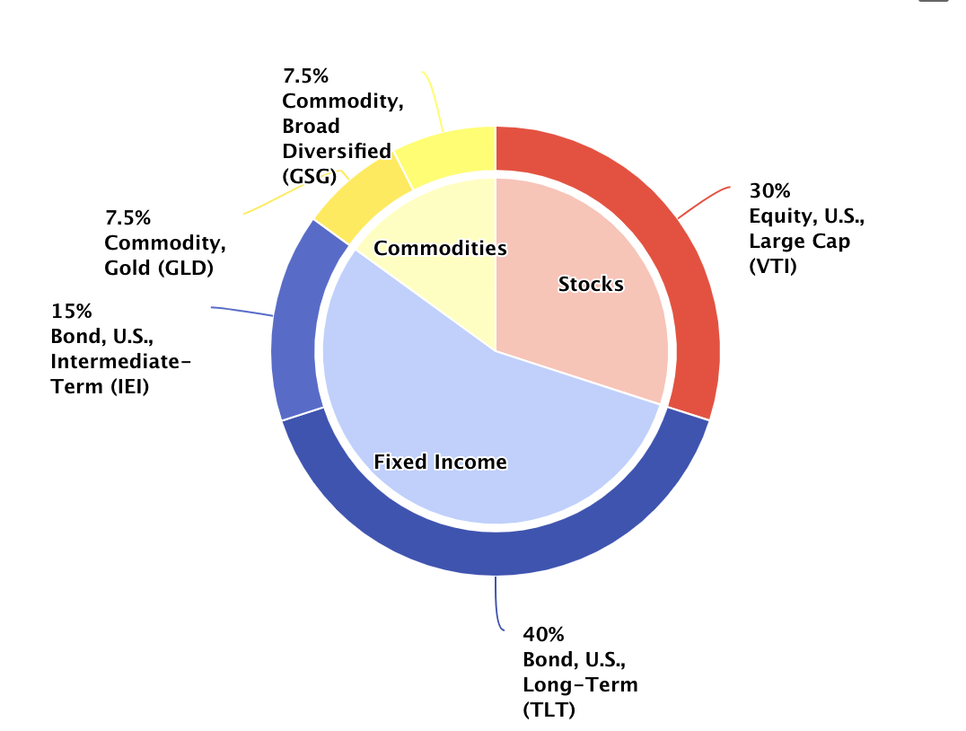
MSTS PYTHON FOR FINANCE
PORTFOLIO BASICS – Asset Allocation and Security Selection
Ray Dalio’s All Weather Portfolio
Asset Allocation
The process of selecting the proportion of your portfolio that will be allocated to the various asset classes elected.
Asset classes include but are not limited to stocks, bonds or commodities or cash for example.
Security Selection
The process of determining which financial securities will be part of the various asset classes you are allocated to.
Securities include but are not limited to specific stocks, commodity futures and exchange traded funds

Slide 6


BUILDING YOUR PORTFOLIO
MEASURING RETURNS
For any given period for a security, this is the formula for measuring return:
The portfolio return is the weighted average of expected returns of the component assets in the portfolio
You can also compute the expected returns for a specific asset allocation within your portfolio; their weighted average will be the expected return of your portfolio
$$R_{t,t+1} =\frac{P_{t+1}−P_{t}}{P_{t}}$$
$$E\left[R_{P}\right]= \sum_{i=1}^{n}{w_{i}E[R_{i}]}$$
Notes:
Check if people have python installed by going into the terminal and typing python

Slide 7




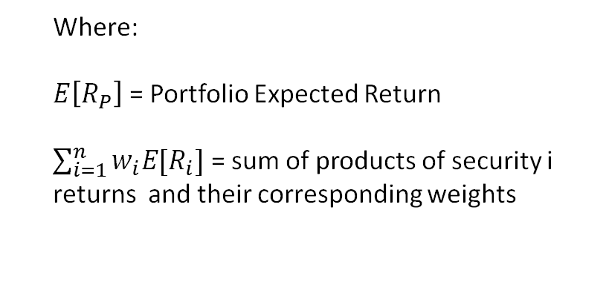
MSTS CODING FOR FINANCE
PORTFOLIO BASICS – Measuring Expected Return
Measuring Security Return
Measuring Portfolio Return
Portfolio Expected Return
$$E\left[R_{P}\right]= \sum_{i=1}^{n}{w_{i}E[R_{i}]}$$
Period Return
$$R_{t,t+1} =\frac{P_{t+1}−P_{t}}{P_{t}}$$
2 Period Return
Security Weight
$w_{i}$ = $\frac{\$ Invested in security i}{Total invested in Portfolio p }$
$R_{t,t+2} =\left(1+R_{t,t+1}\right)$ $\left(1+R_{t+1,t+2}\right) −1$
Where:
$$P_{t+1} = Price at time t+1$$
$R_{t,t+1}$ = Return from period t to the next.
Where:
$E\left[R_{P}\right]$ = Portfolio Expected Return
$\sum_{i=1}^{n}{w_{i}E[R_{i}]}$ = sum of products of security i returns and their corresponding weights
Notes:
Check if people have python installed by going into the terminal and typing python

Slide 8


BUILDING YOUR PORTFOLIO
MEASURING RISK
Volatility is the most common measure of risk in finance, the reason being that the uncertainty of returns is what investors fear
We measure volatility with the variance and standard deviation:
Formula: To obtain the standard deviation, we simply square root the variance
$$σ_{R}^{2}= \frac{1}{N}{\sum_{i=1}^{n}{(R_{i}−\overline{R})}}^{2}$$
$$σ=\sqrt{σ_{R}^{2}}$$
Notes:
Check if people have python installed by going into the terminal and typing python

Slide 9
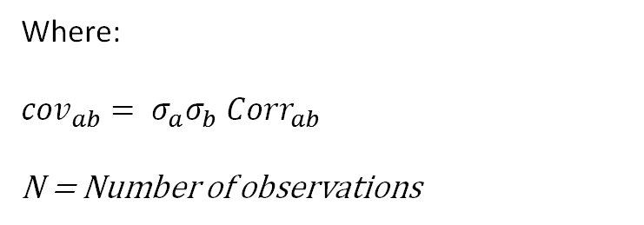

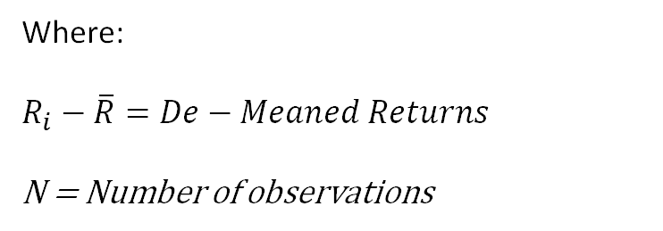



MSTS CODING FOR FINANCE
PORTFOLIO BASICS – Measuring Risk
Measuring Security Risk
Portfolio variance
2-Stock Portfolio Variance
Security Variance
$σ_{R}^{2}= \frac{1}{N}{\sum_{i=1}^{n}{(R_{i}−\overline{R})}}^{2}$
$σ_{p}^{2}=$ $w_{a}^{2}$ $σ_{a}^{2}$ + $w_{b}^{2}$ $σ_{b}^{2}$ + 2$w_{a}$ $w_{b}$ ${cov}_{ab}$
$$σ=\sqrt{σ_{R}^{2}}$$
Covariance of returns
$$Cov\left(r_{i},r_{j}\right)= \frac{\sum{\left(r_{i}−\overline{r}\right)∗} \left(r_{j}−\overline{r}\right)}{N}$$
Standard deviation
Where:
$$R_{i}−\overline{R}=De−Meaned Returns$$
N = Number of observations
Where:
${cov}_{ab}= σ_{a}σ_{b}$ ${Corr}_{ab}$
N = Number of observations
Notes:
Check if people have python installed by going into the terminal and typing python

Slide 10
INTERVIEW QUESTIONS
TRADING AND QUANT ROLES
Roles related to computer science in the finance industry often require creative thinking abilities and good knowledge of mathematics. We’ve chosen some fun questions to end the session.
The questions are of similar difficulty.
QUESTIONS
You have 10 people in a room. How many total handshakes if they all shake hands?
You have a 3-gallon jug and 5-gallon jug, how do you measure out exactly 4 gallons? Is this possible?
Notes:
Check if people have python installed by going into the terminal and typing python

Slide 11
THANK YOU FOR JOINING
THE MSTS TEAM

Slide 12




THANK YOU FOR PARTICIPATING
FOR MORE
Thank you for taking part in MSTS’s first workshop in its series “Python For Finance”
If you’d like to learn more about upcoming workshops or the workshop series itself, please contact tradingsociety@ssmu.ca
If you have questions on the setup including, python, anaconda, NumPy, pandas, matplotlib or questions on the content of this PowerPoint, please contact Stanislas Motte (me) at stanislas.motte@mail.mcgill.ca or find me on Facebook or LinkedIn at Stan Motte and Stanislas Motte respectively
If you’re excited for what is to come, make sure to read our emails, visit our website tradingsociety.wixsite.com/msts
Don’t forget to follow us on Instagram, Facebook, Instagram, and LinkedIn for content, updates and news regarding exclusive MSTS events and signups
Notes:
Check if people have python installed by going into the terminal and typing python

Slide 13
DISCLAIMER
The MSTS members and executives are not licensed financial advisors, registered investment advisers, or registered broker-dealers. The MSTS does not provide investment or financial advice or make investment recommendations, nor is it in the business of transacting trades. Nothing contained in this communication constitutes a solicitation, recommendation, promotion, endorsement, or offer by the MSTS team and members of any particular security, transaction, or investment. The information provided on this presentation should not be taken as legal advice or professional advice on finance or investments. Do not use the information as a substitute for professional advice from legal or certified financial planner or investment professionals. This presentation is intended for McGill University students and the information contained herein is subject to change without notice. The owner and publisher of this presentation is not liable for any inaccuracies in the information provided. MSTS is not liable for the views expressed in this presentation and the damages that may arise from the use of its content.
Notes:
Check if people have python installed by going into the terminal and typing python

