Slide 1


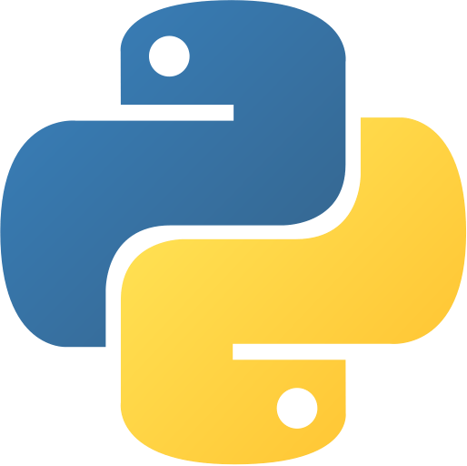
McGill
Students’
Trading Society
PYTHON FOR FINANCE
tradingsociety.wixsite.com/msts

Slide 2
AGENDA
WHAT WILL YOU LEARN?
1. MEAN VARIANCE PREFERENCES
2. PORTFOLIO OPTIMIZATION : BASICS
4. PYTHON : CREATING & OPTIMIZING A STOCK PORTFOLIO
3. MARKOWITZ OPTIMIZATION
5. PYTHON : ALGORITHMIC TRADING STRATEGY
6. INTERVIEW QUESTIONS
Notes:
Before we get started:
Hopefully everyone has installed python and anaconda (send out links to those who have not)
We’re going to be going through with Jupyter, please use it

Slide 3
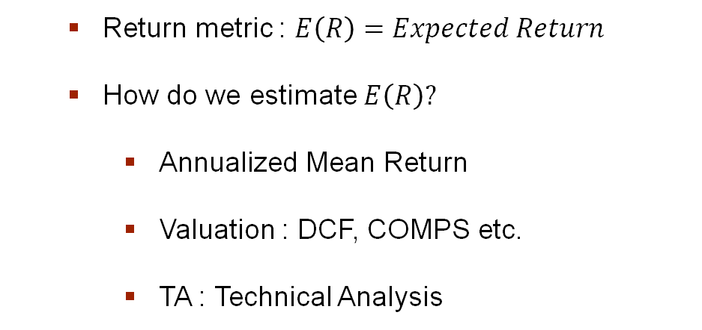
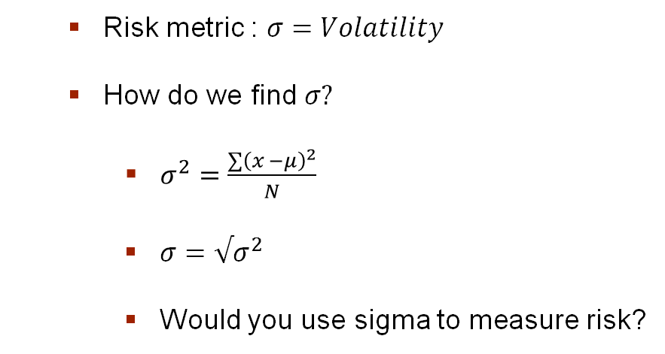
MEAN-VARIANCE PREFERENCES
WHAT STOCK CHARACTERISTICS DO WE CARE ABOUT?
A security, such as a stock, in portfolio theory, is usually evaluated using two metrics
Return
Risk
Return metric : $E\left(R\right)=Expected Return$
How do we estimate $E\left(R\right)?$
Annualized Mean Return
Valuation : DCF, COMPS etc.
TA : Technical Analysis
Risk metric : $σ=Volatility$
How do we find $σ?$
$σ^{2}=\frac{∑{\left(x −μ\right)}^{2}}{N}$
$σ=√σ^{2}$
Would you use sigma to measure risk?
Notes:
Check if people have python installed by going into the terminal and typing python

Slide 4
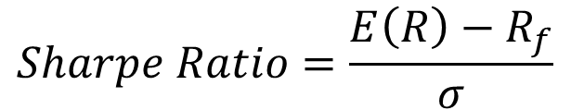
PORTFOLIO OPTIMIZATION BASICS
HOW DO WE EVALUATE A STOCK? A PORTFOLIO OF STOCKS?
The holy grail of basic portfolio management is the Sharpe Ratio
This is the ratio of returns in excess of the risk-free rate to risk
The ratio can be interpreted economically as the additional return in excess of the R_{f} for an additional unit of risk
Why Does it Matter?
The Sharpe Ratio is useful in comparing the change in a portfolio's overall level of risk when adding a new asset class or asset.
The ratio provides insight on how much of the returns are a result of added risk as opposed to good decision. In essence, it is a measure of change in risk-reward based on portfolio composition.
The higher the ratio, the better the expected return in relation to the level of risk associated with the investment.
Where volatility = risk = Std. Dev.
The famous “Sharpe Ratio”
$$Sharpe Ratio=\frac{E\left(R\right)−R_{f}}{σ}$$

Slide 5
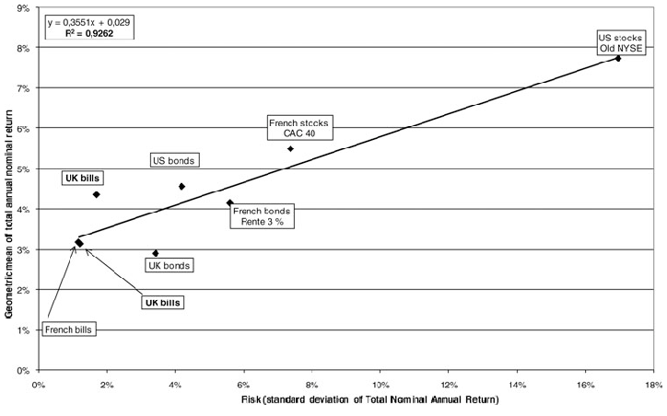
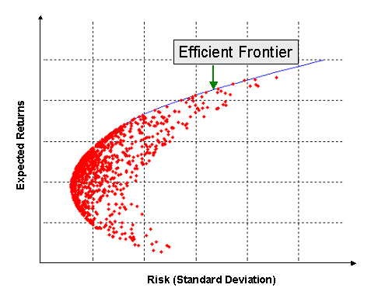
PORTFOLIO OPTIMIZATION BASICS
HOW DO WE EVALUATE A STOCK? A PORTFOLIO OF STOCKS?
Theoretically: “the higher the risk, the higher the return”.
Findings suggest that it is possible to construct an efficient frontier of optimal portfolios that offer maximum E(R) for a given risk.
Efficient Frontier
Feasible Set
Minimum Variance Portfolio

Slide 6
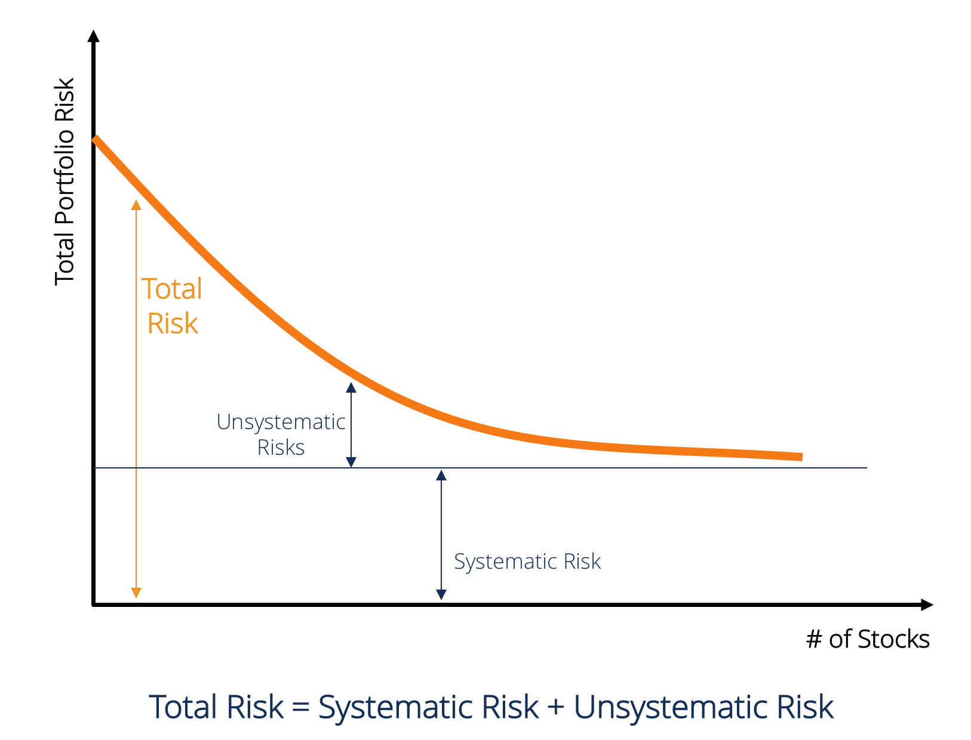
PORTFOLIO OPTIMIZATION BASICS
HOW DO WE EVALUATE A STOCK? A PORTFOLIO OF STOCKS?
Efficient Frontier
Undiversifiable risk
Optimally diversified portfolio
Hedge against downwards market
No portfolio can go “over the frontier”
Systematic risk (market risk) cannot be reduced – it affects the whole market
Objective of portfolio managers
Get closer to the frontier to maximise return for a given risk
Where you lie on the efficient frontier depends on your Target Return and Risk Tolerance

Slide 7

CODING FOR FINANCE
PUTTING ALL INTO PYTHON

Slide 8
INTERVIEW QUESTIONS
TRADING AND QUANT ROLES
Roles related to computer science in the finance industry often require creative thinking abilities and good knowledge of mathematics. We’ve chosen some fun questions to end the session.
The first to questions are knowledge-based, and the third one is designed to assess your understanding of statistical probability
QUESTIONS
How would you compare the performance of two portfolios?
How would you interpret the meaning of Beta in the Capital Asset Pricing Model?
There is 40 people in a room, what is the probability at least two share a birthday?
Notes:
Beta ; systematic risk and expected return
365! / (365^40) / 326! = 0.891

Slide 9
THANK YOU FOR JOINING
THE MSTS TEAM

Slide 10




THANK YOU FOR PARTICIPATING
FOR MORE
Thank you for taking part in MSTS’s first workshop in its series “Python For Finance”
If you’d like to learn more about upcoming workshops or the workshop series itself, please contact tradingsociety@ssmu.ca
If you have questions on the setup including, python, anaconda, NumPy, pandas, matplotlib or questions on the content of this PowerPoint, please contact Stanislas Motte (me) at stanislas.motte@mail.mcgill.ca or find me on Facebook or LinkedIn at Stan Motte and Stanislas Motte respectively
If you’re excited for what is to come, make sure to read our emails, visit our website tradingsociety.wixsite.com/msts
Don’t forget to follow us on Instagram, Facebook, Instagram, and LinkedIn for content, updates and news regarding exclusive MSTS events and signups
Notes:
Check if people have python installed by going into the terminal and typing python

Slide 11
DISCLAIMER
The MSTS members and executives are not licensed financial advisors, registered investment advisers, or registered broker-dealers. The MSTS does not provide investment or financial advice or make investment recommendations, nor is it in the business of transacting trades. Nothing contained in this communication constitutes a solicitation, recommendation, promotion, endorsement, or offer by the MSTS team and members of any particular security, transaction, or investment. The information provided on this presentation should not be taken as legal advice or professional advice on finance or investments. Do not use the information as a substitute for professional advice from legal or certified financial planner or investment professionals. This presentation is intended for McGill University students and the information contained herein is subject to change without notice. The owner and publisher of this presentation is not liable for any inaccuracies in the information provided. MSTS is not liable for the views expressed in this presentation and the damages that may arise from the use of its content.
Notes:
Check if people have python installed by going into the terminal and typing python

