Slide 1

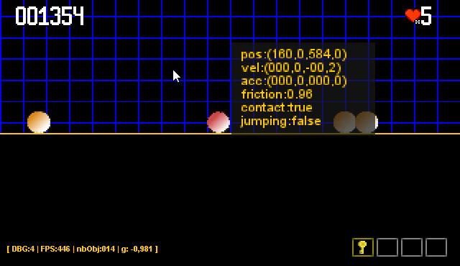
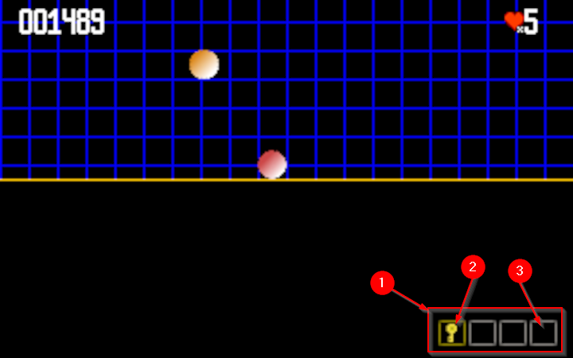

From Class
To Game
A java 2d game framework story
Fork me on Github
Frédéric Delorme
SnapGames
E D I T I O N

Slide 2


SnapGames
E D I T I O N
${title}
${bookdescription}
${author}
${authordescription}
AUTHOR
© Copyright SnapGames 2021 - https://snapgames.fr
Genreated via Pandoc (https://pandoc.org)

Slide 3
SnapGames
E D I T I O N
SnapGames
E D I T I O N

Slide 4
SnapGames
S O F T W A R E
SnapGames
S O F T W A R E

