Slide 1




Machine Learning Workshop
Session 1
Hannah Clayton and William McGough
Notes:
Brief intro to machine learning – what it is, roughly how we do it, and we’ll talk a bit about linear regression, which is a particular kind of ML algorithm

Slide 2
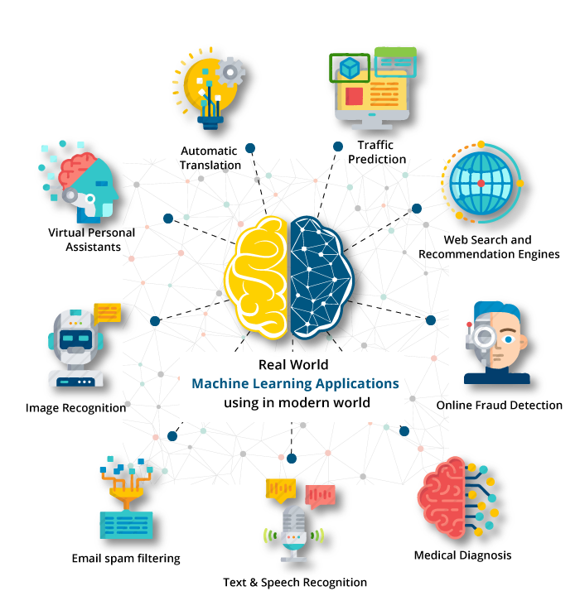
Notes:
You might not know it, but we are actually surrounded by a lot of ML applications in the real world e.g. filtering out spam in your email inbox or recommender systems on Netflix, or applications to medicine – take patient data e.g. images and use them to predict clinical outcomes/diagnose disease
Mention of some applications – spam, recommender systems on Netflix, medical applications

Slide 3
What is Machine Learning?
“Field of study that gives computers the ability to learn without being explicitly programmed”
Notes:
What is ML really? Taken this quote from Andrew Ng’s ML course on coursera (high recommend) and he says that …
Usually when we want a computer to do something for us, we right down line-by-line a list of instructions. But this isn’t appropriate for all tasks, and in ML we do something a bit different…

Slide 4


How do we do it?
Human learning
Machine learning
Notes:
Draw an analogy to human learning (take with a pinch of salt!)
Think about learning in the formal setting e.g. a classroom – two main ingredients: textbook which contains the information we want to learn, and a teacher, someone to guide us in the learning process. Similar in ML, …

Slide 5
How do we do it?
Human learning
Machine learning
Learning material e.g. books/experience
Guidance e.g. teacher
Data
Algorithm
Notes:
But it’s not a teacher and a textbook, but rather data and an algorithm.
Will be different depending on the kind of problem you’re dealing with – e.g. disease diagnosis from screening – lots of radiological images + CNN

Slide 6
How do we do it?
Collect and prepare data
Select appropriate model
Train model
Evaluate model
Notes:
Same kind of steps for each ML problem
Collect and prepare the data or learning material – part of that is making sure that the data is in a nice form. When we want to learn something, it’s much easier if all the info is organised nicely in a textbook, rather than on lots of haphazard pieces of paper written by different people using different conventions. Need to do some work to preprocess the data sometimes – we’ll talk about that later
Select an appropriate model – depends on kind of model. E.g want to learn French, won’t go to a German teacher
Train model – sit in the classroom and learn the material
Evaluate – take the ”exam” – different metrics exist to quantify how well our model is performing at the given task
Focus on middle two steps in this session

Slide 7
Machine learning algorithms
Supervised learning
Unsupervised learning
Learn from data labelled with the “right answer”
Find something interesting in unlabelled data
Notes:
Many different kinds of ML algorithms – we’ll focus on two big branches (but keep in mind that others do exist too)
Supervised learning e.g. medical images with labels about whether there is disease or not. Here, two different kinds of objects – circles and stars (shape = label) – use ML to understand how to separate these two groups. X and y values = features
Unsupervised – no longer have labels, want to find interesting patterns in the data. No different kinds of shapes, but can see there are two distinct groups – there’s some kind of structure in the data, use unsupervised algorithm to uncover this.

Slide 8
Regression
Predict a number
“How much should this cost?”
Classification
Predict categories
“Is this tumour malignant or benign?”
Supervised learning
Next session!
Notes:
Within supervised learning, look at two kinds of problems
Regression – find some sort of trendline
Classification – predict categories e.g. image classification. No perfect separation, real world data is “messy”

Slide 9

Example: linear regression
Have list of apartment sizes and the price at which they sold
Given size of new apartment, want to predict price at which it will sell
Notes:
Simplest case: Linear regression = fit a straight line to the data
Problem: try to predict house price depending on certain characteristics of the house
Data: houses that have already sold, the price they were sold at, and how big they were
Problem: given a new house, know it’s size, want to know a reasonable price to list it at so that it will sell quickly

Slide 10
Example: linear regression
y = mx + c
Notes:
Input and output
M + c = model parameters, control what the line looks like – need to find optimal values for these so that the line describes the data well. Do this during training

Slide 11
Example: linear regression
Model input: apartment size
y = mx + c
Model output: predicted price

Slide 12
Example: linear regression
Model parameter: intercept
y = mx + c
We find optimal values for model parameters during training
Model parameter: slope

Slide 13
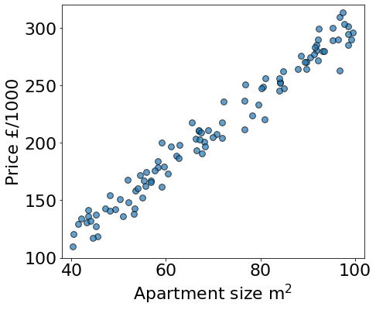
Apartment price prediction
Apartments that have already sold
Notes:
Start by plotting the existing data
Some noise, but following a linear trend

Slide 14
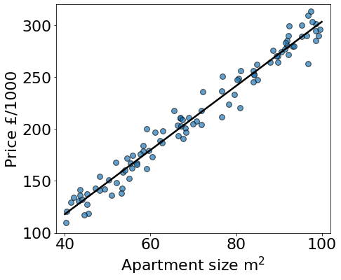
Apartment price prediction
Fit linear model
y = mx + c
Notes:
Fit linear model

Slide 15
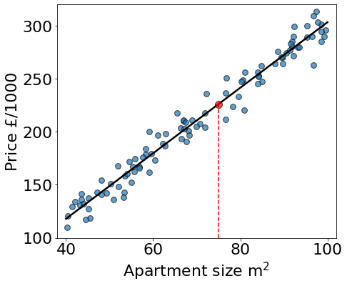
Apartment price prediction
New house: predict price
75
Notes:
Given new apartment size, use best fit line to give price prediction

Slide 16
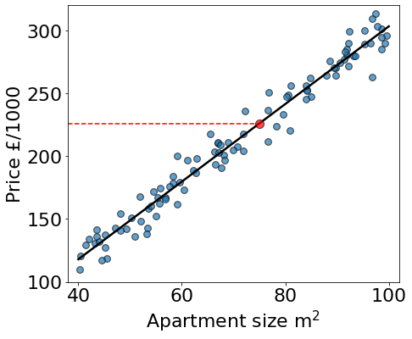
Apartment price prediction
226
New house: predict price

Slide 17
How do we do it?
Collect and prepare data
Select appropriate model
Train model
Evaluate model
Notes:
But how do we work out what that best fit line should be? Ie. Find best values for m and c

Slide 18

How do we train a model?
I want to learn!
Notes:
Introduce robot friend, going to talk about what we need to tell him to work out that best fit line

Slide 19

Training “Recipe”
New model guess
Evaluate model
Update parameters
Notes:
Training recipe that we can follow:
Take a guess – random initialization or look at data and estimate (go back to plot)
See how good that line is at describing the data – need something called the cost function to do this
Update parameters so that the new model does an even better job at describing the data
Many iterations required

Slide 20

How do I know if I’m right?
New model guess
Evaluate model
Update parameters

Slide 21
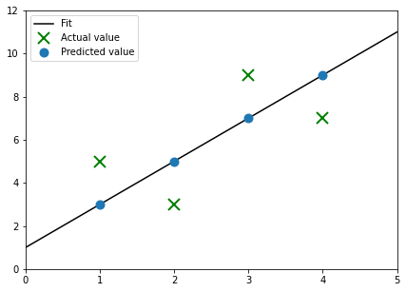
Cost function: measure of difference between the predicted and actual values
Notes:
Cost function tells us how good the model really is at describing the data - measures difference between predicted and actual values
Green crosses – actual values of houses that have already sold
e.g. at 1 – actual value is 5, model predicts 3, difference of 2 between actual and predicted values
Add up all differences/losses – gives us the cost. Good model will minimize those differences

Slide 22
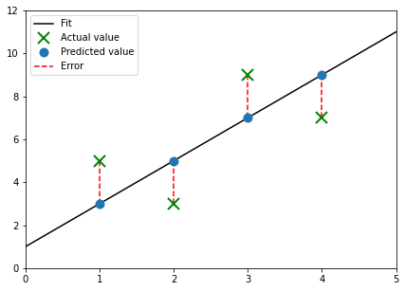
Cost function: measure of difference between the predicted and actual values
We want the sum of these distances to be as small as possible
Notes:
Distance between actual and predicted point tells us how far the model is from describing a particular data point “perfectly”. For a single example, this distance is called the loss. Add up all the distances gives the cost. Want the cost to be as small as possible.
Note: might be best to update the label on this plot – relabel ”error” with loss? Or make mention of it when speaking (there was a question about it)

Slide 23
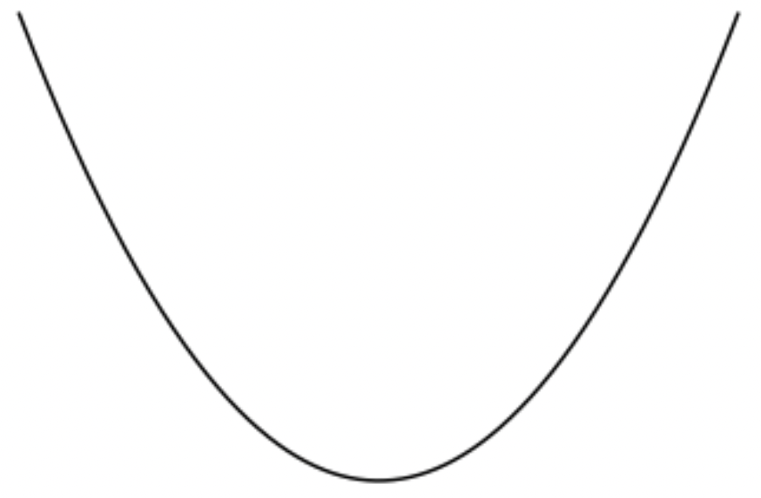
See tutorial: linear regression cost function
Best choice = smallest cost
Cost
Model parameter m
Notes:
Believe us: for linear regression (ignoring the intercept parameter), the cost function looks like this. For a particular value of m, we can measure all the distances between the corresponding fit line and data points, and then calculate the cost, which is the y value on this plot.
Best model corresponds to minimum of the cost function (sum of all errors)

Slide 24

How do I get there?
New model guess
Evaluate model
Update parameters
Notes:
So we want to find the minimum of the cost function… how do we do that after starting at a random place?

Slide 25

Gradient descent: algorithm that finds the cost function minimum (tells us what to try next)
Input data
Fitted line y=mx
Output y
Input x
Notes:
Gradient descent shows us the way!
Tells us how to update the model parameters to get the line closer to the data

Slide 26

How much should I change each time?
New model guess
Evaluate model
Update parameters
Notes:
Could change the line by a big amount, but that might not be good

Slide 27

The learning rate is a number that determines the step size (how much we change the guess on each iteration)
Notes:
Getting the learning rate right can be very important in some problems

Slide 28
Input data
Fitted line y=mx
Cost
Derivative
Cost
Output y
Input x
Parameter m
Remember: best choice = smallest cost
Notes:
Animation emphasizing relationship between best fit line and cost function
Small learning rate – small steps, take a long time to get there,
But too big: overshoot

Slide 29
Size of learning rate is important!
Too small: take too long to find the minimum
Too big: might not even find the minimum!
Notes:
Maybe use image here

Slide 30
Learning rate is too big!
Notes:
Need to clean up gif to match our notation

Slide 31

Time for the tutorial!

