Slide 1


Machine Learning Workshop
Week 2

Slide 2
Recap: ML process
Collect and prepare data
Select appropriate model
Train model
Evaluate model
Notes:
Last time we introduced the basics of ML – what it is, applications and the general process of solving a ML problem (as shown in this flow chart). As in human learning, our machine needs something to learn from (data) and something to guide it in the learning process (the model or algorithm). We looked at a particular kind of supervised learning problem, linear regression (apartment price prediction). We spoke about how to train a linear regression model, and touched on gradient descent, the cost function and the learning rate.
This time, we’ll move onto dealing with classification problems, and later speak about ways of evaluating our model’s performance (the “test” or ”exam”).
First, wanted to make something clear about the data part…

Slide 3

Data: the “learning material”
An object in our dataset has
One or more features (characteristics; things that describe the object)
A label; the thing we want to predict (supervised learning only)
Notes:
Felt I didn’t make this clear enough last time
Use feature values to predict the label

Slide 4


Data: the “learning material”
Example: have images of different animals – want to predict type of animal in each image
Features
Animal colour: orange
Ear shape: pointy
Whiskers: yes
…
Label
Cat

Slide 5

Data: the “learning material”
Example: predict house price
Features
Size: 80 m²
Bedrooms: 2
Bathrooms: 1
…
Label
Price: £400,000
Notes:
Last week’s example: apartment price prediction. The label was the price, and we looked at one feature (apartment size) – there could be other features e.g. number of bedrooms/bathrooms

Slide 6
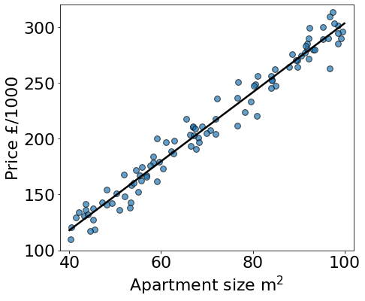
Last week: linear regression
Single input/feature (size)
Single output/label (price)
y = mx + c
Model parameters

Slide 7
Extension: multivariate regression
Multiple inputs (features) used to predict output (label)
Label
Feature 1
Feature 2
Feature 3
Model inputs (x)
Model outputs (y)
Notes:
That’s a very simplistic model – we know that size isn’t the only thing that determines house price. Many other factors – combine all of those in same model to make better prediction
Note: in other examples could also predict more that one output/label – we’ll see this in the tutorial

Slide 8
Extension: multivariate regression
Multiple inputs (features) used to predict output (label)
x₂
Price
Size
No. of bedrooms
No. of bathrooms
x₁
x₃
Model inputs (x)
Model outputs (y)
y
Notes:
That’s a very simplistic model – we know that size isn’t the only thing that determines house price. Many other factors – combine all of those in same model to make better prediction
Note: in other examples could also predict more that one output/label – we’ll see this in the tutorial
Instead of just one x value, we now have three – label with subscripts

Slide 9
Extension: multivariate regression
Multiple inputs (features) used to predict output (label)
y = mx + c
y = m₁x₁ + m₂x₂ + m₃x₃ + c
Weights
Bias
Notes:
Mathematical expression for model – compare with single feature linear regression
Weights – bigger number tells us that feature is more important

Slide 10
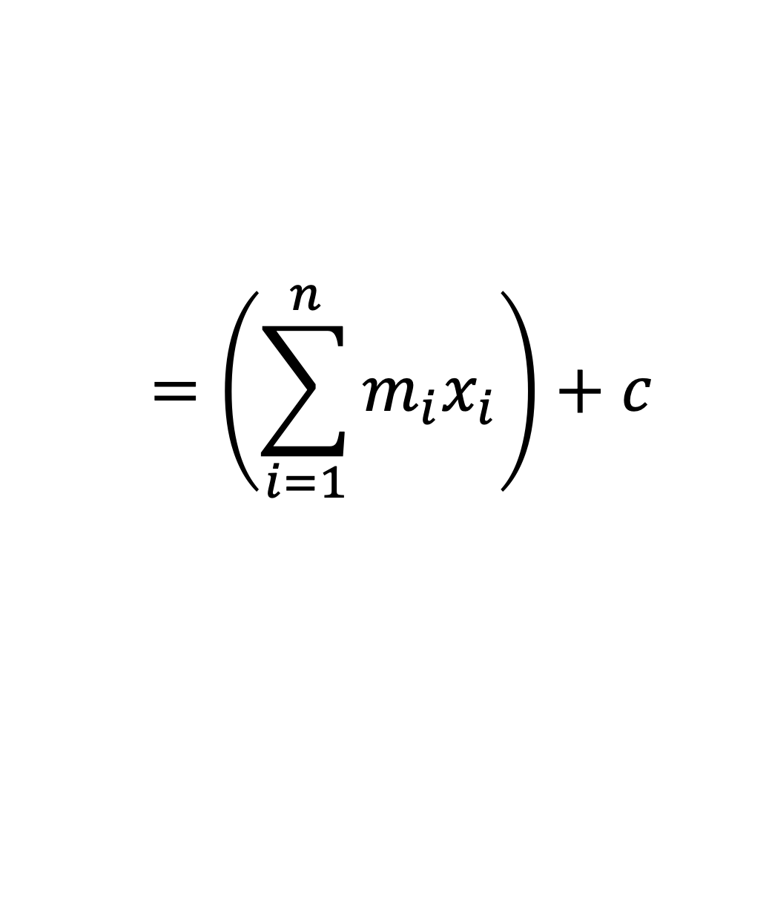
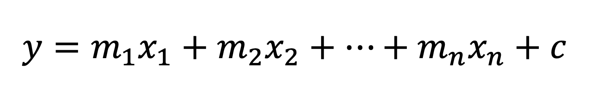
Extension: multivariate regression
In general, could have many more features than just 3…
In this case, have n features:
$$y=m_{1}x_{1}+m_{2}x_{2}+…+m_{n}x_{n}+c$$
$$=\left(\sum_{i=1}^{n}{m_{i}x_{i}}\right)+c$$
See tutorial for more details…
Notes:
General form

Slide 11
Recap: Supervised learning
Regression
Predict a number
“How much should this cost?”
Classification
Predict categories
“Is this tumour malignant or benign?”
Notes:
The two examples we just saw fall into the two types of supervised learning problems we introduced last week – regression for the price prediction and classification for the animal image identification. This week we’ll focus on classification (click to change colour of rectangle)

Slide 12
Classification
Aim: predict categories/classes
Cat
Bird
Dog
Several possibilities -> multi-class classification
Notes:
Given images of animals, might want to predict what animal is in the image. The possible labels are discrete – cat, dog, cow. There are finitely many possibilities (vs price prediction – infinitely many prices possible (in theory))
In this example, we have three (or more) different possible labels. This is a multi-class classification problem. We’ll focus our attention to problems where there are only two possible labels – binary classification

Slide 13



Binary classification
The model output (y) can only be one of two values
Examples:
Is this email spam?
Is this tumour malignant or benign?
Yes | No
True | False
1 | 0
Notes:
Usually:
Yes = presence of something
No = absence of something

Slide 14
Example: binary classification
Have list of tumour sizes and whether it was malignant (1) or not (0)
Given new tumour size, want to predict malignancy
“Decision boundary”
Tumour size
Benign
Malignant
Notes:
Want to find ”boundary” size: tumours below that size are benign and tumours above that size are malignant
Credit: format of next few slides copied from Andrew Ng’s Machine Learning Specialization on Coursera

Slide 15

Example: binary classification
Wait wait… how do I decide on that boundary?
Tumour size
Benign
Malignant
Notes:
How do we find that boundary?

Slide 16
Example: binary classification
Benign
Benign
Malignant
Malignant
Malignant?
(yes) 1
(threshold) 0.5
Tumour size
(no) 0
Notes:
Could try plotting data like this and doing a regression-type fit to the data like this… The regression line tells us about the probability of a particular tumour being malignant (higher y value = higher probability). We then need to choose a probability threshold above which we call the tumour malignant, and below which we call it benign. Standard = 0.5 (click to add line). This is the point. Notice that everywhere to the right the regression line is above 0.5, so all those tumours should be malignant.
Kind of works, but what if we added another point?
Add new point – skews line completely and now some points are misclassified.
Linear regression is highly susceptible to outliers
Need a better way of doing a fit to the data… use a logistic function!

Slide 17
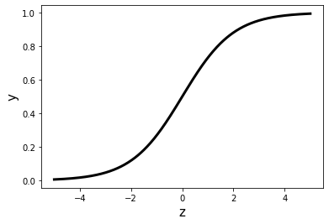
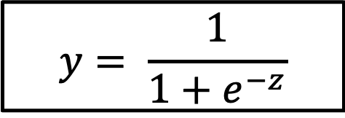
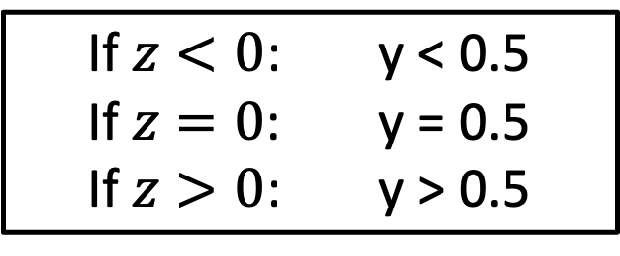
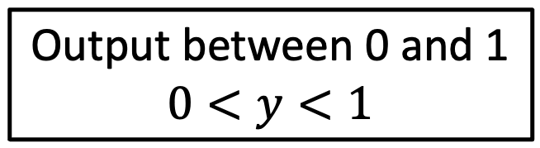
Logistic/sigmoid function
$$y= \frac{1}{1+e^{−z}}$$
Output between 0 and 1
$$0<y<1$$
0.5
If $z<0$: y < 0.5
If $z=0$: y = 0.5
If $z>0$: y > 0.5

Slide 18
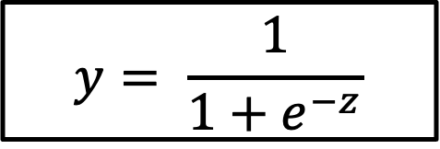
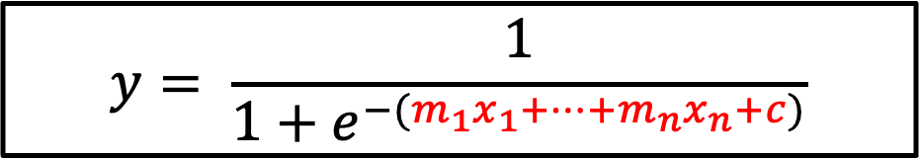
Logistic regression
$$y= \frac{1}{1+e^{−z}}$$
Multivariate regression equation
Logistic regression model
$$y= \frac{1}{1+e^{−(m_{1}x_{1}+…+m_{n}x_{n}+c)}}$$
Goal for model training: find optimal model parameters to fit the data
Model features
Model parameters
Notes:
Replacing z in the logistic function with the multivariate regression expression creates the logistic regression model.
Data won’t necessarily be centered around z=0 – need to be able to wiggle this. We can tweak the weights (the m’s) and bias (c) to smoosh/shift the logistic function to fit our data as needed

Slide 19
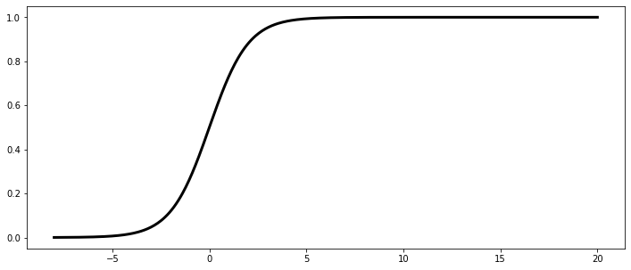
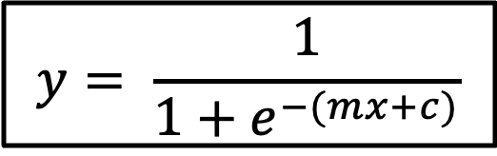
Logistic regression
$$y= \frac{1}{1+e^{−(mx+c)}}$$
Benign
Malignant
Malignant?
(yes) 1
(threshold) 0.5
(no) 0
Tumour size (x)
Notes:
Instead of fitting straight line to data, fit sigmoid/logistic function – much better!

Slide 20
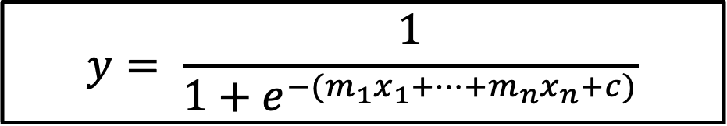
Logistic regression: interpretation
$$y= \frac{1}{1+e^{−(m_{1}x_{1}+…+m_{n}x_{n}+c)}}$$
Output of logistic regression is a number between 0 and 1, not the class label
Interpret output as the probability of something being in class 1
Need to pick threshold to turn probability into class prediction
If output > threshold, then predict class 1
If output < threshold, then predict class 0
Example: If model outputs y = 0.3, then probability of being class 1 is 30%. If threshold is 0.5, then we predict class 0 (since 0.3 < 0.5)

Slide 21
How do we evaluate model performance?
Collect and prepare data
Select appropriate model
Train model
Evaluate model

Slide 22

How do I know if I’m doing a good job?

Slide 23
Training vs test data
Dataset
Training set
Test set
Used to train model
Used to evaluate model performance
Notes:
Given full dataset, need to separate it into training and test sets. Very important that test set is not used during training, otherwise it won’t give a proper estimate of how “good” the model is at making the desired prediction. It’s like giving a student some of the exam questions and answers during class before the exam – they don’t need to learn as much to get a good mark on the exam then, as they could just memorize the right answer (i.e. the correct label)
Mention: training set can further be broken down into training and validation sets. We use the validation set to assess further tweaks to some model settings (hyperparameter tuning).

Slide 24

Classification performance metrics
Performance metric = measure of how good the model is at making the desired prediction
Some useful metrics:
Accuracy
Sensitivity
Specificity
Notes:
Comment: need separate test ”questions” – if you just ask the same questions that the student saw in class, not really testing their understanding of the material

Slide 25
What could happen?
Model makes a prediction
Prediction is correct
Prediction is incorrect

Slide 26
Accuracy: how often is the model right?
Number of correct predictions
Total number of predictions

Slide 27
Binary classification
 | Actually positive | Actually negative
Predicted positive | True positive (TP) | False positive (FP)
Predicted negative | False negative (FN) | True negative (TN)

Slide 28
Binary classification
Number of true positives
Sensitivity =
Total number of actual positives
Number of true negatives
Specificity =
Total number of actual negatives
Notes:
Example: test to diagnose disease. Sensitivity is probability of getting positive test given that the patient has the disease, while specificity is the probability of getting a negative result given that the patient is healthy. High sensitivity test: correctly picks up disease, a negative result can be trusted. High specificity: correctly rejects healthy patients, positive result is reliable.

Slide 29

Time for the tutorial!

