Slide 1
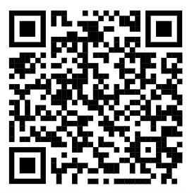
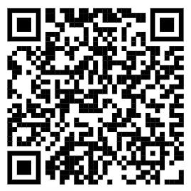
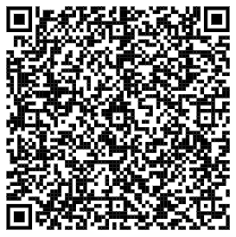
1) Download Git
2) Clone Git Repository
3) Open Tutorial in Colab
4) Sign in to Google Colab with CRSid
5) Upload Data to ‘Sample Data’ folder
6) Skip Section 1 if you are comfortable with Python

Slide 2
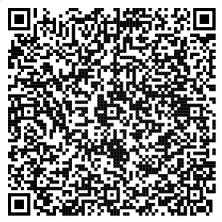
1) Download Git
2) Clone Git Repository
3) Open Tutorial in Colab
4) Sign in to Google Colab with CRSid
5) Upload Data to ‘Sample Data’ folder
6) Skip Section 1 if you are comfortable with Python

Slide 3
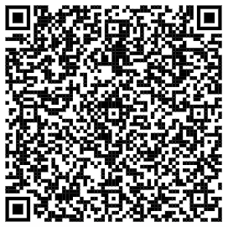
1) Download Git
2) Clone Git Repository
3) Open Tutorial in Colab
4) Sign in to Google Colab with CRSid
5) Upload Data to ‘Sample Data’ folder
6) Change Runtime Settings to run on T4 GPU

Slide 4
Links
Git Download: https://git-scm.com/downloads
Github Repo: https://github.com/mcgoughlin/Python4ML
Tutorial 1: https://colab.research.google.com/github/mcgoughlin/Python4ML/blob/main/week1/tutorial/MLWorkshop_Week1_LinearRegression.ipynb
Tutorial 2: https://colab.research.google.com/github/mcgoughlin/Python4ML/blob/main/week2/tutorial/MLWorkshop_Week2_MultivariateAndLogisticRegression.ipynb
Tutorial 3: https://colab.research.google.com/github/mcgoughlin/Python4ML/blob/main/week3/tutorial/MLWorkshop_Week3_NeuralNetwork.ipynb

