Slide 1

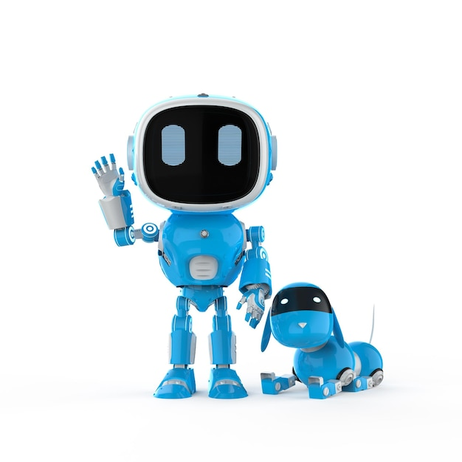


Machine Learning Workshop
Session 1
Hannah Clayton and William McGough

Slide 2
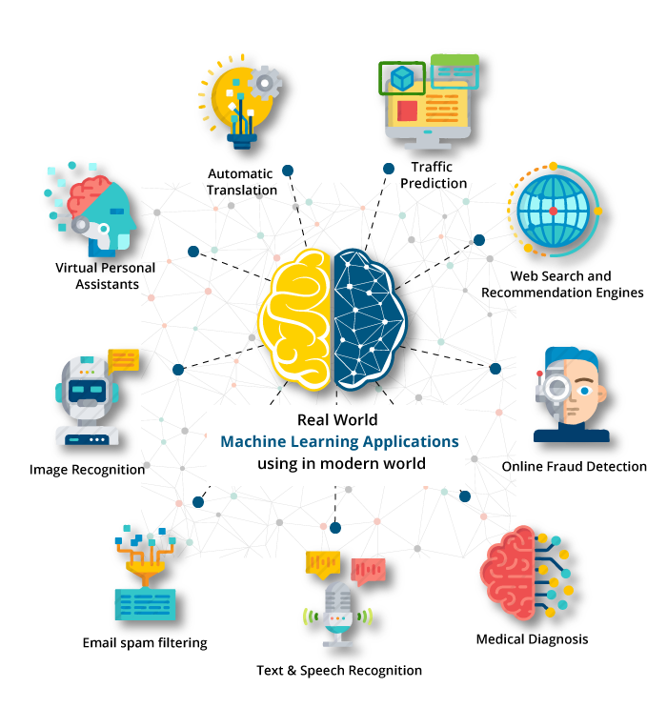
Notes:
Mention of some applications – spam, recommender systems on Netflix, medical applications

Slide 3
What is Machine Learning?
“Field of study that gives computers the ability to learn without being explicitly programmed”

Slide 4
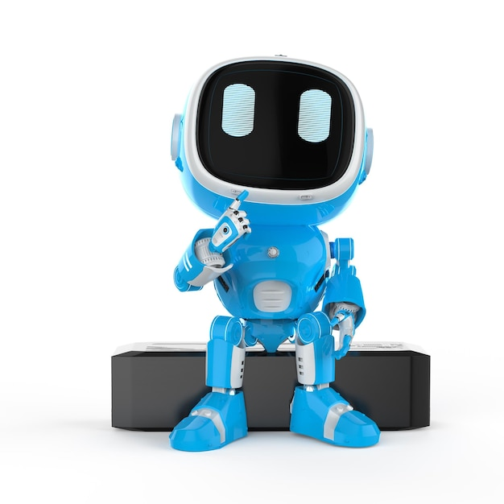

How do we do it?
Human learning
Machine learning

Slide 5
How do we do it?
Human learning
Machine learning
Learning material e.g. books/experience
Guidance e.g. teacher
Data
Algorithm

Slide 6
How do we do it?
Collect and prepare data
Select appropriate model
Train model
Evaluate model

Slide 7
Machine learning algorithms
Supervised learning
Unsupervised learning
Learn from data labelled with the “right answer”
Find something interesting in unlabelled data

Slide 8
Regression
Predict a number
“How much should this cost?”
Classification
Predict categories
“Is this tumour malignant or benign?”
Supervised learning
Next session!

Slide 9
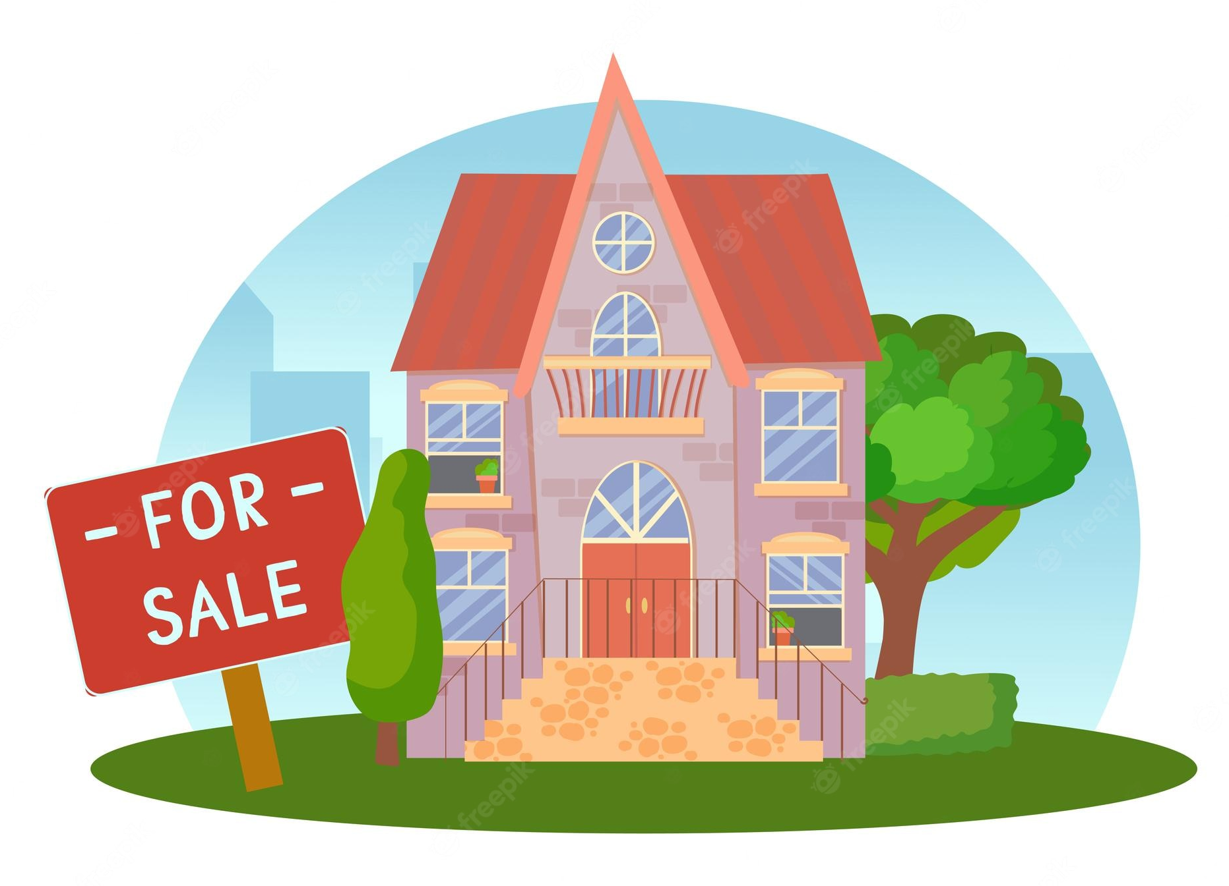
Example: linear regression
Have list of apartment sizes and the price at which they sold
Given size of new apartment, want to predict price at which it will sell

Slide 10
Example: linear regression
y = mx + c

Slide 11
Example: linear regression
Model input: apartment size
y = mx + c
Model output: predicted price

Slide 12
Example: linear regression
Model parameter: intercept
y = mx + c
We find optimal values for model parameters during training
Model parameter: slope

Slide 13
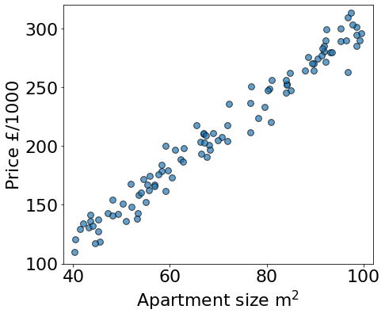
Apartment price prediction
Apartments that have already sold

Slide 14
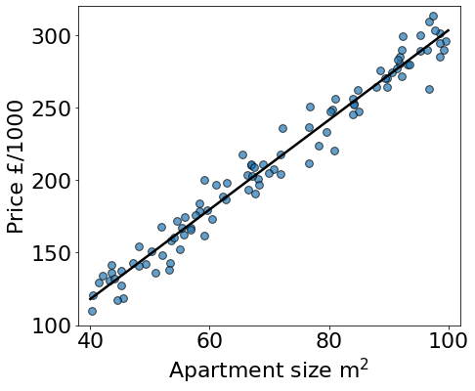
Apartment price prediction
Fit linear model
y = mx + c

Slide 15
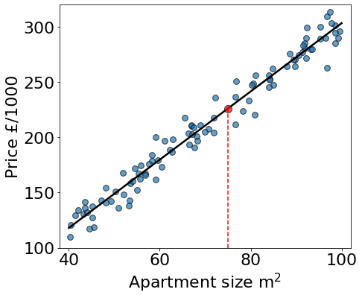
Apartment price prediction
New house: predict price
75

Slide 16
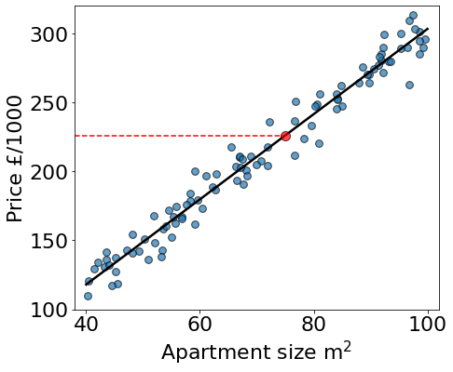
Apartment price prediction
226
New house: predict price

Slide 17
How do we do it?
Collect and prepare data
Select appropriate model
Train model
Evaluate model

Slide 18
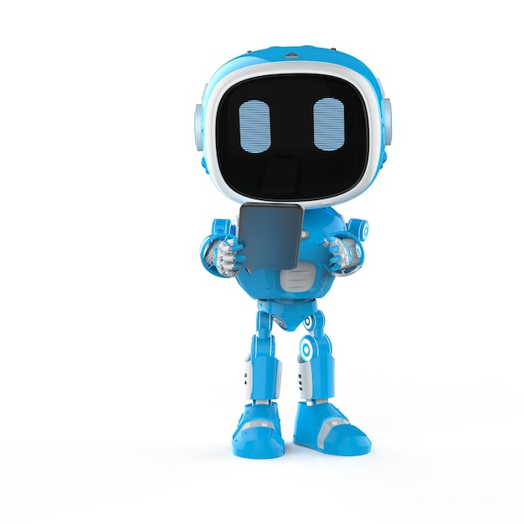
How do we train a model?
I want to learn!

Slide 19

Training “Recipe”
New model guess
Evaluate model
Update parameters
Notes:
Many iterations required

Slide 20

How do I know if I’m right?
New model guess
Evaluate model
Update parameters

Slide 21
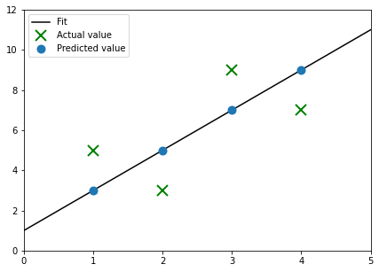
Cost function: measure of difference between the predicted and actual values

Slide 22
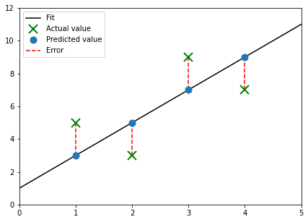
Cost function: measure of difference between the predicted and actual values
We want the sum of these distances to be as small as possible
Notes:
Distance between actual and predicted point tells us how far the model is from describing a particular data point “perfectly”. For a single example, this distance is called the loss. Add up all the distances gives the cost. Want the cost to be as small as possible.
Add in summation notation? Think it might just be unnecessary detail
Note: might be best to update the label on this plot – relabel ”error” with loss? Or make mention of it when speaking (there was a question about it)

Slide 23
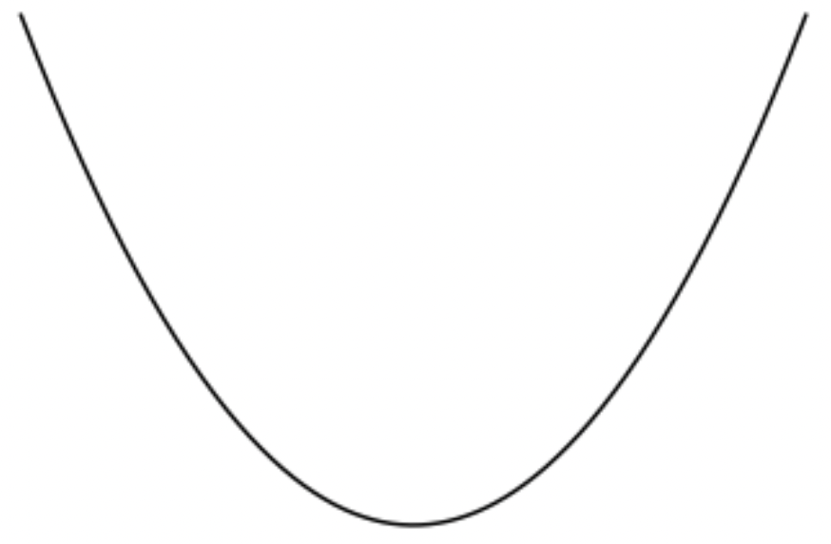
See tutorial: linear regression cost function
Best choice = smallest cost
Cost
Model parameter m
Notes:
Believe us: for linear regression (ignoring the intercept parameter), the cost function looks like this. For a particular value of m, we can measure all the distances between the corresponding fit line and data points, and then calculate the cost, which is the y value on this plot.

Slide 24
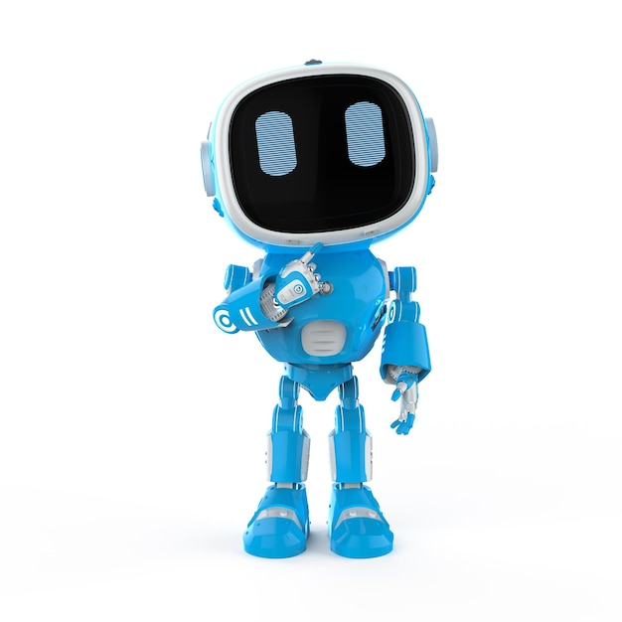
How do I get there?
New model guess
Evaluate model
Update parameters
Notes:
So we want to find the minimum of the cost function… how do we do that after starting at a random place?

Slide 25
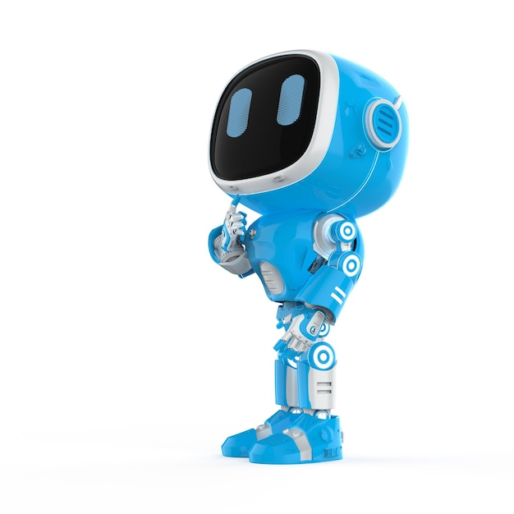
Gradient descent: algorithm that finds the cost function minimum (tells us what to try next)
Input data
Fitted line y=mx
Output y
Input x
Notes:
Gradient descent shows us the way!

Slide 26

How much should I change each time?
New model guess
Evaluate model
Update parameters

Slide 27
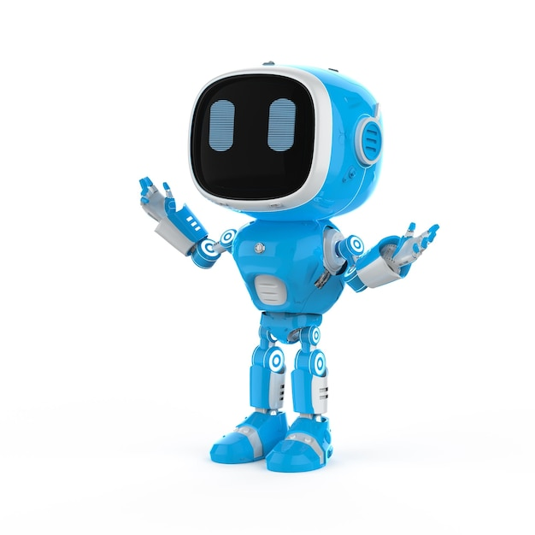
The learning rate is a number that determines the step size (how much we change the guess on each iteration)

Slide 28
Input data
Fitted line y=mx
Cost
Derivative
Cost
Output y
Input x
Parameter m
Remember: best choice = smallest cost

Slide 29
Size of learning rate is important!
Too small: take too long to find the minimum
Too big: might not even find the minimum!
Notes:
Maybe use image here

Slide 30
Learning rate is too big!
Notes:
Need to clean up gif to match our notation

Slide 31

Time for the tutorial!

