Slide 1


Machine Learning Workshop
Week 3

Slide 2
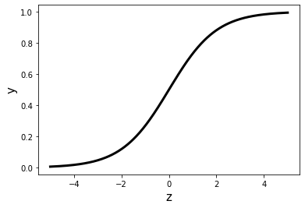
Week 2 recap
Multivariate linear regression
Classification and logistic regression
Performance metrics for classification
Accuracy, sensitivity, specificity
$$y=m_{1}x_{1}+m_{2}x_{2}+…+m_{n}x_{n}+c$$

Slide 3
Evaluating model performance (cont.)
Collect and prepare data
Select appropriate model
Train model
Evaluate model

Slide 4

Recap: binary classification evaluation
 | Actually positive | Actually negative
Predicted positive | True positive (TP) | False positive (FP)
Predicted negative | False negative (FN) | True negative (TN)
Notes:
Clarify specificity and sensitivity comment from last time

Slide 5
Recap: binary classification evaluation
Number of true positives
Sensitivity =
Total number of actual positives
Number of true negatives
Specificity =
Total number of actual negatives
Notes:
Clarify specificity and sensitivity comment from last time

Slide 6
Reminder: classification threshold
Logistic regression
Probability
Class label
Class 1
Probability
Threshold
Class 0
Notes:
Logistic regression outputs probability – used threshold to turn probability into class label
Standard threshold is 0.5

Slide 7
Reminder: classification threshold
Logistic regression
Probability
Class label
Class 1
Threshold
Probability
Class 0
Notes:
But could be higher…

Slide 8
Reminder: classification threshold
Logistic regression
Probability
Class label
Class 1
Probability
Threshold
Class 0
Notes:
Or lower…
Now different thresholds might result in different class labels attributed to same training example. Each threshold will produce different true positive, false positive, etc rates. This information is summarized in the ROC curve

Slide 9
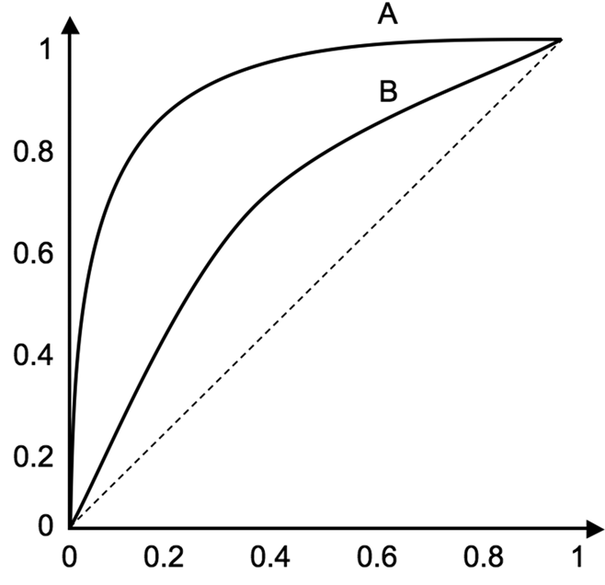
Receiver operating characteristic (ROC) curve
ROC plots sensitivity and specificity for different classification thresholds
Choose optimal threshold for problem
Area under the curve (AUC) is indicator of performance – closer to 1 is better
Sensitivity
1 – Specificity
Notes:
Graph showing the performance of a classification model at all classification thresholds
A perfect model would have sensitivity and specificity of 1 (i.e. 100% accuracy). This would correspond to a step function (demonstrate).
Not achievable in practice – somewhere between random guessing (dotted line) and perfect. Closer to step function the better (here A is better than B). In all problems, we have a trade-off between specificity and sensitivity. Depending on problem, specificity/sensitivity might be more important. Choose threshold accordingly. Perhaps in disease screening you want to flag as many of the patients that really have the disease as possible – prioritise sensitivity. Would then follow up with a different test to verify positive result.

Slide 10
Data preprocessing
Collect and prepare data
Select appropriate model
Train model
Evaluate model

Slide 11


Data preprocessing
Notes:
First need to arrange data neatly to its easy for the machine to learn from. Already said that that might involve things like replacing missing values or removing outliers, could also combine features in clever ways (called feature engineering). But another important step is feature normalization.

Slide 12
Feature normalization
Price
Size
No. of bedrooms
No. of bathrooms
Example: house price prediction
y = m₁x₁ + m₂x₂ + m₃x₃ + c
Number of
bathrooms
Small range
Size m²
Large range
Notes:
Go back to house example: look at two features: size and number of bathrooms. Size is much bigger, bigger range too. Mentioned that bigger coefficient meant more important feature. But only makes sense if two features are on the same scale. Shift and squish distributions to get them to look similar -> convention: want mean 0 and std dev (related to spread) = 1. The way we do this is (show formula). Go to next slide – mention that actually not just a convenience thing for comparing importance of features – vital for convergence.

Slide 13
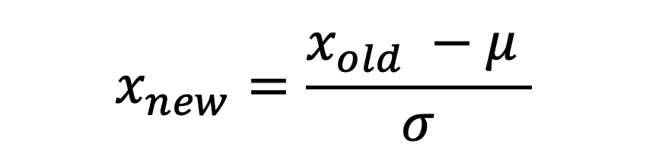
Feature normalization
Unscaled feature value
Mean
$$x_{new}=\frac{x_{old} −μ }{σ}$$
Scaled feature value
Standard deviation
Notes:
This is what we do – shift and smoosh. Calc mean (average), calc std dev (measure of spread) across all values. Then use formula for each data point.
Gives us a mean of zero and standard deviation of 1

Slide 14
Feature normalization
Price
Size
No. of bedrooms
No. of bathrooms
Scaled no. of
bathrooms
y = m₁x₁ + m₂x₂ + m₃x₃ + c
Scaled size m²
Notes:
This is what the scaled data might look like. Notice now both features centered around zero and spread is similar. Why is this important? Several reasons, including quicker/easier convergence of gradient descent (comparison between little and big steps in different features), choice of learning rate, and comparison of importance of features (talk about coefficients in regression model – mentioned last time)

Slide 15
A new kind of model…
x₁
x₂
y₁
x₃
y
y₂
Notes:
Start with single logistic regression unit (3 inputs, 1 output)
Could add another (same inputs, different output)
Then use those outputs as inputs for another unit -> produce final output
Together act as single classifier -> simplest kind of NN called a multilayer perceptron (click)
Logistic regression untis are called nodes, grouped into layers. Input, output and hidden layers in the middle. Freedom to choose number of nodes and layers – varies complexity. See how to train in tutorial.
NNs extremely powerful -> used for variety of applications e.g. in image analysis

Slide 16
Neural network: multi-layer perceptron
x₁
x₂
y₁
x₃
y
y₂

Slide 17
What can go wrong?
Collect and prepare data
Select appropriate model
Train model
Evaluate model

Slide 18
Reminder: training vs test data
Dataset
Training set
Test set
Training accuracy
Test accuracy
Used to train model
Used to evaluate model performance
Notes:
Reminder
Note: can use accuracy metrics for both training and test portions of dataset. NB: just because model has “seen” the training data, doesn’t mean that training accuracy will be 100 (real data is noisy and model won’t fit data perfectly unless it is very complex)

Slide 19
Overfitting vs underfitting
Underfit (high bias)
“Just right”
Overfit (high variance)
Increasing model complexity
Notes:
More wiggles = more complex function (linear -> quadratic -> higher order polynomial)
In case of NNs, more complex networks involve more hidden layers and more nodes per layer

Slide 20

How do I know if things
aren’t working?
Notes:
Easy(ish) if you can visualize the data like that, but what if the problem is more complicated

Slide 21
How do I know if things aren’t working?
Underfit (high bias)
“Just right”
Overfit (high variance)
High/reasonable
test and training accuracy
High training accuracy, but low test accuracy
Low test and training accuracy
Notes:
Compare accuracy metrics on training and test data – talk through options.
If the training accuracy is much higher than the test accuracy, then we say that the model is not generalizable.

Slide 22

What is a “high/low” accuracy?
Need to establish baseline level of performance
What is the level of error you can reasonably expect?
Human level performance
Competing algorithm performance
Guess based on experience
Notes:
Example: diagnosis: high accuracy might be if you can match radiologist performance or do better. What can other models achieve?

Slide 23

How do I fix poor performance?
Get more data!
Try different model/architecture
Try different numbers of features
Regularisation
Notes:
If model performance is poor (either both poor test and train, or good train but poor test), getting more data can help. Either reduce or increase model complexity (number of features, nodes, hidden layers). Regularisation is a way of controlling overfitting – just mention it here, won’t go into details. Amounts to dialing the strength of an extra parameter in the model.
Let’s talk more about getting more data…

Slide 24


I’m still confused… can you give me some more examples please?
Training Centre
Notes:
Say we’ve given our robot some data, but it doesn’t seem to be learning much. Our model isn’t too complex, but for some reason the training and/or test accuracy is lower than our benchmark (i.e. it’s ”failing” the exam). Could try given it more learning material and see if it improves… But what if new material isn’t easily available?

Slide 25

Data augmentation
Problem: need bigger training set, but can’t collect more data
Solution: modify existing training example to create a new example
Distortions should be representative of the expected data
Notes:
Data augmentation = modification of existing training example to create new training example

Slide 26

Time for the tutorial!

