Slide 1
柳永法.RabbitMQ简介
2016年03月25日

Slide 2
Demo
Step I: 演示个活的WorkQueue的例子，激发思考及引起讨论！
Step II:带着问题进入主题！

Slide 3
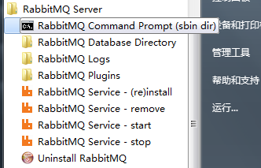
Install windows容易，Linux麻烦
在windows上安装：
下载并安装 erlang运行时，近100M:
http://www.erlang.org/downloads
下载并安装rabbitmq，近5M,
http://www.rabbitmq.com/install-windows.html
以上两个都可以在这里找到：
\\172.18.21.12\技术开发部\转运站\Software\RabbitMQ
装好后:
在菜单里可以看到，reinstall,start,stop，有个菜单点击后进入cmd，可以执行命令。
如：启动插件UI: rabbitmq-plugins enable rabbitmq_management
然后就可以用http://localhost:15672/访问了。
Notes:
Linux安装麻烦是因为有很多前置条件，官方文档写的太简单，导致前置条件没准备好，直接不成功。

Slide 4
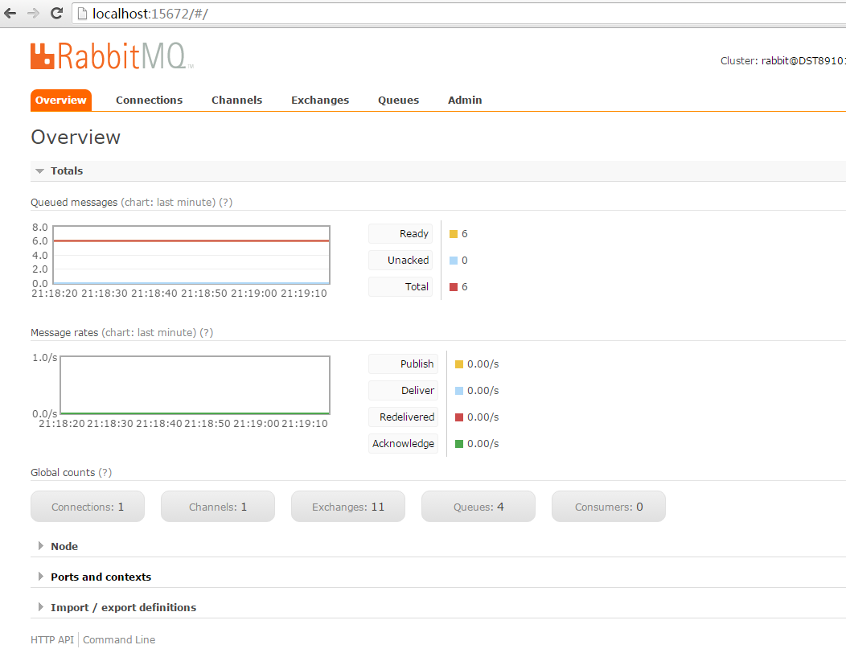
Install windows容易，Linux麻烦

Slide 5
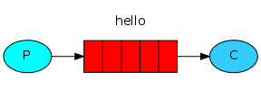
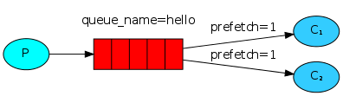
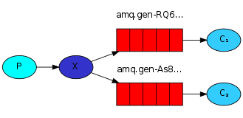
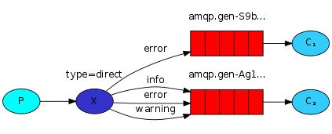
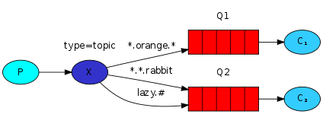
Summary
type=topic
X
Logging
type=fanout
P
X
type=direct
Business
X
Business2

Slide 6
常用接口
using System; using System.Collections.Generic; namespace RabbitMQ.Client { public interface IModel : IDisposable { //发布消息 void BasicPublish(string exchange, string routingKey, IBasicProperties basicProperties, byte[] body);
//消费消息 string BasicConsume(string queue, bool noAck, IBasicConsumer consumer);
//创建交换机，如果存在则忽略，如果参数不同则报错 void ExchangeDeclare(string exchange, string type, bool durable);
//创建队列，如果存在则忽略，如果参数不同则报错 QueueDeclareOk QueueDeclare(string queue, bool durable, bool exclusive, bool autoDelete, IDictionary<string, object> arguments);
//绑定交换机与队列 void QueueBind(string queue, string exchange, string routingKey);
//QOS，最大只保持几个在线 void BasicQos(uint prefetchSize, ushort prefetchCount, bool global);
//消息回执，收到消息并处理完后告知队列如果没收到原消息就处于UnAck状态 void BasicAck(ulong deliveryTag, bool multiple);
//更多请自行研究，此处只列出了常用的几个
} }

Slide 7
1 "Hello World!"
The simplest thing that does something

Slide 8
1 "Hello World!"
using System; using RabbitMQ.Client; using System.Text; class Send { public static void Main() { var factory = new ConnectionFactory() { HostName = "localhost" }; using (var connection = factory.CreateConnection()) using (var channel = connection.CreateModel()) { channel.QueueDeclare(queue: "hello", durable: false, exclusive: false, autoDelete: false, arguments: null); string message = "Hello World!"; var body = Encoding.UTF8.GetBytes(message); channel.BasicPublish(exchange: "", routingKey: "hello", basicProperties: null, body: body); Console.WriteLine(" [x] Sent {0}", message); } Console.WriteLine(" Press [enter] to exit."); Console.ReadLine(); } }
using RabbitMQ.Client; using RabbitMQ.Client.Events; using System; using System.Text; class Receive { public static void Main() { var factory = new ConnectionFactory() { HostName = "localhost" }; using (var connection = factory.CreateConnection()) using (var channel = connection.CreateModel()) { channel.QueueDeclare(queue: "hello", durable: false, exclusive: false, autoDelete: false, arguments: null); var consumer = new EventingBasicConsumer(channel); consumer.Received += (model, ea) => { var body = ea.Body; var message = Encoding.UTF8.GetString(body); Console.WriteLine(" [x] Received {0}", message); }; channel.BasicConsume(queue: "hello", noAck: true, consumer: consumer); Console.WriteLine(" Press [enter] to exit."); Console.ReadLine(); } } }

Slide 9
2 Work queues
Distributing tasks among workers

Slide 10
2 Work queues
使用方法：运行多次，让他多产生些数据，或者循环产生多条数据
class NewTask { public static void Main(string[] args) { var factory = new ConnectionFactory() { HostName = "localhost" }; using (var connection = factory.CreateConnection()) using (var channel = connection.CreateModel()) { channel.QueueDeclare(queue: "task_queue", durable: true, exclusive: false, autoDelete: false, arguments: null); var message = GetMessage(args); var body = Encoding.UTF8.GetBytes(message); var properties = channel.CreateBasicProperties(); properties.Persistent = true; channel.BasicPublish(exchange: "", routingKey: "task_queue", basicProperties: properties, body: body); Console.WriteLine(" [x] Sent {0}", message); } Console.WriteLine(" Press [enter] to exit."); Console.ReadLine(); } private static string GetMessage(string[] args) { return args.Length > 0 ? string.Join(" ", args) : "Hello World!"; } }
使用方法：开多个
class Worker { public static void Main() { var factory = new ConnectionFactory() { HostName = "localhost" }; using (var connection = factory.CreateConnection()) using (var channel = connection.CreateModel()) { channel.QueueDeclare(queue: "task_queue", durable: true, exclusive: false, autoDelete: false, arguments: null); channel.BasicQos(prefetchSize: 0, prefetchCount: 5, global: false); Console.WriteLine(" [*] Waiting for messages.");
//此场景，可以同时接收5条消息，但事件只能一次处理一个，串行的 var consumer = new EventingBasicConsumer(channel); consumer.Received += (model, ea) => { var body = ea.Body; var message = Encoding.UTF8.GetString(body); Console.WriteLine(" [x] Received {0}", message); Thread.Sleep(2000); Console.WriteLine(" [x] Done"); channel.BasicAck(deliveryTag: ea.DeliveryTag, multiple: false); }; channel.BasicConsume(queue: "task_queue", noAck: false, consumer: consumer); Console.WriteLine(" Press [enter] to exit."); Console.ReadLine(); } } }

Slide 11
3 Publish/Subscribe
Sending messages to many consumers at once

Slide 12
3 Publish/Subscribe
使用方法：开多个
class ReceiveLogs { public static void Main() { var factory = new ConnectionFactory() { HostName = "localhost" }; using (var connection = factory.CreateConnection()) using (var channel = connection.CreateModel()) { channel.ExchangeDeclare(exchange: "logs", type: "fanout");
//让RabbitMQ随机生成一个队列 var queueName = channel.QueueDeclare().QueueName; channel.QueueBind(queue: queueName, exchange: "logs", routingKey: ""); Console.WriteLine(" [*] Waiting for logs."); var consumer = new EventingBasicConsumer(channel); consumer.Received += (model, ea) => { var body = ea.Body; var message = Encoding.UTF8.GetString(body); Console.WriteLine(" [x] {0}", message); }; channel.BasicConsume(queue: queueName, noAck: true, consumer: consumer); Console.WriteLine(" Press [enter] to exit."); Console.ReadLine(); } } }
class EmitLog { public static void Main(string[] args) { var factory = new ConnectionFactory() { HostName = "localhost" }; using (var connection = factory.CreateConnection()) using (var channel = connection.CreateModel()) { channel.ExchangeDeclare(exchange: "logs", type: "fanout"); var message = GetMessage(args); var body = Encoding.UTF8.GetBytes(message); channel.BasicPublish(exchange: "logs", routingKey: "", basicProperties: null, body: body); Console.WriteLine(" [x] Sent {0}", message); } Console.WriteLine(" Press [enter] to exit."); Console.ReadLine(); } private static string GetMessage(string[] args) { return args.Length > 0 ? string.Join(" ", args) : "Hello World!"; } }

Slide 13
4 Routing
Receiving messages selectively

Slide 14
4 Routing
调用方法：
EmitLogDirect.exe info InfoLog
EmitLogDirect.exe debug Debug.Log
EmitLogDirect.exe error Error.Log
class EmitLogDirect { public static void Main(string[] args) { var factory = new ConnectionFactory() { HostName = "localhost" }; using (var connection = factory.CreateConnection()) using (var channel = connection.CreateModel()) { channel.ExchangeDeclare(exchange: "direct_logs", type: "direct"); var severity = args.Length > 0 ? args[0] : "info"; var message = args.Length > 1 ? string.Join(" ", args.Skip(1).ToArray()) : "Hello World!"; var body = Encoding.UTF8.GetBytes(message); channel.BasicPublish(exchange: "direct_logs", routingKey: severity, basicProperties: null, body: body); Console.WriteLine(" [x] Sent '{0}':'{1}'", severity, message); } Console.WriteLine(" Press [enter] to exit."); Console.ReadLine(); } }
调用方法：先开两个，等着消息：
ReceiveLogsDirect.exe debug info
ReceiveLogsDirect.exe error
class ReceiveLogsDirect { public static void Main(string[] args) { var factory = new ConnectionFactory() { HostName = "localhost" }; using (var connection = factory.CreateConnection()) using (var channel = connection.CreateModel()) { channel.ExchangeDeclare(exchange: "direct_logs", type: "direct"); var queueName = channel.QueueDeclare().QueueName; foreach (var severity in args) { channel.QueueBind(queue: queueName, exchange: "direct_logs", routingKey: severity); } Console.WriteLine(" [*] Waiting for messages."); var consumer = new EventingBasicConsumer(channel); consumer.Received += (model, ea) => { var body = ea.Body; var message = Encoding.UTF8.GetString(body); var routingKey = ea.RoutingKey; Console.WriteLine($" [x] Received {routingKey}:{message}"); }; channel.BasicConsume(queue: queueName, noAck: true,
consumer: consumer); Console.WriteLine(" Press [enter] to exit."); Console.ReadLine(); } } }

Slide 15
5 Topics
Receiving messages based on a pattern

Slide 16
5 Topics
class EmitLogTopic { public static void Main(string[] args) { var factory = new ConnectionFactory() { HostName = "localhost" }; using (var connection = factory.CreateConnection()) using (var channel = connection.CreateModel()) { channel.ExchangeDeclare(exchange: "topic_logs", type: "topic"); var routingKey = args.Length > 0 ? args[0] : "anonymous.info"; var message = (args.Length > 1) ? string.Join(" ", args.Skip(1).ToArray()) : "Hello World!"; var body = Encoding.UTF8.GetBytes(message); channel.BasicPublish(exchange: "topic_logs", routingKey: routingKey, basicProperties: null, body: body); Console.WriteLine(" [x] Sent '{0}':'{1}'", routingKey, message); } } }
class ReceiveLogsTopic { public static void Main(string[] args) { var factory = new ConnectionFactory() { HostName = "localhost" }; using (var connection = factory.CreateConnection()) using (var channel = connection.CreateModel()) { channel.ExchangeDeclare(exchange: "topic_logs", type: "topic"); var queueName = channel.QueueDeclare().QueueName; foreach (var bindingKey in args) { channel.QueueBind(queue: queueName, exchange: "topic_logs", routingKey: bindingKey); } Console.WriteLine(" [*] Waiting for messages. To exit press CTRL+C"); var consumer = new EventingBasicConsumer(channel); consumer.Received += (model, ea) => { var body = ea.Body; var message = Encoding.UTF8.GetString(body); var routingKey = ea.RoutingKey; Console.WriteLine(" [x] Received '{0}':'{1}'", routingKey, message); }; channel.BasicConsume(queue: queueName, noAck: true, consumer: consumer); Console.WriteLine(" Press [enter] to exit."); Console.ReadLine(); } } }

Slide 17
5 Topics
Run the following examples:
To receive all the logs:
$ ReceiveLogsTopic.exe "#"
To receive all logs from the facility "kern":
$ ReceiveLogsTopic.exe "kern.*"
Or if you want to hear only about "critical" logs:
$ ReceiveLogsTopic.exe "*.critical"
You can create multiple bindings:
$ ReceiveLogsTopic.exe "kern.*" "*.critical"
And to emit a log with a routing key "kern.critical" type:
$ EmitLogTopic.exe "kern.critical" "A critical kernel error"

Slide 18
Mix Multi Exchange
type=topic
X
Logging
type=fanout
P
X
type=direct
查税
X
检测变价

Slide 19
Mix Multi Exchange
channel.ExchangeDeclare("PBS.Exchange.Entry", ExchangeType.Fanout, durable: true); channel.ExchangeDeclare("PBS.Exchange.4Log", ExchangeType.Topic, durable: true); channel.ExchangeDeclare("PBS.Exchange.4Business", ExchangeType.Direct, durable: true); channel.ExchangeBind("PBS.Exchange.4Log", "PBS.Exchange.Entry", ""); channel.ExchangeBind("PBS.Exchange.4Business", "PBS.Exchange.Entry", ""); channel.QueueDeclare("PBS.Queue.Log", durable: true, exclusive: false, autoDelete: false, arguments: null); channel.QueueDeclare("PBS.Queue.Business.SearchTax", durable: true, exclusive: false, autoDelete: false, arguments: null); channel.QueueDeclare("PBS.Queue.Business.CheckChange", durable: true, exclusive: false, autoDelete: false, arguments: null); channel.QueueDeclare("PBS.Queue.Business.GenPnr", durable: true, exclusive: false, autoDelete: false, arguments: null); channel.QueueBind("PBS.Queue.Log", "PBS.Exchange.4Log", "#"); channel.QueueBind("PBS.Queue.Business.SearchTax", "PBS.Exchange.4Business", "PBS.Queue.Business.SearchTax"); channel.QueueBind("PBS.Queue.Business.CheckChange", "PBS.Exchange.4Business", "PBS.Queue.Business.CheckChange"); channel.QueueBind("PBS.Queue.Business.GenPnr", "PBS.Exchange.4Business", "PBS.Queue.Business.GenPnr"); var properties = channel.CreateBasicProperties(); properties.Persistent = true; properties.DeliveryMode = 2; var body = Encoding.UTF8.GetBytes("查税" + DateTime.Now); channel.BasicPublish("PBS.Exchange.Entry", "PBS.Queue.Business.SearchTax", properties, body); Console.WriteLine(" [x] Sent PBS.Queue.Business.SearchTax"); body = Encoding.UTF8.GetBytes("检测变价" + DateTime.Now); channel.BasicPublish("PBS.Exchange.Entry", "PBS.Queue.Business.CheckChange", properties, body); Console.WriteLine(" [x] Sent PBS.Queue.Business.CheckChange"); body = Encoding.UTF8.GetBytes("生成PNR" + DateTime.Now); channel.BasicPublish("PBS.Exchange.Entry", "PBS.Queue.Business.GenPnr", properties, body); Console.WriteLine(" [x] Sent PBS.Queue.Business.GenPnr");

Slide 20

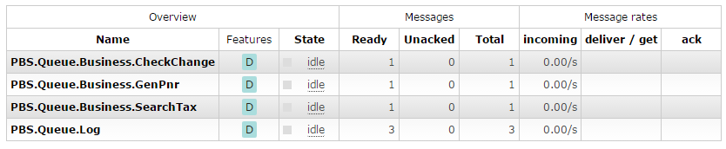
Mix Multi Exchange

Slide 21
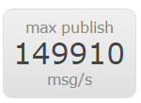
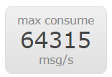
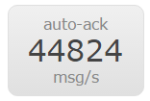
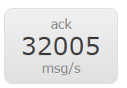
DOC
官方文档：
http://www.rabbitmq.com/getstarted.html
GitHub民间翻译：
http://rabbitmq-into-chinese.readthedocs.org/zh_CN/latest/
http://rabbitmq.mr-ping.com/zh_CN/latest/
https://github.com/mr-ping/RabbitMQ_into_Chinese
官方性能：
http://www.rabbitmq.com/blog/2012/04/17/rabbitmq-performance-measurements-part-1/
http://www.rabbitmq.com/blog/2012/04/25/rabbitmq-performance-measurements-part-2/

Slide 22
End

