Slide 1
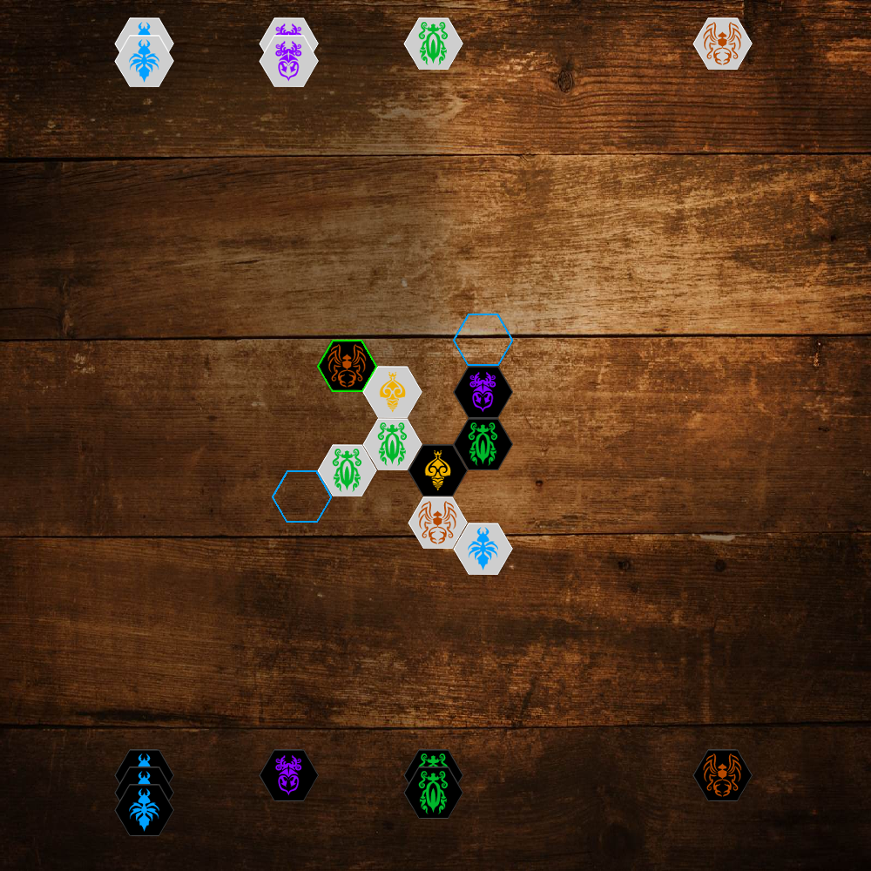
Problem Description
Swarm AI, the focus of this research in the game-playing domain, is a subset of AI inspired by biological processes in nature, notably fish in schools or birds flocking, which attempts to replicate the observed collective intelligence of these processes.
Swarm AI applied to strategy games has rarely been researched, and a game-playing agent using Swarm AI for the insect-based board game, Hive, has not yet been documented.
As such, building a Swarm AI for the game of Hive and comparing it against existing AI may provide insight into the efficacy of Swarm AI for Hive and other strategy-based games.
Screenshot of the game implemented as part of the project

Slide 2
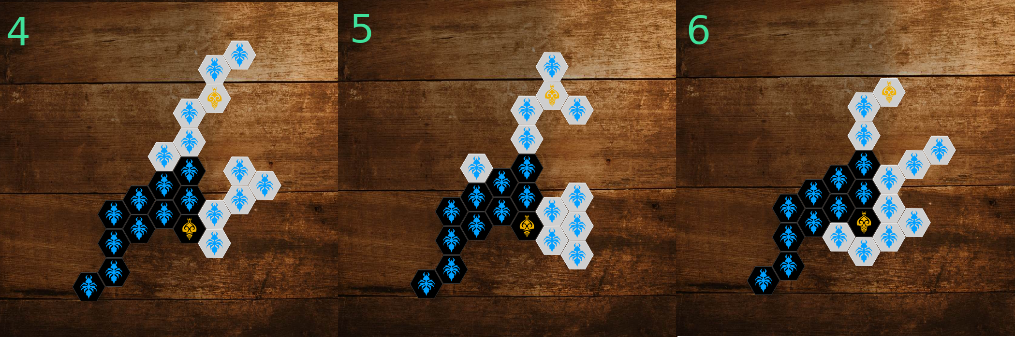
Outline of Solution
Built a UI platform in Python to play the game either with human input, AI input, or replay from previously logged games
Developed and optimised algorithms for the movement of insects according to Hive rules
Developed a Monte-Carlo Search Tree (MCTS) AI as an opponent
Investigated swarming algorithms and chose Particle Swarm Optimisation as the foundational algorithm
Investigated and applied communication methods to determine which insect should move
Early trials of swarming behaviour using PSO with immobile opponent

Slide 3
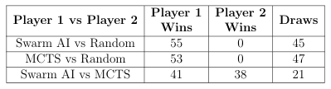
Results and Discussion
Once a final Swarm AI was developed, trial games were conducted with a randomly playing opponent, MCTS, and Swarm AI playing each other over 100 games. Games terminate as a draw after 40 moves each.
Final results of Random, MCTS, and Swarm AI playing head-to-head in 100 games. MCTS is depth-limited to 13 with 500 iterations.
The implementation of MCTS is purposely depth-limited due to the time required to execute a single MCTS move, and thus is not a strong player, but wins the majority of games against a randomly playing opponent. Swarm AI is comparably equal to this version of MCTS.
Swarming looks to be an ideal form of attack, so long as a defensive mechanism is incorporated, and is likely to be suitable for games where coordinated movement of units is required.

