Slide 1
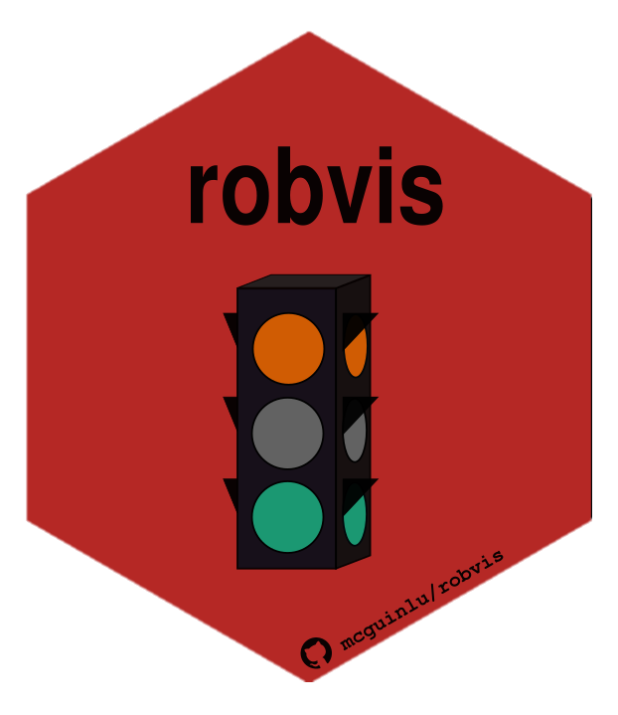



“On the shoulders of giants”
Building on established evidence synthesis packages using the {robvis} package as a case study
Luke McGuinness
Population Health Sciences, University of Bristol
mcguinlu
mcguinlu

Slide 2
The robvis package
R package and web app to create publication- quality risk-of-bias visualisations
Motivation: no tool available to reproducibly create these figures
Currently can produce two types of plots:
Traffic-light plots
Summary barplots

Slide 3
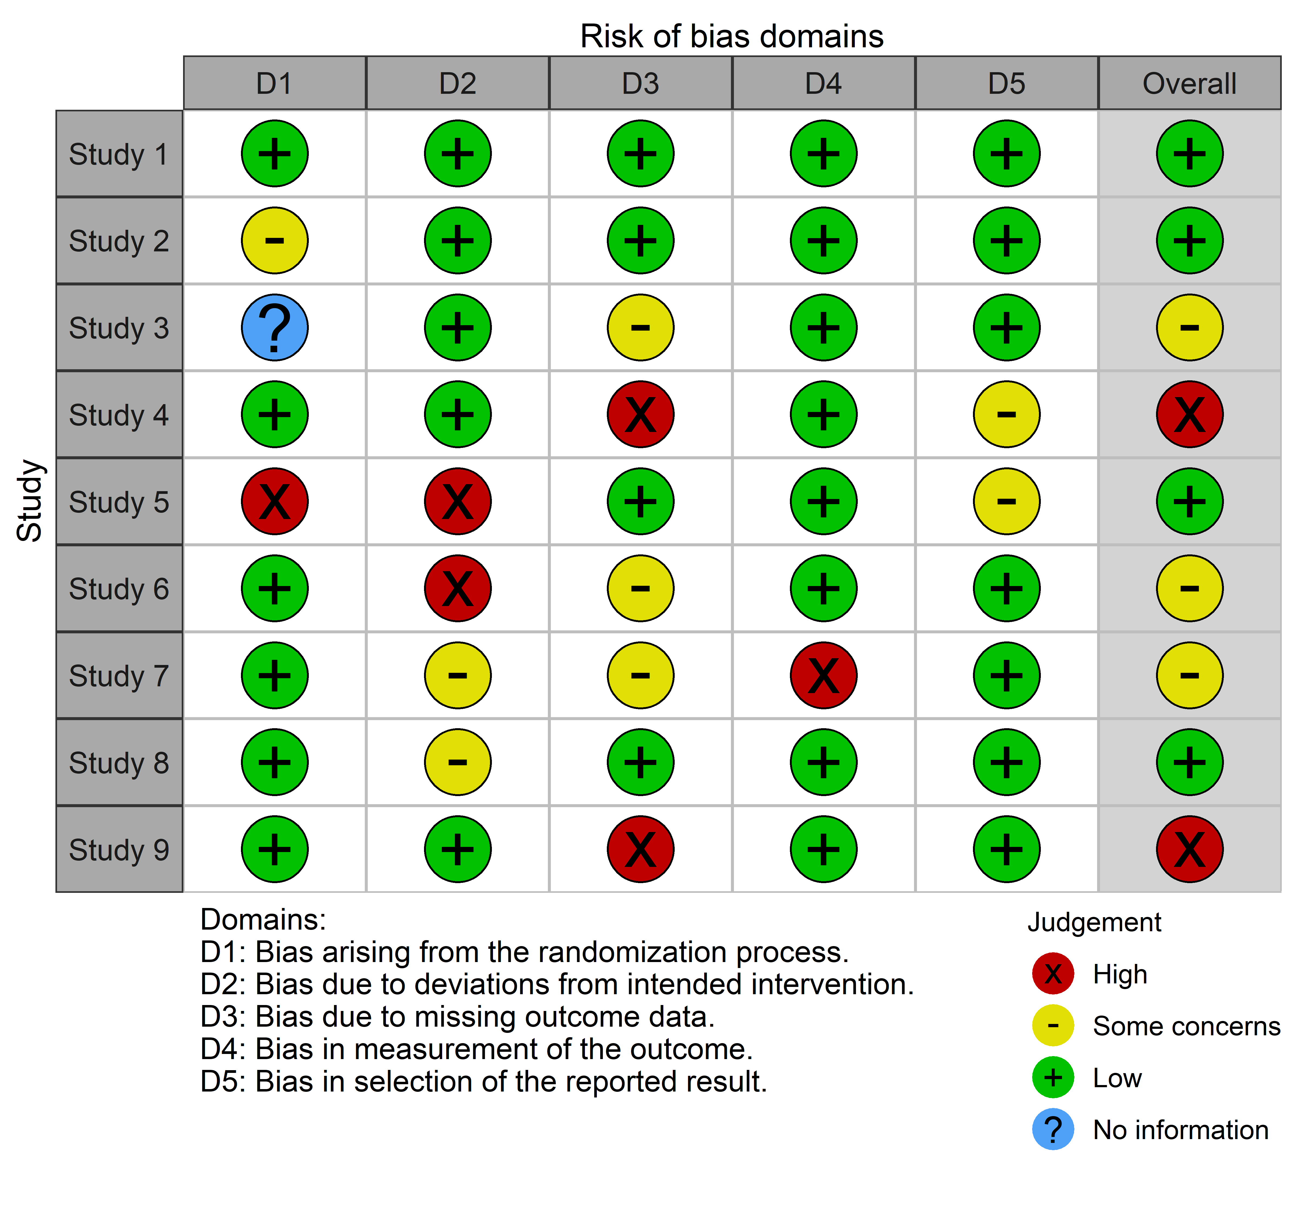
Traffic-light plots

Slide 4
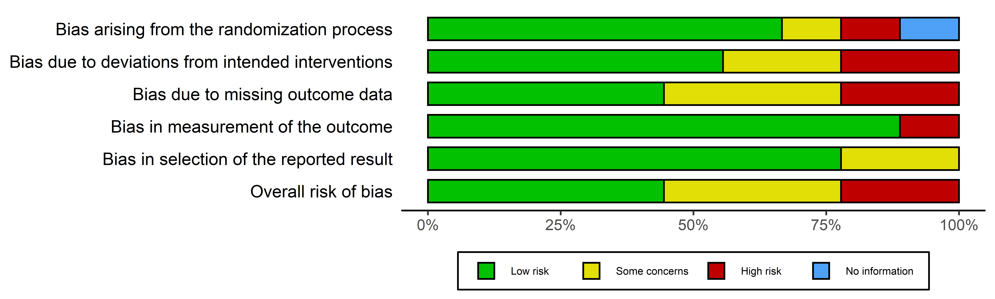
Summary bar-plots

Slide 5
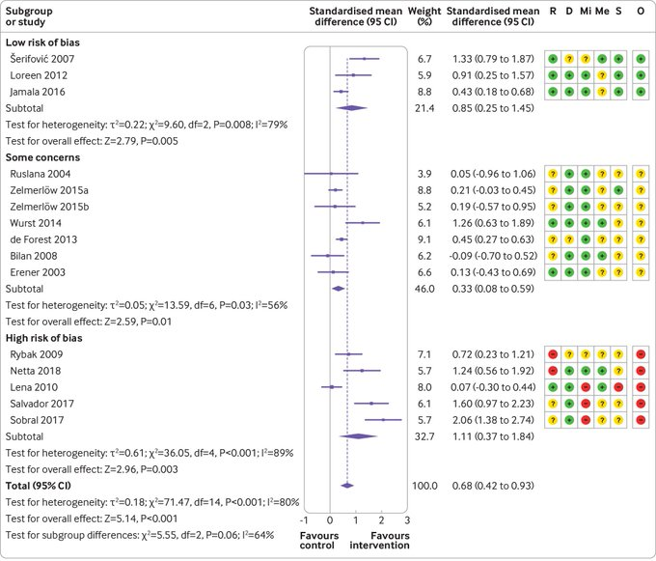
Limitations of the current approach
Risk-of-bias assessments are performed and the figures are relegated to the supplementary material
Better to try and “pair” the assessments to their respective results
Also suggested to perform sub-group meta-analysis by risk-of-bias level

Slide 6
Building on metafor
“Paired” forest/risk-of-bias plots

Slide 7
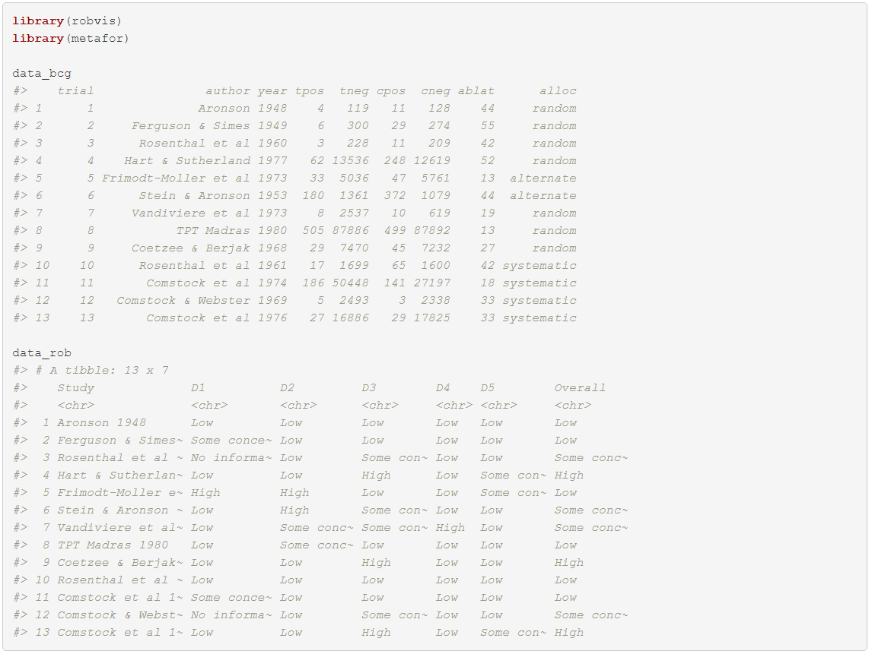
Explore the datasets

Slide 8
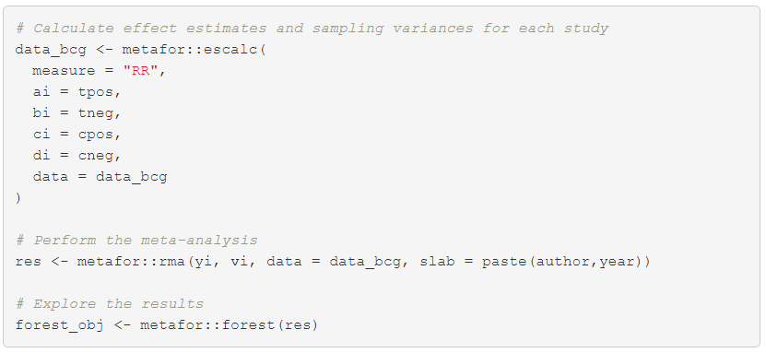
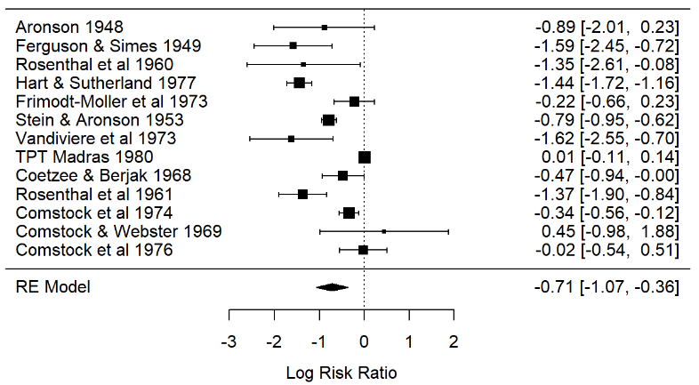
Run a meta-analysis and visualise the results

Slide 9
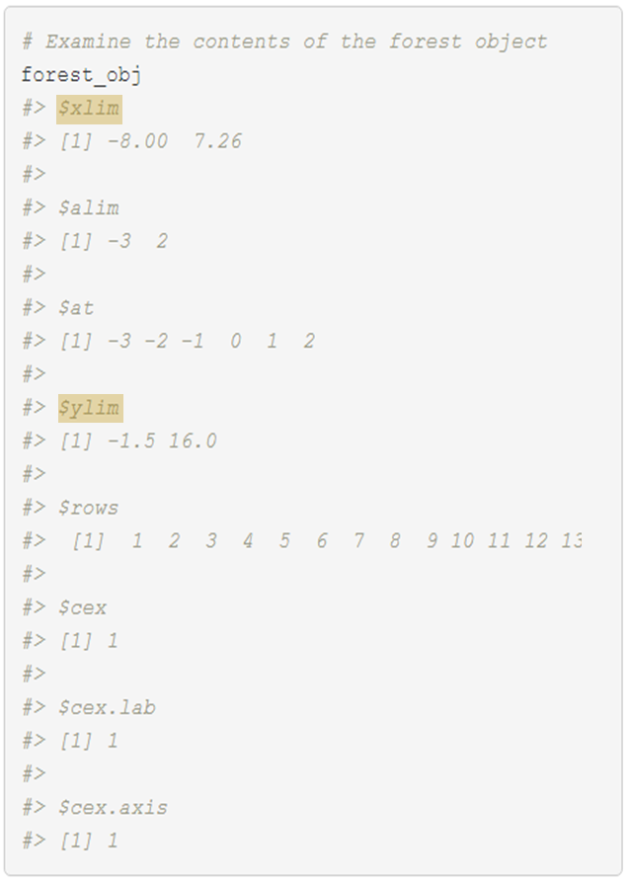
metafor::forest() returns information on dimensions of the plot
The metafor::forest() function produces additional output beyond the plot itself
As seen on the last slide, assigning this output to a variable (e.g. forest_obj) via
forest_obj <- metafor::forest(res)
means we can explore and use this information in subsequent functions
Output includes:
Limits of the forest plot (xlim, ylim)
Axis limits (alim)
Where the breaks at the axis lie (at)
Other information needed for plotting

Slide 10
Invisibly call metafor::forest() to get dimensions of standard plot
(xlim)
xlim

Slide 11
Invisibly call metafor::forest() to get dimensions of standard plot
(xlim)
Update axes to create space for risk- of- bias plot
(new_xlim)
new_xlim

Slide 12
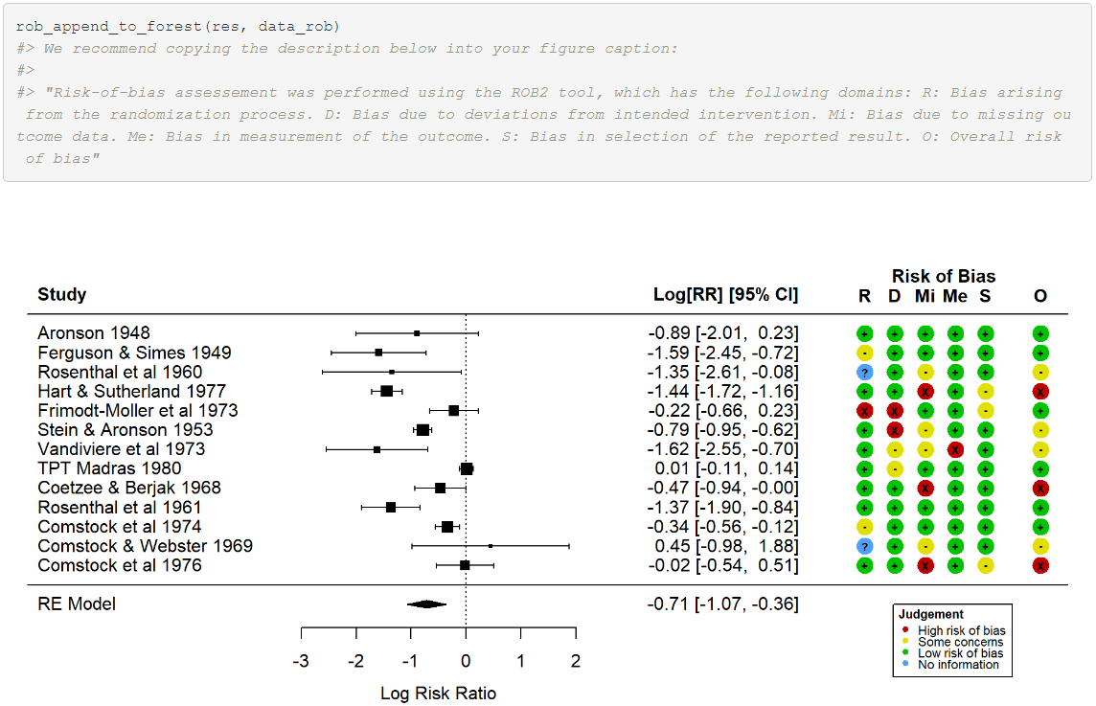
Invisibly call metafor::forest() to get dimensions of standard plot
(xlim)
Update axes to create space for risk- of- bias plot
(new_xlim)
Call metafor::forest(), passing new_xlim, to produce widened plot
new_xlim

Slide 13
Invisibly call metafor::forest() to get dimensions of standard plot
(xlim)
Update axes to create space for risk- of- bias plot
(new_xlim)
Plot risk-of-bias plot in extra space
Call metafor::forest(), passing new_xlim, to produce widened plot
new_xlim

Slide 14
Invisibly call metafor::forest() to get dimensions of standard plot
(xlim)
Update axes to create space for risk- of- bias plot
(new_xlim)
Plot risk-of-bias plot in extra space
Call metafor::forest(), passing new_xlim, to produce widened plot
Wrap as function
new_xlim

Slide 15
rob_append_to_forest()

Slide 16
Take-home messages
Keep an eye out for potential ways to build on existing evidence synthesis packages to expand user functionality
On the flip-side, think about how others might build on your packages (and what information they’ll need!)
Best option: develop packages in tandem, so that cross-talk between them is possible.

Slide 17
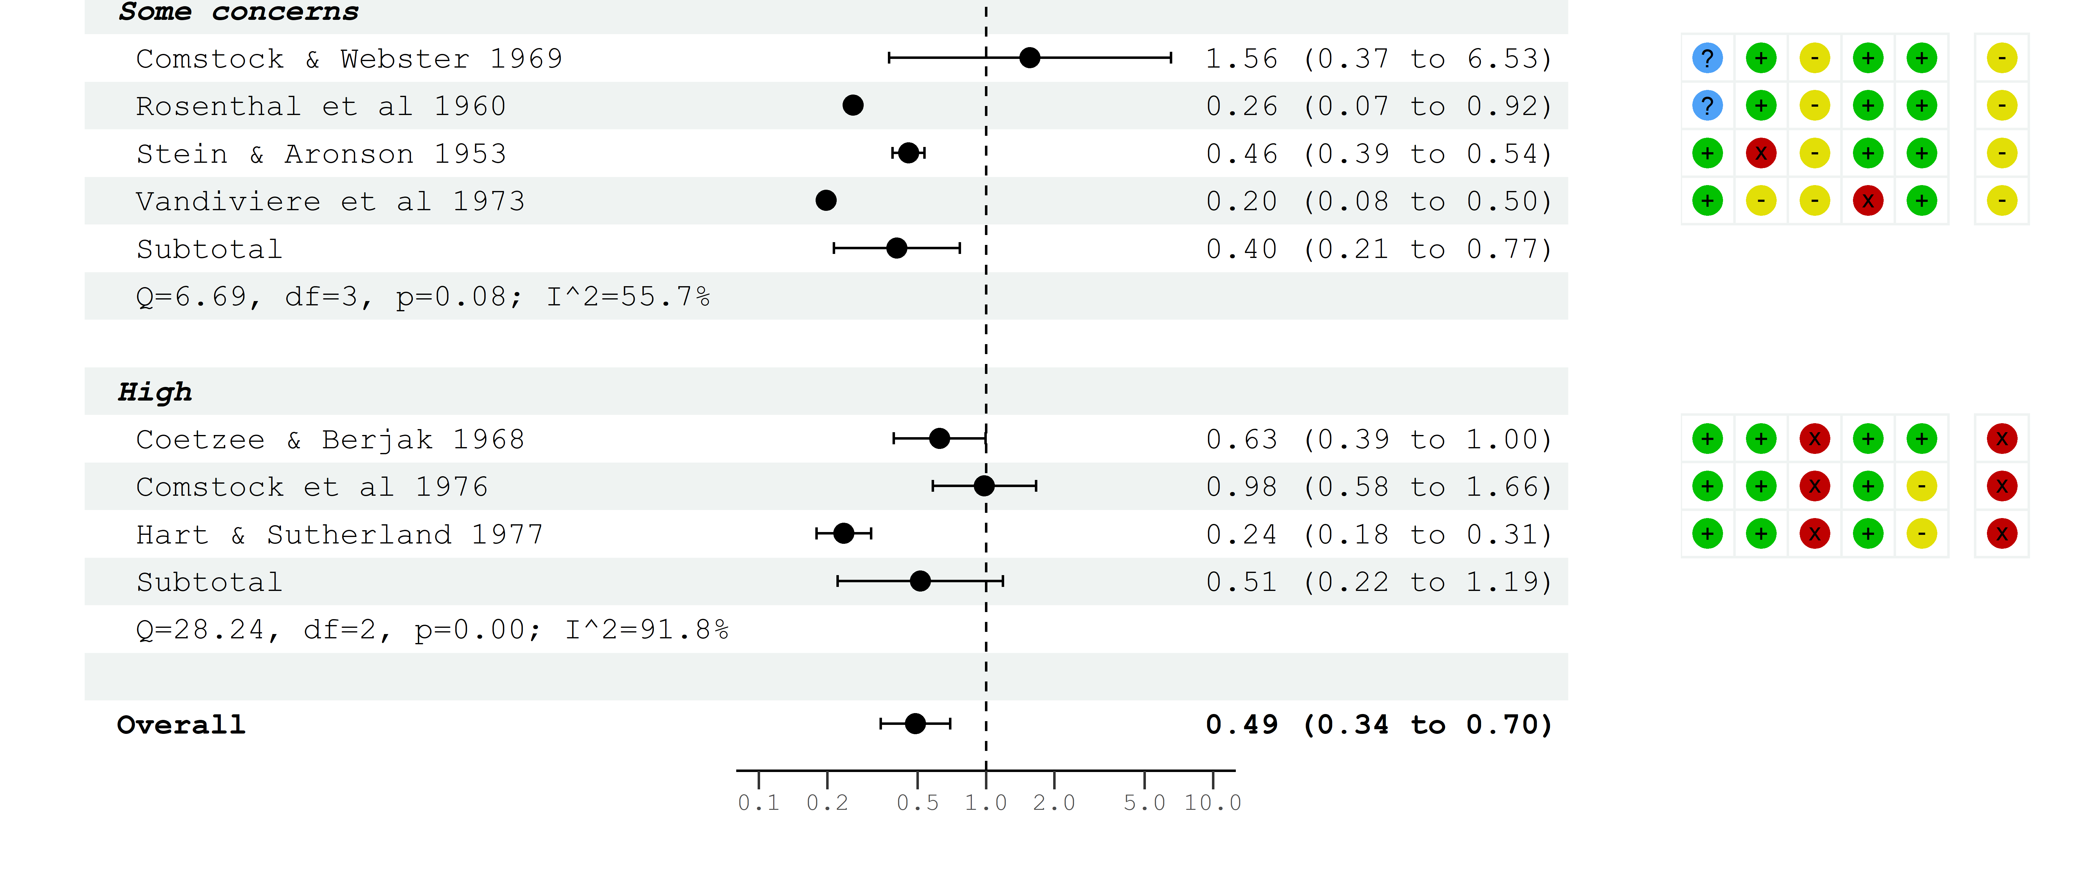
Future work
New function (rob_blobbogram()), which will automatically subset data by risk-of-bias level and perform a meta-analysis on each subset.
Draws on metafor and forester packages

Slide 18
Further info
See docs/info at:
Package website: mcguinlu.github.io/robvis/
Shiny app: mcguinlu.shinyapps.io/robvis/
Paper introducing robvis:
McGuinness, L. A., & Higgins, J. P. (2020). Risk‐of‐bias VISualization (robvis): An R package and Shiny web app for visualizing risk‐of‐bias assessments. Research Synthesis Methods.
Contribute to the package
Open an issue on the GitHub repository
Tweet at me (@mcguinlu)
Send me an email (luke.mcguinness@bistol.ac.uk)

