Slide 1

Convolutional Neural Networks (CNN)
11/14/2017 – Rowan
Sean McGuire
Signal Processing & Pattern Recognition Laboratory
Electrical & Computer Engineering Rowan University, Glassboro, NJ

Slide 2
Outline
Background
Layers
Input
Convolutional
Pooling
ReLU
Fully Connected
Adjustable Parameters
AlexNet Implementation

Slide 3
Background
What can it be used for? What is a CNN?

Slide 4
Applications
Image Recognition
Natural Language Processing
Speech Recognition
Natural Language Generation
Recommender Systems
Predicts a rating or preference to associate with an item
Used in rating movies, music, news, search queries, online dating, twitter pages

Slide 5
Why do we need CNNs?
Why not use a MLP?
For image classifications the input size of images contain many features
A 200x200 pixel RGB picture contains 120,000 input features
In a MLP nodes are fully connected so it suffers from the curse of dimensionality.
Another reason that MLP’s suffer is that they do not take into account the spatial relation of pixels.
A pixel in the top left and bottom right of a picture are treated the same as two pixels next to each other.
120,000
Features

Slide 6
What is a CNN?
At its basis, a CNN is a deep feed forward neural network.
CNNs allow an image to be recognized even if the image is transformed
Rotated
Translated
CNNs are constructed of layers including
Input
Convolutional
Pooling
Fully Connected (The same as a hidden layer in a MLP)

Slide 7
Layers of a CNN
Input
Convolutional
Pooling
ReLU
Fully Connected

Slide 8
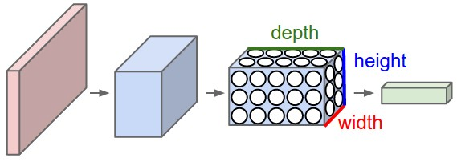
Architecture of Layers in a CNN
For image processing we can think of the height and width of a 3D layer as the height and width in pixels. The depth of the layer can be thought of as the RGB values for each pixel.
Image from: http://cs231n.github.io/convolutional-networks/

Slide 9
Input Layer
Like an MLP a CNN needs an input layer, in a MLP the input layer is a vector of features.
In a CNN the input layer can be a 3D volume. This means that the entire picture can be passed in. Ex. 32x32x3 image
The input layer holds the pixel values for each pixel and color channel.
3
32
32

Slide 10
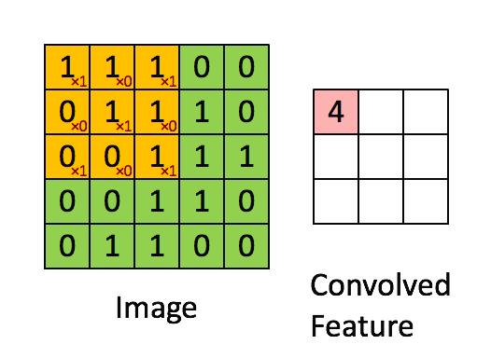
Convolutional Layer
A convolutional layer is often referred to as a layer of filters.
Filter sizes are smaller in terms of width and height than the previous layer, but they have the same depth.
Filters are meant to detect edges and patterns inside of an image.
The filters are moved across the image and the dot product is taken of the filter and the section of the image.
The result of this layer has a smaller width and height dimension with a depth dimension equal to the number of filters used.
https://hackernoon.com/visualizing-parts-of-convolutional-neural-networks-using-keras-and-cats-5cc01b214e59

Slide 11
Constructing the Convolutional Layer
Our example is a 32x32x3 picture.
Lets use a 4x4x3 filter (the last dimension MUST be 5) this filter has a stride length of 1 meaning that the filter moves one pixel at a time (this value can be modified).
To make sure the filter dimensions are acceptable we pass the values through this equation: (Input Size−Filter Size+2*Zero Padding)/Stride+1
The result must be an integer, the result is the dimensions of the output of the layer (32-4+0)/2 = 14 so the output layer is 14x14x5
3
5 Filters
32
4
14
4
3
14
32
5

Slide 12
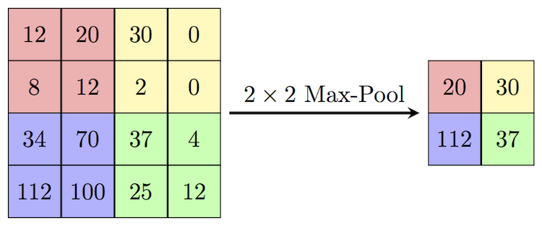
Pooling Layer
The pooling layer takes information from the previous layer and lowers the special dimensionality (Width x Height) of the information. A pooling layer is usually placed between convolutional layers. This is usually done in 2x2 sections.
There are two reasons we use pooling
Reduce computational overhead
To avoid over-fitting
Two different types of pooling
Max Pooling – The most common practice, takes max value in the 2x2 section
Average Pooling – Takes the average of all 4 values and places it in the new matrix
https://cambridgespark.com/content/tutorials/convolutional-neural-networks-with-keras/index.html

Slide 13
ReLU Layer
ReLU stands for Rectified Linear Unit. This layer is responsible for computing the outputs of the CNN neurons.
In practice the equation for ReLU is max(0, x) which is not differentiable at the origin which leads to difficulties when training with backpropogation.
The actual function used is the Softplus function f(x) = ln(1+e^x)
The derivative of this function is the sigmoid function, which we have seen in MLP

Slide 14
Fully Connected Layer
What does the attacker know?
Perfect Knowledge – the attacker knows everything about the machine learning algorithm
Limited Knowledge – the attacker has some limited knowledge about the machine learning algorithm
How limited?
Do they know what algorithm you are using?
Do they know the algorithm free parameters?
Do they know the optimized algorithm parameters?
Do they know the data passed into the algorithm?
Or maybe they can guess where your data comes from based on the application. Ex. ImageNet if the application is object recognition

Slide 15
Adjustable Parameters
Filters
Pooling

Slide 16
Filters
The number of and size of filter layers can be modified for each convolutional layer.
Ex. A 4x4 filter shape with 30 filters and the next convolutional layer can have a 5x5 filter shape with 5 filters.
[1] J. Newsome, B. Karp, and D. Song, “Paragraph: Thwarting Signature Learning by Training Maliciously,” Recent Adv. Intrusion Detect., vol. 4219, pp. 81–105, 2006.

Slide 17
Pooling
The method of and size of pooling can be changed on each layer.
Ex. A pooling layer can consist of a 2x2 shape with Max pooling and the next convolutional layer can have a 4x4 shape with Average pooling.
[1] J. Newsome, B. Karp, and D. Song, “Paragraph: Thwarting Signature Learning by Training Maliciously,” Recent Adv. Intrusion Detect., vol. 4219, pp. 81–105, 2006.

Slide 18
AlexNet Implementaion

