Slide 1

Convolutional Neural Networks (CNN)
11/14/2017 – Rowan
Sean McGuire
Signal Processing & Pattern Recognition Laboratory
Electrical & Computer Engineering Rowan University, Glassboro, NJ

Slide 2
Outline
Background
Layers

Slide 3
Background
What can it be used for? What is a CNN?

Slide 4
Applications
Image Recognition
Natural Language Processing
Speech Recognition
Natural Language Generation
Recommender Systems
Predicts a rating or preference to associate with an item
Used in rating movies, music, news, search queries, online dating, twitter pages

Slide 5
Why do we need CNNs?
Why not use a MLP?
For image classifications the input size of images contain many features
A 200x200 pixel RGB picture contains 120,000 input features
In a MLP nodes are fully connected so it suffers from the curse of dimensionality.
Another reason that MLP’s suffer is that they do not take into account the spatial relation of pixels.
A pixel in the top left and bottom right of a picture are treated the same as two pixels next to each other.
120,000
Features

Slide 6
What is a CNN?
At its basis, a CNN is a deep feed forward neural network.
CNNs allow an image to be recognized even if the image is transformed
Rotated
Translated
Size is increased or decreased
CNNs are constructed of layers including
Input
Convolutional
Pooling
Fully Connected (The same as a hidden layer in a MLP)

Slide 7
Layers of a CNN

Slide 8
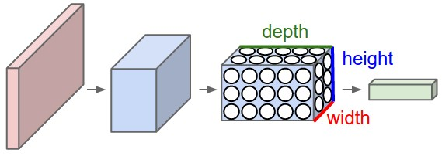
Architecture of Layers in a CNN
For image processing we can think of the height and width of a 3D layer as the height and width in pixels. The depth of the layer can be thought of as the RGB values for each pixel.
Image from: http://cs231n.github.io/convolutional-networks/

Slide 9
Input Layer
Like an MLP a CNN needs an input layer, in a MLP the input layer is a vector of features.
In a CNN the input layer can be a 3D volume. This means that the entire picture can be passed in. Ex. 32x32x3 image
The input layer holds the pixel values for each pixel and color channel.
3
32
32

Slide 10
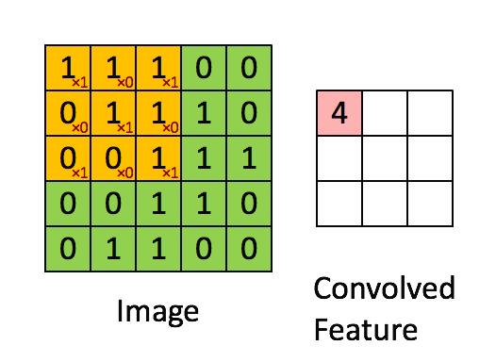
Convolutional Layer
A convolutional layer is often referred to as a layer of filters.
Filter sizes are smaller in terms of width and height than the previous layer, but they have the same depth.
Filters are meant to detect edges and patterns inside of an image.
The filters are moved across the image and the dot product is taken of the filter and the section of the image.
The result of this layer has a smaller width and height dimension with a depth dimension equal to the number of filters used.
https://hackernoon.com/visualizing-parts-of-convolutional-neural-networks-using-keras-and-cats-5cc01b214e59

Slide 11
Constructing the Convolutional Layer
Our example is a 32x32x3 picture.
Lets use a 4x4x3 filter (the last dimension MUST be 5) this filter has a stride length of 1 meaning that the filter moves one pixel at a time (this value can be modified).
To make sure the filter dimensions are acceptable we pass the values through this equation: (InputSize−FilterSize+2ZeroPadding)/Stride+1
The result must be an integer, the result is the dimensions of the output of the layer (32-4+0)/2 = 14 so the output layer is 14x14x5
3
5 Filters
32
5
14
5
3
14
32
5

Slide 12
Security Violation / Attacker Goal
What is the attacker’s goal?
Integrity – goal is to get malicious examples classified as legitimate
Availability – goal is to get legitimate examples misclassified
Privacy – goal is to get confidential information from the classifier

Slide 13
Specificity
What is the attacker’s target?
Targeted – small number of target instances
Indiscriminate – no specific target

Slide 14
Attacker Knowledge
What does the attacker know?
Perfect Knowledge – the attacker knows everything about the machine learning algorithm
Limited Knowledge – the attacker has some limited knowledge about the machine learning algorithm
How limited?
Do they know what algorithm you are using?
Do they know the algorithm free parameters?
Do they know the optimized algorithm parameters?
Do they know the data passed into the algorithm?
Or maybe they can guess where your data comes from based on the application. Ex. ImageNet if the application is object recognition

Slide 15
Attacker Knowledge
What is a reasonable assumption about the attacker knowledge?
“Security through obscurity is no security at all” – Said every security engineer everywhere (or the good ones at least).
It is useful to understand what the attacker can do with different levels of knowledge, but ideally the system should still be secure assuming the attacker has perfect knowledge.
The machine learning models can be stolen by looking at the output [1,2]
An attacker can break into the network / computer and directly steal the model
In practice, you must understand the risks of your particular application
[1] F. Tramer, F. Zhang, A. Jules, M. Reiter, and T. Ristenpart, “Stealing Machine Learning Models via Prediction APIs Florian,” in 25th USENIX Security Symposium, 2016.
[2] Y. Shi, Y. Sagduyu, and A. Grushin, “How to Steal a Machine Learning Classifier with Deep Learning,” 2017.

Slide 16
Attacks Against Supervised Learning
Causative Integrity
Causative Availability
Causative Privacy
Exploratory Integrity
Exploratory Availability
Exploratory Privacy

Slide 17
Disclaimer
Note: This is not intended to be an exhaustive list, but give a sample of what is out there. There is currently no authoritative list of all AML Attacks and Defenses. Many of the named attacks are fairly broad and a few different papers accurately fit the description.

Slide 18
Causative Integrity Attacks
Red Herring

Slide 19
Red Herring
Core Idea: Incorporate spurious features into the target class so that the classifier relies on the spurious features to classify the target class.
Training / t-1
Testing / t
Spam | Ham
Hello | Conference
Conference | Grant
Nigeria | Hello
TOTALLY-NOTSPAM
Spam | Ham
Hello | Conference
Viagra | Grant
Nigeria | Hello
[1] J. Newsome, B. Karp, and D. Song, “Paragraph: Thwarting Signature Learning by Training Maliciously,” Recent Adv. Intrusion Detect., vol. 4219, pp. 81–105, 2006.

Slide 20
Causative Availability Attacks
Correlated Outlier
Allergy

Slide 21
Correlated Outlier
Core Idea: Incorporate spurious features into the target class that also appear in an innocuous sample.
Variants:
Attacks Against SpamBayes
Dictionary Attack: Add a dictionary (Aspell, Usenet) of tokens to the spam email
Focused Attack: Add all of the token in the target email to the spam email
[1] J. Newsome, B. Karp, and D. Song, “Paragraph: Thwarting Signature Learning by Training Maliciously,” Recent Adv. Intrusion Detect., vol. 4219, pp. 81–105, 2006.
[2] G. Robinson, “A statistical approach to the spam problem,” Linux J., vol. 2003, no. 107. p. 3, 2003.
[3] G. Wittel and S. Wu, “On Attacking Statistical Spam Filters.,” Ceas, 2004.

Slide 22
Dictionary Attack
A dictionary attack is an targeted correlated outlier attack
Training / t-1
Testing / t
Spam | Ham (Target)
Hello | Conference
Viagra | Grant
Nigeria | Hello
Conference
Grant
Ham (Target)
Conference
Grant
Hello

Slide 23
Focused Attack
A focused attack is an indiscriminate correlated outlier attack
Training / t-1
Spam | Ham
Hello | Conference
Viagra | Grant
Nigeria | Hello
Ardvark
…
Ham
Conference
Grant
Hello

Slide 24
Allergy
Core Idea: Trick an automatic signature generation system (essentially malware feature extraction) into generating signatures that match normal traffic so that the normal traffic will be blocked.
This is more or less the same thing as the correlated outlier attack, but applied to a particular application (intrusion detection).
There is one extra step and the attacker can’t directly control the features
Ex. Send a large amount of network traffic that you want blocked to random IP addresses so it looks malicious
This possibly could be categorized as an attack on feature selection
[1] S. Chung and A. Mok, “Allergy Attack Against Automatic Signature Generation,” Recent Adv. Intrusion Detect., vol. 4219, pp. 61–80, 2006.

Slide 25
Causative Privacy Attacks
???

Slide 26
Causative Privacy Attacks
I can find only a single reference to a causative privacy attack. They propose an idea, but no research has been done.
“A causative privacy attack, however, would require both manipulation of the training and information obtained from the learned classifier. The attacker could inject malicious PDFs with features identifying a particular author and then subsequently test if other PDFs with those features were labeled as malicious; this observed behavior may leak private information about the authors of other PDFs in the training set.” [1]
[1] S. Chung and A. Mok, “Allergy Attack Against Automatic Signature Generation,” Recent Adv. Intrusion Detect., vol. 4219, pp. 61–80, 2006.

Slide 27
Exploratory Integrity Attacks
Polymorphic Blending
Good Word
Reverse Engineering Classifiers

Slide 28
Polymorphic Blending
Core Idea: Encrypt attack traffic so that it appears statistically identical to normal traffic.
This is fairly specific to malware.
“After learning the normal profile, the adversary creates a new attack instance and encrypts (and blends) it to match the normal profile. A straightforward byte substitution scheme followed by padding can be used for encryption.” [1]
[1] P. Fogla, M. Sharif, R. Perdisci, O. Kolesnikov, and W. Lee, “Polymorphic Blending Attacks,” 15th USENIX Secur. Symp., pp. 241–256, 2006.

Slide 29
Good Word
Core Idea: Add features indicative of ham emails to spam emails.
Testing / t
Spam | Ham
Hello | Conference
Viagra | Grant
Nigeria | Hello
Conference
Grant
[1] D. Lowd and C. Meek, “Good Word Attacks on Statistical Spam Filters,” in Conference on email and anti-spam, 2005.

Slide 30
Reverse Engineering Classifiers
Core Idea: Determine the lowest cost instance put into the desired class by learning the classifier parameters through querying the classifier.
Spam
Poll the classifier to find the nearest instance from some known “spam” data that is classified as “ham.”
Adversarial
Ham
[1] D. Lowd and C. Meek, “Adversarial learning,” Proceeding Elev. ACM SIGKDD Int. Conf. Knowl. Discov. data Min. - KDD ’05, no. January, p. 641, 2005.

Slide 31
Exploratory Availability Attacks
??

Slide 32
Denial of Service
This is simply a DoS attack (not specific to machine learning even)
“sending junk data that causes false alarms (an exploratory availability attack)” [1]
“take advantage of a computationally expensive learning component: for example, spam filters that use image processing to detect advertisements in graphical attachments can take significantly more time than text-based filtering” [2]
[1] M. Kloft and P. Laskov, “Security analysis of online centroid anomaly detection,” J. Mach. Learn. Res., vol. 13, pp. 3681–3724, 2012.
[2] M. A. Barreno, “Evaluating the Security of Machine Learning Algorithms,” 2008.

Slide 33
Exploratory Privacy Attacks
Stealing Machine Learning Models

Slide 34
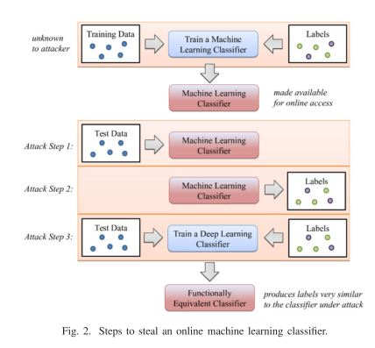
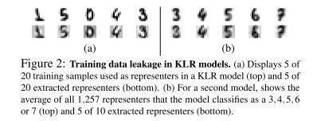
Stealing Machine Learning Models
Core Idea: Look at the output of a machine learning model to recreate the model. Fundamentally, it is based on Hinton’s neural network distillation work. [1]
[3]
[2]
[1] G. Hinton, O. Vinyals, and J. Dean, “Distilling the Knowledge in a Neural Network,” pp. 1–9, 2015.
[2] Y. Shi, Y. Sagduyu, and A. Grushin, “How to Steal a Machine Learning Classifier with Deep Learning,” 2017.
[3] F. Tramer, F. Zhang, A. Jules, M. Reiter, and T. Ristenpart, “Stealing Machine Learning Models via Prediction APIs Florian,” in 25th USENIX Security Symposium, 2016.

Slide 35
Other Ideas
Membership Inference Attacks – Given a machine learning model and some data, determine if the data was used to train the model. [1]
[1] R. Shokri, M. Stronati, C. Song, and V. Shmatikov, “Membership Inference Attacks against Machine Learning Models,” IEEE Secur. Priv., 2017.

Slide 36
What is missing?
Quite a lot. Only a handful of attacks were described for each category.
All of the newer deep learning stuff has been left out!
See: https://blog.openai.com/adversarial-example-research/

Slide 37
Defenses Against Supervised Learning
Reject on Negative Impact

Slide 38
Reject on Negative Impact
Core Idea: For each new data, measure the incremental impact on performance. Eliminate the new data if it has a sufficiently large impact on performance.
[1] B. Nelson, M. Barreno, F. J. Chi, A. D. Joseph, B. I. P. Rubinstein, U. Saini, C. Sutton, J. D. Tygar, and K. Xia, “Exploiting machine learning to subvert your spam filter,” Proc. First Work. Large-scale Exploit. Emerg. Threat., p. Article 7, 2008.

Slide 39
What is missing?
Quite a lot
Randomization
Limiting feedback
Practically the entire field of robust learning!
All defenses that are responses to the deep learning attacks!
Gradient Masking
Feature Squeezing
Defensive Distillation
MagNet
Dense Associative Memory
Distribution Smoothing

Slide 40
Attacks and Defenses Against Unsupervised Learning

Slide 41
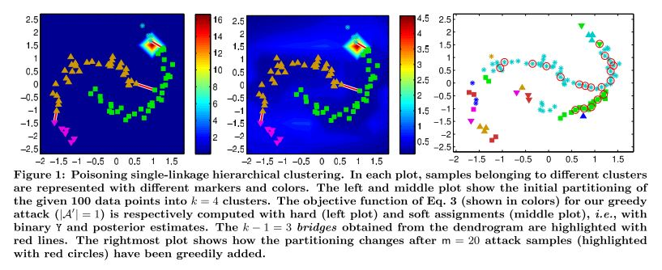
Single Linkage Clustering
Yes, it can be attacked!
Not sure of a defense. RONI using some cluster statistic?
[1] B. Biggio, I. Pillai, S. R. Bulò, and D. Ariu, “Is data clustering in adversarial settings secure?,” in AISec ’13 Proceedings of the 2013 ACM workshop on Artificial intelligence and security, 2013, pp. 87–97.

Slide 42
Attacks and Defenses Against Feature Selection

Slide 43
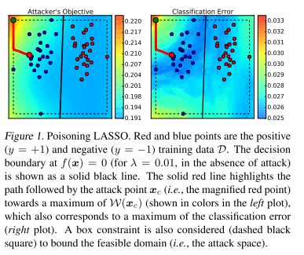
It can also be attacked!
Defense: Outlier detection? RONI?
[1] B. Biggio, I. Pillai, S. R. Bulò, and D. Ariu, “Is data clustering in adversarial settings secure?,” in AISec ’13 Proceedings of the 2013 ACM workshop on Artificial intelligence and security, 2013, pp. 87–97.

Slide 44
Research Gaps and Possible Future Work

Slide 45
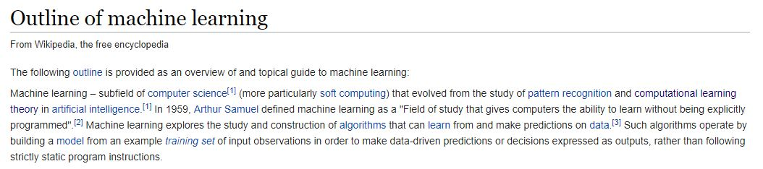
Let’s Play A Mad Lib!
Hey _____, you know what would be cool, adversarial _____ learning!
[1] Dr. Polikar, Alex, Mike
[2] …

Slide 46
Some General Thoughts
A number of very interesting ideas were proposed in “Can machine learning be secure?”
It has been 11 years, has there been a follow up paper on each idea?
I doubt it
While there have been review papers written, there is no single list of all attacks and defenses
[1] looks at the security of an entire machine learning pipeline. This view is far more realistic and should be further explored
[1] N. Papernot, P. Mcdaniel, A. Sinha, and M. Wellman, “SoK: Towards the Science of Security and Privacy in Machine Learning,” Preprint, pp. 1–19, 2016.

Slide 47
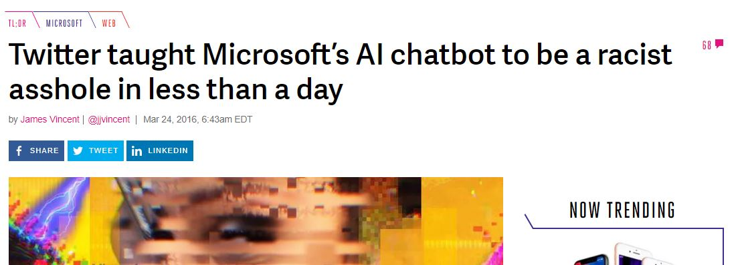
Some Specific Thoughts
Data that maximizes classifier error may be outliers that can be easily detected
You should make a tradeoff between performance and how much of an outlier the adversarial data may be
There is nothing in the literature that would have prevented the Microsoft Tay fiasco
Non-stationary learning approaches may be applied to this problem
Adversarial data is more abrupt than benign (maybe)

Slide 48
Thanks for listening!

Slide 49
Visualization Legend
Labeled Data of Class Blue
Labeled Data of Class Green
Adversarial Example
Decision Boundary

