Slide 1

Convolutional Neural Networks (CNN)
11/14/2017 – Rowan
Sean McGuire
Signal Processing & Pattern Recognition Laboratory
Electrical & Computer Engineering Rowan University, Glassboro, NJ

Slide 2
Outline
Background
Layers
Input
Convolutional
Pooling
ReLU
Fully Connected
AlexNet Implementation

Slide 3
Background
What can it be used for? What is a CNN?

Slide 4
Applications
Image Recognition
Natural Language Processing
Speech Recognition
Natural Language Generation
Recommender Systems
Predicts a rating or preference to associate with an item
Used in rating movies, music, news, search queries, online dating, twitter pages
http://papers.nips.cc/paper/5004-deep-content-based-music-recommendation.pdf

Slide 5
Why do we need CNNs?
Why not use a MLP?
For image classifications the input size of images contain many features
A 200x200 pixel RGB picture contains 120,000 input features
In a MLP nodes are fully connected so it suffers from the curse of dimensionality.
Another reason that MLP’s performance suffers is that they do not take into account the spatial relation of pixels.
A pixel in the top left and bottom right of a picture are treated the same as two pixels next to each other.
120,000
Features

Slide 6
What is a CNN?
At its basis, a CNN is a deep feed forward neural network.
CNNs allow an image to be recognized even if the image is transformed
Rotated
Translated
CNNs are constructed of layers including
Input
Convolutional
Pooling
ReLU
Fully Connected (The same as a hidden layer in a MLP)

Slide 7
Layers of a CNN
Input
Convolutional
Pooling
ReLU
Fully Connected

Slide 8
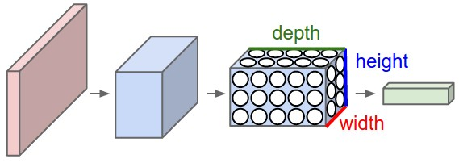
Architecture of Layers in a CNN
For image processing we can think of the height and width of a 3D layer as the height and width in pixels. The depth of the layer can be thought of as the RGB values for each pixel.
http://cs231n.github.io/convolutional-networks/

Slide 9
Input Layer
Like an MLP a CNN needs an input layer, in a MLP the input layer is a vector of features.
In a CNN the input layer can be a 3D volume. This means that the entire picture can be passed in. Ex. 32x32x3 image
The input layer holds the pixel values for each pixel and color channel.
3
32
32

Slide 10
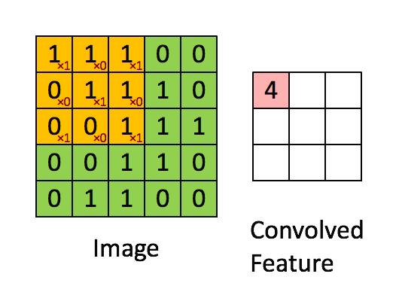
Convolutional Layer
A convolutional layer is often referred to as a layer of filters.
Filters have a smaller width and height than the previous layer, but they must have the same depth.
Filters are used to detect edges and patterns inside of an image.
The filters are moved across the image and the dot product is taken of the filter and the section of the image.
The result of this layer has a smaller width and height dimension with a depth dimension equal to the number of filters used.
https://hackernoon.com/visualizing-parts-of-convolutional-neural-networks-using-keras-and-cats-5cc01b214e59

Slide 11
Constructing the Convolutional Layer
Our example is a 32x32x3 picture.
Lets use a 4x4 filter with a stride length of 1, this means that the filter moves one pixel at a time (this value can be modified).
To make sure the filter dimensions are acceptable we pass the values through this equation: (Input Size−Filter Size+2*Zero Padding)/Stride+1
The result must be an integer, the result is the dimensions of the output of the layer (32-4+0)/2 = 14 so the output layer is 14x14x5
3
5 Filters
32
4
14
4
3
14
32
5

Slide 12
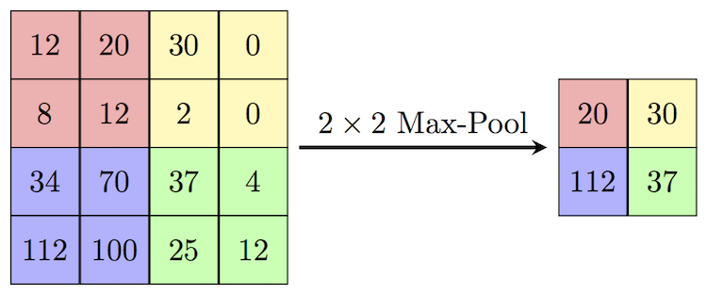
Pooling Layer
The pooling layer takes information from the previous layer and lowers the spatial dimensionality (Width x Height) of the information. A pooling layer is usually placed between convolutional layers. This is typically done in 2x2 sections.
There are two reasons we use pooling
Reduce computational overhead
To avoid over-fitting
Two different types of pooling
Max Pooling – The most common practice, takes max value in the section
Average Pooling – Takes the average of all values and places it in the new matrix
https://cambridgespark.com/content/tutorials/convolutional-neural-networks-with-keras/index.html

Slide 13
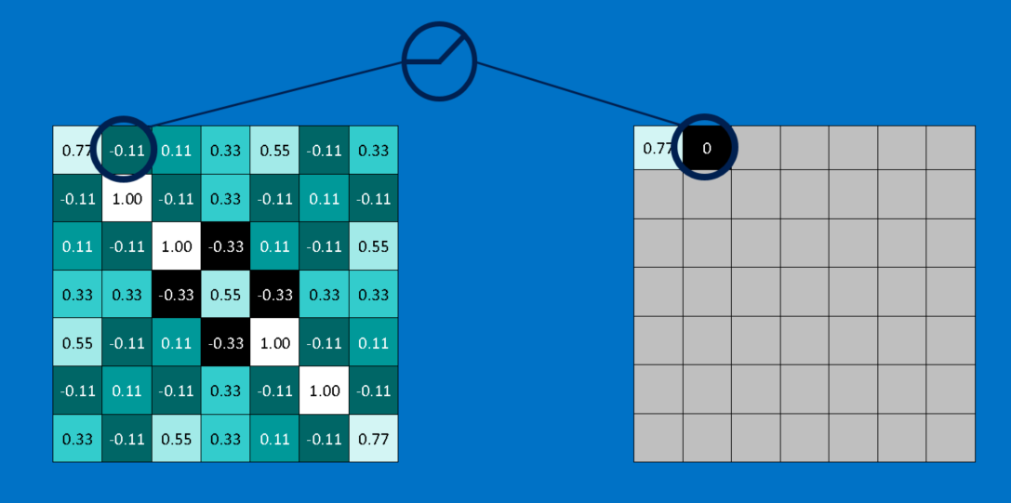
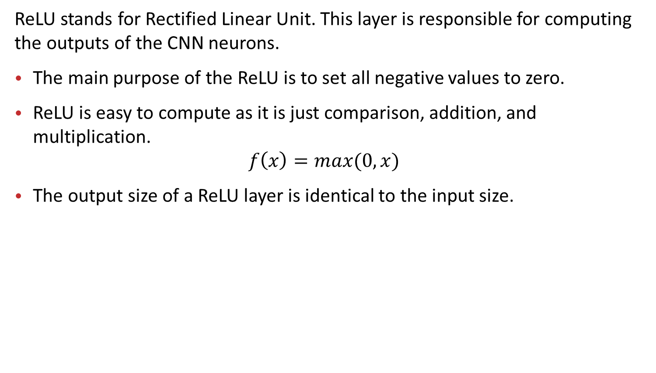
ReLU Layer
ReLU stands for Rectified Linear Unit. This layer is responsible for computing the outputs of the CNN neurons.
The main purpose of the ReLU is to set all negative values to zero.
ReLU is easy to compute as it is just comparison, addition, and multiplication.
$$f\left(x\right)=max⁡(0,x)$$
The output size of a ReLU layer is identical to the input size.
http://brohrer.github.io/how_convolutional_neural_networks_work.html

Slide 14
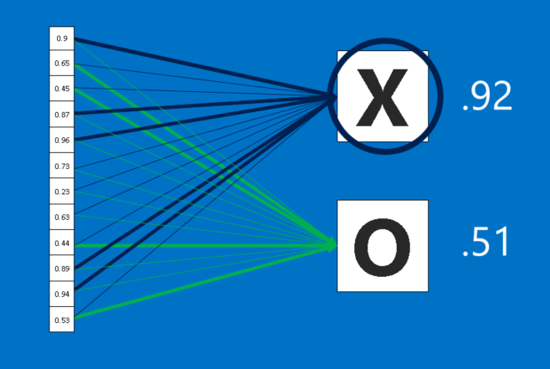
Fully Connected Layer
Works the same as a hidden layer from an MLP
These fully connected layers compute the final likelihoods for each class and from these values a final classification is made.
http://brohrer.github.io/how_convolutional_neural_networks_work.html

Slide 15
AlexNet Implementaion

Slide 16
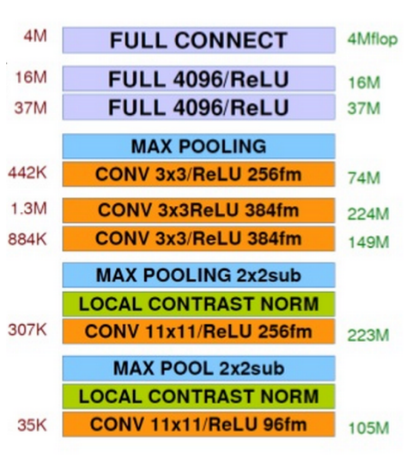
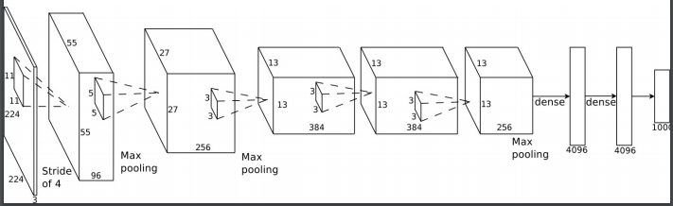
AlexNet Architecture
AlexNet is a CNN trained to perform large scale image recognition.
1.2 Million Images in 1000 classes
Constructed of 5 convolutional layers, 3 max pooling, and 3 fully connected layers.
650K neurons
60 Million parameters
Took 5 to 6 days to train on 2 GPUs
http://vision.stanford.edu/teaching/cs231b_spring1415/slides/alexnet_tugce_kyunghee.pdf
http://www.image-net.org/challenges/LSVRC/2012/supervision.pdf

Slide 17
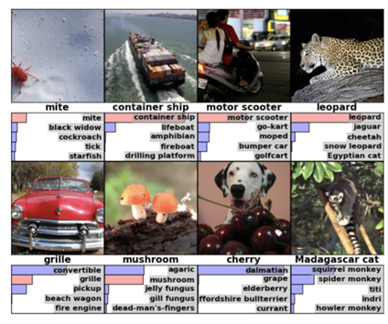
Some Examples of Classifications
Examples of classifications made for the Large Scale Visual Recognition Challenge 2010
https://blog.acolyer.org/2016/04/20/imagenet-classification-with-deep-convolutional-neural-networks/

