Slide 1
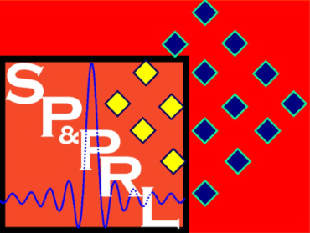
Pattern Recognition Using Deep Learning
12/7/2017 – Rowan
Sean McGuire and Bo-William Gilligan
Signal Processing & Pattern Recognition Laboratory
Electrical & Computer Engineering Rowan University, Glassboro, NJ

Slide 2
Outline
Introduction
Background
Convolutional Neural Network (CNN)
Autoencoder
Implementations and Results
CNN
Autoencoder
Comparing Deep Learning Methods
Advantages/Disadvantages

Slide 3
Introduction
Problem Statement – Classify an image as one of seven Buildings around campus: Science Hall, Robinson Hall, Rowan Hall, Bunce Hall, Chestnut, James Hall, Business
Constraints
Lack of Memory in GPU
Lack of Discriminator
Runtime
Standards
Training and Testing Data divided into 70% and 30% of all data
Keras wrapper for TensorFlow was used to create the CNN
MATLAB’s built-in autoencoder was utilized
Images taken from same orientation

Slide 4
Background
CNN
Autoencoder

Slide 5
Applications of CNNs
Image Recognition
Natural Language Processing
Speech Recognition
Natural Language Generation
Recommender Systems
Predicts a rating or preference to associate with an item
Used in rating movies, music, news, search queries, online dating, twitter pages
[1] Van Den Oord, A., Dieleman, S. and Schrauwen, B. (n.d.). Deep content-based music recommendation. Available at: http://papers.nips.cc/paper/5004-deep-content-based-music-recommendation.pdf

Slide 6
Why do we need CNNs?
Why not use a Multi Layer Perceptron?
For image classifications the input size of images contain many features
A 5312x2988 pixel RGB picture contains 47,616,768 input features
In a MLP nodes are fully connected so its performance exponentially decrease with an increase of features.
Another reason that MLPs performance suffers is that they do not take into account the spatial relation of pixels.
A pixel in the top left and bottom right of a picture are treated the same as two pixels next to each other.
120,000
Features

Slide 7
What is a CNN?
At its basis, a CNN is a deep neural network.
CNNs allow an image to be recognized even if the image is transformed
Rotated
Translated
CNNs are constructed of layers including
Convolutional
Pooling
Activation - ReLU
Fully Connected (Used in MLP)

Slide 8
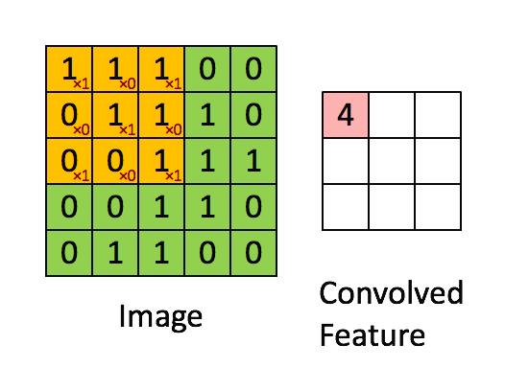
Convolutional Layer
A convolutional layer is often referred to as a layer of filters.
Filters have a smaller width and height than the previous layer, but they must have the same depth.
Filters are used to detect edges and patterns inside of an image.
The filters are moved across the image and the dot product is taken of the filter and the section of the image.
The result of this layer has a smaller width and height dimension with a depth dimension equal to the number of filters used.
[1] https://hackernoon.com/visualizing-parts-of-convolutional-neural-networks-using-keras-and-cats-5cc01b214e59

Slide 9
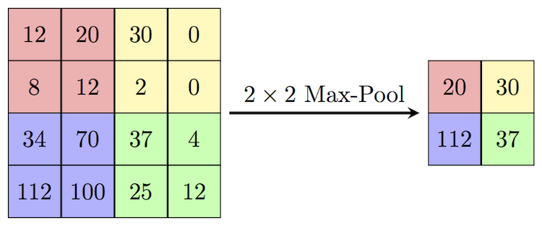
Pooling Layer
The pooling layer takes information from the previous layer and lowers the spatial dimensionality (Width x Height) of the information. A pooling layer is usually placed between convolutional layers. This is typically done in 2x2 sections.
There are two reasons we use pooling
Reduce computational overhead
To avoid over-fitting
Two different types of pooling
Max Pooling – The most common practice, takes max value in the section
Average Pooling – Takes the average of all values and places it in the new matrix
[1] https://cambridgespark.com/content/tutorials/convolutional-neural-networks-with-keras/index.html

Slide 10
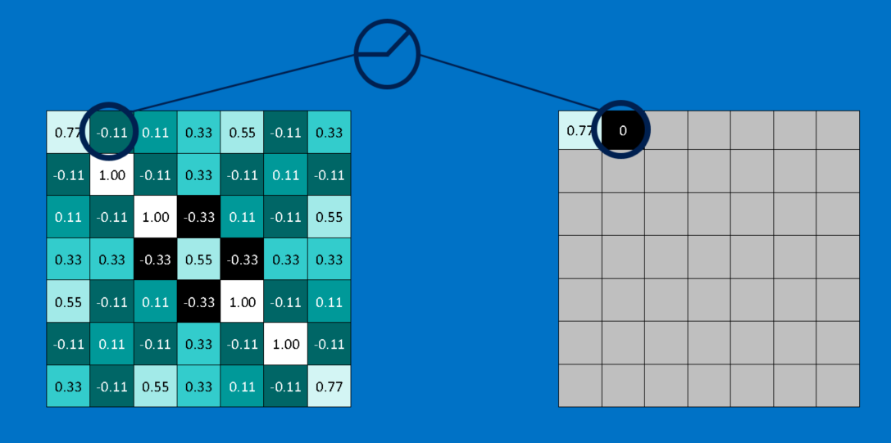
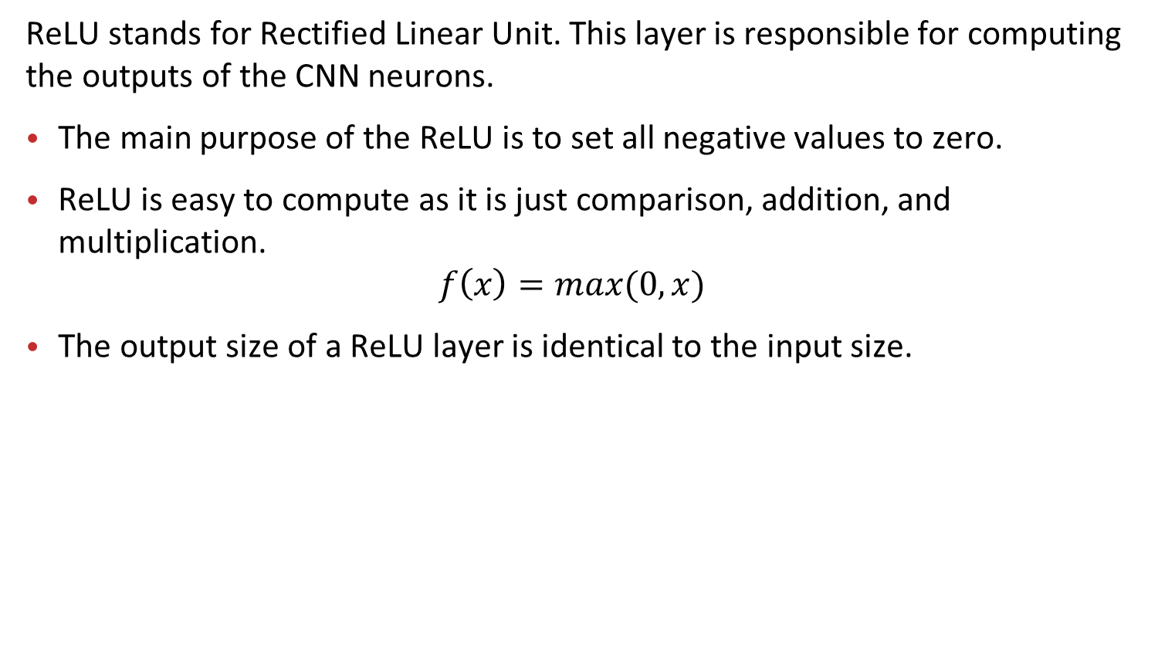
Activation - ReLU Layer
ReLU stands for Rectified Linear Unit. This layer is responsible for computing the outputs of the CNN neurons.
The main purpose of the ReLU is to set all negative values to zero.
ReLU is easy to compute as it is just comparison, addition, and multiplication.
$$f\left(x\right)=max⁡(0,x)$$
The output size of a ReLU layer is identical to the input size.
[1] http://brohrer.github.io/how_convolutional_neural_networks_work.html

Slide 11
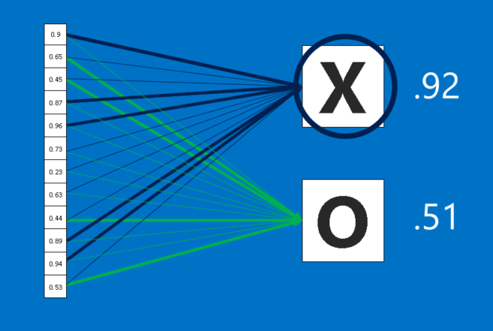
Fully Connected Layer
All nodes in the previous layer is connected to all nodes in the next layer.
These fully connected layers compute the final likelihoods for each class and from these values a final classification is made.
[1] http://brohrer.github.io/how_convolutional_neural_networks_work.html

Slide 12
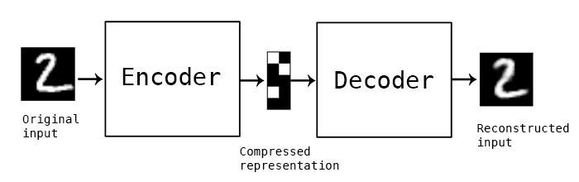
What Are Autoencoders
Autoencoders (also known as autoassociator or Diabolo Network) is a type of unsupervised learning that uses a feed-forward neural network to train to reconstruct the input as the output layer
[1] https://blog.keras.io/building-autoencoders-in-keras.html

Slide 13
Application of Autoencoders
Dimensionality Reduction
Used as a way to study a way to reduce the ‘curse of dimensionality’
Information Retrieval
Uses the reduced values to search for entries that match similar entries
The reduced dimensionality helps hind high dimensionality data in an efficient way
Plagiarism Detector
Used in most cases on images
Can be used to search for images that look similar
Can be used to change a Gray scaled image to RGB image
More Advanced can be used to change blurry pixelated to more enhanced and clearer images

Slide 14
Introduction to Autoencoders
Single Layer Autoencoders have Three Layers: Input Later, Encoding Hidden Layer, and Decoding Layer
A deep autoencoder is an autoencoder with multiple hidden layers.
The amount of Encoding Hidden Layers are equal to the amount of Decoding Layers
Have to be Symmetric
The weights used from the Input Later to the Encoding Hidden Layer are transposed in the Encoding Hidden Layer to the Decoding Layer
These Transposed Weights are called ‘Tied Weights’
W
W^{T}
x h(x) x̂

Slide 15
Architecture of Layers in a CNN
For the task of classifying buildings across the Rowan University campus the following Convolutional Neural Network was designed.
Flattened into Feed Forward Network Layers
Input Image
3
32 Filters
128 Filters
256 Filters
5312
5
3
3
5
3
3
3
3
3
2988
3
3
3
5x5 Max Pooling
3x3 Max Pooling
3x3 Max Pooling
7
256

Slide 16
Filters
As the network trains weights change and filters look different.
Bellow are filters taken as output from the network.

Slide 17
Examples of Misclassification
Some images passed through the network were misclassified, some examples are seen bellow.

