Slide 1

git & version control
an introduction by
Nikit “Nefari0uss” Malkan

Slide 2
table of contents
why use source control?
what is it?

Slide 3
why use version control

Slide 4
why use version control
let's talk workflow

Slide 5
let's talk workflow

Slide 6
let's talk workflow
imagine writing an essay

Slide 7
let's talk workflow
imagine writing an essay
what's the process like

Slide 8
the writing process

Slide 9
the writing process
write the whole thing at once

Slide 10
the writing process
write the whole thing at once
I love coding. It's lots of fun!

Slide 11
the writing process
write the whole thing at once
unlikely

Slide 12
the writing process
write the whole thing at once
unlikely
write bits and pieces in multiple settings

Slide 13
the writing process
write
I love coding.

Slide 14
the writing process
write → save
I love coding.

Slide 15
the writing process
write → save → my-essay.txt
I love coding.

Slide 16
the writing process
write → save → my-essay.txt
procrastinate
I love coding.

Slide 17
the writing process
write → save → write
I love coding. It's lots of fun!

Slide 18
the writing process
write → save → write → save
I love coding. It's lots of fun!

Slide 19
the writing process
write → save → write → save → my-essay.txt
I love coding. It's lots of fun!

Slide 20
the writing process
write → save → write → save → my-essay.txt
it would be a shame if something bad were to happen…
I love coding. It's lots of fun!

Slide 21
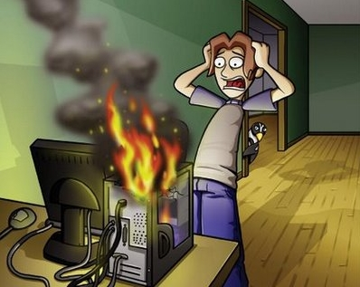
the writing process
write → save → write → save → my-essay.txt

Slide 22
the writing process
write → save → write → save → my-essay.txt
rip progress
I love coding. It's lots of fun!

Slide 23
the writing process (trial 2)
write → save → my-essay.txt
I love coding. It's lots of fun!

Slide 24
the writing process (trial 2)
write → save → my-essay.txt
save backup → my-essay_backup.txt
I love coding. It's lots of fun!

Slide 25
the writing process (trial 2)
write → save → my-essay.txt
save backup
my-essay.txt my-essay_backup.txt
I love coding. It's lots of fun! I love coding. It's lots of fun!

Slide 26
the writing process (trial 2)
my-essay.txt my-essay_backup.txt
I love coding. It's lots of fun! I love coding. It's lots of fun!

Slide 27
the writing process (trial 2)
my-essay.txt my-essay_backup.txt
I love coding. It's lots of fun! I love coding. It's lots of fun!
what if we mess up our active copy

Slide 28
the writing process (trial 2)
my-essay.txt my-essay_backup.txt
I hate coding. It's hard and boring! I love coding. It's lots of fun!
what if we mess up our active copy

Slide 29
the writing process (trial 2)
my-essay.txt my-essay_backup.txt
I hate coding. It's hard and boring! I love coding. It's lots of fun!
what if we mess up our active copy
restore from backup

Slide 30
the writing process (trial 2)
my-essay.txt my-essay_backup.txt
I hate coding. It’s hard and boring! I love coding. It's lots of fun!
what if we mess up our active copy
restore from backup

Slide 31
the writing process (trial 2)
my-essay.txt my-essay_backup.txt
I love coding. It's lots of fun! I love coding. It's lots of fun!
what if we mess up our active copy
restore from backup

Slide 32

the writing process (trial 2)
my-essay.txt my-essay_backup.txt
I love coding. It's lots of fun! I love coding. It's lots of fun!

Slide 33
the writing process (trial 2)
my-essay.txt my-essay_backup.txt
what if we mess up active copy and overwrite the backup

Slide 34
the writing process (trial 2)
my-essay.txt → save → my-essay_backup.txt
I hate coding. It's hard and boring! → I hate coding. It's hard and boring!

Slide 35
the writing process (trial 2)
my-essay.txt my-essay_backup.txt
uh-oh

Slide 36
the writing process (trial 2)
my-essay.txt my-essay_backup.txt
uh-oh
we overwrote our backup with a bad copy

Slide 37
the writing process (trial 3)
write → save → my-essay.txt
I love coding. It's lots of fun!

Slide 38
the writing process (trial 3)
write → save → my-essay.txt
make iterative backups
I love coding. It's lots of fun!

Slide 39
the writing process (trial 3)
my-essay my-essay_2015-09-01 my-essay_2015-09-10
my-essay_2015-09-19 my-essay_2015-09-28
this gets messy very quickly
however, this system allows us to restore from any given point

Slide 40
new problem
which backup has the info we need
my-essay my-essay_2015-09-01 my-essay_2015-09-10
my-essay_2015-09-19 my-essay_2015-09-28

Slide 41
ponder that question for a bit…
let's shift gears for a minute…
let's talk git

Slide 42
what is git

Slide 43
what is git
git: A distributed revision control system with…support for distributed, non-linear workflows. [Wikipedia – Git (software)]
…

Slide 44
what is git
…

Slide 45
what is git
…
try this:

Slide 46
what is git
…
try this:
a version control system that allows a user to
store, update, and maintain files and projects.

Slide 47
why use git
you have all these iterative backups
how do you manage them all

Slide 48
going back…
remember this?

Slide 49
new problem
which backup has the info we need
my-essay my-essay_2015-09-01 my-essay_2015-09-10
my-essay_2015-09-19 my-essay_2015-09-28

Slide 50
new problem
which backup has the info we need
answer is to look at the metadata

Slide 51
metadata
a set of data that describes and gives information about other data
backups should contain metadata

Slide 52
metadata
who
what
when

Slide 53
metadata
who: author of the change
what:
when:

Slide 54
metadata
who: author of the change
what: what was changed
when:

Slide 55
metadata
who: author of the change
what: what was changed
when: date and time of change

Slide 56
metadata
who: author of the change
what: what was changed
when: date and time of change
when used properly, git is a very powerful tool to manage your workflow

Slide 57
fin

Slide 58
fin
thank you for listening

Slide 59
fin
thank you for listening
sorry this presentation is so short

Slide 60
fin
thank you for listening
sorry this presentation is so short
the complete version is far more comprehensive

Slide 61
fin
thank you for listening
sorry this presentation is so short
the complete version is far more comprehensive
it is freely available for anyone to view, edit, or reproduce on GitHub

Slide 62
fin
GitHub profile: Nefari0uss

Slide 63
fin
GitHub profile: Nefari0uss
look under presentations → git

Slide 64
fin
GitHub profile: Nefari0uss
look under presentations → git
https://goo.gl/uyzCs9

Slide 65
fin
GitHub profile: Nefari0uss
look under presentations → git
https://goo.gl/uyzCs9
i hope you learned something!

Slide 66
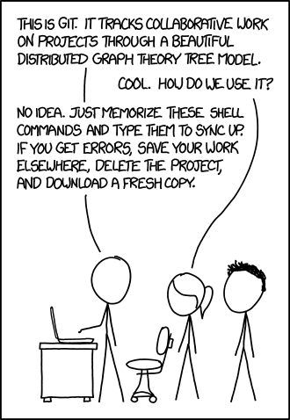
https://xkcd.com/1597/

Slide 67
Sources
Git-SCM book: https://git-scm.com/book
Daniel “paradigm” Thau from Open Source Club at OSU on Git:
https://opensource.osu.edu/au10/git
git – the simple guide: https://rogerdudler.github.io/git-guide/
Atlassian Git Tutorial: https://www.atlassian.com/git/tutorials/
Understanding Git Conceptually: http://www.sbf5.com/~cduan/technical/git/
Wikiepda – Git (software): https://en.wikipedia.org/wiki/Git_(software)
Git Reference: http://gitref.org/basic/
Lots of pictures from Git-SCM Book, Wikipedia and Google/Bing Image searches

