Slide 1

git
an introduction & explanation by
Nikit “Nefari0uss” Malkan

Slide 2
Table of Contents
What is it?
Source control analogy
Why use source control?
Specifically Git?
Terminal vs GUI interface

Slide 3
what is a git
git: [informal] [British] an unpleasant or contemptible person.

Slide 4
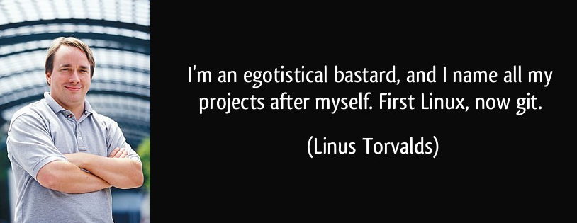
what is a git
git: [informal] [British] an unpleasant or contemptible person.

Slide 5
what is git
git: A distributed revision control system with…support for distributed, non-linear workflows. [Wikipedia – Git (software)]

Slide 6
what is git
…
try this:
a version control system that allows a user to
store, update, and maintain files and projects.

Slide 7
why use version control
let’s talk workflow

Slide 8
let’s talk workflow
imagine writing an essay
what’s the process like

Slide 9
the writing process

Slide 10
the writing process
write the whole thing at once

Slide 11
the writing process
write the whole thing at once
CLG are NALCS champs. TSM is trash.

Slide 12
the writing process
write the whole thing at once
unlikely

Slide 13
the writing process
write the whole thing at once
unlikely
write bits and pieces in multiple settings

Slide 14
the writing process
write
CLG are NALCS champs.

Slide 15
the writing process
write → save
CLG are NALCS champs.

Slide 16
the writing process
write → save → s5secretsgg.docx
CLG are NALCS champs.

Slide 17
the writing process
write → save → s5secretsgg.docx
procrastinate
CLG are NALCS champs.

Slide 18
the writing process
write → save → write
CLG are NALCS champs. TSM is trash.

Slide 19
the writing process
write → save → write → save
CLG are NALCS champs. TSM is trash.

Slide 20
the writing process
write → save → write → save → s5secretsgg.docx
CLG are NALCS champs. TSM is trash.

Slide 21
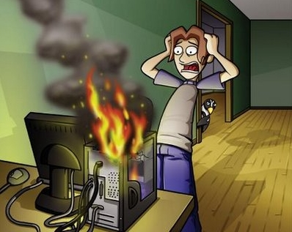
the writing process
write → save → write → save → s5secretsgg.docx

Slide 22
the writing process
write → save → write → save → s5secretsgg.docx
rip progress
CLG are NALCS champs. TSM is trash.

Slide 23
the writing process (trial 2)
write → save → s5secretsgg.docx
CLG are NALCS champs. TSM is trash.

Slide 24
the writing process (trial 2)
write → save → s5secretsgg.docx
save backup → s5secretsgg_backup.docx
CLG are NALCS champs. TSM is trash.

Slide 25
the writing process (trial 2)
write → save → s5secretsgg.docx
save backup
s5secretsgg.docx s5secretsgg_backup.docx
CLG are NALCS champs. TSM is trash. CLG are NALCS champs. TSM is trash.

Slide 26
the writing process (trial 2)
s5secretsgg.docx s5secretsgg_backup.docx
CLG are NALCS champs. TSM is trash. CLG are NALCS champs. TSM is trash.

Slide 27
the writing process (trial 2)
s5secretsgg.docx s5secretsgg_backup.docx
CLG are NALCS champs. TSM is trash. CLG are NALCS champs. TSM is trash.
what if we mess up our active copy

Slide 28
the writing process (trial 2)
s5secretsgg.docx s5secretsgg_backup.docx
TSM are NALCS champs. No thread is safe. CLG are NALCS champs. TSM is trash.
what if we mess up our active copy

Slide 29
the writing process (trial 2)
s5secretsgg.docx s5secretsgg_backup.docx
TSM are NALCS champs. No thread is safe. CLG are NALCS champs. TSM is trash.
what if we mess up our active copy
restore from backup

Slide 30
the writing process (trial 2)
s5secretsgg.docx s5secretsgg_backup.docx
TSM are NALCS champs. No thread is safe. CLG are NALCS champs. TSM is trash.
what if we mess up our active copy
restore from backup

Slide 31
the writing process (trial 2)
s5secretsgg.docx s5secretsgg_backup.docx
CLG are NALCS champs. TSM is trash. CLG are NALCS champs. TSM is trash.
what if we mess up our active copy
restore from backup

Slide 32

the writing process (trial 2)
s5secretsgg.docx s5secretsgg_backup.docx
CLG are NALCS champs. TSM is trash. CLG are NALCS champs. TSM is trash.

Slide 33
the writing process (trial 2)
s5secretsgg.docx s5secretsgg_backup.docx
what if we mess up active copy and overwrite the backup

Slide 34
the writing process (trial 2)
s5secretsgg.docx → save → s5secretsgg_backup.docx
TSM are NALCS champs. No thread is safe. → TSM are NALCS champs. No thread is safe.

Slide 35
the writing process (trial 2)
s5secretsgg.docx s5secretsgg_backup.docx
uh-oh

Slide 36
the writing process (trial 2)
s5secretsgg.docx s5secretsgg_backup.docx
uh-oh
we overwrote our backup with the mess up

Slide 37
the writing process (trial 3)
write → save → s5secretsgg.docx
CLG are NALCS champs. TSM is trash.

Slide 38
the writing process (trial 3)
write → save → s5secretsgg.docx
make iterative backups
CLG are NALCS champs. TSM is trash.

Slide 39
the writing process (trial 3)
s5secretsgg s5secretsgg_2015-09-01 s5secretsgg_2015-09-10
s5secretsgg_2015-09-19 s5secretsgg_2015-09-28
this gets messy very quickly
however, this system allows us to restore from any given point

Slide 40
new problem
which backup has the info we need
s5secretsgg s5secretsgg_2015-09-01 s5secretsgg_2015-09-10
s5secretsgg_2015-09-19 s5secretsgg_2015-09-28

Slide 41
ponder that question for a bit…
let’s shift gears for a minute…
let’s talk git

Slide 42
why use git
you have all these iterative backups
how do you manage them all

Slide 43
why use git
git pros
git cons

Slide 44
git con
considered very hard to learn
lots of weird syntax
understanding git internals helps remedy this tremendously

Slide 45
terminal vs GUI
terminal way is best way
but nefari0uss – that gui application looks so nice and pretty
and that terminal looks scary and hard
I don’t care

Slide 46
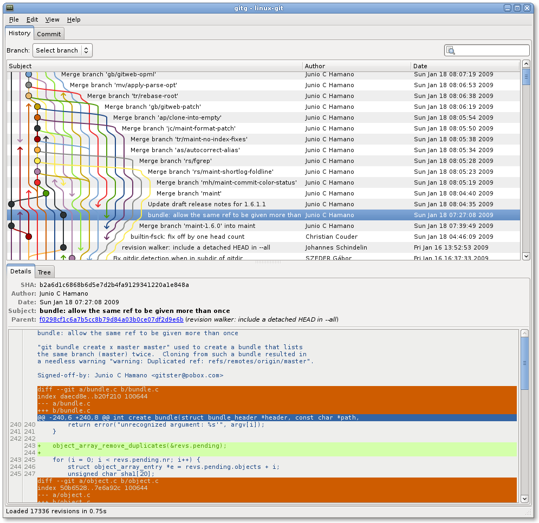

Slide 47
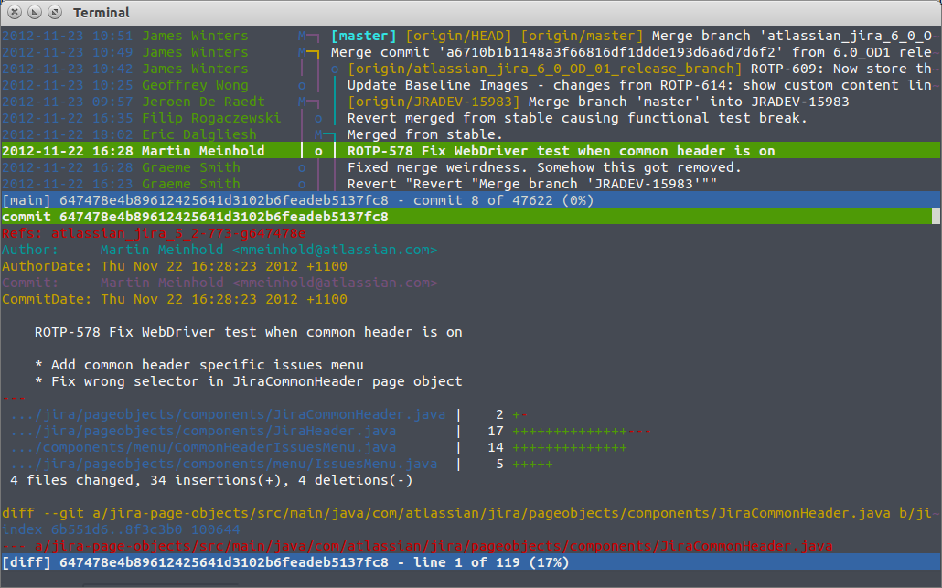

Slide 48
terminal vs GUI
gui applications hide what’s happening
terminal way forces you to learn what’s happening
Murphy’s law will happen
your code base will become borked
knowing how git works will help you fix it

Slide 49
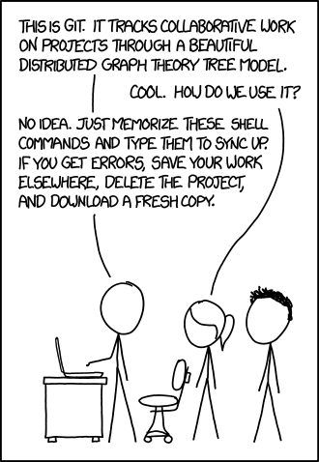
https://xkcd.com/1597/

Slide 50
terminal vs GUI
gui may not always be available
terminal will
༼ つ ◕_◕ ༽つ terminal way is best way ༼ つ ◕_◕ ༽つ

Slide 51
going back…
remember this?

Slide 52
new problem
which backup has the info we need
s5secretsgg s5secretsgg_2015-09-01 s5secretsgg_2015-09-10
s5secretsgg_2015-09-19 s5secretsgg_2015-09-28

Slide 53
new problem
which backup has the info we need
answer is to look at the metadata

Slide 54
git internals
this section is very important to understand
seriously – pay attention to this section

Slide 55
metadata
a set of data that describes and gives information about other data
backups should contain metadata

Slide 56
metadata
who
what
when

Slide 57
metadata
who: author of the change
what: what was changed
when: date and time of change

Slide 58
fin
very this is so short
the full presentation is over 400 slides…
it is freely available on my GitHub profile: Nefari0uss
https://goo.gl/uyzCs9
I hope you learned something!

Slide 59
in case of fire
git commit
git push
leave building

Slide 60
Sources
Git-SCM book: https://git-scm.com/book
Daniel “paradigm” Thau from Open Source Club at OSU on Git:
https://opensource.osu.edu/au10/git
git – the simple guide: https://rogerdudler.github.io/git-guide/
Atlassian Git Tutorial: https://www.atlassian.com/git/tutorials/
Understanding Git Conceptually: http://www.sbf5.com/~cduan/technical/git/
Wikiepda – Git (software): https://en.wikipedia.org/wiki/Git_(software)
Git Reference: http://gitref.org/basic/
Lots of pictures from Git-SCM Book, Wikipedia and Google/Bing Image searches

