Slide 1
Git
An Introduction & Explanation by
Nikit “Nefari0uss” Malkan

Slide 2
Table of Contents
What is it?
Why use source control?
Specifically Git?
Terminal vs GUI interface
Why terminal?
Set up Git, GitHub, BitBucket
Install, ssh keys
How does Git work?
Mix with Commands
Demonstration w/audience

Slide 3
What is a git?

Slide 4
What is a git?
git: [informal] [British] an unpleasant or contemptible person.

Slide 5
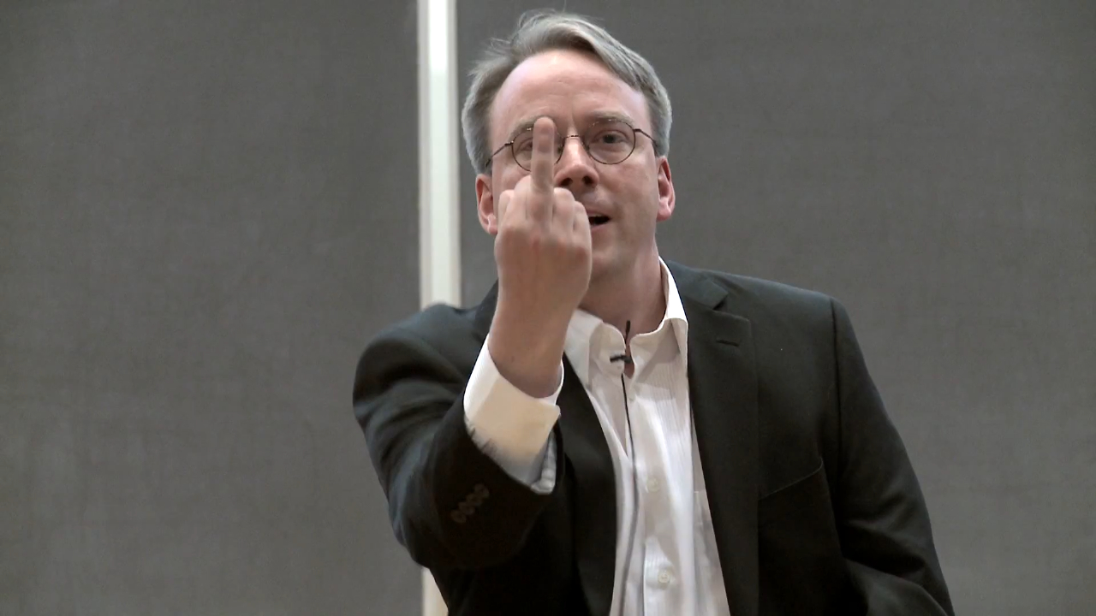
What is a git?
git: [informal] [British] an unpleasant or contemptible person.

Slide 6
What is Git?
git: A distributed revision control system with…support for distributed, non-linear workflows. [Wikipedia – Git (software)]

Slide 7
What is Git?
…

Slide 8
What is Git?
…
Try this: a version control system that allows a user to store, update, and maintain files and projects.

Slide 9
Why use version control?
Let’s talk workflow.

Slide 10
Let’s talk workflow
Imagine writing an essay.

Slide 11
Let’s talk workflow
Imagine writing an essay.
What’s the process like?

Slide 12
The writing process

Slide 13
The writing process
Write the whole thing at once?

Slide 14
The writing process
Write the whole thing at once?
CLG are NALCS champs. TSM is trash.

Slide 15
The writing process
Write the whole thing at once?
Unlikely.

Slide 16
The writing process
Write the whole thing at once?
Unlikely.
Write bits and pieces in multiple settings.

Slide 17
The writing process
write
CLG are NALCS champs.

Slide 18
The writing process
write → save
CLG are NALCS champs.

Slide 19
The writing process
write → save → s5secretsgg.docx
CLG are NALCS champs.

Slide 20
The writing process
write → save → s5secretsgg.docx
procrastinate
CLG are NALCS champs.

Slide 21
The writing process
write → save → write
CLG are NALCS champs. TSM is trash.

Slide 22
The writing process
write → save → write → save
CLG are NALCS champs. TSM is trash.

Slide 23
The writing process
write → save → write → save → s5secretsgg.docx
CLG are NALCS champs. TSM is trash.

Slide 24
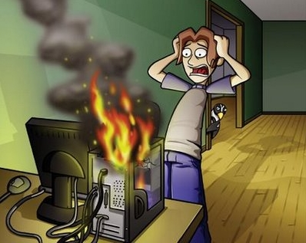
The writing process
write → save → write → save → s5secretsgg.docx

Slide 25
The writing process
write → save → write → save → s5secretsgg.docx
rip progress
CLG are NALCS champs. TSM is trash.

Slide 26
The writing process (trial 2)
write → save → s5secretsgg.docx
CLG are NALCS champs. TSM is trash.

Slide 27
The writing process (trial 2)
write → save → s5secretsgg.docx
save backup → s5secretsgg_backup.docx
CLG are NALCS champs. TSM is trash.

Slide 28
The writing process (trial 2)
write → save → s5secretsgg.docx
save backup.
s5secretsgg.docx s5secretsgg_backup.docx
CLG are NALCS champs. TSM is trash. CLG are NALCS champs. TSM is trash.

Slide 29
The writing process (trial 2)
s5secretsgg.docx s5secretsgg_backup.docx
CLG are NALCS champs. TSM is trash. CLG are NALCS champs. TSM is trash.

Slide 30
The writing process (trial 2)
s5secretsgg.docx s5secretsgg_backup.docx
CLG are NALCS champs. TSM is trash. CLG are NALCS champs. TSM is trash.
What if we mess up our active copy?

Slide 31
The writing process (trial 2)
s5secretsgg.docx s5secretsgg_backup.docx
TSM are NALCS champs. No thread is safe. CLG are NALCS champs. TSM is trash.
What if we mess up our active copy?

Slide 32
The writing process (trial 2)
s5secretsgg.docx s5secretsgg_backup.docx
TSM are NALCS champs. No thread is safe. CLG are NALCS champs. TSM is trash.
What if we mess up our active copy?
Restore from backup!

Slide 33
The writing process (trial 2)
s5secretsgg.docx s5secretsgg_backup.docx
TSM are NALCS champs. No thread is safe. CLG are NALCS champs. TSM is trash.
What if we mess up our active copy?
Restore from backup!

Slide 34
The writing process (trial 2)
s5secretsgg.docx s5secretsgg_backup.docx
CLG are NALCS champs. TSM is trash. CLG are NALCS champs. TSM is trash.
What if we mess up our active copy?
Restore from backup!

Slide 35

The writing process (trial 2)
s5secretsgg.docx s5secretsgg_backup.docx
CLG are NALCS champs. TSM is trash. CLG are NALCS champs. TSM is trash.

Slide 36
The writing process (trial 2)
s5secretsgg.docx s5secretsgg_backup.docx
What if we mess up active copy and overwrite the backup?

Slide 37
The writing process (trial 2)
s5secretsgg.docx → save → s5secretsgg_backup.docx
TSM are NALCS champs. No thread is safe. → TSM are NALCS champs. No thread is safe.

Slide 38
The writing process (trial 2)
s5secretsgg.docx s5secretsgg_backup.docx
Uh-oh. We overwrote our backup with the mess up.

Slide 39
The writing process (trial 3)
write → save → s5secretsgg.docx
CLG are NALCS champs. TSM is trash.

Slide 40
The writing process (trial 3)
write → save → s5secretsgg.docx
make iterative backups
CLG are NALCS champs. TSM is trash.

Slide 41
The writing process (trial 3)
s5secretsgg

Slide 42
The writing process (trial 3)
s5secretsgg s5secretsgg_2015-09-01

Slide 43
The writing process (trial 3)
s5secretsgg s5secretsgg_2015-09-01 s5secretsgg_2015-09-10

Slide 44
The writing process (trial 3)
s5secretsgg s5secretsgg_2015-09-01 s5secretsgg_2015-09-10
s5secretsgg_2015-09-19

Slide 45
The writing process (trial 3)
s5secretsgg s5secretsgg_2015-09-01 s5secretsgg_2015-09-10
s5secretsgg_2015-09-19 s5secretsgg_2015-09-28

Slide 46
The writing process (trial 3)
s5secretsgg s5secretsgg_2015-09-01 s5secretsgg_2015-09-10
s5secretsgg_2015-09-19 s5secretsgg_2015-09-28
This gets messy very quickly.

Slide 47
The writing process (trial 3)
s5secretsgg s5secretsgg_2015-09-01 s5secretsgg_2015-09-10
s5secretsgg_2015-09-19 s5secretsgg_2015-09-28
This gets messy very quickly.
However, this system allows us to restore from any given point.

Slide 48
The writing process (trial 3)
s5secretsgg s5secretsgg_2015-09-01 s5secretsgg_2015-09-10
s5secretsgg_2015-09-19 s5secretsgg_2015-09-28
btw - compute the digital roots of the dates for fun. ☺

Slide 49
The writing process (trial 3)
s5secretsgg s5secretsgg_2015-09-01 s5secretsgg_2015-09-10
s5secretsgg_2015-09-19 s5secretsgg_2015-09-28
This gets messy very quickly.
However, this system allows us to restore from any given point.

Slide 50
new problem

Slide 51
new problem
which backup has the info we need?

Slide 52
new problem
which backup has the info we need?
s5secretsgg s5secretsgg_2015-09-01 s5secretsgg_2015-09-10
s5secretsgg_2015-09-19 s5secretsgg_2015-09-28

Slide 53
metadata

Slide 54
metadata
a set of data that escribes and gives information about other data

Slide 55
metadata
a set of data that escribes and gives information about other data
backups should contain metadata

Slide 56
metadata
when
what
who

Slide 57
metadata
when: date and time
what: what was changed
who: who made the change

Slide 58
Sources
Git-SCM book: https://git-scm.com/book
Daniel “paradigm” Thau from Open Source Club at OSU on Git:
https://opensource.osu.edu/au10/git
git – the simple guide: https://rogerdudler.github.io/git-guide/
Atlassian Git Tutorial: https://www.atlassian.com/git/tutorials/
Understanding Git Conceptually: http://www.sbf5.com/~cduan/technical/git/
Wikiepda – Git (software): https://en.wikipedia.org/wiki/Git_(software)

