Slide 1

git
an introduction & explanation by
Nikit “Nefari0uss” Malkan

Slide 2
disclaimer
this presentation is very long
essentially condensed a book into one presentation
git can be very confusing
ask questions

Slide 3
Table of Contents
Installing Git
What is it?
Source control analogy
Why use source control?
Specifically Git?
Terminal vs GUI interface
Git internals
Set up Git, GitHub, BitBucket
Add ssh keys, make repos
Put your knowledge to work!
Mix with Commands
Demonstration w/audience

Slide 4
installing git

Slide 5
installing git
https://git-scm.com/book/en/v2/Getting-Started-Installing-Git
Windows/Mac: run installer
Linux: use your package manager

Slide 6
installing git
use git from Windows Command Prompt
commit Windows style, commit Unix-style

Slide 7
what is a git
git: [informal] [British] an unpleasant or contemptible person.

Slide 8
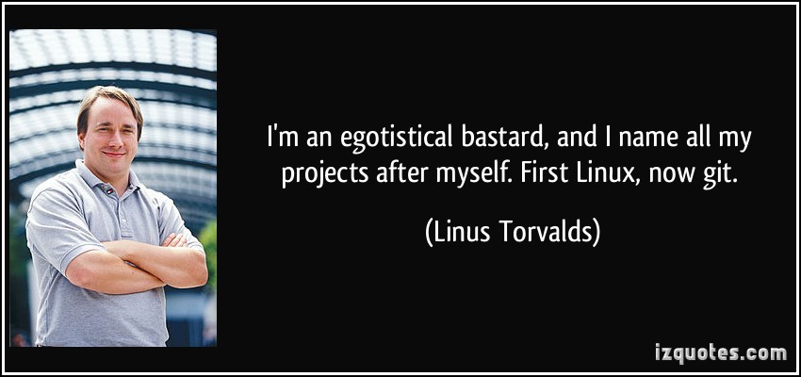
what is a git
git: [informal] [British] an unpleasant or contemptible person.

Slide 9
what is git
git: A distributed revision control system with…support for distributed, non-linear workflows. [Wikipedia – Git (software)]

Slide 10
what is git
…
Try this: a version control system that allows a user to store, update, and maintain files and projects.

Slide 11
why use version control
let’s talk workflow

Slide 12
let’s talk workflow
imagine writing an essay
what’s the process like

Slide 13
the writing process

Slide 14
the writing process
write the whole thing at once

Slide 15
the writing process
write the whole thing at once
CLG are NALCS champs. TSM is trash.

Slide 16
the writing process
write the whole thing at once
unlikely

Slide 17
the writing process
write the whole thing at once
unlikely
write bits and pieces in multiple settings

Slide 18
the writing process
write
CLG are NALCS champs.

Slide 19
the writing process
write → save
CLG are NALCS champs.

Slide 20
the writing process
write → save → s5secretsgg.docx
CLG are NALCS champs.

Slide 21
the writing process
write → save → s5secretsgg.docx
procrastinate
CLG are NALCS champs.

Slide 22
the writing process
write → save → write
CLG are NALCS champs. TSM is trash.

Slide 23
the writing process
write → save → write → save
CLG are NALCS champs. TSM is trash.

Slide 24
the writing process
write → save → write → save → s5secretsgg.docx
CLG are NALCS champs. TSM is trash.

Slide 25
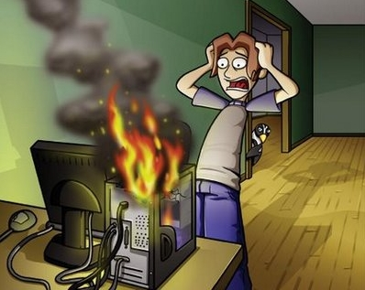
the writing process
write → save → write → save → s5secretsgg.docx

Slide 26
the writing process
write → save → write → save → s5secretsgg.docx
rip progress
CLG are NALCS champs. TSM is trash.

Slide 27
the writing process (trial 2)
write → save → s5secretsgg.docx
CLG are NALCS champs. TSM is trash.

Slide 28
the writing process (trial 2)
write → save → s5secretsgg.docx
save backup → s5secretsgg_backup.docx
CLG are NALCS champs. TSM is trash.

Slide 29
the writing process (trial 2)
write → save → s5secretsgg.docx
save backup
s5secretsgg.docx s5secretsgg_backup.docx
CLG are NALCS champs. TSM is trash. CLG are NALCS champs. TSM is trash.

Slide 30
the writing process (trial 2)
s5secretsgg.docx s5secretsgg_backup.docx
CLG are NALCS champs. TSM is trash. CLG are NALCS champs. TSM is trash.

Slide 31
the writing process (trial 2)
s5secretsgg.docx s5secretsgg_backup.docx
CLG are NALCS champs. TSM is trash. CLG are NALCS champs. TSM is trash.
what if we mess up our active copy

Slide 32
the writing process (trial 2)
s5secretsgg.docx s5secretsgg_backup.docx
TSM are NALCS champs. No thread is safe. CLG are NALCS champs. TSM is trash.
what if we mess up our active copy

Slide 33
the writing process (trial 2)
s5secretsgg.docx s5secretsgg_backup.docx
TSM are NALCS champs. No thread is safe. CLG are NALCS champs. TSM is trash.
what if we mess up our active copy
restore from backup

Slide 34
the writing process (trial 2)
s5secretsgg.docx s5secretsgg_backup.docx
TSM are NALCS champs. No thread is safe. CLG are NALCS champs. TSM is trash.
what if we mess up our active copy
restore from backup

Slide 35
the writing process (trial 2)
s5secretsgg.docx s5secretsgg_backup.docx
CLG are NALCS champs. TSM is trash. CLG are NALCS champs. TSM is trash.
what if we mess up our active copy
restore from backup

Slide 36

the writing process (trial 2)
s5secretsgg.docx s5secretsgg_backup.docx
CLG are NALCS champs. TSM is trash. CLG are NALCS champs. TSM is trash.

Slide 37
the writing process (trial 2)
s5secretsgg.docx s5secretsgg_backup.docx
what if we mess up active copy and overwrite the backup

Slide 38
the writing process (trial 2)
s5secretsgg.docx → save → s5secretsgg_backup.docx
TSM are NALCS champs. No thread is safe. → TSM are NALCS champs. No thread is safe.

Slide 39
the writing process (trial 2)
s5secretsgg.docx s5secretsgg_backup.docx
uh-oh

Slide 40
the writing process (trial 2)
s5secretsgg.docx s5secretsgg_backup.docx
uh-oh
we overwrote our backup with the mess up

Slide 41
the writing process (trial 3)
write → save → s5secretsgg.docx
CLG are NALCS champs. TSM is trash.

Slide 42
the writing process (trial 3)
write → save → s5secretsgg.docx
make iterative backups
CLG are NALCS champs. TSM is trash.

Slide 43
the writing process (trial 3)
s5secretsgg s5secretsgg_2015-09-01 s5secretsgg_2015-09-10
s5secretsgg_2015-09-19 s5secretsgg_2015-09-28
this gets messy very quickly
however, this system allows us to restore from any given point

Slide 44
new problem
which backup has the info we need
s5secretsgg s5secretsgg_2015-09-01 s5secretsgg_2015-09-10
s5secretsgg_2015-09-19 s5secretsgg_2015-09-28

Slide 45
ponder that question for a bit…
let’s shift gears for a minute…
let’s talk git

Slide 46
why use git
you have all these iterative backups
how do you manage them all

Slide 47
why use git
git pros
git cons

Slide 48
git con
considered very hard to learn
lots of weird syntax
understanding git internals helps remedy this tremendously

Slide 49
terminal vs GUI
terminal way is best way
but nefari0uss – that gui application looks so nice and pretty
and that terminal looks scary and hard
I don’t care

Slide 50
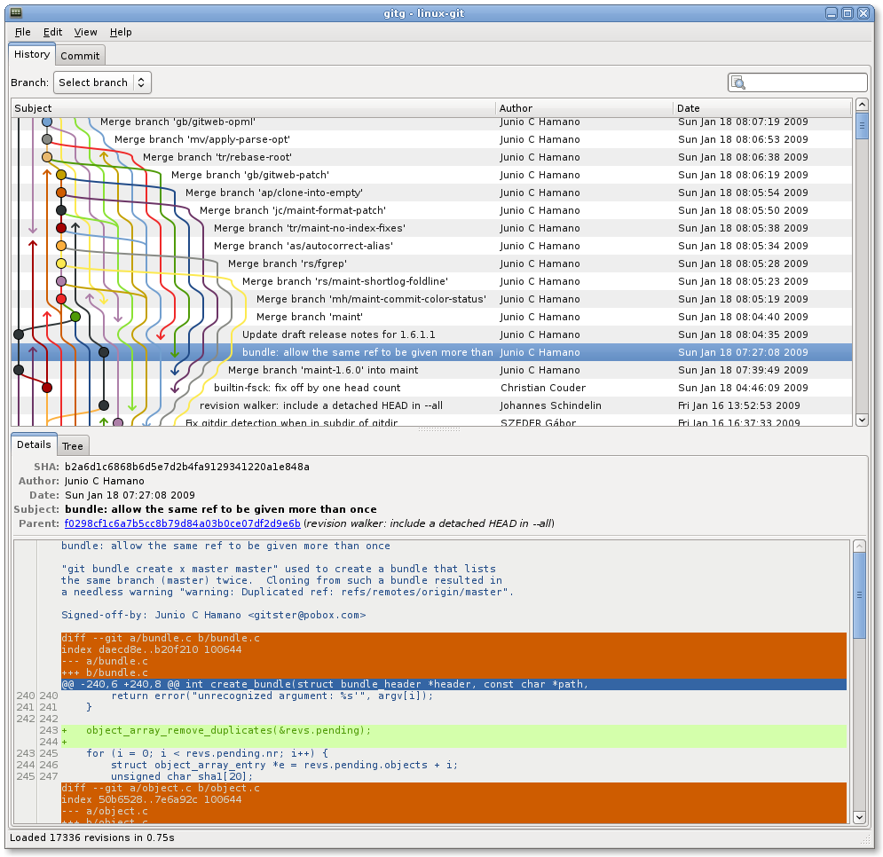

Slide 51
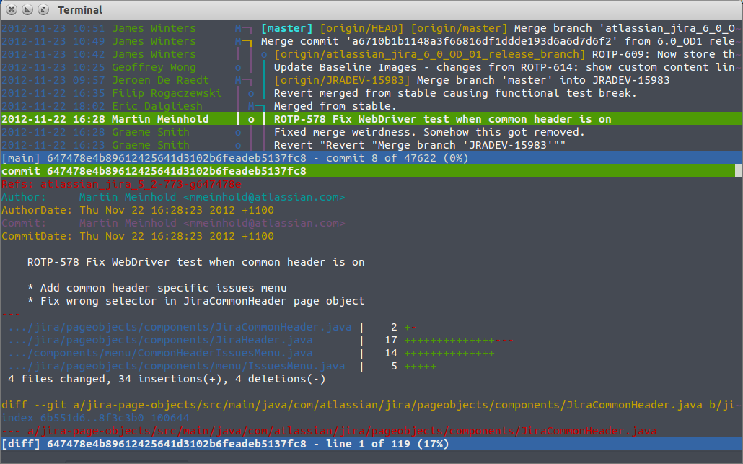

Slide 52
terminal vs GUI
gui applications hide what’s happening
terminal way forces you to learn what’s happening
Murphy’s law will happen
your code base will become borked
knowing how git works will help you fix it

Slide 53
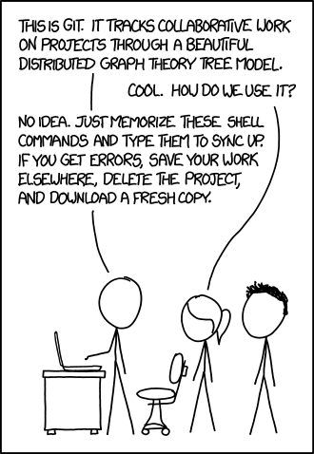
https://xkcd.com/1597/

Slide 54
terminal vs GUI
gui may not always be available
terminal will
༼ つ ◕_◕ ༽つ terminal way is best way ༼ つ ◕_◕ ༽つ

Slide 55
going back…
remember this?

Slide 56
new problem
which backup has the info we need
s5secretsgg s5secretsgg_2015-09-01 s5secretsgg_2015-09-10
s5secretsgg_2015-09-19 s5secretsgg_2015-09-28

Slide 57
new problem
which backup has the info we need
answer is to look at the metadata

Slide 58
git internals
this section is very important to understand
seriously – pay attention to this section

Slide 59
metadata
a set of data that describes and gives information about other data
backups should contain metadata

Slide 60
metadata
who
what
when

Slide 61
metadata
who: author of the change
what: what was changed
when: date and time of change
where are we going with this
commit: record change to the repository (workspace)

Slide 62
repository
the workspace containing all files of a project

Slide 63
git repository
git stores information about the project in the repo.
commit objects
references to commit objects (heads)
info stored inside project root directory in .git folder

Slide 64
commits
before we talk about commit objects, what’s a commit
record change to the repository (workspace)
more specifically, it’s a snapshot of the repo

Slide 65
commits
imagine a game
you have multiple options (branches) you can take
you save the game every time you have a branch (you make a commit)
every new save (commit) is a record of all the actions you’ve taken
sometimes you make a bad decision and don’t realize it till later
you want to see where you made a bad decision

Slide 66
commits
remember metadata
each save lets you know some information about the decision you made
you can go back to a commit and start from there
later on: you can take all the good save results and remove the bad (merging/rebasing/cherry picking)

Slide 67
commit objects
keep in mind the game save analogy

Slide 68
commit objects
3 things
the files in the repo (character data)
parent commits (previous save files)
SHA-1 hash (unique identifier)

Slide 69
hashing
a quick explanation

Slide 70
hashing
mapping data of arbitrary size to data of fixed size
without going too much into it…
data → hash function → data mapped to a value (hash)
example hash function: hash = sum(string.length / 7)

Slide 71
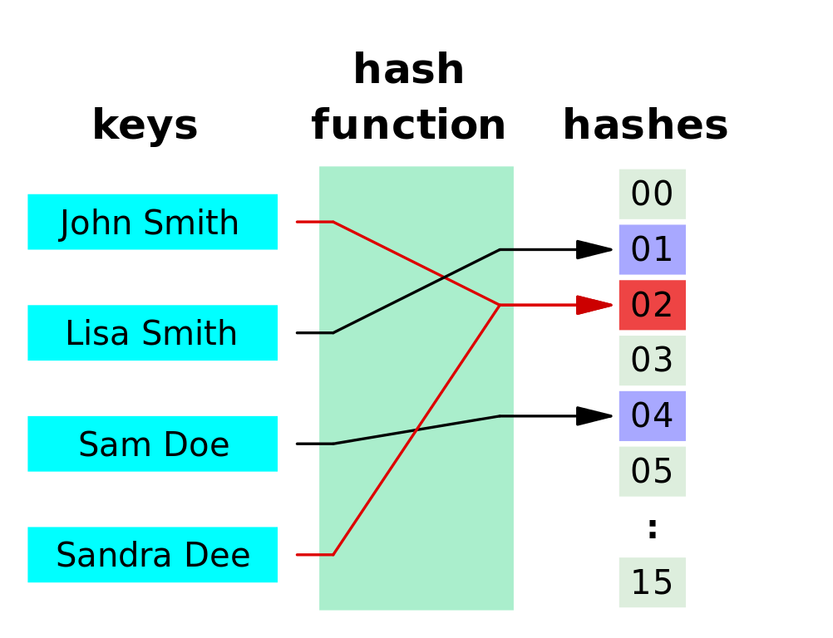

Slide 72
hashing
notice how we have two red lines going to the same thing
this is called a collision
in security collision is bad
imagine if your security key is shares the same hash as someone else’s

Slide 73
cryptographic hashing

Slide 74
cryptographic hashing
cryptographic hashing allows you to verify input to a known hash value
very difficult to guess/reconstruct without input data

Slide 75
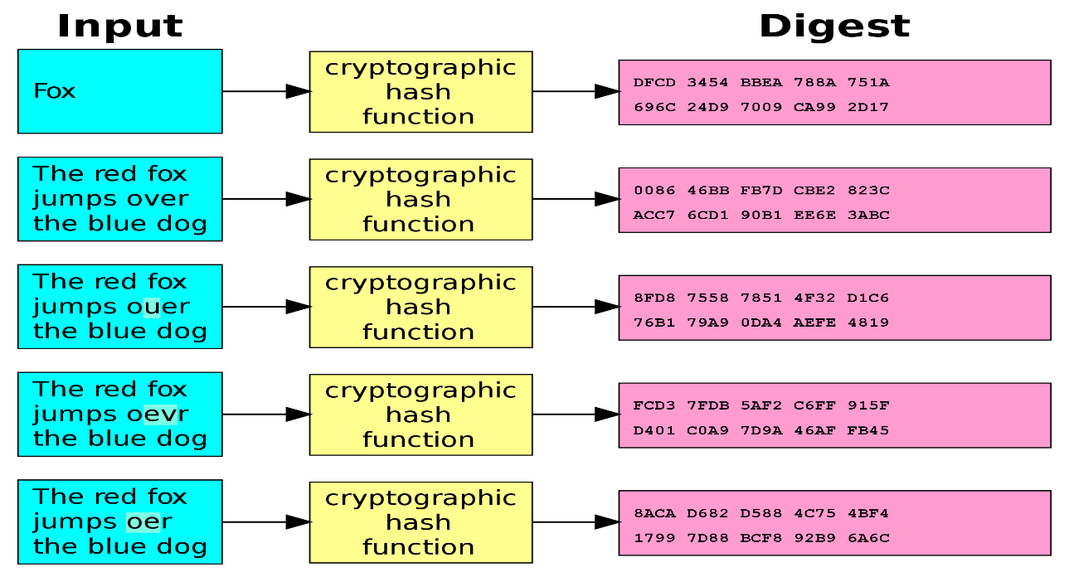

Slide 76
SHA-1
type of cryptographic hashing
has two uses in git
verify that two files are the same
verify that a file hasn’t been altered
40-character string

Slide 77
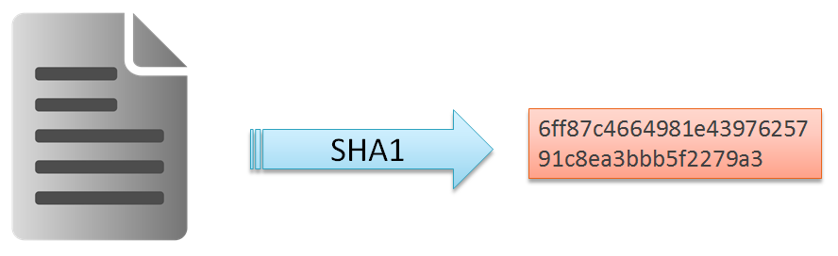
SHA-1
type of cryptographic hashing
has two uses in git
verify that two files are the same
verify that a file hasn’t been altered
40-character string

Slide 78
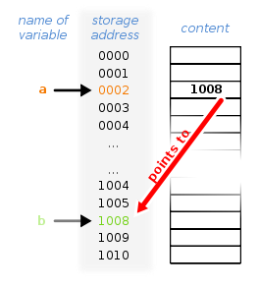
pointers
a value that references a memory location

Slide 79
heads
pointer to a commit object
each head has a name
each branch has a head
current head is aliased as HEAD (always in caps)

Slide 80
heads
think of heads as a name of the save file
it links you to the backup (commit)

Slide 81
tags
essentially a special name given to a commit
generally used to mark a special release/edition/milestone
ex. v1.0

Slide 82
branching
this part can get confusing so please ask questions
where are going with this?
collaboration

Slide 83
branching
think back to commits and saving when faced with options
imagine if you wanted to take option a but a friend wanted to take option b
example:
you want to help an NPC for a potential reward
friend wants to kill the NPC because you can loot the body

Slide 84
branching
you make a save and both do different things
(commit your work and then make a new branch)

Slide 85
branching
so let’s call the original story line “origin”
now let’s assume that you’re the one who is in charge, you make the official decision
let’s call this branch of the story line “master”
your friend’s story line (branch) is now called “dev”
with me so far?
let’s diagram this

Slide 86
branching
origin
time
(A)
you two both agree on choice a

Slide 87
branching
origin
time
master
(A)
right now there is no “dev”, only master

Slide 88
branching
origin
time
HEAD
master
(A)
HEAD points to the latest save

Slide 89
branching
origin
time
HEAD
master
(A)
you two both agree on choice a

Slide 90
branching
origin
time
HEAD
master
(A)
(B)
you two both disagree on choice b
you make a save

Slide 91
branching
origin
time
HEAD
master
(A)
(B)
(C)
dev
you play and make choice c

Slide 92
branching
origin
time
master
(A)
(B)
(C)
(D)
dev
your friend plays and makes
choice d
HEAD

Slide 93
merging branches
you want to combine the two story lines but how
both of you made two disjoint decisions
both decisions have effects on the game that are radically different
if you were to merge the two story lines (branches) you’d have merge conflicts

Slide 94
merging branches
goal: so you want to remove these conflicts
you want all the good parts of both decisions kept
you want all the bad parts of both decisions removed

Slide 95
merging branches
imagine taking the story and doing just that
you keep what you want and remove what you don’t want
you also make some modifications as necessary to cover plot holes

Slide 96
merging branches
let’s relate this back to code
let’s say you worked on a file
your friend worked on the same file

Slide 97
merging branches
you combine the file
pick the parts changed that work
remove the conflicting parts
make some modifications to make it cleaner/work together (refactoring, et cetera)
let’s diagram this

Slide 98
branching
origin
time
master
(A)
(B)
(C)
(D)
dev
this is where we left off
HEAD

Slide 99
branching
origin
time
master
(A)
(B)
(C)
(E)
(D)
dev
HEAD
you perform the merge
but E has conflicts

Slide 100
branching
origin
time
HEAD
master
(A)
(B)
(C)
(E)
(D)
dev
post-merge
no conflicts

Slide 101
distributed vs centralized
centralized work flow vs distributed work flow
centralized: all work is done locally and synchronized on a server
distributed: everyone working on the project has a copy of the project and makes changes locally.
let’s diagram differences

Slide 102
centralized
time
friend local
main server
my local
imagine working on a project

Slide 103
centralized
time
friend local
main server
(A)
my local
this is what start with
(main server ~ cloud storage)

Slide 104
centralized
time
friend local
main server
(A)
my local
(A)
you get a local copy

Slide 105
centralized
time
friend local
main server
(A)
my local
(A)
(B)
you make local changes

Slide 106
centralized
time
friend local
main server
(A)
(B)
my local
(A)
(B)
you upload it to the server

Slide 107
centralized
time
friend local
(B)
main server
(A)
(B)
my local
(A)
(B)
friend downloads it locally

Slide 108
centralized
time
friend local
(B)
(C)
main server
(A)
(B)
my local
(A)
(B)
friend makes changes

Slide 109
centralized
time
friend local
(B)
(C)
main server
(A)
(B)
(C)
my local
(A)
(B)
friend uploads to server

Slide 110
centralized
time
friend local
(B)
(C)
main server
(A)
(B)
(C)
my local
(A)
(B)
what if you both want to make changes

Slide 111
centralized
time
friend local
(B)
(C)
main server
(A)
(B)
(C)
my local
(A)
(B)
(C)
you download C

Slide 112
centralized
time
friend local
(B)
(C)
main server
(A)
(B)
(C)
my local
(A)
(B)
(C)
(D)
keep working on D

Slide 113
centralized
time
friend local
(B)
(C)
(I)
main server
(A)
(B)
(C)
my local
(A)
(B)
(C)
(D)
your friend works on I

Slide 114
centralized
time
friend local
(B)
(C)
(I)
main server
(A)
(B)
(C)
(D)
my local
(A)
(B)
(C)
(D)
you push your code to the server

Slide 115
centralized
time
friend local
(B)
(C)
(I)
main server
(A)
(B)
(C)
(D)
my local
(A)
(B)
(C)
(D)
conflict – the bases are not the same
(common base is C)

Slide 116
centralized
time
friend local
(B)
(C)
(I)
main server
(A)
(B)
(C)
(D)
my local
(A)
(B)
(C)
(D)
(E)
meanwhile, you have code to push

Slide 117
centralized
time
friend local
(B)
(C)
(I)
(J)
main server
(A)
(B)
(C)
(D)
(J)
my local
(A)
(B)
(C)
(D)
(E)
conflict fixed

Slide 118
centralized
time
friend local
(B)
(C)
(I)
(J)
main server
(A)
(B)
(C)
(D)
(J)
my local
(A)
(B)
(C)
(D)
(E)
conflict fixed
but now your code is out of sync

Slide 119
centralized
time
friend local
(B)
(C)
(I)
(J)
main server
(A)
(B)
(C)
(D)
(J)
my local
(A)
(B)
(C)
(D)
(E)
now you have to merge

Slide 120
centralized
time
friend local
(B)
(C)
(I)
(J)
main server
(A)
(B)
(C)
(D)
(J)
(K)
my local
(A)
(B)
(C)
(D)
(E)
(K)
you merge

Slide 121
centralized
time
friend local
(B)
(C)
(I)
(J)
(L)
main server
(A)
(B)
(C)
(D)
(J)
(K)
my local
(A)
(B)
(C)
(D)
(E)
(K)
meanwhile…

Slide 122
centralized
time
friend local
(B)
(C)
(I)
(J)
(L)
main server
(A)
(B)
(C)
(D)
(J)
(K)
my local
(A)
(B)
(C)
(D)
(E)
(K)
meanwhile…
the process continues

Slide 123
centralized
can you see why this might be a problem
you need network access
it’s also very easy for your code base to be out of sync
what if we could always have an updated copy of the codebase

Slide 124
distributed
what if we could always have an updated copy of the codebase
you store this locally and can fix all conflicts locally
let’s diagram this

Slide 125
distributed
time
origin
let “origin” be the name of the main repository

Slide 126
distributed
time
origin-master
let “origin” be the name of the main repository
the branch name is “master”

Slide 127
distributed
time
origin-master
let “origin” be the name of the main repository
the branch name is “master”
this is handled by the administrator

Slide 128
distributed
time
origin-master
note: origin and master are conventions
they do not have to be strictly followed
you can call them whatever you want
best practice dictates that you use origin-master

Slide 129
distributed
time
origin-master
let “nefari0uss” be the name of the my repository
the branch name is “master”
this is handled by me
nefari0uss-master

Slide 130
distributed
time
friend-master
origin-master
let “friend” be the name of the my repository
the branch name is “master”
nefari0uss-master

Slide 131
distributed
time
friend-master
origin-master
(A)
nefari0uss-master
this is the initial code base

Slide 132
distributed
time
friend-master
origin-master
(A)
nefari0uss-master
(G)
you download the entire project locally

Slide 133
distributed
time
friend-master
(R)
origin-master
(A)
nefari0uss-master
(G)
as does your friend

Slide 134
distributed
time
friend-master
(Q)
origin-master
(A)
nefari0uss-master
(G)
(H)
you do some work

Slide 135
distributed
time
friend-master
(Q)
(R)
origin-master
(A)
nefari0uss-master
(G)
(H)
so does your friend

Slide 136
distributed
time
bugfix
(S)
friend-bugfix
(Q)
(R)
origin-master
(A)
nefari0uss-master
(G)
(H)
your friend opens a new branch called bugfix

Slide 137
distributed
time
bugfix
(S)
friend-master
(Q)
(R)
master
(T)
origin-master
(A)
nefari0uss-master
(G)
(H)
and continues development on master

Slide 138
distributed
time
bugfix
(S)
friend-master
(Q)
(R)
(U)
master
(T)
origin-master
(A)
nefari0uss-master
(G)
(H)
bug fix done
merge with master
bug fix branch closed

Slide 139
distributed
time
bugfix
(S)
friend-master
(Q)
(R)
(U)
master
(T)
origin-master
(A)
nefari0uss-master
(G)
(H)
(I)
you were waiting on the bug fix

Slide 140
distributed
time
bugfix
(S)
friend-master
(Q)
(R)
(U)
master
(T)
origin-master
(A)
nefari0uss-master
(G)
(H)
(I)
you pull friend’s code

Slide 141
centralized
time
(S)
friend local
(“nef-friend”)
(Q)
(R)
(U)
(V)
(X)
(Z)
(T)
(Y)
main repo
(“origin”)
(A)
(B)
(C)
(D)
(L)
my local
(“nefari0uss”)
(G)
(H)
(I)
(J)
(K)
(O)
(P)
(N)
meanwhile…

Slide 142
putting things together
will heavily reference game analogy for this

Slide 143
putting things together
repository – the game
commit – the game save
metadata – info about the game save
SHA1 – the internal identifier of the game save
head – the game save name (save 01, save 02, et cetera)
tags – different parts/chapters of the game (part 1, part 2, et cetera)
branch – an option taken by someone
merging – combining the options taken

Slide 144
one more thing
almost done with internals so stick with me

Slide 145
three states of being
working directory: modify files locally
staging area: add snapshots/saves to commit
repository (.git directory): push commit to repository

Slide 146
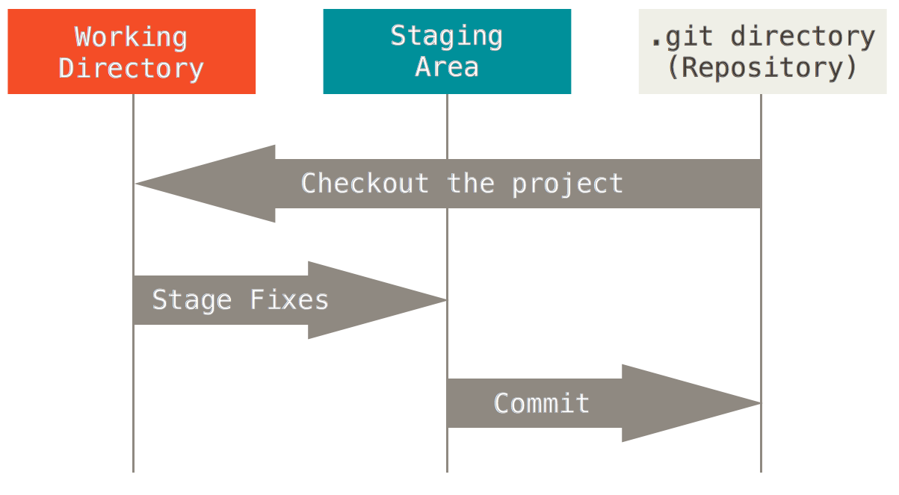

Slide 147
/git-internals
sorry that was so long
I wouldn’t have spent that long if it wasn’t so important
now on to the for the setup

Slide 148
quick setup
set up git config
set up ssh keys

Slide 149
git config
https://git-scm.com/book/en/v2/Getting-Started-First-Time-Git-Setup
open bash and type git config

Slide 150
git config
$ git config –global user.name “John Doe”
$ git config –global user.email johndoe@example.com
--global sets git to always use these settings
run command without --global to override for specific project

Slide 151
git config
$ git config --list
will show all settings

Slide 152
ssh keys
ssh keys are a way to identify your computer to the sever
https://help.github.com/articles/generating-ssh-keys/

Slide 153
ssh keys
$ ls –al ~/.ssh
this will list the files in your .ssh directory
(assuming they exist)

Slide 154
ssh keys
$ ssh-keygen –t rsa –b 4096 –C “your-git-email”
creates a new ssh key using the email as a label

Slide 155
ssh keys
$ [enter password]
passwords are recommended for security
not necessary for our purposes
general good practise

Slide 156
ssh keys
$ eval “$(ssh-agent –s)”
run ssh-agent in background

Slide 157
ssh keys
$ ssh-add ~/.ssh/id_rsa
add ssh key to ssh-agent

Slide 158
ssh keys
$ clip < ~/.ssh/id_rsa.pub
copy key to clipboard

Slide 159
ssh keys
goto Bitbucket/Github
find settings → ssh keys
add key → paste

Slide 160
GitHub & BitBucket
BitBucket: unlimited private repos
GitHub: unlimited public repos
both have edu plans that are worth using

Slide 161
using git
(this is the part where you get to type stuff)

Slide 162
basic commands
init
clone
status, add, rm
push, pull, merge, fetch
branch, remote
log
reset

Slide 163
$ git init
create a new git setup in the current directory
creates .git file

Slide 164
$ git clone [url]
clone a git repo in your working directory
should end in .git

Slide 165
$ git status
shows you the status of files in working directory
run this command a lot

Slide 166
important side note

Slide 167
important side note
I mentioned staging several times…

Slide 168
important side note
I mentioned staging several times…
let me define it properly

Slide 169
four states of being (pre-commit)
untracked: in the working directory, ignored by git
unmodified: unchanged from last commit; tracked by git
modified: changed since last commit; tracked by git
staged: added to staging area; ready to be committed

Slide 170
$ git add [filename.ext]
add current version of a file to staging index
CAUTION
if you modify a file after adding it
the old version is staged, not new!

Slide 171
$ git rm [filename.ext]
remove a file from staging area
CAUTION
$ rm FileName != $git rm FileName
deleting a file does not tell git to remove it from staging

Slide 172
going back…

Slide 174
let’s narrow the scope
what happens between the red and blue boxes

Slide 175
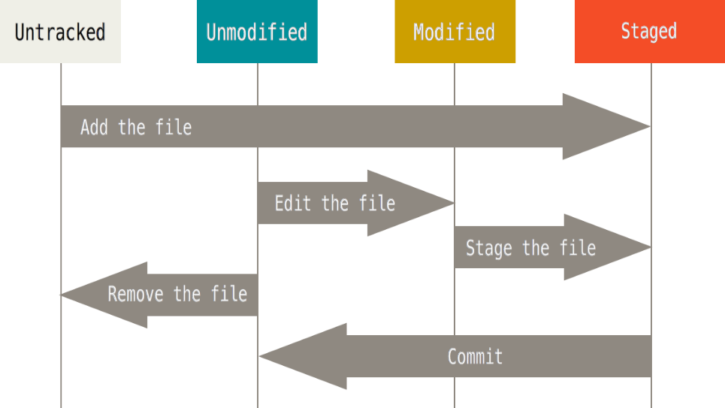

Slide 177
moving forward
what happens between the blue and white boxes

Slide 178
$ git commit
create a commit from staged files
-m (message) will do inline commit

Slide 179
$ git commit
create a commit from staged files
-m will do inline commit
Example: $ git commit –m “this is my commit message”

Slide 180
$ git commit
-amend will let you change the last commit
Example: $ git commit –m –amend “fixed commit message”

Slide 181
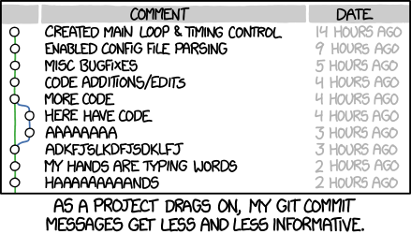
https://xkcd.com/1296/

Slide 182
$ git push [remote] [branch]
push your changes to a remote
Example: $ git push origin master

Slide 183
$ git pull [remote] [branch]
pull a set of changes from a remote
Example: $ git pull origin master

Slide 184
$ git pull [remote] [branch]
pull a set of changes from a remote
Example: $ git pull origin master
is actually the combination of two commands: fetch and merge

Slide 185
$ git fetch
update local information from the remote
Example: $ git fetch origin

Slide 186
$ git merge
create new commit by combining two branches
Example: (if current branch is master)
$ git merge dev

Slide 187
how merging works

Slide 188
how merging works
finds most recent common ancestor
looks at file differences between then and now
applies differences to current branch

Slide 189
merge conflicts
happens when people work on the same file
run $ git status
edit conflicted file
<<< === >>> mark conflicts
resolve conflicts and then stage files

Slide 190
$ git branch [arguments]
does different things depending on the arguments
…
welcome to git

Slide 191
$ git branch [arguments]
no arguments: list branches (heads)
$ git branch
one argument: create new branch and switch to it
$ git branch –b dev
-d: delete branch
$ git branch –d dev

Slide 192
$ git branch [arguments]
CAUTION
$ git branch –b [branch name]
will create a new branch off your current working directory
best to stash/checkout all files before branching

Slide 193
$ git remote [arguments]
remote is the url in which you are pushing/pulling to
in $ git push origin/master, “origin” is the remote
let me diagram this

Slide 194
remotes
time
bugfix
(S)
friend-master
(Q)
(R)
(U)
master
(T)
origin-master
(A)
nefari0uss-master
(G)
(H)
(I)
friend, origin, and nefari0uss are all remote names

Slide 195
distributed
time
bugfix
(S)
friend-master
(Q)
(R)
(U)
master
(T)
origin-master
(A)
nefari0uss-master
(G)
(H)
(I)
friend, origin, and nefari0uss are all remote names
master and bugfix are branch names

Slide 196
$ git checkout [arguments]
two uses
revert modifications to a file $ git checkout [filename.ext]
change branches $ git checkout [branch name]
working directory must be clean when changing branches

Slide 197
$ git log [arguments]
no arguments: show a log of commits
--graph: display tree

Slide 198
$ git reset [arguments]
reset git state
-- soft: does not touch index or working tree
file is reverted to uncommitted (but changed) state
-- hard: resets index and working tree
file is to state of previous commit

Slide 199
intermediate commands
stash
blame

Slide 200
$ git stash
want to save changes but not commit them
store on a stack (not really)
(no args): push changes onto stack
list: show items on stash stack
pop [--index]: pop an item off the stack (uses index if provided)

Slide 201
$ git blame [arguments]
show who made the code base become borked

Slide 202
advanced commands
rebase
cherrypick
bisect

Slide 203
$ git rebase [arguments]
merge but create a single tree

Slide 204
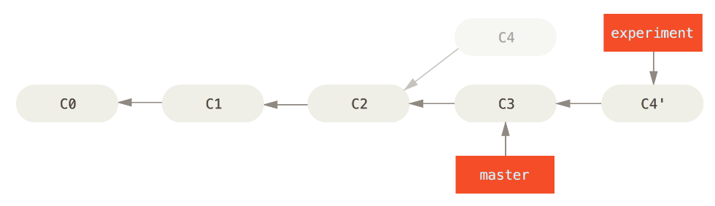

Slide 205
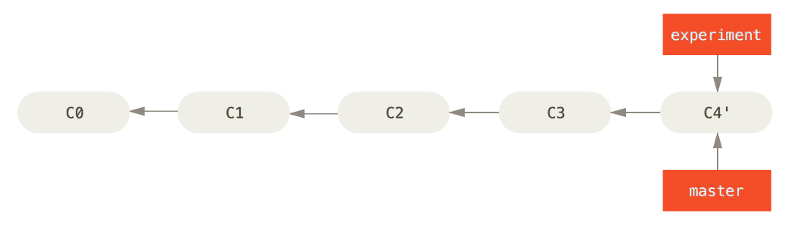

Slide 206
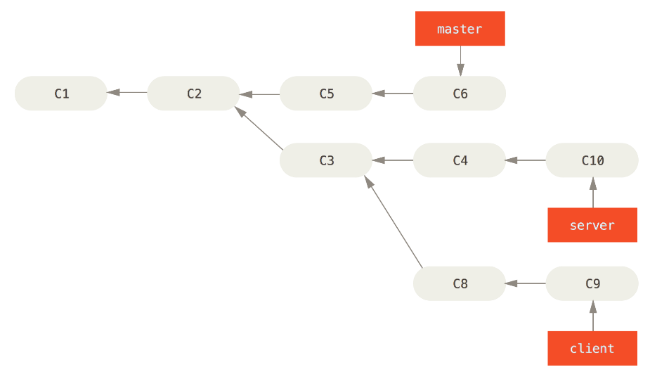

Slide 207
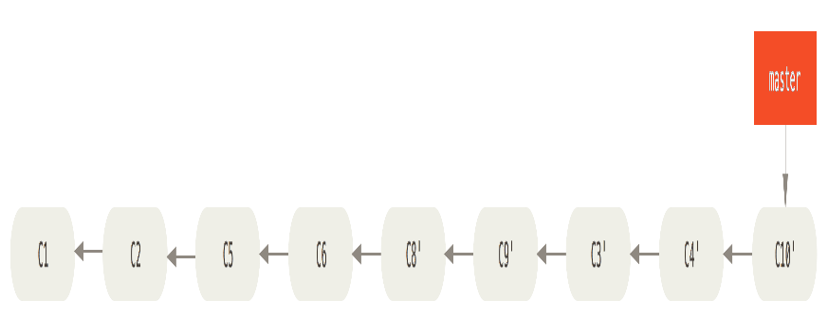

Slide 208
$ git cherrypick
pick the commits you want and merge only those

Slide 209
$ git bisect
like binary search for finding where the last good commit is

Slide 210
fin
very sorry this was so long

Slide 211
fin
very sorry this was so long
I hope you learned something!

Slide 212
in case of fire
git commit
git push
leave building

Slide 213
Sources
Git-SCM book: https://git-scm.com/book
Daniel “paradigm” Thau from Open Source Club at OSU on Git:
https://opensource.osu.edu/au10/git
git – the simple guide: https://rogerdudler.github.io/git-guide/
Atlassian Git Tutorial: https://www.atlassian.com/git/tutorials/
Understanding Git Conceptually: http://www.sbf5.com/~cduan/technical/git/
Wikiepda – Git (software): https://en.wikipedia.org/wiki/Git_(software)
Git Reference: http://gitref.org/basic/
Lots of pictures from Git-SCM Book, Wikipedia and Google/Bing Image searches

