Slide 1

git
an introduction & explanation by
Nikit “Nefari0uss” Malkan

Slide 2
disclaimer

Slide 3
disclaimer
this presentation is very long (~2 hours)

Slide 4
disclaimer
this presentation is very long (~2 hours)
first time trying something interactive

Slide 5
disclaimer
this presentation is very long (~2 hours)
first time trying something interactive
ask questions

Slide 6
Table of Contents
What is it?
Source control analogy
Why use source control?
Specifically Git?
Terminal vs GUI interface
Git internals
Set up Git, GitHub, BitBucket
Install git, add ssh keys, make repos
Put your knowledge to work!
Mix with Commands
Demonstration w/audience

Slide 7
what is a git

Slide 8
what is a git
git: [informal] [British] an unpleasant or contemptible person.

Slide 9
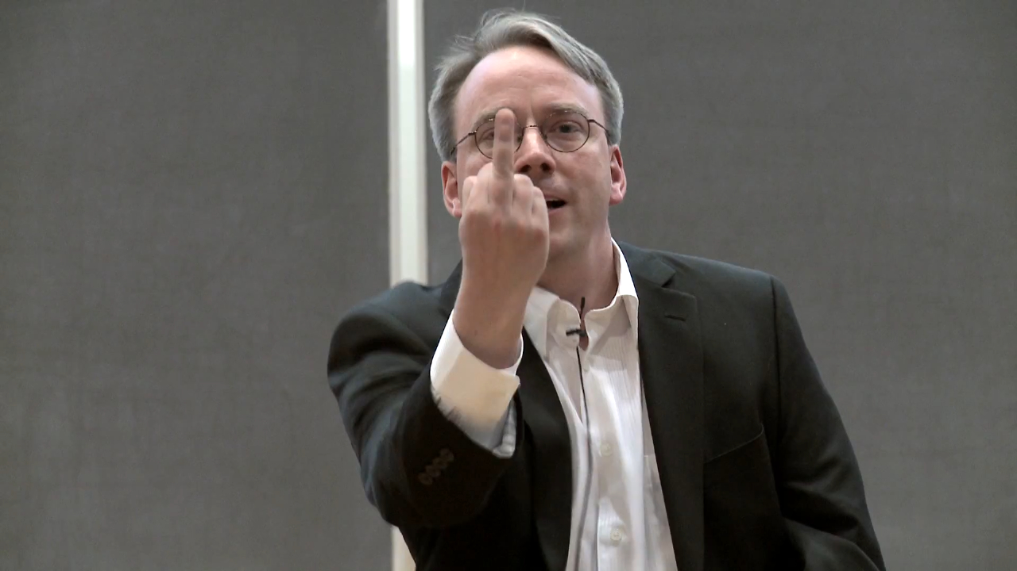
what is a git
git: [informal] [British] an unpleasant or contemptible person.

Slide 10
what is git
git: A distributed revision control system with…support for distributed, non-linear workflows. [Wikipedia – Git (software)]

Slide 11
what is git
…

Slide 12
what is git
…
Try this: a version control system that allows a user to store, update, and maintain files and projects.

Slide 13
why use version control
let’s talk workflow

Slide 14
let’s talk workflow
imagine writing an essay

Slide 15
let’s talk workflow
imagine writing an essay
what’s the process like

Slide 16
the writing process

Slide 17
the writing process
write the whole thing at once

Slide 18
the writing process
write the whole thing at once
CLG are NALCS champs. TSM is trash.

Slide 19
the writing process
write the whole thing at once
unlikely

Slide 20
the writing process
write the whole thing at once
unlikely
write bits and pieces in multiple settings

Slide 21
the writing process
write
CLG are NALCS champs.

Slide 22
the writing process
write → save
CLG are NALCS champs.

Slide 23
the writing process
write → save → s5secretsgg.docx
CLG are NALCS champs.

Slide 24
the writing process
write → save → s5secretsgg.docx
procrastinate
CLG are NALCS champs.

Slide 25
the writing process
write → save → write
CLG are NALCS champs. TSM is trash.

Slide 26
the writing process
write → save → write → save
CLG are NALCS champs. TSM is trash.

Slide 27
the writing process
write → save → write → save → s5secretsgg.docx
CLG are NALCS champs. TSM is trash.

Slide 28
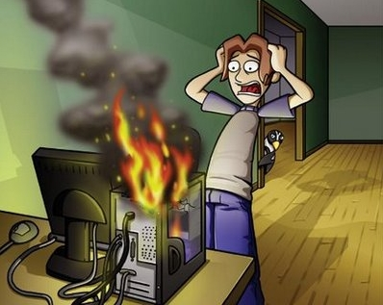
the writing process
write → save → write → save → s5secretsgg.docx

Slide 29
the writing process
write → save → write → save → s5secretsgg.docx
rip progress
CLG are NALCS champs. TSM is trash.

Slide 30
the writing process (trial 2)
write → save → s5secretsgg.docx
CLG are NALCS champs. TSM is trash.

Slide 31
the writing process (trial 2)
write → save → s5secretsgg.docx
save backup → s5secretsgg_backup.docx
CLG are NALCS champs. TSM is trash.

Slide 32
the writing process (trial 2)
write → save → s5secretsgg.docx
save backup
s5secretsgg.docx s5secretsgg_backup.docx
CLG are NALCS champs. TSM is trash. CLG are NALCS champs. TSM is trash.

Slide 33
the writing process (trial 2)
s5secretsgg.docx s5secretsgg_backup.docx
CLG are NALCS champs. TSM is trash. CLG are NALCS champs. TSM is trash.

Slide 34
the writing process (trial 2)
s5secretsgg.docx s5secretsgg_backup.docx
CLG are NALCS champs. TSM is trash. CLG are NALCS champs. TSM is trash.
what if we mess up our active copy

Slide 35
the writing process (trial 2)
s5secretsgg.docx s5secretsgg_backup.docx
TSM are NALCS champs. No thread is safe. CLG are NALCS champs. TSM is trash.
what if we mess up our active copy

Slide 36
the writing process (trial 2)
s5secretsgg.docx s5secretsgg_backup.docx
TSM are NALCS champs. No thread is safe. CLG are NALCS champs. TSM is trash.
what if we mess up our active copy
restore from backup

Slide 37
the writing process (trial 2)
s5secretsgg.docx s5secretsgg_backup.docx
TSM are NALCS champs. No thread is safe. CLG are NALCS champs. TSM is trash.
what if we mess up our active copy
restore from backup

Slide 38
the writing process (trial 2)
s5secretsgg.docx s5secretsgg_backup.docx
CLG are NALCS champs. TSM is trash. CLG are NALCS champs. TSM is trash.
what if we mess up our active copy
restore from backup

Slide 39

the writing process (trial 2)
s5secretsgg.docx s5secretsgg_backup.docx
CLG are NALCS champs. TSM is trash. CLG are NALCS champs. TSM is trash.

Slide 40
the writing process (trial 2)
s5secretsgg.docx s5secretsgg_backup.docx
what if we mess up active copy and overwrite the backup

Slide 41
the writing process (trial 2)
s5secretsgg.docx → save → s5secretsgg_backup.docx
TSM are NALCS champs. No thread is safe. → TSM are NALCS champs. No thread is safe.

Slide 42
the writing process (trial 2)
s5secretsgg.docx s5secretsgg_backup.docx
uh-oh

Slide 43
the writing process (trial 2)
s5secretsgg.docx s5secretsgg_backup.docx
uh-oh
we overwrote our backup with the mess up

Slide 44
the writing process (trial 3)
write → save → s5secretsgg.docx
CLG are NALCS champs. TSM is trash.

Slide 45
the writing process (trial 3)
write → save → s5secretsgg.docx
make iterative backups
CLG are NALCS champs. TSM is trash.

Slide 46
the writing process (trial 3)
s5secretsgg

Slide 47
the writing process (trial 3)
s5secretsgg s5secretsgg_2015-09-01

Slide 48
the writing process (trial 3)
s5secretsgg s5secretsgg_2015-09-01 s5secretsgg_2015-09-10

Slide 49
the writing process (trial 3)
s5secretsgg s5secretsgg_2015-09-01 s5secretsgg_2015-09-10
s5secretsgg_2015-09-19

Slide 50
the writing process (trial 3)
s5secretsgg s5secretsgg_2015-09-01 s5secretsgg_2015-09-10
s5secretsgg_2015-09-19 s5secretsgg_2015-09-28

Slide 51
the writing process (trial 3)
s5secretsgg s5secretsgg_2015-09-01 s5secretsgg_2015-09-10
s5secretsgg_2015-09-19 s5secretsgg_2015-09-28
this gets messy very quickly

Slide 52
the writing process (trial 3)
s5secretsgg s5secretsgg_2015-09-01 s5secretsgg_2015-09-10
s5secretsgg_2015-09-19 s5secretsgg_2015-09-28
this gets messy very quickly
however, this system allows us to restore from any given point

Slide 53
new problem

Slide 54
new problem
which backup has the info we need

Slide 55
new problem
which backup has the info we need
s5secretsgg s5secretsgg_2015-09-01 s5secretsgg_2015-09-10
s5secretsgg_2015-09-19 s5secretsgg_2015-09-28

Slide 56
ponder that question for a bit…

Slide 57
ponder that question for a bit…
let’s shift gears for a minute…

Slide 58
ponder that question for a bit…
let’s shift gears for a minute…
let’s talk git

Slide 59
why use git

Slide 60
why use git
you have all these iterative backups

Slide 61
why use git
you have all these iterative backups
how do you manage them all

Slide 62
why use git
git pros
git cons

Slide 63
git pro
helps you manage version control

Slide 64
git pro
helps you manage version control
distributed (explained later)

Slide 65
git pro
helps you manage version control
distributed (explained later)
fast

Slide 66
git pro
helps you manage version control
distributed (explained later)
fast
used nearly everywhere in software world

Slide 67
git pro
helps you manage version control
distributed (explained later)
fast
used nearly everywhere in software world
can be used to non-software projects (like this)

Slide 68
git pro
helps you manage version control
distributed (explained later)
fast
used nearly everywhere in software world
can be used to non-software projects (like this)
it’s not SVN

Slide 69
git pro
helps you manage version control
distributed (explained later)
fast
used nearly everywhere in software world
can be used to non-software projects (like this)
it’s not SVN
(the fact that my opinion happens to be the right opinion is a happy coincidence)

Slide 70
git con
considered very hard to learn

Slide 71
git con
considered very hard to learn
lots of weird syntax

Slide 72
git con
considered very hard to learn
lots of weird syntax
understanding git internals helps remedy this tremendously

Slide 73
terminal vs GUI

Slide 74
terminal vs GUI
terminal way is best way

Slide 75
terminal vs GUI
terminal way is best way
but nefari0uss – that gui application looks so nice and pretty

Slide 76
terminal vs GUI
terminal way is best way
but nefari0uss – that gui application looks so nice and pretty
and that terminal looks scary and hard

Slide 77
terminal vs GUI
terminal way is best way
but nefari0uss – that gui application looks so nice and pretty
and that terminal looks scary and hard
well fuck you

Slide 78
terminal vs GUI
gui applications hide what’s happening

Slide 79
terminal vs GUI
gui applications hide what’s happening
terminal way forces you to learn what’s happening

Slide 80
terminal vs GUI
gui applications hide what’s happening
terminal way forces you to learn what’s happening
Murphy’s law will happen

Slide 81
terminal vs GUI
gui applications hide what’s happening
terminal way forces you to learn what’s happening
Murphy’s law will happen
your code base will become borked

Slide 82
terminal vs GUI
gui applications hide what’s happening
terminal way forces you to learn what’s happening
Murphy’s law will happen
your code base will become borked
knowing how git works will help you fix it

Slide 83
terminal vs GUI
gui may not always be available

Slide 84
terminal vs GUI
gui may not always be available
terminal will

Slide 85
terminal vs GUI
gui may not always be available
terminal will
༼ つ ◕_◕ ༽つ terminal way is best way ༼ つ ◕_◕ ༽つ

Slide 86
going back…

Slide 87
going back…
remember this?

Slide 88
new problem
which backup has the info we need
s5secretsgg s5secretsgg_2015-09-01 s5secretsgg_2015-09-10
s5secretsgg_2015-09-19 s5secretsgg_2015-09-28

Slide 89
new problem
which backup has the info we need
answer is to look at the metadata

Slide 90
git internals

Slide 91
git internals
this section is very important to understand

Slide 92
git internals
this section is very important to understand
seriously – pay attention to this section

Slide 93
metadata

Slide 94
metadata
a set of data that describes and gives information about other data

Slide 95
metadata
a set of data that describes and gives information about other data
backups should contain metadata

Slide 96
metadata
who
what
when

Slide 97
metadata
who: author of the change
what:
when:

Slide 98
metadata
who: author of the change
what: what was changed
when:

Slide 99
metadata
who: author of the change
what: what was changed
when: date and time of change

Slide 100
metadata
who: author of the change
what: what was changed
when: date and time of change
where are we going with this

Slide 101
metadata
who: author of the change
what: what was changed
when: date and time of change
where are we going with this
commit: record change to the repository (workspace)

Slide 102
repository

Slide 103
repository
the workspace containing all files of a project

Slide 104
git repository

Slide 105
git repository
git stores information about the project in the repo.

Slide 106
git repository
git stores information about the project in the repo.
commit objects
references to commit objects (heads)

Slide 107
git repository
git stores information about the project in the repo.
commit objects
references to commit objects (heads)
info stored inside project root directory in .git folder

Slide 108
commits

Slide 109
commits
before we talk about commit objects, what’s a commit

Slide 110
commits
before we talk about commit objects, what’s a commit
record change to the repository (workspace)

Slide 111
commits
before we talk about commit objects, what’s a commit
record change to the repository (workspace)
more specifically, it’s a snapshot of the repo

Slide 112
commits
imagine a game

Slide 113
commits
imagine a game
you have multiple options (branches) you can take

Slide 114
commits
imagine a game
you have multiple options (branches) you can take
you save the game every time you have a branch (you make a commit)

Slide 115
commits
imagine a game
you have multiple options (branches) you can take
you save the game every time you have a branch (you make a commit)
every new save (commit) is a record of all the actions you’ve taken

Slide 116
commits
imagine a game
you have multiple options (branches) you can take
you save the game every time you have a branch (you make a commit)
every new save (commit) is a record of all the actions you’ve taken
sometimes you make a bad decision and don’t realize it till later
you want to see where you made a bad decision

Slide 117
commits
remember metadata

Slide 118
commits
remember metadata
each save lets you know some information about the decision you made

Slide 119
commits
remember metadata
each save lets you know some information about the decision you made
you can go back to a commit and start from there

Slide 120
commits
remember metadata
each save lets you know some information about the decision you made
you can go back to a commit and start from there
later on: you can take all the good save results and remove the bad (cherry picking)

Slide 121
commit objects

Slide 122
commit objects
keep in mind the game save analogy

Slide 123
commit objects
3 things

Slide 124
commit objects
3 things
the files in the repo (character data)

Slide 125
commit objects
3 things
the files in the repo (character data)
parent commits (previous save files)

Slide 126
commit objects
3 things
the files in the repo (character data)
parent commits (previous save files)
SHA-1 hash (unique identifier)

Slide 127
hashing

Slide 128
hashing
a quick explanation

Slide 129
hashing
mapping data of arbitrary size to data of fixed size

Slide 130
hashing
mapping data of arbitrary size to data of fixed size
without going too much into it…

Slide 131
hashing
mapping data of arbitrary size to data of fixed size
without going too much into it…
data → hash function → data mapped to a value (hash)

Slide 132
hashing
mapping data of arbitrary size to data of fixed size
without going too much into it…
data → hash function → data mapped to a value (hash)
example hash function: hash = sum(string.length / 7)

Slide 133
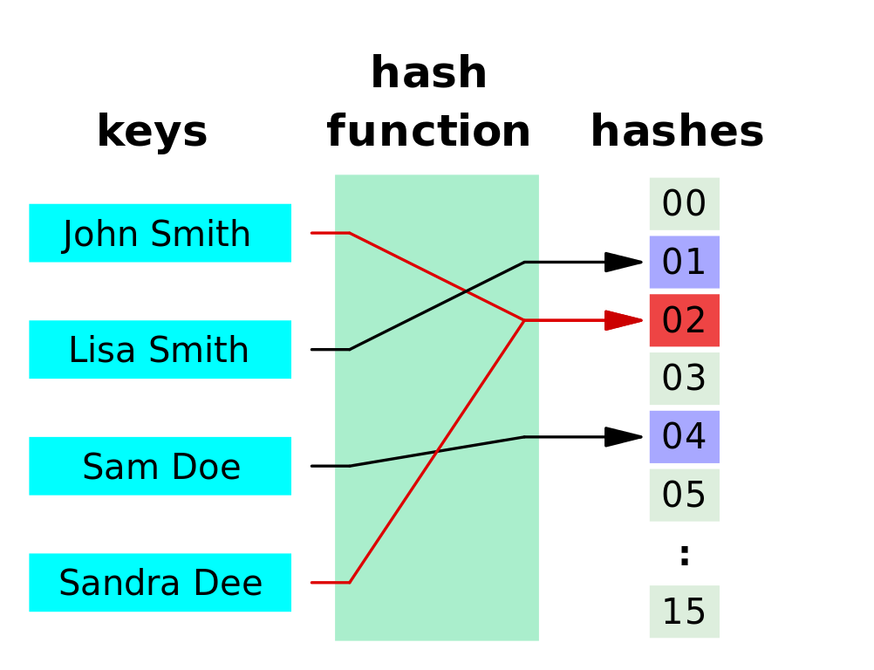

Slide 134
hashing
notice how we have two red lines going to the same thing

Slide 135
hashing
notice how we have two red lines going to the same thing
this is called a collision

Slide 136
hashing
notice how we have two red lines going to the same thing
this is called a collision
in security collision is bad

Slide 137
hashing
notice how we have two red lines going to the same thing
this is called a collision
in security collision is bad
imagine if your security key is shares the same hash as someone else’s

Slide 138
cryptographic hashing

Slide 139
cryptographic hashing
cryptographic hashing allows you to verify input to a known hash value

Slide 140
cryptographic hashing
cryptographic hashing allows you to verify input to a known hash value
very difficult to guess/reconstruct without input data

Slide 141
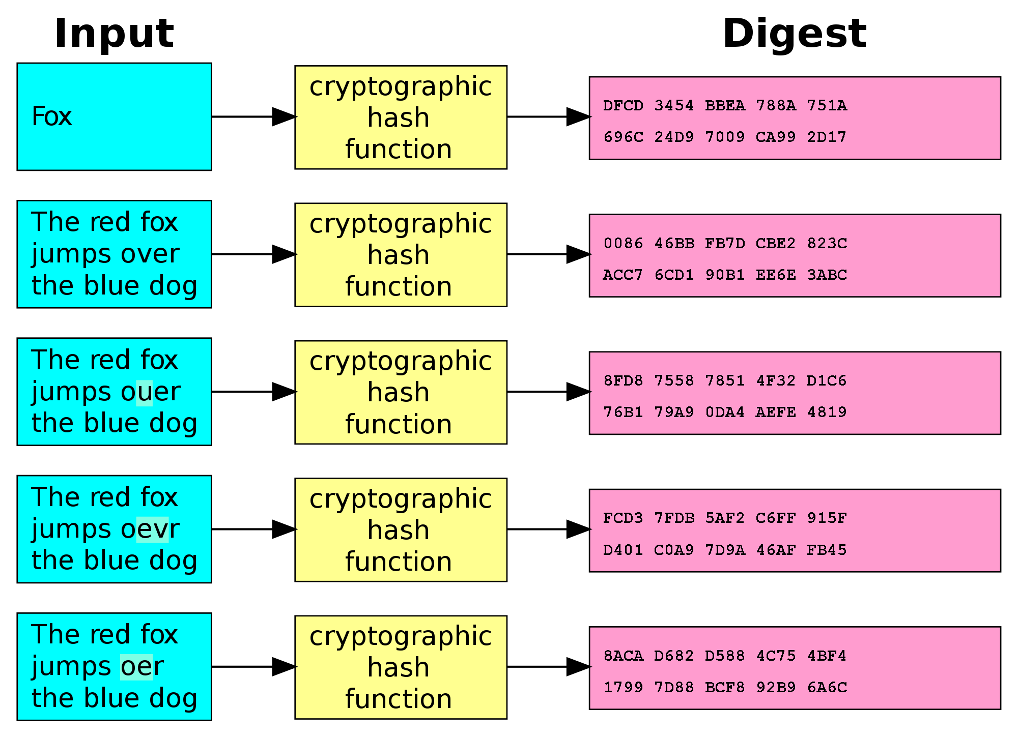

Slide 142
SHA-1

Slide 143
SHA-1
type of cryptographic hashing

Slide 144
SHA-1
type of cryptographic hashing
has two uses in git

Slide 145
SHA-1
type of cryptographic hashing
has two uses in git
verify that two files are the same

Slide 146
SHA-1
type of cryptographic hashing
has two uses in git
verify that two files are the same
verify that a file hasn’t been altered

Slide 147
SHA-1
type of cryptographic hashing
has two uses in git
verify that two files are the same
verify that a file hasn’t been altered
40-character string

Slide 148
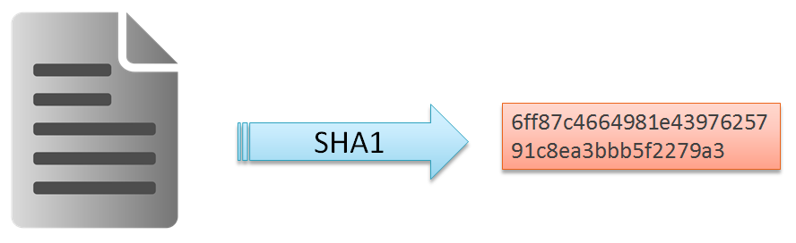
SHA-1
type of cryptographic hashing
has two uses in git
verify that two files are the same
verify that a file hasn’t been altered
40-character string

Slide 149
pointers

Slide 150
pointers
a value that references a memory location

Slide 151
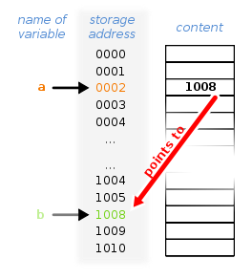
pointers
a value that references a memory location

Slide 152
heads

Slide 153
heads
pointer to a commit object

Slide 154
heads
pointer to a commit object
each head has a name

Slide 155
heads
pointer to a commit object
each head has a name
each repository has a head called master

Slide 156
heads
pointer to a commit object
each head has a name
each repository has a head called master
current head is aliased as HEAD (always in caps)

Slide 157
heads
think of heads as a name of the save file

Slide 158
heads
think of heads as a name of the save file
it links you to the backup (commit)

Slide 159
branching

Slide 160
branching
ok, now let’s start putting things together

Slide 161
tags

Slide 162
tags
essentially a special name given to a commit

Slide 163
tags
essentially a special name given to a commit
generally used to mark a special release/edition/milestone

Slide 164
tags
essentially a special name given to a commit
generally used to mark a special release/edition/milestone
ex. v1.0

Slide 165
putting things together

Slide 166
putting things together
will heavily reference game analogy for this

Slide 167
putting things together
repository – the game

Slide 168
putting things together
repository – the game
commit – the game save

Slide 169
putting things together
repository – the game
commit – the game save
metadata – info about the game save

Slide 170
putting things together
repository – the game
commit – the game save
metadata – info about the game save
SHA1 – the internal identifier of the game save

Slide 171
putting things together
repository – the game
commit – the game save
metadata – info about the game save
SHA1 – the internal identifier of the game save
head – the game save name (save 01, save 02, et cetera)

Slide 172
putting things together
repository – the game
commit – the game save
metadata – info about the game save
SHA1 – the internal identifier of the game save
head – the game save name (save 01, save 02, et cetera)
tags – different parts/chapters of the game (part 1, part 2, et cetera)

Slide 173
putting things together
repository – the game
commit – the game save
metadata – info about the game save
SHA1 – the internal identifier of the game save
head – the game save name (save 01, save 02, et cetera)
tags – different parts/chapters of the game (part 1, part 2, et cetera)
branch – an option taken by someone

Slide 174
setting up git

Slide 175
quick setup

Slide 176
ssh keys

Slide 177
Github & BitBucket

Slide 178
basic commands

Slide 179
advanced commands

Slide 180
live demonstration

Slide 181
Sources
Git-SCM book: https://git-scm.com/book
Daniel “paradigm” Thau from Open Source Club at OSU on Git:
https://opensource.osu.edu/au10/git
git – the simple guide: https://rogerdudler.github.io/git-guide/
Atlassian Git Tutorial: https://www.atlassian.com/git/tutorials/
Understanding Git Conceptually: http://www.sbf5.com/~cduan/technical/git/
Wikiepda – Git (software): https://en.wikipedia.org/wiki/Git_(software)
Git Reference: http://gitref.org/basic/
Lots of pictures from Wikipedia and Google/Bing Image searches

