Slide 1

git
an introduction & explanation by
Nikit “Nefari0uss” Malkan

Slide 2
disclaimer

Slide 3
disclaimer
this presentation is very long (~2 hours)

Slide 4
disclaimer
this presentation is very long (~2 hours)
first time trying something interactive

Slide 5
disclaimer
this presentation is very long (~2 hours)
first time trying something interactive
ask questions

Slide 6
Table of Contents
What is it?
Source control analogy
Why use source control?
Specifically Git?
Terminal vs GUI interface
Git internals
Set up Git, GitHub, BitBucket
Install git, add ssh keys, make repos
Put your knowledge to work!
Mix with Commands
Demonstration w/audience

Slide 7
what is a git

Slide 8
what is a git
git: [informal] [British] an unpleasant or contemptible person.

Slide 9
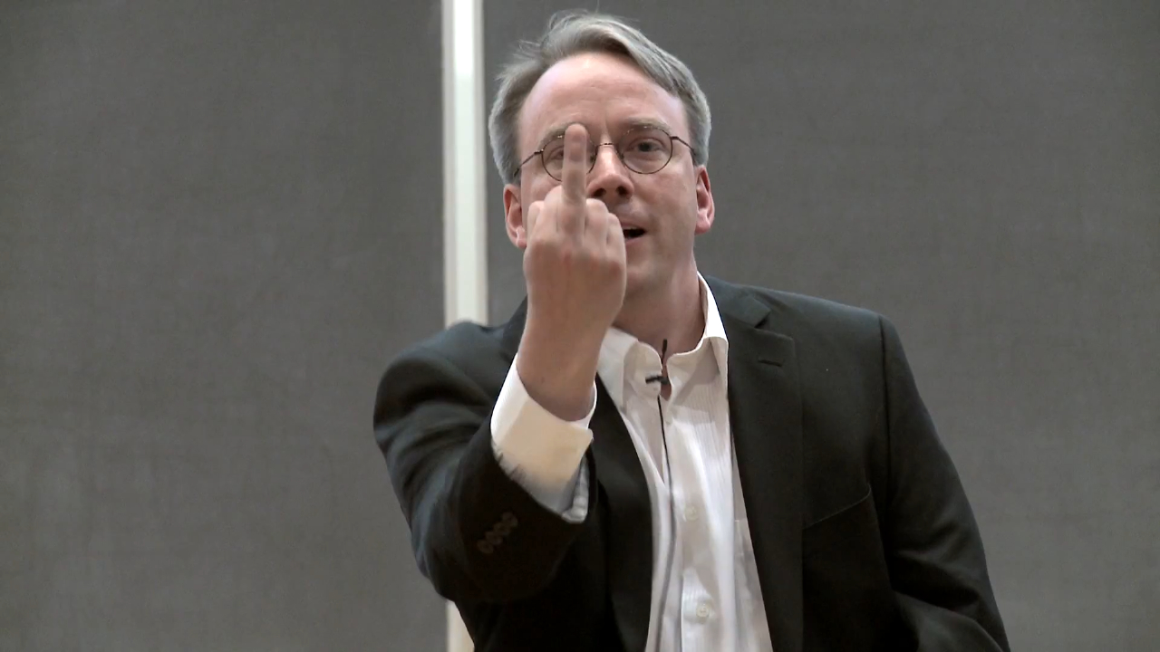
what is a git
git: [informal] [British] an unpleasant or contemptible person.

Slide 10
what is git
git: A distributed revision control system with…support for distributed, non-linear workflows. [Wikipedia – Git (software)]

Slide 11
what is git
…

Slide 12
what is git
…
Try this: a version control system that allows a user to store, update, and maintain files and projects.

Slide 13
why use version control
let’s talk workflow

Slide 14
let’s talk workflow
imagine writing an essay

Slide 15
let’s talk workflow
imagine writing an essay
what’s the process like

Slide 16
the writing process

Slide 17
the writing process
write the whole thing at once

Slide 18
the writing process
write the whole thing at once
CLG are NALCS champs. TSM is trash.

Slide 19
the writing process
write the whole thing at once
unlikely

Slide 20
the writing process
write the whole thing at once
unlikely
write bits and pieces in multiple settings

Slide 21
the writing process
write
CLG are NALCS champs.

Slide 22
the writing process
write → save
CLG are NALCS champs.

Slide 23
the writing process
write → save → s5secretsgg.docx
CLG are NALCS champs.

Slide 24
the writing process
write → save → s5secretsgg.docx
procrastinate
CLG are NALCS champs.

Slide 25
the writing process
write → save → write
CLG are NALCS champs. TSM is trash.

Slide 26
the writing process
write → save → write → save
CLG are NALCS champs. TSM is trash.

Slide 27
the writing process
write → save → write → save → s5secretsgg.docx
CLG are NALCS champs. TSM is trash.

Slide 28
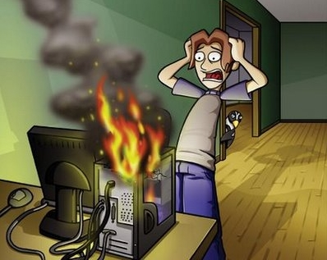
the writing process
write → save → write → save → s5secretsgg.docx

Slide 29
the writing process
write → save → write → save → s5secretsgg.docx
rip progress
CLG are NALCS champs. TSM is trash.

Slide 30
the writing process (trial 2)
write → save → s5secretsgg.docx
CLG are NALCS champs. TSM is trash.

Slide 31
the writing process (trial 2)
write → save → s5secretsgg.docx
save backup → s5secretsgg_backup.docx
CLG are NALCS champs. TSM is trash.

Slide 32
the writing process (trial 2)
write → save → s5secretsgg.docx
save backup
s5secretsgg.docx s5secretsgg_backup.docx
CLG are NALCS champs. TSM is trash. CLG are NALCS champs. TSM is trash.

Slide 33
the writing process (trial 2)
s5secretsgg.docx s5secretsgg_backup.docx
CLG are NALCS champs. TSM is trash. CLG are NALCS champs. TSM is trash.

Slide 34
the writing process (trial 2)
s5secretsgg.docx s5secretsgg_backup.docx
CLG are NALCS champs. TSM is trash. CLG are NALCS champs. TSM is trash.
what if we mess up our active copy

Slide 35
the writing process (trial 2)
s5secretsgg.docx s5secretsgg_backup.docx
TSM are NALCS champs. No thread is safe. CLG are NALCS champs. TSM is trash.
what if we mess up our active copy

Slide 36
the writing process (trial 2)
s5secretsgg.docx s5secretsgg_backup.docx
TSM are NALCS champs. No thread is safe. CLG are NALCS champs. TSM is trash.
what if we mess up our active copy
restore from backup

Slide 37
the writing process (trial 2)
s5secretsgg.docx s5secretsgg_backup.docx
TSM are NALCS champs. No thread is safe. CLG are NALCS champs. TSM is trash.
what if we mess up our active copy
restore from backup

Slide 38
the writing process (trial 2)
s5secretsgg.docx s5secretsgg_backup.docx
CLG are NALCS champs. TSM is trash. CLG are NALCS champs. TSM is trash.
what if we mess up our active copy
restore from backup

Slide 39

the writing process (trial 2)
s5secretsgg.docx s5secretsgg_backup.docx
CLG are NALCS champs. TSM is trash. CLG are NALCS champs. TSM is trash.

Slide 40
the writing process (trial 2)
s5secretsgg.docx s5secretsgg_backup.docx
what if we mess up active copy and overwrite the backup

Slide 41
the writing process (trial 2)
s5secretsgg.docx → save → s5secretsgg_backup.docx
TSM are NALCS champs. No thread is safe. → TSM are NALCS champs. No thread is safe.

Slide 42
the writing process (trial 2)
s5secretsgg.docx s5secretsgg_backup.docx
uh-oh

Slide 43
the writing process (trial 2)
s5secretsgg.docx s5secretsgg_backup.docx
uh-oh
we overwrote our backup with the mess up

Slide 44
the writing process (trial 3)
write → save → s5secretsgg.docx
CLG are NALCS champs. TSM is trash.

Slide 45
the writing process (trial 3)
write → save → s5secretsgg.docx
make iterative backups
CLG are NALCS champs. TSM is trash.

Slide 46
the writing process (trial 3)
s5secretsgg

Slide 47
the writing process (trial 3)
s5secretsgg s5secretsgg_2015-09-01

Slide 48
the writing process (trial 3)
s5secretsgg s5secretsgg_2015-09-01 s5secretsgg_2015-09-10

Slide 49
the writing process (trial 3)
s5secretsgg s5secretsgg_2015-09-01 s5secretsgg_2015-09-10
s5secretsgg_2015-09-19

Slide 50
the writing process (trial 3)
s5secretsgg s5secretsgg_2015-09-01 s5secretsgg_2015-09-10
s5secretsgg_2015-09-19 s5secretsgg_2015-09-28

Slide 51
the writing process (trial 3)
s5secretsgg s5secretsgg_2015-09-01 s5secretsgg_2015-09-10
s5secretsgg_2015-09-19 s5secretsgg_2015-09-28
this gets messy very quickly

Slide 52
the writing process (trial 3)
s5secretsgg s5secretsgg_2015-09-01 s5secretsgg_2015-09-10
s5secretsgg_2015-09-19 s5secretsgg_2015-09-28
this gets messy very quickly
however, this system allows us to restore from any given point

Slide 53
new problem

Slide 54
new problem
which backup has the info we need

Slide 55
new problem
which backup has the info we need
s5secretsgg s5secretsgg_2015-09-01 s5secretsgg_2015-09-10
s5secretsgg_2015-09-19 s5secretsgg_2015-09-28

Slide 56
ponder that question for a bit…
let’s shift gears for a minute…

Slide 57
ponder that question for a bit…
let’s shift gears for a minute…
let’s talk git

Slide 58
why use git

Slide 59
why use git
you have all these iterative backups

Slide 60
why use git
you have all these iterative backups
how do you manage them all

Slide 61
why use git
git pros
git cons

Slide 62
git pro
helps you manage version control

Slide 63
git pro
helps you manage version control
distributed (explained later)

Slide 64
git pro
helps you manage version control
distributed (explained later)
fast

Slide 65
git pro
helps you manage version control
distributed (explained later)
fast
used nearly everywhere in software world

Slide 66
git pro
helps you manage version control
distributed (explained later)
fast
used nearly everywhere in software world
can be used to non-software projects (like this)

Slide 67
git pro
helps you manage version control
distributed (explained later)
fast
used nearly everywhere in software world
can be used to non-software projects (like this)
it’s not SVN

Slide 68
git pro
helps you manage version control
distributed (explained later)
fast
used nearly everywhere in software world
can be used to non-software projects (like this)
it’s not SVN (centralized)
(the fact that my opinion happens to be the right opinion is a happy coincidence)

Slide 69
git con
considered very hard to learn

Slide 70
git con
considered very hard to learn
lots of weird syntax

Slide 71
git con
considered very hard to learn
lots of weird syntax
understanding git internals helps remedy this tremendously

Slide 72
terminal vs GUI

Slide 73
terminal vs GUI
terminal way is best way

Slide 74
terminal vs GUI
terminal way is best way
but nefari0uss – that gui application looks so nice and pretty

Slide 75
terminal vs GUI
terminal way is best way
but nefari0uss – that gui application looks so nice and pretty
and that terminal looks scary and hard

Slide 76
terminal vs GUI
terminal way is best way
but nefari0uss – that gui application looks so nice and pretty
and that terminal looks scary and hard
I don’t care

Slide 77
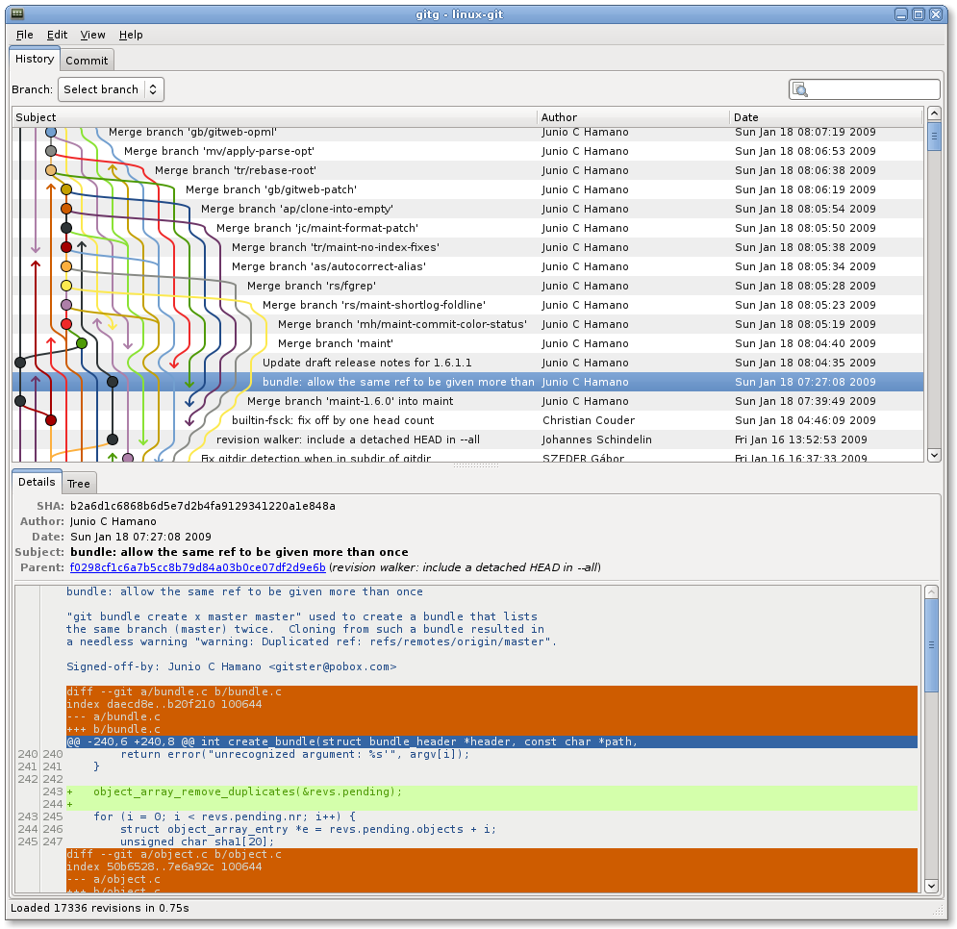

Slide 78
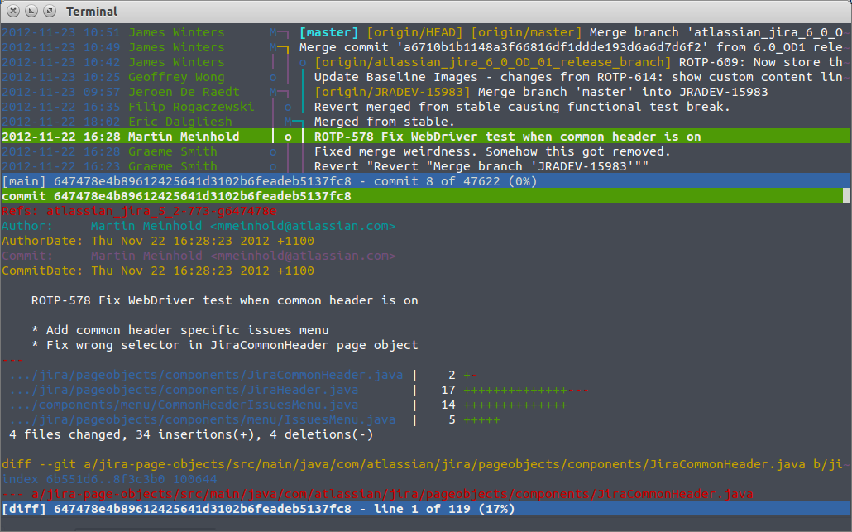

Slide 79
terminal vs GUI
gui applications hide what’s happening

Slide 80
terminal vs GUI
gui applications hide what’s happening
terminal way forces you to learn what’s happening

Slide 81
terminal vs GUI
gui applications hide what’s happening
terminal way forces you to learn what’s happening
Murphy’s law will happen

Slide 82
terminal vs GUI
gui applications hide what’s happening
terminal way forces you to learn what’s happening
Murphy’s law will happen
your code base will become borked

Slide 83
terminal vs GUI
gui applications hide what’s happening
terminal way forces you to learn what’s happening
Murphy’s law will happen
your code base will become borked
knowing how git works will help you fix it

Slide 84
terminal vs GUI
gui may not always be available

Slide 85
terminal vs GUI
gui may not always be available
terminal will

Slide 86
terminal vs GUI
gui may not always be available
terminal will
༼ つ ◕_◕ ༽つ terminal way is best way ༼ つ ◕_◕ ༽つ

Slide 87
going back…

Slide 88
going back…
remember this?

Slide 89
new problem
which backup has the info we need
s5secretsgg s5secretsgg_2015-09-01 s5secretsgg_2015-09-10
s5secretsgg_2015-09-19 s5secretsgg_2015-09-28

Slide 90
new problem
which backup has the info we need
answer is to look at the metadata

Slide 91
git internals

Slide 92
git internals
this section is very important to understand

Slide 93
git internals
this section is very important to understand
seriously – pay attention to this section

Slide 94
metadata

Slide 95
metadata
a set of data that describes and gives information about other data

Slide 96
metadata
a set of data that describes and gives information about other data
backups should contain metadata

Slide 97
metadata
who
what
when

Slide 98
metadata
who: author of the change
what:
when:

Slide 99
metadata
who: author of the change
what: what was changed
when:

Slide 100
metadata
who: author of the change
what: what was changed
when: date and time of change

Slide 101
metadata
who: author of the change
what: what was changed
when: date and time of change
where are we going with this

Slide 102
metadata
who: author of the change
what: what was changed
when: date and time of change
where are we going with this
commit: record change to the repository (workspace)

Slide 103
repository

Slide 104
repository
the workspace containing all files of a project

Slide 105
git repository

Slide 106
git repository
git stores information about the project in the repo.

Slide 107
git repository
git stores information about the project in the repo.
commit objects
references to commit objects (heads)

Slide 108
git repository
git stores information about the project in the repo.
commit objects
references to commit objects (heads)
info stored inside project root directory in .git folder

Slide 109
commits

Slide 110
commits
before we talk about commit objects, what’s a commit

Slide 111
commits
before we talk about commit objects, what’s a commit
record change to the repository (workspace)

Slide 112
commits
before we talk about commit objects, what’s a commit
record change to the repository (workspace)
more specifically, it’s a snapshot of the repo

Slide 113
commits
imagine a game

Slide 114
commits
imagine a game
you have multiple options (branches) you can take

Slide 115
commits
imagine a game
you have multiple options (branches) you can take
you save the game every time you have a branch (you make a commit)

Slide 116
commits
imagine a game
you have multiple options (branches) you can take
you save the game every time you have a branch (you make a commit)
every new save (commit) is a record of all the actions you’ve taken

Slide 117
commits
imagine a game
you have multiple options (branches) you can take
you save the game every time you have a branch (you make a commit)
every new save (commit) is a record of all the actions you’ve taken
sometimes you make a bad decision and don’t realize it till later

Slide 118
commits
imagine a game
you have multiple options (branches) you can take
you save the game every time you have a branch (you make a commit)
every new save (commit) is a record of all the actions you’ve taken
sometimes you make a bad decision and don’t realize it till later
you want to see where you made a bad decision

Slide 119
commits
remember metadata

Slide 120
commits
remember metadata
each save lets you know some information about the decision you made

Slide 121
commits
remember metadata
each save lets you know some information about the decision you made
you can go back to a commit and start from there

Slide 122
commits
remember metadata
each save lets you know some information about the decision you made
you can go back to a commit and start from there
later on: you can take all the good save results and remove the bad (merging/rebasing/cherry picking)

Slide 123
commit objects

Slide 124
commit objects
keep in mind the game save analogy

Slide 125
commit objects
3 things

Slide 126
commit objects
3 things
the files in the repo (character data)

Slide 127
commit objects
3 things
the files in the repo (character data)
parent commits (previous save files)

Slide 128
commit objects
3 things
the files in the repo (character data)
parent commits (previous save files)
SHA-1 hash (unique identifier)

Slide 129
hashing

Slide 130
hashing
a quick explanation

Slide 131
hashing
mapping data of arbitrary size to data of fixed size

Slide 132
hashing
mapping data of arbitrary size to data of fixed size
without going too much into it…

Slide 133
hashing
mapping data of arbitrary size to data of fixed size
without going too much into it…
data → hash function → data mapped to a value (hash)

Slide 134
hashing
mapping data of arbitrary size to data of fixed size
without going too much into it…
data → hash function → data mapped to a value (hash)
example hash function: hash = sum(string.length / 7)

Slide 135
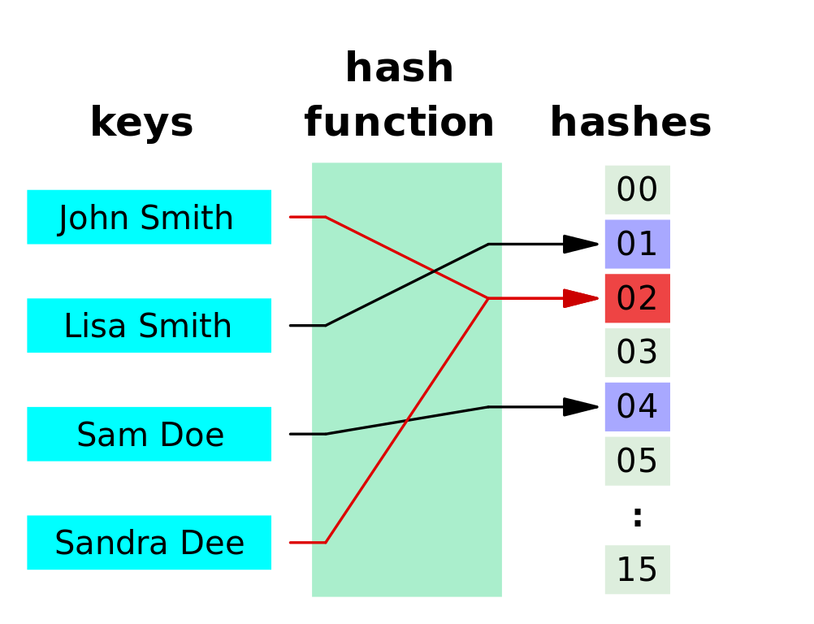

Slide 136
hashing
notice how we have two red lines going to the same thing

Slide 137
hashing
notice how we have two red lines going to the same thing
this is called a collision

Slide 138
hashing
notice how we have two red lines going to the same thing
this is called a collision
in security collision is bad

Slide 139
hashing
notice how we have two red lines going to the same thing
this is called a collision
in security collision is bad
imagine if your security key is shares the same hash as someone else’s

Slide 140
cryptographic hashing

Slide 141
cryptographic hashing
cryptographic hashing allows you to verify input to a known hash value

Slide 142
cryptographic hashing
cryptographic hashing allows you to verify input to a known hash value
very difficult to guess/reconstruct without input data

Slide 143
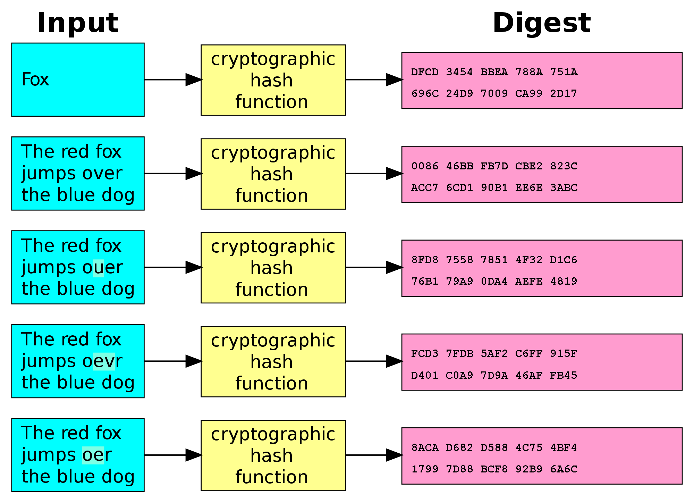

Slide 144
SHA-1

Slide 145
SHA-1
type of cryptographic hashing

Slide 146
SHA-1
type of cryptographic hashing
has two uses in git

Slide 147
SHA-1
type of cryptographic hashing
has two uses in git
verify that two files are the same

Slide 148
SHA-1
type of cryptographic hashing
has two uses in git
verify that two files are the same
verify that a file hasn’t been altered

Slide 149
SHA-1
type of cryptographic hashing
has two uses in git
verify that two files are the same
verify that a file hasn’t been altered
40-character string

Slide 150
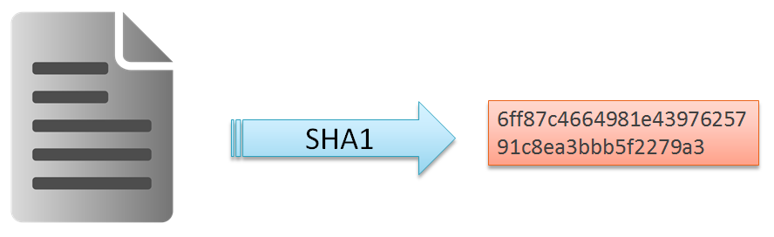
SHA-1
type of cryptographic hashing
has two uses in git
verify that two files are the same
verify that a file hasn’t been altered
40-character string

Slide 151
pointers

Slide 152
pointers
a value that references a memory location

Slide 153
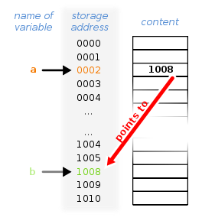
pointers
a value that references a memory location

Slide 154
heads

Slide 155
heads
pointer to a commit object

Slide 156
heads
pointer to a commit object
each head has a name

Slide 157
heads
pointer to a commit object
each head has a name
each branch has a head

Slide 158
heads
pointer to a commit object
each head has a name
each branch has a head
current head is aliased as HEAD (always in caps)

Slide 159
heads
think of heads as a name of the save file

Slide 160
heads
think of heads as a name of the save file
it links you to the backup (commit)

Slide 161
tags

Slide 162
tags
essentially a special name given to a commit

Slide 163
tags
essentially a special name given to a commit
generally used to mark a special release/edition/milestone

Slide 164
tags
essentially a special name given to a commit
generally used to mark a special release/edition/milestone
ex. v1.0

Slide 165
branching

Slide 166
branching
this part can get confusing so please ask questions

Slide 167
branching
this part can get confusing so please ask questions
where are going with this?

Slide 168
branching
this part can get confusing so please ask questions
where are going with this?
collaboration

Slide 169
branching
think back to commits and saving when faced with options

Slide 170
branching
think back to commits and saving when faced with options
imagine if you wanted to take option a but a friend wanted to take option b

Slide 171
branching
think back to commits and saving when faced with options
imagine if you wanted to take option a but a friend wanted to take option b
example:
you want to help an NPC for a potential reward

Slide 172
branching
think back to commits and saving when faced with options
imagine if you wanted to take option a but a friend wanted to take option b
example:
you want to help an NPC for a potential reward
friend wants to kill the NPC because you can loot the body

Slide 173
branching
you make a save and both do different things

Slide 174
branching
you make a save and both do different things
(commit your work and then make a new branch)

Slide 175
branching
so let’s call the original story line “origin”

Slide 176
branching
so let’s call the original story line “origin”
now let’s assume that you’re the one who is in charge, you make the official decision

Slide 177
branching
so let’s call the original story line “origin”
now let’s assume that you’re the one who is in charge, you make the official decision
let’s call this branch of the story line “master”

Slide 178
branching
so let’s call the original story line “origin”
now let’s assume that you’re the one who is in charge, you make the official decision
let’s call this branch of the story line “master”
your friend’s story line (branch) is now called “dev”

Slide 179
branching
so let’s call the original story line “origin”
now let’s assume that you’re the one who is in charge, you make the official decision
let’s call this branch of the story line “master”
your friend’s story line (branch) is now called “dev”
with me so far?
let’s diagram this

Slide 180
branching

Slide 181
branching
origin

Slide 182
branching
origin
time

Slide 183
branching
origin
time
(A)
you two both agree on choice a

Slide 184
branching
origin
time
master
(A)
right now there is no “dev”, only master

Slide 185
branching
origin
time
HEAD
master
(A)
HEAD points to the latest save

Slide 186
branching
origin
time
HEAD
master
(A)
you two both agree on choice a

Slide 187
branching
origin
time
HEAD
master
(A)
(B)
you two both disagree on choice b
you make a save

Slide 188
branching
origin
time
HEAD
master
(A)
(B)
(C)
dev
you play and make choice c

Slide 189
branching
origin
time
master
(A)
(B)
(C)
(D)
dev
your friend plays and makes
choice d
HEAD

Slide 190
merging branches

Slide 191
merging branches
you want to combine the two story lines but how

Slide 192
merging branches
you want to combine the two story lines but how
both of you made two disjoint decisions

Slide 193
merging branches
you want to combine the two story lines but how
both of you made two disjoint decisions
both decisions have effects on the game that are radically different

Slide 194
merging branches
you want to combine the two story lines but how
both of you made two disjoint decisions
both decisions have effects on the game that are radically different
if you were to merge the two story lines (branches) you’d have merge conflicts

Slide 195
merging branches
goal: so you want to remove these conflicts

Slide 196
merging branches
goal: so you want to remove these conflicts
you want all the good parts of both decisions kept

Slide 197
merging branches
goal: so you want to remove these conflicts
you want all the good parts of both decisions kept
you want all the bad parts of both decisions removed

Slide 198
merging branches
imagine taking the story and doing just that

Slide 199
merging branches
imagine taking the story and doing just that
you keep what you want and remove what you don’t want

Slide 200
merging branches
imagine taking the story and doing just that
you keep what you want and remove what you don’t want
you also make some modifications as necessary to cover plot holes

Slide 201
merging branches
let’s relate this back to code

Slide 202
merging branches
let’s relate this back to code
let’s say you worked on a file

Slide 203
merging branches
let’s relate this back to code
let’s say you worked on a file
your friend worked on the same file

Slide 204
merging branches
you combine the file

Slide 205
merging branches
you combine the file
pick the parts changed that work

Slide 206
merging branches
you combine the file
pick the parts changed that work
remove the conflicting parts

Slide 207
merging branches
you combine the file
pick the parts changed that work
remove the conflicting parts
make some modifications to make it cleaner/work together (refactoring, et cetera)

Slide 208
merging branches
you combine the file
pick the parts changed that work
remove the conflicting parts
make some modifications to make it cleaner/work together (refactoring, et cetera)
let’s diagram this

Slide 209
branching
origin
time
master
(A)
(B)
(C)
(D)
dev
this is where we left off
HEAD

Slide 210
branching
origin
time
master
(A)
(B)
(C)
(E)
(D)
dev
HEAD
you perform the merge
but E has conflicts

Slide 211
branching
origin
time
HEAD
master
(A)
(B)
(C)
(E)
(D)
dev
post-merge
no conflicts

Slide 212
distributed vs centralized

Slide 213
distributed vs centralized
centralized work flow vs distributed work flow

Slide 214
distributed vs centralized
centralized work flow vs distributed work flow
centralized: all work is done locally and synchronized on a server

Slide 215
distributed vs centralized
centralized work flow vs distributed work flow
centralized: all work is done locally and synchronized on a server
distributed: everyone working on the project has a copy of the project and makes changes locally.

Slide 216
distributed vs centralized
centralized work flow vs distributed work flow
centralized: all work is done locally and synchronized on a server
distributed: everyone working on the project has a copy of the project and makes changes locally.
let’s diagram differences

Slide 217
centralized
time
friend local
main server
my local
imagine working on a project

Slide 218
centralized
time
friend local
main server
(A)
my local
this is what start with
(main server ~ cloud storage)

Slide 219
centralized
time
friend local
main server
(A)
my local
(A)
you get a local copy

Slide 220
centralized
time
friend local
main server
(A)
my local
(A)
(B)
you make local changes

Slide 221
centralized
time
friend local
main server
(A)
(B)
my local
(A)
(B)
you upload it to the server

Slide 222
centralized
time
friend local
(B)
main server
(A)
(B)
my local
(A)
(B)
friend downloads it locally

Slide 223
centralized
time
friend local
(B)
(C)
main server
(A)
(B)
my local
(A)
(B)
friend makes changes

Slide 224
centralized
time
friend local
(B)
(C)
main server
(A)
(B)
(C)
my local
(A)
(B)
friend uploads to server

Slide 225
centralized
time
friend local
(B)
(C)
main server
(A)
(B)
(C)
my local
(A)
(B)
what if you both want to make changes

Slide 226
centralized
time
friend local
(B)
(C)
main server
(A)
(B)
(C)
my local
(A)
(B)
(C)
you download C

Slide 227
centralized
time
friend local
(B)
(C)
main server
(A)
(B)
(C)
my local
(A)
(B)
(C)
(D)
keep working on D

Slide 228
centralized
time
friend local
(B)
(C)
(I)
main server
(A)
(B)
(C)
my local
(A)
(B)
(C)
(D)
your friend works on I

Slide 229
centralized
time
friend local
(B)
(C)
(I)
main server
(A)
(B)
(C)
(D)
my local
(A)
(B)
(C)
(D)
you push your code to the server

Slide 230
centralized
time
friend local
(B)
(C)
(I)
main server
(A)
(B)
(C)
(D)
my local
(A)
(B)
(C)
(D)
conflict – the bases are not the same
(common base is C)

Slide 231
centralized
time
friend local
(B)
(C)
(I)
main server
(A)
(B)
(C)
(D)
my local
(A)
(B)
(C)
(D)
(E)
meanwhile, you have code to push

Slide 232
centralized
time
friend local
(B)
(C)
(I)
(J)
main server
(A)
(B)
(C)
(D)
(J)
my local
(A)
(B)
(C)
(D)
(E)
conflict fixed

Slide 233
centralized
time
friend local
(B)
(C)
(I)
(J)
main server
(A)
(B)
(C)
(D)
(J)
my local
(A)
(B)
(C)
(D)
(E)
conflict fixed
but now your code is out of sync

Slide 234
centralized
time
friend local
(B)
(C)
(I)
(J)
main server
(A)
(B)
(C)
(D)
(J)
my local
(A)
(B)
(C)
(D)
(E)
now you have to merge

Slide 235
centralized
time
friend local
(B)
(C)
(I)
(J)
main server
(A)
(B)
(C)
(D)
(J)
(K)
my local
(A)
(B)
(C)
(D)
(E)
(K)
you merge

Slide 236
centralized
time
friend local
(B)
(C)
(I)
(J)
(L)
main server
(A)
(B)
(C)
(D)
(J)
(K)
my local
(A)
(B)
(C)
(D)
(E)
(K)
meanwhile…

Slide 237
centralized
time
friend local
(B)
(C)
(I)
(J)
(L)
main server
(A)
(B)
(C)
(D)
(J)
(K)
my local
(A)
(B)
(C)
(D)
(E)
(K)
meanwhile…
the process continues

Slide 238
centralized
can you see why this might be a problem

Slide 239
centralized
can you see why this might be a problem
you need network access

Slide 240
centralized
can you see why this might be a problem
you need network access
it’s also very easy for your code base to be out of sync

Slide 241
centralized
can you see why this might be a problem
you need network access
it’s also very easy for your code base to be out of sync
what if we could always have an updated copy of the codebase

Slide 242
distributed
what if we could always have an updated copy of the codebase

Slide 243
distributed
what if we could always have an updated copy of the codebase
you store this locally and can fix all conflicts locally

Slide 244
distributed
what if we could always have an updated copy of the codebase
you store this locally and can fix all conflicts locally
let’s diagram this

Slide 245
distributed
time
origin
let “origin” be the name of the main repository

Slide 246
distributed
time
origin-master
let “origin” be the name of the main repository
the branch name is “master”

Slide 247
distributed
time
origin-master
let “origin” be the name of the main repository
the branch name is “master”
this is handled by the administrator

Slide 248
distributed
time
origin-master
note: origin and master are conventions

Slide 249
distributed
time
origin-master
note: origin and master are conventions
they do not have to be strictly followed

Slide 250
distributed
time
origin-master
note: origin and master are conventions
they do not have to be strictly followed
you can call them whatever you want

Slide 251
distributed
time
origin-master
note: origin and master are conventions
they do not have to be strictly followed
you can call them whatever you want
best practice dictates that you use origin-master

Slide 252
distributed
time
origin-master
let “nefari0uss” be the name of the my repository
nefari0uss

Slide 253
distributed
time
origin-master
let “nefari0uss” be the name of the my repository
the branch name is “master”
nefari0uss-master

Slide 254
distributed
time
origin-master
let “nefari0uss” be the name of the my repository
the branch name is “master”
this is handled by me
nefari0uss-master

Slide 255
distributed
time
friend
origin-master
let “friend” be the name of the my repository
nefari0uss-master

Slide 256
distributed
time
friend-master
origin-master
let “friend” be the name of the my repository
the branch name is “master”
nefari0uss-master

Slide 257
distributed
time
friend-master
origin-master
(A)
nefari0uss-master
this is the initial code base

Slide 258
distributed
time
friend-master
origin-master
(A)
nefari0uss-master
(B)
you download the entire project locally

Slide 259
distributed
time
friend-master
(R)
origin-master
(A)
nefari0uss-master
(B)
as does your friend

Slide 260
centralized
time
(T)
friend local
(“nef-friend”)
(R)
(S)
(U)
(J)
(L)
(L)
(V)
(U)
main repo
(“origin”)
(A)
(B)
(K)
(K)
(T)
my local
(“nefari0uss”)
(B)
(U)
(D)
(J)
(K)
(U)
(L)
(V)
meanwhile…

Slide 261
centralized
time
(T)
friend local
(“nef-friend”)
(R)
(S)
(U)
(J)
(L)
(L)
(V)
(U)
main repo
(“origin”)
(A)
(B)
(K)
(K)
(T)
my local
(“nefari0uss”)
(B)
(U)
(D)
(J)
(K)
(U)
(L)
(V)
meanwhile…

Slide 262
centralized
time
(T)
friend local
(“nef-friend”)
(R)
(S)
(U)
(J)
(L)
(L)
(V)
(U)
main repo
(“origin”)
(A)
(B)
(K)
(K)
(T)
my local
(“nefari0uss”)
(B)
(U)
(D)
(J)
(K)
(U)
(L)
(V)
meanwhile…

Slide 263
centralized
time
(T)
friend local
(“nef-friend”)
(R)
(S)
(U)
(J)
(L)
(L)
(V)
(U)
main repo
(“origin”)
(A)
(B)
(K)
(K)
(T)
my local
(“nefari0uss”)
(B)
(U)
(D)
(J)
(K)
(U)
(L)
(V)
meanwhile…

Slide 264
centralized
time
(T)
friend local
(“nef-friend”)
(R)
(S)
(U)
(J)
(L)
(L)
(V)
(U)
main repo
(“origin”)
(A)
(B)
(K)
(K)
(T)
my local
(“nefari0uss”)
(B)
(U)
(D)
(J)
(K)
(U)
(L)
(V)
meanwhile…

Slide 265
centralized
time
(T)
friend local
(“nef-friend”)
(R)
(S)
(U)
(J)
(L)
(L)
(V)
(U)
main repo
(“origin”)
(A)
(B)
(K)
(K)
(T)
my local
(“nefari0uss”)
(B)
(U)
(D)
(J)
(K)
(U)
(L)
(V)
meanwhile…

Slide 266
putting things together

Slide 267
putting things together
will heavily reference game analogy for this

Slide 268
putting things together
repository – the game

Slide 269
putting things together
repository – the game
commit – the game save

Slide 270
putting things together
repository – the game
commit – the game save
metadata – info about the game save

Slide 271
putting things together
repository – the game
commit – the game save
metadata – info about the game save
SHA1 – the internal identifier of the game save

Slide 272
putting things together
repository – the game
commit – the game save
metadata – info about the game save
SHA1 – the internal identifier of the game save
head – the game save name (save 01, save 02, et cetera)

Slide 273
putting things together
repository – the game
commit – the game save
metadata – info about the game save
SHA1 – the internal identifier of the game save
head – the game save name (save 01, save 02, et cetera)
tags – different parts/chapters of the game (part 1, part 2, et cetera)

Slide 274
putting things together
repository – the game
commit – the game save
metadata – info about the game save
SHA1 – the internal identifier of the game save
head – the game save name (save 01, save 02, et cetera)
tags – different parts/chapters of the game (part 1, part 2, et cetera)
branch – an option taken by someone

Slide 275
putting things together
repository – the game
commit – the game save
metadata – info about the game save
SHA1 – the internal identifier of the game save
head – the game save name (save 01, save 02, et cetera)
tags – different parts/chapters of the game (part 1, part 2, et cetera)
branch – an option taken by someone
merging – combining the options taken

Slide 276
one more thing
almost done with internals so stick with me

Slide 277
three states of being

Slide 278
three states of being
staged
indexed
cached

Slide 279
/git-internals

Slide 280
/git-internals
sorry that was so long

Slide 281
/git-internals
sorry that was so long
now on to the fun stuff

Slide 282
setting up git

Slide 283
setting up git

Slide 284
quick setup

Slide 285
ssh keys

Slide 286
Github & BitBucket

Slide 287
basic commands

Slide 288
advanced commands

Slide 289
live demonstration

Slide 290
Sources
Git-SCM book: https://git-scm.com/book
Daniel “paradigm” Thau from Open Source Club at OSU on Git:
https://opensource.osu.edu/au10/git
git – the simple guide: https://rogerdudler.github.io/git-guide/
Atlassian Git Tutorial: https://www.atlassian.com/git/tutorials/
Understanding Git Conceptually: http://www.sbf5.com/~cduan/technical/git/
Wikiepda – Git (software): https://en.wikipedia.org/wiki/Git_(software)
Git Reference: http://gitref.org/basic/
Lots of pictures from Wikipedia and Google/Bing Image searches

