Slide 1

Linux
An Introduction
Nikit “Nefari0uss” Malkan

Slide 2
Before we start…
A note on my presentation style

Slide 3
Quick Side Note
Clear concise definitions.
Give context.
Interactive presentations
Ask questions!
Feedback
I can’t improve without it!

Slide 4
What is Linux?
And who uses it anyways?

Slide 5
IT’S A UNIX SYSTEM
https://youtu.be/dxIPcbmo1_U reddit.com/r/itsaunixsystem

Slide 6
Who uses it?

Slide 7
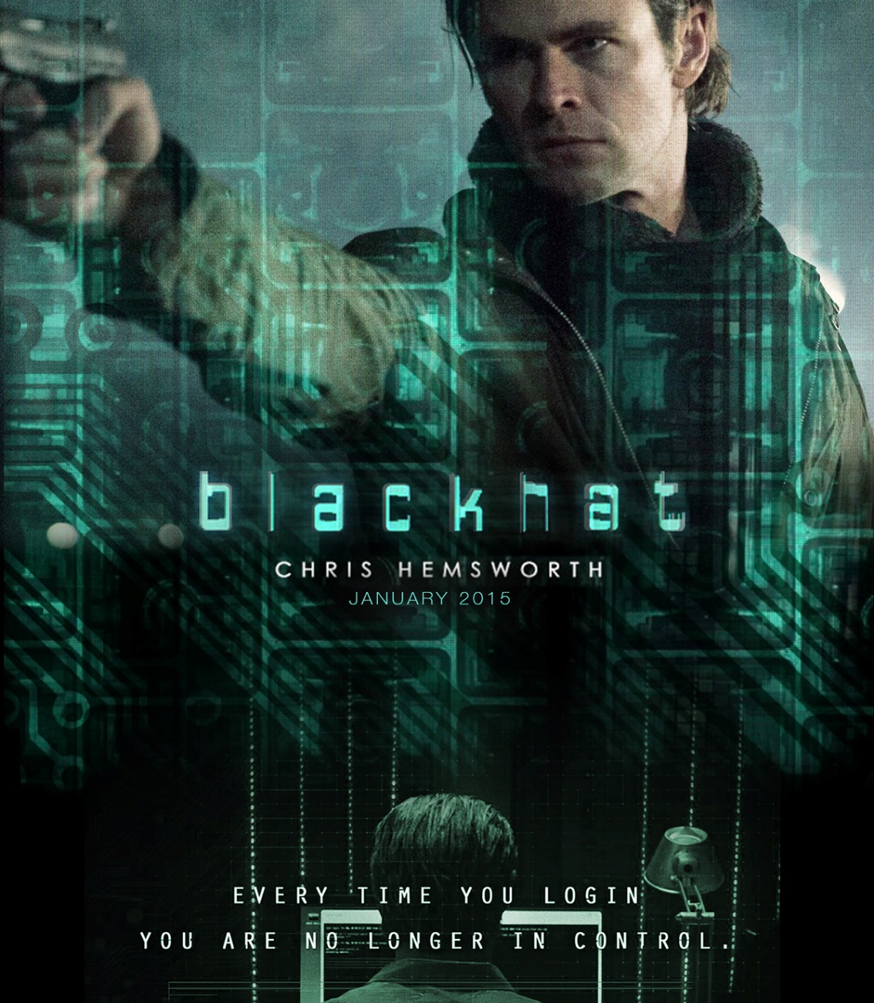
Who uses it?
Hackers?
All the bad guys in the movies?
(Bonus points if it’s a woman.)

Slide 8
Who uses it?
Hackers?
All the bad guys in the movies?
(Bonus points if it’s a woman.)
Geeks and nerds?
That’s all of you in here btw.

Slide 9
Who uses it?
Hackers?
All the bad guys in the movies?
(Bonus points if it’s a woman.)
Geeks and nerds?
That’s all of you in here btw.
IT? System admins?

Slide 10
Who uses it?
US Department of Defense
Single biggest install base of Red Hat Linux

Slide 11
Who uses it?
US Department of Defense
Single biggest install base of Red Hat Linux
The City of Munich, Germany
Migrated government desktops due to price and ability to customize to needs of city.

Slide 12
Who uses it?
US Department of Defense
Single biggest install base of Red Hat Linux
The City of Munich, Germany
Migrated government desktops due to price and ability to customize to needs of city.
Spain
Created their own distro (LinEx) and have been using it since 2002.

Slide 13
Who uses it?
Amazon
Servers, databases, and data centers run Linux.

Slide 14
Who uses it?
Amazon
Servers, databases, and data centers run Linux.
Android
Linux at its core.

Slide 15
Who uses it?
Amazon
Servers, databases, and data centers run Linux.
Android
Linux at its core.
THE Ohio State University
Student Linux (Red Hat Enterprise)

Slide 16
Key Terms

Slide 17
Key Terms
OS: Operating System

Slide 18
Key Terms
OS: Operating System
OSS: Open Source Software that can be freely used, changed, modified, and shared. Usually under a copyleft license.

Slide 19
Key Terms
OS: Operating System
OSS: Open Source Software that can be freely used, changed, modified, and shared. Usually under a copyleft license.
Proprietary software: opposite of OSS, software that cannot be modified or has heavy restrictions upon use.

Slide 20
Key Terms
OS: Operating System
OSS: Open Source Software that can be freely used, changed, modified, and shared. Usually under a copyleft license.
Proprietary software: opposite of OSS, software that cannot be modified or has heavy restrictions upon use.
FLOSS: Free Libre Open Source Software

Slide 21
Key Terms
GNU: Gnu’s Not Unix; An OS that respects user freedom.
Technically it’s the utilities that go with the OS.

Slide 22
Key Terms
GNU: Gnu’s Not Unix; An OS that respects user freedom.
Technically it’s the utilities that go with the OS.
GNU/Linux: the combination of GNU (the utilities) and Linux (the kernel).
Often shortened to just Linux.

Slide 23
Key Terms
GNU: Gnu’s Not Unix; An OS that respects user freedom.
Technically it’s the utilities that go with the OS.
GNU/Linux: the combination of GNU (the utilities) and Linux (the kernel).
Often shortened to just Linux.
Kernel: the core of the operating system. Where all the black magic happens.

Slide 24
What is it?
It helps to start at the origin

Slide 25
Brief History
To understand the ideas and philosophies behind GNU/Linux.

Slide 26
A Brief History of Linux
Two very important men to remember:
Richard Stallman
Linus Torvalds

Slide 27
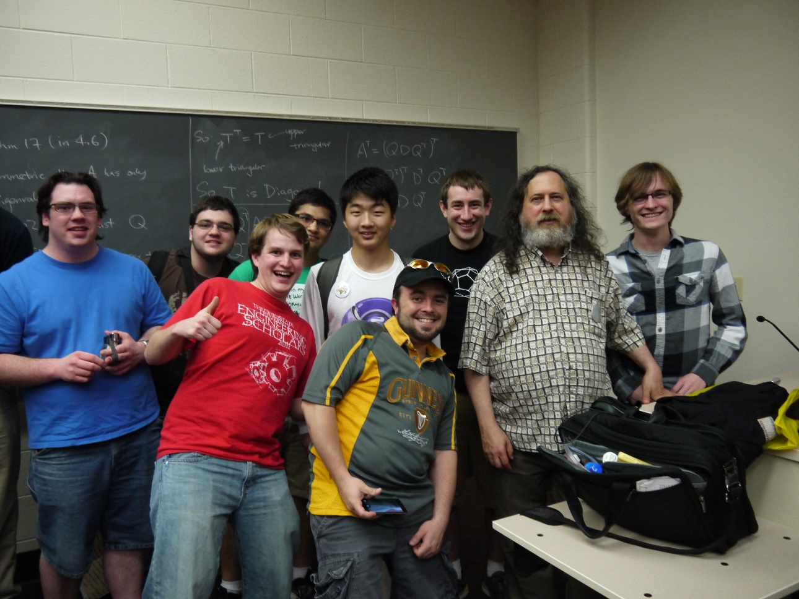
A Brief History of Linux
Richard Stallman
Founder of the GNU project and FSF.
Bit of an extremist.
Visited OSU!

Slide 28
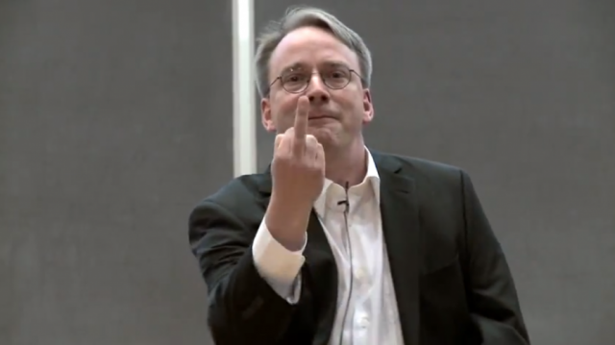
A Brief History of Linux
Linus Torvalds
Wrote the Linux kernel.
Loves yelling at people in mailing lists.

Slide 29
A Brief History of Linux
Richard Stallman
Pioneer of the concept of “free software”
Free as in freedom, not free cost.
Started the GNU project in1983.
Left MIT in 1984 to work on the project full time.

Slide 30
A Brief History of Linux
The GNU Project
GNU is Gnu’s Not Unix.
Goal: Develop a Unix-compatible OS.
Must use only free software.
Most components were completed by 1991
Was missing kernel.

Slide 31
Brief History
Linus Torvalds
Was a student at University of Helsinki at the time. (~1991)
Used non-free UNIX OS called Minix.

Slide 32
Brief History
Linus Torvalds
Was a student at University of Helsinki at the time. (~1991)
Used non-free UNIX OS called Minix.
Many users, including Tovarlds sent improvements to creator.
Minix creator rejected them citing them as unnecessary.

Slide 33
Brief History
Linus Torvalds
Was a student at University of Helsinki at the time. (~1991)
Used non-free UNIX OS called Minix.
Many users, including Tovarlds sent improvements to creator.
Minix creator rejected them citing them as unnecessary.
Tovarlds decided to write his own OS.
Wrote Linux kernel in 1991.
And thus a beautiful harmony was born.

Slide 34
Takeaway - Core Philosophies
Anyone should be able to contribute.
Users tend be rather obstinate.
Self-sufficient
“If it doesn’t exist, I’ll make it myself”

Slide 35
Takeaway - Core Philosophies
Anyone should be able to contribute.
Users tend be rather obstinate.
Self-sufficient
“If it doesn’t exist, I’ll make it myself”
Every single person in this room can contribute.
That’s a very powerful philosophy.

Slide 36
OK but what is it?
Linux is the kernel of the OS.
people commonly refer to the entire OS ecosystem as simply Linux or Gnu/Linux.

Slide 37
Installing Linux
Some things to be aware of

Slide 38
Quick Steps
1) Disable secure boot, fast boot, and the like.
2) Partition your hard disk.
3) Burn live USB and boot from it.
4) Install to blank partition.
5) Enjoy!

Slide 39
More Key Terms
Yes, I have a lot of these. Deal with it.

Slide 40
Key Terms
Dual booting: Installing two OSes on a computer.

Slide 41
Key Terms
Dual booting: Installing two OSes on a computer.
Partition: allocate free space on the hard disk.

Slide 42
Key Terms
Dual booting: Installing two OSes on a computer.
Partition: allocate free space on the hard disk.
Bootloader: software that runs upon system startup.
Allows you to select which OS to run.

Slide 43
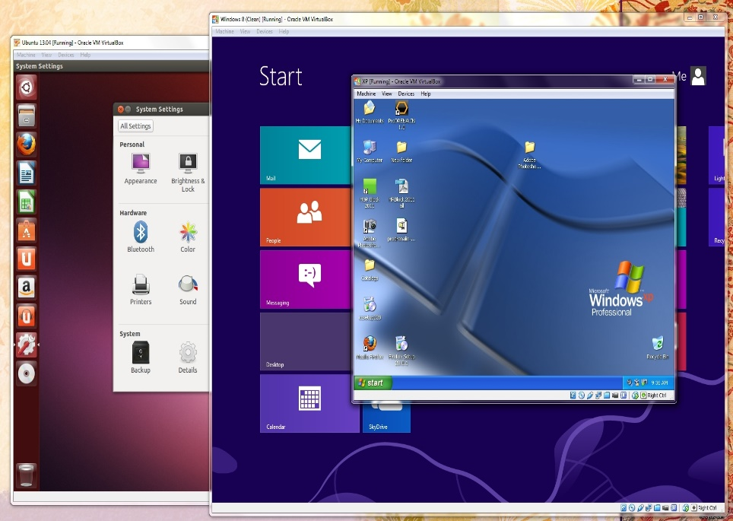
Key Terms
Dual booting: Installing two OSes on a computer.
Partition: allocate free space on the hard disk.
Bootloader: software that runs upon system startup.
Allows you to select which OS to run.
Virtualization: Running an OS while running an OS.
Software that pretends to be the hardware.

Slide 44
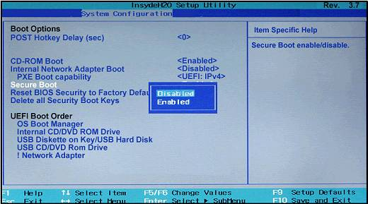
Secure Boot
Malicious software can run upon startup.
Secure boot only allows trusted software to run during start up.
Unfortunately, GRUB (boot loader) needs to run upon start up for dual booting.
Turn on computer and go to BIOS.
Each laptop manufacturer has different way.
Turn off secure boot.

Slide 45
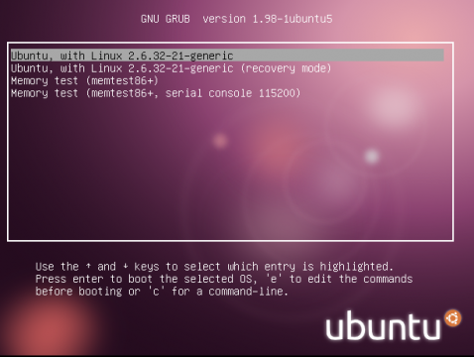
Grub

Slide 46
Partitioning Your Hard Disk
100 % Windows
1 TB
50% Windows
500 GB
Free Space
500 GB
50% Windows
500 GB
50% Linux
500 GB
Pre-Allocation
Post-Allocation
Post-Install

Slide 47
Partitioning Your Hard Disk
ONLY PARTITION IN WINDOWS.

Slide 48
Partitioning Your Hard Disk
ONLY PARTITION IN WINDOWS.
Windows + X
Disk Management
Right click on C drive
Shrink Volume
Allocate space
1024 MB = 1 GB
Trying Linux? Don’t need much.
20-30 GB is sufficient.

Slide 49
Quick Steps
6) Get bored of Ubuntu.

Slide 50
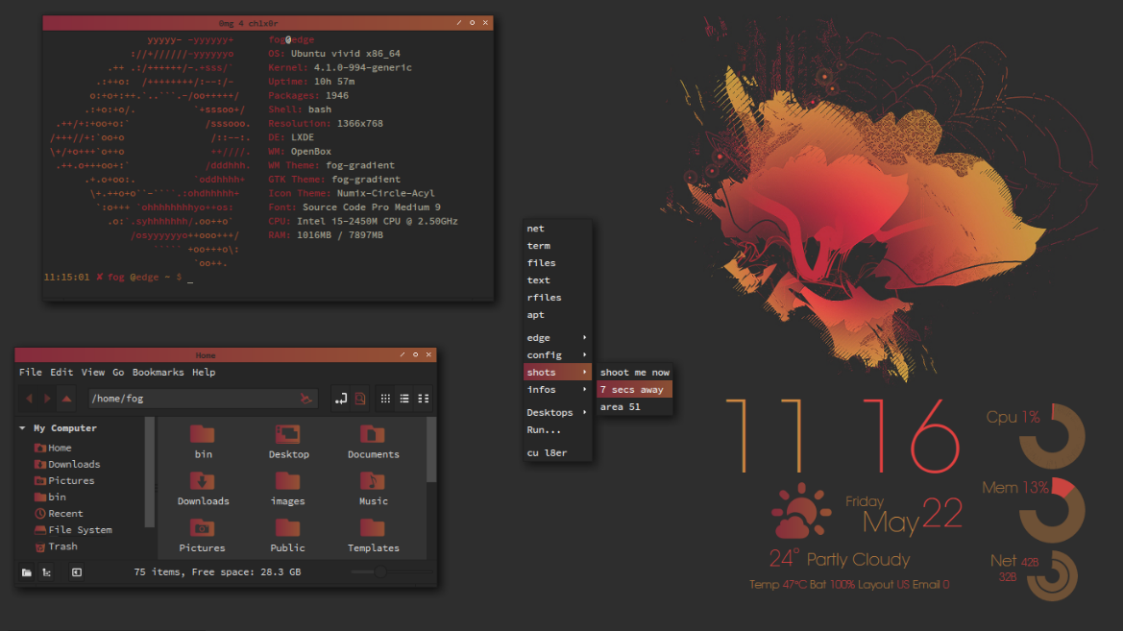
Quick Steps
6) Get bored of Ubuntu.
7) Look at all the sexy installations online.

Slide 51
Quick Steps
6) Get bored of Ubuntu.
7) Look at all the sexy installations online.
8) Attempt install Gentoo.

Slide 52
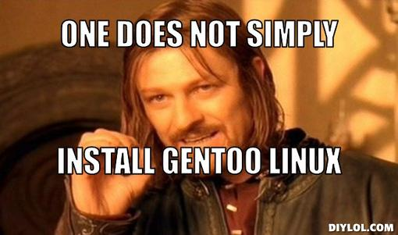
Quick Steps
6) Get bored of Ubuntu.
7) Look at all the sexy installations online.
8) Attempt install Gentoo.
9) Cry

Slide 53
Quick Steps
6) Get bored of Ubuntu.
7) Look at all the sexy installations online.
8) Attempt install Gentoo.
9) Cry
10) Go back to Ubuntu.

Slide 54
Distros
Why are there so many versions of Linux?

Slide 55
Distros
Short for distribution.
Windows comes in different flavors such as Home, Pro, Ultimate, et cetera.

Slide 56
Distros
Short for distribution.
Windows comes in different flavors such as Home, Pro, Ultimate, et cetera.
Linux is kinda the same way.
Imagine if each version of Windows came with a different desktop environment and way of doing things.
Two of the most popular distros are Ubuntu and Linux Mint.
Both are easy to use and excellent introductions to Linux.

Slide 57
Distros
Why have so many options and differences?

Slide 58
Distros
Why have so many options and differences?
Remember the core philosophies?
Everyone can contribute.
“I can do it myself”

Slide 59
Distros
Why have so many options and differences?
Remember the core philosophies?
Everyone can contribute.
“I can do it myself”
Or this?

Slide 60
Distros
Why have so many options and differences?
Remember the core philosophies?
Everyone can contribute.
“I can do it myself”
Or this?
People like to customize.
Make it the way they like.

Slide 61
Linux Family Tree
https://en.wikipedia.org/wiki/List_of_Linux_distributions

Slide 62
Environments
Everyone’s got an opinion

Slide 63
Environments
GUI: Graphical User Interface. Mouse, folders, buttons, etc.
DE: Desktop Environment. This is the stuff you interact with using the GUI while operating a computer.
GNOME, KDE, Unity: Various DE. Like Distros, they can be customized how you see fit.

Slide 64
Terminal
You have to use it at some point

Slide 65
Terminal
Terminal/console/shell
Linux equivalent of the Windows CMD/PowerShell.
Very powerful and flexible, you can type commands to do just about anything.

Slide 66
Terminal
Terminal/console/shell
Linux equivalent of the Windows CMD/PowerShell.
Very powerful and flexible, you can type commands to do just about anything.
Bash: The most common shell environment. Stdlinux uses c-shell.

Slide 67
Terminal
Terminal/console/shell
Linux equivalent of the Windows CMD/PowerShell.
Very powerful and flexible, you can type commands to do just about anything.
Bash: The most common shell environment. Stdlinux uses c-shell.
SUDO: super user do – equivalent to administrator in Windows.
Root: see su.
Technically there is a difference. For our intents, it does not matter.

Slide 68
Terminal
Lots of commands. More next week!
su – switch user (run command as another user)
sudo – super user do (run command as admin)
pwd – present working directory
ls – list files in current directory
mv – move
cp – copy
cd – change directory
mkdir – make directory
rmdir – remove directory

Slide 69
Terminal
Compiling/building
Turning the raw source code into something executable.
Binary: a machine readable file.
Usually refers to a file you can run.

Slide 70
Terminal
Compiling/building
Turning the raw source code into something executable.
Binary: a machine readable file.
Usually refers to a file you can run.
“compile the binaries”
You are compiling the source.
You are running the binaries.
Saying “compile to the binary” sounds weird.

Slide 71
Terminal
Be very careful when doing anything that requires root access.
Do not blindly copy and paste commands!
Knowledge is power.
Learn what they do before typing anything!

Slide 72
Terminal
Be very careful when doing anything that requires root access.
Do not blindly copy and paste commands!
Knowledge is power.
Learn what they do before typing anything!
DO NOT ENTER THE FOLLOWING COMMANDS

Slide 73
Terminal
$ sudo rm –rf / –no-preserve-root
sudo – super user do
rm – remove files
-rf - recursive, force
/ - the directory; in this case, the root directory.
-no-preserve-root – remove safety flag.
DO NOT ENTER THIS IN THE TERMINAL.

Slide 74
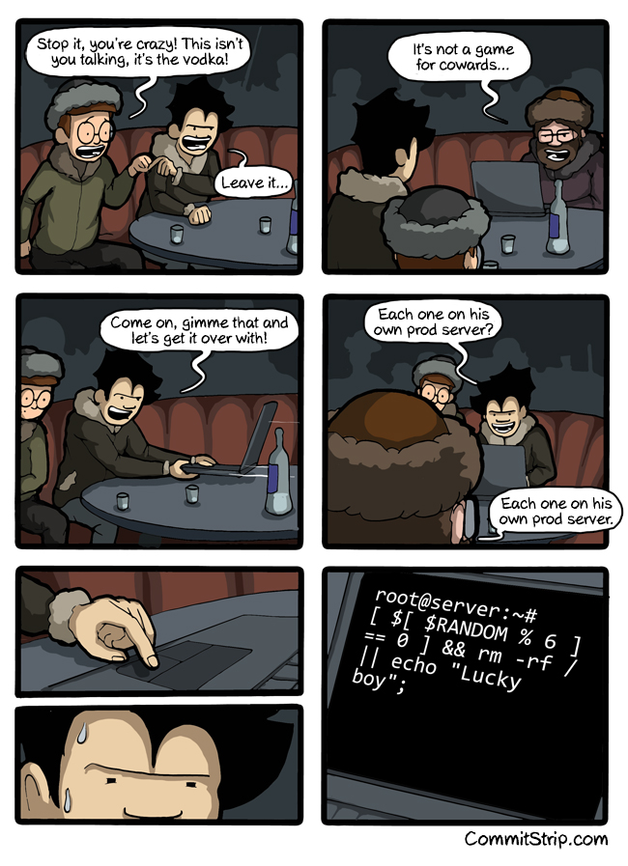

Slide 75
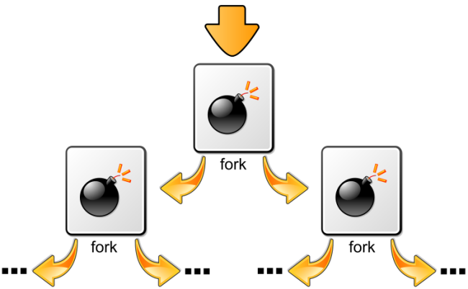
Terminal
Forkbomb: :(){ :|: & };:
A shell function that continuously creates copies of itself.
The process eventually takes up all of your CPU.
DO NOT ENTER THIS ON YOUR TERMINAL.

Slide 76
Applications/Software
Yes, Linux has software!

Slide 77
Applications/Software
Myth: Linux has no software.

Slide 78
Applications/Software
Myth: Linux has no software.
Linux has tons of software.
Some is closed source, much is open.

Slide 79
Applications/Software
Myth: Linux has no software.
Linux has tons of software.
Some is closed source, much is open.
Usually you download software from repositories.
Ex: $ sudo apt-get install vim

Slide 80
Applications/Software
Myth: Linux has no software.
Linux has tons of software.
Some is closed source, much is open.
Usually you download software from repositories.
Ex: $ sudo apt-get install vim
Sometimes you download the source code and compile it yourself.
Cloud storage program: Copy.

Slide 81
Applications/Software
Package managers make downloading software easy.
Ex: $ sudo apt-get install vim

Slide 82
Applications/Software
Package managers make downloading software easy.
Ex: $ sudo apt-get install vim
sudo: super user do.
apt-get: application-packaging-tool get
Install – let the OS know that we want to install software
vim – the name of the application.

Slide 83
Applications/Software
Package managers make downloading software easy.
Ex: $ sudo apt-get install vim
sudo: super user do.
apt-get: application-packaging-tool get
Install – let the OS know that we want to install software
vim – the name of the application.
If you have to compile it, the software is usually accompanied by a make file.
$ make

Slide 84
Licensing
Why are they important?

Slide 85
Licenses
All published software in the United States require a licensed.
(Otherwise it is assumed to be public domain.)

Slide 86
Licenses
All published software in the United States require a licensed.
(Otherwise it is assumed to be public domain.)
Most traditional license are restrictive (copyright).
They limit what you are allowed to do with the software.

Slide 87
Licenses
All published software in the United States require a licensed.
(Otherwise it is assumed to be public domain.)
Most traditional license are restrictive (copyright).
They limit what you are allowed to do with the software.
Copyleft licenses
Allow you various degrees of freedom.
GPL, MIT, BSD, et cetera.

Slide 88
Fixing Things in Linux
Credit to TheOeatmeal.com

Slide 89
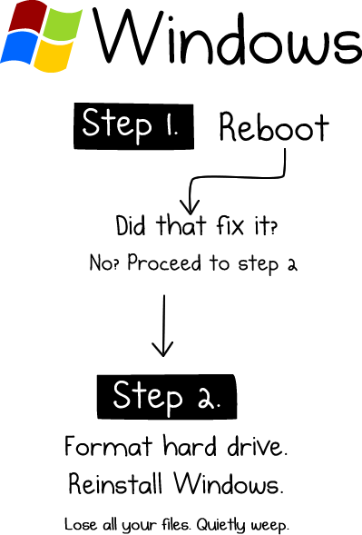

Slide 90
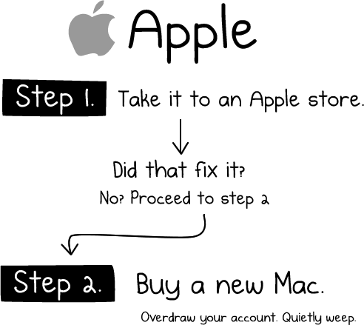

Slide 91
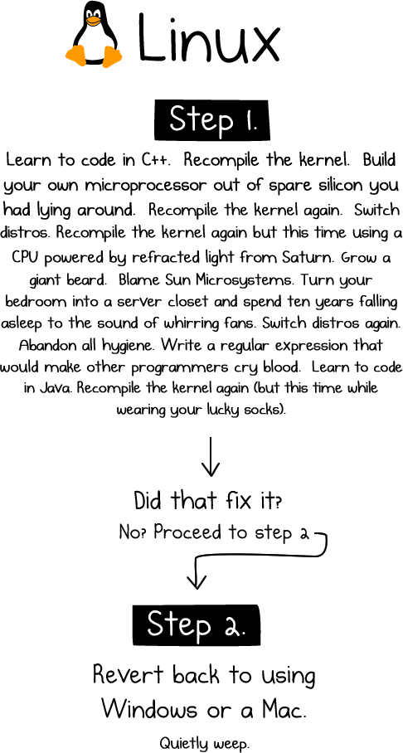

Slide 92
Fin
Thanks for listening. Hope you learned something!

Slide 93
Questions?
Ask away!

