Slide 1

git
an introduction & explanation by
Nikit “Nefari0uss” Malkan

Slide 2
disclaimer

Slide 3
disclaimer
this presentation is very long

Slide 4
disclaimer
this presentation is very long
essentially condensed a book into one presentation

Slide 5
disclaimer
this presentation is very long
essentially condensed a book into one presentation
git can be very confusing

Slide 6
disclaimer
this presentation is very long
essentially condensed a book into one presentation
git can be very confusing
ask questions

Slide 7
Table of Contents
Installing Git
What is it?
Source control analogy
Why use source control?
Specifically Git?
Terminal vs GUI interface
Git internals
Set up Git, GitHub, BitBucket
Add ssh keys, make repos
Put your knowledge to work!
Mix with Commands
Demonstration w/audience

Slide 8
installing git

Slide 9
installing git
https://git-scm.com/book/en/v2/Getting-Started-Installing-Git
Windows/Mac: run installer
Linux: use your package manager

Slide 10
installing git
use git from Windows Command Prompt
commit Windows style, commit Unix-style

Slide 11
what is a git

Slide 12
what is a git
git: [informal] [British] an unpleasant or contemptible person.

Slide 13
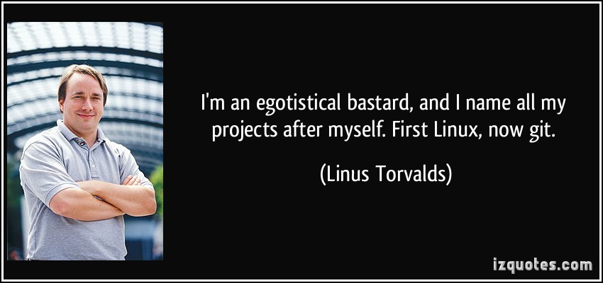
what is a git
git: [informal] [British] an unpleasant or contemptible person.

Slide 14
what is git
git: A distributed revision control system with…support for distributed, non-linear workflows. [Wikipedia – Git (software)]

Slide 15
what is git
…

Slide 16
what is git
…
Try this: a version control system that allows a user to store, update, and maintain files and projects.

Slide 17
why use version control
let’s talk workflow

Slide 18
let’s talk workflow
imagine writing an essay

Slide 19
let’s talk workflow
imagine writing an essay
what’s the process like

Slide 20
the writing process

Slide 21
the writing process
write the whole thing at once

Slide 22
the writing process
write the whole thing at once
CLG are NALCS champs. TSM is trash.

Slide 23
the writing process
write the whole thing at once
unlikely

Slide 24
the writing process
write the whole thing at once
unlikely
write bits and pieces in multiple settings

Slide 25
the writing process
write
CLG are NALCS champs.

Slide 26
the writing process
write → save
CLG are NALCS champs.

Slide 27
the writing process
write → save → s5secretsgg.docx
CLG are NALCS champs.

Slide 28
the writing process
write → save → s5secretsgg.docx
procrastinate
CLG are NALCS champs.

Slide 29
the writing process
write → save → write
CLG are NALCS champs. TSM is trash.

Slide 30
the writing process
write → save → write → save
CLG are NALCS champs. TSM is trash.

Slide 31
the writing process
write → save → write → save → s5secretsgg.docx
CLG are NALCS champs. TSM is trash.

Slide 32
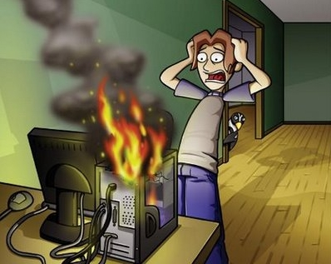
the writing process
write → save → write → save → s5secretsgg.docx

Slide 33
the writing process
write → save → write → save → s5secretsgg.docx
rip progress
CLG are NALCS champs. TSM is trash.

Slide 34
the writing process (trial 2)
write → save → s5secretsgg.docx
CLG are NALCS champs. TSM is trash.

Slide 35
the writing process (trial 2)
write → save → s5secretsgg.docx
save backup → s5secretsgg_backup.docx
CLG are NALCS champs. TSM is trash.

Slide 36
the writing process (trial 2)
write → save → s5secretsgg.docx
save backup
s5secretsgg.docx s5secretsgg_backup.docx
CLG are NALCS champs. TSM is trash. CLG are NALCS champs. TSM is trash.

Slide 37
the writing process (trial 2)
s5secretsgg.docx s5secretsgg_backup.docx
CLG are NALCS champs. TSM is trash. CLG are NALCS champs. TSM is trash.

Slide 38
the writing process (trial 2)
s5secretsgg.docx s5secretsgg_backup.docx
CLG are NALCS champs. TSM is trash. CLG are NALCS champs. TSM is trash.
what if we mess up our active copy

Slide 39
the writing process (trial 2)
s5secretsgg.docx s5secretsgg_backup.docx
TSM are NALCS champs. No thread is safe. CLG are NALCS champs. TSM is trash.
what if we mess up our active copy

Slide 40
the writing process (trial 2)
s5secretsgg.docx s5secretsgg_backup.docx
TSM are NALCS champs. No thread is safe. CLG are NALCS champs. TSM is trash.
what if we mess up our active copy
restore from backup

Slide 41
the writing process (trial 2)
s5secretsgg.docx s5secretsgg_backup.docx
TSM are NALCS champs. No thread is safe. CLG are NALCS champs. TSM is trash.
what if we mess up our active copy
restore from backup

Slide 42
the writing process (trial 2)
s5secretsgg.docx s5secretsgg_backup.docx
CLG are NALCS champs. TSM is trash. CLG are NALCS champs. TSM is trash.
what if we mess up our active copy
restore from backup

Slide 43

the writing process (trial 2)
s5secretsgg.docx s5secretsgg_backup.docx
CLG are NALCS champs. TSM is trash. CLG are NALCS champs. TSM is trash.

Slide 44
the writing process (trial 2)
s5secretsgg.docx s5secretsgg_backup.docx
what if we mess up active copy and overwrite the backup

Slide 45
the writing process (trial 2)
s5secretsgg.docx → save → s5secretsgg_backup.docx
TSM are NALCS champs. No thread is safe. → TSM are NALCS champs. No thread is safe.

Slide 46
the writing process (trial 2)
s5secretsgg.docx s5secretsgg_backup.docx
uh-oh

Slide 47
the writing process (trial 2)
s5secretsgg.docx s5secretsgg_backup.docx
uh-oh
we overwrote our backup with the mess up

Slide 48
the writing process (trial 3)
write → save → s5secretsgg.docx
CLG are NALCS champs. TSM is trash.

Slide 49
the writing process (trial 3)
write → save → s5secretsgg.docx
make iterative backups
CLG are NALCS champs. TSM is trash.

Slide 50
the writing process (trial 3)
s5secretsgg

Slide 51
the writing process (trial 3)
s5secretsgg s5secretsgg_2015-09-01

Slide 52
the writing process (trial 3)
s5secretsgg s5secretsgg_2015-09-01 s5secretsgg_2015-09-10

Slide 53
the writing process (trial 3)
s5secretsgg s5secretsgg_2015-09-01 s5secretsgg_2015-09-10
s5secretsgg_2015-09-19

Slide 54
the writing process (trial 3)
s5secretsgg s5secretsgg_2015-09-01 s5secretsgg_2015-09-10
s5secretsgg_2015-09-19 s5secretsgg_2015-09-28

Slide 55
the writing process (trial 3)
s5secretsgg s5secretsgg_2015-09-01 s5secretsgg_2015-09-10
s5secretsgg_2015-09-19 s5secretsgg_2015-09-28
this gets messy very quickly

Slide 56
the writing process (trial 3)
s5secretsgg s5secretsgg_2015-09-01 s5secretsgg_2015-09-10
s5secretsgg_2015-09-19 s5secretsgg_2015-09-28
this gets messy very quickly
however, this system allows us to restore from any given point

Slide 57
new problem

Slide 58
new problem
which backup has the info we need

Slide 59
new problem
which backup has the info we need
s5secretsgg s5secretsgg_2015-09-01 s5secretsgg_2015-09-10
s5secretsgg_2015-09-19 s5secretsgg_2015-09-28

Slide 60
ponder that question for a bit…
let’s shift gears for a minute…

Slide 61
ponder that question for a bit…
let’s shift gears for a minute…
let’s talk git

Slide 62
why use git

Slide 63
why use git
you have all these iterative backups

Slide 64
why use git
you have all these iterative backups
how do you manage them all

Slide 65
why use git
git pros
git cons

Slide 66
git pro
helps you manage version control

Slide 67
git pro
helps you manage version control
distributed (explained later)

Slide 68
git pro
helps you manage version control
distributed (explained later)
fast

Slide 69
git pro
helps you manage version control
distributed (explained later)
fast
used nearly everywhere in software world

Slide 70
git pro
helps you manage version control
distributed (explained later)
fast
used nearly everywhere in software world
can be used to non-software projects (like this)

Slide 71
git pro
helps you manage version control
distributed (explained later)
fast
used nearly everywhere in software world
can be used to non-software projects (like this)
it’s not SVN

Slide 72
git pro
helps you manage version control
distributed (explained later)
fast
used nearly everywhere in software world
can be used to non-software projects (like this)
it’s not SVN (centralized)
(the fact that my opinion happens to be the right opinion is a happy coincidence)

Slide 73
git con
considered very hard to learn

Slide 74
git con
considered very hard to learn
lots of weird syntax

Slide 75
git con
considered very hard to learn
lots of weird syntax
understanding git internals helps remedy this tremendously

Slide 76
terminal vs GUI

Slide 77
terminal vs GUI
terminal way is best way

Slide 78
terminal vs GUI
terminal way is best way
but nefari0uss – that gui application looks so nice and pretty

Slide 79
terminal vs GUI
terminal way is best way
but nefari0uss – that gui application looks so nice and pretty
and that terminal looks scary and hard

Slide 80
terminal vs GUI
terminal way is best way
but nefari0uss – that gui application looks so nice and pretty
and that terminal looks scary and hard
I don’t care

Slide 81
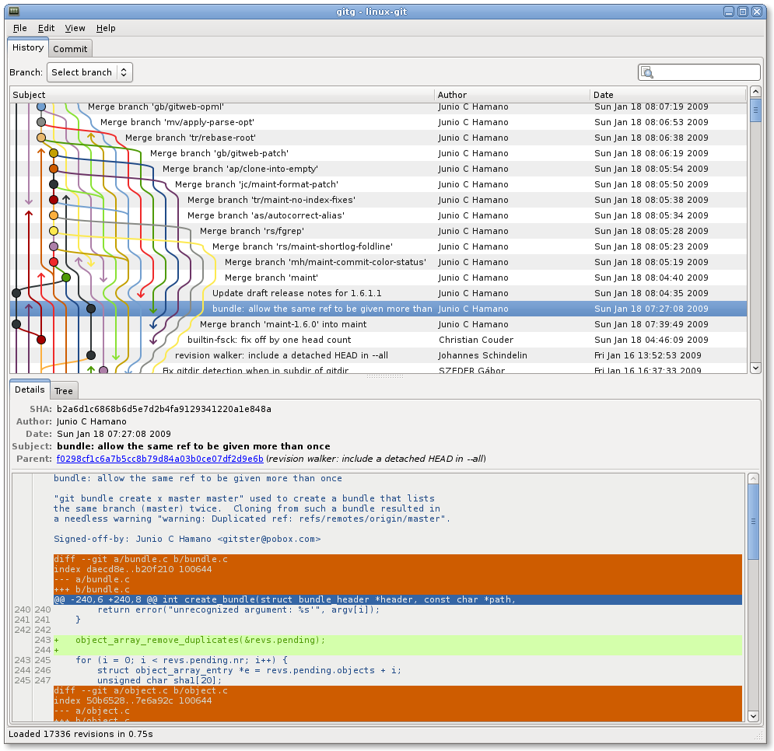

Slide 82
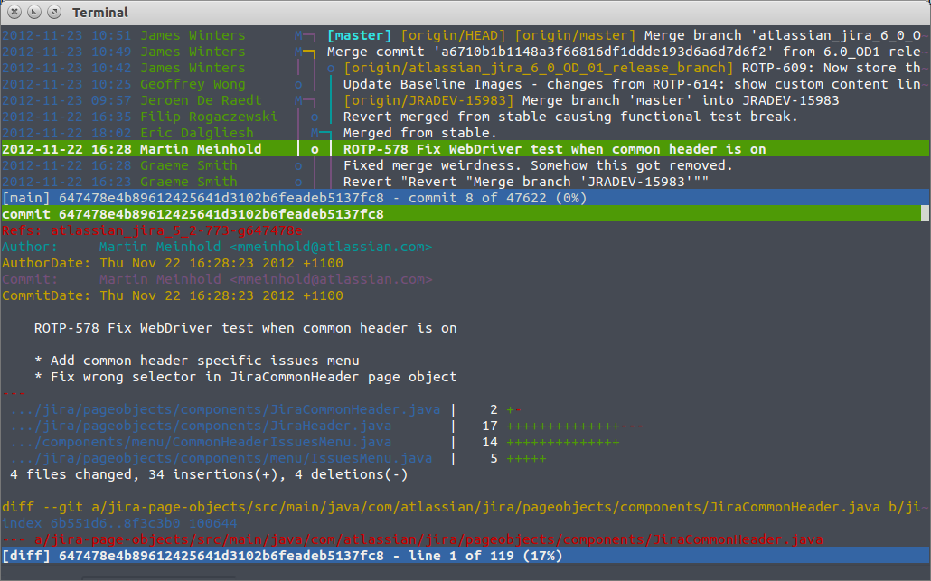

Slide 83
terminal vs GUI
gui applications hide what’s happening

Slide 84
terminal vs GUI
gui applications hide what’s happening
terminal way forces you to learn what’s happening

Slide 85
terminal vs GUI
gui applications hide what’s happening
terminal way forces you to learn what’s happening
Murphy’s law will happen

Slide 86
terminal vs GUI
gui applications hide what’s happening
terminal way forces you to learn what’s happening
Murphy’s law will happen
your code base will become borked

Slide 87
terminal vs GUI
gui applications hide what’s happening
terminal way forces you to learn what’s happening
Murphy’s law will happen
your code base will become borked
knowing how git works will help you fix it

Slide 88
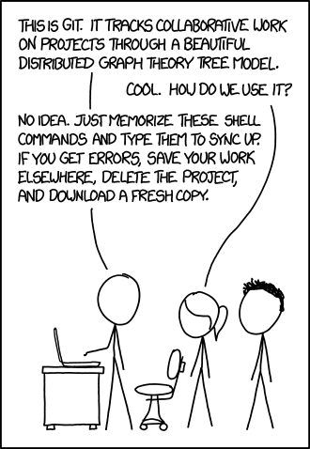
https://xkcd.com/1597/

Slide 89
terminal vs GUI
gui may not always be available

Slide 90
terminal vs GUI
gui may not always be available
terminal will

Slide 91
terminal vs GUI
gui may not always be available
terminal will
༼ つ ◕_◕ ༽つ terminal way is best way ༼ つ ◕_◕ ༽つ

Slide 92
going back…

Slide 93
going back…
remember this?

Slide 94
new problem
which backup has the info we need
s5secretsgg s5secretsgg_2015-09-01 s5secretsgg_2015-09-10
s5secretsgg_2015-09-19 s5secretsgg_2015-09-28

Slide 95
new problem
which backup has the info we need
answer is to look at the metadata

Slide 96
git internals

Slide 97
git internals
this section is very important to understand

Slide 98
git internals
this section is very important to understand
seriously – pay attention to this section

Slide 99
metadata

Slide 100
metadata
a set of data that describes and gives information about other data

Slide 101
metadata
a set of data that describes and gives information about other data
backups should contain metadata

Slide 102
metadata
who
what
when

Slide 103
metadata
who: author of the change
what:
when:

Slide 104
metadata
who: author of the change
what: what was changed
when:

Slide 105
metadata
who: author of the change
what: what was changed
when: date and time of change

Slide 106
metadata
who: author of the change
what: what was changed
when: date and time of change
where are we going with this

Slide 107
metadata
who: author of the change
what: what was changed
when: date and time of change
where are we going with this
commit: record change to the repository (workspace)

Slide 108
repository

Slide 109
repository
the workspace containing all files of a project

Slide 110
git repository

Slide 111
git repository
git stores information about the project in the repo.

Slide 112
git repository
git stores information about the project in the repo.
commit objects
references to commit objects (heads)

Slide 113
git repository
git stores information about the project in the repo.
commit objects
references to commit objects (heads)
info stored inside project root directory in .git folder

Slide 114
commits

Slide 115
commits
before we talk about commit objects, what’s a commit

Slide 116
commits
before we talk about commit objects, what’s a commit
record change to the repository (workspace)

Slide 117
commits
before we talk about commit objects, what’s a commit
record change to the repository (workspace)
more specifically, it’s a snapshot of the repo

Slide 118
commits
imagine a game

Slide 119
commits
imagine a game
you have multiple options (branches) you can take

Slide 120
commits
imagine a game
you have multiple options (branches) you can take
you save the game every time you have a branch (you make a commit)

Slide 121
commits
imagine a game
you have multiple options (branches) you can take
you save the game every time you have a branch (you make a commit)
every new save (commit) is a record of all the actions you’ve taken

Slide 122
commits
imagine a game
you have multiple options (branches) you can take
you save the game every time you have a branch (you make a commit)
every new save (commit) is a record of all the actions you’ve taken
sometimes you make a bad decision and don’t realize it till later

Slide 123
commits
imagine a game
you have multiple options (branches) you can take
you save the game every time you have a branch (you make a commit)
every new save (commit) is a record of all the actions you’ve taken
sometimes you make a bad decision and don’t realize it till later
you want to see where you made a bad decision

Slide 124
commits
remember metadata

Slide 125
commits
remember metadata
each save lets you know some information about the decision you made

Slide 126
commits
remember metadata
each save lets you know some information about the decision you made
you can go back to a commit and start from there

Slide 127
commits
remember metadata
each save lets you know some information about the decision you made
you can go back to a commit and start from there
later on: you can take all the good save results and remove the bad (merging/rebasing/cherry picking)

Slide 128
commit objects

Slide 129
commit objects
keep in mind the game save analogy

Slide 130
commit objects
3 things

Slide 131
commit objects
3 things
the files in the repo (character data)

Slide 132
commit objects
3 things
the files in the repo (character data)
parent commits (previous save files)

Slide 133
commit objects
3 things
the files in the repo (character data)
parent commits (previous save files)
SHA-1 hash (unique identifier)

Slide 134
hashing

Slide 135
hashing
a quick explanation

Slide 136
hashing
mapping data of arbitrary size to data of fixed size

Slide 137
hashing
mapping data of arbitrary size to data of fixed size
without going too much into it…

Slide 138
hashing
mapping data of arbitrary size to data of fixed size
without going too much into it…
data → hash function → data mapped to a value (hash)

Slide 139
hashing
mapping data of arbitrary size to data of fixed size
without going too much into it…
data → hash function → data mapped to a value (hash)
example hash function: hash = sum(string.length / 7)

Slide 140
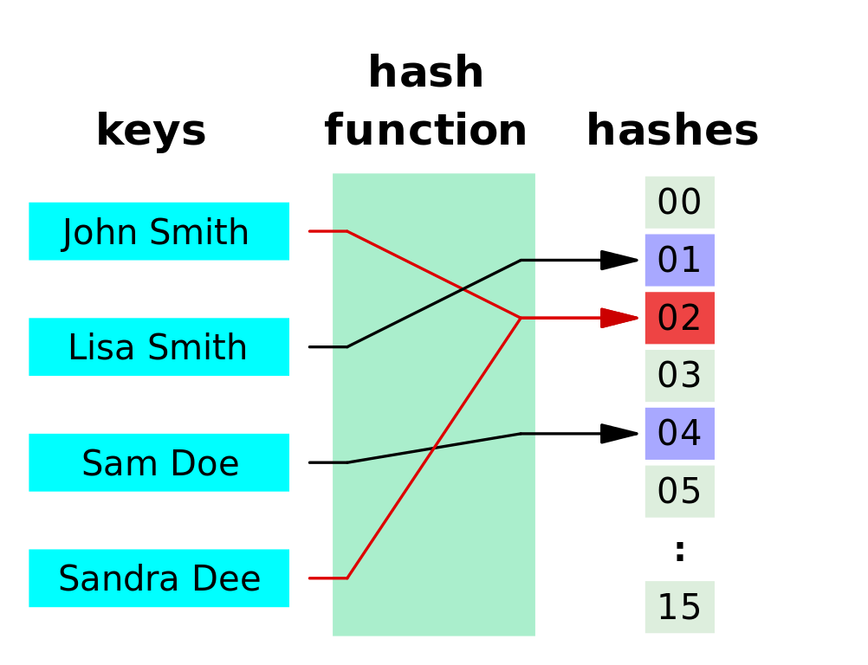

Slide 141
hashing
notice how we have two red lines going to the same thing

Slide 142
hashing
notice how we have two red lines going to the same thing
this is called a collision

Slide 143
hashing
notice how we have two red lines going to the same thing
this is called a collision
in security collision is bad

Slide 144
hashing
notice how we have two red lines going to the same thing
this is called a collision
in security collision is bad
imagine if your security key is shares the same hash as someone else’s

Slide 145
cryptographic hashing

Slide 146
cryptographic hashing
cryptographic hashing allows you to verify input to a known hash value

Slide 147
cryptographic hashing
cryptographic hashing allows you to verify input to a known hash value
very difficult to guess/reconstruct without input data

Slide 148
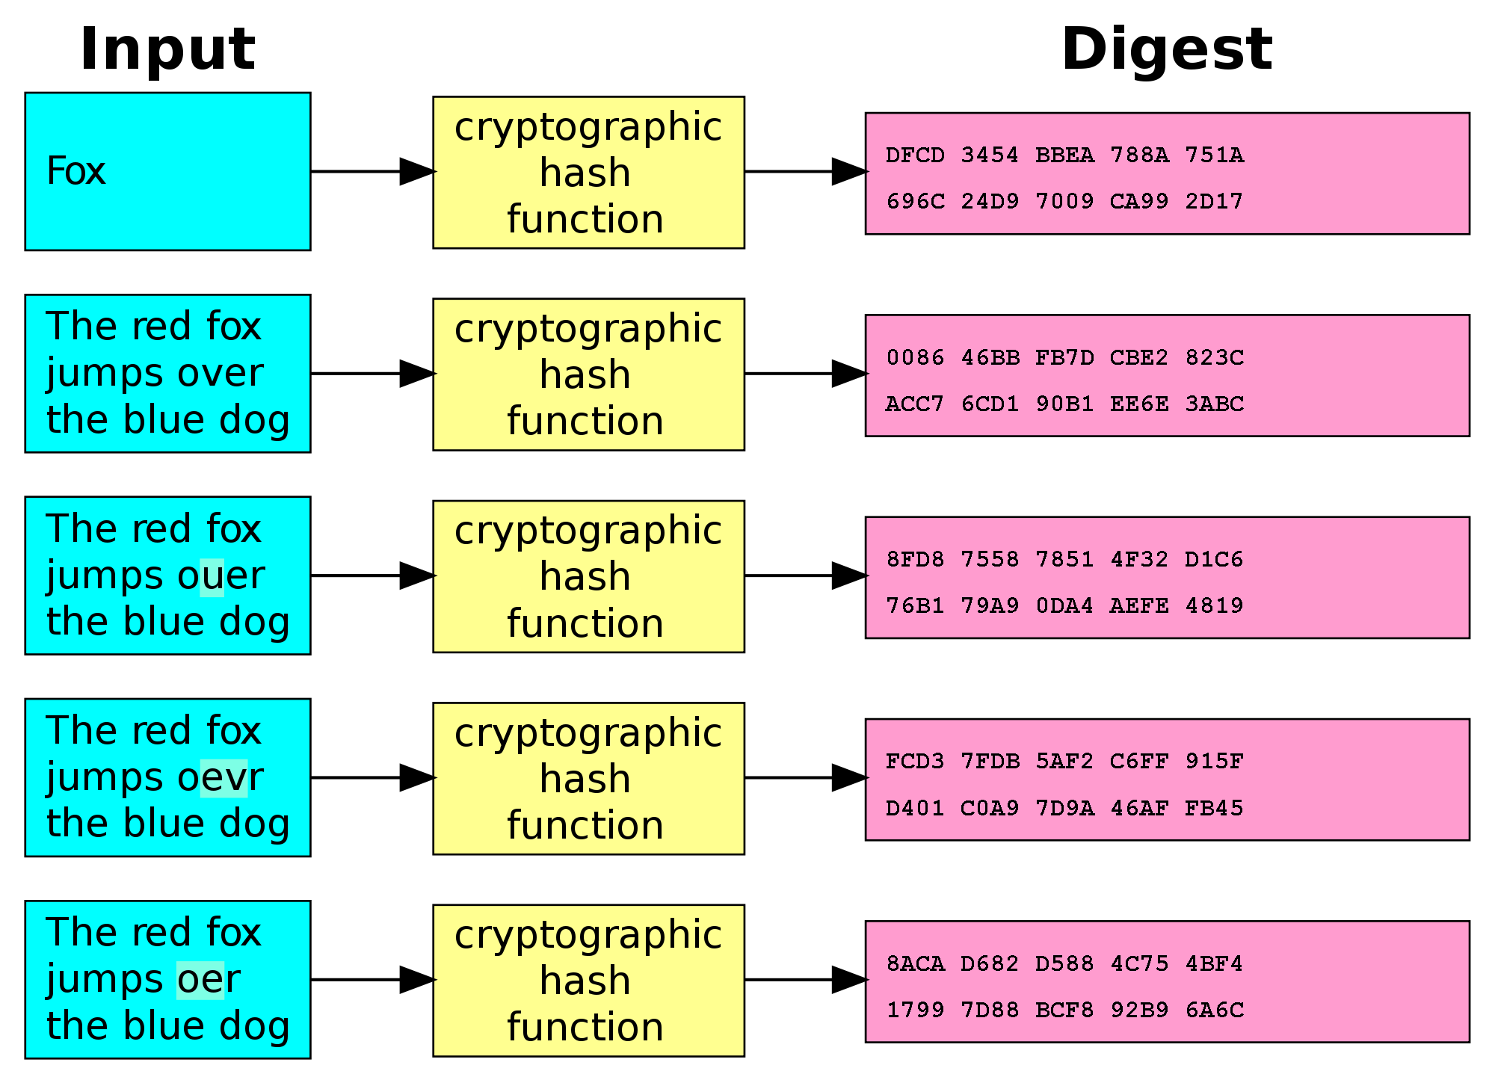

Slide 149
SHA-1

Slide 150
SHA-1
type of cryptographic hashing

Slide 151
SHA-1
type of cryptographic hashing
has two uses in git

Slide 152
SHA-1
type of cryptographic hashing
has two uses in git
verify that two files are the same

Slide 153
SHA-1
type of cryptographic hashing
has two uses in git
verify that two files are the same
verify that a file hasn’t been altered

Slide 154
SHA-1
type of cryptographic hashing
has two uses in git
verify that two files are the same
verify that a file hasn’t been altered
40-character string

Slide 155
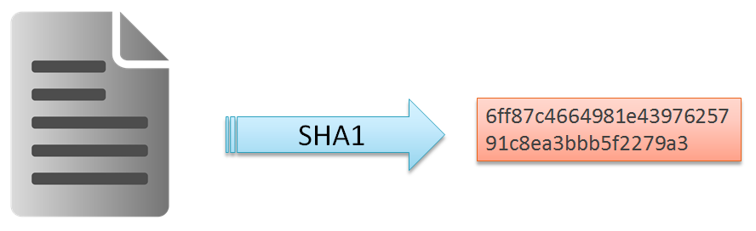
SHA-1
type of cryptographic hashing
has two uses in git
verify that two files are the same
verify that a file hasn’t been altered
40-character string

Slide 156
pointers

Slide 157
pointers
a value that references a memory location

Slide 158
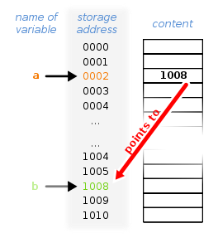
pointers
a value that references a memory location

Slide 159
heads

Slide 160
heads
pointer to a commit object

Slide 161
heads
pointer to a commit object
each head has a name

Slide 162
heads
pointer to a commit object
each head has a name
each branch has a head

Slide 163
heads
pointer to a commit object
each head has a name
each branch has a head
current head is aliased as HEAD (always in caps)

Slide 164
heads
think of heads as a name of the save file

Slide 165
heads
think of heads as a name of the save file
it links you to the backup (commit)

Slide 166
tags

Slide 167
tags
essentially a special name given to a commit

Slide 168
tags
essentially a special name given to a commit
generally used to mark a special release/edition/milestone

Slide 169
tags
essentially a special name given to a commit
generally used to mark a special release/edition/milestone
ex. v1.0

Slide 170
branching

Slide 171
branching
this part can get confusing so please ask questions

Slide 172
branching
this part can get confusing so please ask questions
where are going with this?

Slide 173
branching
this part can get confusing so please ask questions
where are going with this?
collaboration

Slide 174
branching
think back to commits and saving when faced with options

Slide 175
branching
think back to commits and saving when faced with options
imagine if you wanted to take option a but a friend wanted to take option b

Slide 176
branching
think back to commits and saving when faced with options
imagine if you wanted to take option a but a friend wanted to take option b
example:
you want to help an NPC for a potential reward

Slide 177
branching
think back to commits and saving when faced with options
imagine if you wanted to take option a but a friend wanted to take option b
example:
you want to help an NPC for a potential reward
friend wants to kill the NPC because you can loot the body

Slide 178
branching
you make a save and both do different things

Slide 179
branching
you make a save and both do different things
(commit your work and then make a new branch)

Slide 180
branching
so let’s call the original story line “origin”

Slide 181
branching
so let’s call the original story line “origin”
now let’s assume that you’re the one who is in charge, you make the official decision

Slide 182
branching
so let’s call the original story line “origin”
now let’s assume that you’re the one who is in charge, you make the official decision
let’s call this branch of the story line “master”

Slide 183
branching
so let’s call the original story line “origin”
now let’s assume that you’re the one who is in charge, you make the official decision
let’s call this branch of the story line “master”
your friend’s story line (branch) is now called “dev”

Slide 184
branching
so let’s call the original story line “origin”
now let’s assume that you’re the one who is in charge, you make the official decision
let’s call this branch of the story line “master”
your friend’s story line (branch) is now called “dev”
with me so far?
let’s diagram this

Slide 185
branching

Slide 186
branching
origin

Slide 187
branching
origin
time

Slide 188
branching
origin
time
(A)
you two both agree on choice a

Slide 189
branching
origin
time
master
(A)
right now there is no “dev”, only master

Slide 190
branching
origin
time
HEAD
master
(A)
HEAD points to the latest save

Slide 191
branching
origin
time
HEAD
master
(A)
you two both agree on choice a

Slide 192
branching
origin
time
HEAD
master
(A)
(B)
you two both disagree on choice b
you make a save

Slide 193
branching
origin
time
HEAD
master
(A)
(B)
(C)
dev
you play and make choice c

Slide 194
branching
origin
time
master
(A)
(B)
(C)
(D)
dev
your friend plays and makes
choice d
HEAD

Slide 195
merging branches

Slide 196
merging branches
you want to combine the two story lines but how

Slide 197
merging branches
you want to combine the two story lines but how
both of you made two disjoint decisions

Slide 198
merging branches
you want to combine the two story lines but how
both of you made two disjoint decisions
both decisions have effects on the game that are radically different

Slide 199
merging branches
you want to combine the two story lines but how
both of you made two disjoint decisions
both decisions have effects on the game that are radically different
if you were to merge the two story lines (branches) you’d have merge conflicts

Slide 200
merging branches
goal: so you want to remove these conflicts

Slide 201
merging branches
goal: so you want to remove these conflicts
you want all the good parts of both decisions kept

Slide 202
merging branches
goal: so you want to remove these conflicts
you want all the good parts of both decisions kept
you want all the bad parts of both decisions removed

Slide 203
merging branches
imagine taking the story and doing just that

Slide 204
merging branches
imagine taking the story and doing just that
you keep what you want and remove what you don’t want

Slide 205
merging branches
imagine taking the story and doing just that
you keep what you want and remove what you don’t want
you also make some modifications as necessary to cover plot holes

Slide 206
merging branches
let’s relate this back to code

Slide 207
merging branches
let’s relate this back to code
let’s say you worked on a file

Slide 208
merging branches
let’s relate this back to code
let’s say you worked on a file
your friend worked on the same file

Slide 209
merging branches
you combine the file

Slide 210
merging branches
you combine the file
pick the parts changed that work

Slide 211
merging branches
you combine the file
pick the parts changed that work
remove the conflicting parts

Slide 212
merging branches
you combine the file
pick the parts changed that work
remove the conflicting parts
make some modifications to make it cleaner/work together (refactoring, et cetera)

Slide 213
merging branches
you combine the file
pick the parts changed that work
remove the conflicting parts
make some modifications to make it cleaner/work together (refactoring, et cetera)
let’s diagram this

Slide 214
branching
origin
time
master
(A)
(B)
(C)
(D)
dev
this is where we left off
HEAD

Slide 215
branching
origin
time
master
(A)
(B)
(C)
(E)
(D)
dev
HEAD
you perform the merge
but E has conflicts

Slide 216
branching
origin
time
HEAD
master
(A)
(B)
(C)
(E)
(D)
dev
post-merge
no conflicts

Slide 217
distributed vs centralized

Slide 218
distributed vs centralized
centralized work flow vs distributed work flow

Slide 219
distributed vs centralized
centralized work flow vs distributed work flow
centralized: all work is done locally and synchronized on a server

Slide 220
distributed vs centralized
centralized work flow vs distributed work flow
centralized: all work is done locally and synchronized on a server
distributed: everyone working on the project has a copy of the project and makes changes locally.

Slide 221
distributed vs centralized
centralized work flow vs distributed work flow
centralized: all work is done locally and synchronized on a server
distributed: everyone working on the project has a copy of the project and makes changes locally.
let’s diagram differences

Slide 222
centralized
time
friend local
main server
my local
imagine working on a project

Slide 223
centralized
time
friend local
main server
(A)
my local
this is what start with
(main server ~ cloud storage)

Slide 224
centralized
time
friend local
main server
(A)
my local
(A)
you get a local copy

Slide 225
centralized
time
friend local
main server
(A)
my local
(A)
(B)
you make local changes

Slide 226
centralized
time
friend local
main server
(A)
(B)
my local
(A)
(B)
you upload it to the server

Slide 227
centralized
time
friend local
(B)
main server
(A)
(B)
my local
(A)
(B)
friend downloads it locally

Slide 228
centralized
time
friend local
(B)
(C)
main server
(A)
(B)
my local
(A)
(B)
friend makes changes

Slide 229
centralized
time
friend local
(B)
(C)
main server
(A)
(B)
(C)
my local
(A)
(B)
friend uploads to server

Slide 230
centralized
time
friend local
(B)
(C)
main server
(A)
(B)
(C)
my local
(A)
(B)
what if you both want to make changes

Slide 231
centralized
time
friend local
(B)
(C)
main server
(A)
(B)
(C)
my local
(A)
(B)
(C)
you download C

Slide 232
centralized
time
friend local
(B)
(C)
main server
(A)
(B)
(C)
my local
(A)
(B)
(C)
(D)
keep working on D

Slide 233
centralized
time
friend local
(B)
(C)
(I)
main server
(A)
(B)
(C)
my local
(A)
(B)
(C)
(D)
your friend works on I

Slide 234
centralized
time
friend local
(B)
(C)
(I)
main server
(A)
(B)
(C)
(D)
my local
(A)
(B)
(C)
(D)
you push your code to the server

Slide 235
centralized
time
friend local
(B)
(C)
(I)
main server
(A)
(B)
(C)
(D)
my local
(A)
(B)
(C)
(D)
conflict – the bases are not the same
(common base is C)

Slide 236
centralized
time
friend local
(B)
(C)
(I)
main server
(A)
(B)
(C)
(D)
my local
(A)
(B)
(C)
(D)
(E)
meanwhile, you have code to push

Slide 237
centralized
time
friend local
(B)
(C)
(I)
(J)
main server
(A)
(B)
(C)
(D)
(J)
my local
(A)
(B)
(C)
(D)
(E)
conflict fixed

Slide 238
centralized
time
friend local
(B)
(C)
(I)
(J)
main server
(A)
(B)
(C)
(D)
(J)
my local
(A)
(B)
(C)
(D)
(E)
conflict fixed
but now your code is out of sync

Slide 239
centralized
time
friend local
(B)
(C)
(I)
(J)
main server
(A)
(B)
(C)
(D)
(J)
my local
(A)
(B)
(C)
(D)
(E)
now you have to merge

Slide 240
centralized
time
friend local
(B)
(C)
(I)
(J)
main server
(A)
(B)
(C)
(D)
(J)
(K)
my local
(A)
(B)
(C)
(D)
(E)
(K)
you merge

Slide 241
centralized
time
friend local
(B)
(C)
(I)
(J)
(L)
main server
(A)
(B)
(C)
(D)
(J)
(K)
my local
(A)
(B)
(C)
(D)
(E)
(K)
meanwhile…

Slide 242
centralized
time
friend local
(B)
(C)
(I)
(J)
(L)
main server
(A)
(B)
(C)
(D)
(J)
(K)
my local
(A)
(B)
(C)
(D)
(E)
(K)
meanwhile…
the process continues

Slide 243
centralized
can you see why this might be a problem

Slide 244
centralized
can you see why this might be a problem
you need network access

Slide 245
centralized
can you see why this might be a problem
you need network access
it’s also very easy for your code base to be out of sync

Slide 246
centralized
can you see why this might be a problem
you need network access
it’s also very easy for your code base to be out of sync
what if we could always have an updated copy of the codebase

Slide 247
distributed
what if we could always have an updated copy of the codebase

Slide 248
distributed
what if we could always have an updated copy of the codebase
you store this locally and can fix all conflicts locally

Slide 249
distributed
what if we could always have an updated copy of the codebase
you store this locally and can fix all conflicts locally
let’s diagram this

Slide 250
distributed
time
origin
let “origin” be the name of the main repository

Slide 251
distributed
time
origin-master
let “origin” be the name of the main repository
the branch name is “master”

Slide 252
distributed
time
origin-master
let “origin” be the name of the main repository
the branch name is “master”
this is handled by the administrator

Slide 253
distributed
time
origin-master
note: origin and master are conventions

Slide 254
distributed
time
origin-master
note: origin and master are conventions
they do not have to be strictly followed

Slide 255
distributed
time
origin-master
note: origin and master are conventions
they do not have to be strictly followed
you can call them whatever you want

Slide 256
distributed
time
origin-master
note: origin and master are conventions
they do not have to be strictly followed
you can call them whatever you want
best practice dictates that you use origin-master

Slide 257
distributed
time
origin-master
let “nefari0uss” be the name of the my repository
nefari0uss

Slide 258
distributed
time
origin-master
let “nefari0uss” be the name of the my repository
the branch name is “master”
nefari0uss-master

Slide 259
distributed
time
origin-master
let “nefari0uss” be the name of the my repository
the branch name is “master”
this is handled by me
nefari0uss-master

Slide 260
distributed
time
friend
origin-master
let “friend” be the name of the my repository
nefari0uss-master

Slide 261
distributed
time
friend-master
origin-master
let “friend” be the name of the my repository
the branch name is “master”
nefari0uss-master

Slide 262
distributed
time
friend-master
origin-master
(A)
nefari0uss-master
this is the initial code base

Slide 263
distributed
time
friend-master
origin-master
(A)
nefari0uss-master
(G)
you download the entire project locally

Slide 264
distributed
time
friend-master
(R)
origin-master
(A)
nefari0uss-master
(G)
as does your friend

Slide 265
distributed
time
friend-master
(Q)
origin-master
(A)
nefari0uss-master
(G)
(H)
you do some work

Slide 266
distributed
time
friend-master
(Q)
(R)
origin-master
(A)
nefari0uss-master
(G)
(H)
so does your friend

Slide 267
distributed
time
bugfix
(S)
friend-bugfix
(Q)
(R)
origin-master
(A)
nefari0uss-master
(G)
(H)
your friend opens a new branch called bugfix

Slide 268
distributed
time
bugfix
(S)
friend-master
(Q)
(R)
master
(T)
origin-master
(A)
nefari0uss-master
(G)
(H)
and continues development on master

Slide 269
distributed
time
bugfix
(S)
friend-master
(Q)
(R)
(U)
master
(T)
origin-master
(A)
nefari0uss-master
(G)
(H)
bug fix done
merge with master
bug fix branch closed

Slide 270
distributed
time
bugfix
(S)
friend-master
(Q)
(R)
(U)
master
(T)
origin-master
(A)
nefari0uss-master
(G)
(H)
(I)
you were waiting on the bug fix

Slide 271
distributed
time
bugfix
(S)
friend-master
(Q)
(R)
(U)
master
(T)
origin-master
(A)
nefari0uss-master
(G)
(H)
(I)
you pull friend’s code

Slide 272
centralized
time
(S)
friend local
(“nef-friend”)
(Q)
(R)
(U)
(V)
(X)
(Z)
(T)
(Y)
main repo
(“origin”)
(A)
(B)
(C)
(D)
(L)
my local
(“nefari0uss”)
(G)
(H)
(I)
(J)
(K)
(O)
(P)
(N)
meanwhile…

Slide 273
putting things together

Slide 274
putting things together
will heavily reference game analogy for this

Slide 275
putting things together
repository – the game

Slide 276
putting things together
repository – the game
commit – the game save

Slide 277
putting things together
repository – the game
commit – the game save
metadata – info about the game save

Slide 278
putting things together
repository – the game
commit – the game save
metadata – info about the game save
SHA1 – the internal identifier of the game save

Slide 279
putting things together
repository – the game
commit – the game save
metadata – info about the game save
SHA1 – the internal identifier of the game save
head – the game save name (save 01, save 02, et cetera)

Slide 280
putting things together
repository – the game
commit – the game save
metadata – info about the game save
SHA1 – the internal identifier of the game save
head – the game save name (save 01, save 02, et cetera)
tags – different parts/chapters of the game (part 1, part 2, et cetera)

Slide 281
putting things together
repository – the game
commit – the game save
metadata – info about the game save
SHA1 – the internal identifier of the game save
head – the game save name (save 01, save 02, et cetera)
tags – different parts/chapters of the game (part 1, part 2, et cetera)
branch – an option taken by someone

Slide 282
putting things together
repository – the game
commit – the game save
metadata – info about the game save
SHA1 – the internal identifier of the game save
head – the game save name (save 01, save 02, et cetera)
tags – different parts/chapters of the game (part 1, part 2, et cetera)
branch – an option taken by someone
merging – combining the options taken

Slide 283
one more thing
almost done with internals so stick with me

Slide 284
three states of being

Slide 285
three states of being
working directory
staging area
repository (.git directory)

Slide 286
three states of being
working directory: modify files locally
staging area
repository (.git directory)

Slide 287
three states of being
working directory: modify files locally
staging area: add snapshots/saves to commit
repository (.git directory)

Slide 288
three states of being
working directory: modify files locally
staging area: add snapshots/saves to commit
repository (.git directory): push commit to repository

Slide 289
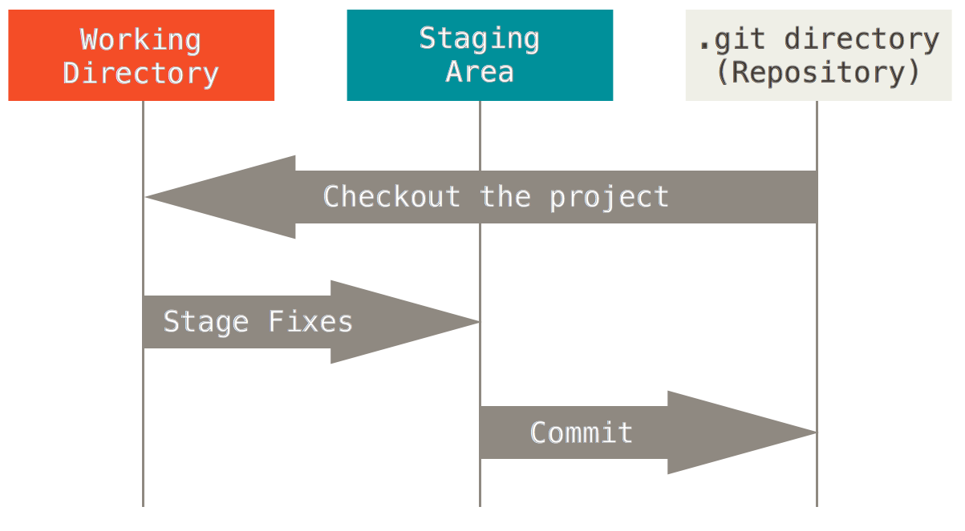

Slide 290
/git-internals

Slide 291
/git-internals
sorry that was so long

Slide 292
/git-internals
sorry that was so long
I wouldn’t have spent that long if it wasn’t so important

Slide 293
/git-internals
sorry that was so long
I wouldn’t have spent that long if it wasn’t so important
now on to the for the setup

Slide 294
quick setup
set up git config
set up ssh keys

Slide 295
git config

Slide 296
git config
https://git-scm.com/book/en/v2/Getting-Started-First-Time-Git-Setup

Slide 297
git config
https://git-scm.com/book/en/v2/Getting-Started-First-Time-Git-Setup
open bash and type git config

Slide 298
git config
$ git config –global user.name “John Doe”
$ git config –global user.email johndoe@example.com

Slide 299
git config
$ git config –global user.name “John Doe”
$ git config –global user.email johndoe@example.com
--global sets git to always use these settings
run command without --global to override for specific project

Slide 300
git config
$ git config --list
will show all settings

Slide 301
ssh keys

Slide 302
ssh keys
ssh keys are a way to identify your computer to the sever
https://help.github.com/articles/generating-ssh-keys/

Slide 303
ssh keys
$ ls –al ~/.ssh
this will list the files in your .ssh directory
(assuming they exist)

Slide 304
ssh keys
$ ssh-keygen –t rsa –b 4096 –C “your-git-email”
creates a new ssh key using the email as a label

Slide 305
ssh keys
$ [enter password]
passwords are recommended for security
not necessary for our purposes
general good practise

Slide 306
ssh keys
$ eval “$(ssh-agent –s)”
run ssh-agent in background

Slide 307
ssh keys
$ ssh-add ~/.ssh/id_rsa
add ssh key to ssh-agent

Slide 308
ssh keys
$ clip < ~/.ssh/id_rsa.pub
copy key to clipboard

Slide 309
ssh keys
goto Bitbucket/Github

Slide 310
ssh keys
goto Bitbucket/Github
find settings → ssh keys

Slide 311
ssh keys
goto Bitbucket/Github
find settings → ssh keys
add key → paste

Slide 312
GitHub & BitBucket

Slide 313
GitHub & BitBucket
BitBucket: unlimited private repos

Slide 314
GitHub & BitBucket
BitBucket: unlimited private repos
GitHub: unlimited public repos

Slide 315
GitHub & BitBucket
BitBucket: unlimited private repos
GitHub: unlimited public repos
both have edu plans that are worth using

Slide 316
using git

Slide 317
using git
(this is the part where you get to type stuff)

Slide 318
basic commands
init
clone
status, add, rm
push, pull, merge, fetch
branch, remote
log
reset

Slide 319
$ git init
create a new git setup in the current directory
creates .git file

Slide 320
$ git clone [url]
clone a git repo in your working directory
should end in .git

Slide 321
$ git status
shows you the status of files in working directory
run this command a lot

Slide 322
important side note

Slide 323
important side note
I mentioned staging several times…

Slide 324
important side note
I mentioned staging several times…
let me define it properly

Slide 325
four states of being (pre-commit)

Slide 326
four states of being (pre-commit)
untracked
unmodified
modified
staged

Slide 327
four states of being (pre-commit)
untracked: in the working directory, ignored by git
unmodified
modified
staged

Slide 328
four states of being (pre-commit)
untracked: in the working directory, ignored by git
unmodified: unchanged from last commit; tracked by git
modified:
staged

Slide 329
four states of being (pre-commit)
untracked: in the working directory, ignored by git
unmodified: unchanged from last commit; tracked by git
modified: changed since last commit; tracked by git
staged

Slide 330
four states of being (pre-commit)
untracked: in the working directory, ignored by git
unmodified: unchanged from last commit; tracked by git
modified: changed since last commit; tracked by git
staged: added to staging area; ready to be committed

Slide 331
$ git add [filename.ext]
add current version of a file to staging index

Slide 332
$ git add [filename.ext]
add current version of a file to staging index
CAUTION

Slide 333
$ git add [filename.ext]
add current version of a file to staging index
CAUTION
if you modify a file after adding it
the old version is staged, not new!

Slide 334
$ git rm [filename.ext]
remove a file from staging area

Slide 335
$ git rm [filename.ext]
remove a file from staging area
CAUTION

Slide 336
$ git rm [filename.ext]
remove a file from staging area
CAUTION
$ rm FileName != $git rm FileName

Slide 337
$ git rm [filename.ext]
remove a file from staging area
CAUTION
$ rm FileName != $git rm FileName
deleting a file does not tell git to remove it from staging

Slide 338
going back…

Slide 340
let’s narrow the scope
what happens between the red and blue boxes

Slide 341
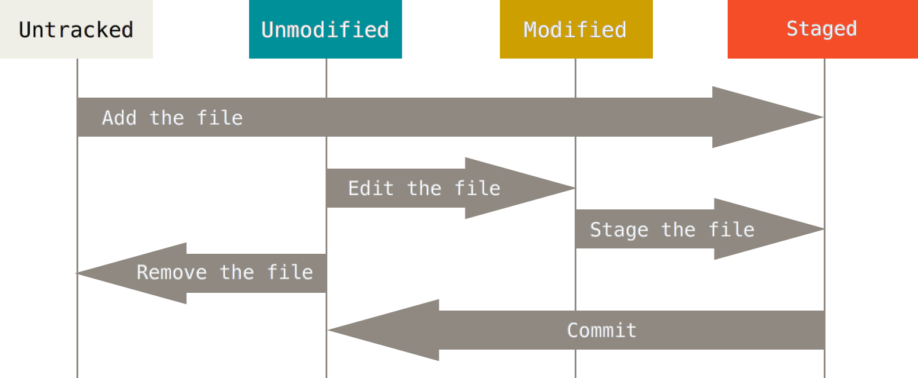

Slide 343
moving forward
what happens between the blue and white boxes

Slide 344
$ git commit
create a commit from staged files

Slide 345
$ git commit
create a commit from staged files
-m (message) will do inline commit

Slide 346
$ git commit
create a commit from staged files
-m will do inline commit
Example: $ git commit –m “this is my commit message”

Slide 347
$ git commit
-amend will let you change the last commit

Slide 348
$ git commit
-amend will let you change the last commit
Example: $ git commit –m –amend “fixed commit message”

Slide 349
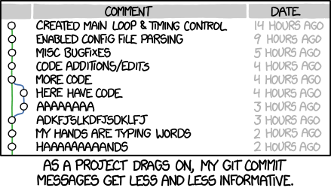
https://xkcd.com/1296/

Slide 350
$ git push [remote] [branch]
push your changes to a remote

Slide 351
$ git push [remote] [branch]
push your changes to a remote
Example: $ git push origin master

Slide 352
$ git pull [remote] [branch]
pull a set of changes from a remote

Slide 353
$ git pull [remote] [branch]
pull a set of changes from a remote
Example: $ git pull origin master

Slide 354
$ git pull [remote] [branch]
pull a set of changes from a remote
Example: $ git pull origin master
is actually the combination of two commands: fetch and merge

Slide 355
$ git fetch
update local information from the remote
Example: $ git fetch origin

Slide 356
$ git merge
create new commit by combining two branches

Slide 357
$ git merge
create new commit by combining two branches
Example: (if current branch is master)
$ git merge dev

Slide 358
how merging works

Slide 359
how merging works
finds most recent common ancestor

Slide 360
how merging works
finds most recent common ancestor
looks at file differences between then and now

Slide 361
how merging works
finds most recent common ancestor
looks at file differences between then and now
applies differences to current branch

Slide 362
merge conflicts
happens when people work on the same file

Slide 363
merge conflicts
happens when people work on the same file
run $ git status

Slide 364
merge conflicts
happens when people work on the same file
run $ git status
edit conflicted file

Slide 365
merge conflicts
happens when people work on the same file
run $ git status
edit conflicted file
<<< === >>> mark conflicts

Slide 366
merge conflicts
happens when people work on the same file
run $ git status
edit conflicted file
<<< === >>> mark conflicts
resolve conflicts and then stage files

Slide 367
$ git branch [arguments]
does different things depending on the arguments
…
welcome to git

Slide 368
$ git branch [arguments]
no arguments: list branches (heads)
$ git branch

Slide 369
$ git branch [arguments]
no arguments: list branches (heads)
$ git branch
one argument: create new branch and switch to it
$ git branch –b dev

Slide 370
$ git branch [arguments]
no arguments: list branches (heads)
$ git branch
one argument: create new branch and switch to it
$ git branch –b dev
-d: delete branch
$ git branch –d dev

Slide 371
$ git branch [arguments]
CAUTION

Slide 372
$ git branch [arguments]
CAUTION
$ git branch –b [branch name]

Slide 373
$ git branch [arguments]
CAUTION
$ git branch –b [branch name]
will create a new branch off your current working directory

Slide 374
$ git branch [arguments]
CAUTION
$ git branch –b [branch name]
will create a new branch off your current working directory
best to stash/checkout all files before branching

Slide 375
$ git remote [arguments]
remote is the url in which you are pushing/pulling to
in $ git push origin/master, “origin” is the remote
let me diagram this

Slide 376
remotes
time
bugfix
(S)
friend-master
(Q)
(R)
(U)
master
(T)
origin-master
(A)
nefari0uss-master
(G)
(H)
(I)
friend, origin, and nefari0uss are all remote names

Slide 377
distributed
time
bugfix
(S)
friend-master
(Q)
(R)
(U)
master
(T)
origin-master
(A)
nefari0uss-master
(G)
(H)
(I)
friend, origin, and nefari0uss are all remote names
master and bugfix are branch names

Slide 378
$ git checkout [arguments]
two uses

Slide 379
$ git checkout [arguments]
two uses
revert modifications to a file $ git checkout [filename.ext]

Slide 380
$ git checkout [arguments]
two uses
revert modifications to a file $ git checkout [filename.ext]
change branches $ git checkout [branch name]

Slide 381
$ git checkout [arguments]
two uses
revert modifications to a file $ git checkout [filename.ext]
change branches $ git checkout [branch name]
working directory must be clean when changing branches

Slide 382
$ git log [arguments]
no arguments: show a log of commits
--graph: display tree

Slide 383
$ git reset [arguments]
reset git state

Slide 384
$ git reset [arguments]
reset git state
-- soft: does not touch index or working tree
file is reverted to uncommitted (but changed) state

Slide 385
$ git reset [arguments]
reset git state
-- soft: does not touch index or working tree
file is reverted to uncommitted (but changed) state
-- hard: resets index and working tree
file is to state of previous commit

Slide 386
intermediate commands
stash
blame

Slide 387
$ git stash
want to save changes but not commit them

Slide 388
$ git stash
want to save changes but not commit them
store on a stack (not really)

Slide 389
$ git stash
want to save changes but not commit them
store on a stack (not really)
(no args): push changes onto stack
list: show items on stash stack
pop [--index]: pop an item off the stack (uses index if provided)

Slide 390
$ git blame [arguments]
show who made the code base become borked

Slide 391
advanced commands
rebase
cherrypick
bisect

Slide 392
$ git rebase [arguments]
merge but create a single tree

Slide 393
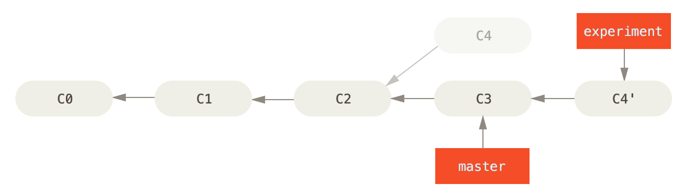

Slide 394
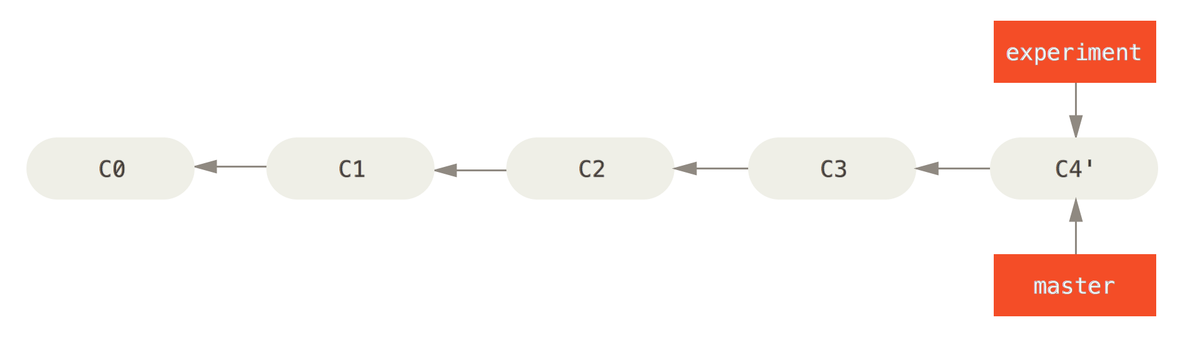

Slide 395
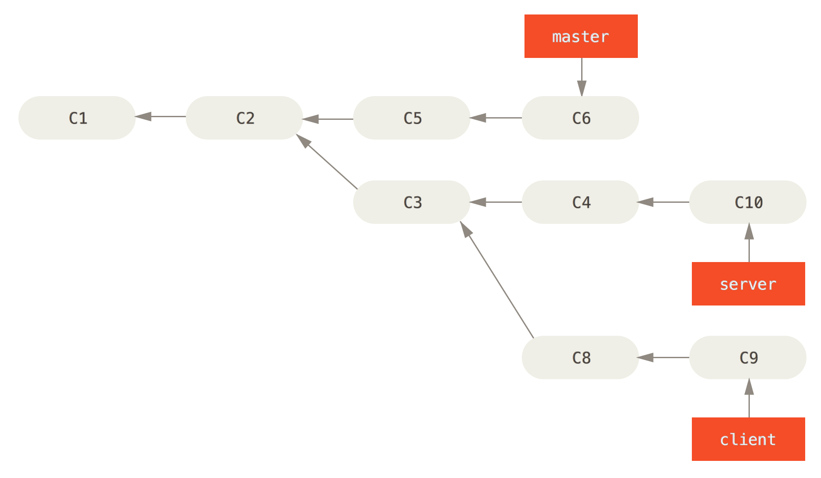

Slide 396
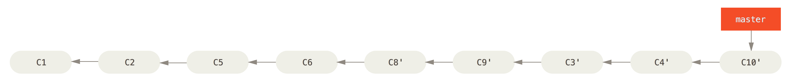

Slide 397
$ git cherrypick
pick the commits you want and merge only those

Slide 398
$ git bisect
like binary search for finding where the last good commit is

Slide 399
$ git bisect
like binary search for finding where the last good commit is

Slide 400
fin
very sorry this was so long

Slide 401
fin
very sorry this was so long
I hope you learned something!

Slide 402
in case of fire
git commit
git push
leave building

Slide 403
Sources
Git-SCM book: https://git-scm.com/book
Daniel “paradigm” Thau from Open Source Club at OSU on Git:
https://opensource.osu.edu/au10/git
git – the simple guide: https://rogerdudler.github.io/git-guide/
Atlassian Git Tutorial: https://www.atlassian.com/git/tutorials/
Understanding Git Conceptually: http://www.sbf5.com/~cduan/technical/git/
Wikiepda – Git (software): https://en.wikipedia.org/wiki/Git_(software)
Git Reference: http://gitref.org/basic/
Lots of pictures from Git-SCM Book, Wikipedia and Google/Bing Image searches

