Slide 1
DATA VISUALIZATION Mid Term Examination Spring 2020
Manoj Kumar Chalamala

Slide 2
What do you like about this slide?
The main thing I like about the slide is the chart clearly shows there is a 16% lower post procedure cost which saves $3422 per patient.
The other thing I like about the slide is white space is leveraged. There are no empty spaces in the visual.
The content is legible and clear.

Slide 3
List of Questions to ask your colleague
What is Y axis referring to in the plot ? This shows scale from 0 to 30 but the chart is showing information in dollars.
What is the MAX value listed in the table ? Why is it not mentioned in the visual
The Visual shows that 89.8 % of patients are clinically successful who uses optimal settings. But it is no where mentioned in the data and the plot.
In the chart there is an information about pts. ( i.e., 85 pts and 142 pts). What kind of information is this related to?

Slide 4
Changes
Change the colors: The colors used in the plot are very bright. It is very difficult to focus for colorblind audience.
Organize the content: The content is not organized well. The information on the left side is not organized well according to the information plotted on the graph.
Change the takeaway title: The Takeaway title is not giving enough information related to the story
Change the Scale value and label the Axes titles properly

Slide 5
Recommendations for presenting to a non-technical audience?
Remove P Value from the graph – Audience will be not aware of P value. Graph does not depict any useful information about P. (remove P < 0.001)
Remove Error bars: Error bars on the graph is showing Maximum treatment value which will confuse the audience with the total cost. Make sure to differentiate between Maximum cost and total cost.
Add a New Plot for Adverse Events: The visual is not showing how the rate of adverse events post treatment is varying for all the competitors.

Slide 6
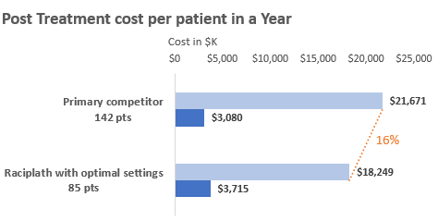
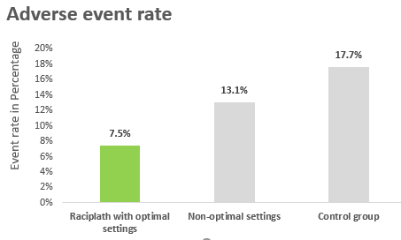
Adverse rate of Events decreases with Optimal Settings
Reduced treatment cost with Optimal Settings
Racipalth with optimal settings shows a 16% decrease in post treatment cost per patient in year compared to other competitors.
Maximum cost of the pretreatment is slightly higher for Racipalth with optimal settings.
Adverse events post treatment
Raciplath patients with optimal settings has a very less adverse event rate when compared with non optimal settings and control group.
Clinical success in 89.8% of patients using optimal settings

Slide 7


