Slide 1
An AI-Driven High School Rigor Classification
MSDS 498 Capstone — Midterm · Week 6
Capstone Team · July 2026 (add team member names)

Slide 2
Problem & objective
- College Board discontinued Landscape (Sept 2025) — admissions lost standardized high-school context.
- ~25% of applicants arrive with no school-context profile (Bastedo et al., 2023).
- Objective: a transparent, reproducible, defensible methodology to classify high-school rigor…
- …built from public data, that NU can adopt and tie to its internal data.

Slide 3
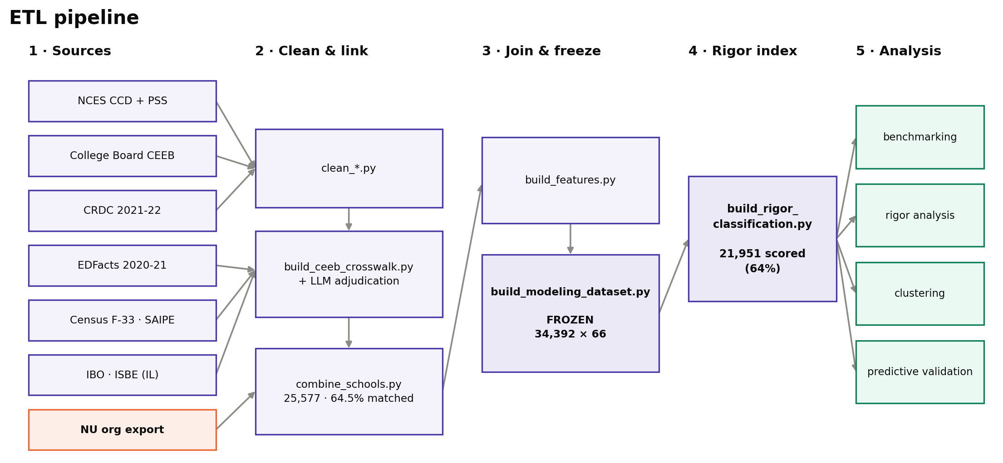
Data & reproducible pipeline
- Sources: NCES, CRDC 2021-22, Census F-33/SAIPE, NU export, IB, ISBE.
- Pipeline: Dockerized ETL, re-runnable without engineering support (Boettiger, 2015).
- Scale: ~34,000 high schools.
- Governance: per-variable data dictionary + source/vintage tracking (client requirement).

Slide 4
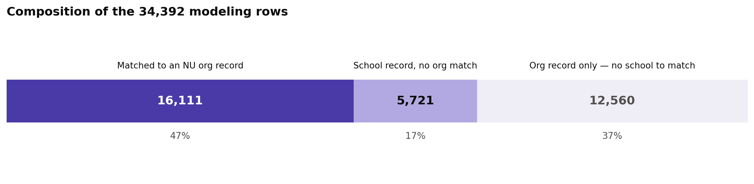
Record linkage without a shared identifier
- Problem: CEEB and NCES have no common key.
- Decision rule: auto-accept / review / reject = Fellegi–Sunter three-way (1969).
- Similarity: token-based over edit distance for school names (Cohen et al., 2003).
- Reporting: match rates reported as a matter of course.

Slide 5
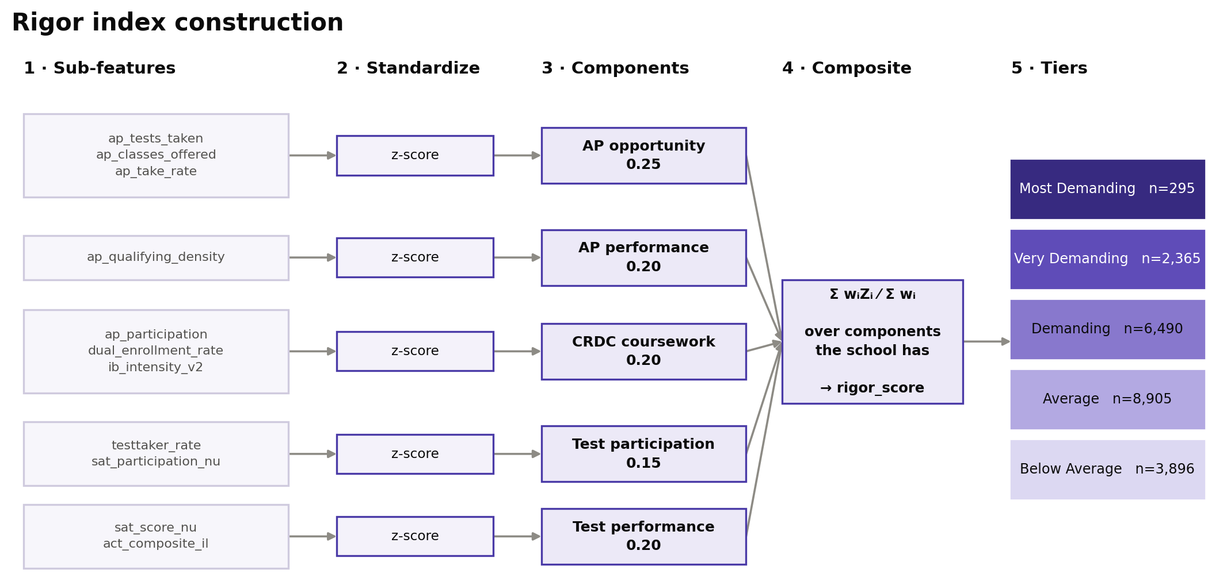
Feature engineering → the rigor index
- Form: a weighted composite index — transparent and decomposable, not a black box.
- Principle: performance over availability (Geiser & Santelices, 2004).
- Structure: five components, per-row proportional weighting over available components.
- v4: adds AP qualifying density + verified IB intensity.

Slide 6
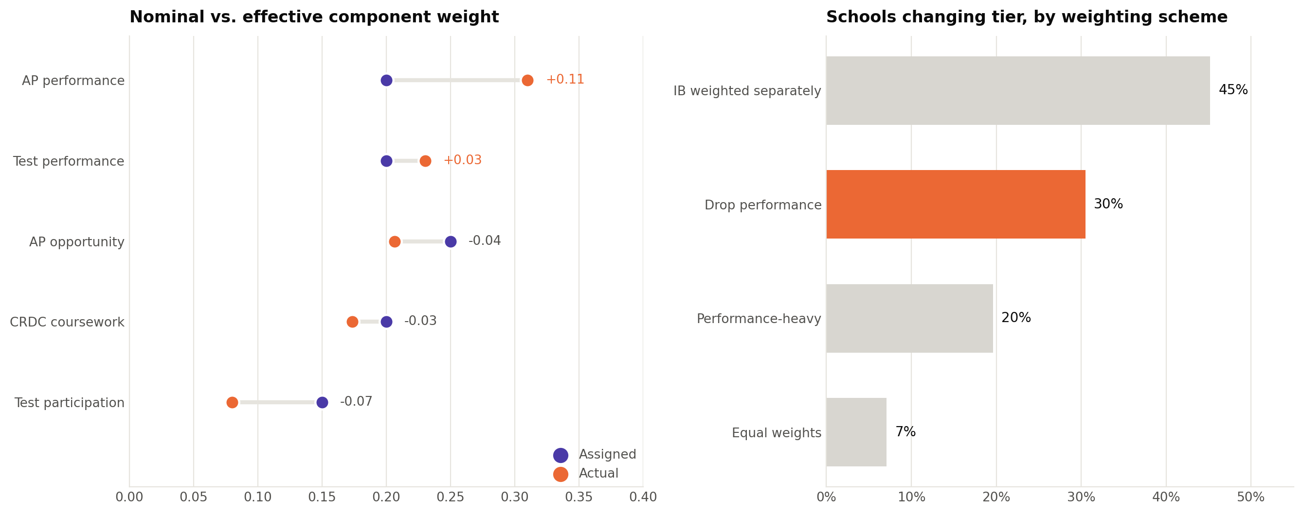
Nominal vs. effective weights
- Issue: assigned weights ≠ actual influence when features correlate (CADRE, 2024).
- Finding: AP performance leads the effective weight (~0.31); participation is absorbed.
- Practice: both reported, plus a sensitivity analysis across weighting schemes.

Slide 7
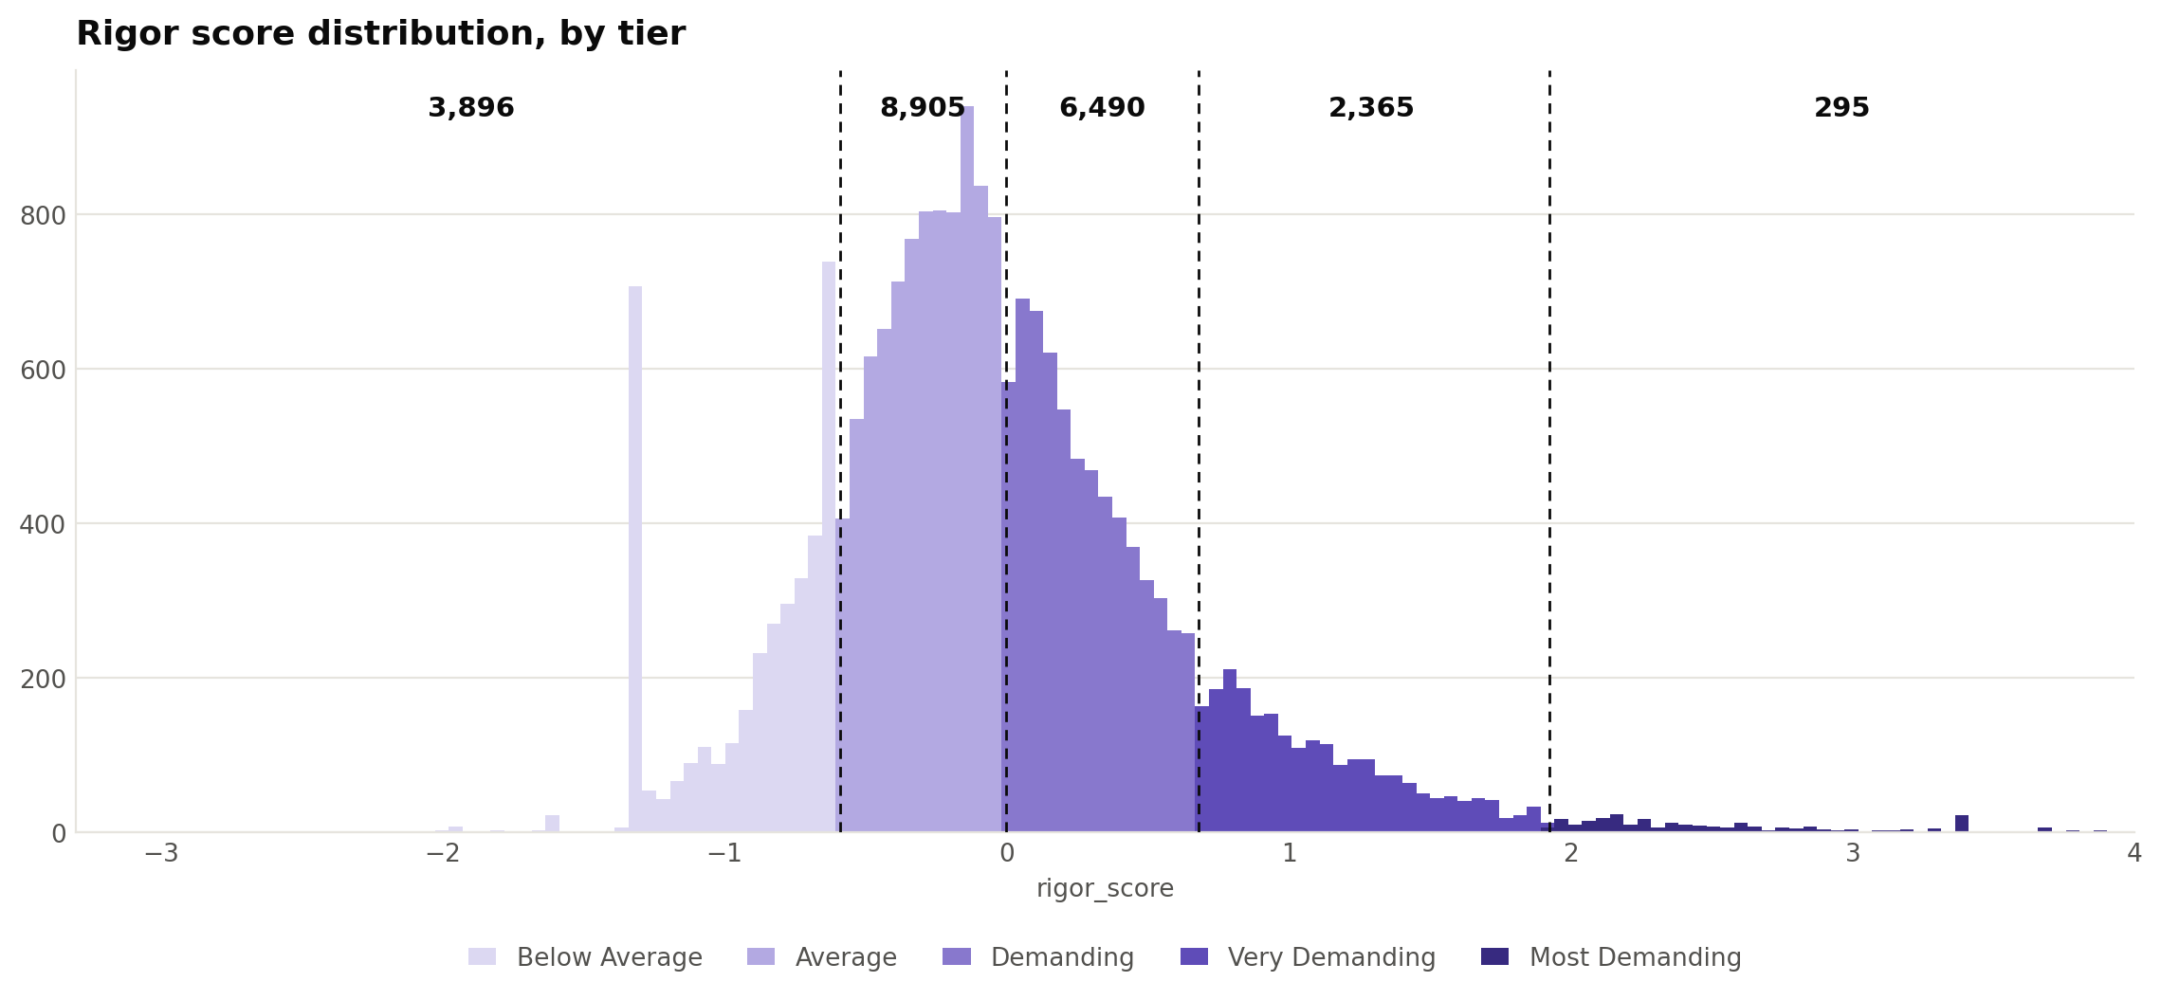
From score to tiers — natural breaks
- Method: Jenks natural breaks (Jenks, 1967; Fisher, 1958) — cuts at gaps in the distribution.
- Why not quantiles: Reardon cautions against splitting near-identical schools.
- Frame: norm-referenced (Glaser, 1963); criterion-referenced is the alternative (Cizek & Bunch, 2007).
- Result: 'Most Demanding' = 295 schools, not a forced top fifth.

Slide 8
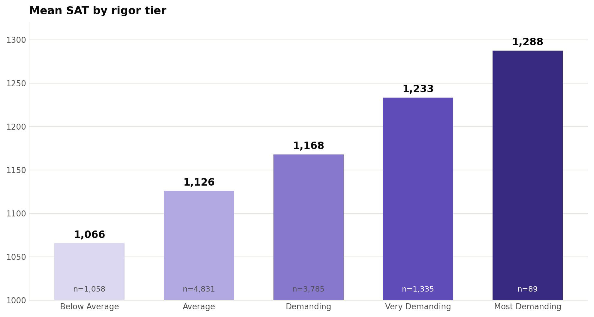
Validation against independent outcomes
- SAT: rises across tiers (1052 → 1303), no inversions — and not a model input.
- Grad rate: sharply separates the bottom tier.
- Honest finding: grad rate/STEM plateau at the top — 'most demanding' = performance, not catalog size.

Slide 9
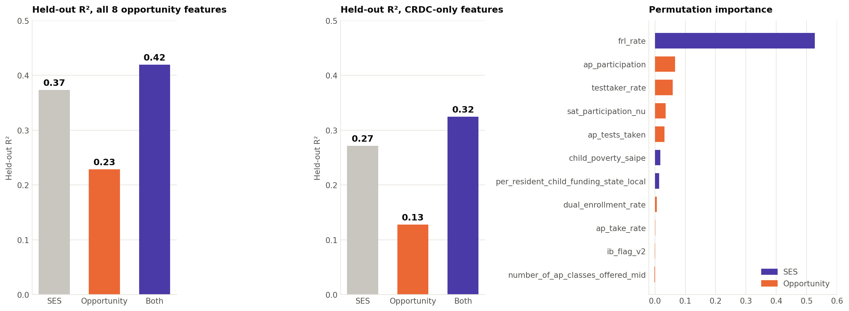
Predictive validation — the supervised model
- Design: gradient boosting + linear; grad rate ~ opportunity, SES-controlled (Adelman; Reardon).
- Result: opportunity adds +0.05 R² beyond SES — stable across two specs, both model families.
- Importance: free-lunch rate dominates (0.53) — the outcome is SES-driven…
- …yet the index correlates with poverty only −0.11 → evidence it is not an SES proxy.

Slide 10
A three-layer modeling system
- Measurement model: the composite rigor index (the deliverable).
- Unsupervised ML: K-means + hierarchical clustering with PCA (school segments).
- Supervised ML: gradient boosting predicting outcomes (validation).
- Rationale: no ground-truth rigor label exists — so an auditable index, validated by ML.

Slide 11
Limitations (documented, not hidden)
- Ecological inference: we measure the school, not the student.
- Levels, not growth: Reardon's caution — we report the SES-confounding check.
- Coverage: performance data ~35%, skewed to the recruiting universe.
- Gaps: private-school blind spot (CRDC public-only); per-course AP scores unavailable.
- Framing: most map onto NU's internal-data handoff — extension points, not dead ends.

Slide 12
Grounded in literature
- Adelman (1999, 2006): curriculum intensity predicts degree completion.
- Geiser & Santelices (2004): exam performance predicts; availability does not.
- Reardon / SEDA: levels reproduce SES — check for confounding.
- Landscape / ECD: keep the indicators transparent.
- Jenks/Fisher, Glaser, Cizek & Bunch, Nardo et al.: the tiering methodology.

Slide 13
Next steps (Weeks 6 → 10)
- Finalize v4 and commit its generation code (reproducibility).
- Separate public/private tiering; second-outcome validation (college-going).
- Methodology handoff guide for NU integration.
- Final report: Methods, results, limitations.

