Slide 1

NU Capstone Midterm Report
Every U.S. high school, one trusted picture -- a complete, fair, and refreshable intelligence platform for undergraduate admissions
MSDS 498 Capstone — Midterm · July 2026

Slide 2




01 · THE OPPORTUNITY
Why Now
Context is everything
Admissions reads applicants through their high school -- but reference data is fragmented across a dozen systems
The list has blind spots
The in-house school list grew organically for decades: rich where NU recruits, silent everywhere else
The market has a gap
College Board withdrew Landscape in 2019 -- no transparent replacement exists
The moment is right
Federal open data now makes a verified, national, annually refreshable picture possible

Slide 3



02 · FOUNDATION
The Data Behind It: Six Families of Sources
Federal education data
College Board world
IB Organization
NCES · CRDC · EDFacts
CEEB codes · AP data
programme authorizations
One Master Database
verified · linked · refreshable
State & local
Census community data
NU admissions export
Illinois report card · CPS
income · education · poverty
SAT / AP performance

Slide 4



03 · THE PLATFORM
What We Built
25,577
127
11
verified U.S. high schools, public + private
data points per school
data systems unified in one pipeline
Verified identity, enrollment, coursework, outcomes, and community context for every school
The admissions office's own knowledge (SAT / AP performance) merged in, not replaced
One command refreshes everything when new data years are released

Slide 5



04 · INTEGRATION
It Plugs Into the Current Workflow
Every record links to the codes admissions already uses (CEEB)
83.5%
Smart matching handles renamings, abbreviations, district quirks; AI adjudicates edge cases -- fully audited
linked
Accuracy verified geographically: paired records agree to ~1 km

Slide 6
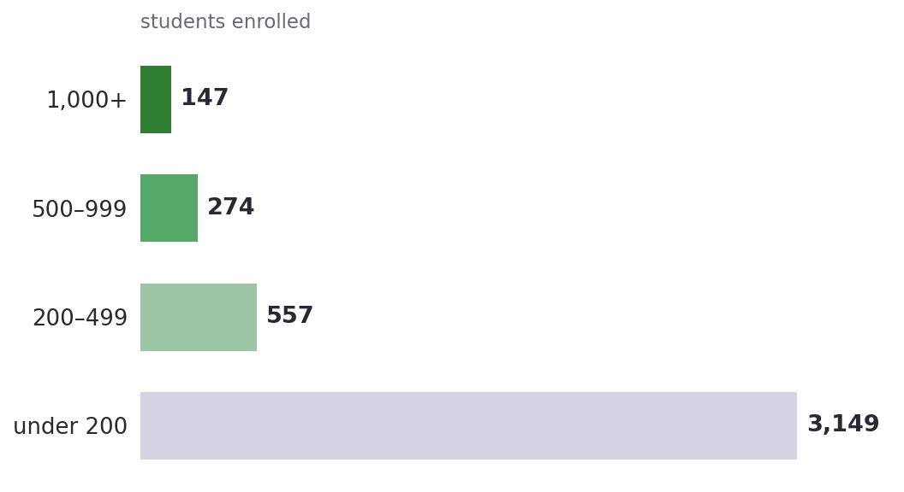



05 · DISCOVERY
We Found Schools No One Was Watching
4,218 newly identified high schools
421 have 500+ students; 41 offer the IB Diploma
Five 3,000-student suburban campuses opened in the early 2000s -- growth the list never caught
Delivered as a ranked prospect list with academic profile attached
New recruiting territory, discovered by connecting data the list never touched.

Slide 7


06 · THE MODEL
How the Rigor Score Is Built
What a school offers AND how its students perform -- performance signals carry the most influence
Missing data never punishes: weights reallocate to what a school actually reports; no-signal schools stay unscored
Scores cut into five tiers at natural gaps in the distribution -- not forced quotas
Stress-tested: alternate weightings barely reorder schools (rank agreement 0.97+)
Built as a transparent index in the academic tradition (Adelman) -- every school's score can be decomposed and explained.

Slide 8
07 · THE MODEL
Five Transparent Tiers of Academic Rigor
Scores what schools offer and how students perform: AP, IB, dual enrollment, exams
Fully transparent -- every tier can be explained to a counselor or a dean
'Most Demanding' is earned by ~1% of schools: a true national elite set

Slide 9
08 · FAIRNESS
It Measures Opportunity — Not Wealth
Test scores largely mirror community wealth -- our tier barely does
Independently validated: what a school offers predicts real outcomes beyond demographics
The transparent, defensible successor to what Landscape tried to be

Slide 10
09 · UNDER THE HOOD
The Models We Use
Rigor tiers
Transparent weighted index + natural-breaks tiering
Every tier decomposes into visible ingredients -- deliberately not a black box
School groupings
K-means clustering with PCA
Finds families of similar schools across academics, funding, geography
Validation
Regression models (linear + gradient boosting)
Confirms the index predicts real outcomes beyond demographics
Record matching
Rule engine + AI adjudication (Claude)
Rules resolve ~88%; AI judges the hard cases, fully audited
Principle: statistical models stay simple and explainable; AI is used only where judgment is needed -- and always leaves an audit trail.

Slide 11
10 · ROADMAP
Where We Take It Next
1
2
3
4
Model sign-off
Discovery list in use
Deeper private-school data
Annual-refresh automation
Team + client review of the v4 tiers before adoption
Newly identified schools handed to recruiting, sorted by fit
AI extraction from published school profiles
One-command update with an auto-generated change report
Quality backlog: refresh COVID-era outcomes as new federal years publish; resolve source-system code issues with the data owner.

Slide 12
Ready for the Next Step
Today: a working platform -- national database, admissions-list integration, rigor tiers, discovery list.
Next: final model sign-off · discovery list into recruiting hands · annual-refresh automation.
MSDS 498 Capstone — Midterm

