Slide 1
High School Rigor Methodology
Week-6 Client Update · for Bob & Adam, NU Admissions
MSDS 498 Capstone · July 2026
Notes:
Frame the meeting: everything here answers something they asked for in Week 5. Close on the per-course AP data ask -- that is what we need from them.

Slide 2
Where we are
- Goal: a transparent, school-level measure of academic rigor, from public data, that NU can tie to its own internal data.
- Built from your Week-5 asks: AP exam scores, the low-offering/high-scores idea, coverage transparency, STEM, graduation rate.
- Validated: the tiers track real outcomes, and are not just a proxy for socioeconomic status.
- Scope: we describe the school an applicant came from — not the applicant.
Notes:
The last bullet is the guardrail. If they ask 'can this rank students?', the answer is no by design: this gives a reader context for a transcript.

Slide 3
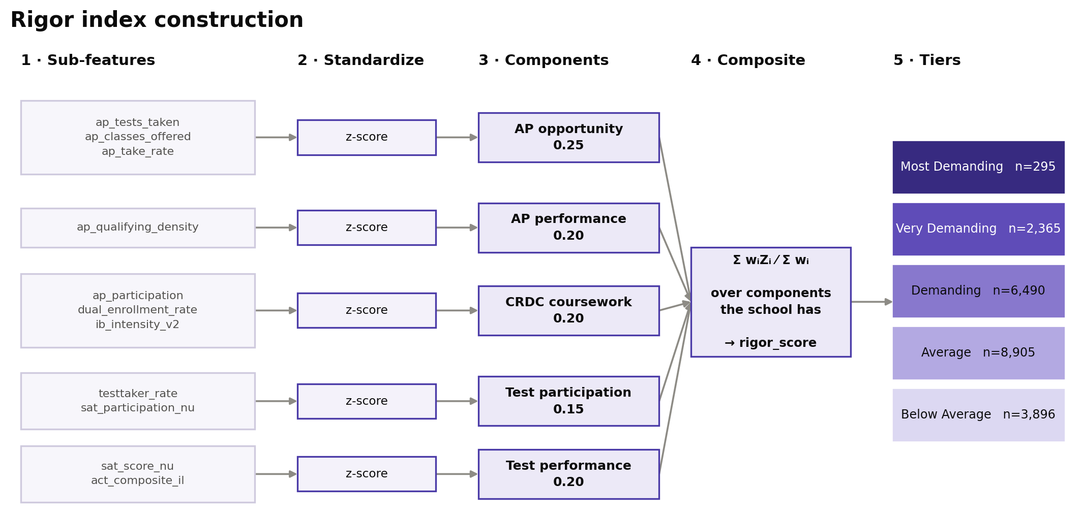
How we measure rigor — an index, not a black box
- Composite index: a weighted average of five standardized components → one rigor score.
- Decomposable: every tier traces back to the features that produced it (the Landscape lesson).
- Performance-weighted: AP exam scores, not just what's offered (Geiser & Santelices, 2004).
- No imputation: a school is scored on the components it actually has, or not scored at all.
Notes:
Landscape's failure mode was opacity. Ours is auditable: any tier can be walked back to its inputs, which is what lets them defend a decision.

Slide 4
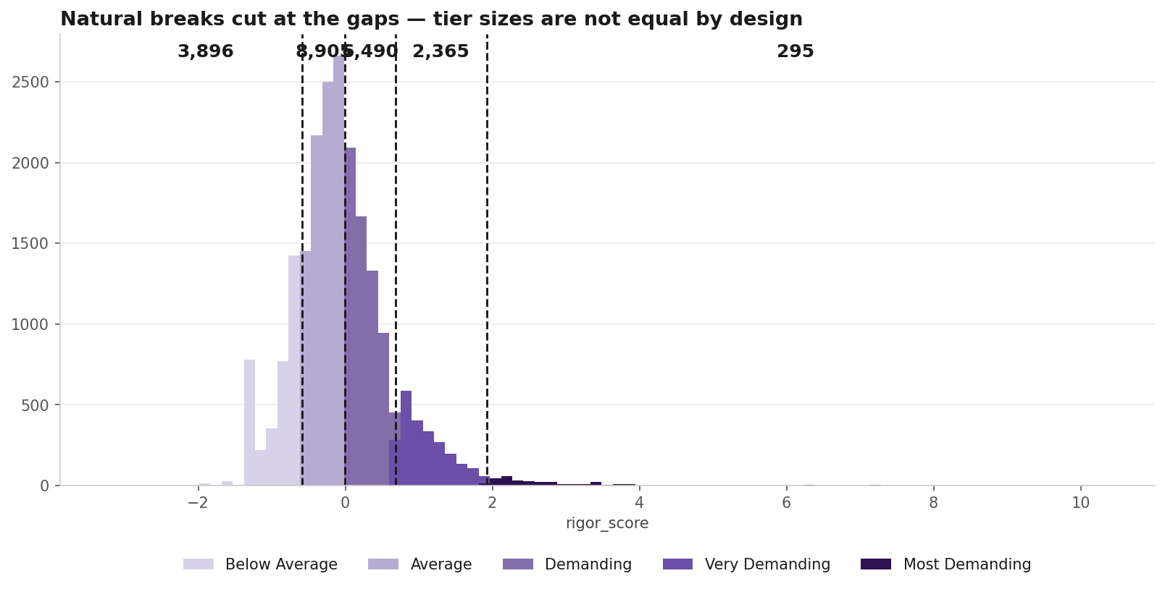
Your ask: not equal buckets
- Method: natural breaks — cuts fall at the real gaps in the distribution, not at fixed percentiles.
- Result: 'Most Demanding' is 295 schools, not a forced top 20%.
- Tier sizes vary because schools genuinely cluster — 8,905 land in the middle.
- Alternative kept on the shelf: equal-fifths, if you ever want fixed-size tiers.
Notes:
This is a direct answer to Bob's Week-5 pushback on equal buckets. The two schemes agree on only about half of schools, so the choice is consequential -- worth saying.

Slide 5
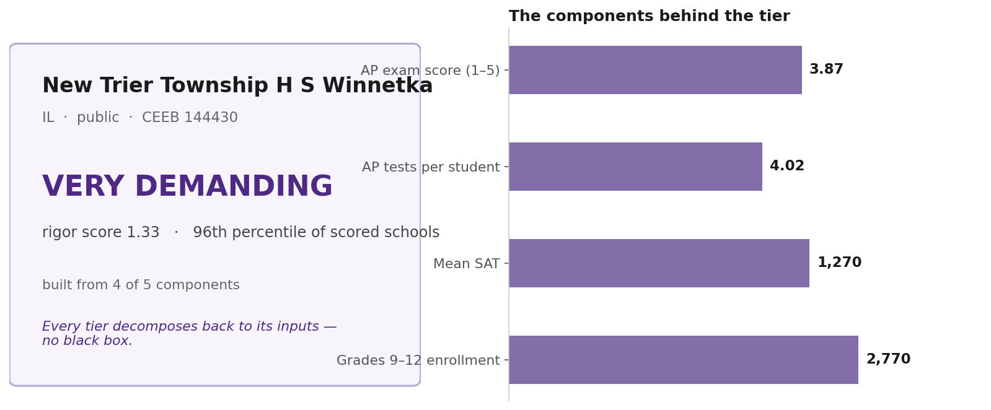
What a school looks like when it comes out
- Deliverable: per school — a tier, a score, a percentile, and the components behind it.
- Auditable: a counselor or reader can see exactly why a school landed where it did.
- Joinable: keyed on CEEB, so it drops straight into your existing systems.
- Coverage note: this school scored on 4 of 5 components — we show that, we don't hide it.
Notes:
Show the product, not just the method. Expect them to name a school they know and ask where it lands -- New Trier is Very Demanding, 96th percentile, and that is a reasonable-sounding answer to defend.

Slide 6
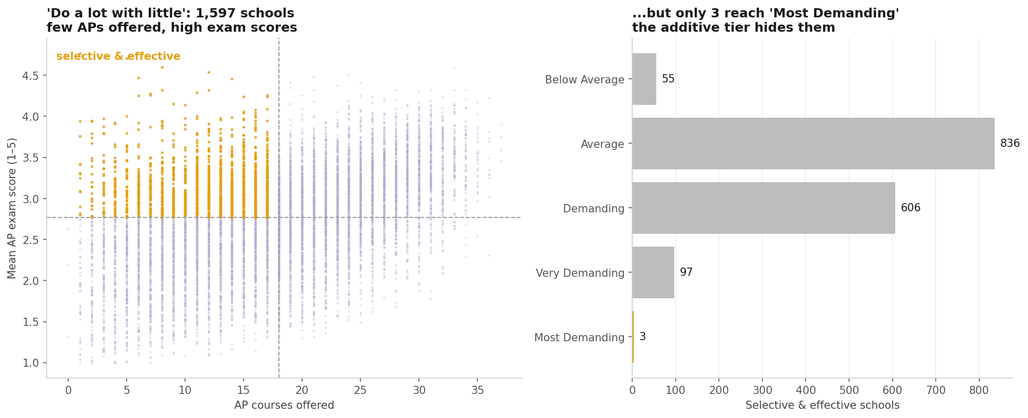
Your idea: low AP offering / high AP scores
- Selective & effective: few APs offered, high exam scores — 1,597 schools.
- The catch: only 3 reach the top tier; a thin catalog drags the composite down.
- So: these 'do a lot with little' schools are hidden by the tier alone.
- Use: a recruiting signal — ships alongside the tier, not folded into it.
Notes:
This came directly from Bob. Worth crediting him. The honest finding is that the additive index cannot surface these schools, so we ship the flag separately.

Slide 7
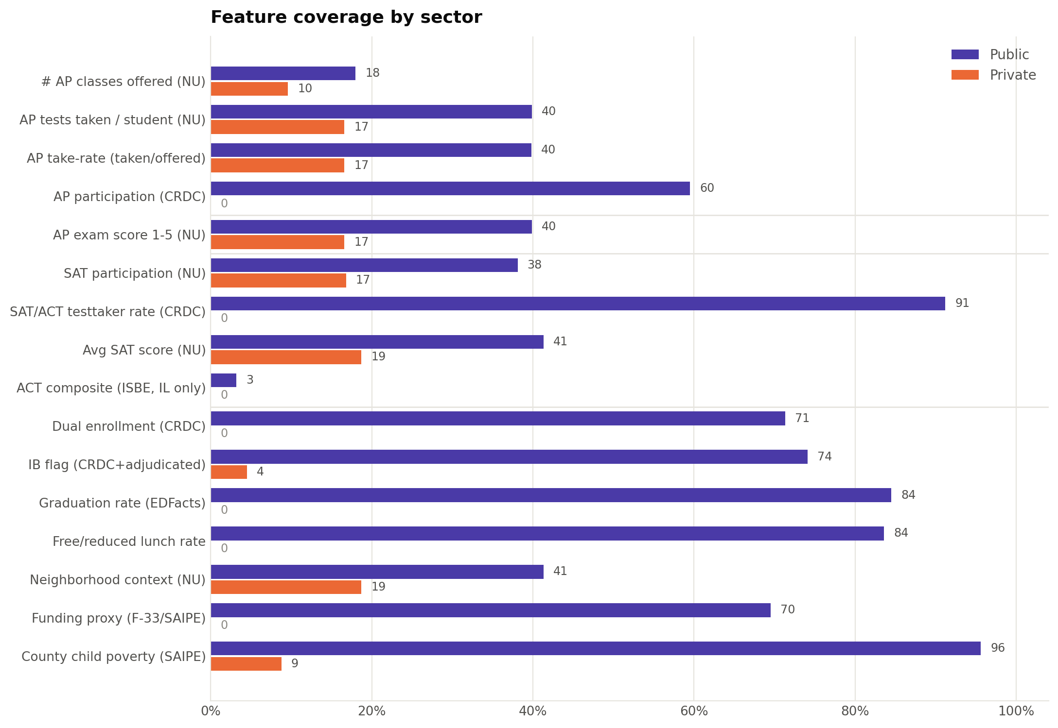
Data coverage — public vs private
- Not missing-at-random: reported per sector.
- CRDC: AP participation, testtaker rate, grad rate — public-only by law → ~0% private.
- NU analytics: AP/SAT scores track your recruiting universe (~35%).
- Consequence: private-school tiers rest on the thin NU block + IB — a documented blind spot.
Notes:
Answers their Week-5 question about the private-school number. Do not soften this: the blind spot is structural, and naming it is what makes the rest credible.

Slide 8
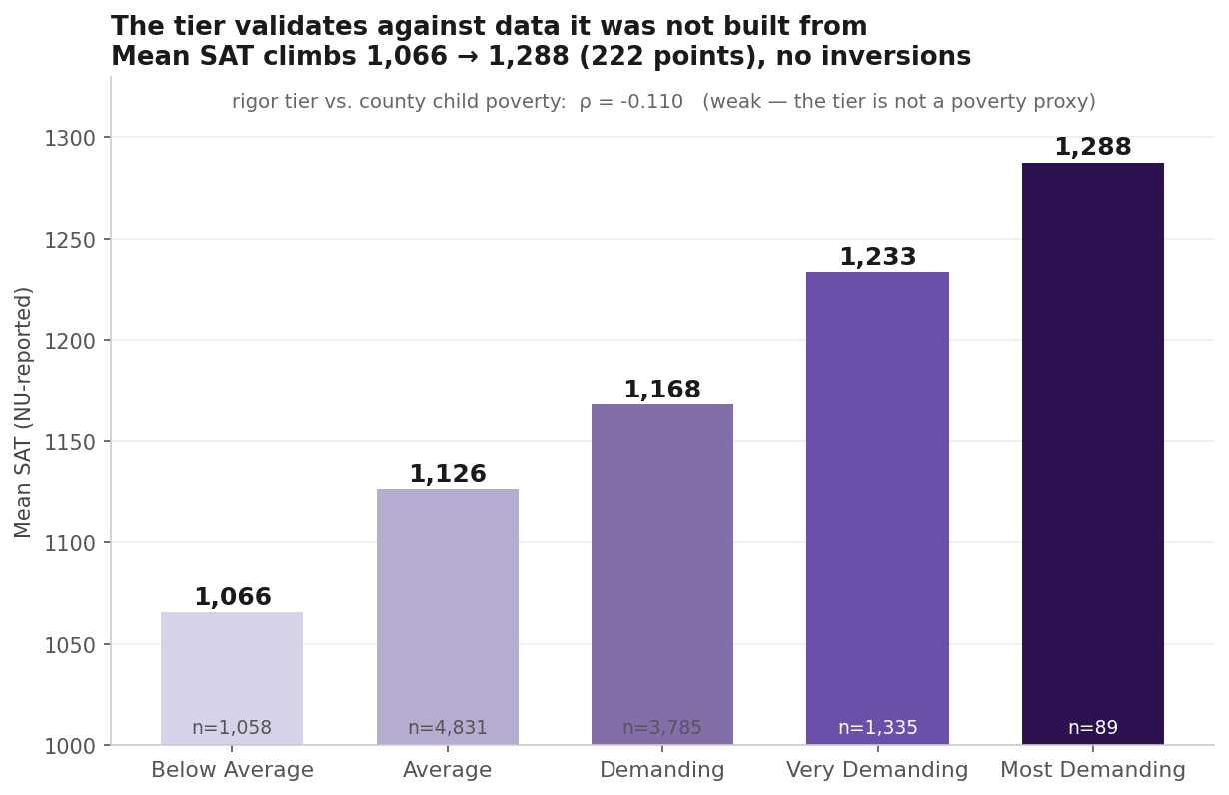
Does the tier mean something? Yes.
- Checked against measures the tier was NOT built from:
· SAT rises across every tier: 1,066 → 1,288, no inversions.
· Graduation rate separates the bottom tier sharply (70% vs 84–89%).
- Honest note: the top tier reflects exam performance, not catalog size — so grad rate plateaus at the top rather than peaking.
Notes:
The SAT check is the strongest single result: an independent measure, never used to build the tier, rises monotonically across all five. Volunteer the grad-rate dip before they find it.

Slide 9
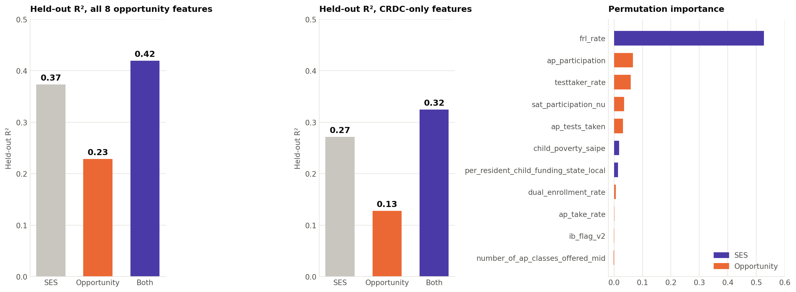
It predicts outcomes — and isn't just an SES proxy
- Model: graduation rate ~ opportunity features (Adelman, 1999).
- Result: opportunity adds +5 pts R² beyond socioeconomic status — stable across models.
- Tension: the outcome IS SES-driven (free-lunch rate dominates)…
- …yet the index correlates with poverty at only −0.11 → opportunity, not laundered demographics.
Notes:
This is the defensive slide. If anyone claims the tier just re-ranks wealthy suburbs, this is the answer -- and the poverty correlation is the number to quote.

Slide 10
What we'd need from you, and how it ties in
- Data ask: per-course AP score distributions (Calc BC vs Calc BC across schools) — lets us verify rigor at the course level.
- Open question: the measurement vintage of the org export — what year do those SAT/AP averages describe?
- Level: our tier is school-level; your counselor 'most demanding coursework' field is per-student — they complement each other.
- Handoff: the methodology is built to recalibrate against your internal outcomes (enrollment, GPA, retention).
Notes:
The real purpose of the meeting. Land the per-course ask concretely and get a yes/no. The vintage question has been open since Week 4.

Slide 11
Next steps & discussion
- Tier public and private separately — they aren't built from the same data.
- Validate on a second outcome (college-going).
- Package the methodology for handoff to your team.
- Your input: tier definitions, the per-course data ask, priority use-case (contextualization vs. outreach).
Notes:
End on their decision, not ours. The priority use-case question determines what we build in the remaining weeks.

