Slide 1
An AI-Driven High School Rigor Classification
MSDS 498 Capstone — Midterm · Week 6
Capstone Team · July 2026 (add team member names)
Notes:
One-line pitch: admissions lost its standardized school-context tool, and we rebuilt one from public data that anyone can audit.

Slide 2
Problem & objective
- College Board discontinued Landscape (Sept 2025) — admissions lost standardized high-school context.
- ~25% of applicants arrive with no school-context profile (Bastedo et al., 2023).
- The reader's problem: the same transcript means different things at different schools.
- Objective: a transparent, reproducible measure of a school's academic rigor — so a student's coursework can be read in the context of what their school actually offered.
Notes:
Be precise here: we measure schools, not students, and there is no admissions outcome in this data. The student-level version is the handoff, not this project.

Slide 3
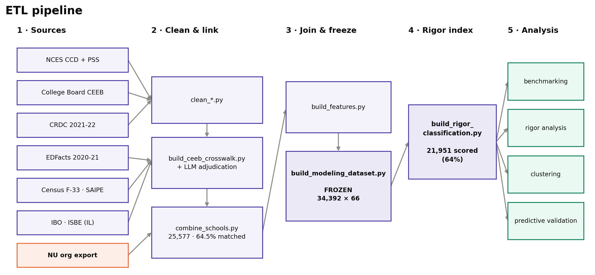
Data & reproducible pipeline
- Sources: NCES, CRDC 2021-22, Census F-33/SAIPE, NU export, IB, ISBE.
- Pipeline: Dockerized ETL, re-runnable without engineering support (Boettiger, 2015).
- Scale: ~34,000 high schools.
- Governance: per-variable data dictionary + source/vintage tracking (client requirement).
Notes:
The pipeline is a deliverable in its own right -- the client can re-run it when new CRDC or NCES vintages land.

Slide 4
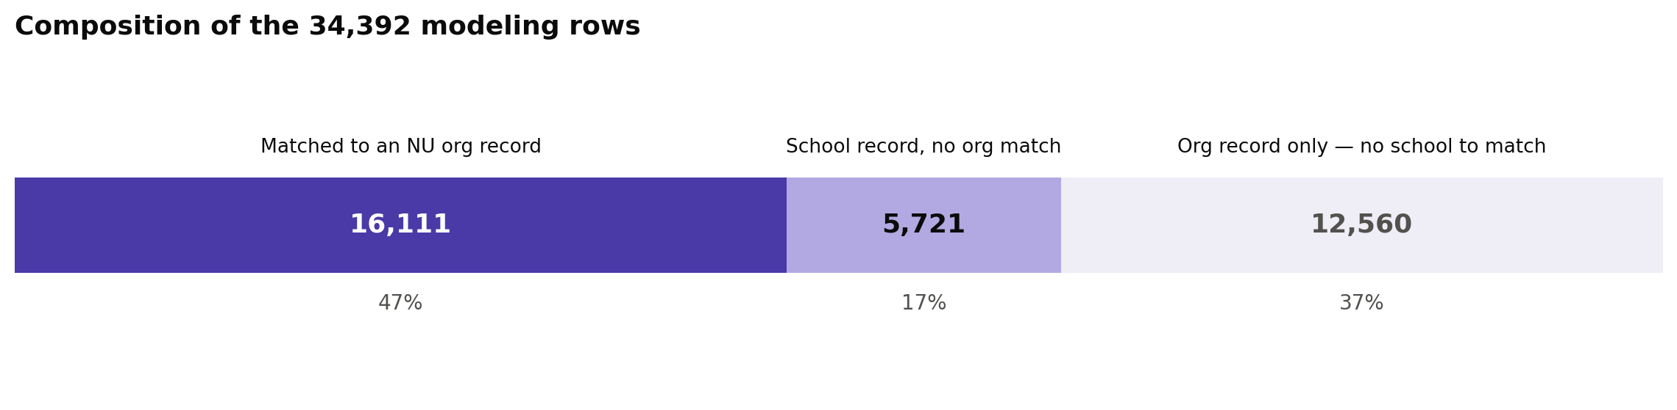
Record linkage without a shared identifier
- Problem: CEEB and NCES have no common key.
- Decision rule: auto-accept / review / reject = Fellegi–Sunter three-way (1969).
- Similarity: token-based over edit distance for school names (Cohen et al., 2003).
- Ambiguous middle band: an LLM adjudicates the review-tier pairs a threshold cannot settle — each decision logged and auditable.
- Reporting: match rates reported as a matter of course.
Notes:
Classic entity-resolution problem. The three-way decision rule matters because forcing a binary match/no-match would quietly inject false links into everything downstream.

Slide 5
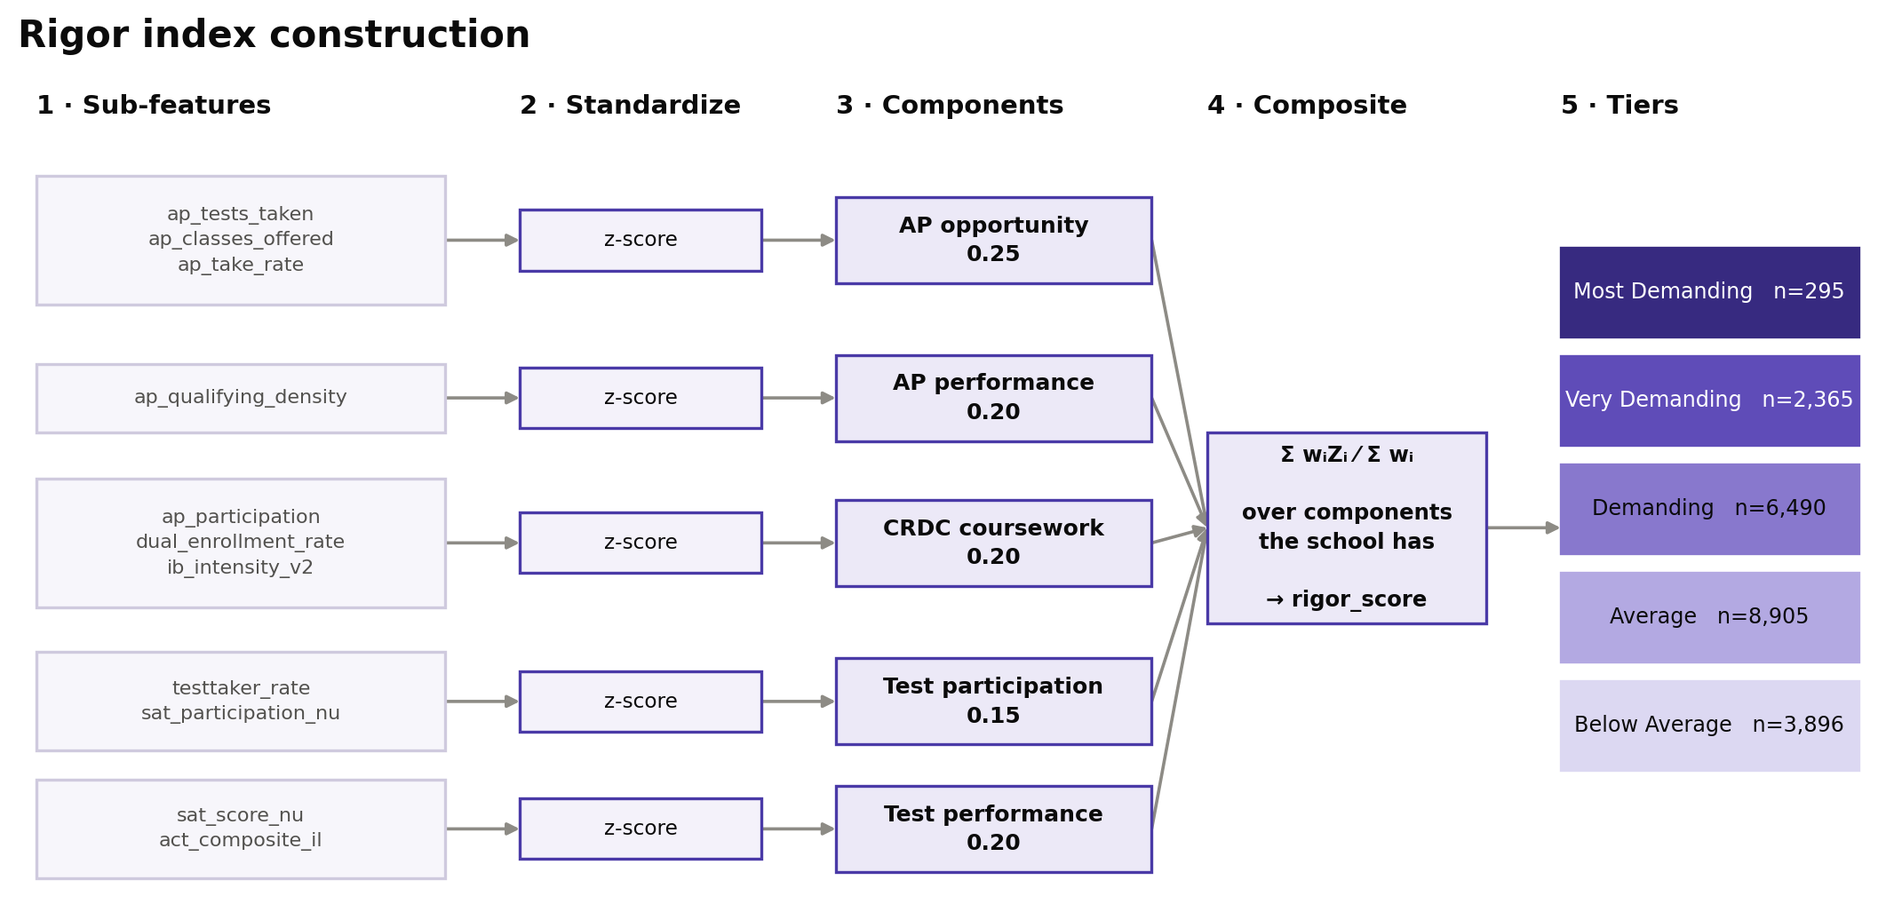
Feature engineering → the rigor index
- Form: a weighted composite index — transparent and decomposable, not a black box.
- Principle: performance over availability (Geiser & Santelices, 2004).
- Structure: five components, per-row proportional weighting over available components.
- Latest revision: AP qualifying density (expected passing exams per student) + a verified IB signal.
Notes:
Qualifying density replaced mean AP score because a mean rewards gatekeeping -- a school that only lets its strongest students sit the exam posts a high average.

Slide 6
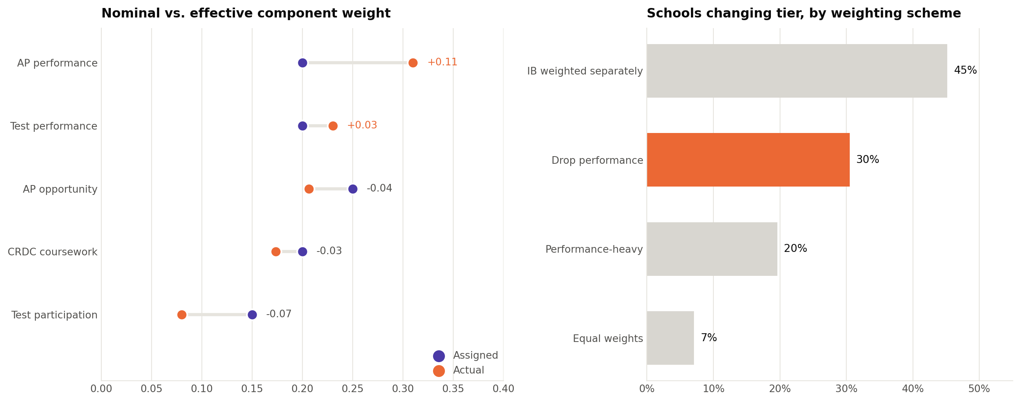
Nominal vs. effective weights
- Issue: assigned weights ≠ actual influence when features correlate (CADRE, 2024).
- Finding: AP performance leads the effective weight (~0.31); participation is absorbed.
- Sensitivity: drop the performance components and 30% of schools change tier — the literature-driven change was not cosmetic.
- Practice: both reported, across four weighting schemes.
Notes:
The 30% number is the answer to 'did following the literature actually matter?'. Equal weights move only 7%, so the index is stable to reasonable reweighting but genuinely sensitive to dropping performance.

Slide 7
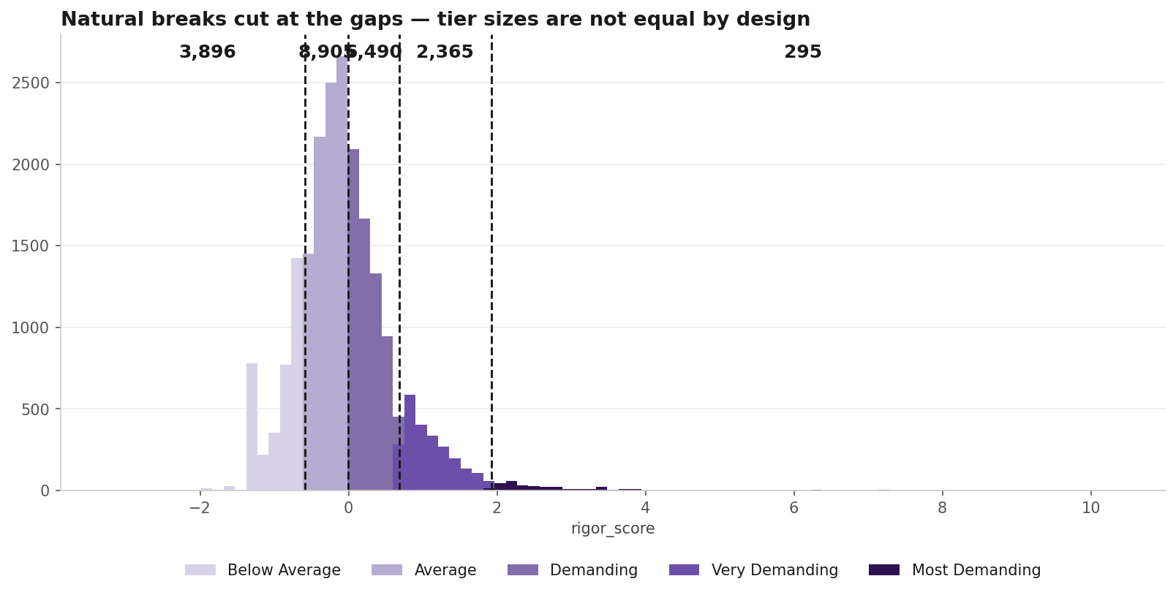
From score to tiers — natural breaks
- Method: Jenks natural breaks (Jenks, 1967; Fisher, 1958) — 1-D k-means, cutting at gaps in the distribution.
- Why not quantiles: Reardon cautions against splitting near-identical schools.
- Frame: norm-referenced (Glaser, 1963); criterion-referenced is the alternative (Cizek & Bunch, 2007).
- Result: 'Most Demanding' = 295 schools, not a forced top fifth.
Notes:
Key caveat to state out loud: these cuts are relative to our scored population, not an absolute standard. Re-run on a different population and they move.

Slide 8
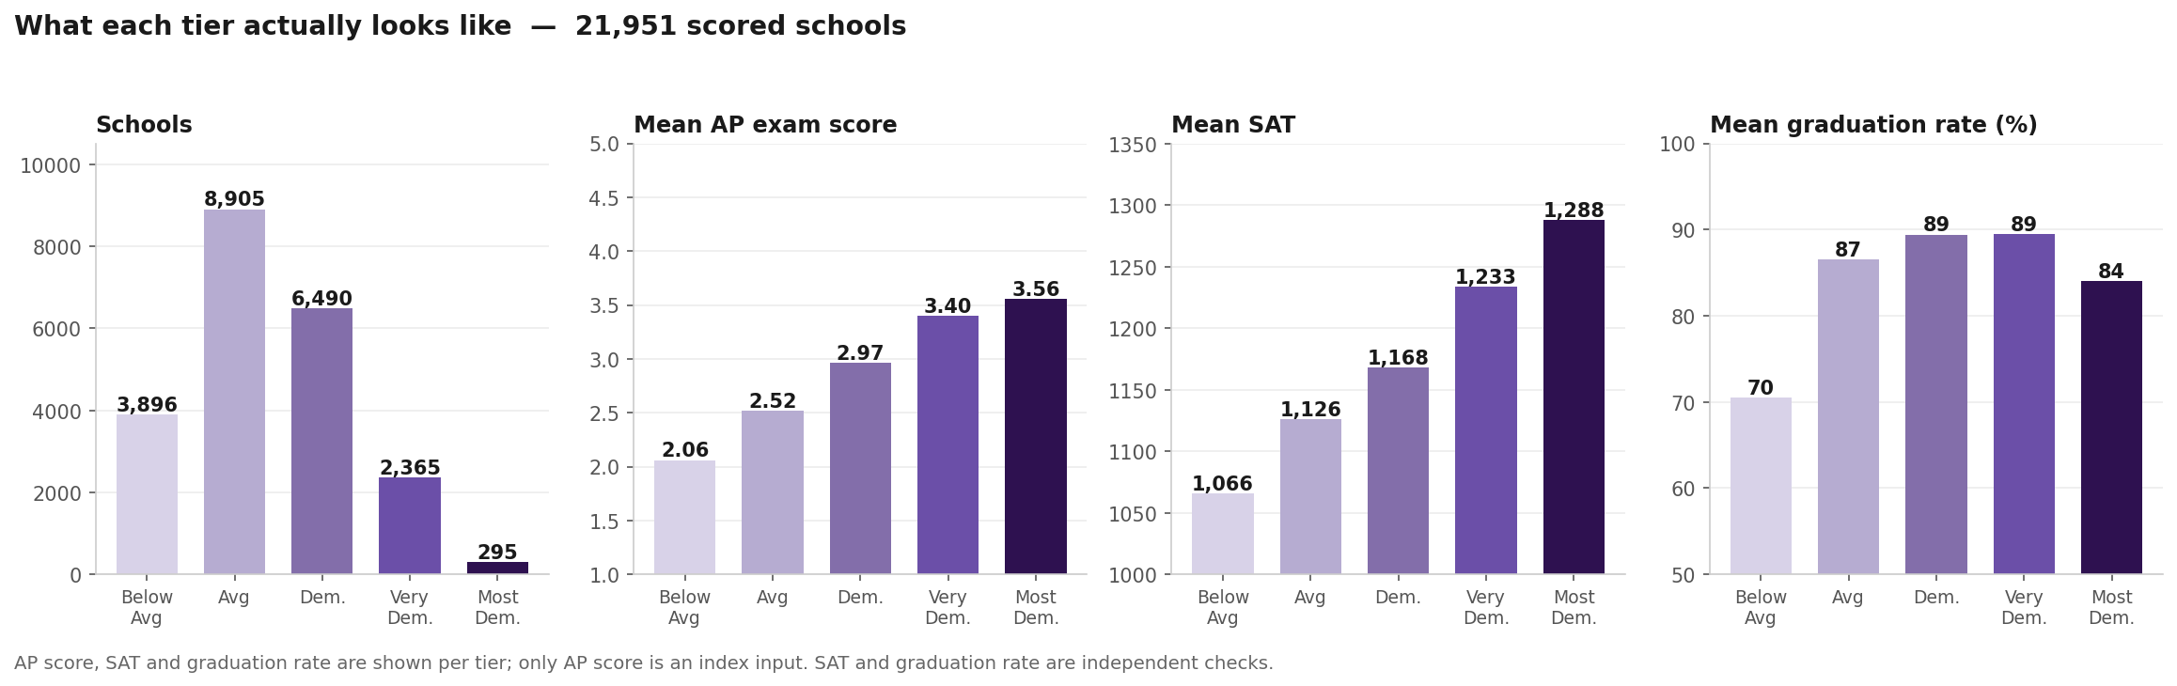
Results — what each tier actually looks like
- 21,951 schools scored; 12,441 left unscored rather than imputed.
- AP exam score rises 2.06 → 3.56 across tiers — an index input, so this is internal consistency.
- SAT rises 1,066 → 1,288 — not an input, so this is external validation.
- Graduation rate separates the bottom tier, then plateaus — reported as found.
Notes:
The results slide. Walk the four panels left to right: how many, how they differ on an input, then on two things the model never saw.

Slide 9
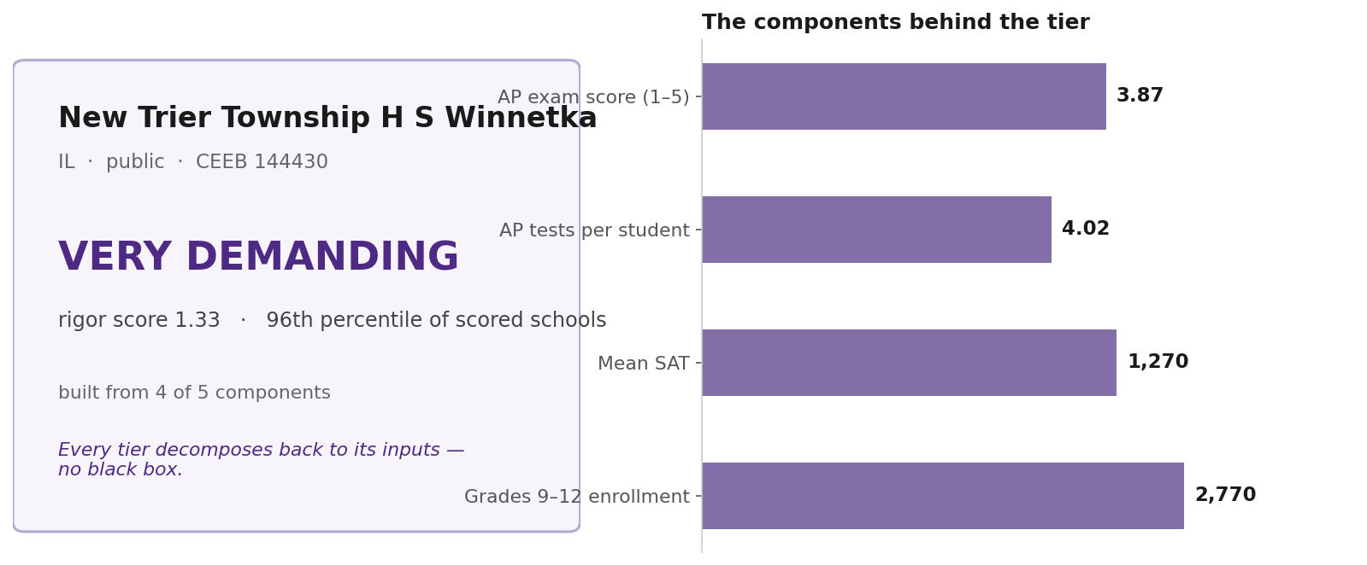
What comes out, per school
- Deliverable: tier, score, percentile, and the components behind it — keyed on CEEB.
- Decomposable by construction: no school gets a tier without a traceable reason.
- Missingness surfaced: '4 of 5 components' is part of the output, not a footnote.
- Face validity: known-selective schools land where domain experts expect.
Notes:
Anticipate 'show me a school I know'. Having one on the slide beats improvising.

Slide 10
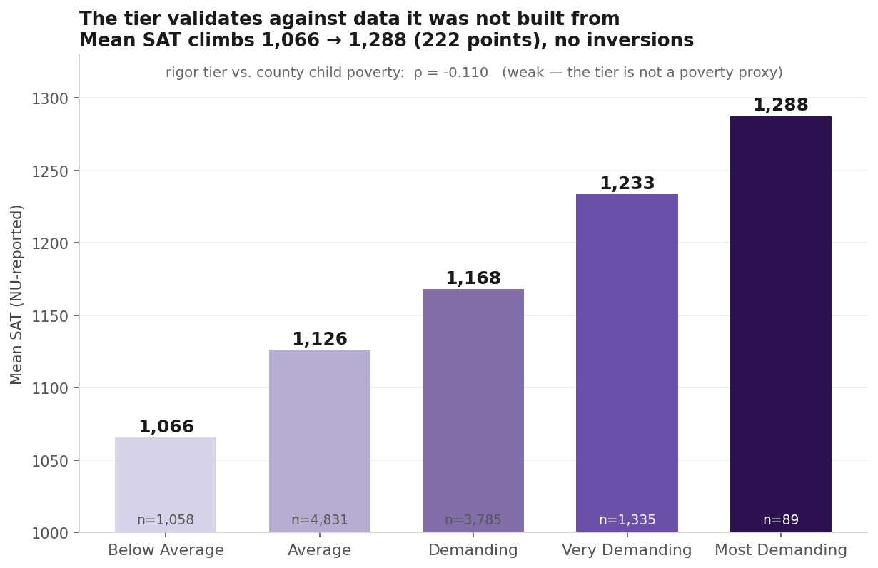
Validation against independent outcomes
- SAT rises across tiers (1,066 → 1,288, a 222-point spread), no inversions — and never a model input.
- Graduation rate sharply separates the bottom tier.
- Honest finding: grad rate plateaus at the top — 'most demanding' means performance, not catalog size.
- Face-validity audit across known schools as a qualitative check.
Notes:
Strongest empirical result in the deck. Monotonic across all five tiers on a measure the index never touched.

Slide 11
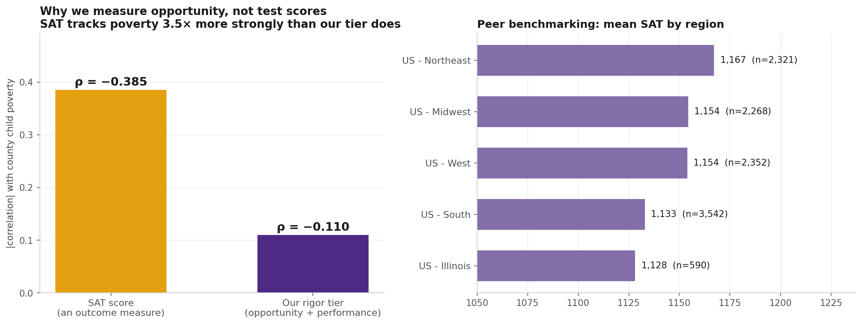
Why opportunity, not test scores
- The obvious alternative: just rank schools by mean SAT. We tested that.
- SAT correlates with county child poverty at −0.385; our tier, at −0.110.
- So an outcome measure is ~3.5× more socioeconomically confounded than an opportunity measure.
- This is empirical support for the design choice, not just a literature citation (Reardon / SEDA).
Notes:
This slide converts a literature argument into our own evidence. If you only keep one methods-defense slide, keep this one.

Slide 12
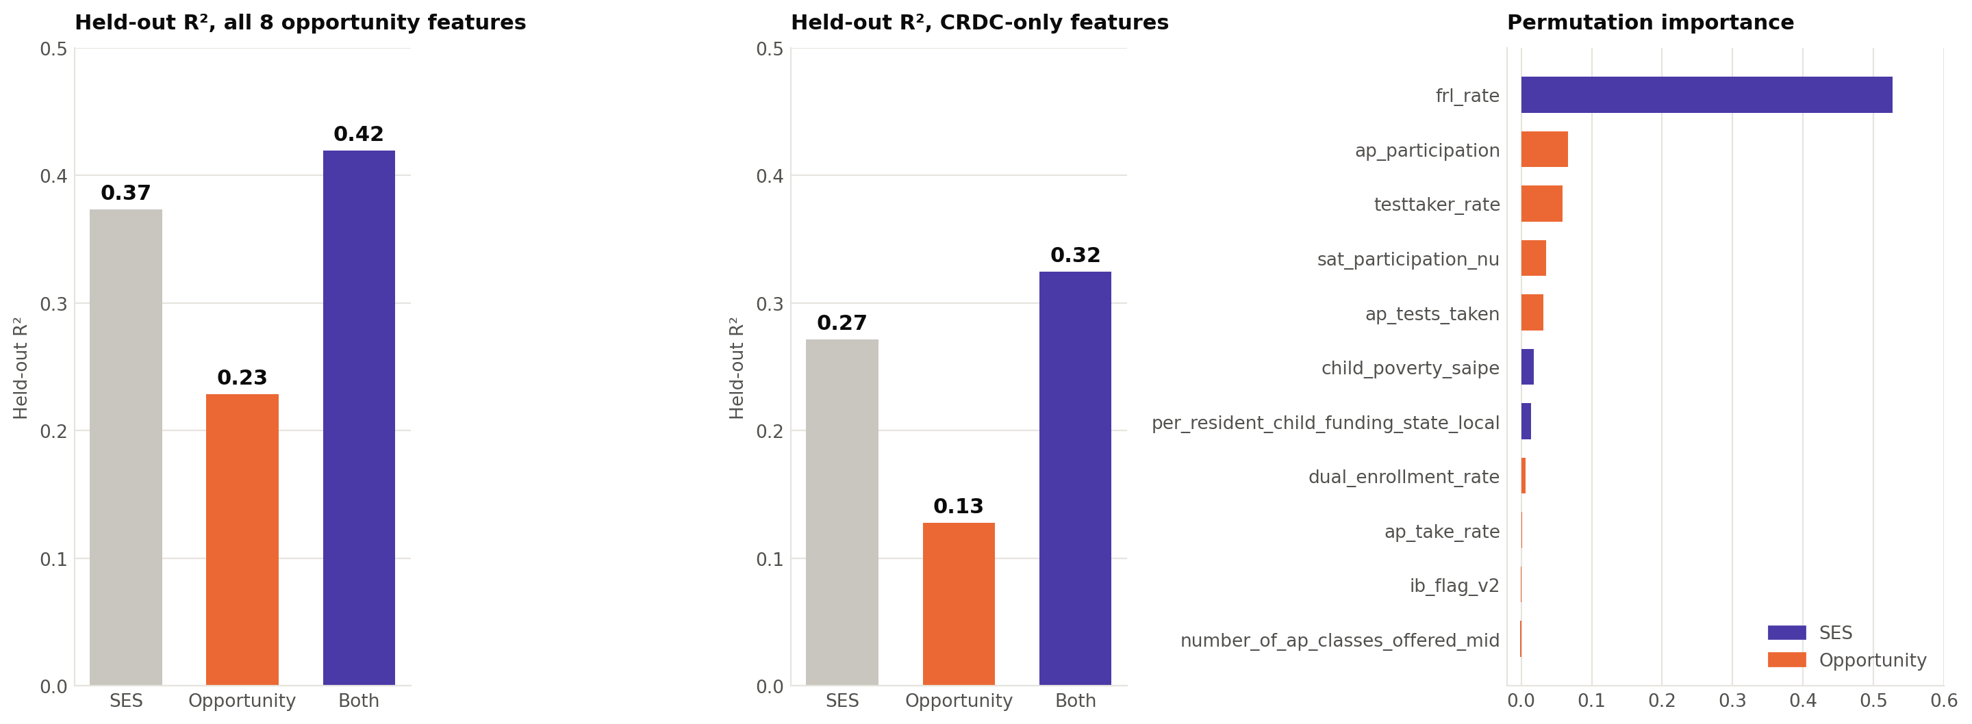
Predictive validation — the supervised model
- Design: HistGradientBoosting + linear baseline; grad rate ~ opportunity, SES-controlled (Adelman; Reardon).
- Discipline: 80/20 held-out split, fixed seed, permutation importance (10 repeats), R²/RMSE on the test set.
- Result: opportunity adds +0.05 R² beyond SES — stable across two specs, both model families.
- Importance: free-lunch rate dominates (0.53) — the outcome is SES-driven…
- …yet the index correlates with poverty only −0.11 → evidence it is not an SES proxy.
Notes:
Emphasise that this model validates the index; it is not the deliverable. Predicting graduation is how we test that the construct carries signal.

Slide 13
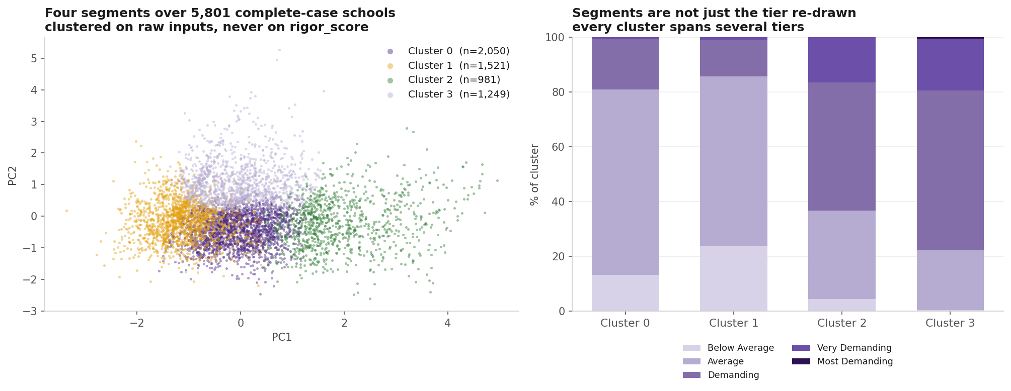
Unsupervised segments
- K-means + hierarchical over PCA components (90% variance retained); region, academic profile, funding.
- k=4 selected by gap statistic (Tibshirani et al., 2001), cross-checked against silhouette; the two algorithms compared by adjusted Rand index.
- Deliberately excludes rigor_score — otherwise 'do the clusters match the tier?' is circular.
- Finding: every cluster spans several tiers — segments describe a different cut of the data.
- Limitation: 5,801 complete-case schools — the clustering universe is much smaller than the tiering one.
Notes:
Expect 'why not just cluster to get the tiers?'. Because clustering gives unordered groups, and rigor is inherently ordinal -- plus no ground truth to name the order.

Slide 14
A three-layer modeling system
- Measurement model: the composite rigor index — the deliverable.
- Unsupervised ML: K-means + hierarchical clustering with PCA — school segments.
- Supervised ML: gradient boosting predicting outcomes — validation, not the product.
- Why not train the tier directly: no ground-truth rigor label exists anywhere — inventing one would make the model unfalsifiable.
- So: an auditable measurement instrument, validated by ML rather than produced by it.
Notes:
This is the 'where is the model?' answer. Three layers, each doing a job the others cannot. The absence of a ground-truth label is the reason for the architecture.

Slide 15
Limitations (documented, not hidden)
- Ecological inference: we measure the school, not the student.
- Levels, not growth: Reardon's caution — we report the SES-confounding check.
- Coverage: performance data ~35%, skewed to the recruiting universe.
- Gaps: private-school blind spot (CRDC public-only); per-course AP scores unavailable.
- Fragility: losing CRDC access would reshuffle ~40% of the CRDC-covered population.
Notes:
Volunteering limitations is what buys credibility on the rest. Each one maps to an extension point in the NU handoff rather than a dead end.

Slide 16
Next steps (Weeks 7 → 10)
- Separate public/private tiering — different feature availability, different models.
- Second-outcome validation (college-going), and a post-COVID graduation vintage.
- Methodology handoff guide for NU integration.
- Final report: methods, results, limitations.
Notes:
Close on the handoff. The measure is built to be recalibrated against NU's internal outcomes, which is the natural continuation of the work.

