Slide 1
SCIALOG: Temporal & Sequence-Based Behavioral Analysis
Notes:
Need to check the speaker notes (redid slides Jan 15)
claude ….
cursor + MD = SWE

Slide 2
SCIALOG: Temporal & Sequence-Based Behavioral Analysis
(Core analyses complete; refinement ongoing)
Study Description: Using the codebook synthesized from existing literature reviews, we constructed temporal and sequence-based behavioral features to examine whether when and how behaviors unfold predict team roles.
Study Questions:
Do early meeting behaviors predict later roles and outcomes?
Do facilitators, team members, and funded participants exhibit distinct temporal patterns?
Data Sample:
128 SCIALOG meeting recordings (1-1.5 hrs with 6-18 participants)
Gemini + human-validated behavioral annotations (aligned with the meetings split into thirds)
Three outcomes: (1) facilitator role, (2) team membership, (3) funding status

Slide 3
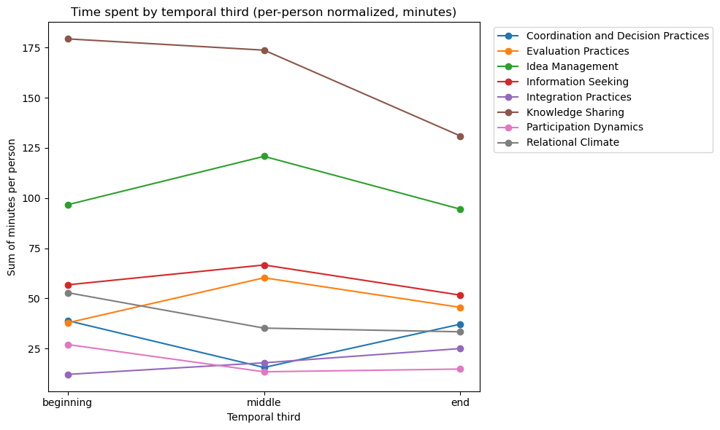
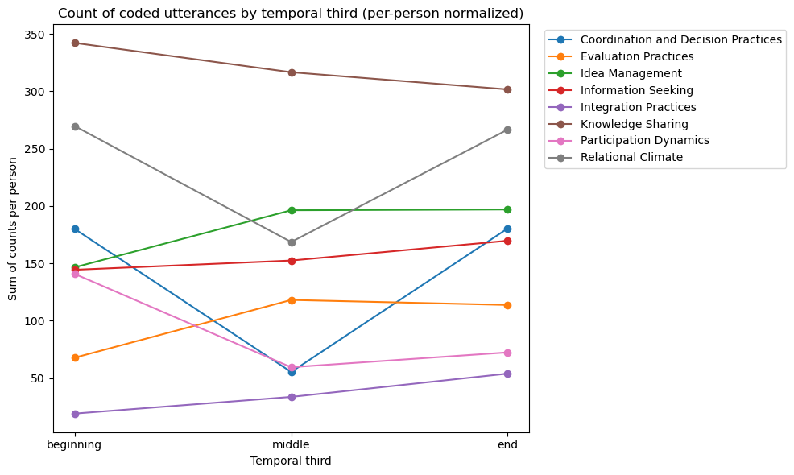
Temporal Behavioral Patterns Across All SCIALOG Meetings
Knowledge Sharing is front-loaded, while Idea Management peaks mid-meeting, suggesting early grounding and mid-phase structuring. Relational and participation behaviors dip mid-meeting before partially recovering towards the end
Notes:
Evey’s Comment 2:52PM January 9th:
do you think there might be biases in using the sum of time spent on strategies? (because what if it just normally takes more time to share knowledge because you have to articulate and explain a lot of things?)
what are the pros and cons of using "count" of appearance instead of total time?
Mx’s response to Evey’s Comment:
Right, this was something I had realized a few months after I had initially made the "sum annotations graph" as time was a better metric because it can at least measure depth (or is a better assumption), without having to dig into the transcript (which could be done too, if we had wanted to be absolutely sure about the data.
I do believe that time is actually a better measurement bc of those reasons, and i ended up replacing the graph with a time-based minutes version, in this context.
From my current understanding, summing of the annotation codes could be better if we were to track distribution…. something like this for e.g.:
Meeting A: Knowledge Sharing appears once (explanation appears 12 minutes)
Meeting B: Knowledge Sharing appears 12 times (each time it shows up, it lasts 20 seconds)
If we were to sum it up, it would say Meeting B has more Knowledge Sharing than Meeting A by sheer occurrence rate.
If we were use track length of time: it would say Meeting A spent more of the meeting doing more Knowledge Sharing than Meeting B
Progress on Jan 15, 2025:
Added in summation of annotation code graph

Slide 4
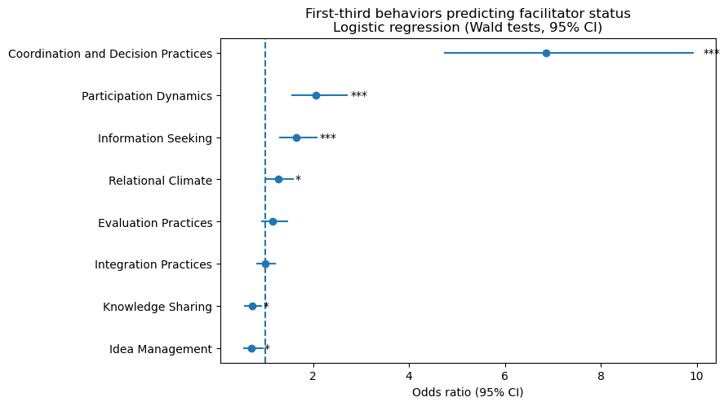
Which First ⅓ of a Meeting Behaviors Distinguish Facilitators From Non-Facilitators?
Facilitators exhibit higher early Coordination, Participation, Information Seeking, and Relational Climate
Higher Idea Management and Knowledge Sharing are less characteristic of facilitators
Features represent summed speaking time (minutes) per code annotation
Notes:
This analysis focuses on the role differentiation under relatively balanced conditions, so standard logistic regression is appropriate
Evey’s Comment 2:38 PM Jan 8:
what test is this?
Max’s response:
It’s a multivariable logistic regression that predicts facilitator status (binary) from behaviors in the first ⅓ of the meeting. The bars are 95% confidence intervals (Wald).
Evey’s Comment 2:39 PM Jan 8:
can you explain how to read this graph with a concrete example like idea management?
Max’s response:
To read the confidence interval (CI) plot, the vertical dashed line at 1.0 represents no difference between facilitators and non-facilitators. If a behavior’s 95% confidence interval does not include 1.0, the behavior significantly distinguishes the two roles.
The position of the odds ratio (the dot) indicates the direction of the effect. Values above 1 indicate behaviors more characteristic of facilitators, while values below 1 indicate behaviors more characteristic of non-facilitators.
For example, Idea Management has an odds ratio below 1 and a confidence interval entirely below 1.0. This means that, holding other behaviors constant, participants who engage more in early Idea Management behaviors are less likely to be facilitators
P-values (see dec-2025-status.ipynb for complete code chunk; put here for quick access):
Significant predictors (95% CI excludes 1):
Coordination & Decision Practices
OR = 8.36, p ≈ 2.6e-26
Strongest association with facilitator status by a wide margin.
Participation Dynamics
OR = 2.15, p ≈ 1.8e-7
Information Seeking
OR = 1.63, p ≈ 4.9e-5
Relational Climate
OR = 1.32, p ≈ 0.019
Idea Management
OR = 0.73, p ≈ 0.047
Lower odds of facilitator status when early idea management is higher.
Not statistically significant:
Knowledge Sharing
OR = 0.82, p ≈ 0.21
Integration Practices
OR = 0.98, p ≈ 0.84
Evaluation Practices
OR = 1.10, p ≈ 0.47
Meeting with Evey Jan 14 2026:
check if this is time or summation of the code annotations
if it is time added in the counting? → time summation of the code annotations

Slide 5
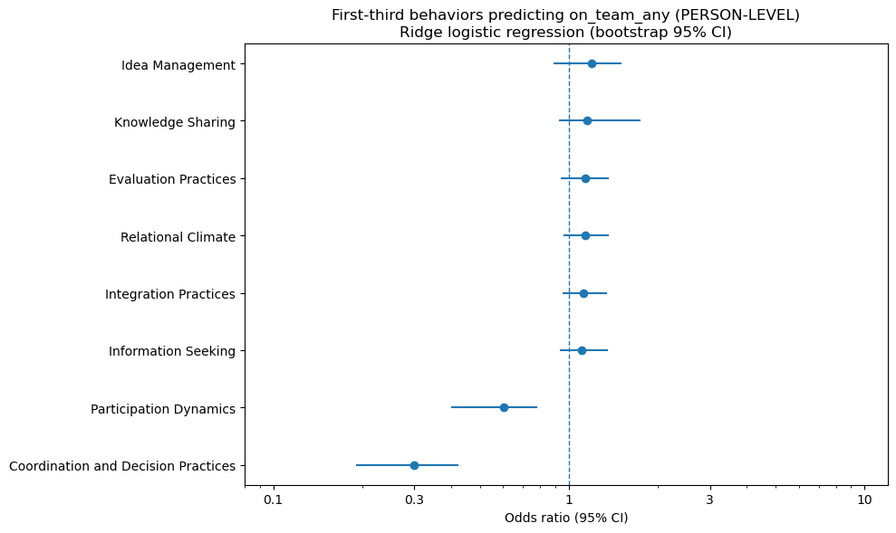
Meeting Behaviors in the First ⅓ of a Meeting Differentiate Team Formation
summation of time per annotation code @ individual level
Higher early Participation Dynamics and Coordination & Decision Practices are associated with lower odds of team formation
Other early behaviors show weaker or inconsistent associations
In General:
team formation (more people on a team)
team funding success (more balanced)
successful/unsuccessful proposals that have significant differences (5% sig differences)
what distinguishes the most successful teams from unsuccessful ones (and how big is that effect)
Keep this graph, if i go back to check (count/time) it would be nice to have (see EV graph photo)
E.g. you WANT TO SEE (for e.g. 30% difference) - you want it to be visual lol
Notes:
This analysis focuses on early behavioral signals under correlated predictors and moderate imbalance, so I used ridge regression with bootstrap-based inference.
Evey’s comment Jan 8 at 2:42 PM
again, what test is this / what is the model?
Max’s response:
Model / Test
This is a ridge-regularized logistic regression model predicting person-level team formation from behaviors in the first ⅓ of the meeting.
Because the outcome is imbalanced with signs of separation and several predictors are correlated, I used ridge regularization to stabilize coefficient estimates and bootstrap resampling to compute 95% confidence intervals for the odds ratios, rather than relying on Wald p-values for inference.
Odds ratios are reported per 1 standard deviation increase in each behavioral feature.
P-values (reference only; plain, unpenalized logistic Wald tests — unstable under imbalance/separation):
(See dec-2025-status.ipynb / person-level logit cell for full code; listed here for quick access)
Significant predictors (p < .05):
Coordination & Decision Practices
OR = 0.34, p ≈ 2.1e-13
→ Strong negative association with being on a team
Participation Dynamics
OR = 0.62, p ≈ 6.3e-05
→ Fewer turn-taking / participation dynamics among team members
Knowledge Sharing
OR = 1.23, p ≈ .025
→ Higher early knowledge sharing increases likelihood of team membership
Not significant:
Information Seeking (p ≈ .14)
Evaluation Practices (p ≈ .33)
Idea Management (p ≈ .49)
Integration Practices (p ≈ .50)
Relational Climate (p ≈ .70)

Slide 6
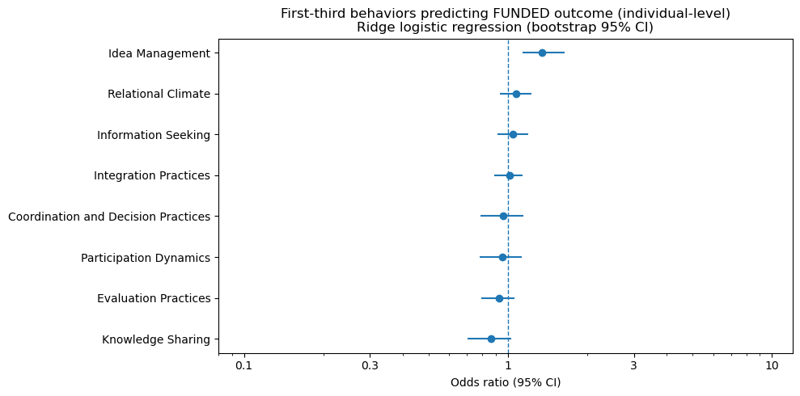
First ⅓ of a Meeting Behaviors and Funding Outcomes
At the individual level, only Idea Management shows a reliable association with funded outcomes
Other early behaviors show no reliable early association with funding outcomes
Notes:
This analysis targets a highly imbalanced outcome, so inference is based on bootstrap confidence intervals rather than p-values
this is the slide i should compare to evey (initially wasn’t lining up → now it is)
Model / Test
This slide uses a ridge-regularized logistic regression model to predict funding outcomes from behaviors observed in the first ⅓ of the meeting.
Because the outcome is highly imbalanced (many more funded than non-funded teams), ridge regularization is used to stabilize coefficient estimates. Statistical inference is based on bootstrap 95% confidence intervals for odds ratios, rather than Wald p-values, which can be unreliable under imbalance and near-separation.
Interpretation
Odds ratios are reported per 1 standard deviation increase in each behavior (features were standardized).
Results (bootstrap-based inference)
Evaluation Practices shows a robust negative association with funding outcomes in the first ⅓ of the meeting (bootstrap CI excludes OR = 1). All other behaviors show directional effects, but their bootstrap confidence intervals overlap OR = 1 and are therefore interpreted as weaker evidence.
Significant (p < .05):
Coordination & Decision Practices: OR ≈ 0.28, p ≈ 5.3 × 10⁻¹¹
Participation Dynamics: OR ≈ 0.64, p ≈ 0.0010
Not significant (p ≥ .05):
Knowledge Sharing: OR ≈ 1.22, p ≈ 0.067
Idea Management: OR ≈ 1.16, p ≈ 0.143
Evaluation Practices: OR ≈ 1.07, p ≈ 0.399
Integration Practices: OR ≈ 1.06, p ≈ 0.41
Information Seeking: OR ≈ 1.02, p ≈ 0.785
Relational Climate: OR ≈ 0.99, p ≈ 0.916
Wald p-values are reported for reference only and are not used for the primary claims on this slide.
Jan 14 2026 15:00 MEETING NOTES:
Not really useful: relational climate and participation dynamics.
are these having idea or closure.
what are the ideas proposed and how are they proposed (that’s what linkogrpahy is showing)
from slide notes:
show the significance (this graph captures the direction)
we want the sizeable effect and the stat sig
(this get address in slide “6B” otherwise known as slide 7 in slidedeck)

Slide 7
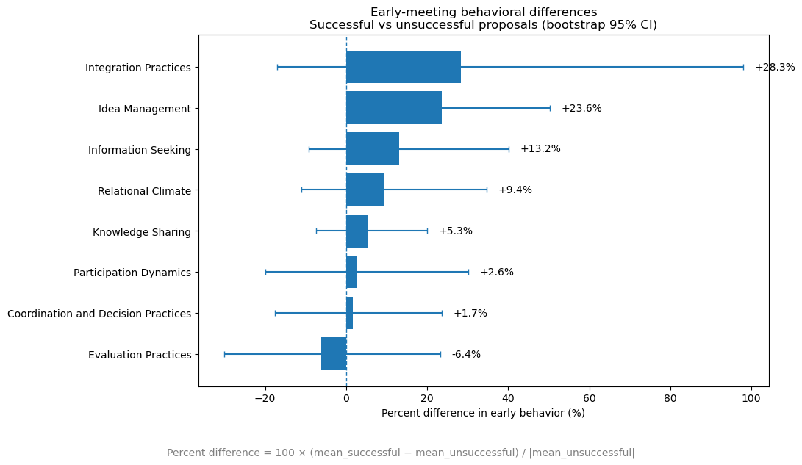
First ⅓ of a Meeting Behavioral Differences Between Successful and Unsuccessful Proposals
Unsuccessful proposals area characterized by higher levels of early Evaluation, Integration, and Coordination & Decision Practices
The largest differences appear in Evaluation, Integration Practices (≅20-30%)
Notes:
Bootstrap significance (session-level, 95% CI; primary inference):
Idea Management: +23.6%, 95% CI ≈ [1.0%, 50.2%], p_boot = .041
All other early behaviors have bootstrap p > .20 and CIs crossing 0
Interpretation: Only Idea Management shows a statistically reliable early-session difference between successful and unsuccessful proposals; other effects are directionally suggestive but unstable under resampling.
Reference (descriptive bootstrap p-values; not inferential):
Integration Practices: p_boot = .276
Information Seeking: p_boot = .244
Relational Climate: p_boot = .382
Knowledge Sharing: p_boot = .418
Participation Dynamics: p_boot = .838
Coordination & Decision Practices: p_boot = .848
Evaluation Practices: p_boot = .686

Slide 8
What Signals from the First ⅓ of Meetings Reveal
Early meeting behaviors already differentiate roles, team formation, and funding outcomes
The strongest early signals reflect idea-focused behaviors (Knowledge Sharing, Information Seeking, etc.) not the raw participation volume
Temporal positioning of behaviors suggests structured idea flow early in meetings, motivating a linkography-inspired interpretation
  (implemented in subsequent slides)

Slide 9
Linkography as a Model of Idea Flow
Adapted from: Linkography: Unfolding the Design Process - Gabriela Goldschmidt
Linkography represents how conceptual contributions connect, build, and converge over time, rather than treating utterances as independent events
Originally developed to study design reasoning, capturing moments of expansion, refinement, and synthesis
Focuses on structural relationships between ideas, not speaking volume or turn-based conversations
Why this matters: Early temporal patterns suggested structured idea flow that requires modeling relationships between ideas, not just behavioral-segmented counts
Notes:
Evey’s comment Jan 8 at 3:25 PM
what is an "idea" in our context and data?
Max’s response (Jan 9 at 14:40pm)
I updated the wording to “conceptual contributions” to better reflect the SCIALOG context, since “ideas” was too vague. In these meetings, participants are engaged in proposal-oriented reasoning. This involves discussing, refining, and evaluating emerging conceptual explanations and solution directions. These conceptual contributions accumulate and interact over time as teams work toward a fundable research proposal.
In the context of the data, this may mean an observable, coded behavior in which the participants advances/modifies/evaluates/etc. proposal-relevant content during the meeting.
In practice, this may look like (to list a few):
Proposing a potential hypothesis, or explanation
(e.g. suggesting how a biological process might work)
Developing or refining an earlier contribution
(adding detail, clarifying assumptions)
Evaluating feasibility, plausibility, or relevance
(critiquing, rejecting/accepting an idea, etc.)
Integrating multiple contributions (think of the team members)
(linking concepts across speakers, domains, prior discussions)
Structuring or coordinating proposal direction —> think of the “facilitator role”
(deciding what to pursue, drop, prioritize)
These are also shown through the coded behaviors (Idea Management, Evaluation Practices, Knowledge Sharing, etc.)
Think conceptually: why does this matter or link to our previous slides (and successful teams - roles, temporal thirds - what kind of additional ) how does it help an insufficient idea
why care about the coupling of the strategies / annotation codes
10: what did you find using this technique, how does this give deeper understanding of teams.

Slide 10
Mapping Linkography Concepts to Behavioral Annotations
Linkography concept | STM annotation(s) | How is it detected | Why it matters
Forelink | Knowledge Sharing, Idea Management | Consecutive ideation segments | Progressive idea development
Backlink | Evaluation Practices | Explicit reference to prior statement | References to prior ideas
Critical Move | Integration Practices, Coordination & Decision | Moments of idea integration | Decision or transition points
Chunk | Repeated Knowledge Sharing / Idea Management clusters | Short sequences of repeated idea-focused actions | Sustained shared focus
“Idea” | Idea Management, Knowledge Sharing, Integration Practices | The topical or conceptual concept being proposed, referenced, refined, or evaluated within a conceptual contribution | Ideas are the semantic material that conceptual contributions act upon and link over time; tracking them enables proposal convergence, divergence, and refinement across the meeting
We map core linkography concepts (e.g., forelinks, backlinks, critical moves) to existing SCIALOG behavioral annotations
This enables an approximate representation of idea flow
Notes:
Jan 9: Added in the “Idea” column

Slide 11
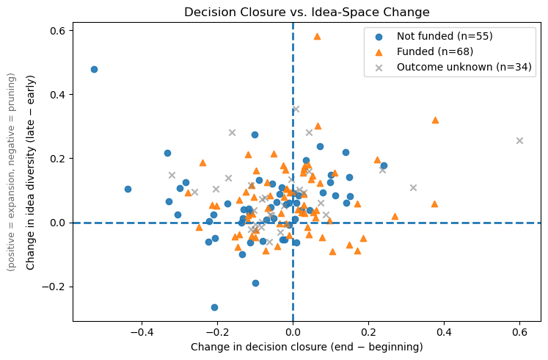
Late-Stage Convergence Differentiates Successful Proposals
Slide 10 - First Attempt
Funded teams show late-stage idea narrowing coupled with decision closure
Non-funded teams tend to maintain or expand idea space without comparable closure
Across sessions, successful proposals are associated with late-stage pruning of idea-space alongside increased decision and commitment behavior. In contrast, unsuccessful or unresolved sessions tend to retain higher late-stage idea diversity without decisive convergence.
Notes:
Scratch notes for rewriting this slide:
Meeting w/ Evey (01/07/2026)
more context in (for linkography) what have i tried, what worked, didn’t work etc.
make sense of it.
scratch:
what happens before a specific code etc. or after etc. ?
Maybe something like this?
P( Integration | Evaluation, middle)
P(Decision | Integration, end)
P(Evaluation | Knowledge Sharing, beginning)
Rather than treating behavioral codes as independent signals, we model how specific behaviors function as transitions between idea states—capturing when critique leads to synthesis versus stagnation.
“What role does Knowledge Sharing play in moving the team toward alignment, decision, or breakdown?”
next missing step?: “When Knowledge Sharing appears in this configuration, what happens next at the meeting level?”
Maybe something like this (for redoing this slide → written Jan 14):
Do funded teams show different idea-flow structure than unfunded teams?
and
Can behavioral codes explain that structure?
Or something like this:
“What late-stage interaction patterns are associated with different proposal outcomes?”
—------------------------
Jan 14 2026 15:00 MEETING NOTES:
From this graph (EVEY)
- what is important for these teams, these are brainstorming ideas,
why do teams narrow things down and have idea closure (important)
this stuff aligns with linkography
if this is starting to show in the analysis, how do we amplify this result, (and simplify this by: )
maybe ignore slide 9, and focus on the small parts on linkography
maybe this graph isn’t the best way to show it
How do you visualize differences b/w teams successful/unsuccessful teams (this will make sense to people)
SLIDE 10: TEXT MAKES SENSE - BUT HOW TF DID I GET THERE
HOW ARE THEY HAVING DECISION CLOSURE, AND HOW DID YOU KNOW TEAMS ARE NARROWING DOWN
HOW DID YOU REACH THESE CONCLUSIONS, AND HOW DO WE AMPLIFY THESE RESULTS
RESEARCH - THE DIFFICULT PART IS EXPLAINING. NOT CODING. HOW DO YOU BREAK DOWN THIS MULTI-STEP AND STILL GET WHAT YOU ARE GETTING, AND BELIEVE IN YOUR RESULTS
IDEA CLOSURE:
what kind of behaviors codes/couplets of the annotation might mean team is wrapping up on an idea.
might have to figure out a way to distinguish them (FP / FN)
proposed idea / similarities
even we were to IDEA CLOSURE

Slide 12
Slide 10 - Explanation (Part 1)
I started by treating the annotation codes as basic behavioral building blocks, rather than the labels they were in the codebook. This is because I kept relaying back to the idea of team formation, rather team funding as the finalized output -- that's what was on my mind at the time cause everything keeps tying back to that. Cause I was trying to describe at the certain parts, what gets a team funded?
So then trying to piece those parts together because there could be up to three codes with one utterance, I was trying to make it a bit simpler on myself. As I also knew the annotation codes wouldn't be able to tell the story by themselves - I also ended up using the respective transcripts to end up checking it as well. For this, I ended up grouping the original annotation codes by the cognitive function they serve in a team's reasoning process, rather than focusing on the duration or frequency a specific annotation code shows up.
That led to this idea of something like the following (just to keep my head intact, not saying all meetings followed this structure to a tee):
**Seeding/Expansion --> Stress-testing --> Synthesis --> Commitment**
I had grouped `Knowledge Sharing` and `Information Seeking` under a `Expansion/Seeding` category because both of these behaviors introduce or clarify information that expands the set of possible ideas under consideration. `Knowledge Sharing` ends up bringing in content into the conversation; `Information Seeking` deals with missing information or clarification.
I had grouped `Evaluation Practices` on its own under a `Stress-testing` category because it does not expand the idea space, but rather compares, critiques or constrains the existing ideas. This all represents `stress-testing`, which alternatives are weighed against feasibility, overall group goals, or other possible constraints. This had often marked a turning point between the exploration and convergence.
Notes:
Part 1
EV Comment: 1:51pm Jan 21 comment:
“could you elaborate what is a "behavioral building block" and the difference between that and the label in codebook? a concrete example would be helpful”
“similar to the comments on "cognitive function": try to think a bit harder and use simpler language, what really are you trying to say? what is really the difference between those codes "blocks" or "cognitive functions"?”
in response to “annotation codes as basic behavioral building blocks, rather than the labels they were in the codebook.”
MX response:
What I was trying to get at with “behavioral building blocks” is the difference between describing what someone said and understanding what the behavior did for the idea over time.
In the codebook, each annotation (e.g. Knowledge Sharing, Evaluation Practices, Integration Practices) is a label for what type of behavior appears in a single utterance. At that level, the code is descriptive, but does not show how it contributes to the development of an idea across the meeting.
When I refer to the codes as “behavioral building blocks” or “cognitive functions” I am using the same annotations, but interpreting them by the role they play when combined with surrounding behaviors. This then focuses from individual utterances, to how ideas are constructed over time.
For e.g.
A Knowledge Sharing utterance such as:
“Here’s what we found in the initial data.”
This tells us information was introduced, but nothing about how it was used.
If this was followed by an Evaluation Practices utterance such as:
“Does that scale with our constraints?”
The Knowledge Sharing behavior now functions as the input that is being stress-tested, or evaluated.
If these are later followed by an Integration Practices utterance such as:
“So we can frame this as X while accounting for Y”
Then those same codes collectively describe a sequence in which the information is introduced, evaluated, and synthesized. In this sense, the annotations act as building blocks for tracking how an idea develops, rather than as stand alone labels.
EV Comment 1:51PM Jan 21 comment:
“how is the cognitive function inferred ? how do you know what function each code serves?” “what will be the simplest language you can use to exchange the jargon here? so that everyone can understand what you meant”
in response to “I ended up grouping the original annotation codes by the cognitive function…”
MX response:
When I say that I grouped the annotation codes by “cognitive function”, I’m not saying that the function is explicitly encoded into the codeboook nor it was inferred via some formal model. I had based it around the idea for each of the annotation codes from the codebook –
what does this behavior do to the set of ideas under discussion?
This might mean asking whether it (1) adds/clarifies ideas, (2) questions, compares or contrasts ideas, (3) combine/reconciles ideas or even (4) does this lock in a direction OR move the group forward.
Based on that question:
I treated Knowledge Sharing and Information Seeking as a way to expanding the idea space. This is b/c they introduce new information or clarify missing pieces of information.
Evaluation Practices I had treated as a form of stress-testing. This is because they do not add any new information, but instead assess the possible feasibility/constraints/tradeoffs of an idea
Integration Practices were treated as synthesis, because they explicitly combine or reconcile multiple ideas into a more coherent proposal.
Coordination and Decision Practices were treated as commitment, because they signal alignment, next steps, or closure rather than exploration.
The “cognitive function” labels were not meant to introduce new theory. They were shorthand for how each behavior moves an idea forward when looking across multiple utterances, rather than at a single moment in isolation.
EV Comment 1:52PM Jan 21
“is this a cognitive function”?
in response to: “under a `Expansion/Seeding` category”
MX response:
When I used the term “cognitive function”, I wasn’t trying to claim a psychological function in individuals. What I had meant was the functional role a behavior plays in the group’s reasoning process.
E.g. I had labeled Knowledge Sharing and Information Seeking as “Expansion/Seeding” not b/c they represent a distinct cognitive function, but bc at the interaction level, they consistently expand the set of ideas or information under discussion. They increase what the team is considering, regardless of who is speaking or what mental process is involved.
EV Comment 1:58PM Jan 21 :
“what is your argument for this? for example, now i am evaluating your writing and leaving open questions and push back, do you not think this is expanding "idea space"?” “wouldn't it also "expand" idea space by showing alternative idea spaces?”
in response to: “because it does not expand the idea space, but rather compares”
MX Response:
That’s true when evaluation can sometimes expand idea space, especially when it exposes gaps, contradictions, or alternative decisions. I don’t mean to claim that Evaluation Practices never expand ideas.
What I was trying to distinguish is the primary role the behavior plays at the moment it occurs. In my grouping, Expansion/Seeding behaviors directly introduce new candidate ideas or information into the discussion, whereas Evaluation Practices typically operate on ideas that are already on the table by questioning their feasibility, relevance, or fit.
Evaluation most often reshapes or constraints the existing idea space rather than adding new ideas outright, even though it can indirectly lead to new ideas later. That’s why I grouped it separately as “stress-testing” rather than expansion.
EV Comment 2PM Jan 21:
“is this something you observed in the data? or is there literature to back it up (then add citations)”
in response to: “This had often marked a turning point between the exploration and convergence.”
MX Response:
This claim is based on patterns observed in the SCIALOG data rather than directly from prior literature. In several meetings, Evaluation Practices tended to occur after idea expansion and before synthesis or coordination, coinciding with a shift toward narrowing the space of ideas. I treat this as an observed tendency in the dataset, not a universal rule.

Slide 13
Slide 10 - Explanation (Part 2)
I had grouped `Integration Practices` as a `synthesis` category because it involves the combining, reconciling, or reframing multiple ideas into a more robust structure. This actively constructs something new from existing ideas.
I had finally grouped `Coordination and Decision Practices` as a `commitment` behavior. This effectively signals alignment and forward movement; not necessarily an idea exploration. This may include choosing a direction, assigning tasks, defining next steps, formalizing decisions. Not all of a scientific teams' interactions would show this behavior, but this behavior was the last "part" that still needed to be included.
`Idea Management` was given its own category of `IDEA_MGNT` because it captures the meta-behavior about how ideas are tracked, referenced, or organized over time. This also may include behaviors such as labeling ideas, revisiting earlier suggestions, considering alternative ideas, transitioning between ideas, or even just the continuity throughout the meeting -- keeping the structure together.
For this, `Relational Climate` was never filtered into one of these categories, or given its own, because it was more so about the emotional aspect of these scientific team meetings, cause I again, kept tying all of this to the proposal outcomes.
After I had defined all of these higher-level behavioral, I then incorporated all of this back into the temporal third segments (beginning, middle, end). The goal was to test whether these grouped behaviors shift over time in ways consistent with convergence. Because of the large amount of meetings and knowing they all would be different in terms of structure, I had focused on how these grouped behaviors transition into one another. This then allowed me to find out which behavioral states, trying to keep in-tact an idea-state flow rather than isolating the individual annotation codes. For this I treated `IDEA_MGMT` as a way to support the transitions without implying convergence (also to keep true to the codebook), to seeing if a relationship with these behaviors hold. This is before tying it to outcomes such as team formation or funding.
Notes:
Part 2
EV comment 2:17PM Jan 21
“even though i have read everything before this multiple times; i still am not sure why you chose to group codes into these categories: (1) what are your arguments for grouping them, (2) what goals are you trying to achieve and why you can't achieve this without these groups, and (3) how did you decide on these categories and which ones to be grouped? (purely based on your "idea" is not good enough an answer. could you provide evidence to support your argument. such as second order statistical analysis on relationships between codes, or quotes from data, or literature you could cite.)
could you try again to answer these questions specifically”
“i think you are getting there though in the sense that you are trying to separate codes by whether they are "expanding" or "contracting"; we just need more evidence and arguments to support your choices of grouping beyond just what you *think”
“and im just trying to push you little by little to be clearer with your thinking and arguments”
In response to “After I had defined all of these higher-level behavioral, …”
MX Response:
Goal.
The goal of grouping the annotation codes was to test whether higher-level behavioral patterns over time could indicate idea convergence or narrowing in team meetings. Specifically, I was interested in whether meetings show directional movement from idea expansion toward consolidation or commitment, rather than simply documenting which behaviors occur.
Why grouping was necessary:
At the level of individual annotation codes, the data is too fine-grained and sparse to reason about trajectories across an entire meeting. Many codes appear infrequently, and analyzing transitions between all the original code results in a large number of low-signal transitions that are difficult to interpret in terms of convergence. Grouping the codes was a way to reduce complexity, and make it possible to examine whether families of related behaviors increase or decrease over time. This goal could not be achieved by treating each code independently, because convergence is inherently a higher-level process that unfolds across multiple utterances rather than within a single coded behavior.
How the groupings were chosen.
The groupings were initially hypothesis-driven and informed by two sources:
the functional definitions in the codebook, and
The recurring sequencing patterns observed in the SCIALOG transcripts
Rather than grouping arbitrarily, I grouped codes based on whether they tended to (a) introduce or clarify information (Knowledge Sharing, Information Seeking), (b) interrogate or constrain existing ideas (Evaluation Practices), (c) combine or reframe ideas (Integration Practices), or (d) formalize alignment and next steps (Coordination and Decision Practices). This reflects an expansion-contraction framing, where behaviors are differentiated by whether they tend to open the idea space or narrow it
Evidence and limitations:
This grouping is not presented as a definitive cognitive taxonomy. It is an exploratory operationalization intended to test a specific question about convergence dynamics. Evidence for this framing comes from observed temporal ordering in the data (e.g., evaluation frequently following knowledge sharing and preceding integration), as well as transition analyses showing non-random co-occurence between certain codes. However, I acknowledge that stronger support would require second-order statistical analysis of code co-occurence or explicit grounding in prior literature on idea generation and convergence. The limitations revealed by this approach ultimately motivated a shift toward linkography-based representations that preserve idea identity rather than relying solely on behavioral abstraction.

Slide 14
Slide 10 - Explanation (Part 3)
Once all these transitions were figured out, I had to figure out whether a `synthesis` or `commitment/closure` reflected genuine idea-level convergence or saying it was the end of a meeting. For these two behaviors (`synthesis` and `commitment/closure`, which involves the behaviors these are associated with in the codebook - see earlier section) I had figured out that these coordination and decision-like behaviors often increase near the end of the meetings due to the facilitation, reporting, or time management - not necessarily due to substantive agreement. I ended up running a false-positive diagnostic analysis while auditing the transcript for reference and using a lexical pattern detection. I then inspected these segments in context to distinguish when the meeting actually finished (because they ran out of time) compared to a genuine convergence, when people were wrapping up on an idea.
This then led me to figuring out that the narrowing does not rely on the behavioral annotations. This is what led me to figure out whether the diversity of ideas under discussion decreases over time. This led me to using an entropy to measure this conceptual spread. This motivation was because that the genuine convergence (e.g. a best idea, correct idea, final decision, successful outcome, etc.) should not only be reflected in how teams behave, but also to the extend the ideas are actually being considered. I then computed the entropy separately for the first-third and last-third of each meeting. For that, I defined a pruning score as the change in entropy over time -- negative values indicate narrowing of an idea space.
Notes:
Part 3
EV Comment 2:10pm Jan 21
“show a concrete example (quotes) from your audit”
In response to: “I had figured out that these coordination and decision-like behaviors often increase near the end of the meetings due to the facilitation, reporting, or time management - not necessarily due to substantive agreement. I ended up running a false-positive diagnostic analysis while auditing the transcript for reference and using a lexical pattern detection. I then inspected these segments in context to distinguish when the meeting actually finished (because they ran out of time) compared to a genuine convergence, when people were wrapping up on an idea.”
MX Response:
In other words, I will need to find/select a single SCIALOG meeting where Coordination/Decision behaviors increase in the final third of meeting, BUT where the transcript shows the meeting ending due to time or reporting constraints rather than idea-level agreement.
I will then include verbatim transcript excerpts illustrating (1) structural/logical closure and (2) a contrasting instance of genuine idea convergence, to make the distinction explicit
EV Comment 2:28PM Jan 21
“very interesting approach! makes sense!”
in response to: “using an entropy to measure this conceptual spread.”
MX Response:
Noted, nothing else to do here.
EV Comment 2:29PM Jan 21
“this is super clear! love it.” “more details on this method please: what is the unit of analysis and how did you calculate entropy
better with graphs and visuals”
in response to: “This motivation was because that the genuine convergence (e.g. a best idea, correct idea, final decision, successful outcome, etc.) should not only be reflected in how teams behave, but also to the extend the ideas are actually being considered.”
MX Response:
To clarify the method:
The unit of analysis is a single SCIALOG meeting, split into temporal thirds (early vs. late).
For each third, I treat the distribution of ideas under discussion as a proxy for the team’s conceptual state. Concretely, I operationalize this as the distribution of idea references (or idea states derived from transcript segmentation) within that segment.
Entropy is then computed over this distribution using standard Shannon entropy:
H = - \sum_i p_i \log p_i
where p_i represents the proportion of references to idea i within that temporal segment.
To assess narrowing, I compute entropy separately for the first third and last third of each meeting, and define a pruning score as:
\Delta H = H_{\text{late}} - H_{\text{early}}
Negative values indicate a reduction in conceptual spread (i.e., narrowing of the idea space).
In the slides, I will visualize this using:
distributions of entropy values across meetings
paired early vs. late entropy plots
example meetings showing alignment vs. mismatch between behavioral convergence and entropy-based narrowing
EV Comment 2:32PM Jan 21
“could this test be used to support your decision in grouping codes based on their role in "expansion" vs "narrowing" of idea spaces? then you will have concrete evidence to support your decisions that will be much more convincible”
in response to: “computed the entropy separately for the first-third and last-third of each meeting. For that, I defined a pruning score as the change in entropy over time -- negative values indicate narrowing of an idea space.”
MX Response:
Yes - this was something I started to realize after computing the pruning score.
Because the entropy provides a code-agnostic signal of idea-space narrowing, it can be used as a validation layer for the behavioral groupings. The idea would be to test whether utterances coded as Expansion/Seeding tend to precede stable or increasing entropy, while Synthesis and Commitment behaviors tend to precede entropy decreases.
If that pattern holds consistently across meetings, it would provide empirical support that these grouped codes differ not just conceptually, but in their observable effect on the idea space. This would allow the grouping to be defended based on outcomes in the data, rather than solely on theoretical interpretation.
EV Comment 2:44 PM Jan 21
“how are you defining and measuring "convergence"?”
in response to: “`commitment/closure` reflected genuine idea-level convergence”
MX Response:
In this work, I define convergence operationally rather than normatively. I am not claiming that teams converge on the “best” or “correct” idea. Instead, I define convergence as a reduction in the set of ideas actively under discussion, accompanied by signals of alignment or forward movement.
I measured convergence along two complementary dimensions:
Behavioral convergence was inferred from increases in synthesis and commitment/coordination behaviors, particularly when these followed earlier exploratory and evaluative behaviors rather than occurring in isolation.
Conceptual convergence was measured using entropy over idea states, where a decrease in entropy from the first to the last third of a meeting indicates narrowing of the idea space.
I treat convergence as present when either or both of these signals appear, and I explicitly examine cases where they diverge to avoid over-interpreting coordination or meeting closure as genuine idea-level convergence.

Slide 15
Slide 10 - Explanation (Part 4)
After this part was run, it was figured out that some of the meetings had strong `synthesis` and `commitment/closure` behaviors without a reduction in the entropy. Others showed conceptual narrowing without clear `commitment/closure` behavior. For this part I ended up checking against the transcript to figure out the exact cases and words spoken by the researchers.
Addressing this limitation, this holds because teams can exhibit `synthesis` and coordination behaviors without adhering to a specific idea, and they can narrow their idea space without signaling commitment through decision-oriented behaviors. This therefore shows that these annnotations and transition dynamics can help figuring out where convergence of an idea may be occuring, but insufficient on what the team has converged on. Some sort of semantic tracking would be required to confirm genuine ideal-level closure.
So then given all of this, **to assess decision closure**, I computed late-stage gains in Commitment/Closure relative to early segments, and examined whether these gains occurred after synthesis rather than in isolation. However, because commitment-like behaviors often occur near the end of meetings due to facilitation or reporting, I implemented a false-positive diagnostic using lexical pattern detection. Specifically, utterances containing facilitation or report-out language (e.g., time management, slide preparation, reporting instructions) were flagged via regex-based matching and audited in the transcript. Commitment or synthesis signals overlapping with these patterns were treated as potential structural closure rather than genuine idea-level convergence.
**To assess narrowing independently of behavioral annotations**, I computed idea-space entropy for the first and last thirds of each meeting, treating the distribution of idea states as a proxy for conceptual spread. A pruning score was defined as the change in entropy over time, with negative values indicating narrowing of the idea space. This provided a code-agnostic measure of whether teams reduced the range of ideas under active discussion.
Finally, I compared behavioral convergence signals (`synthesis` and `commitment` gains) with entropy-based narrowing. Meetings where these signals aligned were treated as strong candidates for convergence, while mismatches were examined via transcript inspection. These mismatches revealed that behavioral convergence and conceptual narrowing do not always co-occur, motivating the conclusion that behavioral annotations can localize where convergence may be occurring, but are insufficient to determine what idea a team has converged on without additional semantic tracking.
Notes:
Part 4
Note to self: need to go through these remaining six comments.
(Jan 21 2026 at 4:55PM)
EV Comment 2:36PM Jan 21
“add graphs/visualizations to illustrate this. concrete examples from the data will also help. this is a very interesting finding”
for this part: “After this part was run, it was figured out that some of the meetings had strong `synthesis` and `commitment/closure` behaviors without a reduction in the entropy. Others showed conceptual narrowing without clear `commitment/closure` behavior. For this part I ended up checking against the transcript to figure out the exact cases and words spoken by the researchers.”
MX Comment:
Noted, will find examples + graph/viz.
EV Comment 2:39PM Jan 21
“examples from data please; or visualizations/graphs”
For this part: “this holds because teams can exhibit `synthesis` and coordination behaviors without adhering to a specific idea, and they can narrow their idea space without signaling commitment through decision-oriented behaviors.”
MX Comment:
Noted, will find examples + graph/viz.
EV Comment 2:39 Jan 21
“what is "transition dynamics"?”
For this part: “these annnotations and transition dynamics can help figuring”
MX Comment:
By “transition dynamics”, I mean how teams move from one type of behavior to another over time, such as sharing information → evaluating it → synthesizing it. I focus on these shifts because they better reflect how ideas develop than any single annotation on its own.
EV Comment 3:05pm Jan 21
“why should this computation work? and *dumb this language down even more?”
For this part: “**to assess decision closure**, I computed late-stage gains in Commitment/Closure relative to early segments, and examined whether these gains occurred after synthesis rather than in isolation. ”
MX Comment:
The idea is that real decisions usually come after ideas have been worked through. By checking whether commitment increases near the end and follows synthesis, I’m testing whether closure looks like a natural outcome of reasoning rather than just a meeting ending.
EV Comment 3:07pm Jan 21
“why?”
For this part: “**To assess narrowing independently of behavioral annotations**, I computed idea-space entropy for the first and last thirds of each meeting, treating the distribution of idea states as a proxy for conceptual spread. ”
MX Comment:
The reason for using entropy here is that it provides a simple, code-agnostic way to quantify how spread out the ideas under discussion are at a given point in the meeting. When teams are exploring, conversation tends to be distributed across many different ideas. When teams narrow, discussion concentrates on fewer ideas more repeatedly.
EV Comment 3:07pm Jan 21
“why? what were you trying to achieve with this?”
For this part: “I compared behavioral convergence signals (`synthesis` and `commitment` gains) with entropy-based narrowing. ”
MX Comment:
I did this to check whether behaviors that signal convergence actually align with teams narrowing their ideas, or whether they sometimes occur without real conceptual agreement.

Slide 16
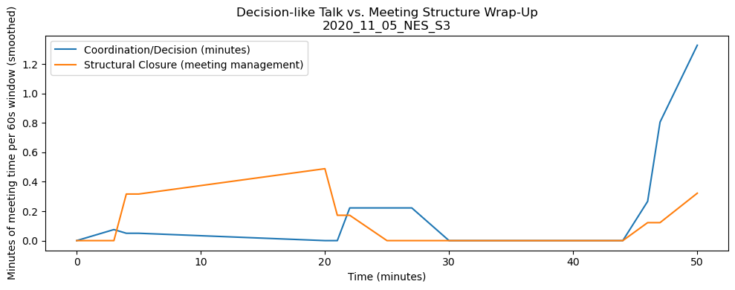
Why Decision ≠ Convergence
Quote from the example session (46:26 - 46:48):
“Great. So we’re actually at about eight minutes from close here… I’d like to give Xiao some help with reporting… do you want to share your screen…”
Notes:
Note to self: this is the idea I am trying to get across:
Teams can sound like they’re making decisions without actually converging on an idea.
By tracking coordination talk and whether the content space is narrowing, we can distinguish real convergence from surface-level decision activity.

Slide 17
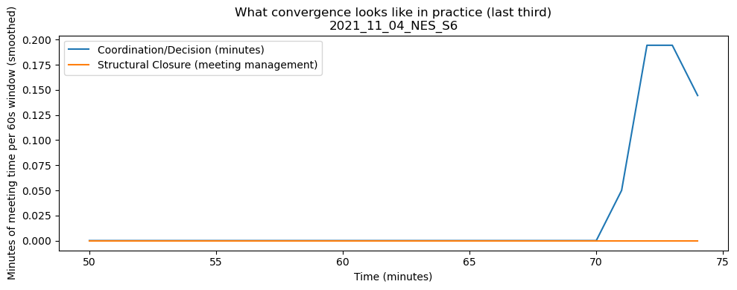
What Convergence Looks Like in Practice
Quote from the example session (72:42 - 73:08):
“Okay, yeah, I agree with you Will… we need to be more specific about what we’re going to do and have a clear plan for how we’re going to achieve the goals”
Notes:
This utterance qualifies as convergence because it expresses explicit agreement, occurs within a decision-oriented segment, and reiterates a single future-oriented commitment without introducing new alternatives.

Slide 18
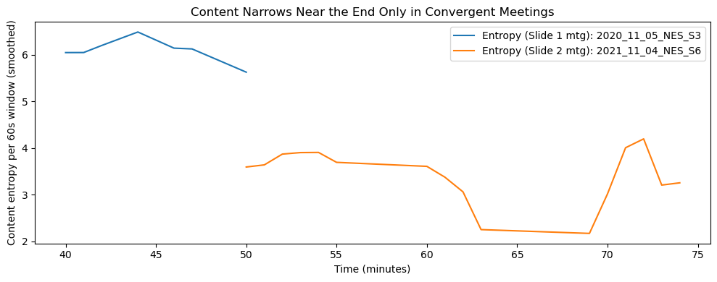
Only Some End-of-Meeting Decisions Narrow the Discussion
entropy of what?
what is said? how many people participating ?
In meetings with convergence, entropy drops near the end, indicating that the discussion narrows onto a small subset of ideas.
Notes:
“We show that decision talk alone is a poor signal for convergence because it often reflects meeting management. When teams truly converge, decision-like talk appears without structural closure, and the conversation narrows to fewer ideas. We capture that narrowing using entropy, which drops near the end only in convergent meetings.”
In the meeting that genuinely converges, entropy drops near the end, showing that the discussion concentrates on fewer ideas.
In the meeting that only sounds decisive, entropy does not drop, indicating continued exploration despite wrap-up talk.

Slide 19
Convergence Defined by Co-occurring Signals
Unit of Analysis: 60-second time bins of utterances within a meeting.
What’s Tracked: Annotation Codes (Coordination/Decision Practices) treated as categorical states.
Entropy Used: Shannon entropy over the distribution of active annotation codes within each 60-second bin.

Slide 20
When Do We Call a Moment ‘Convergent’?
From the two session examples:
Coordination & Decision Practices are sustained
Content entropy remains low, indicating focus on fewer ideas

Slide 21
Why Use Entropy as a Signal of Convergence?
Putman & Paulus (2009): Groups generate many ideas, then converge on a small subset for implementation
Kirschner et al. (2006): Collaboration involves moving from diverse perspectives toward shared common ground
Mondada (2006): Interactional practices activity closure before explicit decisions are stated
Wiltshire et al. (2017): Declines in communication entropy mark transitions toward more focused problem-solving.
Notes:
Putman & Paulus (2009): Groups generate many ideas but subsequently narrow to a small subset selected for implementation.
Kirschner et al. (2006): Collaboration involves negotiating from diverse perspectives toward shared standpoints and common ground.
Mondada (2006): Participants orient to activity closure through interactional practices before explicit decisions are formally stated.
Wiltshire et al. (2017): Declines in communication entropy signal phase transitions toward more ordered, focused team problem-solving.
Linked the sources above

Slide 22
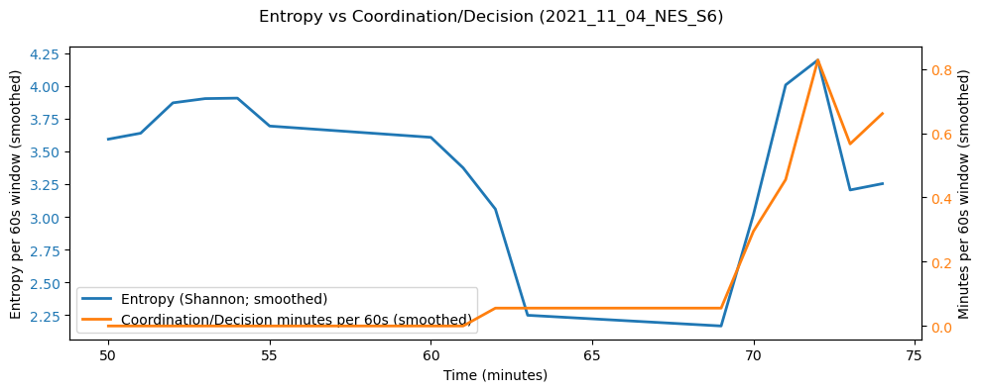
Convergence Appears Before Decisions Are Stated
NES_S6: convergent case (second example)

