Slide 1
Semantic Trajectory Analysis on Canonical v2 Outputs
Weighted semantic links across meetings, using the updated v2 annotation schema

Slide 2
Why This Layer
The canonical v2 outputs already track idea trajectory, decision crystallization, and related meeting-state signals.
This layer uses a fuzzy-linkography approach to add weighted links between utterances across the meeting.
The current implementation uses Latent Semantic Analysis as the semantic-similarity model inside that approach.
The current rerun also filters out auxiliary ATTN files.

Slide 3
Coverage
Metric | Value
Conferences included | 8 (2020NES, 2021ABI, 2021CMC, 2021MND, 2021MZT, 2021NES, 2021SLU, 2022MND)
Meetings analyzed | 179
Chunks analyzed | 1219
Sessions with outcomes | 136
Methodology | Fuzzy linkography
Similarity model | Latent Semantic Analysis

Slide 4
What Comes From The JSONs vs What We Compute
Directly from Evey's JSON outputs | Added by fuzzy linkography
chunk_summary.idea_trajectory | weighted links inferred between utterances across the full meeting
chunk_summary.decision_crystallization_level | meeting-level summary scores built from those inferred links
chunk_summary.collective_engagement_level | cross-chunk connection structure across the whole session
utterance_annotations | a session-level layer that is not directly stored in the JSON files
* The JSON files already contain chunk-level annotations. The fuzzy-linkography step adds a separate meeting-level layer by inferring weighted semantic links across utterances over time.

Slide 5
Worked Example: Added Meeting-Level Layer
Conference: 2020NES | Session: 2020_11_05_NES_S1 | Meeting: 1_DAC_Simulations_Zoom_Meeting_2020_11_05_12_24_10
Chunk | Time | idea_trajectory | decision level | full utterance quote
1 | 00:00 | divergent | 1 | The main question we are asked in this session is how your new technology development or new materials would interact with the earth system basically. One of the reasons people like converting CO2 to high energy density hydrocarbon is we already know how to move hydrocarbon all over the globe without losing energy density too much. how your new technology development
3 | 00:04 | divergent | 1 | I definitely think so Valentina that we should have a set of... wide range of technologies. direct air capture in Beijing versus New York would be very different
5 | 00:02 | convergent | 3 | if you look at CO2 hydrogenation to something like methanol, you need high pressures... being at sub-atmospheric pressures really hurts you in terms of equilibrium conversions. there needs to be a significant energy input in the form of pressure... and you need a source of hydrogen. based on my reading... you need high pressures
From | To | Weight
Chunk 1 | Chunk 5 | 0.997
* Worked example from one canonical SCIALOG meeting. Decision level comes from chunk_summary (1 = earlier/open discussion, 3 = more crystallized discussion). The left table comes directly from the JSON content; the right table is added by fuzzy linkography, which infers weighted links between those utterances across the meeting. Each row is one utterance from a longer meeting dialogue, not the full dialogue.

Slide 6
Current Direct Comparison
When the goal is funding, this added meeting-level layer does not give one clear score that separates funded from unfunded sessions.
Some differences appear in individual comparisons, but they do not stay consistent enough to treat as the main finding.
So the main thing this analysis is pulling out right now is session-level structure, not a clean funding signal.

Slide 7
How This Connects To The v2 JSON Terms
v2 JSON term | What it already gives us | What the added meeting-level layer contributes
idea_trajectory | The chunk-level direction of discussion in the JSONs | This added layer looks across the whole meeting and asks how strongly utterances stay related over time
decision_crystallization_level | How clearly the discussion is moving toward a decision | This added layer tracks whether later discussion reconnects to earlier content as decisions develop
collective_engagement_level | How active and mutually engaged the group seems | This added layer can show whether continuity is mostly within one speaker or carried across speakers
shared_vision / commitment flags | Signals that the team is aligning around an idea | This added layer helps show whether that alignment is sustained across the meeting rather than only inside one chunk

Slide 8
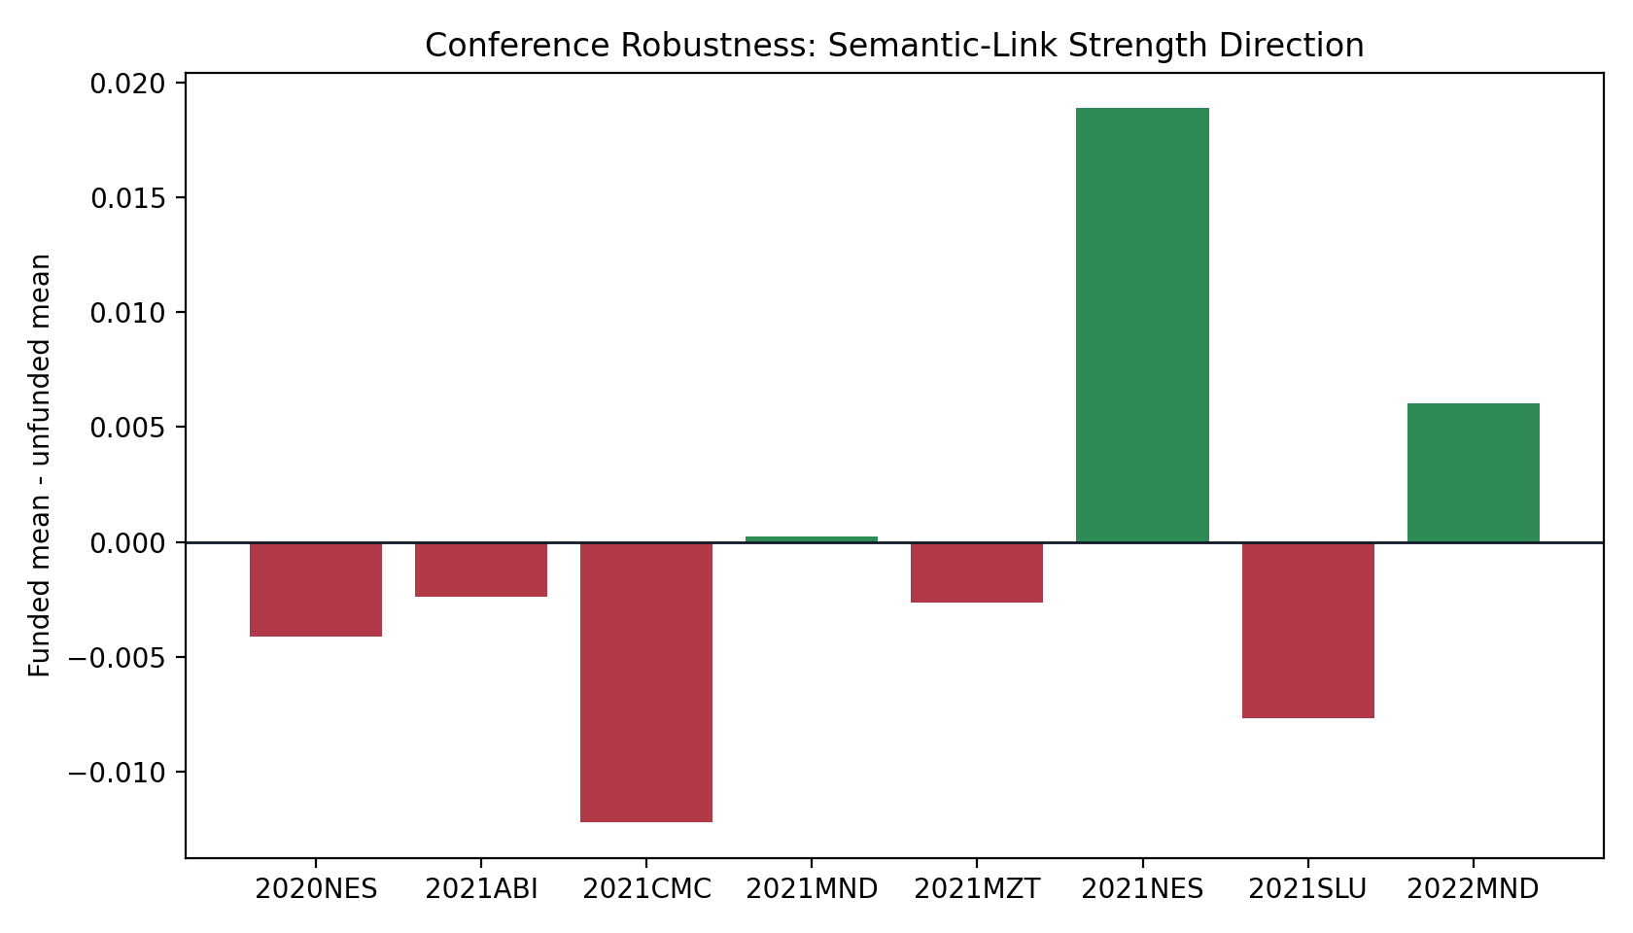
Across Conferences
One direction repeats in 5 of 8 conferences, but not across the full corpus.
Direction is mixed rather than stable across cohorts.
So this does not support one robust conference-invariant funding story.

Slide 9
Conference Breakdown
Conference | N | Funded Mean | Unfunded Mean | Diff
2020NES | 16 | 0.177 | 0.181 | -0.004
2021ABI | 18 | 0.186 | 0.189 | -0.002
2021CMC | 18 | 0.192 | 0.204 | -0.012
2021MND | 23 | 0.181 | 0.181 | +0.000
2021MZT | 15 | 0.171 | 0.174 | -0.003
2021NES | 15 | 0.199 | 0.180 | +0.019
2021SLU | 20 | 0.168 | 0.176 | -0.008
2022MND | 11 | 0.181 | 0.175 | +0.006

Slide 10
Example Meetings To Review: Higher-Score Cases
Conference | Session | Chunks | Funded
2020NES | 2020_11_05_NES_S1 | 2 | 0
2021MND | 2021_04_23_MND_S1 | 2 | 0
2021MND | 2021_04_22_MND_S8 | 1 | 0
2021NES | 2021_11_04_NES_S6 | 4 | 1
* Review examples only: these meetings were selected from the highest and lowest mean_nonzero_weight values after filtering to meetings with at least 10 extracted moves. They are not 'best' or 'worst' meetings.

Slide 11
Example Meetings To Review: Lower-Score Cases
Conference | Session | Chunks | Funded
2020NES | 2020_11_05_NES_S6 | 2 | 0
2021MND | 2021_04_22_MND_S7 | 2 | 0
2020NES | 2020_11_05_NES_S5 | 2 | 1
2020NES | 2020_11_06_NES_S1 | 4 | 1
* Review examples only: these meetings were selected from the highest and lowest mean_nonzero_weight values after filtering to meetings with at least 10 extracted moves. They are not 'best' or 'worst' meetings.

Slide 12
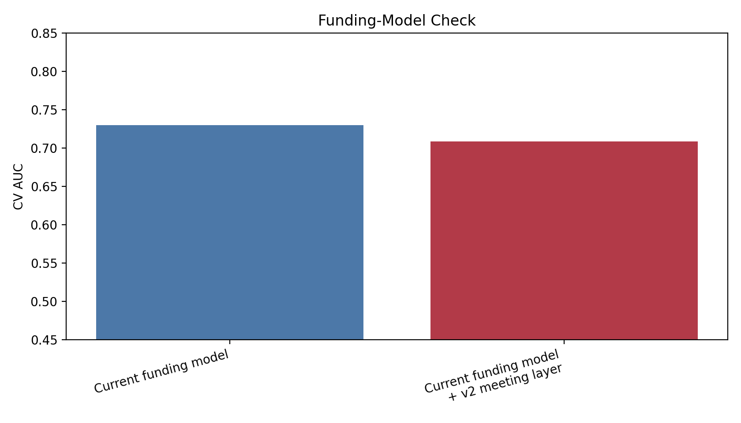
Main Modeling Result
This slide checks one question: does adding the v2 meeting-level layer help the current funding model?
Current funding model AUC = 0.730.
Current funding model + v2 meeting layer = 0.708.
Estimated change = -0.022.

Slide 13
What This Means Right Now
The canonical-source rerun gives broader coverage and cleaner outcome linkage.
But in this version, the new layer from Evey's updated JSON outputs is not improving the existing outcome model.
So the current value is to summarize and compare whole meetings on top of chunk_summary and utterance_annotations, rather than to claim better funding prediction yet.

Slide 14
Simple Model Comparison
Model | CV AUC
Current funding model | 0.730
Current funding model + v2 meeting layer | 0.708

Slide 15
How This Fits The v2 Outputs
Evey's canonical outputs add the updated JSON schema across 8 conferences, including chunk_summary and utterance_annotations.
This added meeting-level layer is a way to summarize the full session on top of those updated chunk annotations.
At the moment, its strongest use is to help characterize meetings and select sessions for closer review, not to claim a predictive gain by itself.

Slide 16
Next Step
Read the example meetings back against their chunk_summary and utterance_annotations.
Check whether the meeting-level patterns line up with idea_trajectory, decision_crystallization_level, and shared_vision_indicator in the underlying JSONs.
If needed, revise the semantic-similarity component while keeping the same overall fuzzy-linkography framework.
Keep the interpretation in the v2 annotation language rather than introducing a separate vocabulary.

