Slide 1
Web Development using React js
Sharma’ake Ali Kahie(Kahie)
Lecturer
Faculty of Computer & IT
Jamahiriya University of Science & Technology
kahie@just.edu.so

Slide 2
Advanced
Classes
Object
Arrow function
Default Parameter Values
Synchronous
Asynchronous
HTTP Request
JSON
Promise
JavaScript

Slide 3
Classes
Classes are a template for creating objects. They encapsulate data with code to work on that data. Classes in JS are built on prototypes but also have some syntax and semantics that are not shared with ES5 class-like semantics.
Classes are in fact "special functions", and just as you can define function expressions and function declarations, the class syntax has two components: class expressions and class declarations.

Slide 4
Constructor
A constructor function is initialized with a number of parameters, which would be assigned as properties of this, referring to the function itself. The first letter of the identifier would be capitalized by convention
The constructor method is a special method for creating and initializing an object created with a class. There can only be one special method with the name "constructor" in a class. A SyntaxError will be thrown if the class contains more than one occurrence of a constructor method.
It creates a new blank object.
It makes this to point to this newly created object inside the constructor function
It sets the prototype of the newly created object to the constructor function's prototype.
It makes the constructor function return the newly created object IF it is not returning anything.

Slide 5
Example
class Person
{ constructor(name)
{ this.name = name; }
introduce()
{
console.log(`Hello, my name is ${this.name}`);
}
}

Slide 6
Object
Object– An Object is a unique entity that contains property and methods. For example “car” is a real life Object, which has some characteristics like color, type, model, horsepower and performs certain action like drive. The characteristics of an Object are called as Property, in Object-Oriented Programming and the actions are called methods. An Object is an instance of a class. Objects are everywhere in JavaScript almost every element is an Object whether it is a function, array, and string
const otto = new Person('Otto’);
otto.introduce();

Slide 7
Object
JavaScript is designed on a simple object-based paradigm. An object is a collection of properties, and a property is an association between a name (or key) and a value. A property's value can be a function, in which case the property is known as a method. In addition to objects that are predefined in the browser, you can define your own objects. This chapter describes how to use objects, properties, functions, and methods, and how to create your own objects.
Objects in JavaScript, just as in many other programming languages, can be compared to objects in real life. The concept of objects in JavaScript can be understood with real life, tangible objects.
In JavaScript, an object is a standalone entity, with properties and type.
Compare it with a cup, for example. A cup is an object, with properties. A cup has a color, a design, weight, a material it is made of, etc. The same way, JavaScript objects can have properties, which define their characteristics.

Slide 8
Object
all JavaScript variables, both the object name (which could be a normal variable) and property name are case sensitive. You can define a property by assigning it a value. For example, let's create an object named myCar and give it properties named make, model, and year as follows:
const myCar = new Object();
myCar.make = 'Ford’;
myCar.model = 'Mustang’;
myCar.year = 1969;
The above example could also be written using an object initializer, which is a comma-delimited list of zero or more pairs of property names and associated values of an object, enclosed in curly braces ({}):
const myCar = { make: 'Ford', model: 'Mustang', year: 1969 };

Slide 9
Object
Unassigned properties of an object are undefined (and not null).
myCar.color; // undefined
Properties of JavaScript objects can also be accessed or set using a bracket notation (for more details see property accessors). Objects are sometimes called associative arrays, since each property is associated with a string value that can be used to access it. So, for example, you could access the properties of the myCar object as follows
myCar['make'] = 'Ford’;
myCar['model'] = 'Mustang’;
myCar['year'] = 1969;

Slide 10
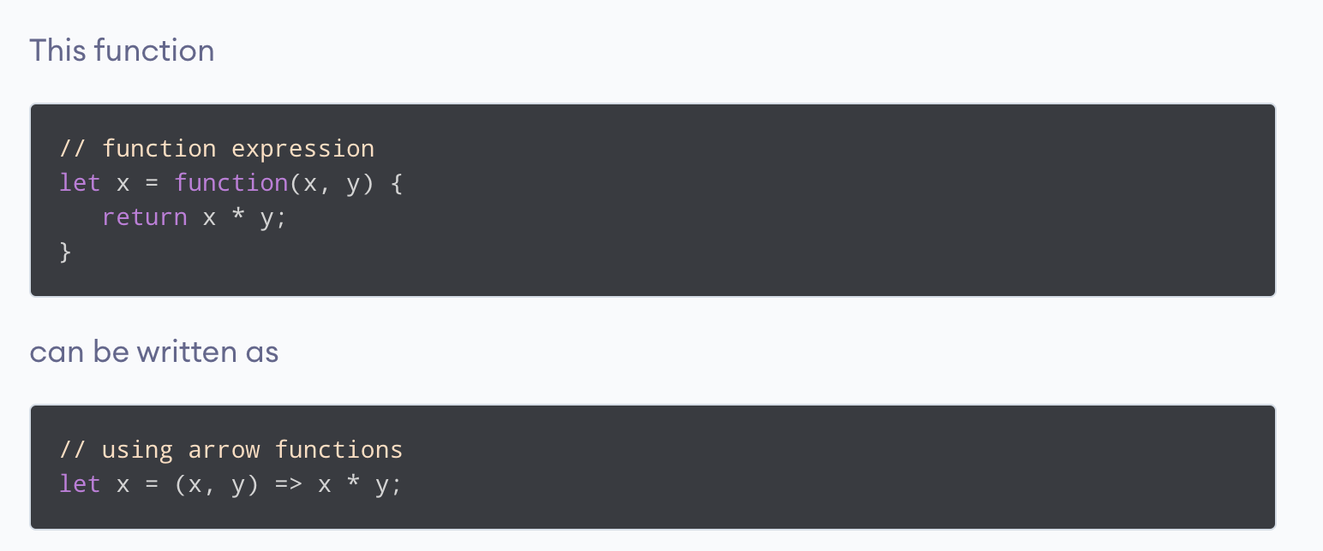
Arrow function
Arrow function is one of the features introduced in the ES6 version of JavaScript. It allows you to create functions in a cleaner way compared to regular functions. For example

Slide 11
Default Parameter Values
If a function in JavaScript is called with missing arguments (less than declared), the missing values are set to undefined.
Sometimes this is acceptable, but sometimes it is better to assign a default value to the parameter
function multiply(a, b = 1) {
return a * b;
}
console.log(multiply(5, 2));
// expected output: 10
console.log(multiply(5));

Slide 12
Function Rest Parameter
The rest parameter syntax allows a function to accept an indefinite number of arguments as an array, providing a way to represent variadic functions in JavaScript.
function sum(...args) { let sum = 0; for (let arg of args) sum += arg; return sum; } let x = sum(4, 9, 16, 25, 29, 100, 66, 77);

Slide 13
Callback function
A callback function is a function passed into another function as an argument, which is then invoked inside the outer function to complete some kind of routine or action.
function getName(name) {
alert('Hello ' + name);
}
function processUserInput(callback) {
var name = prompt('Please enter your name.');
callback(name);
}
processUserInput(getName);

Slide 14
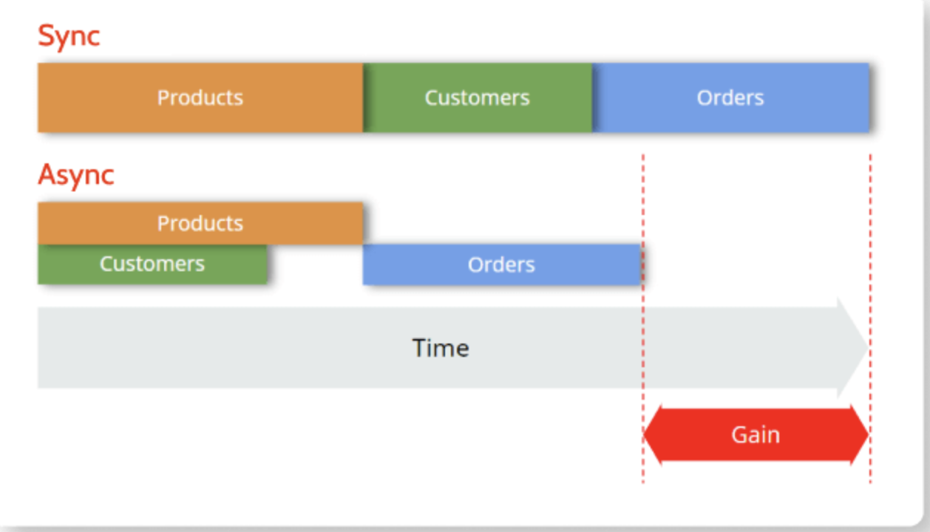
Asynchronous vs. Synchronous Programming
In synchronous operations tasks are performed one at a time and only when one is completed, the following is unblocked. In other words, you need to wait for a task to finish to move to the next one.
In asynchronous operations, on the other hand, you can move to another task before the previous one finishes. This way, with asynchronous programming you’re able to deal with multiple requests simultaneously, thus completing more tasks in a much shorter period of time
https://www.outsystems.com/blog/posts/asynchronous-vs-synchronous-programming/

Slide 15
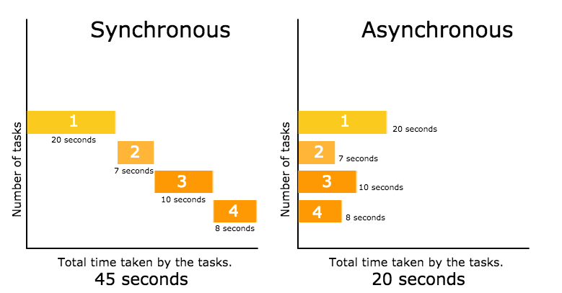
Asynchronous vs. Synchronous Programming

Slide 16
HTTP Request
XMLHttpRequest supports both synchronous and asynchronous communications. In general, however, asynchronous requests should be preferred to synchronous requests for performance reasons.
Synchronous requests block the execution of code which causes "freezing" on the screen and an unresponsive user experience
XMLHttpRequest()The constructor initializes an XMLHttpRequest. It must be called before any other method calls.
HTTP Methods
GET: is used to request data from a specified resource and most common HTTP methods
POST: is used to send data to a server to create/update a resource and most common HTTP methods
PUT: is used to send data to a server to create/update a resource
HEAD: is almost identical to GET, but without the response body
DELETE : method deletes the specified resource.
PATCH
OPTIONS
Free fake API for testing and prototyping.
https://jsonplaceholder.typicode.com/

Slide 17
HTTP response status codes
HTTP response status codes indicate whether a specific HTTP request has been successfully completed. Responses are grouped in five classes:
Informational responses (100–199)
Successful responses (200–299)
Redirection messages (300–399)
Client error responses (400–499)
Server error responses (500–599)

Slide 18
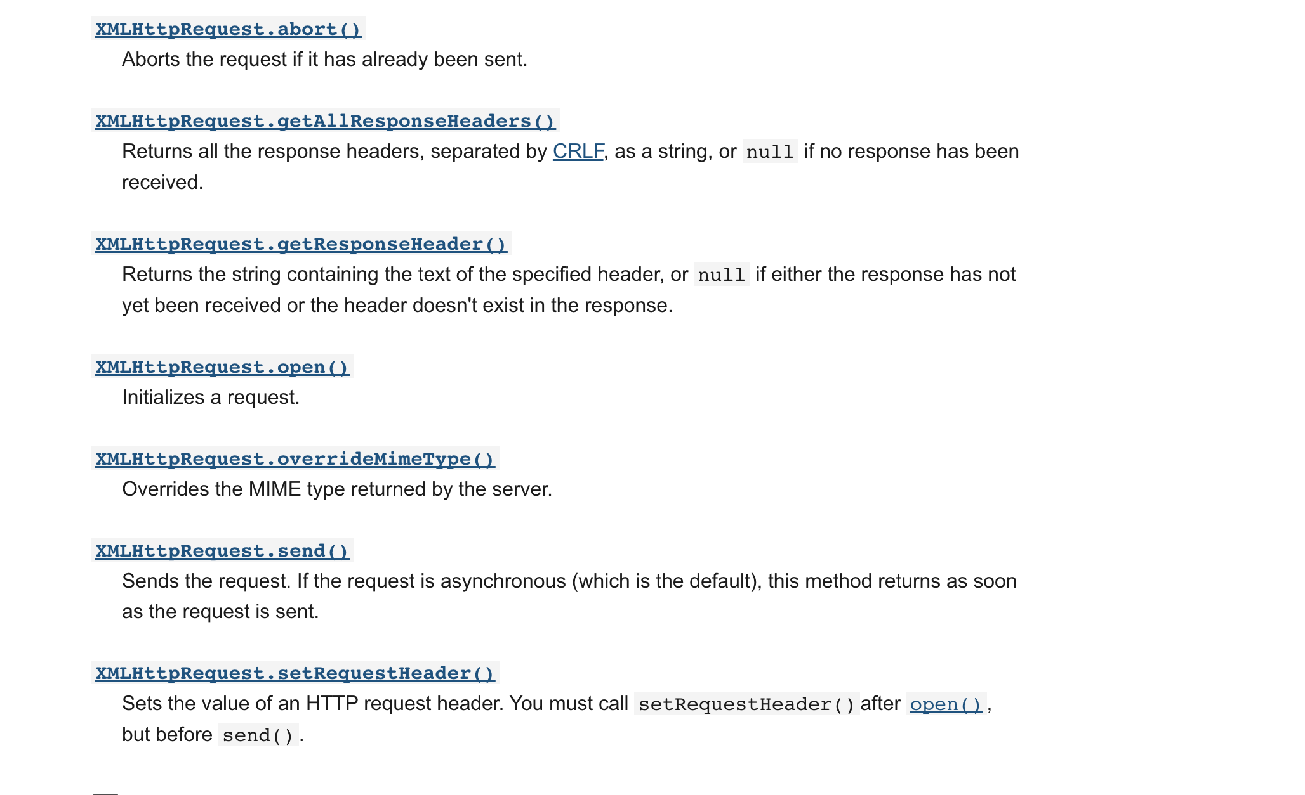
Methods

Slide 19
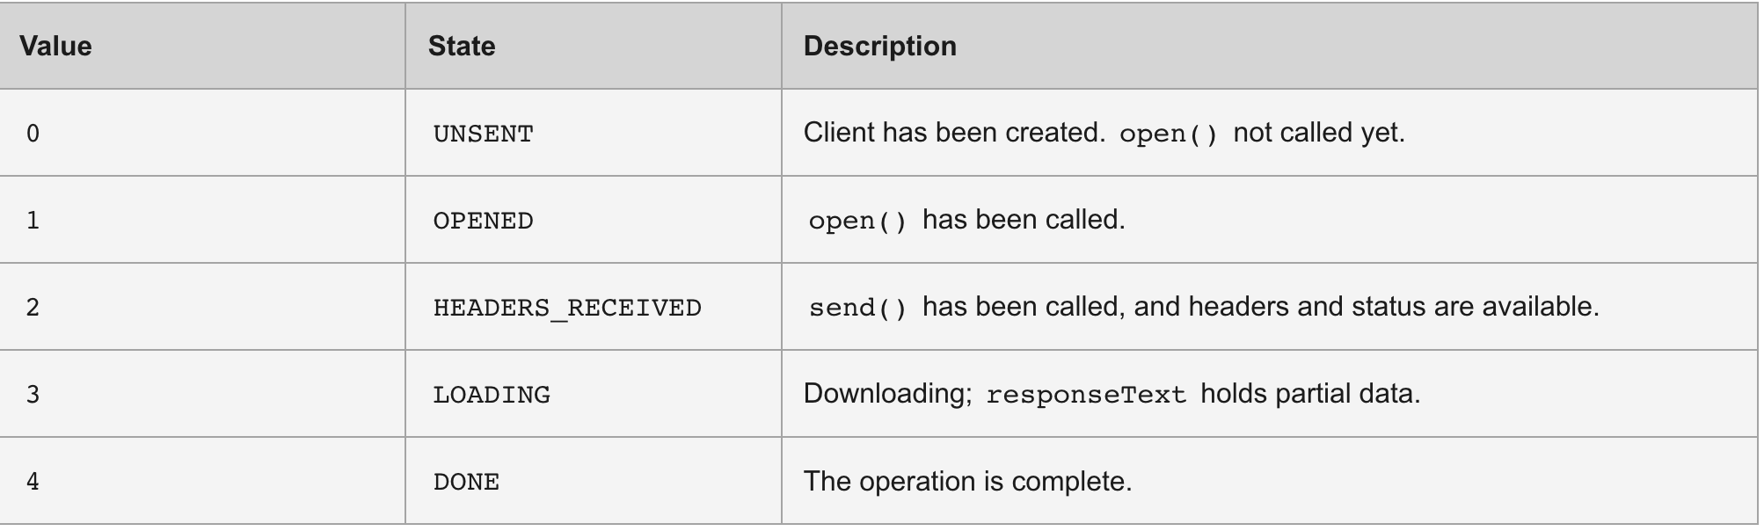
XMLHttpRequest.readyState
The XMLHttpRequest.readyState property returns the state an XMLHttpRequest client is in. An XHR client exists in one of the following states:
Notes:
https://developer.mozilla.org/en-US/docs/Web/API/XMLHttpRequest/readyState

Slide 20
Get data into XMLHttpRequest
XMLHttpRequest.responseText
The read-only XMLHttpRequest property responseText returns the text received from a server following a request being sent.
Syntax
var resultText = XMLHttpRequest.responseText;
A DOMString which contains either the textual data received using the XMLHttpRequest or null if the request failed or "" if the request has not yet been sent by calling send().
While handling an asynchronous request, the value of responseText always has the current content received from the server, even if it's incomplete because the data has not been completely received yet.
You know the entire content has been received when the value of readyState becomes XMLHttpRequest.DONE (4), and status becomes 200 ("OK").

Slide 21
HTTP Request using AJAX
Ajax is the traditional way to make an asynchronous HTTP request. Data can be sent using the HTTP POST method and received using the HTTP GET method. Let’s take a look and make a GET request. I’ll be using JSONPlaceholder, a free online REST API for developers that returns random data in JSON format
To make an HTTP call in Ajax, you need to initialize a new XMLHttpRequest() method, specify the URL endpoint and HTTP method (in this case GET). Finally, we use the open() method to tie the HTTP method and URL endpoint together and call the send() method to fire off the request
We log the HTTP response to the console by using the XMLHTTPRequest.onreadystatechange property which contains the event handler to be called when the readystatechanged event is fired
The onreadystatechange property has two methods, readyState and status which allow us to check the state of our request.
If readyState is equal to 4, it means the request is done. The readyState property has 5 responses

Slide 22
Get and Post method
The $.get method is used to execute GET requests. It takes two parameters: the endpoint and a callback function
The $.post method is another way to post data to the server. It take three parameters: the url, the data you want to post, and a callback function

Slide 23
Fetch
The Fetch API provides a JavaScript interface for accessing and manipulating parts of the HTTP pipeline, such as requests and responses. It also provides a global fetch() method that provides an easy, logical way to fetch resources asynchronously across the network.

Slide 24
JSON
JSON
JSON.stringify
JSON.parse
JSON (JavaScript Object Notation) is a lightweight data-interchange format. It is easy for humans to read and write. It is easy for machines to parse and generate. It is based on a subset of the JavaScript Programming Language
method converts a JavaScript object or value to a JSON string, optionally replacing values if a replacer function is specified or optionally including only the specified properties if a replacer array is specified
method parses a JSON string, constructing the JavaScript value or object described by the string. An optional reviver function can be provided to perform a transformation on the resulting object before it is returned.

Slide 25
JSON.stringify
console.log(JSON.stringify({ x: 5, y: 6 }));
// expected output: "{"x":5,"y":6}"
console.log(JSON.stringify([new Number(3), new String('false'), new Boolean(false)]));
// expected output: "[3,"false",false]"
console.log(JSON.stringify({ x: [10, undefined, function(){}, Symbol('')] }));
// expected output: "{"x":[10,null,null,null]}"
console.log(JSON.stringify(new Date(2006, 0, 2, 15, 4, 5)));

Slide 26
JSON.parse
const json = '{"result":true, "count":42}';
const obj = JSON.parse(json);
console.log(obj.count);
// expected output: 42
console.log(obj.result);
// expected output: true

Slide 27
Promise
The Promise object represents the eventual completion (or failure) of an asynchronous operation and its resulting value
A Promise is a proxy for a value not necessarily known when the promise is created. It allows you to associate handlers with an asynchronous action's eventual success value or failure reason. This lets asynchronous methods return values like synchronous methods: instead of immediately returning the final value, the asynchronous method returns a promise to supply the value at some point in the future
A Promise is in one of these states:
pending: initial state, neither fulfilled nor rejected.
fulfilled: meaning that the operation was completed successfully.
rejected: meaning that the operation failed.

Slide 28
Promise
A pending promise can either be fulfilled with a value or rejected with a reason (error). When either of these options happens, the associated handlers queued up by a promise's then method are called. If the promise has already been fulfilled or rejected when a corresponding handler is attached, the handler will be called, so there is no race condition between an asynchronous operation completing and its handlers being attached.
As the Promise.prototype.then() and Promise.prototype.catch() methods return promises, they can be chained.

Slide 29
Fetch API
The Fetch API provides a JavaScript interface for accessing and manipulating parts of the HTTP pipeline, such as requests and responses. It also provides a global fetch() method that provides an easy, logical way to fetch resources asynchronously across the network.
This kind of functionality was previously achieved using XMLHttpRequest. Fetch provides a better alternative that can be easily used by other technologies such as Service Workers. Fetch also provides a single logical place to define other HTTP-related concepts such as CORS and extensions to HTT

Slide 30
async keyword
First of all we have the async keyword, which you put in front of a function declaration to turn it into an async function. An async function is a function that knows how to expect the possibility of the await keyword being used to invoke asynchronous code
Try typing the following lines into your browser's JS console:
function hello() { return "Hello" };
hello();
The function returns "Hello" — nothing special, right?
But what if we turn this into an async function? Try the following:
async function hello() { return "Hello" };
hello();

Slide 31
await keyword
The advantage of an async function only becomes apparent when you combine it with the await keyword. await only works inside async functions within regular JavaScript code, however it can be used on its own with JavaScript modules
await can be put in front of any async promise-based function to pause your code on that line until the promise fulfills, then return the resulting value.
You can use await when calling any function that returns a Promise, including web API functions.
Here is a trivial example:
async function hello() {
return await Promise.resolve("Hello");
};
hello().then(alert);

Slide 32
End

