Slide 1
Support Vector Machines

Slide 2

Support Vector Machine (SVM)
Support Vector Machine (SVM) is a powerful supervised learning algorithm used for classification and regression tasks. It is particularly useful in high-dimensional spaces and works well when the data is not linearly separable.

Slide 3
SVM is a type of supervised learning algorithm that analyzes data for classification and regression. It is based on the concept of finding a hyperplane that best separates the data into different classes.
Key Features:
Effective in high-dimensional spaces.
Works well with both linear and non-linear classification problems.
Robust to overfitting, especially in high-dimensional feature spaces.

Slide 5

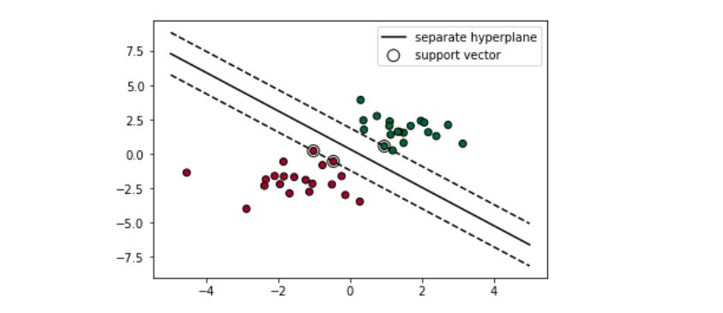
Creating a boundary between points ??

Slide 6
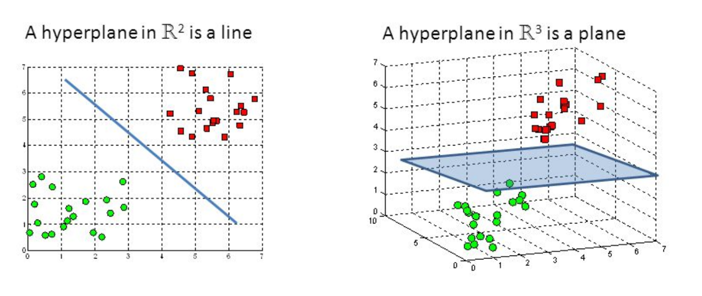
Classification with hyper planes
For example, the following figure depicts hyperplanes that separate groups of circles and squares in two and three dimensions. Because the circles and squares can be separated perfectly by the straight line or flat surface, they are said to be linearly separable

Slide 7
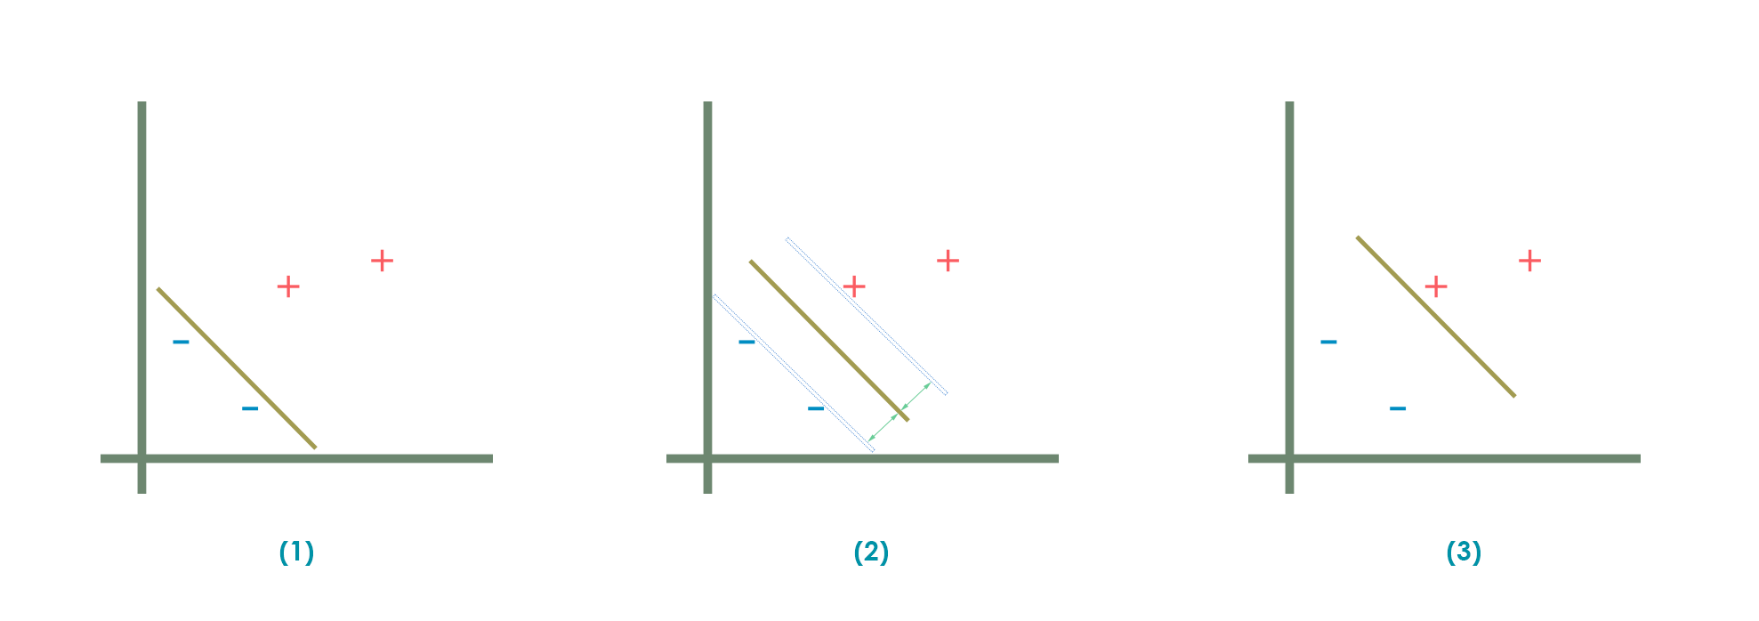
Which line to be considered that separates 2 classes
It finds out a line/ hyper-plane in multidimensional space that separate outs classes

Slide 8
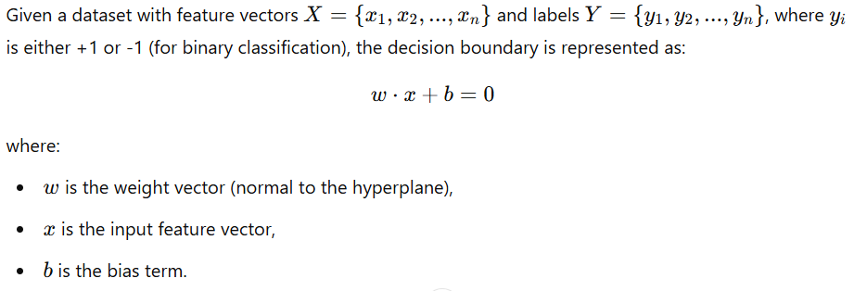
Linear SVM
If the data is linearly separable, SVM finds a hyperplane that maximizes the margin between the closest points of different classes. These closest points are called support vectors.
Mathematical Representation

Slide 9
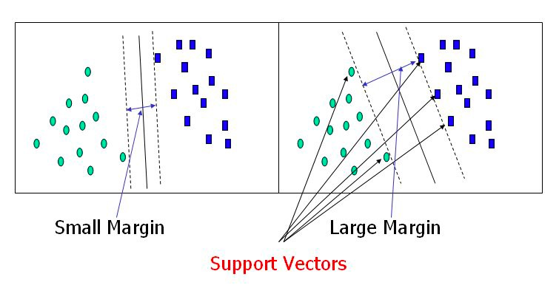
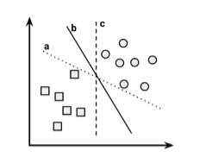
Which is the “best” Fit!
In two dimensions, the task of the SVM algorithm is to identify a line that separates the two classes. As shown in the following figure, there is more than one choice of dividing line between the groups of circles and squares. How does the algorithm choose

Slide 10
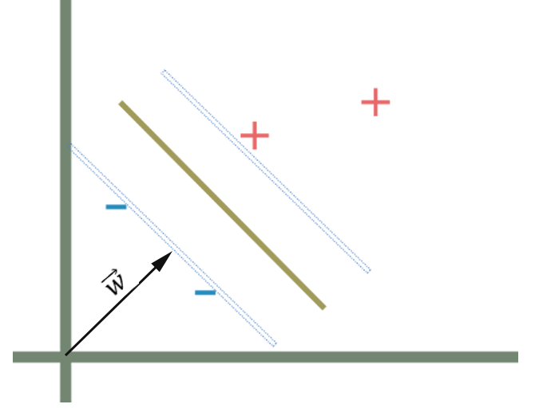
Thus, to generalize the representation of the plane of the decision boundary the vector that is normal (perpendicular) to the medium of the plane can be utilized. That is how any plane (line) can be described using a single equation
To represent the decision boundary, a vector (w) starting from the origin and normal the plane is drawn. But we don’t know about the parameters as well as the length of the vector w.

Slide 11
SVM in linear non-separable cases

Slide 12
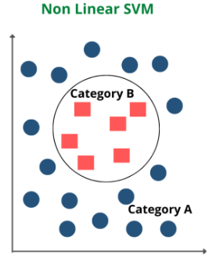
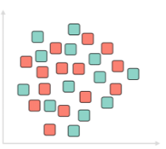
In the linearly separable case, SVM is trying to find the hyperplane that maximizes the margin, with the condition that both classes are classified correctly. But in reality, datasets are probably never linearly separable, so the condition of 100% correctly classified by a hyperplane will never be met.
SVM address non-linearly separable cases by introducing Kernel Tricks

Slide 13
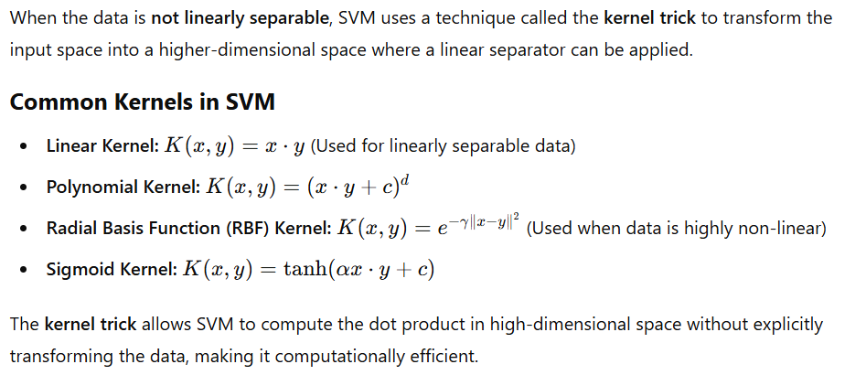
Non-Linearly Separable Data & Kernel Trick

Slide 14
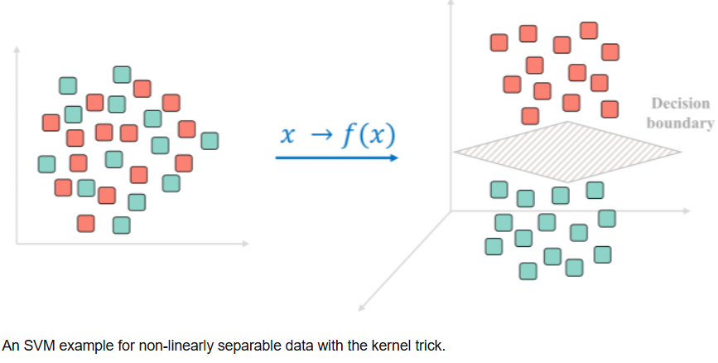
Kernel Trick
Clearly, there is no line that can separate the two classes in this x-y plane.
We apply transformation and add one more dimension as we call it z-axis.

Slide 15
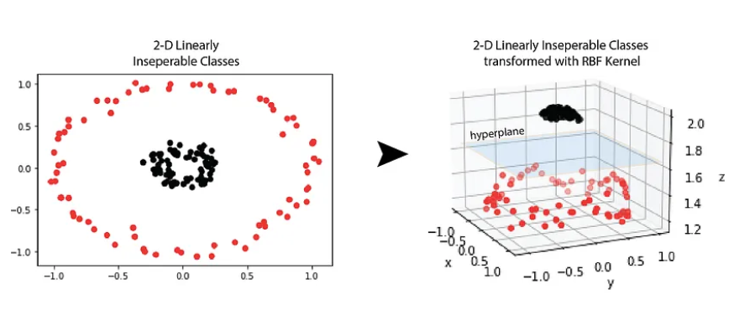
Using kernels for non-linear spaces
A key feature of SVMs is their ability to map the problem into a higher dimension space using a process known as the kernel trick. In doing so, a nonlinear relationship may suddenly appear to be quite linear.
What Kernel Trick does is it utilizes existing features, applies some transformations, and creates new features. Those new features are the key for SVM to find the nonlinear decision boundary.

Slide 16
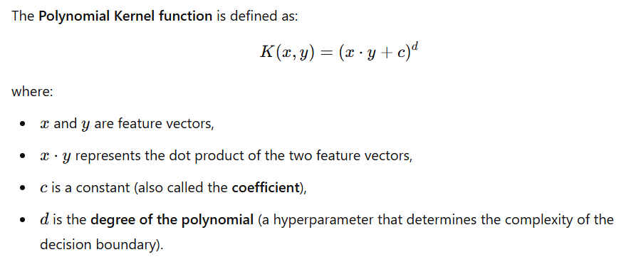
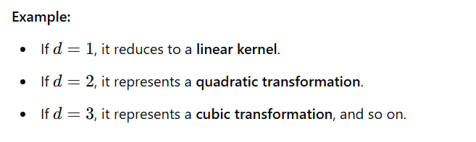
Kernel: Polynomial

Slide 17
Choosing the Degree of the Polynomial Kernel
The degree of the polynomial (d) determines the complexity of the model.
Effects of Different Values of d
d=1: The polynomial kernel becomes a linear kernel (no transformation).
d=2 (Quadratic Kernel): Can handle data with slight curvature.
d=3 (Cubic Kernel): Can handle more complex decision boundaries.
d>3: Increases model complexity but may lead to overfitting.
Trade-off:
Higher d → More flexibility but may overfit.
Lower d → Simpler model but may underfit.

Slide 18
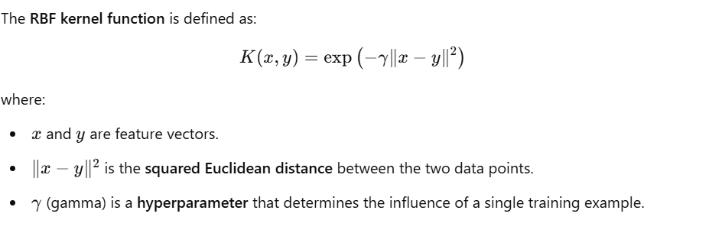
Kernel: Radial basis function

Slide 19
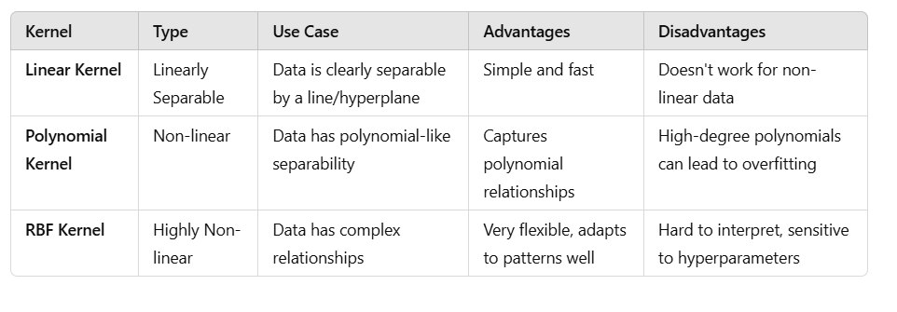
Comparison of SVM Kernels

Slide 20
Pros and Cons of SVM
Advantages
✔️ Works well in high-dimensional spaces. ✔️ Effective when the number of features is greater than the number of samples. ✔️ Kernel trick allows handling non-linearly separable data. ✔️ Robust to overfitting in high-dimensional spaces.
Disadvantages
❌ Computationally expensive for large datasets. ❌ Difficult to tune the kernel and hyperparameters. ❌ Does not perform well with a lot of noise in the data.

Slide 21
Applications of SVM
SVM is widely used in various domains, including:
Image Classification: Face recognition, handwriting recognition.
Text Classification: Spam detection, sentiment analysis.
Medical Diagnosis: Cancer detection using MRI scans.
Bioinformatics: Gene classification and protein structure prediction.

Slide 22
Conclusion
Support Vector Machine is a powerful and flexible supervised learning algorithm that can handle both linear and non-linear data. By maximizing the margin, SVM ensures better generalization, making it a great choice for many classification tasks. However, choosing the right kernel and tuning hyperparameters are key to getting the best performance.

Slide 23
Thank you

