Slide 1

Downloading Spark,Getting Started,SimpleSparkApplications ,
Scala and Python Example Programs, Intro to Scala

Slide 2

Overview
Introduction to Spark
Spark vs Hadoop
Spark Application Overview
Introduction to Scala
Scala Overview

Slide 3
Apache Spark
Fast processing engine with development APIs.
In-memory cluster computing framework for ETL with Resilient Distributed Dataset (RDD).
Open source software allowing Machine Learning & SQL Workloads to Hadoop.
Allows developers to create applications & insights.
Includes Spark Core API that supports Java, Scala, Python, SQL, & R.

Slide 4
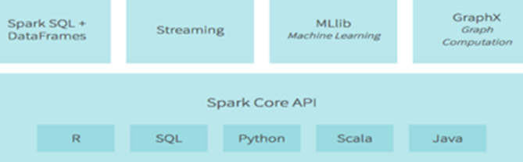
Apache Spark Ecosystem Overview
Streaming: Ability to process & analyze data real-time interactively.
Spark SQL: Exploring & processing structured Data using SQL queries.
GraphX: ability to graph structured data, & derive valuable insights.
MLib: very scalable machine learning library which produces advanced algorithms. The library can be used in Java, Python, & Scala.
Spark Core API: foundation which all functions are built on top of supporting Java, Scala, Python, SQL, & R.

Slide 5
Apache Spark Ecosystem Continued
Spark SQL for querying structured data via SQL and Hive Query Language (HQL)
Spark Streaming mainly enables you to create analytical and interactive applications for live streaming data. You can do the streaming of the data and then, Spark can run its operations from the streamed data itself.
Spark Core Engine allows writing raw Spark programs and Scala programs and launch them; it also allows writing Java programs before launching them. All these are being executed by Spark Core Engine.
MLLib is a machine learning library that is built on top of Spark, and has the provision to support many machine learning algorithms. But the point difference is that it runs almost 100 times faster than MapReduce.
Spark has its own Graph Computation Engine, called GraphX.

Slide 6
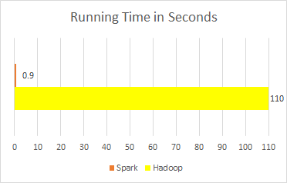
Spark vs. Hadoop MapReduce
Performance: Spark normally faster but with caveats
Spark can process data in-memory; Hadoop MapReduce persists back to the disk after a map or reduce action
Spark generally outperforms MapReduce, but it often needs lots of memory to do well; if there are other resource-demanding services or can’t fit in memory, Spark degrades
MapReduce easily runs alongside other services with minor performance differences, & works well with the 1-pass jobs it was designed for
Ease of use: Spark is easier to program
Data processing: Spark more general
Maturity: Spark maturing, Hadoop MapReduce mature

Slide 7
Downloading and Getting started
Download at http://spark.apache.org/downloads.html
Select package type as “Pre-built for Hadoop 2.7 and later” and download the compressed TAR file. Unpack the file after downloading
Spark provides a simple way to learn the API, as well as a powerful tool to analyze data interactively.
It is available in either Scala (which runs on the Java VM which is a good way to use existing Java libraries) or Python.
Spark shell can be opened by typing “./bin/spark-shell” for Scala version and “./bin/pyspark ” for Python Version
The primary abstraction is a distributed collection of items called a Dataset. Datasets can be created from Hadoop Input Formats (such as HDFS files) or by transforming other Datasets.

Slide 8
Spark Application Overview
Like MapReduce applications, each Spark application is a self-contained computation that runs user-supplied code to compute a result, however spark has many advantages over MapReduce
In MapReduce, the highest-level unit of computation is a job while In Spark, the highest-level unit of computation is an application.
A Spark application can be used for a single batch job, an interactive session with multiple jobs, or a long-lived server continually satisfying requests.
MapReduce starts a process for each task. In contrast, a Spark application can have processes running on its behalf even when it's not running a job
Spark application execution involves runtime concepts such as driver, executor, stage, job.
Multiple tasks can run within the same executor. Both combine to enable extremely fast task startup time as well as in-memory data storage, resulting in orders of magnitude faster performance over MapReduce.

Slide 9
Spark Application Overview
There are several programming languages that Spark supports. Written in Scala, it already comes with capabilities to be programmed in it, however it can also run using Java or Python
Types of abstractions in its applications- RDD, Data Frame
RDD (Resilient Distributed Dataset)
Shared variables
Broadcast variables
Accumulators

Slide 10
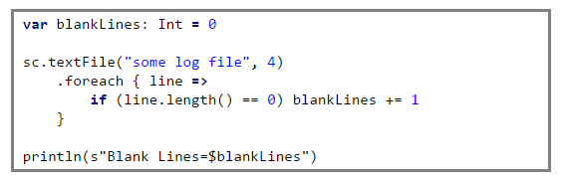
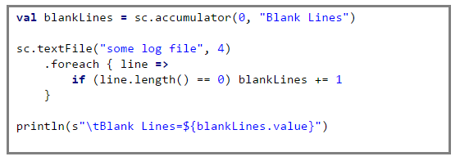
Simple Spark Application Continued
Accumulator: Stores variable that can have additive and cumulative functions performed onto it.
Broadcast: Sends variable to other memory devices in cluster. Efficient algorithm pre-built that helps reduce communication costs. Should only be used if the same data is needed in all nodes
Foreach (Reducer): Runs function on each element in dataset, output is best to be an accumulator object for safe updates

Slide 11


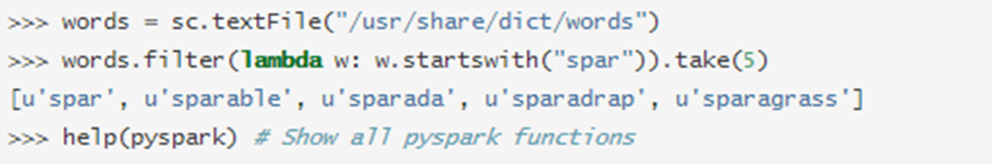

PySpark
PySpark is an interactive shell for Spark in Python.
The PySpark supports Python 2.6 and above.
The .bin/pyspark script launches a Python interpreter that is configured to run PySpark applications
PySpark applications are executed using a standard CPython interpreter in order to support Python modules that use C extensions.
PYSPARK_PYTHON environment variable in conf/spark-env.sh (or .cmd on Windows).
By default, the bin/pyspark shell creates SparkContext that runs applications on a single core.
$ MASTER=spark://IP:PORT ./bin/pyspark
$ MASTER=local[4] ./bin/pyspark
In PySpark, RDDs(Resilient Distributed Dataset) support the same methods as their Scala counterparts but take Python functions and return Python collection types.
There are two ways to create RDDs in PySpark:

Slide 12
PySpark Continued
RDDs can hold objects of multiple types with python
In PySpark, RDDs support the same methods as their Scala counterparts but take Python functions and return Python collection types. Short functions can be passed to RDD methods using Python’s lambda syntax:
logData = sc.textFile(logFile).cache()
errors = logData.filter(lambda line: "ERROR" in line)
You can also pass functions that are defined with the def keyword; this is useful for longer functions that can’t be expressed using lambda:
def is_error(line):
return "ERROR" in line
errors = logData.filter(is_error)
PySpark can also be used from standalone Python scripts by creating a SparkContext in your script and running the script using bin/pyspark
Code dependencies can be deployed by listing them in the pyFiles option in the SparkContext constructor:
from pyspark import SparkContext
sc = SparkContext("local", "App Name", pyFiles=['MyFile.py', 'lib.zip', 'app.egg'])
RDDs have actions, which return values, and transformations, which return pointers to new RDDs.
textFile.count()
linesWithSpark = textFile.filter(lambda line: "Spark" in line)
textFile.filter(lambda line: "Spark" in line).count()

Slide 13
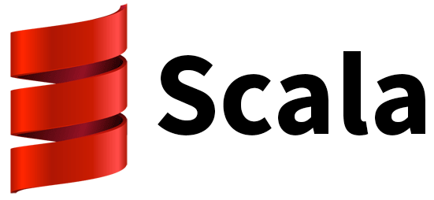

What is Scala...?
Developed by Martin Odersky and his team in 2001.
First public release was in 2004 for JVM platform.
Scala is a general-purpose programming language
Supports both Object-Oriented and Functional Programing Styles.
Major Apache Frameworks like Apache Spark & Apache Kafka have their implementations in Scala.

Slide 14
Features of Scala
Statically Typed
Statically typed language binds the type to a variable for its entire scope
Dynamically typed language binds the type to the actual value referenced by a variable.
Mixed Paradigm
Scala Fully Supports Object oriented Programming
Scala supports Functional Programming

Slide 15
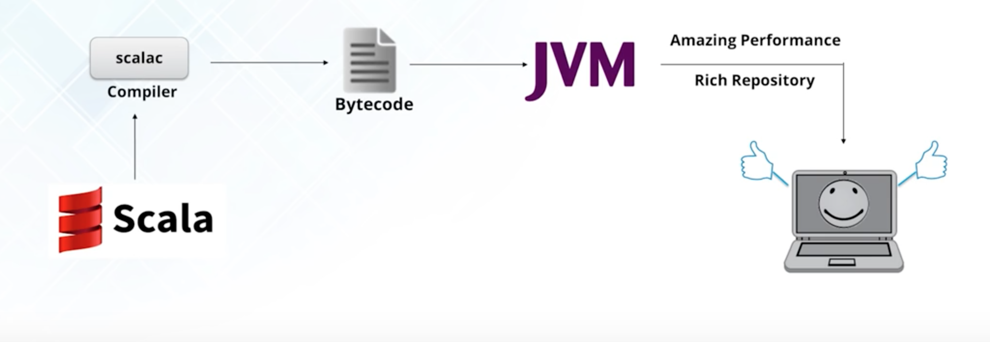
How Scala Works….?

Slide 16
Downloading Scala
Go to : http://www.scala-lang.org/download/
Make sure that you have Java installed
we can check the version of java using “java -version” command.
we can install Scala in 2 ways
by installing an IDE such as IntelliJ or sbt
from the installer download links for specific operating systems.

Slide 17
For MAC OS
Unzip the file and copy the scala folder to /usr/local folder using :
sudo cp -R Name_of_folder /usr/local/scala
Go to Home folder and search for .bash_profile and open it
Add scala/bin folder to your path using :
export PATH=/usr/local/scala/bin:$PATH
That’s it, Type Scala to use scala in your terminal.

Slide 18
For Windows
Open the .msi installer and follow the instructions as shown.
once after the installation is done. Set the path in environment variable to “c:\Program Files(x86)\scala\bin”
Now Go to Advanced system settings->Environment Variables->Path Variables and set the path.
Open the command prompt and type Scalac for verifying whether the installation is successful or not.
You can download the Scala Eclipse : http://scala-ide.org/

Slide 19


