Slide 1
JS Mechanics

Slide 2
Plan
Event driven mechanics
Events in the browser
Prototype chain
Notes:
We will talk about performance during the entire presentation

Slide 4
JS approach to I/O
Single threaded language
HTTP requests
DB
Memory and disk read/write
Notes:
Non-blocking I/O
In JavaScript, almost all I/O is non-blocking. This includes HTTP requests, database operations and disk reads and writes; the single thread of execution asks the runtime to perform an operation, providing a callback function and then moves on to do something else. When the operation has been completed, a message is enqueued along with the provided callback function. At some point in the future, the message is dequeued and the callback fired.
The decoupling of the caller from the response allows for the JavaScript runtime to do other things while waiting for your asynchronous operation to complete and their callbacks to fire. But where in memory do these callbacks live – and in what order are they executed? What causes them to be called?
JavaScript runtimes contain a message queue which stores a list of messages to be processed and their associated callback functions. These messages are queued in response to external events (such as a mouse being clicked or receiving the response to an HTTP request) given a callback function has been provided. If, for example a user were to click a button and no callback function was provided – no message would have been enqueued.
In a loop, the queue is polled for the next message (each poll referred to as a “tick”) and when a message is encountered, the callback for that message is executed.

Slide 5
Don’t make the thread wait
Blocking thread requests
Register a callback
Handle multiple concurrent operations on one thread

Slide 6
How it’s handled in JS?
Message queue
Event loop

Slide 7
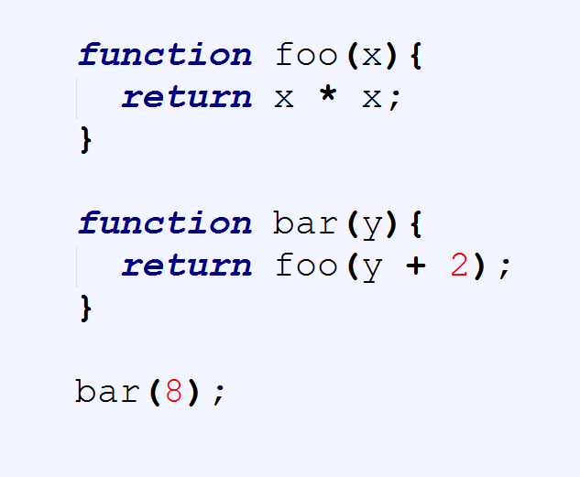
Stack calls
Stack

Slide 8
Stack calls
Stack
bar(8)

Slide 9
Stack calls
Stack
foo(10)
bar(8)

Slide 10
Stack calls
Stack
return
bar(8)

Slide 11
Stack calls
Stack
bar(8)

Slide 12
Stack calls
Stack
return

Slide 13
Stack calls
Stack
GC

Slide 14
Stack calls
Stack

Slide 15
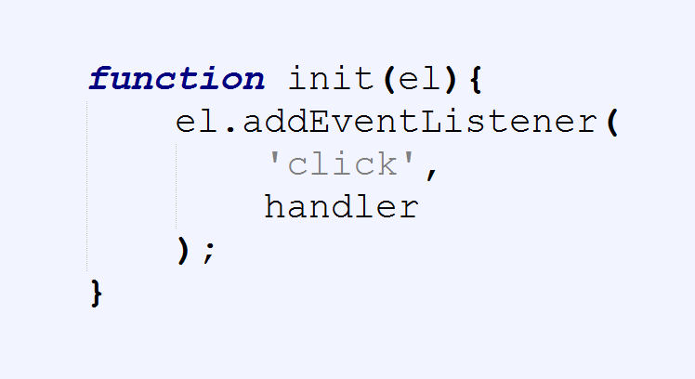

Slide 16
Stack
Browser APIs
Hidden implementation

Slide 17
Stack
Browser APIs
Hidden implementation
init

Slide 18
Stack
Browser APIs
Hidden implementation
addEventListener
init

Slide 19
Stack
Browser APIs
Hidden implementation
addEventListener
init
EventCallback

Slide 20
Stack
Browser APIs
Hidden implementation
return
init
EventCallback

Slide 21
Stack
Browser APIs
Hidden implementation
return
EventCallback

Slide 22
Stack
Browser APIs
Hidden implementation
GC
EventCallback

Slide 23
Stack
Browser APIs
Hidden implementation
EventCallback

Slide 24
Stack
Browser APIs
Hidden implementation
Message queue
……
EventCallback

Slide 25
Stack
Event
Loop
Browser APIs
Hidden implementation
Message queue
……
EventCallback

Slide 26
Stack
Event
Loop
Browser APIs
Hidden implementation
Message queue
H
……
EventCallback

Slide 27
Stack
Event
Loop
Browser APIs
Hidden implementation
GC
Message queue
H
H
EventCallback

Slide 28
Stack
Event
Loop
Browser APIs
Hidden implementation
Message queue
H
H
EventCallback

Slide 29
Stack
Event
Loop
Browser APIs
Hidden implementation
Message queue
H
H
handler
EventCallback

Slide 30
Stack
Event
Loop
Browser APIs
Hidden implementation
Message queue
H
handler
EventCallback

Slide 31
Stack
Event
Loop
Browser APIs
Hidden implementation
Message queue
H
return
EventCallback

Slide 32
Stack
Event
Loop
Browser APIs
Hidden implementation
GC
Message queue
H
EventCallback

Slide 33
Stack
Event
Loop
Browser APIs
Hidden implementation
Message queue
H
EventCallback

Slide 34
Stack
Event
Loop
Browser APIs
Hidden implementation
Message queue
H
handler
EventCallback

Slide 35
Stack
Event
Loop
Browser APIs
Hidden implementation
Message queue
handler
EventCallback

Slide 36
Stack
Event
Loop
Browser APIs
Hidden implementation
Message queue
return
EventCallback

Slide 37
Stack
Event
Loop
Browser APIs
Hidden implementation
GC
Message queue
EventCallback

Slide 38
Stack
Event
Loop
Browser APIs
Hidden implementation
Message queue
EventCallback

Slide 39
Synchronous operations
For
While
Recursion?

Slide 40
De-bouncing
setTimeout
setInterval
requestAnimationFrame

Slide 41
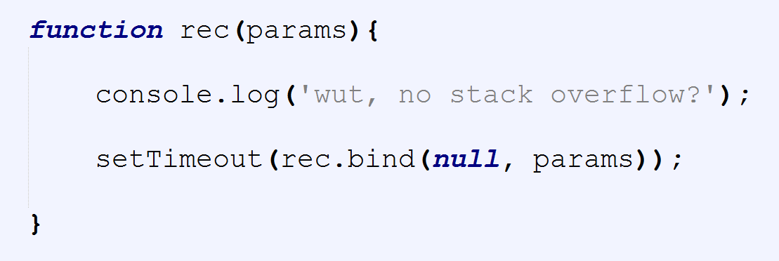

Slide 43
Common mistakes
Blocking the thread
Writing synchronous code
Stack overflow

Slide 44
Best practices
Asynchronous code
Deferred executions
Debounced functions
Web Workers

Slide 46


Slide 47


Slide 48

Links
Connect:
LinkedIn: https://goo.gl/CRRJ2Y
Mail: martin.c@sbtech.com
Github: https://github.com/mchaov

