Slide 1
Сортиране!

Slide 2
Какво е сортиране?
Latin?
French??
SORS -> SORTE -> SORT
Notes:
Arrange systematically in groups; separate according to type.
Sorting refers to ordering data in an increasing or decreasing fashion according to some linear relationship among the data items.

Slide 3
Демек?
Подреждане в организирана редица
Търсене на елемент
Сливане

Slide 4
Сортиране в програмирането
Какво сортираме?
Как сортираме?

Slide 5
Алгоритми за сортиране
Insertion sort
Merge sort
Quick sort
Radix sort
Heap sort
Selection sort
Bubble sort
Notes:
Insertion sort.
In this method, sorting is done by inserting elements into an existing sorted list. Initially, the sorted list has only one element. Other elements are gradually added into the list in the proper position.
Merge Sort.
In this method, the elements are divided into partitions until each partition has sorted elements. Then, these partitions are merged and the elements are properly positioned to get a fully sorted list.
Quick Sort.
In this method, an element called pivot is identified and that element is fixed in its place by moving all the elements less than that to its left and all the elements greater than that to its right.
Radix Sort.
In this method, sorting is done based on the place values of the number. In this scheme, sorting is done on the less-significant digits first. When all the numbers are sorted on a more significant digit, numbers that have the same digit in that position but different digits in a less-significant position are already sorted on the less-significant position.
Heap Sort
In this method, the file to be sorted is interpreted as a binary tree. Array, which is a sequential representation of binary tree, is used to implement the heap sort.
The basic premise behind sorting an array is that its elements start out in some random order and need to be arranged from lowest to highest.
It is easy to see that the list
1, 5, 6, 19, 23, 45, 67, 98, 124, 401
is sorted, whereas the list
4, 1, 90, 34, 100, 45, 23, 82, 11, 0, 600, 345
is not. The property that makes the second one "not sorted" is that there are adjacent elements that are out of order. The first item is greater than the second instead of less, and likewise the third is greater than the fourth and so on. Once this observation is made, it is not very hard to devise a sort that proceeds by examining adjacent elements to see if they are in order, and swapping them if they are not.
Selection sort: In this technique, the first element is selected and compared with all other elements. If any other element is less than the first element swapping should take place. By the end of this comparison, the least element most top position in the array. This is known as pass1. In pass II, the second element is selected and compared with all other elements. Swapping takes place if any other element is less than selected element. This process continuous until array is sorted.
The no. of passes in array compare to size of array –1.
Bubble sort: This technique compares last element with the preceding element. If the last element is less than that of preceding element swapping takes place. Then the preceding element is compared with that previous element. This process continuous until the II and I elements are compared with each other. This is known as pass 1.
This way the number of passes would be equal to size of array –1.

Slide 6
Вградени методи
sort
filter
find
map
pop
push
reduce
reverse

Slide 7
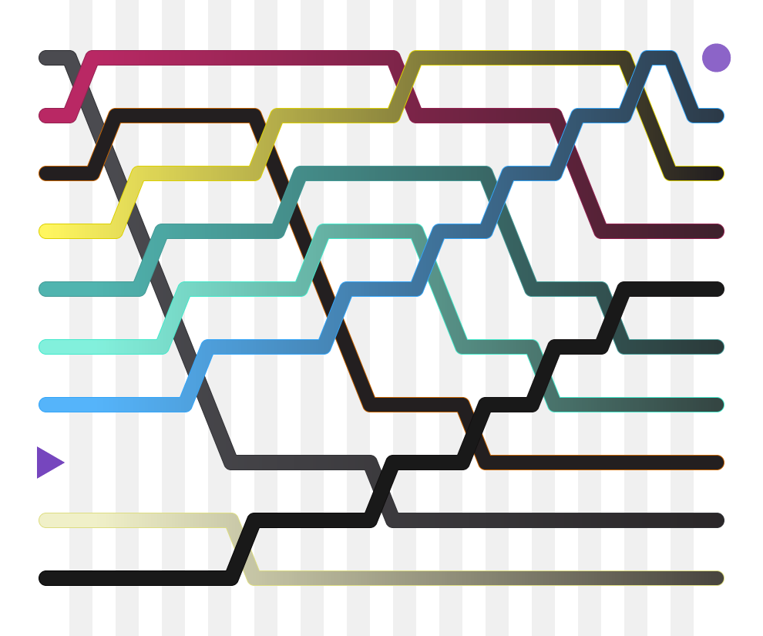
Метода на мехурчето

Slide 8
Мехуреста производителност
Notes:
Performance[edit]
Bubble sort has worst-case and average complexity both О(n²), where n is the number of items being sorted.
There exist many sorting algorithms with substantially better worst-case or average complexity of O(n log n). Even other О(n²) sorting algorithms, such as insertion sort, tend to have better performance than bubble sort. Therefore, bubble sort is not a practical sorting algorithm when n is large.
The only significant advantage that bubble sort has over most other implementations, even quicksort, but not insertion sort, is that the ability to detect that the list is sorted efficiently is built into the algorithm. When the list is already sorted (best-case), the complexity of bubble sort is only O(n).
By contrast, most other algorithms, even those with better average-case complexity, perform their entire sorting process on the set and thus are more complex.
However, not only does insertion sort have this mechanism too, but it also performs better on a list that is substantially sorted (having a small number of inversions).
Bubble sort should be avoided in the case of large collections. It will not be efficient in the case of a reverse-ordered collection.

Slide 9
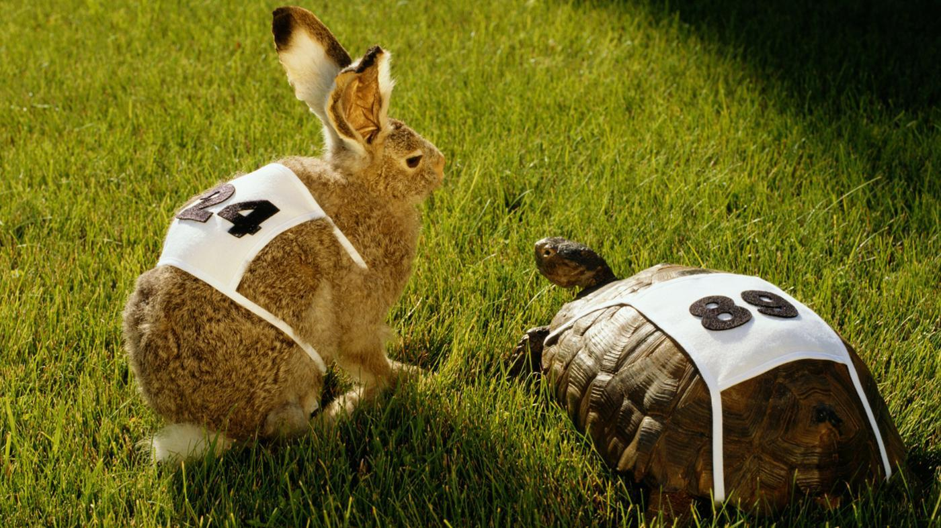
Notes:
The distance and direction that elements must move during the sort determine bubble sort's performance because elements move in different directions at different speeds. An element that must move toward the end of the list can move quickly because it can take part in successive swaps.
For example, the largest element in the list will win every swap, so it moves to its sorted position on the first pass even if it starts near the beginning.
On the other hand, an element that must move toward the beginning of the list cannot move faster than one step per pass, so elements move toward the beginning very slowly. If the smallest element is at the end of the list, it will take n−1 passes to move it to the beginning.
This has led to these types of elements being named rabbits and turtles, respectively, after the characters in Aesop's fable of The Tortoise and the Hare.
Various efforts have been made to eliminate turtles to improve upon the speed of bubble sort. Cocktail sort is a bi-directional bubble sort that goes from beginning to end, and then reverses itself, going end to beginning. It can move turtles fairly well, but it retains O(n²) worst-case complexity. Comb sort compares elements separated by large gaps, and can move turtles extremely quickly before proceeding to smaller and smaller gaps to smooth out the list. Its average speed is comparable to faster algorithms like quicksort.

Slide 11

Стъпки на изпълнение

Slide 12
Първи цикъл
( 5 1 4 2 8 ) -> ( 1 5 4 2 8 ) 5 > 1
( 1 5 4 2 8 ) -> ( 1 4 5 2 8 ) 5 > 4
( 1 4 5 2 8 ) -> ( 1 4 2 5 8 ) 5 > 2
( 1 4 2 5 8 ) -> ( 1 4 2 5 8 ) 8 > 5

Slide 13
Втори цикъл
( 1 4 2 5 8 ) -> ( 1 4 2 5 8 )
( 1 4 2 5 8 ) -> ( 1 2 4 5 8 ) 4 > 2
( 1 2 4 5 8 ) -> ( 1 2 4 5 8 )
( 1 2 4 5 8 ) -> ( 1 2 4 5 8 )

Slide 14
Трети цикъл
( 1 2 4 5 8 ) -> ( 1 2 4 5 8 )
( 1 2 4 5 8 ) -> ( 1 2 4 5 8 )
( 1 2 4 5 8 ) -> ( 1 2 4 5 8 )
( 1 2 4 5 8 ) -> ( 1 2 4 5 8 )

Slide 15
Метода на мехурчето....
На практика
Спорове за името
Вариации
Notes:
Debate over name
Bubble sort has been occasionally referred to as a "sinking sort".
For example, in Donald Knuth's The Art of Computer Programming, Volume 3: Sorting and Searching he states in section 5.2.1 'Sorting by Insertion', that [the value] "settles to its proper level" and that this method of sorting has sometimes been called the sifting or sinking technique.
This debate is perpetuated by the ease with which one may consider this algorithm from two different but equally valid perspectives:
The larger values might be regarded as heavier and therefore be seen to progressively sink to the bottom of the list
The smaller values might be regarded as lighter and therefore be seen to progressively bubble up to the top of the list
Variations
Odd-even sort is a parallel version of bubble sort, for message passing systems.
Cocktail sort is another parallel version of the bubble sort
In some cases, the sort works from right to left (the opposite direction), which is more appropriate for partially sorted lists, or lists with unsorted items added to the end.

Slide 16
Нужни познания за имплементацията
FOR
WHILE
IF
SWAP

Slide 17
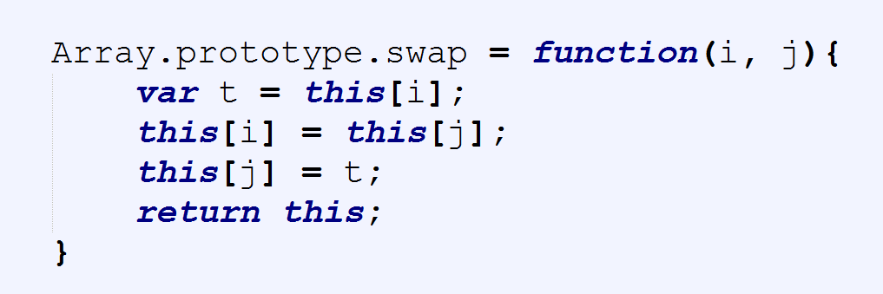
Мехуреста имплементация
Размяна на елементи в масив!

Slide 18
Мехуреста имплементация
Разписване на алгоритъма
Функция [bubble], която приема за аргумент масив [arr]
Променливи:
Length -> кешира размера на масива
Swapped -> запомня дали е извършена промяна
Iterator -> итератор в цикъл
While Swapped -> Циклим масива
For -> проверка на елементите двойка по двойка
If -> размяна на местата при условие X < Y

Slide 19
Мехуреста оптимизация

Slide 21


