Slide 1
Prototype chain

Slide 2
So….
… is not pepper …

Slide 3
[[Proto wut?]]
Object creation
Linkage
Shadowing
… other witchcraft
Notes:
Objects in JavaScript have an internal property, denoted in the specification as [[Prototype]], which is simply a reference to another object. Almost all objects are given a non-null value for this property, at the time of their creation.
1. Objects may be created in various ways including via a literal notation or via constructors which create objects and then execute code that initializes all or part of them by assigning initial values to their properties. Each constructor is a function that has a property named "prototype" that is used to implement prototype‑ based inheritance and shared properties. Objects are created by using constructors in new expressions
2. Every object created by a constructor has an implicit reference (called the object's prototype) to the value of its constructor's "prototype" property.
3. When a is created by calling new Foo(), one of the things that happens is that a gets an internal [[Prototype]] link to the object that Foo.prototype is pointing at.
In class-oriented languages, multiple copies (aka, "instances") of a class can be made, like stamping something out from a mold. As we saw in Chapter 4, this happens because the process of instantiating (or inheriting from) a class means, "copy the behavior plan from that class into a physical object", and this is done again for each new instance.
But in JavaScript, there are no such copy-actions performed. You don't create multiple instances of a class. You can create multiple objects that [[Prototype]] link to a common object. But by default, no copying occurs, and thus these objects don't end up totally separate and disconnected from each other, but rather, quite linked.
new Foo() results in a new object (we called it a), and that new object a is internally [[Prototype]] linked to theFoo.prototype object.
We end up with two objects, linked to each other. That's it. We didn't instantiate a class. We certainly didn't do any copying of behavior from a "class" into a concrete object. We just caused two objects to be linked to each other.

Slide 4
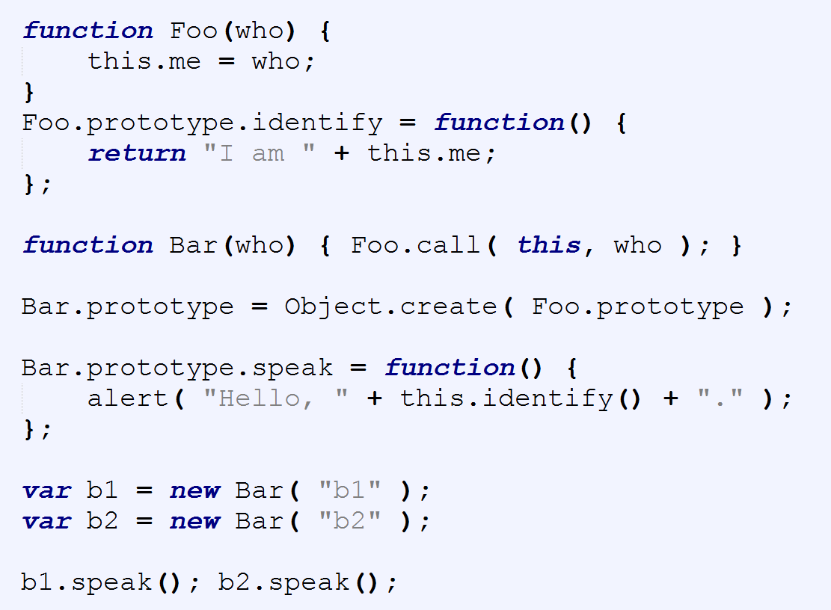

Slide 5
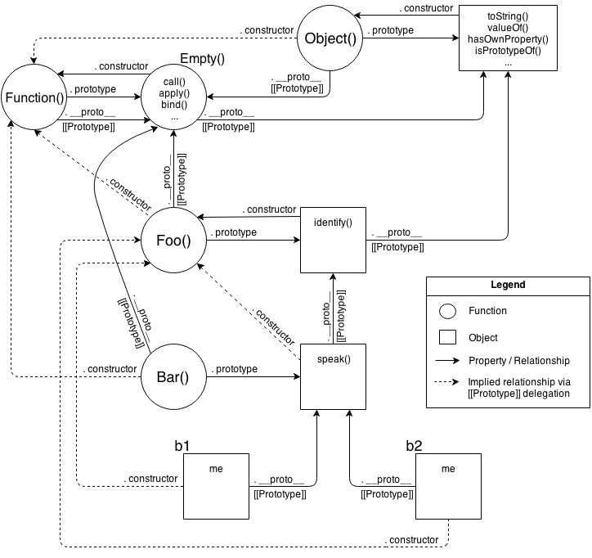
Notes:
We take exactly the same advantage of [[Prototype]] delegation from b1 to Bar to Foo as we did in the previous snippet between b1, Bar.prototype, and Foo.prototype. We still have the same 3 objects linked together.
But, importantly, we've greatly simplified all the other stuff going on, because now we just set up objects linked to each other, without needing all the cruft and confusion of things that look (but don't behave!) like classes, with constructors and prototypes and new calls.
Ask yourself: if I can get the same functionality with OLOO style code as I do with "class" style code, but OLOO is simpler and has less things to think about, isn't OLOO better?
Let's examine the mental models involved between these two snippets.
First, the class-style code snippet implies this mental model of entities and their relationships:

Slide 6


Slide 7
Convention’s got a name!
Happy debugging, f*****s
I hate JavaScript
Why can’t we have nice things

Slide 9
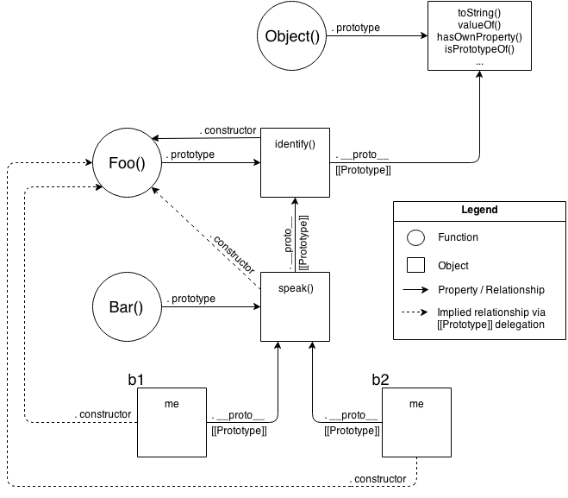
Notes:
Actually, that's a little unfair/misleading, because it's showing a lot of extra detail that you don't technically need to know at all times (though you do need to understand it!).
One take-away is that it's quite a complex series of relationships. But another take-away: if you spend the time to follow those relationship arrows around, there's an amazing amount of internal consistency in JS's mechanisms.
For instance, the ability of a JS function to access call(..), apply(..), and bind(..) (see Chapter 2) is because functions themselves are objects, and function-objects also have a [[Prototype]] linkage, to the Function.prototype object, which defines those default methods that any function-object can delegate to.
JS can do those things, and you can too!.
OK, let's now look at a slightly simplified version of that diagram which is a little more "fair" for comparison -- it shows only the relevant entities and relationships.
Still pretty complex, eh? The dotted lines are depicting the implied relationships when you setup the "inheritance" betweenFoo.prototype and Bar.prototype and haven't yet fixed the missing .constructor property reference (see "Constructor Redux" in Chapter 5).
Even with those dotted lines removed, the mental model is still an awful lot to juggle every time you work with object linkages.

Slide 10
JS Class syntax
Class
Constructor
Super
Extends

Slide 11
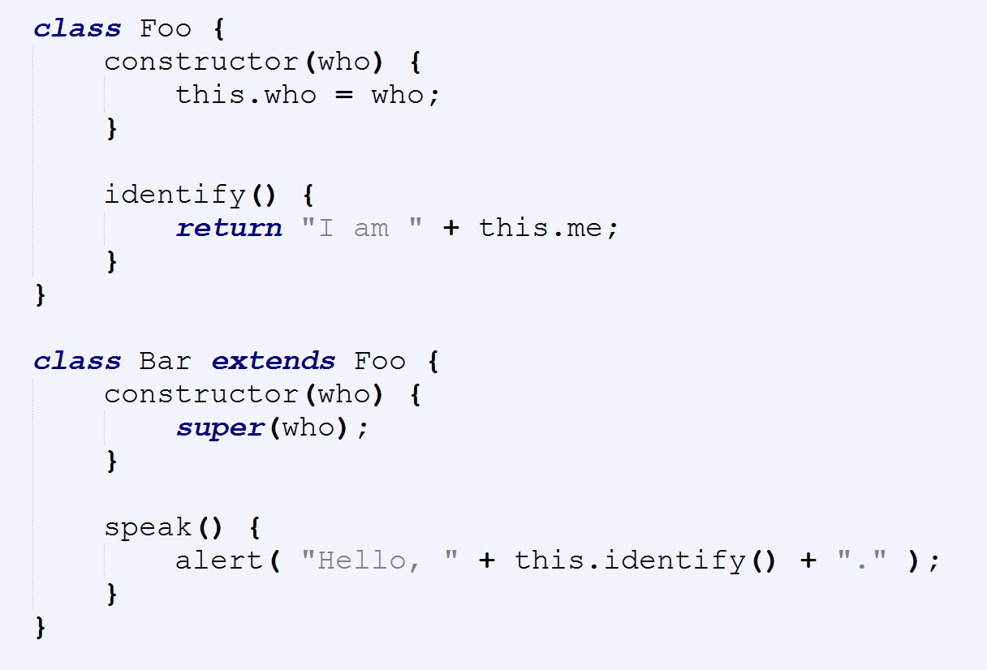

Slide 12
OLOO to the rescue?
Simpler syntax
Cutting the middle man
Introspection?
Notes:
// relating `Foo` and `Bar` to each other
Foo.isPrototypeOf( Bar ); // true
Object.getPrototypeOf( Bar ) === Foo; // true
// relating `b1` to both `Foo` and `Bar`
Foo.isPrototypeOf( b1 ); // true
Bar.isPrototypeOf( b1 ); // true
Object.getPrototypeOf( b1 ) === Bar; // true

Slide 13
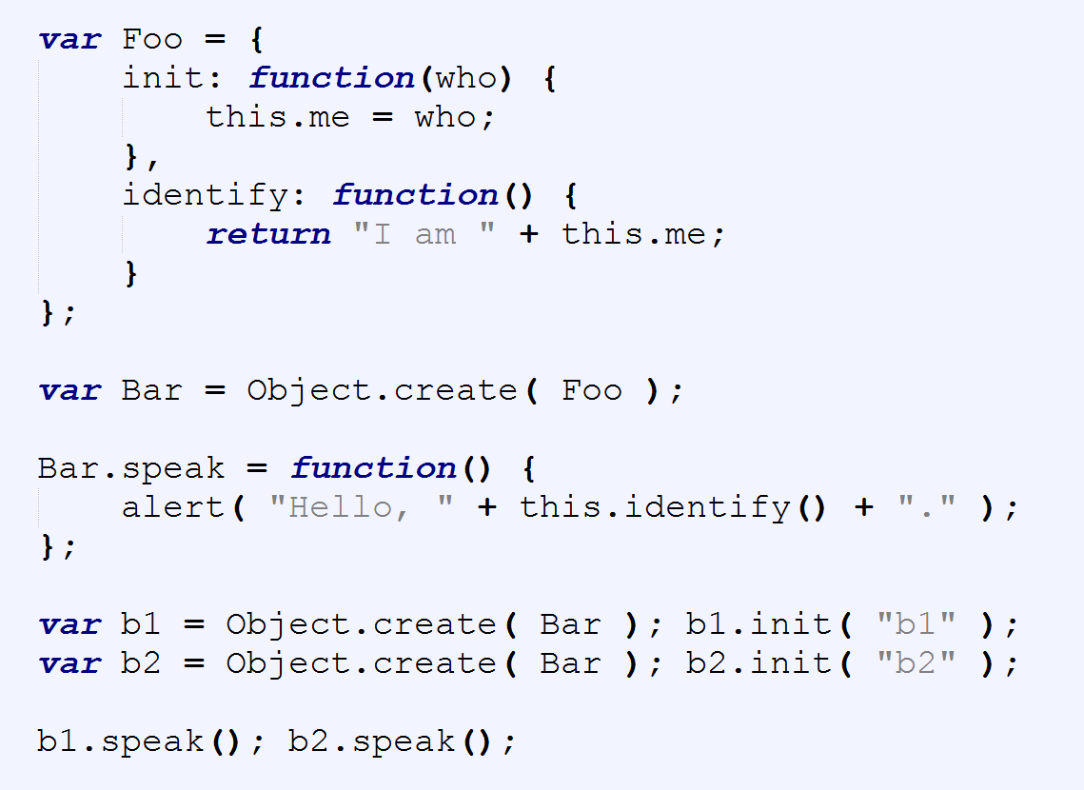

Slide 14
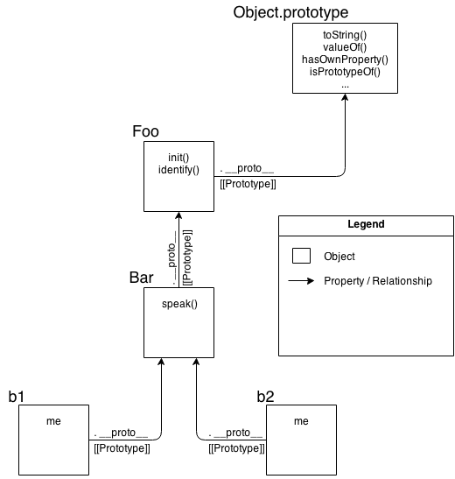
Notes:
As you can see comparing them, it's quite obvious that OLOO-style code has vastly less stuff to worry about, because OLOO-style code embraces the fact that the only thing we ever really cared about was the objects linked to other objects.
All the other "class" cruft was a confusing and complex way of getting the same end result. Remove that stuff, and things get much simpler (without losing any capability).

Slide 15
Compromise?
IIFE
OLOO
Object composition
Notes:
Classes and inheritance are a design pattern you can choose, or not choose, in your software architecture. Most developers take for granted that classes are the only (proper) way to organize code, but here we've seen there's another less-commonly talked about pattern that's actually quite powerful: behavior delegation.
Behavior delegation suggests objects as peers of each other, which delegate amongst themselves, rather than parent and child class relationships. JavaScript's [[Prototype]] mechanism is, by its very designed nature, a behavior delegation mechanism. That means we can either choose to struggle to implement class mechanics on top of JS (see Chapters 4 and 5), or we can just embrace the natural state of [[Prototype]] as a delegation mechanism.
When you design code with objects only, not only does it simplify the syntax you use, but it can actually lead to simpler code architecture design.
OLOO (objects-linked-to-other-objects) is a code style which creates and relates objects directly without the abstraction of classes. OLOO quite naturally implements [[Prototype]]-based behavior delegation.

Slide 16
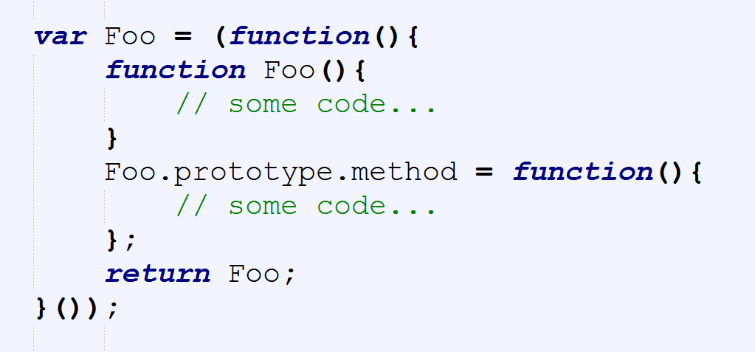

Slide 17
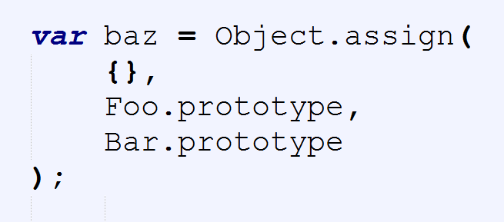

Slide 18
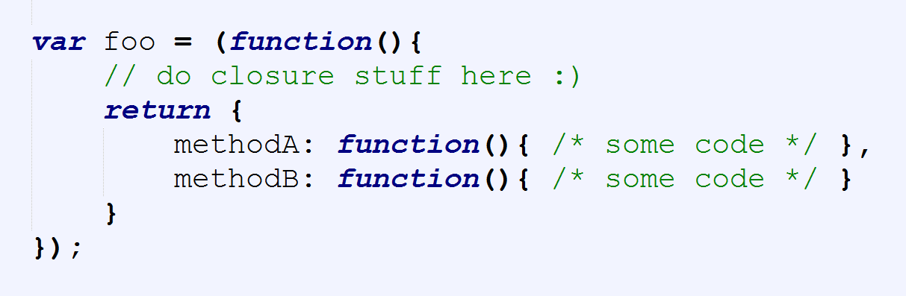
Simplify further

Slide 19
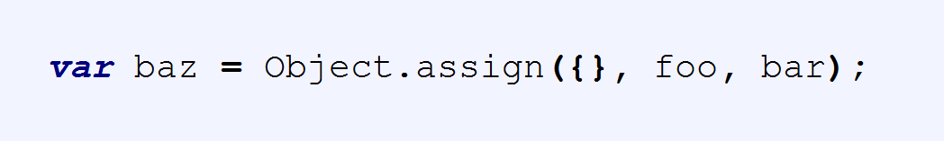
Notes:
Classes and inheritance are a design pattern you can choose, or not choose, in your software architecture.
Most developers take for granted that classes are the only (proper) way to organize code, but here we've seen there's another less-commonly talked about pattern that's actually quite powerful: behavior delegation.
Behavior delegation suggests objects as peers of each other, which delegate amongst themselves, rather than parent and child class relationships. JavaScript's [[Prototype]] mechanism is, by its very designed nature, a behavior delegation mechanism.
That means we can either choose to struggle to implement class mechanics on top of JS (see Chapters 4 and 5), or we can just embrace the natural state of [[Prototype]] as a delegation mechanism.
When you design code with objects only, not only does it simplify the syntax you use, but it can actually lead to simpler code architecture design.
OLOO (objects-linked-to-other-objects) is a code style which creates and relates objects directly without the abstraction of classes. OLOO quite naturally implements [[Prototype]]-based behavior delegation.

