Slide 1
JS Mechanics

Slide 2
Plan
Event driven mechanics
Events in the browser
Prototype chain
Notes:
We will talk about performance during the entire presentation

Slide 4
JS approach to I/O
Single threaded language
HTTP requests
DB
Memory and disk read/write
Notes:
Non-blocking I/O
In JavaScript, almost all I/O is non-blocking. This includes HTTP requests, database operations and disk reads and writes; the single thread of execution asks the runtime to perform an operation, providing a callback function and then moves on to do something else. When the operation has been completed, a message is enqueued along with the provided callback function. At some point in the future, the message is dequeued and the callback fired.
The decoupling of the caller from the response allows for the JavaScript runtime to do other things while waiting for your asynchronous operation to complete and their callbacks to fire. But where in memory do these callbacks live – and in what order are they executed? What causes them to be called?
JavaScript runtimes contain a message queue which stores a list of messages to be processed and their associated callback functions. These messages are queued in response to external events (such as a mouse being clicked or receiving the response to an HTTP request) given a callback function has been provided. If, for example a user were to click a button and no callback function was provided – no message would have been enqueued.
In a loop, the queue is polled for the next message (each poll referred to as a “tick”) and when a message is encountered, the callback for that message is executed.

Slide 5
Don’t make the thread wait
Blocking thread requests
Register a callback
Handle multiple concurrent operations on one thread

Slide 6
How it’s handled in JS?
Message queue
Event loop

Slide 7
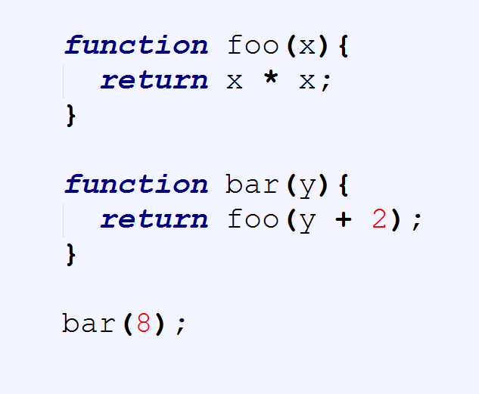
Stack calls
Stack

Slide 8
Stack calls
Stack
bar(8)

Slide 9
Stack calls
Stack
foo(10)
bar(8)

Slide 10
Stack calls
Stack
return
bar(8)

Slide 11
Stack calls
Stack
bar(8)

Slide 12
Stack calls
Stack
return

Slide 13
Stack calls
Stack
GC

Slide 14
Stack calls
Stack

Slide 15
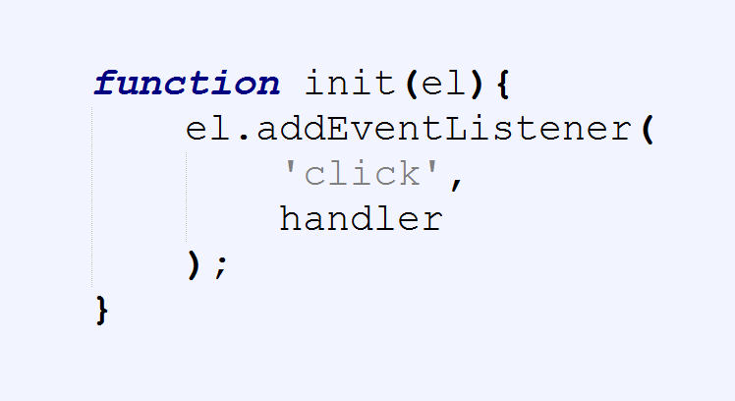

Slide 16
Stack
Browser APIs
Hidden implementation

Slide 17
Stack
Browser APIs
Hidden implementation
init

Slide 18
Stack
Browser APIs
Hidden implementation
addEventListener
init

Slide 19
Stack
Browser APIs
Hidden implementation
addEventListener
init
EventCallback

Slide 20
Stack
Browser APIs
Hidden implementation
return
init
EventCallback

Slide 21
Stack
Browser APIs
Hidden implementation
return
EventCallback

Slide 22
Stack
Browser APIs
Hidden implementation
GC
EventCallback

Slide 23
Stack
Browser APIs
Hidden implementation
EventCallback

Slide 24
Stack
Browser APIs
Hidden implementation
Message queue
……
EventCallback

Slide 25
Stack
Event
Loop
Browser APIs
Hidden implementation
Message queue
……
EventCallback

Slide 26
Stack
Event
Loop
Browser APIs
Hidden implementation
Message queue
H
……
EventCallback

Slide 27
Stack
Event
Loop
Browser APIs
Hidden implementation
GC
Message queue
H
H
EventCallback

Slide 28
Stack
Event
Loop
Browser APIs
Hidden implementation
Message queue
H
H
EventCallback

Slide 29
Stack
Event
Loop
Browser APIs
Hidden implementation
Message queue
H
H
handler
EventCallback

Slide 30
Stack
Event
Loop
Browser APIs
Hidden implementation
Message queue
H
handler
EventCallback

Slide 31
Stack
Event
Loop
Browser APIs
Hidden implementation
Message queue
H
return
EventCallback

Slide 32
Stack
Event
Loop
Browser APIs
Hidden implementation
GC
Message queue
H
EventCallback

Slide 33
Stack
Event
Loop
Browser APIs
Hidden implementation
Message queue
H
EventCallback

Slide 34
Stack
Event
Loop
Browser APIs
Hidden implementation
Message queue
H
handler
EventCallback

Slide 35
Stack
Event
Loop
Browser APIs
Hidden implementation
Message queue
handler
EventCallback

Slide 36
Stack
Event
Loop
Browser APIs
Hidden implementation
Message queue
return
EventCallback

Slide 37
Stack
Event
Loop
Browser APIs
Hidden implementation
GC
Message queue
EventCallback

Slide 38
Stack
Event
Loop
Browser APIs
Hidden implementation
Message queue
EventCallback

Slide 39
Synchronous operations
For
While
Recursion?

Slide 40
De-bouncing
setTimeout
setInterval
requestAnimationFrame

Slide 41
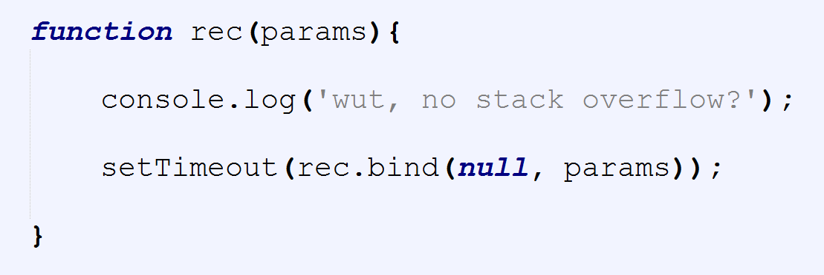

Slide 43
Common mistakes
Blocking the thread
Writing synchronous code
Stack overflow

Slide 44
Best practices
Asynchronous code
Deferred executions
Debounced functions
Web Workers

Slide 45
DOM Events

Slide 46
Event Phases
Window
CAPTURE
BUBBLING
Document
<HTML>
<BODY>
<HEADER>
<DIV>
<DIV>
<A>
<A>
TARGET

Slide 47
Event object
Properties
target
timeStamp
isTrusted
clientX/Y
Methods
preventDefault
stopPropagation

Slide 48
Event Listener
addEventListener();
removeEventListener();
htmlRef.addEventListener( ‘click’ , handler , false );
htmlRef.removeEventListener( ‘click’ , handler);

Slide 49
Event handler
function handler(event){
this => object, html reference
event => object, event configuration
}

Slide 50
Common mistakes
Using onEvent handlers
Attaching/detaching in a loop
Lambda expression
Libraries madness
Easy to get it wrong

Slide 51
Best practices
One event listener
Map events to methods
Named functions
Prepare events up front

Slide 52
Prototype chain

Slide 53
[[Proto wut?]]
Object creation
Linkage
Shadowing
… other witchcraft
Notes:
Objects in JavaScript have an internal property, denoted in the specification as [[Prototype]], which is simply a reference to another object. Almost all objects are given a non-null value for this property, at the time of their creation.
1. Objects may be created in various ways including via a literal notation or via constructors which create objects and then execute code that initializes all or part of them by assigning initial values to their properties. Each constructor is a function that has a property named "prototype" that is used to implement prototype‑ based inheritance and shared properties. Objects are created by using constructors in new expressions
2. Every object created by a constructor has an implicit reference (called the object's prototype) to the value of its constructor's "prototype" property.
3. When a is created by calling new Foo(), one of the things that happens is that a gets an internal [[Prototype]] link to the object that Foo.prototype is pointing at.
In class-oriented languages, multiple copies (aka, "instances") of a class can be made, like stamping something out from a mold. As we saw in Chapter 4, this happens because the process of instantiating (or inheriting from) a class means, "copy the behavior plan from that class into a physical object", and this is done again for each new instance.
But in JavaScript, there are no such copy-actions performed. You don't create multiple instances of a class. You can create multiple objects that [[Prototype]] link to a common object. But by default, no copying occurs, and thus these objects don't end up totally separate and disconnected from each other, but rather, quite linked.
new Foo() results in a new object (we called it a), and that new object a is internally [[Prototype]] linked to theFoo.prototype object.
We end up with two objects, linked to each other. That's it. We didn't instantiate a class. We certainly didn't do any copying of behavior from a "class" into a concrete object. We just caused two objects to be linked to each other.

Slide 54
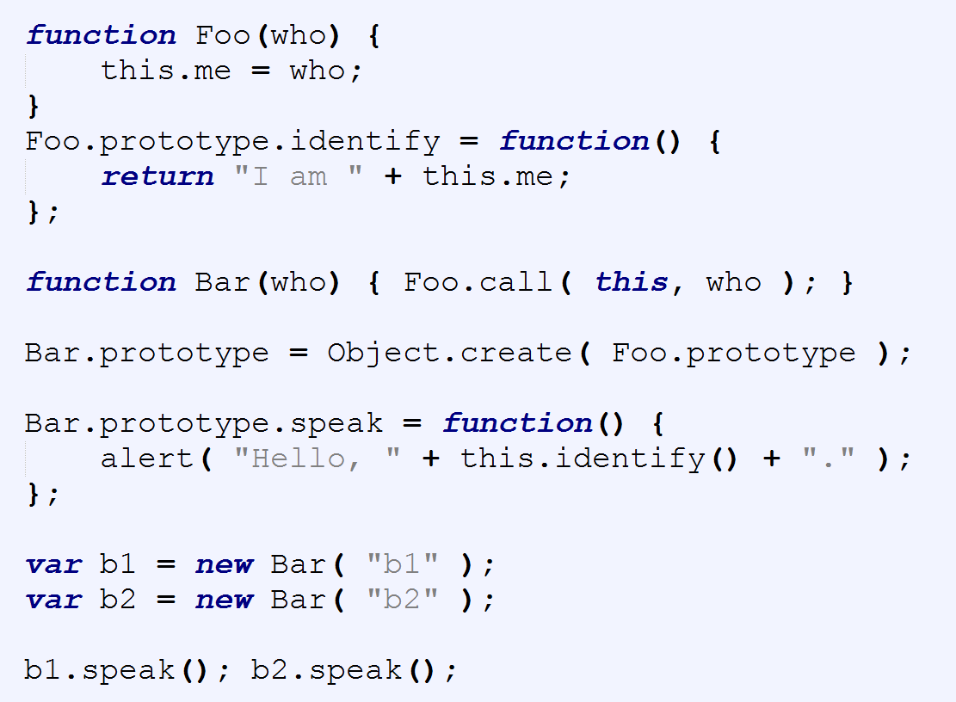

Slide 55
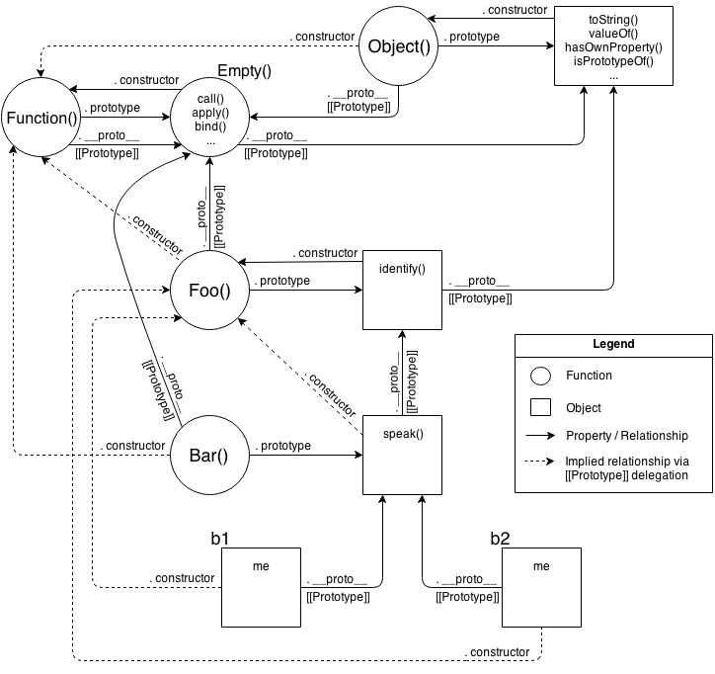
Notes:
We take exactly the same advantage of [[Prototype]] delegation from b1 to Bar to Foo as we did in the previous snippet between b1, Bar.prototype, and Foo.prototype. We still have the same 3 objects linked together.
But, importantly, we've greatly simplified all the other stuff going on, because now we just set up objects linked to each other, without needing all the cruft and confusion of things that look (but don't behave!) like classes, with constructors and prototypes and new calls.
Ask yourself: if I can get the same functionality with OLOO style code as I do with "class" style code, but OLOO is simpler and has less things to think about, isn't OLOO better?
Let's examine the mental models involved between these two snippets.
First, the class-style code snippet implies this mental model of entities and their relationships:

Slide 56


Slide 57
Convention’s got a name!
Happy debugging, f*****s
I hate JavaScript
Why can’t we have nice things

Slide 59
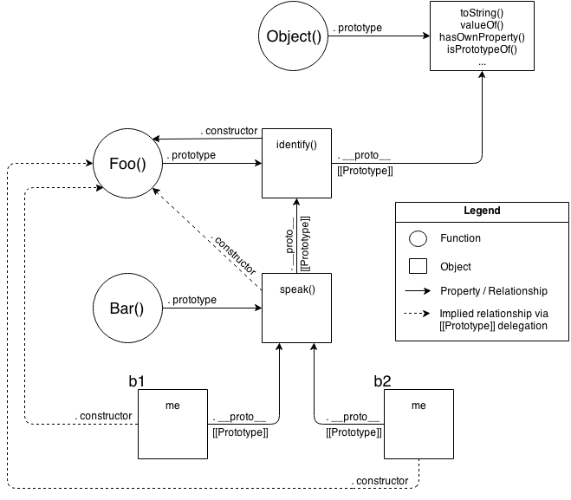
Notes:
Actually, that's a little unfair/misleading, because it's showing a lot of extra detail that you don't technically need to know at all times (though you do need to understand it!).
One take-away is that it's quite a complex series of relationships. But another take-away: if you spend the time to follow those relationship arrows around, there's an amazing amount of internal consistency in JS's mechanisms.
For instance, the ability of a JS function to access call(..), apply(..), and bind(..) (see Chapter 2) is because functions themselves are objects, and function-objects also have a [[Prototype]] linkage, to the Function.prototype object, which defines those default methods that any function-object can delegate to.
JS can do those things, and you can too!.
OK, let's now look at a slightly simplified version of that diagram which is a little more "fair" for comparison -- it shows only the relevant entities and relationships.
Still pretty complex, eh? The dotted lines are depicting the implied relationships when you setup the "inheritance" betweenFoo.prototype and Bar.prototype and haven't yet fixed the missing .constructor property reference (see "Constructor Redux" in Chapter 5).
Even with those dotted lines removed, the mental model is still an awful lot to juggle every time you work with object linkages.

Slide 60
JS Class syntax
Class
Constructor
Super
Extends

Slide 61
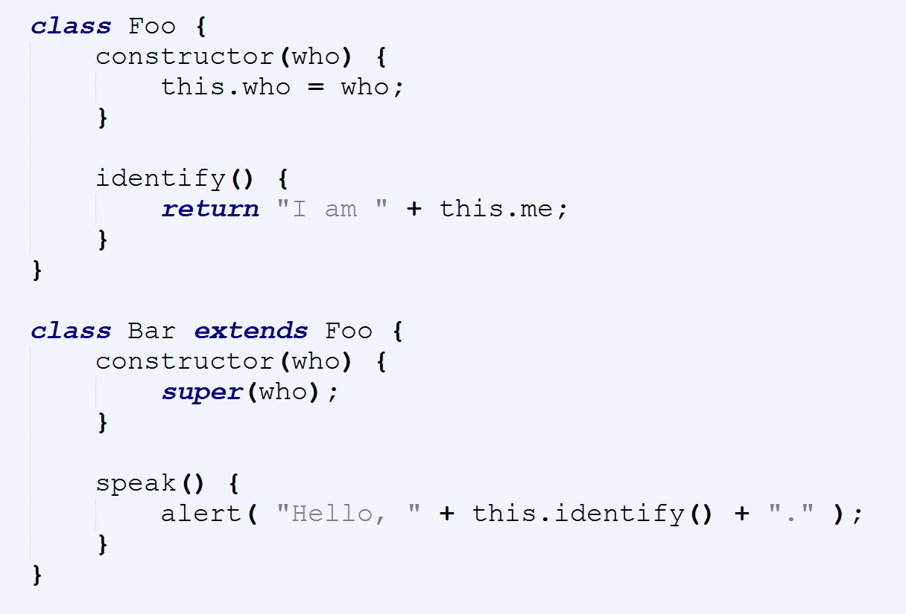

Slide 62
OLOO to the rescue?
Simpler syntax
Cutting the middle man
Introspection?
Notes:
// relating `Foo` and `Bar` to each other
Foo.isPrototypeOf( Bar ); // true
Object.getPrototypeOf( Bar ) === Foo; // true
// relating `b1` to both `Foo` and `Bar`
Foo.isPrototypeOf( b1 ); // true
Bar.isPrototypeOf( b1 ); // true
Object.getPrototypeOf( b1 ) === Bar; // true

Slide 63
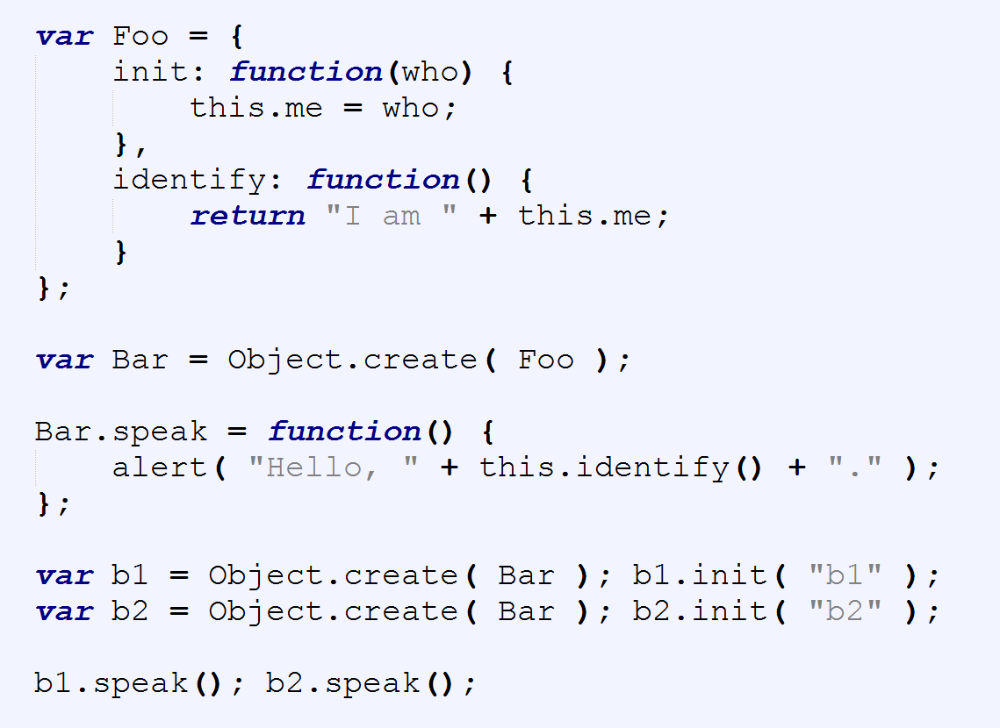

Slide 64
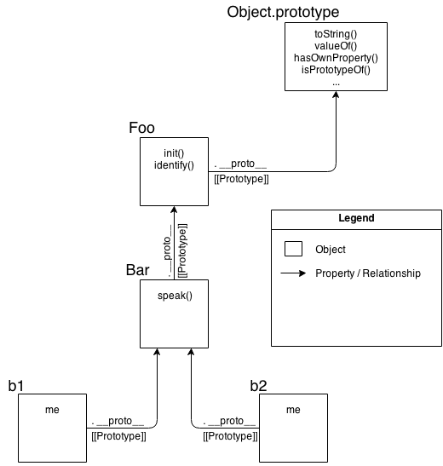
Notes:
As you can see comparing them, it's quite obvious that OLOO-style code has vastly less stuff to worry about, because OLOO-style code embraces the fact that the only thing we ever really cared about was the objects linked to other objects.
All the other "class" cruft was a confusing and complex way of getting the same end result. Remove that stuff, and things get much simpler (without losing any capability).

Slide 65
Compromise?
IIFE
OLOO
Object composition
Notes:
Classes and inheritance are a design pattern you can choose, or not choose, in your software architecture. Most developers take for granted that classes are the only (proper) way to organize code, but here we've seen there's another less-commonly talked about pattern that's actually quite powerful: behavior delegation.
Behavior delegation suggests objects as peers of each other, which delegate amongst themselves, rather than parent and child class relationships. JavaScript's [[Prototype]] mechanism is, by its very designed nature, a behavior delegation mechanism. That means we can either choose to struggle to implement class mechanics on top of JS (see Chapters 4 and 5), or we can just embrace the natural state of [[Prototype]] as a delegation mechanism.
When you design code with objects only, not only does it simplify the syntax you use, but it can actually lead to simpler code architecture design.
OLOO (objects-linked-to-other-objects) is a code style which creates and relates objects directly without the abstraction of classes. OLOO quite naturally implements [[Prototype]]-based behavior delegation.

Slide 66
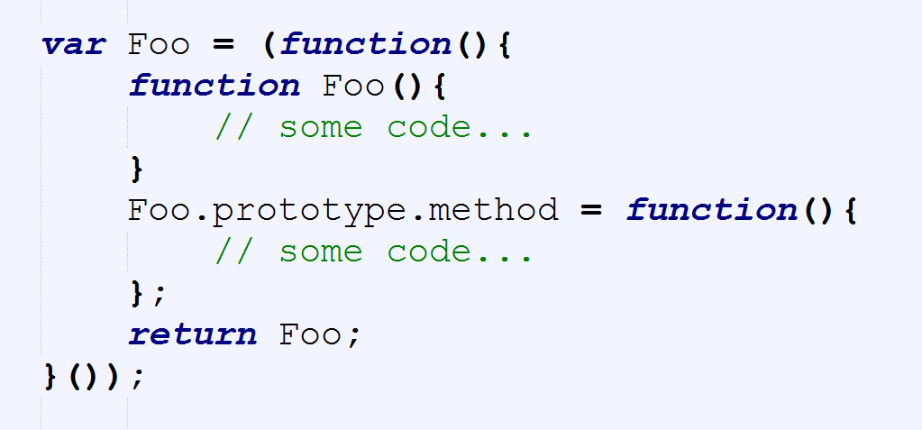

Slide 67
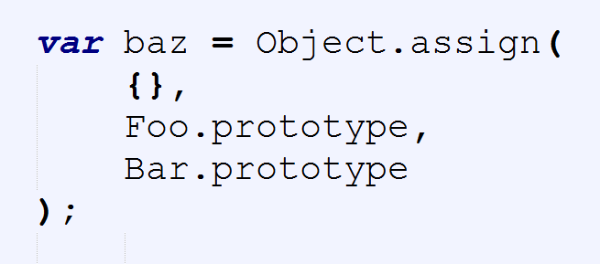

Slide 68
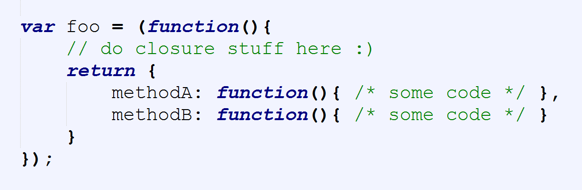
Simplify further

Slide 69
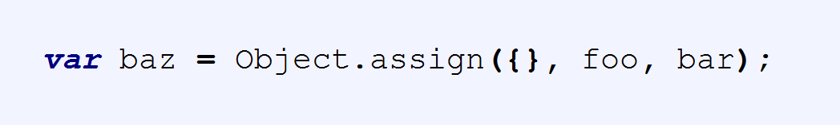
Notes:
Classes and inheritance are a design pattern you can choose, or not choose, in your software architecture.
Most developers take for granted that classes are the only (proper) way to organize code, but here we've seen there's another less-commonly talked about pattern that's actually quite powerful: behavior delegation.
Behavior delegation suggests objects as peers of each other, which delegate amongst themselves, rather than parent and child class relationships. JavaScript's [[Prototype]] mechanism is, by its very designed nature, a behavior delegation mechanism.
That means we can either choose to struggle to implement class mechanics on top of JS (see Chapters 4 and 5), or we can just embrace the natural state of [[Prototype]] as a delegation mechanism.
When you design code with objects only, not only does it simplify the syntax you use, but it can actually lead to simpler code architecture design.
OLOO (objects-linked-to-other-objects) is a code style which creates and relates objects directly without the abstraction of classes. OLOO quite naturally implements [[Prototype]]-based behavior delegation.

Slide 71


