Slide 1
Calculator
Martin Chaov 25833

Slide 2
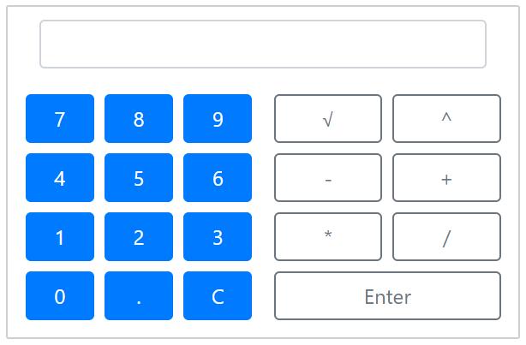

Slide 3
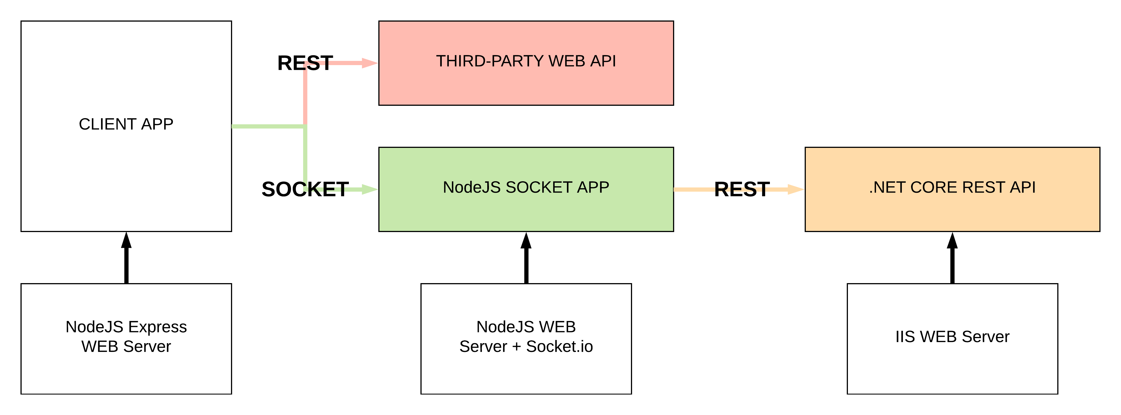

Slide 4
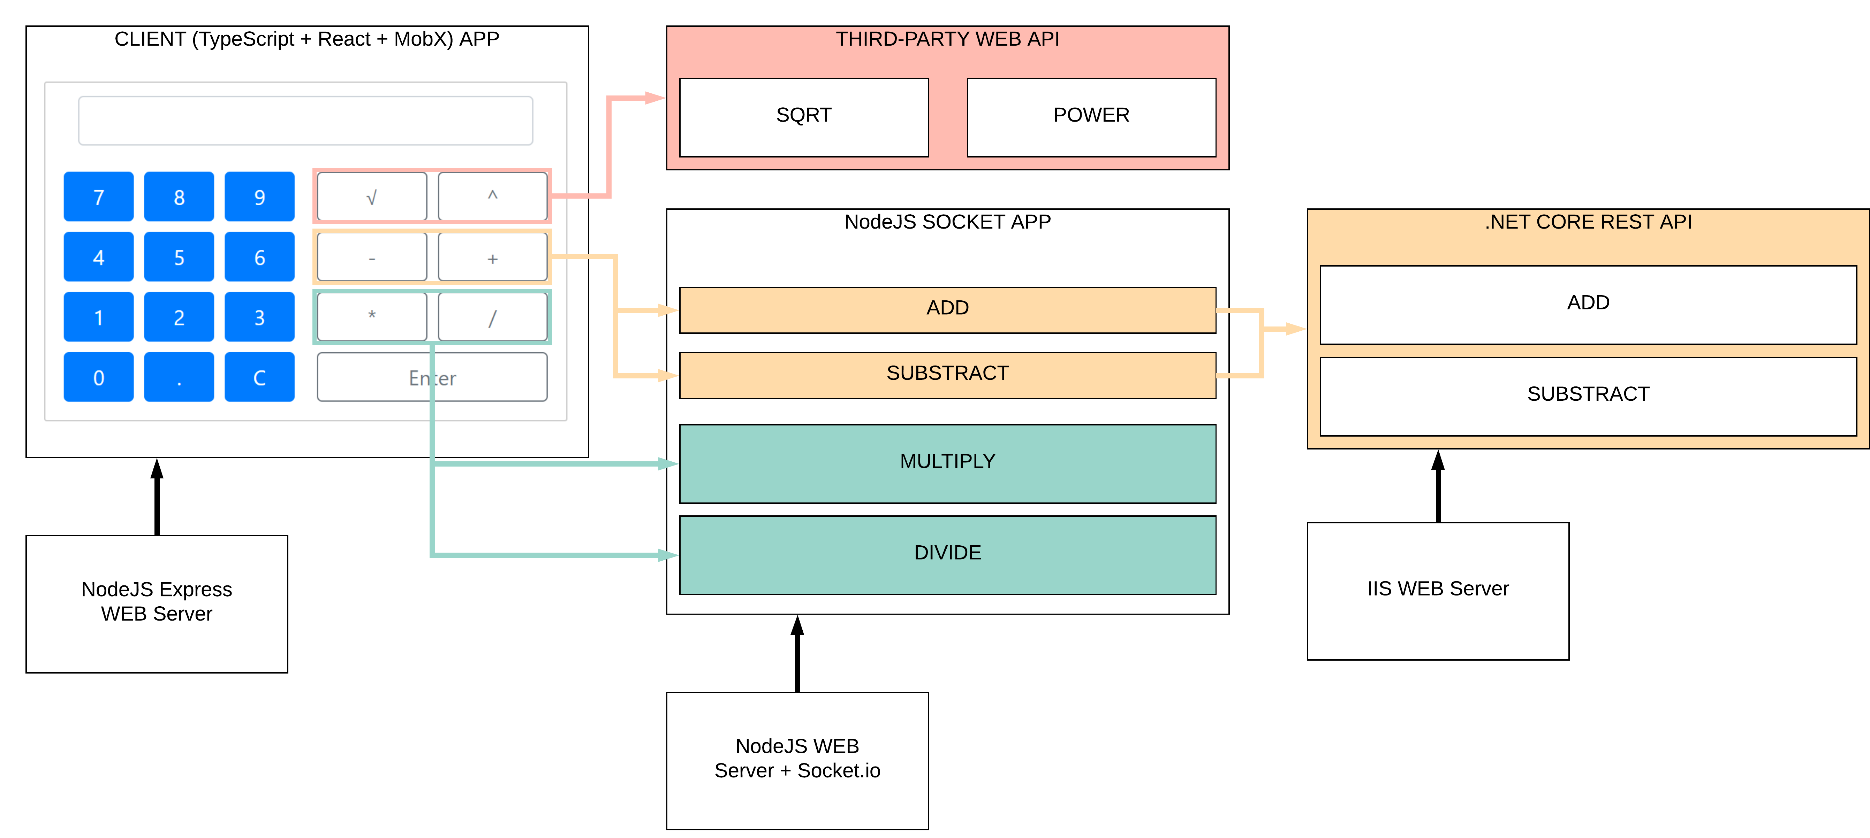

Slide 5
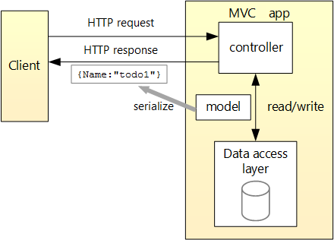

Slide 6
4 Application
Client App
Socket App
Web API
Third-party service

Slide 7
Tech Stack
TypeScript
JavaScript
C#
.NET Core
IIS
Express
NodeJS
Socket.io

Slide 8
Questions?

