Slide 1







Technology Trend Analysis
Mona Chapla
1/31/2024

Slide 2



OUTLINE
Executive Summary
Introduction
Methodology
Results
Visualization – Charts
Dashboard
Discussion
Findings & Implications
Conclusion
Appendix

Slide 3

EXECUTIVE SUMMARY
Current Technology Usage Trend
Language
Database
Platform
Web Frame
Future Technology Trend
Language
Database
Platform
Web Frame
Demographic Survey
Country
Age
Gender

Slide 4

INTRODUCTION
Analyze technology trends in software and web development among developers around the world
Purpose of the Analysis
Identify current top programming languages, databases, platforms and web frames skills in demand
Identify top programming languages, databases, platforms and web frames skills desired in future
Identify gap in the industry
Audience of this presentation
IT industry representatives
Programmers
Computer Science students

Slide 5

METHODOLOGY
Data Collection Sources
Stack overflow developer 2019 survey
GitHub job postings
Programming languages survey data
Data Wrangling
Exploratory Data Analysis
Data Visualization
Python matplotlib
IBM Cognos Analytics
Presentation of Findings

Slide 6
RESULTS
Findings and implications are presented in following slides for:
Programming Language Trends
Database Trends
Demographic survey for Gender, Age, Country

Slide 7
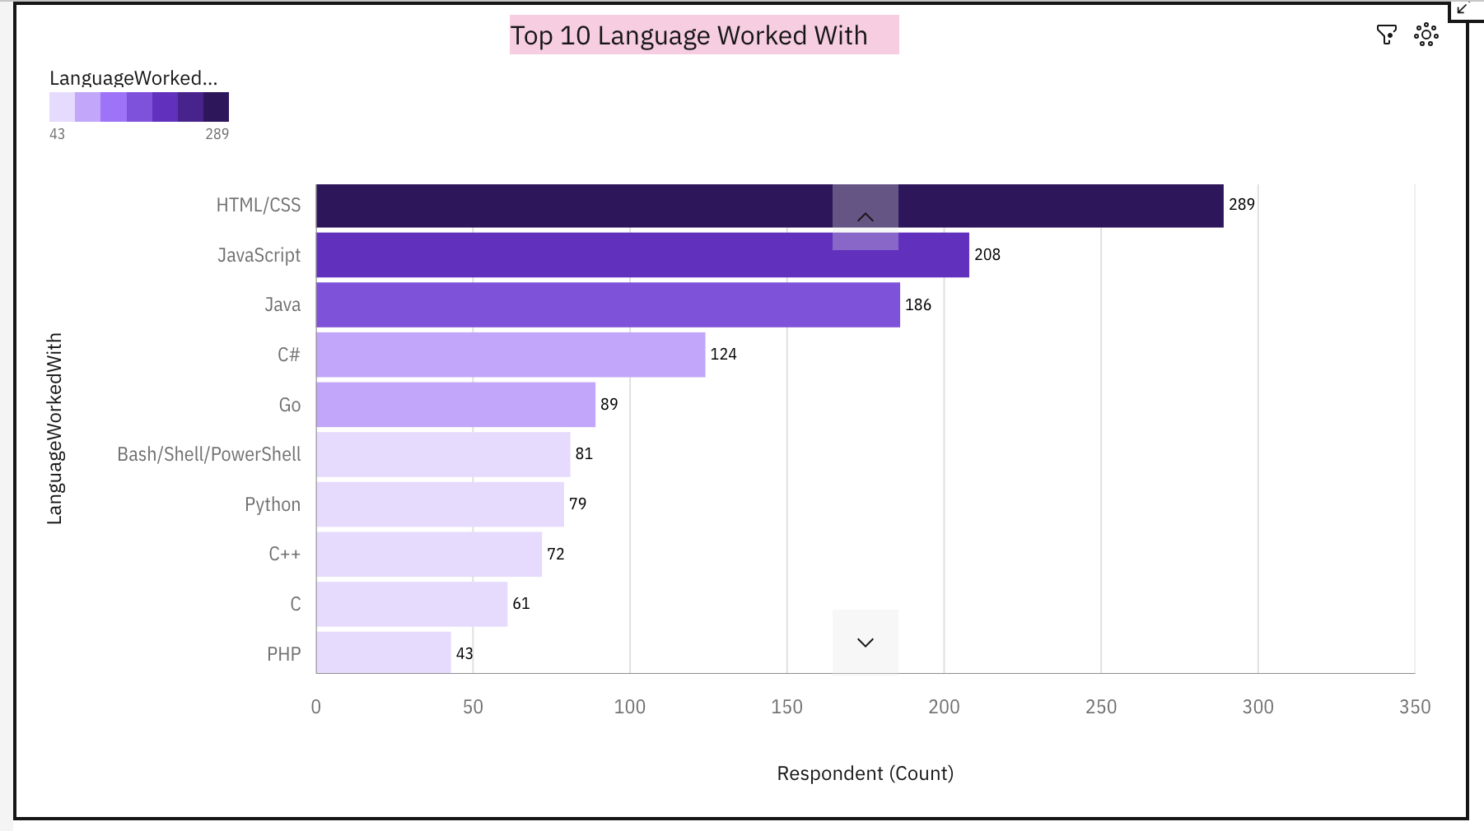
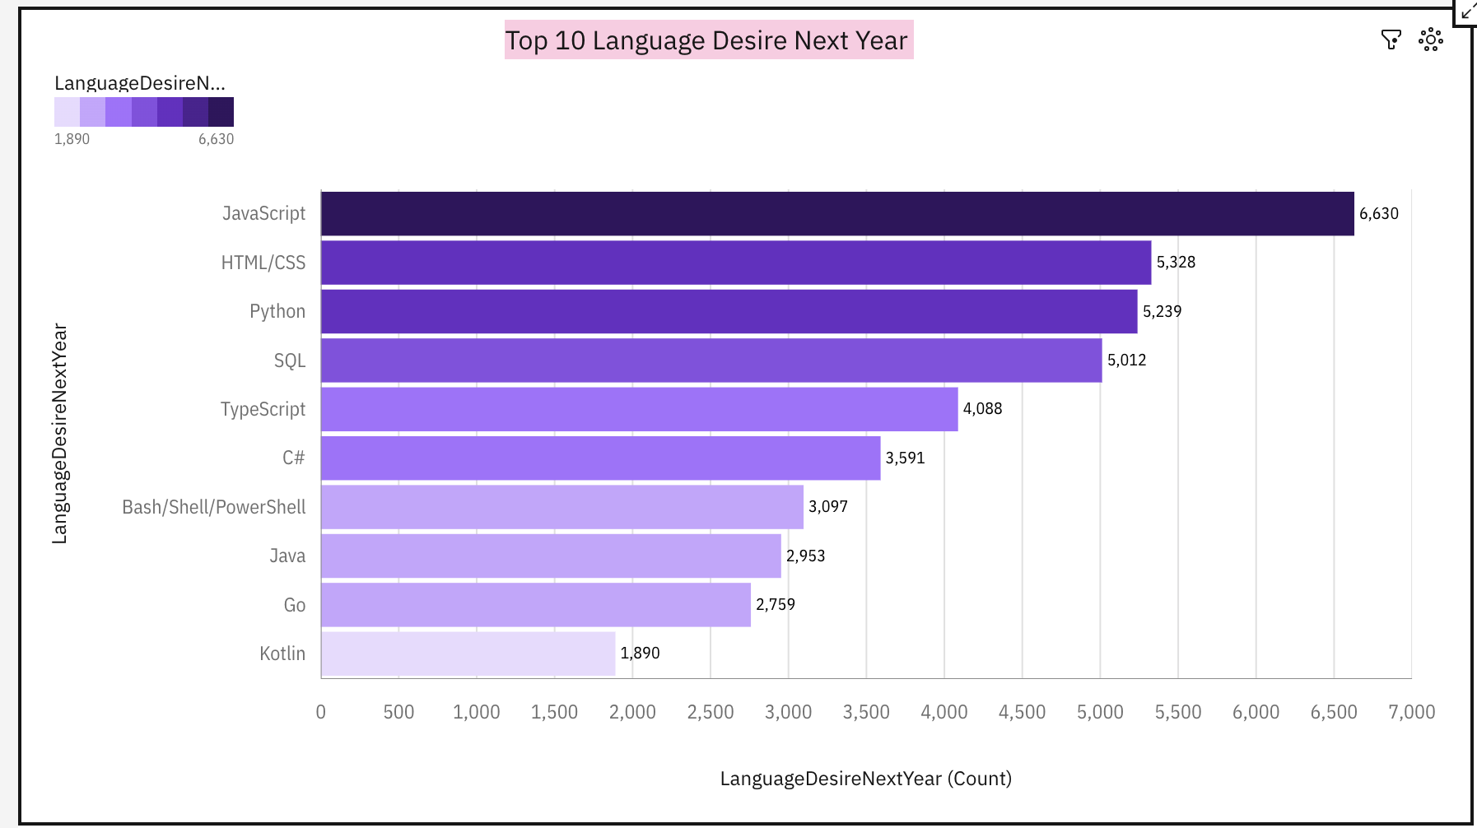
PROGRAMMING LANGUAGE TRENDS
Current Year
Next Year
< Bar chart of top 10 programming languages for the next year goes here.>

Slide 8
PROGRAMMING LANGUAGE TRENDS - FINDINGS & IMPLICATIONS
Findings
JavaScript is top trending language in the world
Python and TypeScript are becoming more popular
HTML/CSS and SQL has great demand in current and future trend
Implications
Web development are in high demand
JavaScript and TypeScript are crucial to learn for developers
With rising demand in AI and ML, Python had become popular choice among developers

Slide 9
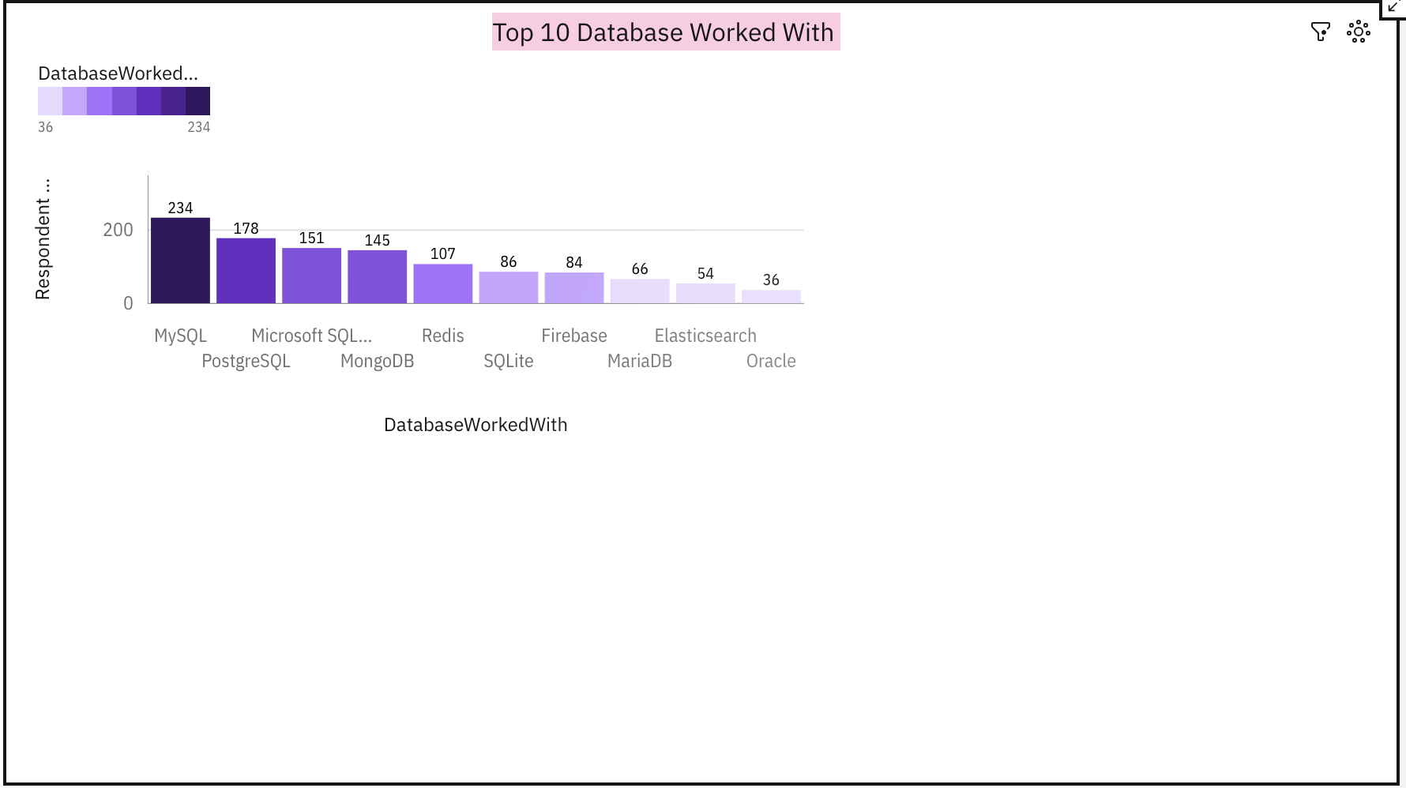
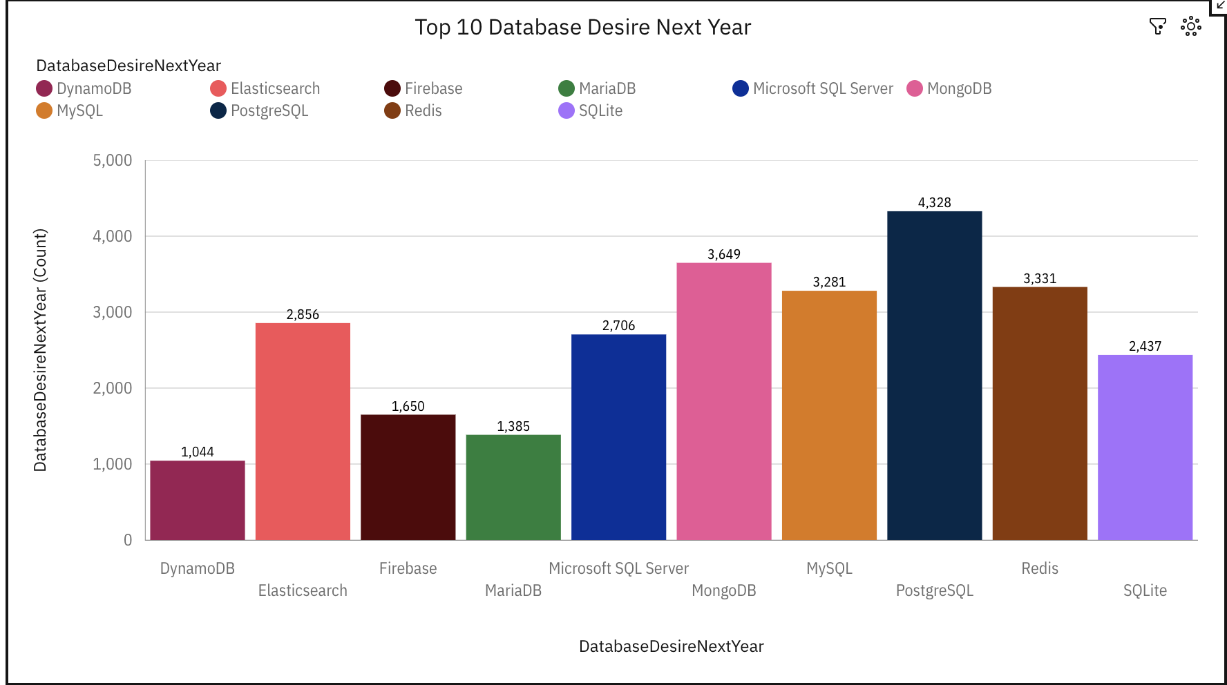
DATABASE TRENDS
Current Year
Next Year
< Bar chart of top 10 databases for the current year goes here >
< Bar chart of top 10 databases for the next year goes here.>

Slide 10
DATABASE TRENDS - FINDINGS & IMPLICATIONS
Findings
MySQL is the most popular database
MongoDB and Redis are most popular NoSQL database
Elasticsearch showing trend for gaining popularity
Implications
Open source databases like MySQL are still preferable
Software development and Big Data technology still require SQL
NoSQL databases will make an impact for non relational databases

Slide 11

DASHBOARD
IBM-Dashboard-Capstone/Final Dashboard.pdf at main · mchapla123/IBM-Dashboard-Capstone · GitHub

Slide 12
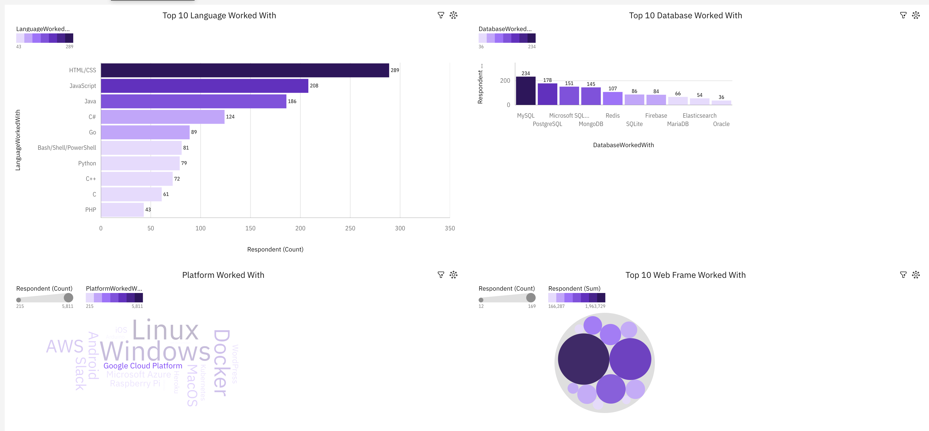
DASHBOARD TAB 1
Screenshot of dashboard tab 1 goes here

Slide 13
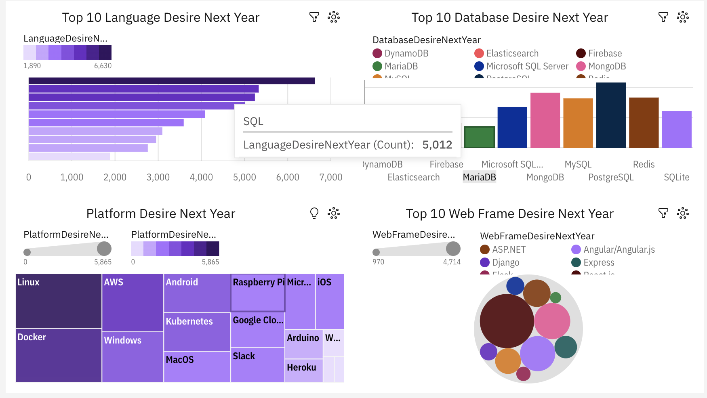
DASHBOARD TAB 2
Screenshot of dashboard tab 2 goes here

Slide 14
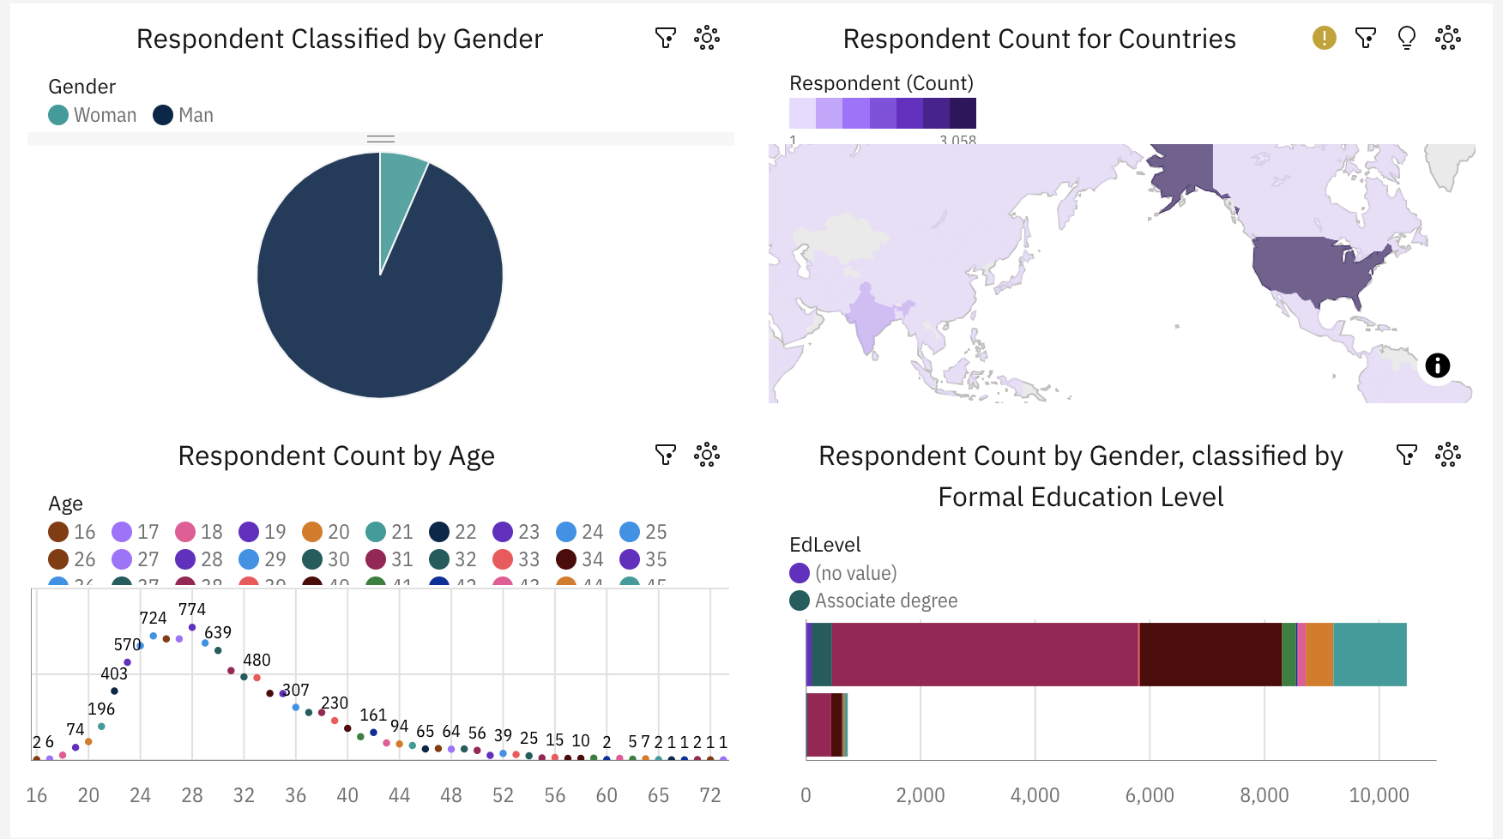
DASHBOARD TAB 3
Screenshot of dashboard tab 3 goes here

Slide 15
DISCUSSION
Technology usage trend now and future
Gender, Age and Education discrimination in IT industry
Technology gaps in developing countries
Female participation in technology field

Slide 16
OVERALL FINDINGS & IMPLICATIONS
Findings
Technology trends changes every year
USA is the top technology country
Extreme gender and age disparity
Docker and AWS are the most popular platform
Implications
Programmers need to be flexible to adapt latest technology trends
More countries should have exposure to new technology
In future, there will be shift to faster app deployments and could services

Slide 17

CONCLUSION
Company and programmers needs to adapt to latest technology trends.
Python becomes more popular choice among developers with rising demand in AI and ML
There is need for developing and other lagging countries to pick up with latest technology trend
Companies should work on reducing gender and age disparity in technology field

Slide 18

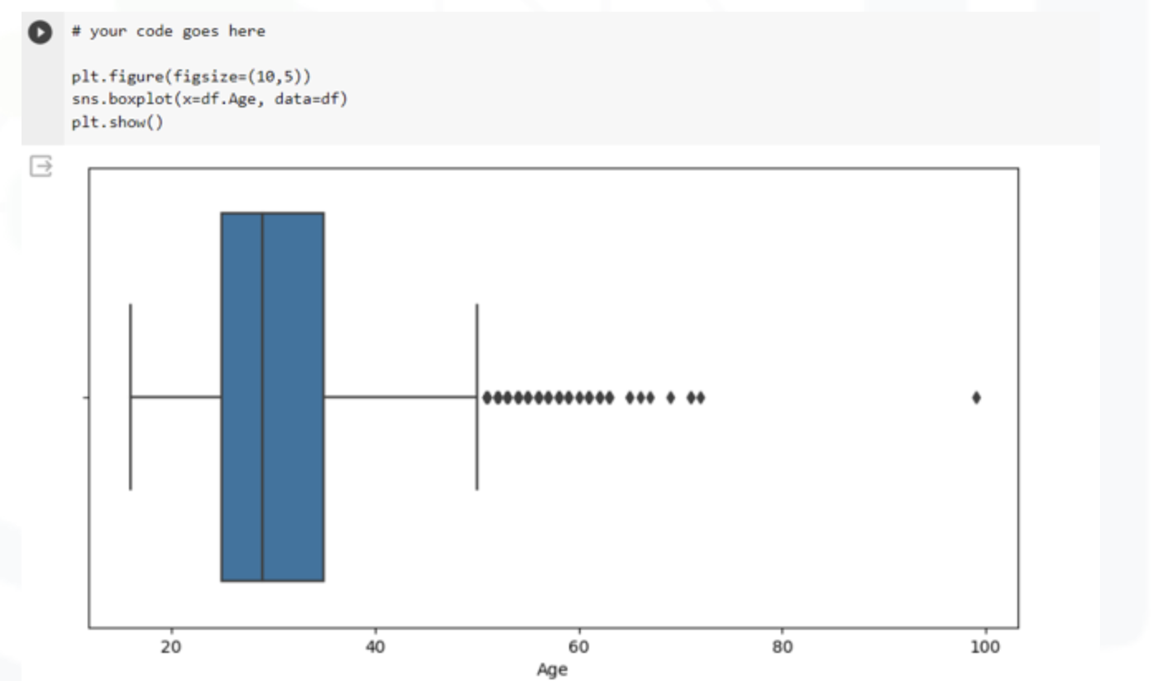
APPENDIX
Boxplot showing age concentration at age 24-34 for respondents

Slide 19
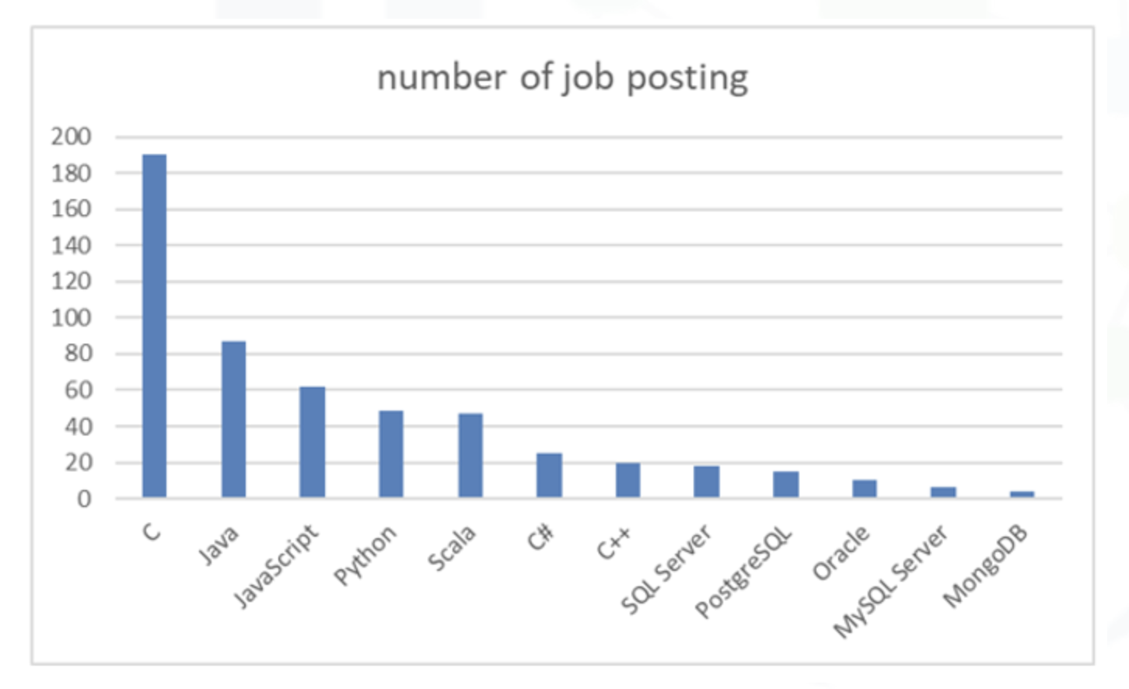
JOB POSTINGS
Bar chart presenting Job Posting data using job collected using GitHub job API

Slide 20
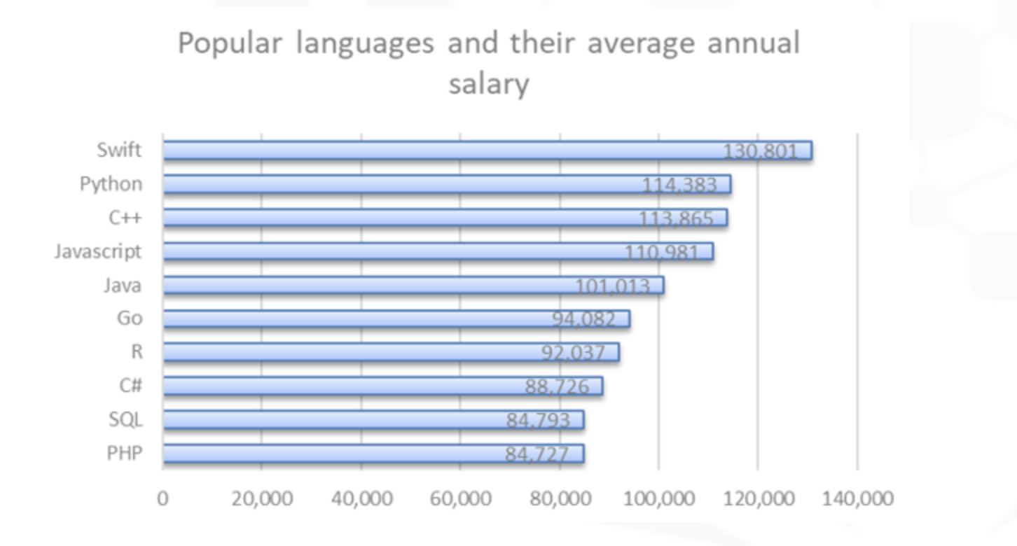
POPULAR LANGUAGES
Bar chart displaying popular languages and their average annual salary collected through web scraping the GitHub jobs data

