Slide 1


BROWSER-TO-SERVER
COMUNICATION
AJAX
MARCH 24, 2017

Slide 2
MAKSYM CHAPLIUK
Front-End Developer
Primary skills: JavaScript, AngularJS 1.x
maksym_chapliuk@epam.com
Ask me:
MARCH 24, 2017

Slide 3
AGENDA
1
HTTP
2
AJAX
3
XMLHttpRequest
4
Cross Domain Requests
5
Fetch
6
JSONP
7
CSRF
8
Where you can find XHR

Slide 4
HTTP
Hypertext Transfer Protocol (HTTP) is an application-layer protocol for transmitting hypermedia documents, such as HTML. It was designed for communication between web browsers and web servers
CLIENT (e.g. web browser)
HTTP Request
SERVER
HTTP
HTTP Request
Notes:
1. Client sends a request to the Server (by entering a URL in the address bar, clicking on the button with the AJAX handler, submitting the form)
2. Server prepares the response (looks for the requested data in the database, looks for the index.html or a picture of a kitten), process the data and sends back to the client.
3. Client receives the response and handle it (shows to the user, process the data)

Slide 5
HTTP Request Structure
REQUEST LINE | HEADERS | MESSAGE BODY
METHOD URI HTTP/V | name: value | Data
POST /login HTTP/1.1 | Content-Type: application/json | { “username”: “myname”, “password”: “qwerty” }
GET, HEAD, POST, PUT, UPDATE, DELETE, OPTIONS
Mandatory | Optional | Optional
 | Wikipedia | Empty line before msg
Notes:
START LINE
Required part of the HTTP response
Consists of Method, requested URI, http version
Methods list (upper- lowercase doesn’t matter, usually verbs) - indicates the desired action to be performed
URI – relative path to the resource
http version – one of the 0.9, 1.0, 1.1 – the last one, introduced in 1997
HEADERS
Headers defines operating parameters of the transaction
name-value pairs in clear-text string format
case-insensitive
Show the Wikipedia link
Custom headers without X-
MESSAGE
Message body: any data (json, image, plain text)

Slide 6
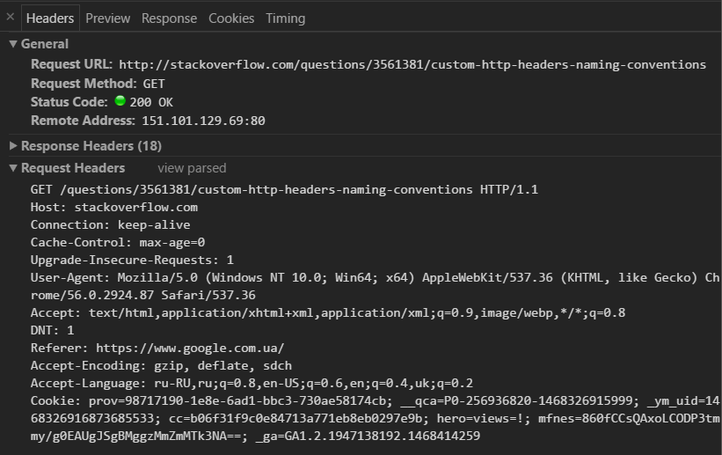
HTTP Request Structure. Example
Notes:
name-value pairs in clear-text string format
Show the Wikipedia link

Slide 7
HTTP Response Structure
STATUS LINE | HEADERS | MESSAGE BODY
HTTP/V STATUS Code Msg | name: value | Data
HTTP/1.1 200 OK HTTP/1.1 404 Not Found | Content-Type: application/json | { “username”: “myname”, “password”: “qwerty” }
Mandatory | Optional | Optional
 | Wikipedia | Empty line before msg
Notes:
STATUS LINE
Protocol Version, Status Code, Status Text

Slide 8
HTTP Status Codes
STATUS CODES
1xx Informational responses
2xx Success
3xx Redirection
4xx Client errors
5xx Server error
Notes:
Also unofficial status codes which are not specified by any standard
IIS codes, nginx codes etc.

Slide 9
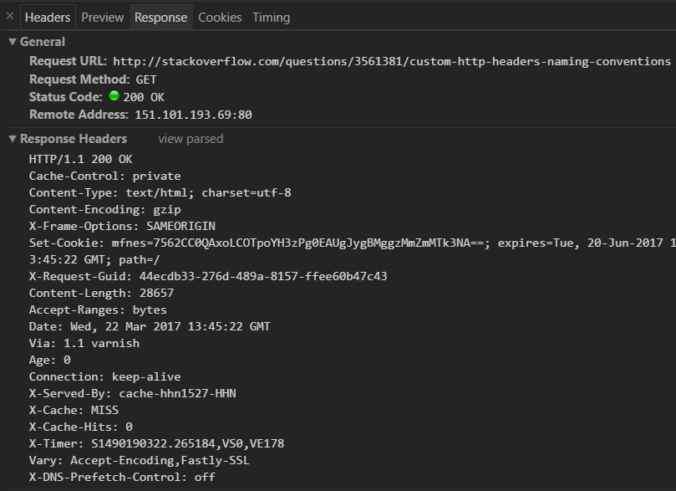
HTTP Response Structure. Example
Notes:
There is a response (plain html) – content-type

Slide 10


AJAX
Asynchronous JavaScript + XML, is a set of Web development techniques using many Web technologies on the client side to create asynchronous Web applications. With Ajax, Web applications can send data to and retrieve from a server asynchronously (in the background) without interfering with the display and behavior of the existing page.
The term "Ajax" was publicly stated on 18 February 2005 by Jesse James Garrett in an article titled "Ajax: A New Approach to Web Applications", based on techniques used on Google pages.

Slide 11
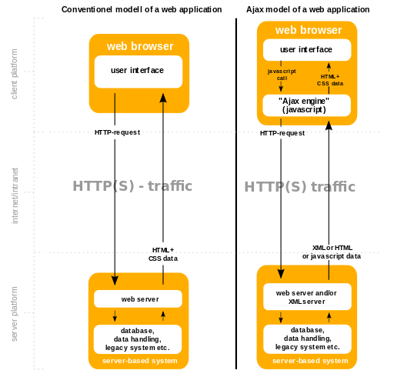
AJAX vs. Browser Requests
Notes:
PLAIN REQUESTS
User change the URL, inserts script with src
Browser initiates the request
Server responds with data
Browser handles the data
AJAX
AJAX requests have JS middleware
Browser asks JS to get the data
JS initiates the request (user doesn’t see it)
Server responds with data
JS handles the data

Slide 12
XMLHttpRequest
XMLHttpRequest is an API that provides client functionality for transferring data between a client and a server.
const xhr = new XMLHttpRequest();
Notes:
Known as XHR
JS API
Every request needs its own XHR, because you can override previous one if it is not finished yet

Slide 13
XHR. Demo
const xhr = new XMLHttpRequest(); xhr.open('GET', '/customers'); xhr.send(null);
Notes:
SHOW DEMO
A simple GET request to get a list of customers
New XHR – should be the 1st one, no parameters.
Mozilla adds non-standard parameter
Show example step-by-step
No Sync XHR anymore. Use

Slide 14
XHR Response
xhr.onreadystatechange = function() { if (xhr.readyState === XMLHttpRequest.DONE) { if (xhr.status === 200) { // process response.... } } };
.readyState
Value | State | Description
0 | UNSENT | Client has been created. open() not called yet.
1 | OPENED | open() has been called.
2 | HEADERS_RECEIVED | send() has been called, and headers and status are available.
3 | LOADING | Downloading; responseText holds partial data.
4 | DONE | The operation is complete.
Notes:
SHOW DEMO
readyState - returns the state an XMLHttpRequest client is in. An XHR client exists in one of the following states:

Slide 15
XHR2
XMLHttpRequest Level 2 introduces a slew of new capabilities which put an end to crazy hacks in our web apps; things like cross-origin requests, uploading progress events, and support for uploading/downloading binary data. These allow AJAX to work in concert with many of the bleeding edge HTML5 APIs such as File System API, Web Audio API, and WebGL.
function sendForm(form) { var formData = new FormData(form); // Append extra data before send. formData.append('secret_token', '1234567890'); var xhr = new XMLHttpRequest(); xhr.open('POST', form.action, true); xhr.onload = function(e) { ... }; xhr.send(formData); return false; // Prevent page from submitting. }
Notes:
XHR2 it's part of the incremental improvements browser vendors are making to the core platform
A revamped send() method has been overridden to accept any of the following types: DOMString, Document, FormData, Blob, File, ArrayBuffer.

Slide 16
XHR2. Event Handlers
Attribute | Description
onabort | A JavaScript function object that gets invoked if the operation is canceled by the user.
onerror | A JavaScript function object that gets invoked if the operation fails to complete due to an error.
onload | A JavaScript function object that gets invoked when the operation is successfully completed.
onloadend | A JavaScript function object that gets invoked when the operation is completed for any reason; it will always follow a an abort, error, or load event.
onloadstart | A JavaScript function object that gets invoked exactly once when the operation begins.
onprogress | A JavaScript function object that gets invoked zero or more times, after the loadstart event, but before any abort, error, or load events occur.
Notes:
onreadystatechange as a property of the XMLHttpRequest instance is supported in all browsers.
When handlers are called – they receive a parameter ProgressEvent

Slide 17
CROSS DOMAIN REQUEST
Browsers restrict cross-origin HTTP requests initiated from within scripts
Form and iframes allow cross domain request, but browser blocks script to read the response
Simple requests
GET, HEAD, POST
Limited number of Headers
Limited number of Content-Types
To improve web applications, developers asked browser vendors to allow cross-domain requests.
Access-Control-Allow-Origin: * || origin Access-Control-Expose-Headers: list of allowed headers Access-Control-Allow-Credentials: boolean
Notes:
SHOW DEMO
A resource makes a cross-origin HTTP request when it requests a resource from a different domain, or port than the one which the first resource itself serves.
The Access-Control-Allow-Credentials header Indicates whether or not the response to the request can be exposed when the credentials flag is true.
http request Origin
From XHR2
Tag script allow cross domain request. See JSONP

Slide 18
XHR and PROMISES
let request = function (httpConfig) { return new Promise((resolve, reject) => { const xhr = new XMLHttpRequest(); xhr.open(httpConfig.method || 'GET', httpConfig.url); if (httpConfig.headers) { Object.keys(httpConfig.headers).forEach(key => { xhr.setRequestHeader(key, httpConfig.headers[key]); }); } xhr.onload = function () { xhr.status >= 200 && xhr.status < 300 ? resolve(xhr.response) : reject(xhr.statusText); }; xhr.onerror = function () { reject(xhr.statusText); }; xhr.send(httpConfig.body); }); }; request({ method: 'get', url: '/user/12' }) .then(userInfo => /* process response*/) .catch(error => /* process error */);
Notes:
SHOW DEMO
Chaining
More convenient in developing

Slide 19
FETCH
The Fetch API provides a JavaScript interface for accessing and manipulating parts of the HTTP pipeline, such as requests and responses. It also provides a global fetch() method that provides an easy, logical way to fetch resources asynchronously across the network.
fetch('/path/to/resource').then(response => /* process response */);
uses JavaScript Promises to handle results/callbacks
you can use the Cache API with the request and response objects
You can perform no-cors requests, getting a response from a server that doesn't implement CORS. You can't access the response body directly from JavaScript, but you can use it with other APIs (e.g. the Cache API)
Streaming responses (with XHR the entire response is buffered in memory, with fetch you will be able to access the low-level stream)

Slide 20
FETCH. EXAMPLE
function fetchData() { const request = new Request('/fetch_example', { method: 'GET', mode: 'cors', headers: new Headers({ 'Content-Type': 'text/plain' }) }); fetch(request).then(response => { response .text() .then(text => { console.log(text); }) }); }
Web API interfaces: new Request(); new Response(); new Headers(); Body
Notes:
SHOW DEMO
Not standardized yet
Not fully implemented in browsers
There are polyfills
The fetch() method takes one mandatory argument

Slide 21
AJAX. PROS and CONS
PROS
More interactive and responsive UI
Only content to be updated is requested and transferred
Reduced connections to the web server
Load delayed content
CONS
Depends on JS
Security
Indexing problem
Notes:
Pros – asynchronous!
Less server requests: no need to load styles and images every time when page updates
Load delayed content depends on user’s actions
Security: CSRF

Slide 22
JSONP (JSON + PADDING)
JSONP is a method for sending JSON data without worrying about cross-domain issues.
JSONP does not use the XMLHttpRequest object.
JSONP uses the <script> tag instead.
function getData() { const script = document.createElement('SCRIPT'); script.src = '/jsonp_example?callback=parseData'; document.getElementsByTagName('body')[0].appendChild(script); } function parseData(data) { // process the request }
Notes:
SHOW DEMO
Browser will process any code it got from server, so you should trust the server!
Requesting a file from another domain can cause problems, due to cross-domain policy.
Requesting an external script from another domain does not have this problem.
JSONP uses this advantage, and request files using the the script tag instead of the XMLHttpRequest object.
Default name is callback. You can use your own
XHR2 can do cross domain request

Slide 23
CSRF/XSRF
Cross-site request forgery, also known as one-click attack or session riding and abbreviated as CSRF (sometimes pronounced sea-surf[1]) or XSRF, is a type of malicious exploit of a website where unauthorized commands are transmitted from a user that the website trusts.
User works with his online bank account
On the forum he clicks a “link” from someone
Link do some bad operations on the bank site from the #1 from user’s account

Slide 24
CSRF. DEFENCE
Verify the content of the “Referer” header
Use unique identifier
Alternate CSRF Defense: Require User Interaction
Any state changing operation requires a secure random token (e.g., CSRF token) to prevent CSRF attacks
Characteristics of a CSRF Token
Unique per user session
Large random value
Generated by a cryptographically secure random number generator
The CSRF token is added as a hidden field for forms or within the URL if the state changing operation occurs via a GET
The server rejects the requested action if the CSRF token fails validation
Notes:
2 main methods for preventing CSRF attacks
Clever attacker can forge the content of the Referer header
Referer (referrer) shows the URL from which user came to the current site
Ideally, both these methods would be combined to defend against a CSRF attack.

Slide 25
AJAX in (FRAMEWORKS && LIBRARIES)
jQuery
.ajax
Angular 1.x
$http
$resource
Angular 2
HttpModule
React
No AJAX
VueJS
No AJAX
EmberJS
Adapter
RESTAdapter
JSONAPIAdapter
Notes:
And its shorthands
$resource is over $http
XHR everywhere

Slide 26
IMPROVE KNOWLEDGE ON AJAX
David Flanagan “The Definitve Guide”
http://learn.javascript.ru
https://developer.mozilla.org/
wikipedia
google

Slide 27

?
Notes:
Q&A

Slide 28

THANK YOU

