Slide 1



HEALTH DATA SCIENCE CAPSTONE PROJECT
Sabindra Rai, MS-HDS
Mentor by : Mark Charipar , Project Manager and Data Scientist

Slide 2

Research Question

Slide 3
Abstract

Slide 4

Introduction I
Organization: Plan4Co
Preceptor: Mark Charipar,
Project Manager
Data Scientist
About the Organization’s Structure: Plan4Co is a relatively new data science startup with less than 75 contractors. Plan4Co specializes solving data science problems and needs for small businesses for a competitive price, while offering a polished product and a “can do attitude”.
About the Project: The project involved a non-for-profit call center and forecasting the number of calls that are related to mental health.

Slide 5
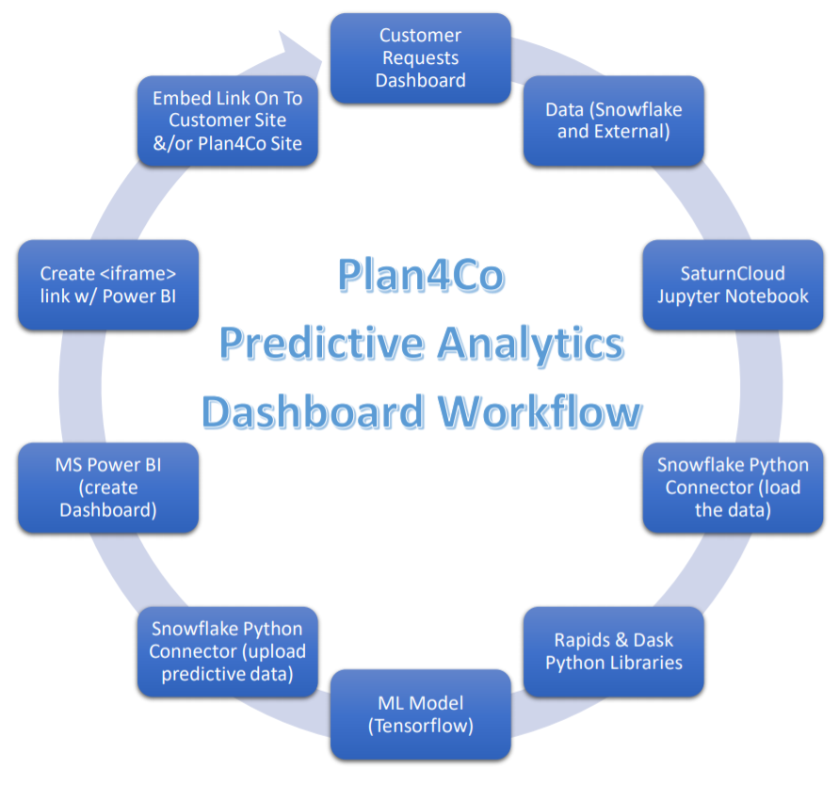
Introduction II
Takes a call centers CRM database data (iCarol) from excel files and uploads them to a cloud SQL database (Snowflake).
The call centers data is then transformed on the SQL database via Python and an API.
Then the data is loaded to a local machine and further transformed to be input into a ML model (LSTM).
The model forecasts the number of calls made to the call center that are related to mental health, as is defined by their taxonomy system.
The forecasted number of calls is uploaded to the SQL database in a new table.
Microsoft Power BI Pro is then connected to the SQL database using direct query mode and a visualization is created.
An embed public URL link is then created with Microsoft Power BI Pro and the URL was shared with the call centers IT personnel.
The call center then forwards monthly data from their CRM database
Upon receiving the updated data another python file is executed that updates the SQL database with the new data and predictions.
This was the initial sketch for the ML pipeline
The data turned out to be much smaller than was anticipated
Did not need to use SaturnCloud or Rapids & Dask libraries
Reduced the resources needed to complete the project
Project done all in Python in tandem with:
Snowflake (Cloud SQL Database)
Microsoft Power BI

Slide 6
Introduction III
Literature
<insert something here, what you’re using from your report>

Slide 7
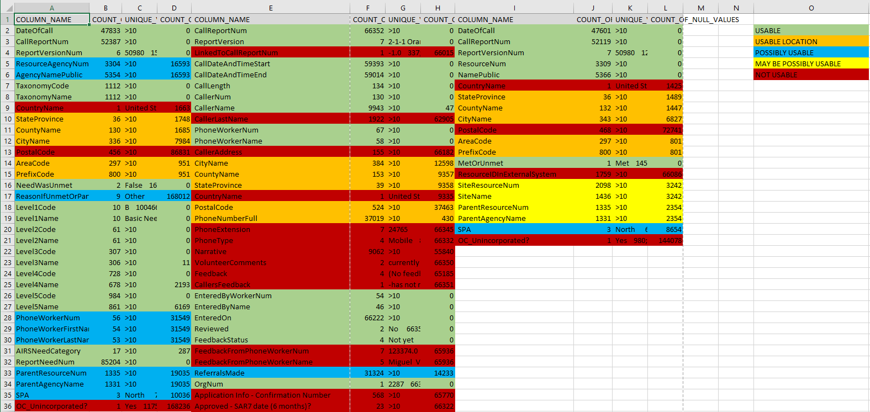
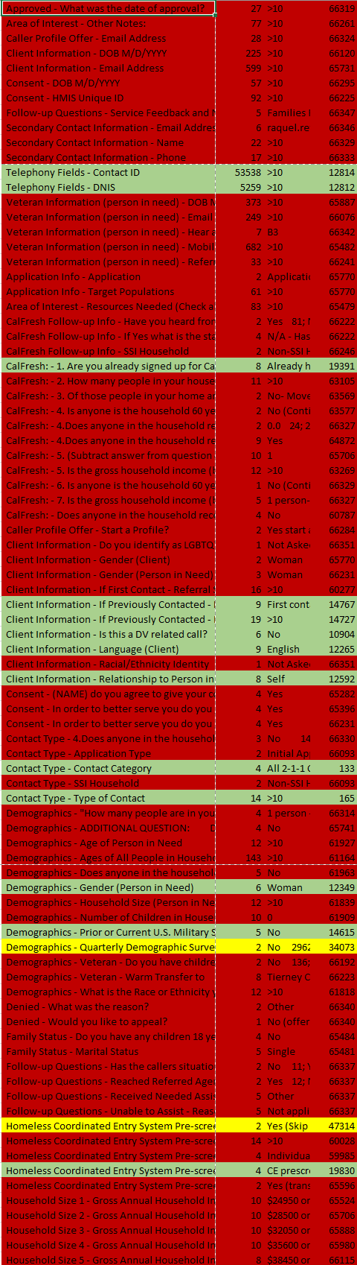
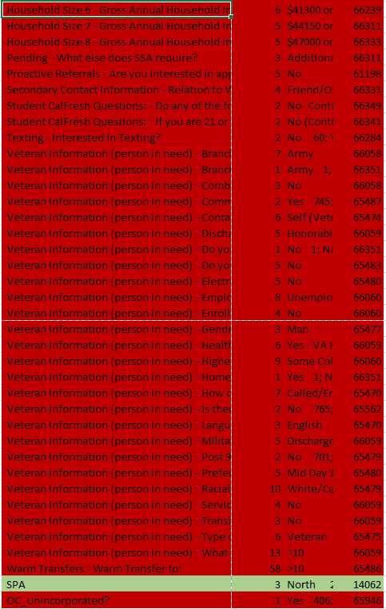
Methods
Created a python file that provided the number of unique and NULL values for each column
The majority of the data was unusable because there were to many NULL values
There were several columns that had the same caller information
Could use several columns that were relevant for the call centers request:
Date Of Call
Taxonomy Code
This classified the calls
Taxonomy Codes that begin with ‘R’ correspond to “Mental Health”
Gender
Current or prior military experience

Slide 8
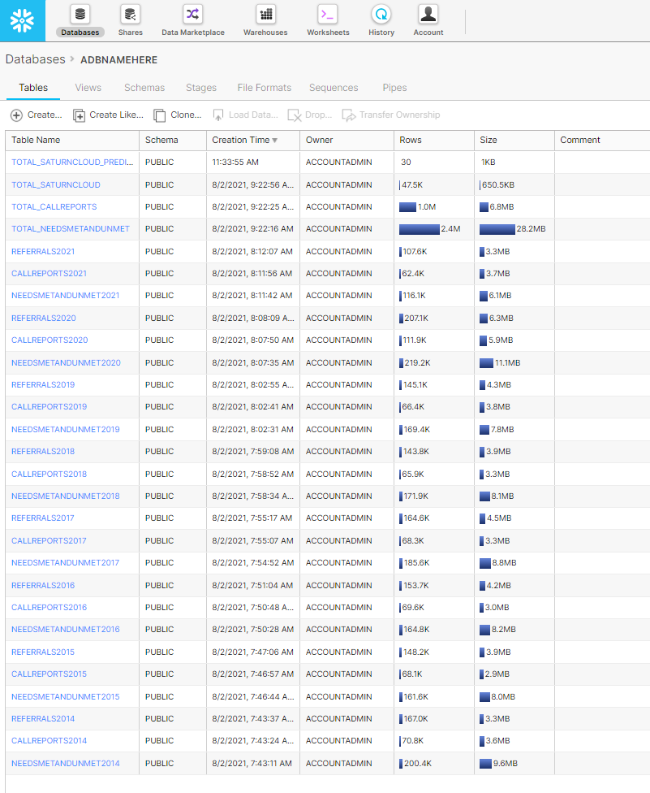
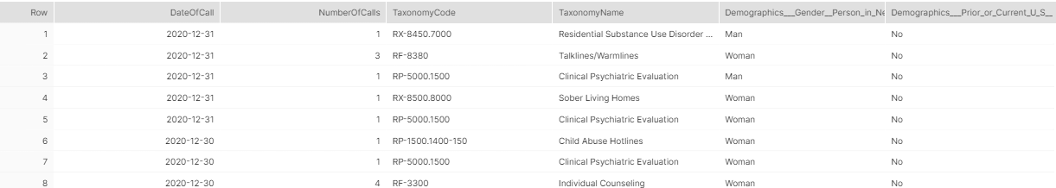
Methods
Each excel file contained a year's worth of caller's data and contained 3 sheets.
Each sheet was made into a table.
Only 2 of the sheets from each file were needed because of the columns that were selected to build the model.
The 2 tables from each year (2014-2021) were then merged into a single macro table using on the relevant columns.
The data was then cleaned by selecting only the mental health taxonomy codes and by removing null values and recategorizing some values as ‘other’.
Then a “Number of Calls” column is created and filled by using a group by method.
After the exploratory analysis was done the data was further cleaned as well.

Slide 9
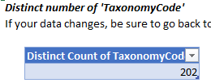
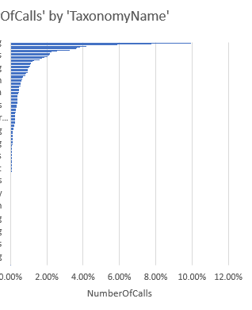
Methods
The data was further transformed using python.
There were over 202 unique Taxonomy codes starting with ‘R’.
The data was then filtered and grouped by the Taxonomy level 2 codes.
Where needed the data was then value encoded.

Slide 10
Methods
The call center was asking for a time series forecast.
Structured the data for data windowing
Tested the data on several models.
RRN LSTM provided the best metrics and visualization.
This ensured accuracy relative to the other tested models.
Allowed the customer to gain valued insight with the visualization from the models predictions.

Slide 11
Methods
.

Slide 12
Results

Slide 13
Interpretation

Slide 14
Limitations
In an article on Feb. 13th 2021 from “Data Science Process Alliance” titled “Why Big Data Science & Data Analytics Projects Fail”
“Through 2022, only 20% of analytic insights will deliver business outcomes” (Gartner, 2019)
Lists 8 reasons why projects fail:
Not having the Right Data
Not having the Right Talent
Solving the Wrong Problem
Not Deploying Value
Thinking Deployment is the Last Step
Applying the Wrong (or No) Process
Forgetting Ethics
Overlooking Culture
Statistically speaking the project chances of success were low to begin with
Felt we had a responsibility to see the project through because of the data being related to people's mental health
Many different things to troubleshoot with the code and the customer

Slide 15
Reference

