Slide 1
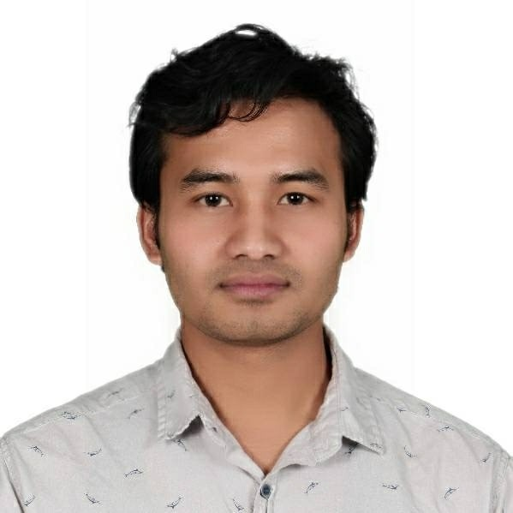
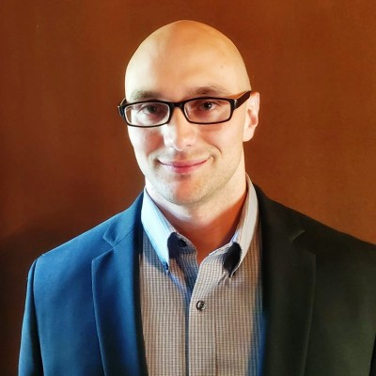

HEALTH DATA SCIENCE CAPSTONE PROJECT
Sabindra Rai, MS-HDS
Mentor by : Mark Charipar , Project Manager and Data Scientist

Slide 2

Research Question

Slide 3
Abstract

Slide 4
Introduction

Slide 5
Methods

Slide 6
Methods

Slide 7
Methods

Slide 8
Results

Slide 9
Interpretation

Slide 10
Limitations

Slide 11
Reference

