Slide 1
Weather Patterns and subway ridership in new York city
By makai charles

Slide 2
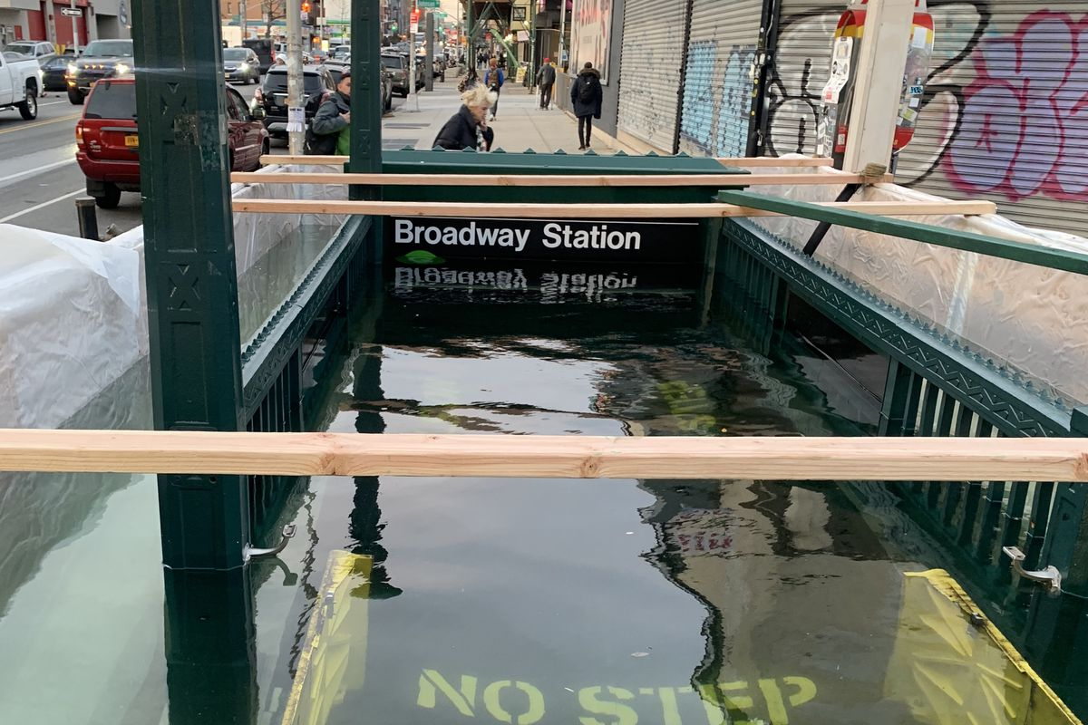
introduction
________________________________________________________________________________________________
Growing concern of climate change
Goal: Figure out if poor weather conditions have an impact on subway ridership

Slide 3
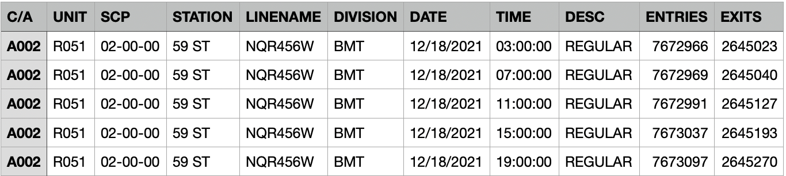
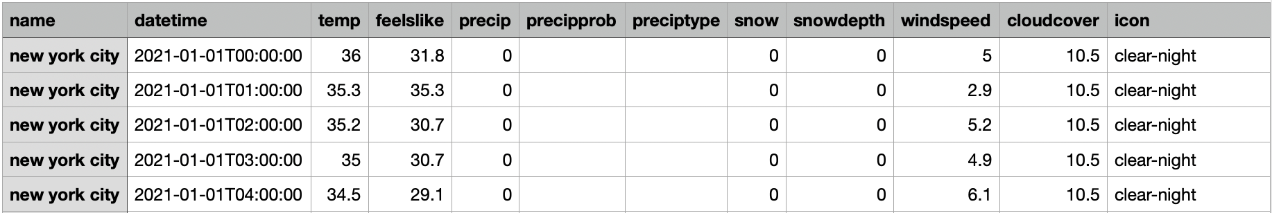
Mta Turnstile data
NEW YORK CITY WEATHER DATA

Slide 4




Tools
_____________________________________________________________________________________________

Slide 5
Data aggregation
Main DataFrame (except foot_traffic column)
Examples of Data Manipulation

Slide 6
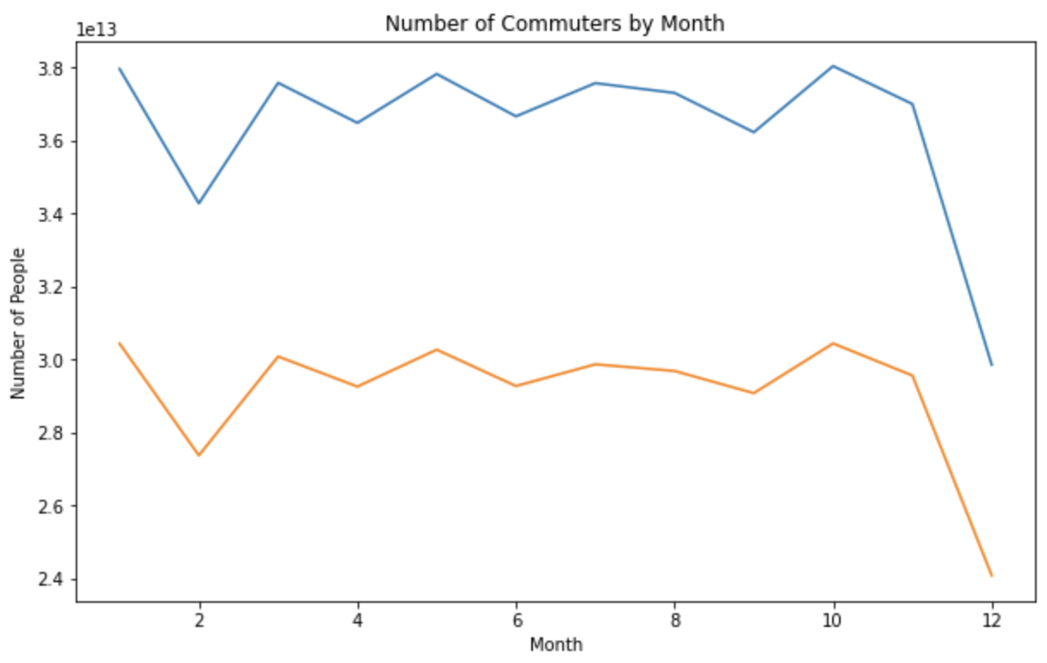
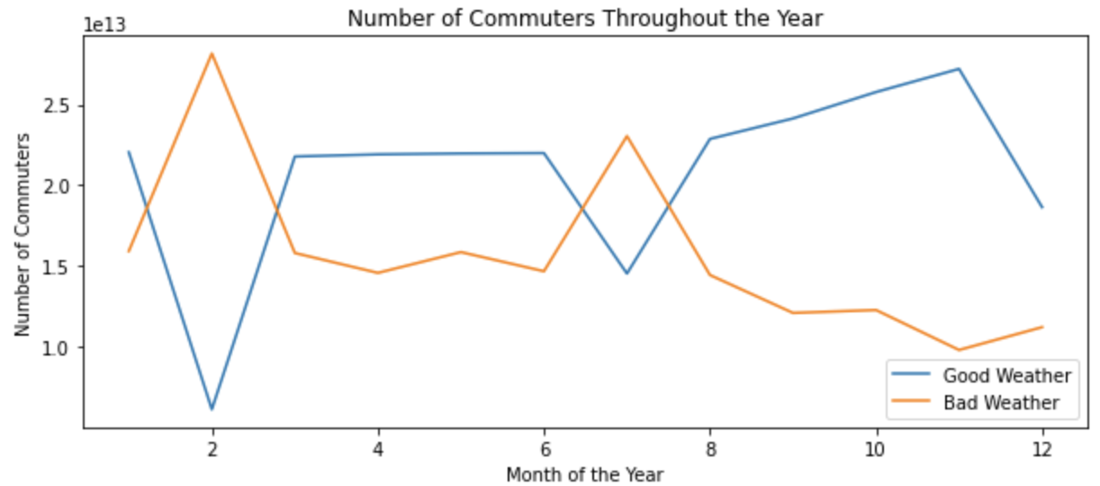


Results

Slide 7
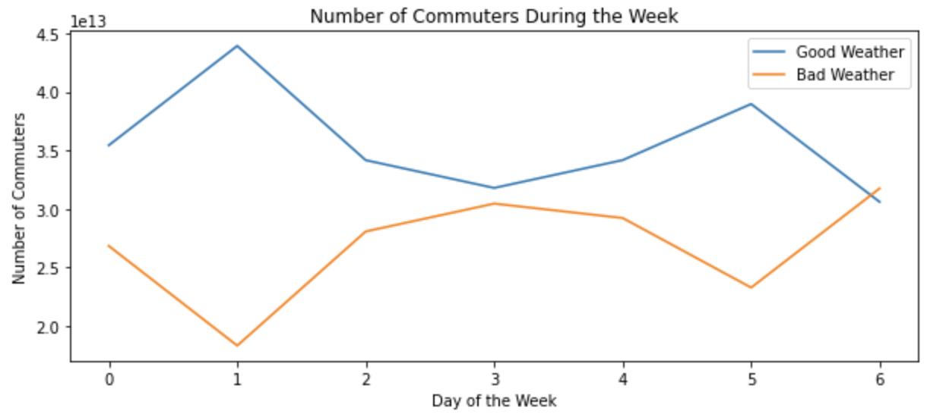
Results

Slide 8
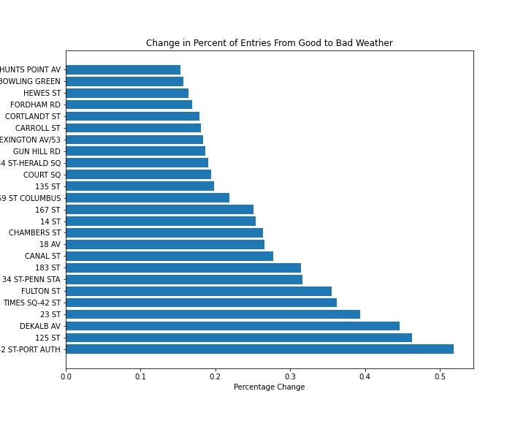
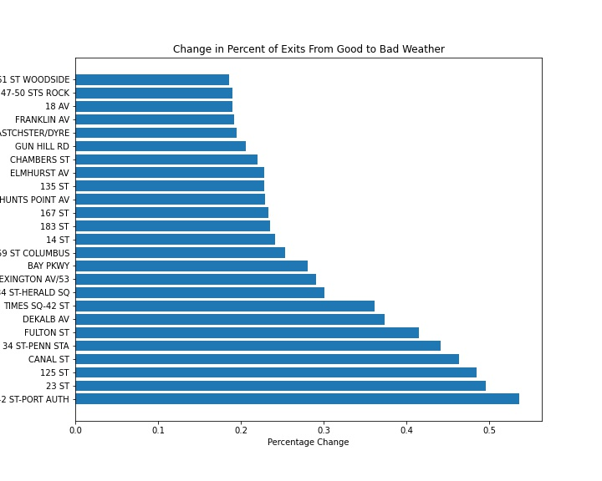
Results

Slide 9
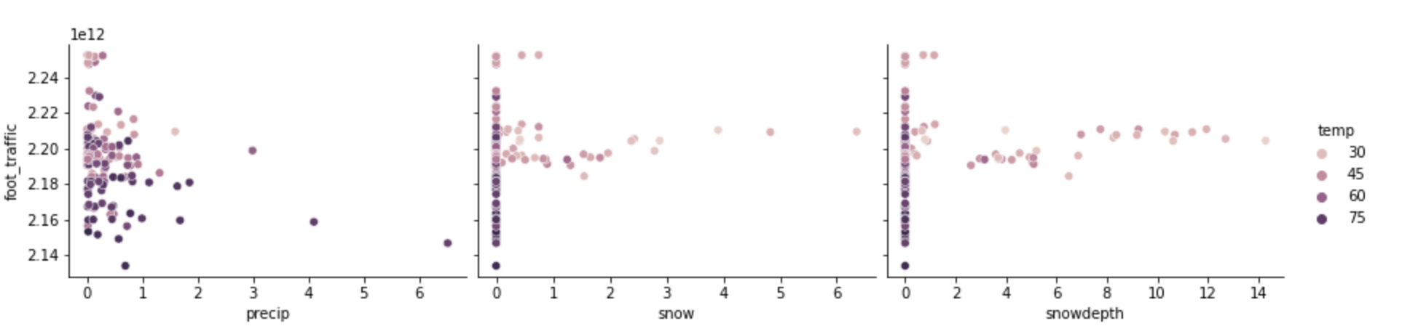
Results
Commuter Patterns During Bad Weather

Slide 10
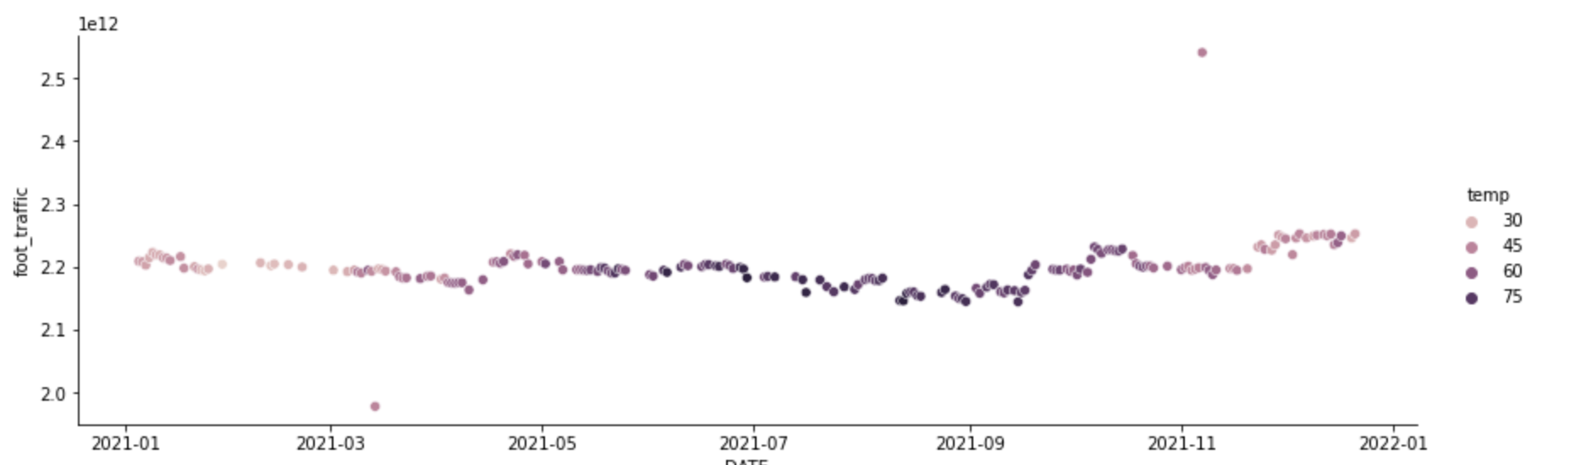
results
Commuter Patterns During Good Weather

Slide 11
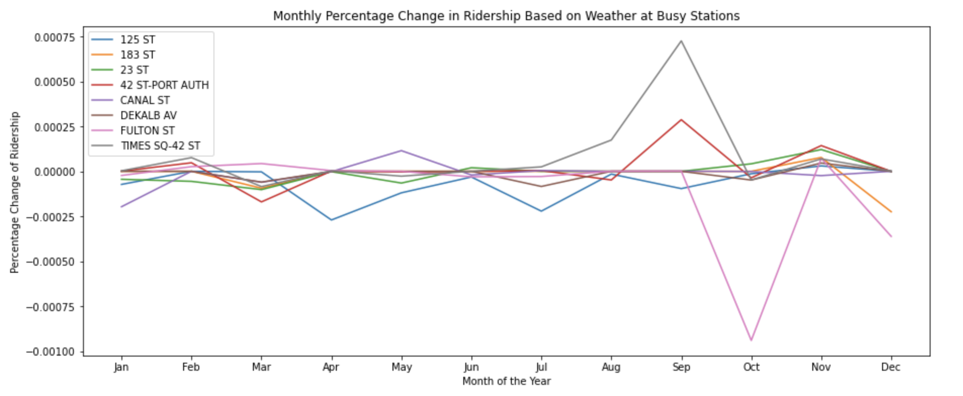
Results

Slide 12
Conclusions
Impact of poor weather is very small, other factors may cause bigger changes in ridership
Data from before 2020 or in the future may have more information

Slide 13
Future Work
Look at subway ridership in different cities and the weather patterns unique to that area
Research if there’s a difference between the weather today and weather from the past

