Slide 1
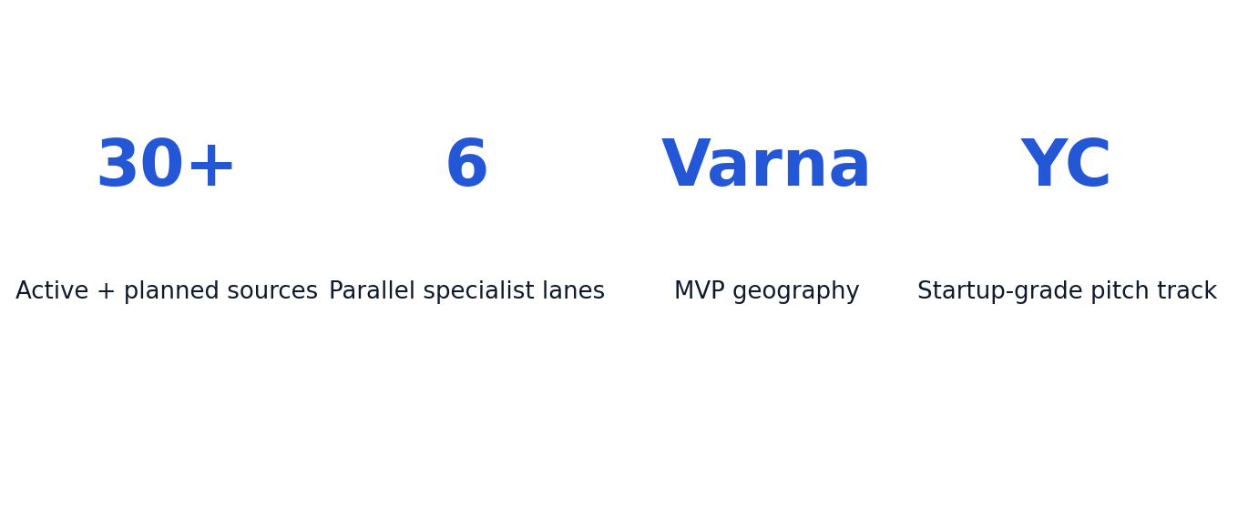
Bulgaria Real Estate Platform
We are building the first unified property marketplace for Bulgaria that combines multi-source listing aggregation, deduplication, map-first search, and an AI property assistant. The immediate wedge is Varna and the coastal corridor, where price growth, construction intensity, and short-term rental demand create a high-velocity market with clear monetization.
Sources: NSI, Eurostat, project source registry (2024-2026).

Slide 2
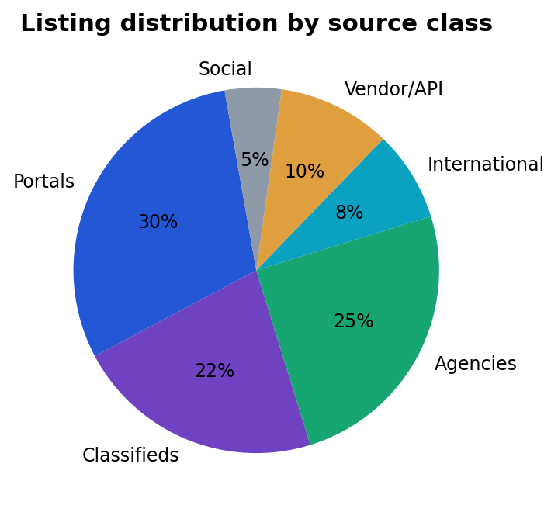
Problem: Fragmented Supply, Broken Discovery
Buyers and renters must manually check many disconnected portals, agencies, and social channels to see a representative set of supply. This creates search fatigue, duplicate listings, and delayed decisions while agencies and owners lose qualified demand because discovery is fragmented.
Sources: Project source matrix, Bulgarian portals audit (2026-04).

Slide 3
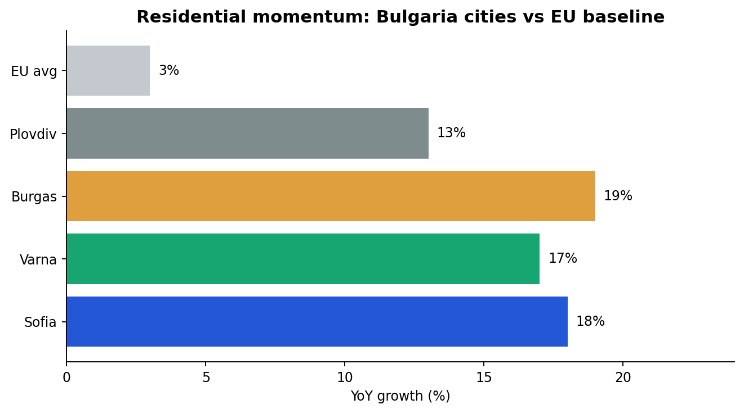
Why Now: Market Momentum Is Exceptional
Bulgaria's residential market is expanding faster than the EU average, with coastal cities showing sustained momentum and strong transaction activity. This timing allows a modern product to establish distribution before incumbents close UX and data-quality gaps.
Sources: Eurostat HPI, national market reviews, regional agency reports.

Slide 4
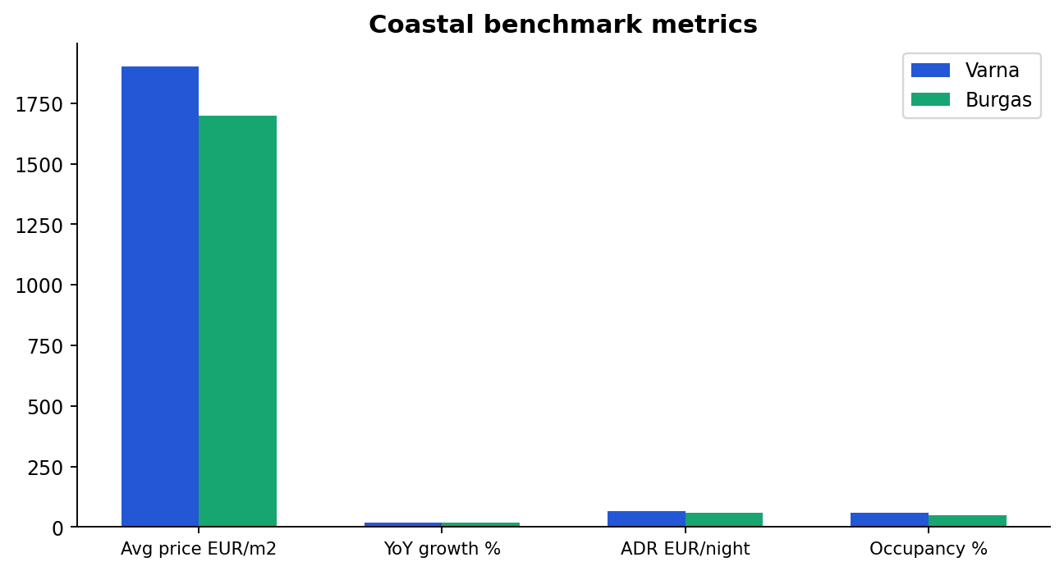
Beachhead Market: Varna + Burgas
Varna is the MVP focus because it combines high listing churn, strong buyer intent, and compelling map-based discovery use cases. Burgas is a natural second coastal expansion to scale supply depth and improve model quality for price and demand prediction.
Sources: Regional price and construction snapshots (2024-2026).

Slide 5
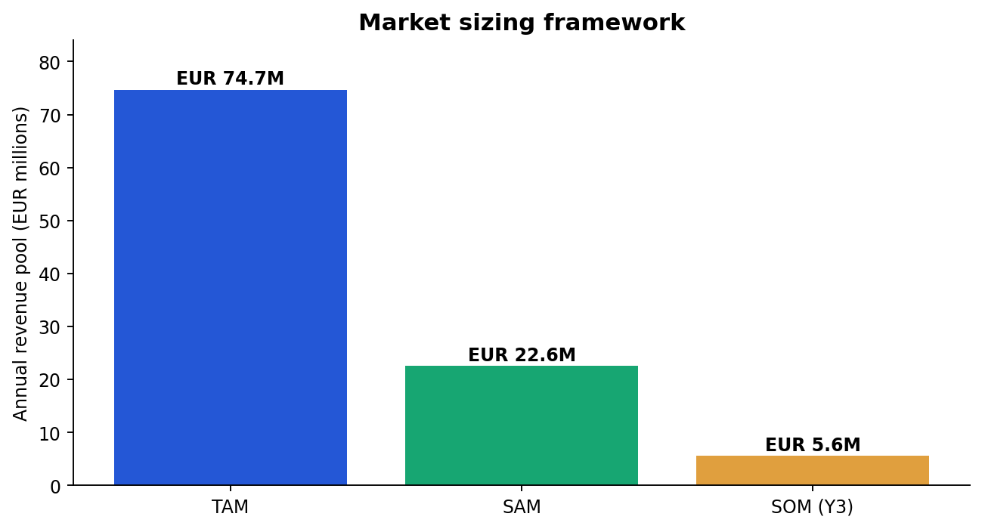
Market Size: TAM, SAM, SOM
The addressable revenue pool supports a venture-scale business if execution compounds from coastal leadership to national coverage. Our SOM assumptions are grounded in phased rollout, controlled CAC, and progressive source onboarding with legal/compliance gates.
Sources: Internal unit economics model and market sizing assumptions.

Slide 6
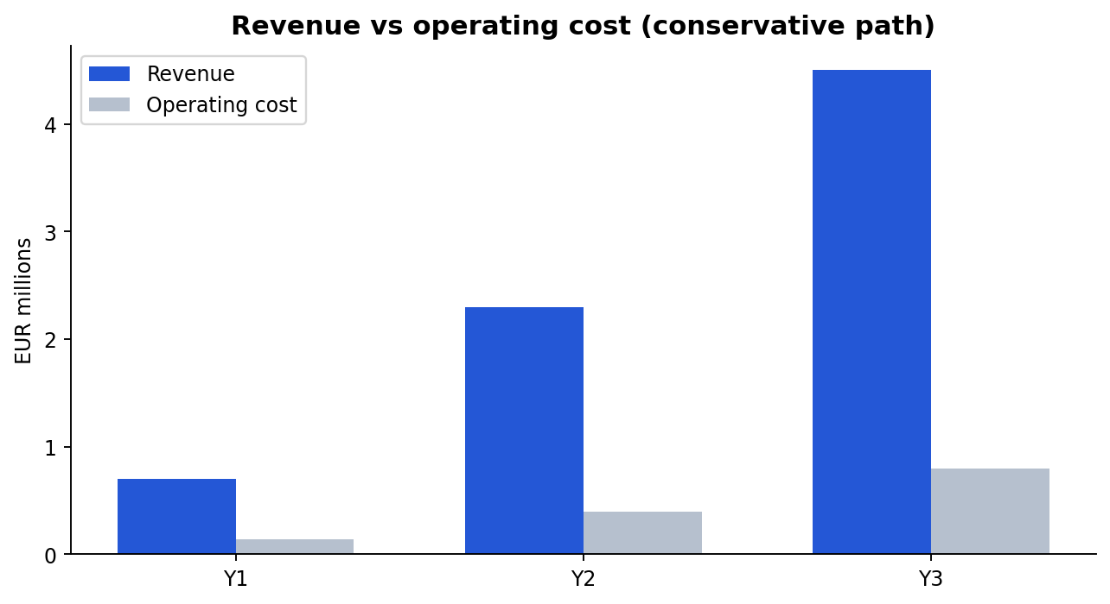
Business Model and Unit Economics
Revenue is diversified across agency subscriptions, premium listings, lead products, analytics, and future AI add-ons. The model targets strong gross margins by keeping ingestion and ranking systems highly automated while preserving compliance controls.
Sources: Internal pricing model, planned SKU structure, cost baseline.

Slide 7
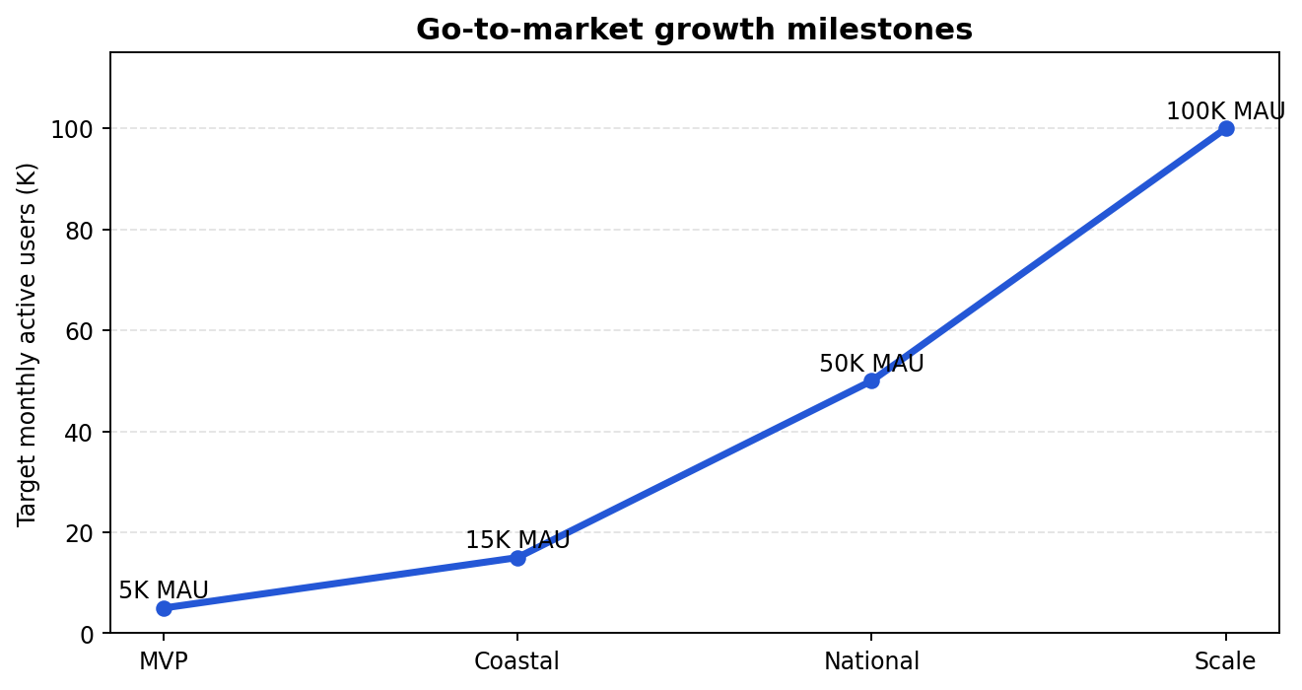
Go-To-Market and Expansion
The launch motion starts with focused inventory quality and buyer-side utility in Varna, then expands to Burgas and additional cities. Each stage increases defensibility through better coverage, better ranking, and higher switching costs for agencies and power users.
Sources: Execution roadmap in PLAN.md and TASKS.md.

Slide 8
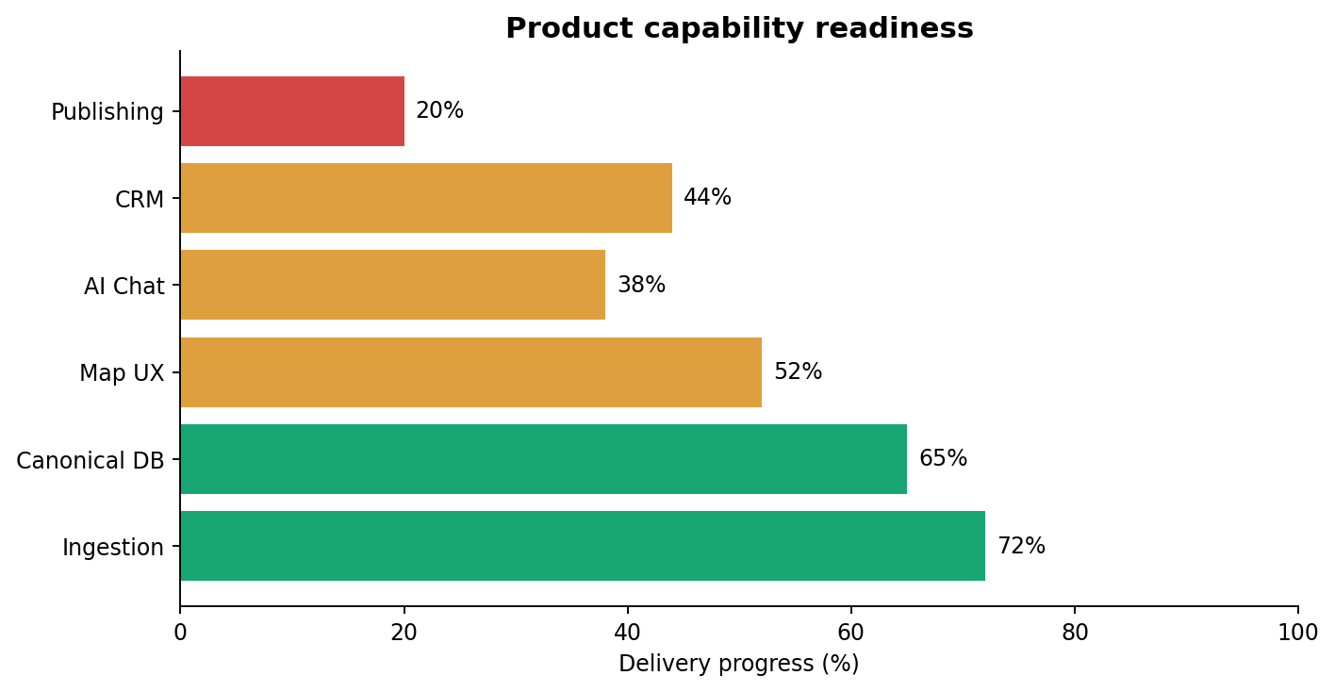
Product Experience: Search, Map, AI Chat
The core experience is map-first with rich filters, canonical property pages, and an AI chat layer that helps users narrow options quickly. This creates a faster decision loop than static listing portals and supports future conversational commerce flows.
Sources: Product UX structure and architecture execution guide.

Slide 9
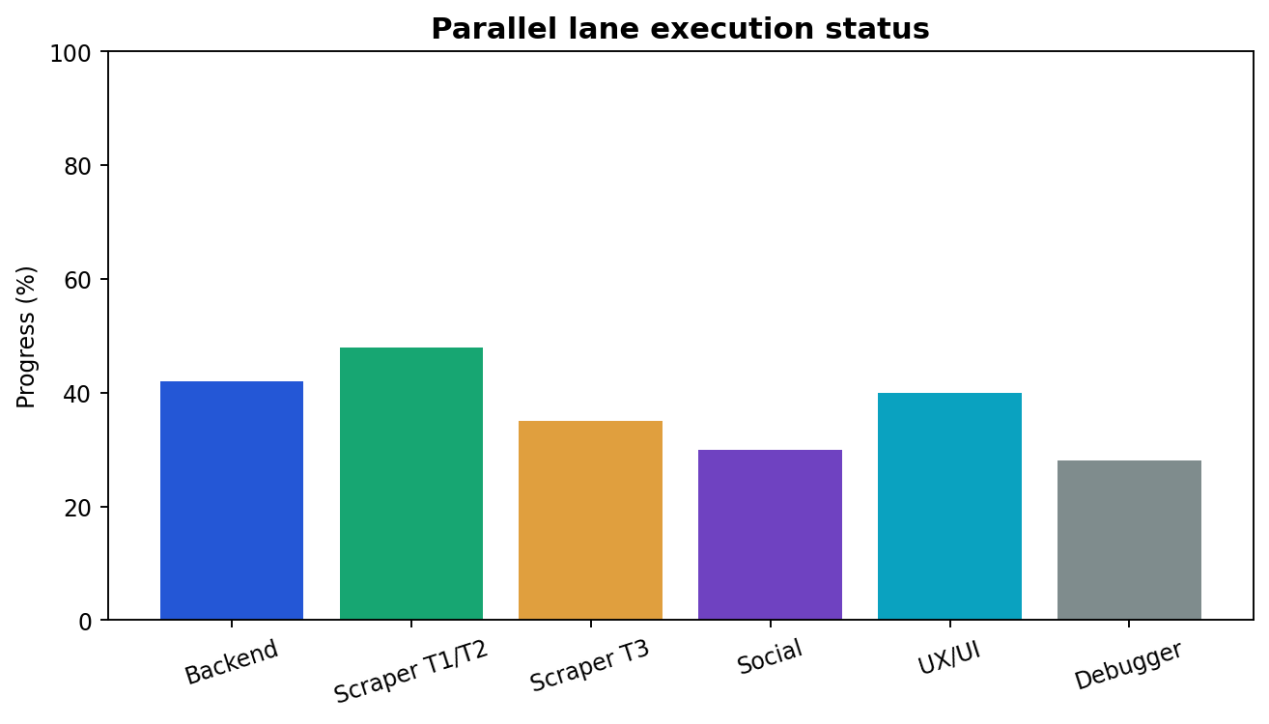
Execution Progress and Delivery Velocity
The program is organized into parallel specialist lanes with explicit dependencies and verification gates. This structure keeps engineering throughput high while preserving quality on data, compliance, and product experience.
Sources: docs/agents/TASKS.md, dashboard exports, journey logs.

Slide 10
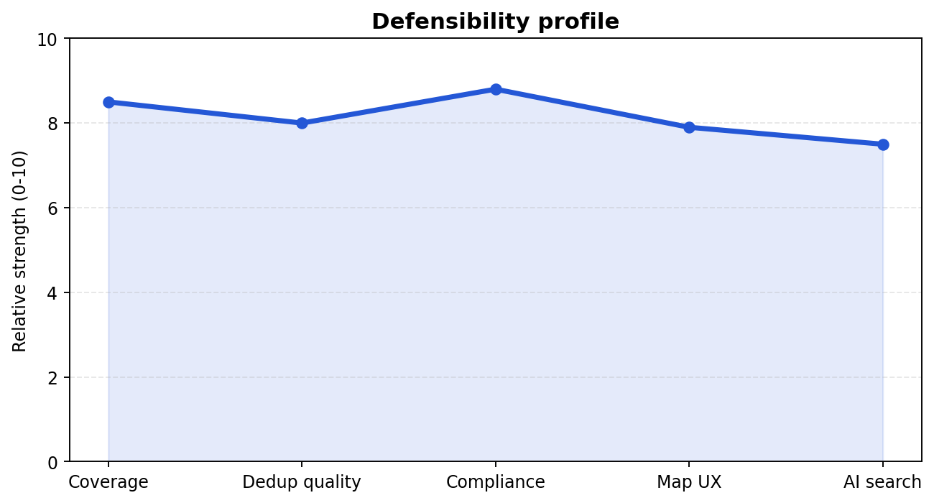
Defensibility and Moat
Our moat compounds from canonical data quality, cross-source deduplication, legal-safe ingestion workflows, and map/chat UX differentiation. As data density and user interaction increase, search relevance and lead quality improve, reinforcing the business flywheel.
Sources: Platform architecture and competitive benchmarking assumptions.

Slide 11
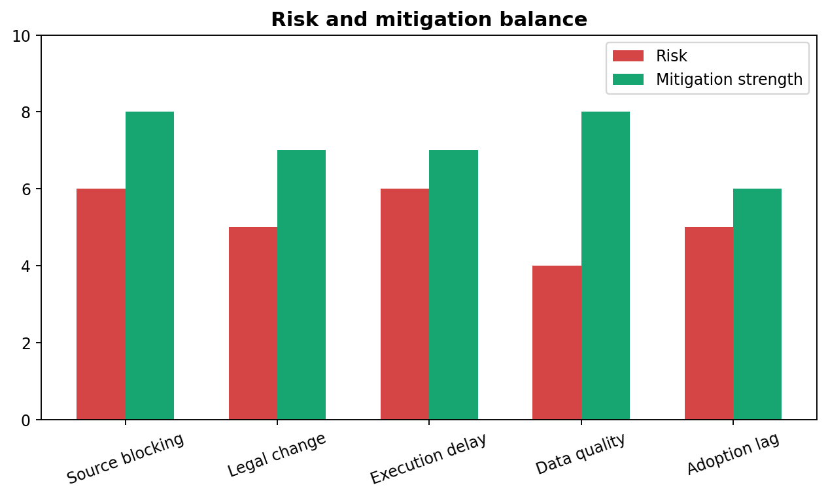
Risks and Mitigations
Primary risks include source volatility, legal constraints, and execution complexity. Mitigation is built into the operating model through source-tier controls, fixture-first testing, auditability, and staged geographic rollouts.
Sources: Source registry legal/risk/access gates and QA protocol.

Slide 12
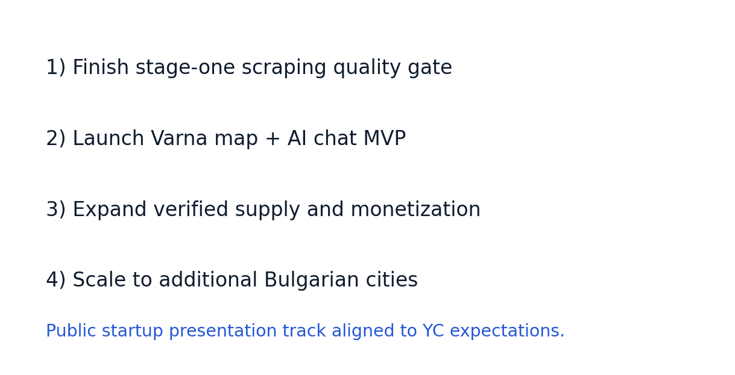
The Ask
We are preparing a public startup-grade launch and fundraising story with a clear sequence: finish stage-one scraping quality gates, ship Varna map-plus-chat MVP, and scale monetization by expanding verified supply and lead conversion outcomes.
Sources: Current roadmap and investor model assumptions.

