Slide 1
Final Project
4/29/13

Slide 2
Pre-Calculus Final Project
GOAL:
Students explore a mathematics topic in more depth, gaining an advanced understanding of the material and real-world applications of it
You will get to choose a topic that interests you

Slide 3
project options
If there is something you are really excited to explore that is NOT on this list, come up with a proposal to share with me during Office Hours
 | Difficulty of Math | Level of Support
Teach Yourself Python (coding) (internet access required) | Medium | Medium
Reddit & Google Algorithms | Medi | Low
Modular Arithmetic and Number Theory | High | Medium
Modular Arithmetic and Encryption | High | Medium
Teach Yourself a New Math Topic! | Variable, depending on topic chosen | Low
Finance - Create a Budget and Educational Materials about one Specialized Topic | Low | Low
Modeling - Space Debris | Medium | High
Climate Change | Low | Low
Discover - e | Medium | High

Slide 4

Finance – Create a budget and become an expert
Research future jobs and their salaries as well as future expenses.
Then create educational materials about a specialized topic like leasing a car vs. buying.

Slide 5


Reddit & google Algorithm
You’ll look at the algorithm behind how Reddit ranks posts as well as how Google chooses to prioritize search results.
You will explain how those mathematical functions work, then choose a website and develop three alogrithms that would produce different user experiences.

Slide 6
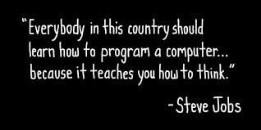
Teach yourself to code
Learn how a computer could help you solve math problems!
You will teach yourself how to code in Python using Codeacademy.com and then apply your skills
Notes:
Video: http://www.code.org/teach

Slide 7

Space debris
Create several models to predict how much space debris there will be orbiting the Earth at different points of time
Answer guided questions about what your model means

Slide 8

Climate Change – is it real?
Create a model that helps answer the question – is climate change happening?
Think about different variables you can compare to find correlations

Slide 9

Modular arithmetic and encryption
Public key cryptography is a common way to secure information on the Internet, like credit card transmissions. Learn how to encrypt and decrypt using RSA.
In the process, become familiar with modular arithmetic and prime number theory.

Slide 10
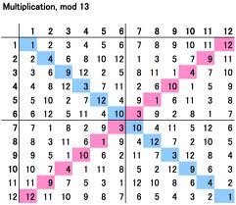
Modular Arithmetic and number theory
Teach yourself modular arithmetic and use it to do complete some proofs.

Slide 11
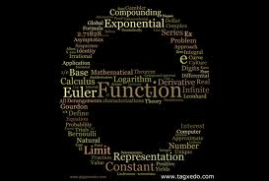
Discover e
Explore e, Euler’s Number, and its various applications
St. Louis Gateway Arch
Transcendental numbers like e and pi
Connections to imaginary numbers

Slide 12
Teach yourself a new math topic
Harmonic Analysis
Given two sinusoids, learn how to form a new graph by adding or multiplying y-coordinates.
Proofs by Induction
Learn how to prove certain types of mathematical properties using mathematical induction.
…or any other topic you’re interested in and make a book!

Slide 13
You must choose your project by
5/6 | 5/7 | 5/8 | 5/9 | 5/10
Check in on Essential Question |  |  |  | Check in on Math Process & Strategies
5/13 | 5/14 | 5/15 | 5/16 | 5/17

Slide 14
Review the Rubric
With your partner, read through the Proficient and Advanced sections
what separates an advanced project from a proficient one?
do you have any questions?

