Slide 1
Blockchain based Energy Trade for Shared Wireless Chargers

Slide 2
Outline
Background
Problem
Relate work
System Model
Scenario

Slide 3






Background
Wireless Charging Technology is getting popular
Power consuming in smart phone is huge and battery is not good (cannot afford for one day usage)
Bring an additional battery can be a burden to users
Electric vehicle market become significant large.
Shared wireless charging becomes a new trend

Slide 4
Problem
It is hard to record the energy trade transactions since people is moving, and use services in different areas.
Centralized way lose its function.
User not take cash or card.

Slide 5
Relate Work

Slide 6



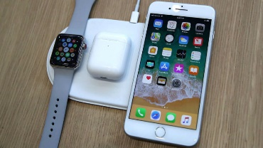

A Scenario
Cloud
Pay cloud usage fee
Offload computation resources for miner
Offload computation resources for miner
Blockchain
Blockchain
Café Shop
Airport
Wireless Charger
Wireless Charger
Wireless Charger
Wireless Charger
Wireless Charger
Wireless Charger
Pay wireless charging fee

Slide 7



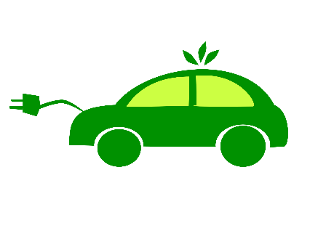

1. The process of payment wireless charging
The café shop as a energy seller. The IoT device as energy buyer.
In this layer, we consider the IoT device don’t have enough computing ability. So we decide to use the shop record the transaction and encryption.
They may have problems:
The maximum satisfaction of buyer.
The minimum cost of seller.
The user of IoT devices privacy.
The edge network security.
Miner
Wireless charger
Layer 1. Wireless charging model

Slide 8























Computing Power
Computing Power
Computing Power
Packing transactions
computing
transactions

Slide 9
Computing Power
Computing Power
Computing Power
Packing transactions
computing
transactions

Slide 10







Computing Power
Computing Power
Computing Power
Packing transactions
computing
transactions

Slide 11
Computing Power
Packing transactions
Computing Power
computing
transactions

Slide 12







2. The process of Blockchain network.
The building should include the aggregator. aggregator as a node of the blockchain network.
In this layer, each aggregator could validate transactions and blocks, also they could generate transactions and blocks.
They may have problems:
The aggregator may very expensive.
The benefit not enough for the cost.
Miner
Wireless charger
Blockchain
Blockchain
Miner
Wireless charger
Blockchain
Miner
Wireless charger
Layer 2. Blockchain model

Slide 13




3. The cloud services
Cloud Computation Resource
Blockchain
Cloud is provide computing and technical support.
In this modeling, shop could got cloud computation resource if they don’t want set aggregator inside. But shop need have a sever to storage the blockchain and some data.
The price of the cloud could changed. It depend on the shop’s benefit. Another satisfaction problem between cloud and shop.
The cloud could be a center of the modeling, because the block size could be changed by cloud macro-control.
They may have problems:
The cloud should save the blockchain or not?
If need macro-control, all the node should connect with cloud. Looks like the could will be centralization.
computing
No Aggregator
Blockchain
computing
Blockchain
computing
Blockchain
Blockchain
Aggregator
No Aggregator
No Aggregator
Aggregator
Modeling of Cloud computing

Slide 14
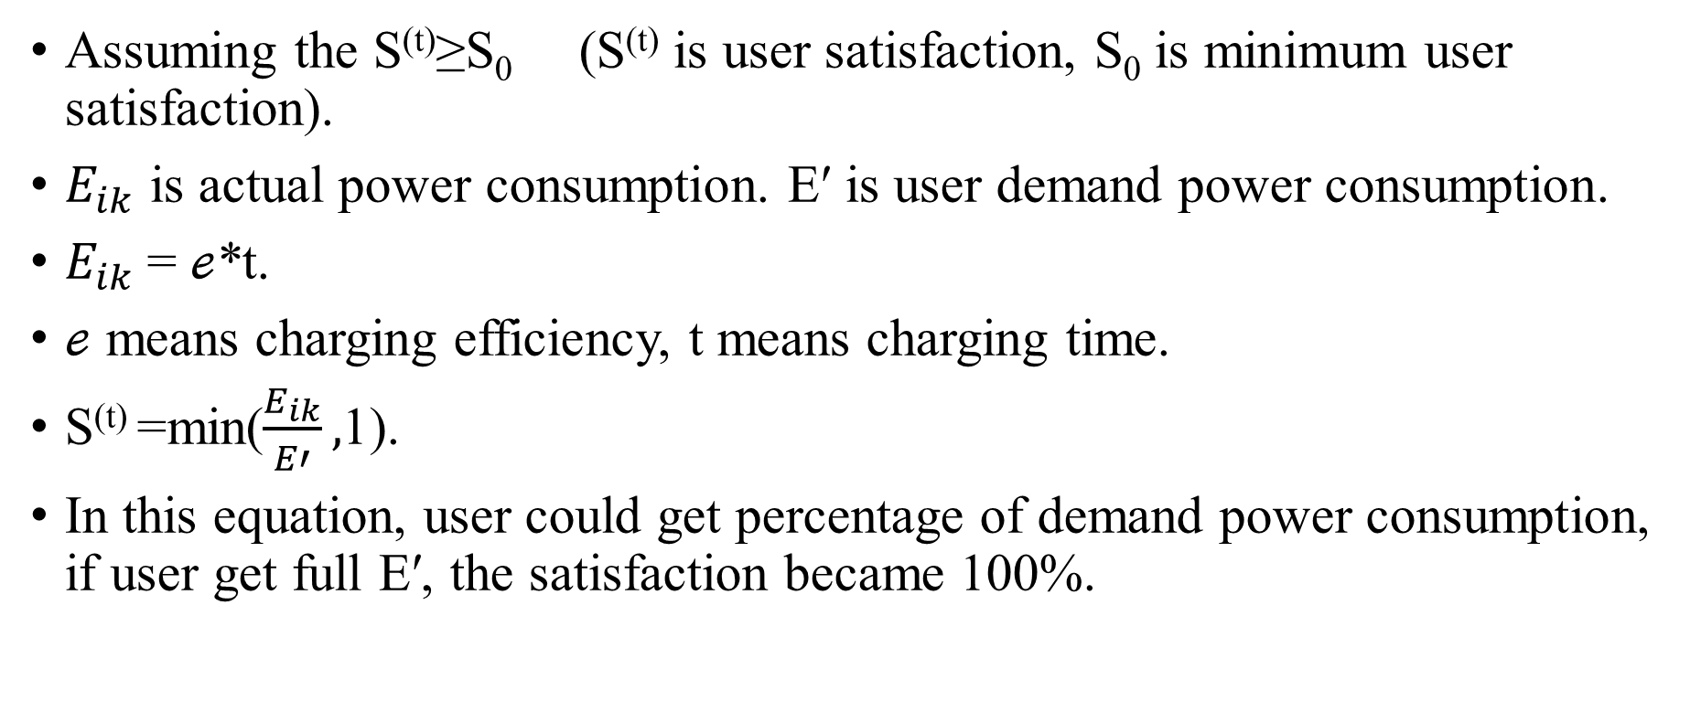
4.1 User satisfaction
Assuming the S^{(t)}≥S₀ (S^{(t)} is user satisfaction, S₀ is minimum user satisfaction).
$E_{ik}$ is actual power consumption. E′ is user demand power consumption.
$E_{ik}$= $ℯ$*t.
$ℯ$ means charging efficiency, t means charging time.
S^{(t)} =min($\frac{E_{ik}}{E′},$1).
In this equation, user could get percentage of demand power consumption, if user get full E′, the satisfaction became 100%.

Slide 15
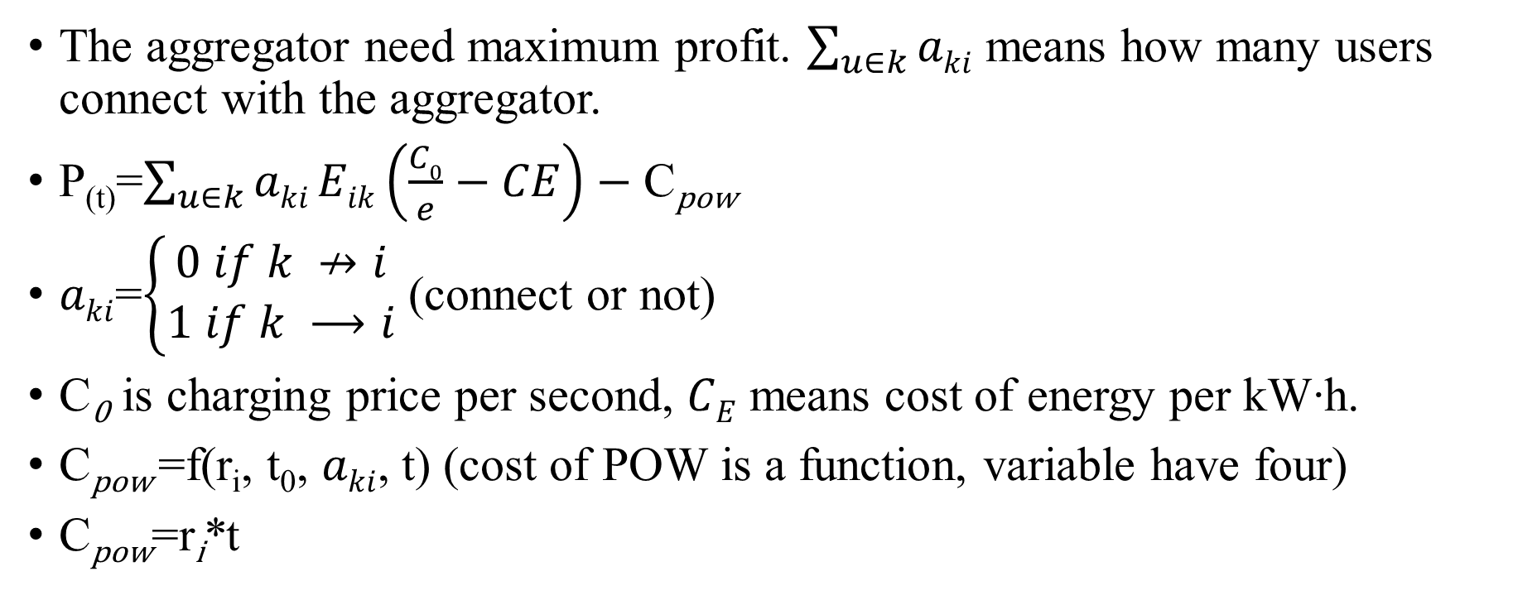
4.2 Aggregator profit
The aggregator need maximum profit. $\sum_{u∈k}{aki}$ means how many users connect with the aggregator.
P_{(t)}=$\sum_{u∈k}{aki}Eik\left(\frac{C0}{e}−CE\right)−\text{C}\text{pow}$
$aki$=$\left\{\begin{aligned}0 if k ↛i \\ 1 if k ⟶i\end{aligned}\right.$ (connect or not)
C₀ is charging price per second, $CE$ means cost of energy per kW∙h.
C_{pow} =f(r_{i}, t₀, $aki$, t) (cost of POW is a function, variable have four)
C_{pow} =r_{i}*t

Slide 16
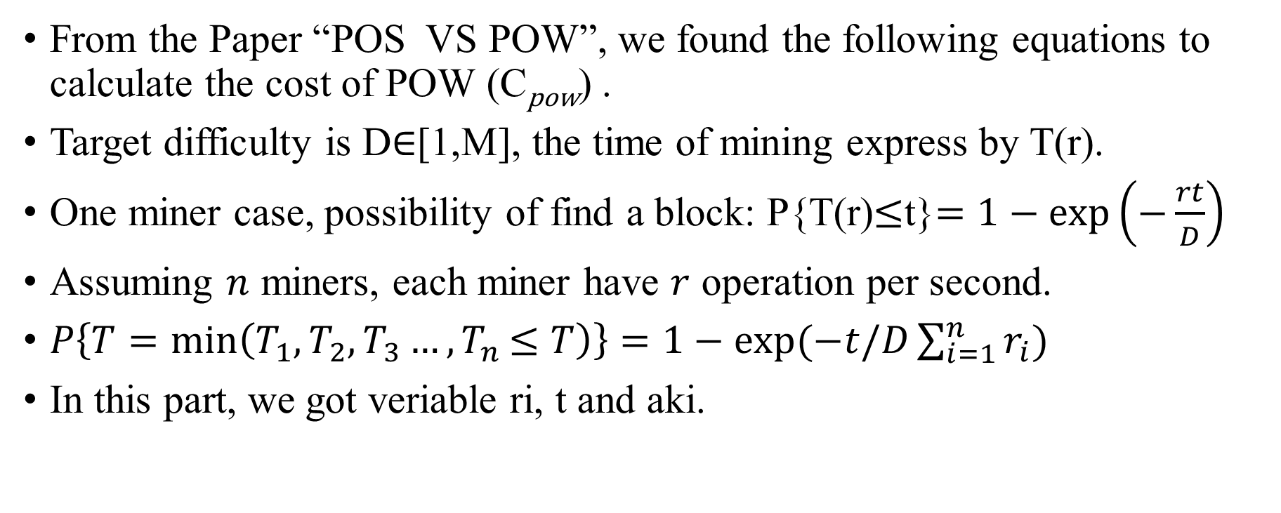
4.2.1
From the Paper “POS VS POW”, we found the following equations to calculate the cost of POW (C_{pow}) .
Target difficulty is D$∈$[1,M], the time of mining express by T(r).
One miner case, possibility of find a block: P{T(r)$≤$t}$=1−\exp\left(−\frac{rt}{D}\right)$
Assuming $n$ miners, each miner have $r$ operation per second.
$P\left\{T=\min\left(T_{1},T_{2},T_{3}…{,T}_{n}≤T\right)\right\}=1−exp⁡(−t/D\sum_{i=1}^{n}{r_{i}})$
In this part, we got veriable ri, t and aki.
Notes:
Because P{T1>t}*P(T2>t)*…P(Tn>t), that’s why the n miner express.

Slide 17
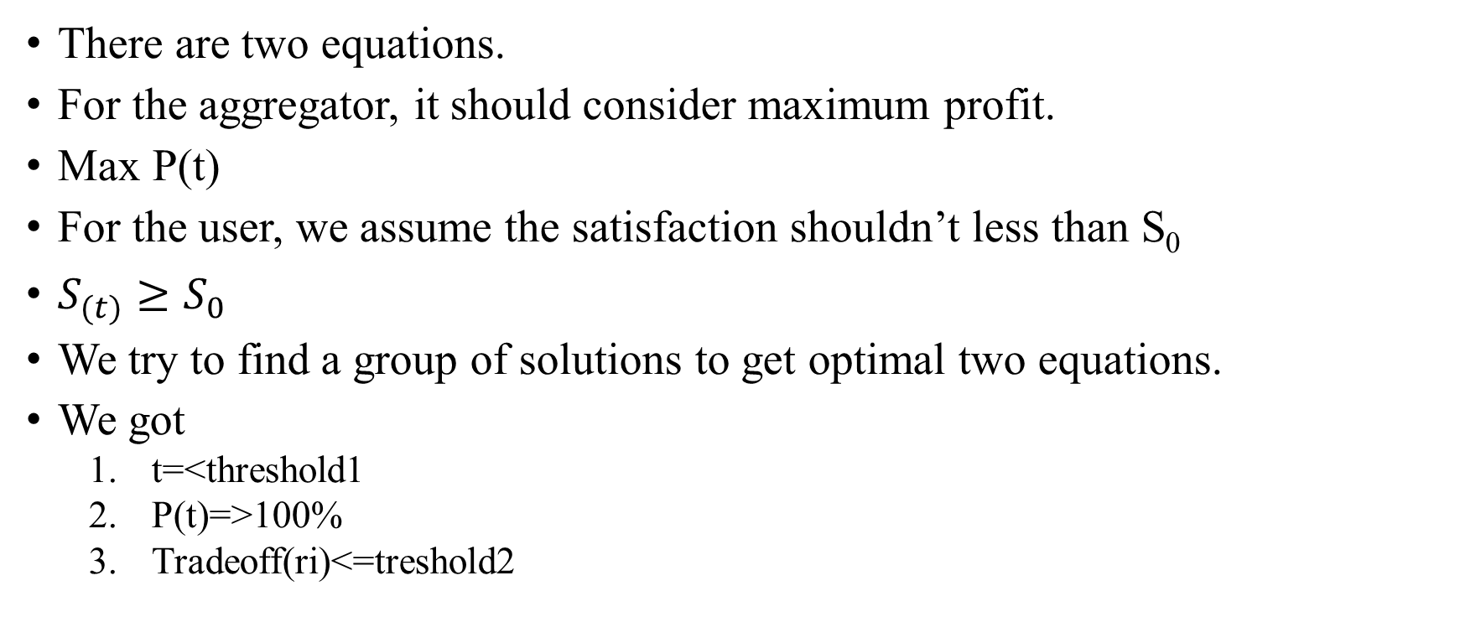
4.3 The optimal solutions
There are two equations.
For the aggregator, it should consider maximum profit.
Max P(t)
For the user, we assume the satisfaction shouldn’t less than S₀
$S_{(t)}≥S_{0}$
We try to find a group of solutions to get optimal two equations.
We got
t=<threshold1
P(t)=>100%
Tradeoff(ri)<=treshold2

