Slide 1
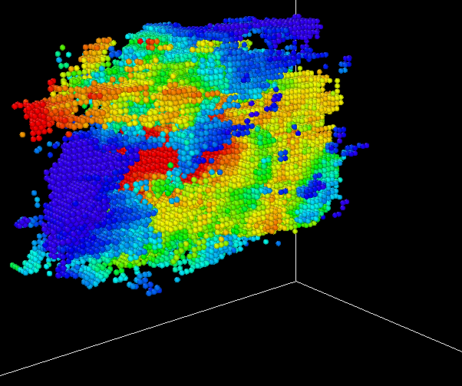
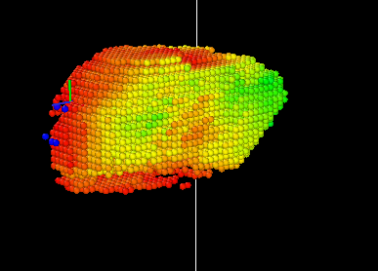
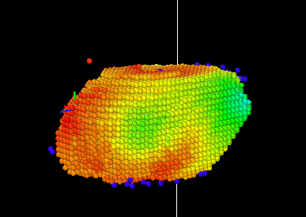
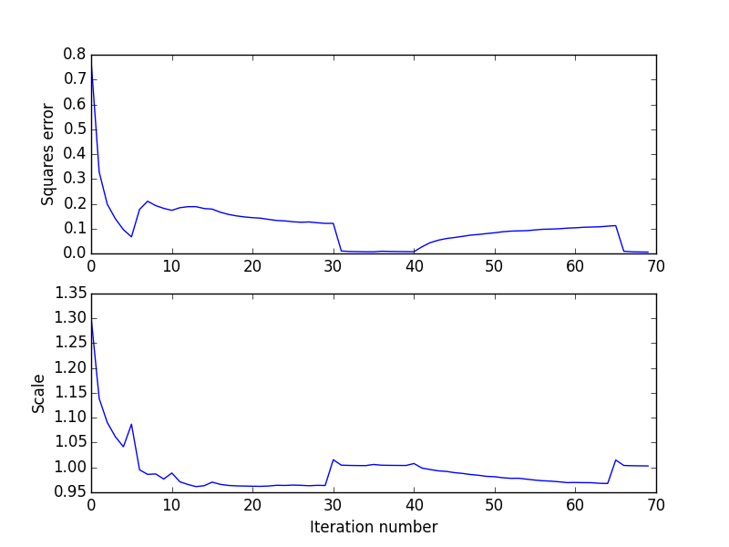
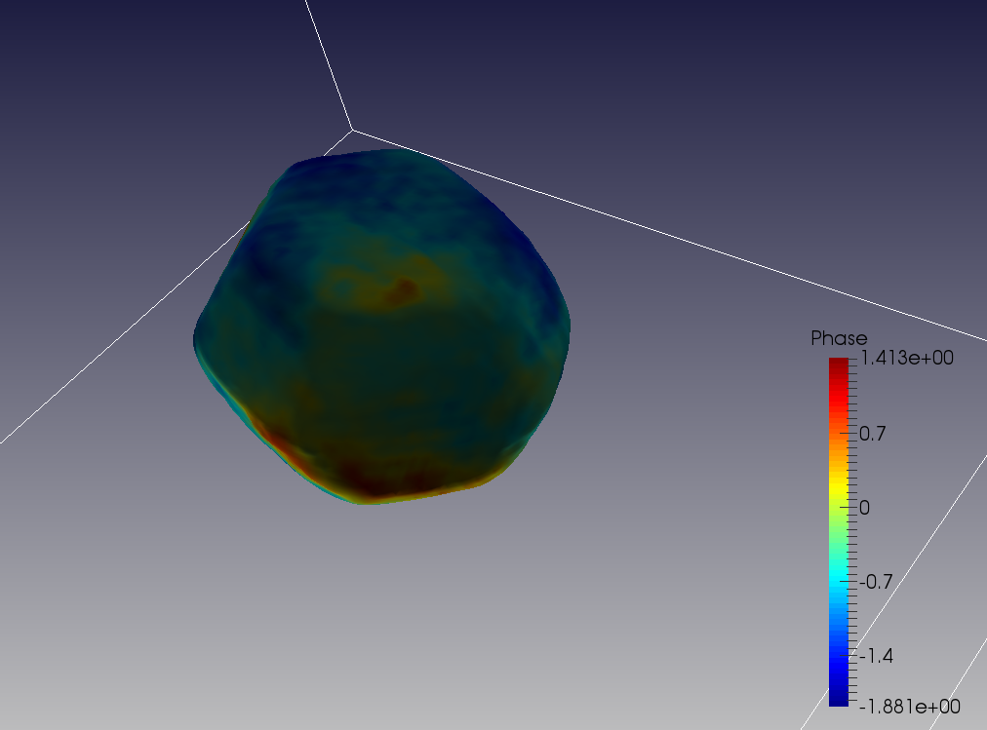
End of 1st ER
End of 1st HIO
End of 2nd HIO
End of simulations,
Adjusted coordinates

Slide 2

PC-HIO evolution movie
Support evolution movie

