Slide 1

Trending Course!!!
AWS DevOps

Slide 2
What is Cloud Computing
It is the use of remote servers on the internet to store, manage and process data rather than a local server or personal computer. There are basically 3 categories in cloud computing
1.SAAS
2.PAAS
3.IAAS

Slide 3
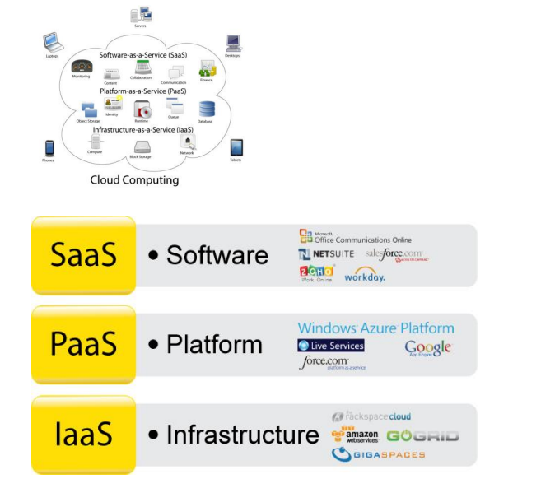

Slide 4
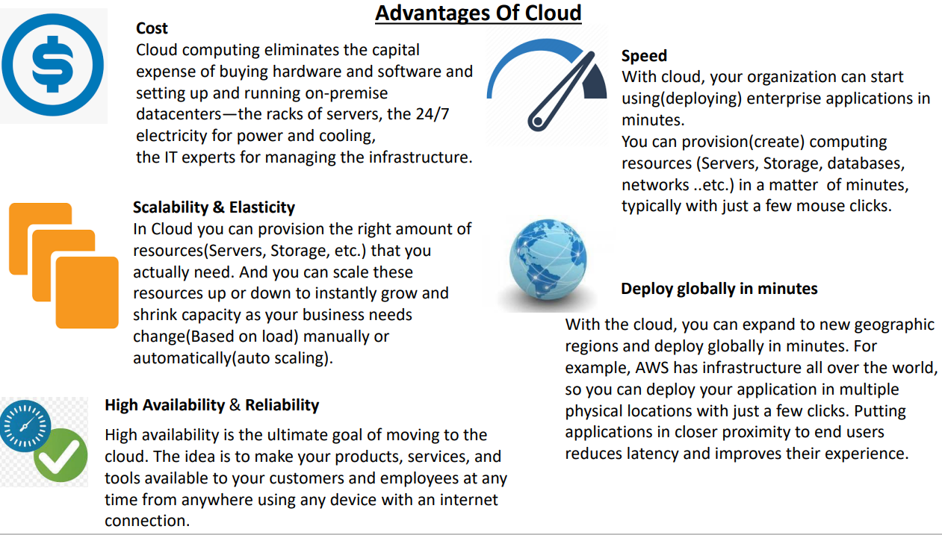

Slide 5
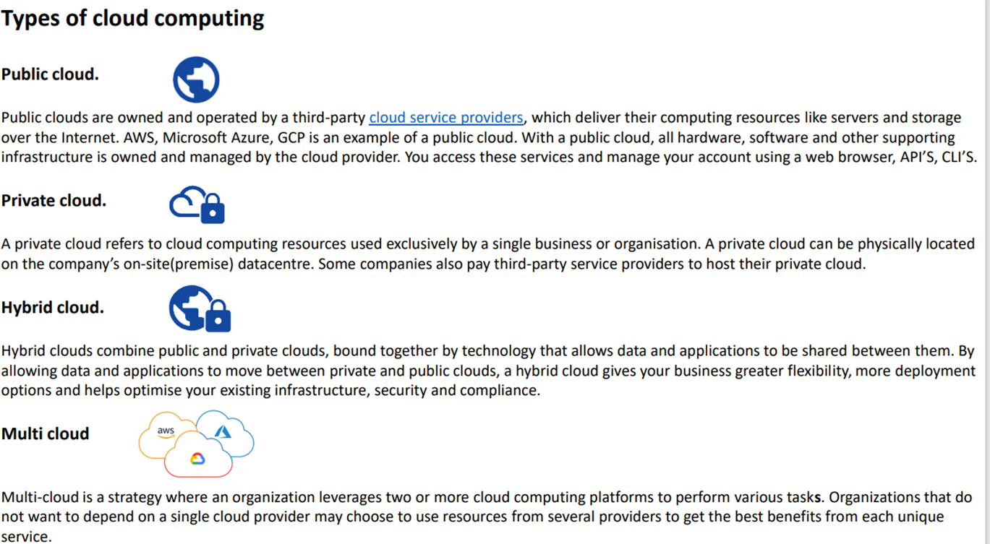

Slide 6
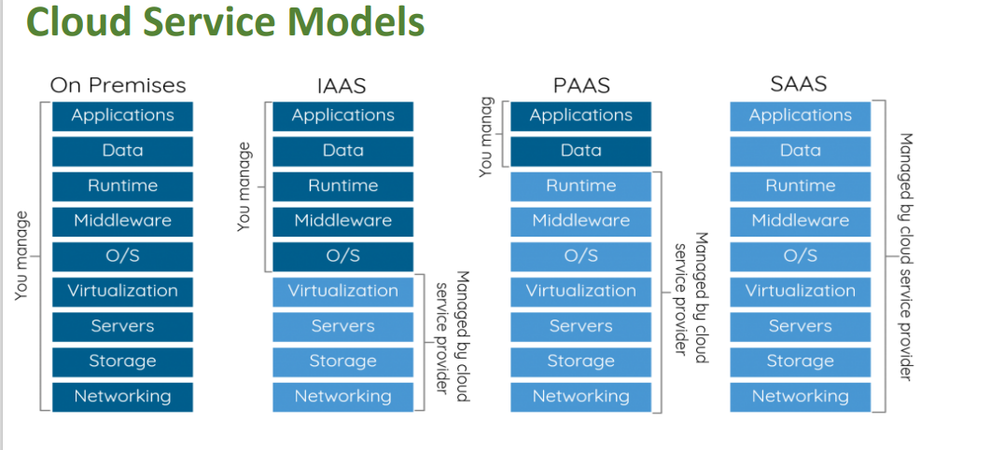

Slide 7
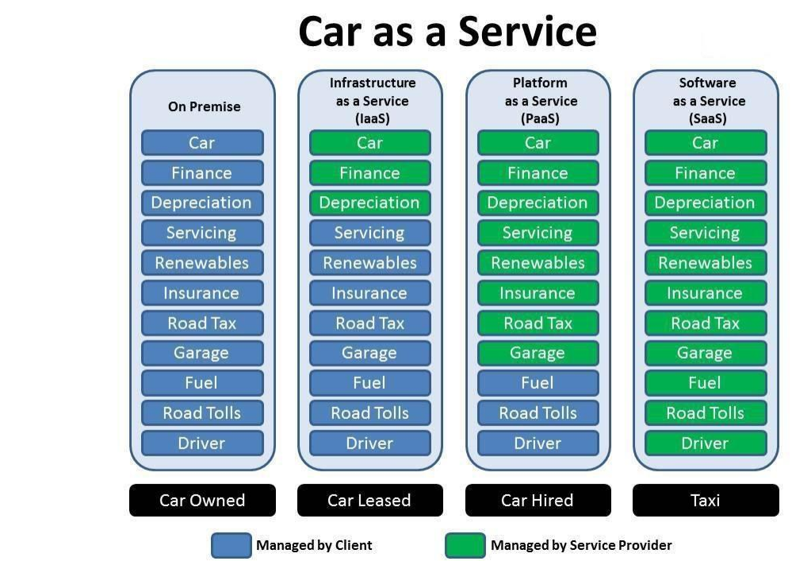

Slide 8
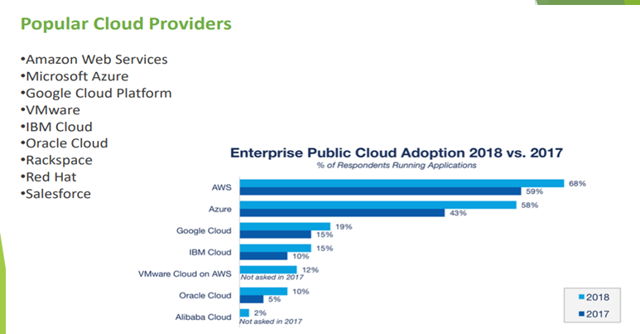

Slide 9
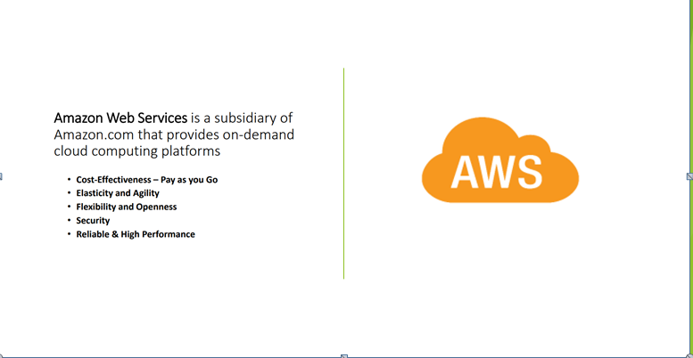

Slide 10
Uses of AWS
A small manufacturing organization uses their expertise to expand their business by leaving their IT management to the AWS.
A large enterprise spread across the globe can utilize the AWS to deliver the training to the distributed workforce.
An architecture consulting company can use AWS to get the high-compute rendering of construction prototype.
A media company can use the AWS to provide different types of content such as ebox or audio files to the worldwide files.

Slide 11
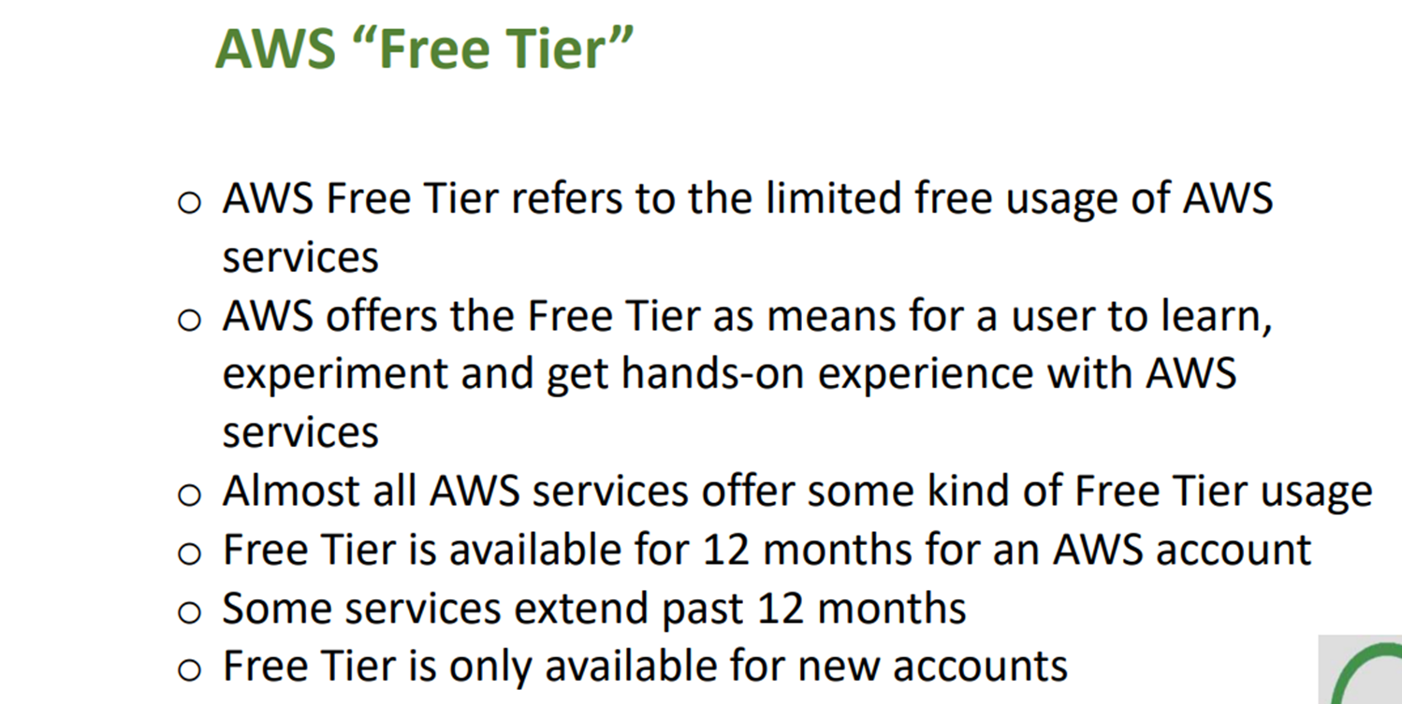

Slide 12
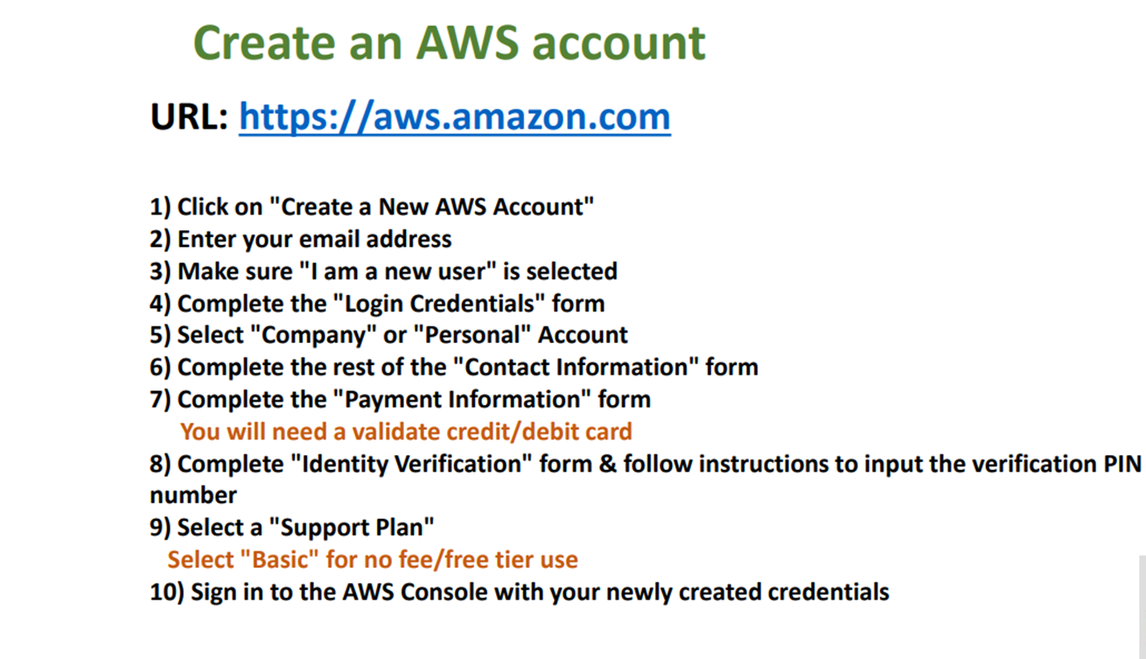

Slide 13
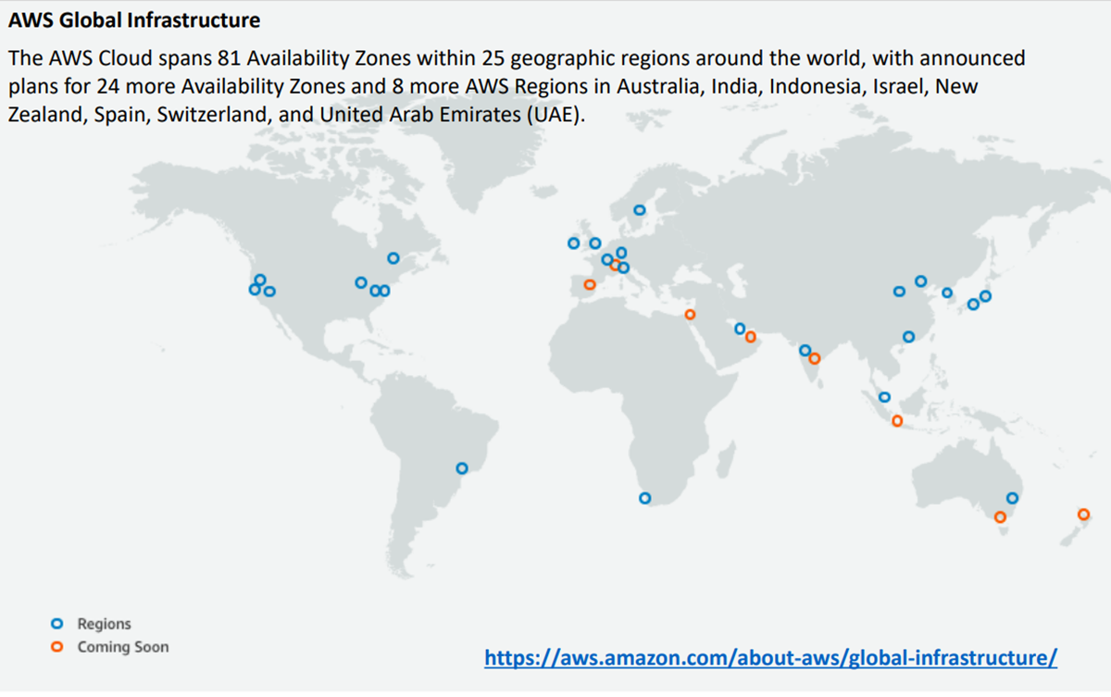

Slide 14
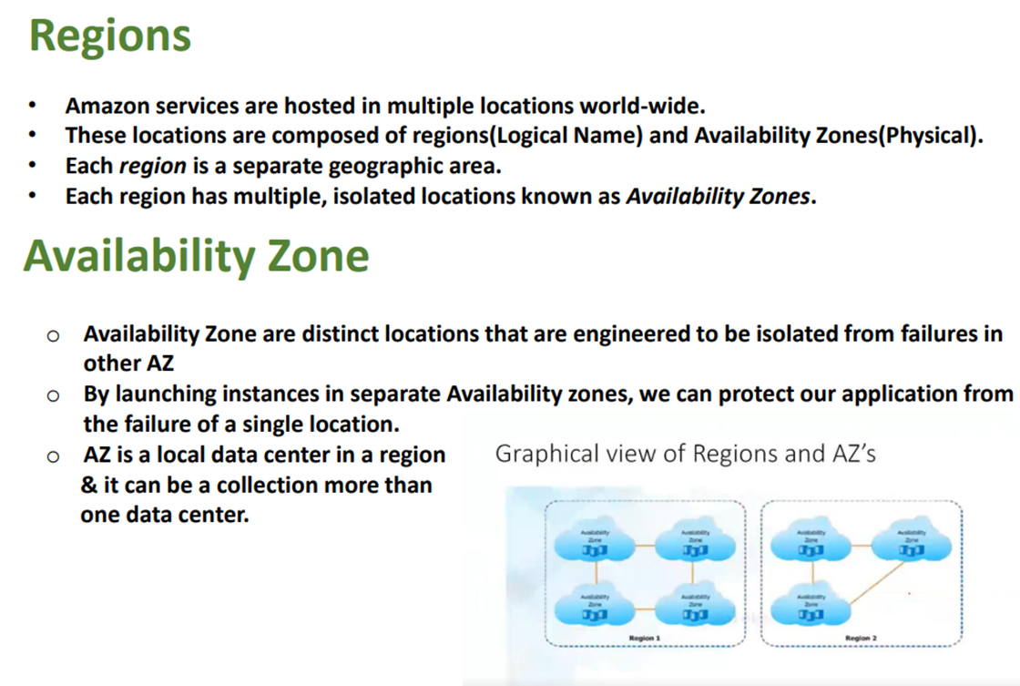

Slide 15
AWS SERVICES
EC2 — Elastic Cloud Computing
IAM — Identity and Access Management
VPC—Virtual Private Cloud
EBS—Elastic Block Storage
Rds — Relational Database Service
S3 — Simple Storage Service
Ecr — Elastic Container Registry
EKS--Elastic Kubernetes Service
CLOUD WATCH etc…

Slide 16
EC2
EC2 stands for Amazon Elastic Compute Cloud.
It is a web service which provides re-sizable compute capacity in the cloud.
It is designed to make the web scale computing easier for developers

Slide 17
AWS EC2 offers 5 types of instances
General Instances
Compute Instances
For applications that require a balance of performance and cost.
▪ E.g email responding systems, where you need a prompt response as well as the it should be cost effective, since it doesn’t require much processing.
t2
m4
m3
For applications that require a lot of processing from the CPU.
▪ E.g analysis of data from a stream of data, like Twitter stream
C4
C3

Slide 18
Memory Instances
Storage Instances
For applications that are heavy in nature, therefore, require a lot of RAM.
▪ E.g when your system needs a lot of applications running in the background i.e
multitasking.
R3
x1
For applications that are huge in size or have a data set that occupies a lot of space.
▪ E.g When your application is of huge size.
I2
d2

Slide 19
GPU Instances
For applications that require some heavy graphics rendering.
E.g 3D modelling etc..
G2

Slide 20
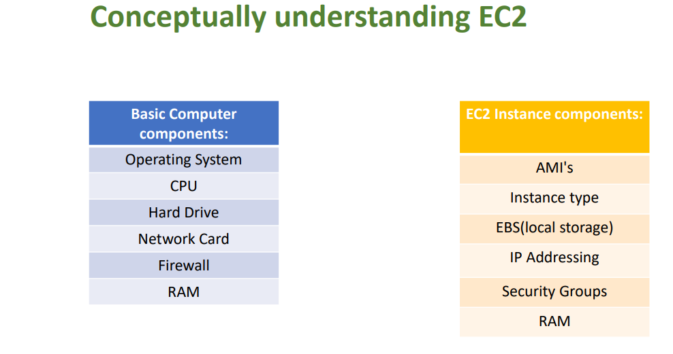

Slide 21
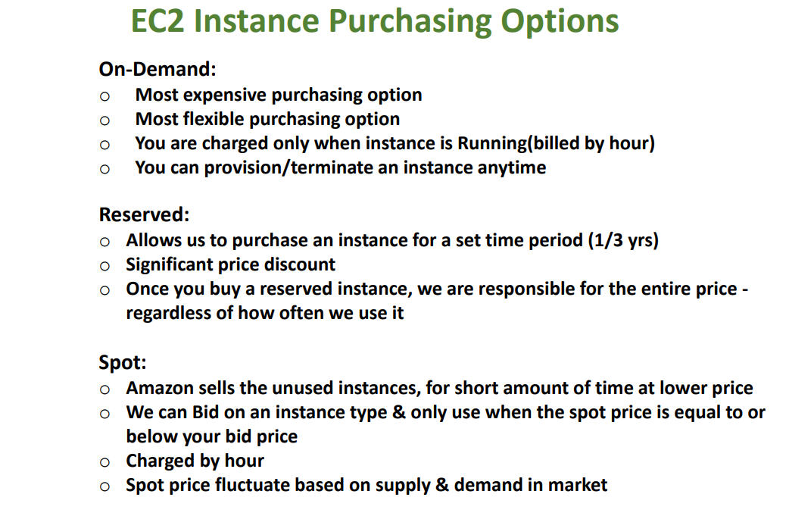

Slide 22
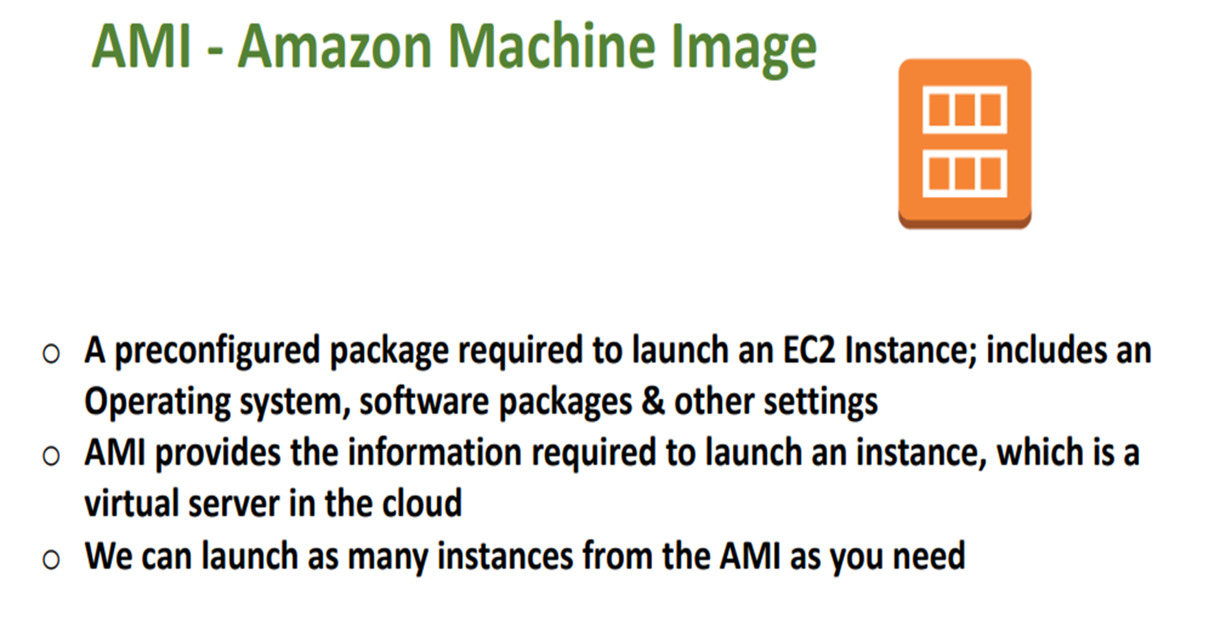

Slide 23
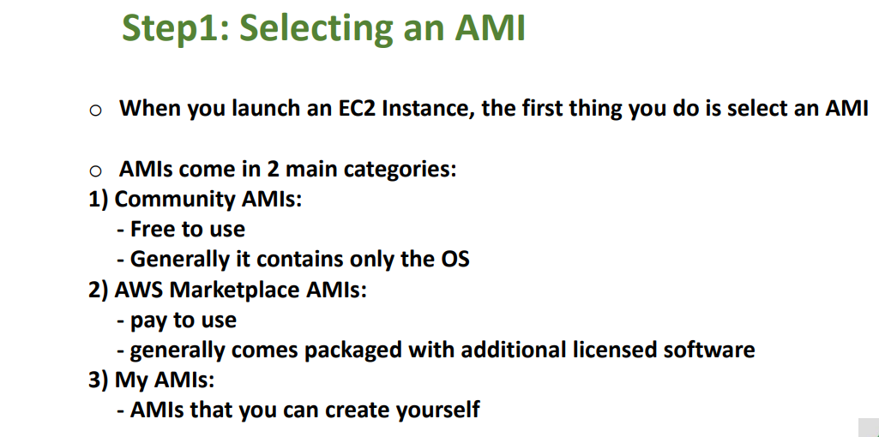

Slide 24
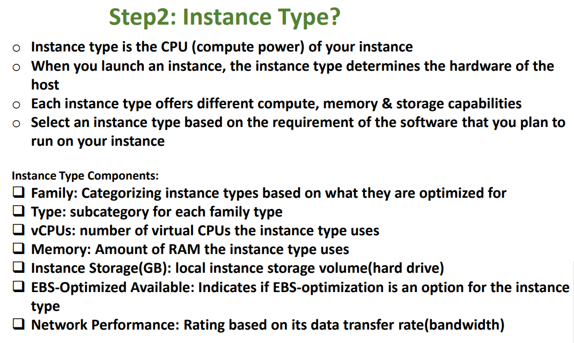

Slide 25
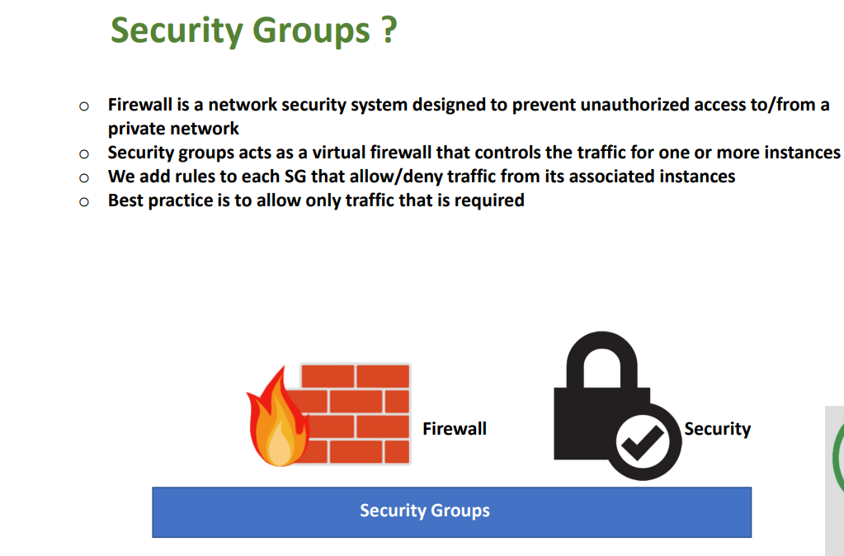

Slide 26
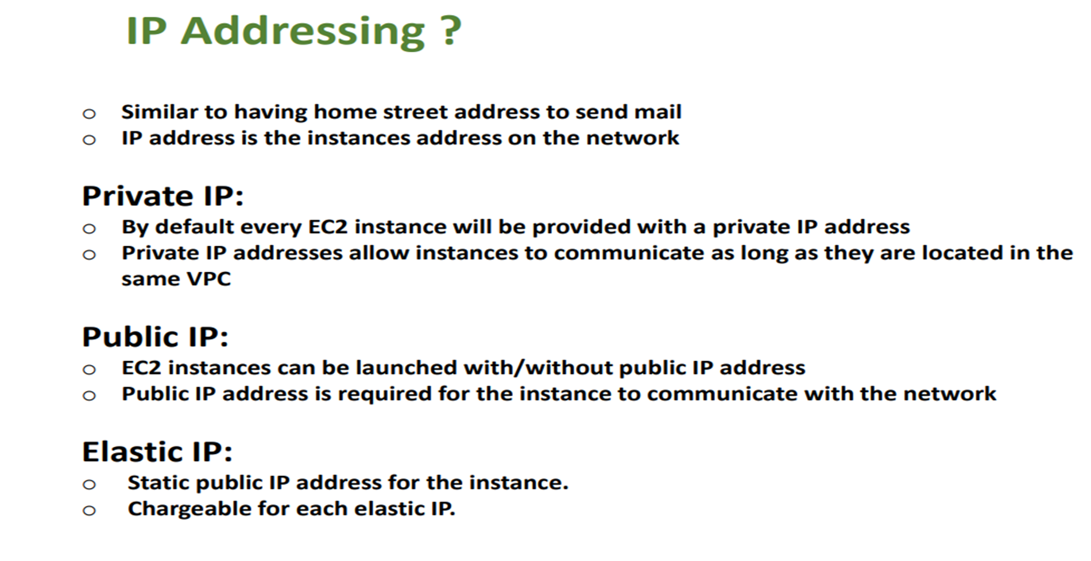

Slide 27
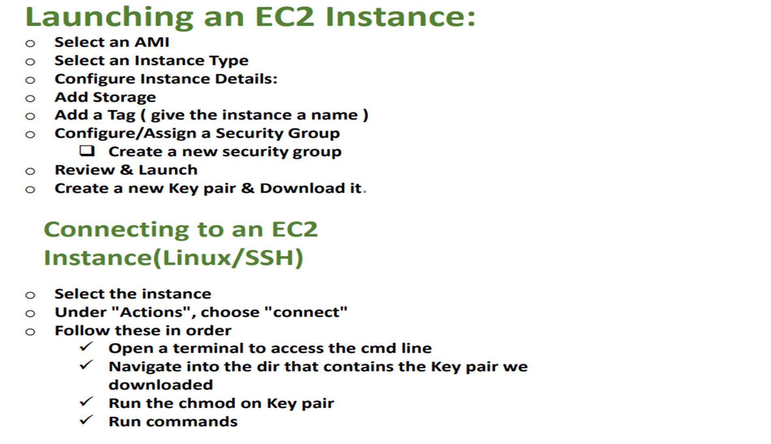

Slide 28
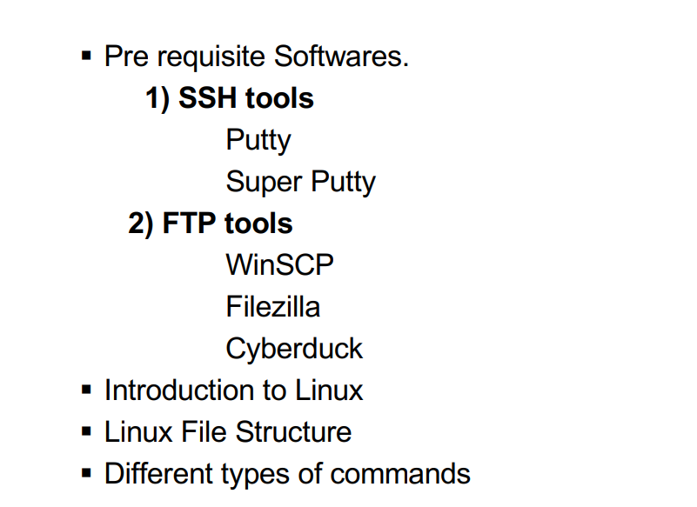
Linux

Slide 29
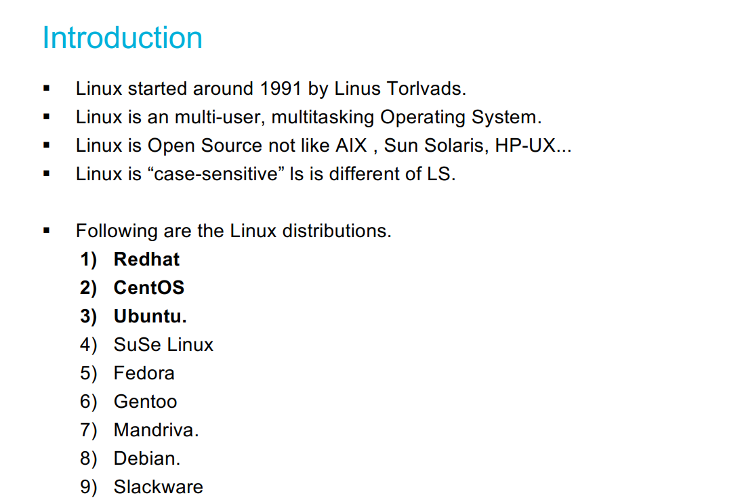
Linux

Slide 30
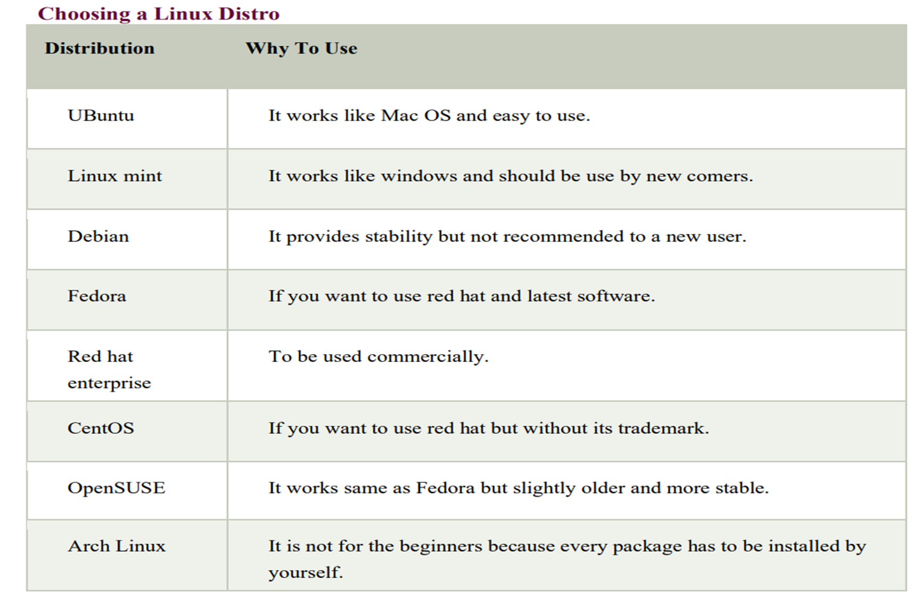

Slide 31
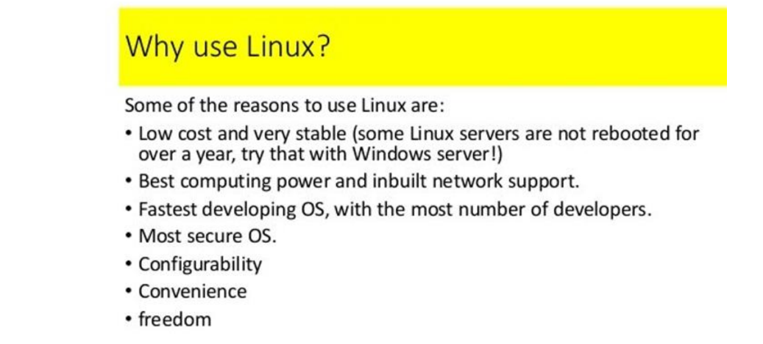

Slide 32
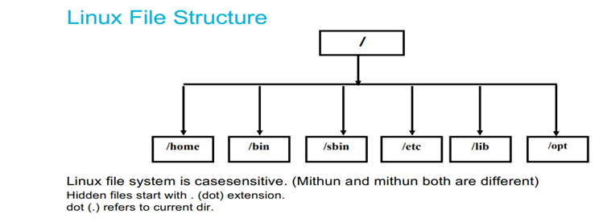

Slide 33
Linux File System
In linux everything is a file
Linux do not contain physical hard drive like windows
Linux has a logical hierarchical file structure
Linux is case sensitive
/ is the Root directory
Hidden files start with (.)dot extension
Dot(.) refers to current directory

Slide 34
1)/bin - In this binaries folder we are having commands
2)/opt - If we download 3rd party s/w in linux that will store in this optional folder
3)/boot - whenever you on the system, booting data present. So that boot code will present in this folder
4)/root - Root user data present
5)/dev - device folder - External devices info stored here
6)/home - Every user data stored here

Slide 35
7)/tmp - we can store the temporary data
8)/usr - In linux kernel info and system binaries info present in user folder
9)/lib - shareable files present in libraries folder
10)/sbin - system binaries -extra commands present when we compared to bin
11)/mnt - mount - If we put pendrive, usb from external that data is coming into this directory
12)/var - In this variable folder, all logs stored.

