Slide 1
Visual impairment workshop
SLT Inservice, 5th June 2019
Presented by
Michael Cheung

Slide 2
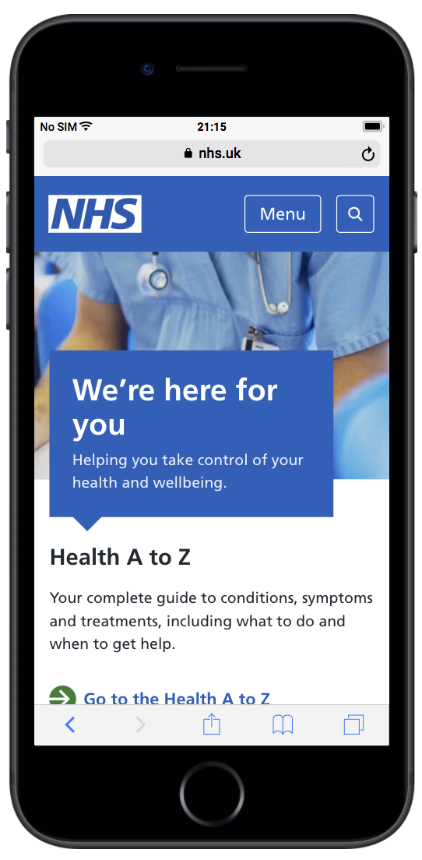
Introduction
I’m Michael, web developer, NHS.UK website Lead on making the website accessible
Notes:
Who am I

Slide 3
Accessibility
Making the website work for people with disabilities
Notes:
What do I mean by making the site accessible?
Making it easy to use, particularly for those who use assistive technologies

Slide 4




Disabilities
Visual
Auditory
Physical
Cognitive and neurological
Microsoft Inclusive Design https://www.microsoft.com/design/inclusive/
Notes:
Here’s a list of some of the disabilities that need to be considered when looking at accessibility, particularly with regards to the web

Slide 5
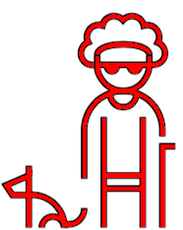
Disabilities
Visual
Auditory
Physical
Cognitive and neurological
Microsoft Inclusive Design https://www.microsoft.com/design/inclusive/
Notes:
What we’re interested in today is visual

Slide 6
“ More than 2 million people are estimated to be living with sight loss in the UK today”
Royal National Institute of Blind People
“ Visual field defects are estimated to affect 20% to 57% of people who have had a stroke”
Alex Pollock et al “Interventions for visual field defects in people with stroke” Cochrane Systematic Review
Notes:
This sight loss is severe enough to have a significant impact on their daily lives.
Sight loss may include partial loss or full loss, in one or both eyes, or reduced or increased sensitivity to certain colours or bright colours
Colour blindness affects approx. 1 in 12 men, and 1 in 200 women
360,000 people are registered as blind or partially sighted Recent article published 23rd May

Slide 7
Main causes of blindness and sight loss in adults
Age-related macular degeneration
Cataracts
Glaucoma
Diabetic retinopathy
Notes:
What we’ll try and do is give you an idea of what these ‘look’ like by using some simulation glasses, called VINE glasses

Slide 8
Age-related macular degeneration
Affects central part of the retina (macula)
Causes changes to your central vision
Doesn't cause pain and doesn't lead to the total loss of sight
Affects the vision you use when you're looking straight at something, reading, watching television, looking at websites
Central vision can become distorted or blurry, and over time, a blank path may appear in the centre of your vision
Most often seen in those aged over 65, but can develop in people in their forties and fifties
More women have it then men, but probably because women live longer
May be hereditary
Smoking increases risk of developing it

Slide 9
Cataracts
A cataract is a clouding of the lens in your eye
May affect sight in the following ways:
becomes misty and cloudy
more difficult to see in dim or very bright light
more sensitive to light
colours may look faded or less clear
get double vision
see a halo around bright lights
Treated by surgery, during which the cloudy lens is removed and replaced by an artificial lens
Main cause of impaired vision worldwide
Most people start to develop cataracts after the age of 65, but can develop for some people in their forties or fifties
Men and women are equally affected

Slide 10
Glaucoma
Optic nerve is damaged by the pressure of the fluid inside your eye
It affects peripheral vision first
Advanced stages can result in tunnel vision
Can cause total sight loss
Can affect one or both eyes

Slide 11
Diabetic retinopathy
Caused by a weakening of the blood vessels at the back of the eye and is a complication of diabetes
Can lead to black spots appearing in the field of vision
The retina can be damaged by small bleeds that can then result in blurred, patchy vision
A person with this condition may have fluctuating vision where some days are better than others
Diabetic retinopathy is one of the most common causes of visual impairment in the developed world and is on the increase
Most people with diabetes will develop problems with their vision as a result of the effects of diabetes on the retina

Slide 12
VINE
Visual Impairment North-East is a small independent charity.
They aim to improve the lives of visually impaired people through
promoting greater understanding of eye conditions and problems
faced by visually impaired people.
Notes:
VINE stands for Visual Impairment North East
They’ve being going since 1984, and they’ve made a simulation package, which, among other things, contain…

Slide 13
VINE spectacles
10 pairs of spectacles simulating the most common symptoms of the most common eye conditions.
Notes:
They’ve been produced to enable better understanding of the varying visual problems of those who are registered blind and partially sighted
And these are what we are going to have a look at now…

Slide 14
VINE spectacles
Total loss of peripheral vision (tunnel vision)
Loss of half the visual field (right-sided hemianopia)
Loss of half the visual field (left-sided hemianopia)
Reduced clarity of vision (just below UK driving standard)
Loss of central vision (early stage)
Hazy vision with light scatter and glare
Loss of central vision (advanced stage)
Patchy vision
Light perception only in one eye and poor vision in the other
Light perception only in both eyes
Notes:
Common sight loss symptoms that the spectacles simulate

Slide 15
Getting to know the glasses
- mobility exercise

Slide 16
RNIB tips on how to guide people with sight problems
Introduce yourself, communicate clearly when offering help and listen to their response (they will confirm if they want assistance).
Ask where and how they would like to be guided. Allow them to take your arm, rather than you holding or grabbing theirs.
Point out kerbs and steps as you approach them and say whether they go up or down. Mention any potential hazards that lie ahead and say where they are.
If you are guiding someone to a seat, place their hand on the back of the seat before they sit down, so that they can orientate themselves.
Say when you have finished providing assistance and are leaving them - make sure they know where they are and which way they are facing.
Notes:
RNIB tips on how to guide people with sight problems

Slide 17
Tasks
Practice the correct grip and straight line guiding.
Guide around the room and out of the room and back again. The person using the glasses must be as independent as possible. The guide should do as little as possible (such as opening doors, move objects etc.) for the glasses user.
Guiding to a seat and sitting down.
Try different glasses and switch roles.
Notes:
Common sight loss symptoms that the spectacles simulate

Slide 18
Getting to know the glasses
- reading and writing

Slide 19
Tasks
Read bits from the newspaper and discuss any techniques.
Write / sign your name and write some sentences.
Use your laptop / mobile phone. View a website. Write an email or send a text / tweet.
Try different glasses and switch roles.
Notes:
Common sight loss symptoms that the spectacles simulate

Slide 20
How did you find that?

Slide 21
Thank you

