Slide 1
Home Depot Case Study: Data Analysis and Forecasting of Page Views
By: Manik Chhabra
Date: 11/22/2024

Slide 2
Agenda
Business Problem Overview and Solution Approach
Data Dictionary
Exploratory Data Analysis Results
Forecasting Model Summary
Business Recommendations

Slide 3
BUSINESS PROBLEM OVERVIEW AND SOLUTION APPROACH
Business Problem
Aggregate and analyze page view data to characterize consumer trends on Home Depot’s website. The goal is to generate business insights that will improve efficacy of marketing campaigns, optimize ad space pricing and identify areas for growth.
Solution Approach
Conducted exploratory data analysis on page views per specific holiday, page type, first level of taxonomy, merchandising department, and time.
Created a forecasting model to predict future trends

Slide 4
Data Dictionary
Merged Data Set (merged taxonomy_views and merch_mapping sheets)
week_start - a date column that corresponds to the Monday date of each week
page_type – this column identifies different categories of pages on the Home Depot website; CLP – Category Landing Page, PLP – Product Landing Page, HP – Home Page, TY – Thank You or Checkout Page
taxonomy – specific name of the website page that was visited; ex: bath>bathroom faucets>bathrooms sink faucets
key – this is a unique identifier; It incorporates page_type into the taxonomy name
L1 – this column represents the first level of a taxonomy. For example, in the “furniture > kitchen & dining room furniture > cabinets” taxonomy, “furniture” would be L1 or Level 1 of the taxonomy
holiday – identifies whether there was an important holiday corresponding to that week
page_views – tracks the count of times a page/taxonomy was viewed on a given week
merch_dept – provides the merchandising department

Slide 5
Exploratory Data Analysis Results

Slide 6
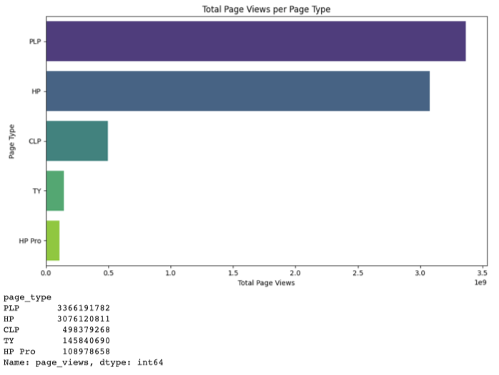
Page Views per page Type
Bivariate Analysis – Total Page Views per Page Type
Figure 2 highlights that PLP (Product Landing Page) and HP (Home Page) are the top 2 page types with the most views
TY (Thank You or Checkout) page is one of the lowest viewed pages because most people are viewing the products versus converting on the products.
HP Pro is the lowest viewed page
Figure 1

Slide 7
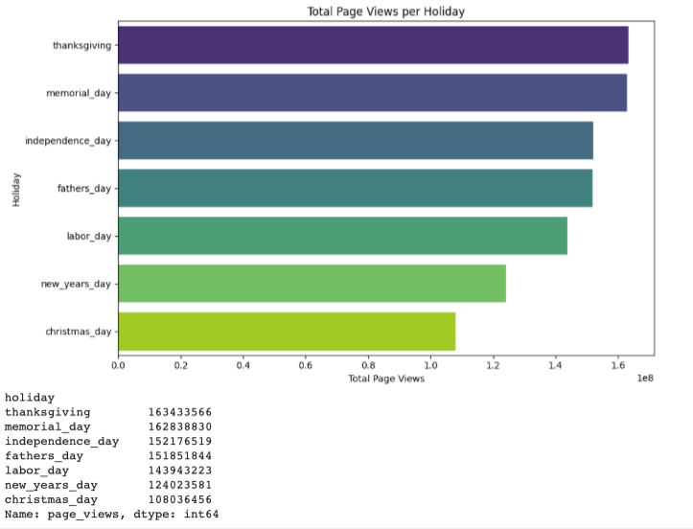
Page Views Per Holiday
Bivariate Analysis – Total Page Views per Holiday
Summary of findings:
Views highest on Thanksgiving, Memorial Day, and Independence Day
Views lowest on New Years and Xmas day
Insights/Assumptions:
Home improvement gifts are bought before New Years and Xmas in preparation, leading to lower spending on holidays themselves.
Highest sales of season during thanksgiving along with Memorial/Independence day sales without family obligations prompts higher spendings
Figure 2

Slide 8
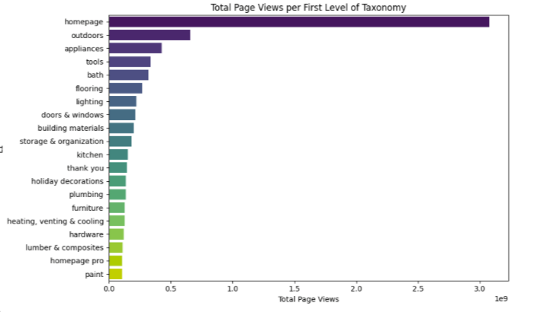
Page views per First level of Taxonomy
Bivariate Analysis – Total Page Views per First Level of Taxonomy
Summary of Findings:
Homepage, Outdoors, Appliances, Tools, and Bath have the top 5 most page views respectively
(Heating, venting, and cooling), hardware, (lumber and composites), homepage pro, and paint have the least amount of views, respectively
Insights:
Taxonomies that are geared for use by everyday consumers generate more views than those that would be used by professionals
Products that last longer and are bought at less frequent intervals by homeowners have less page views
Business Recommendations:
Views for first level of Taxonomy should be integrated into ad-space pricing
Figure 3

Slide 9
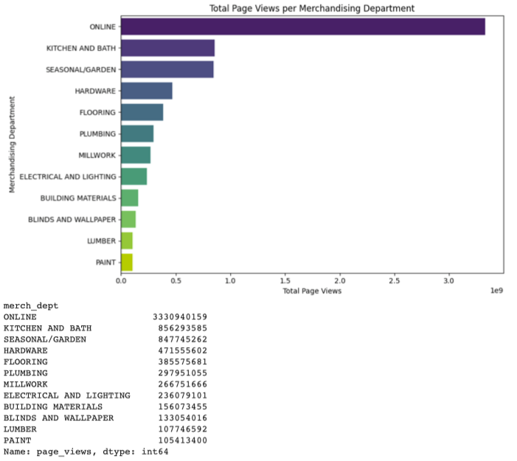
Page views per merchandising Department
Bivariate Analysis – Total Page Views per Merchandising Department
Summary of Findings:
Kitchen and Bath, Seasonal/garden, and Hardware are respectively the top 3 departments with the most views
Blinds and Wallpaper, Lumber, and Paint departments are displaying the least amount of views, respectively
Insights/Assumptions:
Everyday use items accumulate more views
Products with lower upgrade/replacement rates have lower page views
Business Recommendations:
Link existing Home Depot Ad Campaigns to page view results to identify success vs. areas for growth
Advertise existing HD DIY workshops to encourage individual consumer engagement with areas such as Paint, Lumber, and Electrical and Lighting
Integrate interior design trends into marketing campaigns to increase frequency of upgrades
Figure 4

Slide 10
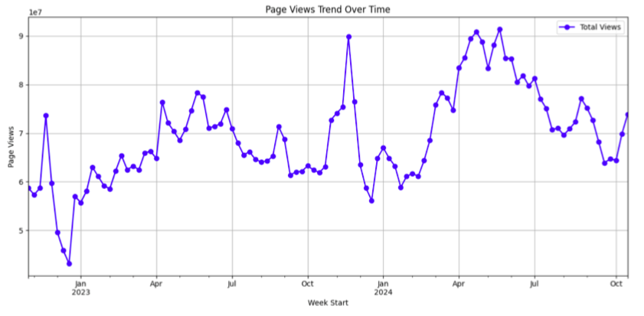
Page Views Trend over time
Bivariate Analysis – Page Views Trend Over Week Time
Summary of Findings:
The highest views occurs in mid-May of 2024, while the lowest views occurs in mid-December of 2022
There is a sharp increase in views from mid-December till January 1st, indicating the effect of Christmas and New Year’s buying
A sharp increase in views occurs from the first week of February 2024 till mid April 2024; this area of the curve appears to be the biggest jump in views in the whole graph
A severe increase in views occurs from mid-October 2023 till mid-November 2023; Then a severe drop in views occurs from the third week of November till mid-December, potentially indicating the end of Black Friday shopping
Figure 5

Slide 11
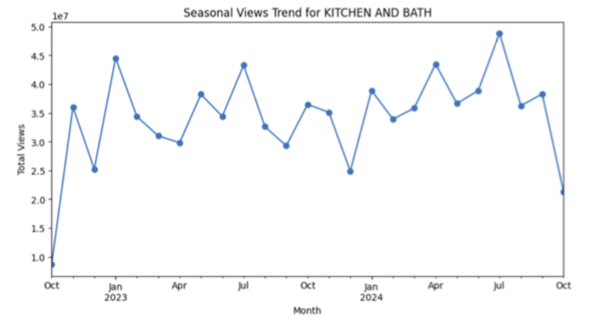
Seasonal Views Trend for Kitchen and Bath
Multivariate Analysis – Seasonal Views Trend for ‘Kitchen and Bath’ (high traffic department)
Summary of Findings:
Surge in views occurs in the period between December and January
July 2024 (48,827,175 views) had the highest views for the Kitchen and Bath merchandising department.
The lowest engagement occurred in October 2022, with only 8,696,833 views
Insights/Assumptions:
Overall, kitchen and bath maintain steady performance throughout the year, indicating consistent demand for these products.
Surge views between Dec and Jan highlights plans to renew bathrooms in the New Year
Low traffic during the fall may be due to desire to reduce renovations prior to the holiday season with regular family and friend visits to the home. High traffic in July indicates summers are ripe for renewal
Business Recommendations:
Leverage high demand for kitchen and bath products in New year and summer with complementary ad campaigns
Create ad campaigns centered around preparing the home for thanksgiving and hosting family to increase Kitchen-related page views and buys in the beginning of Fall
Figure 6

Slide 12
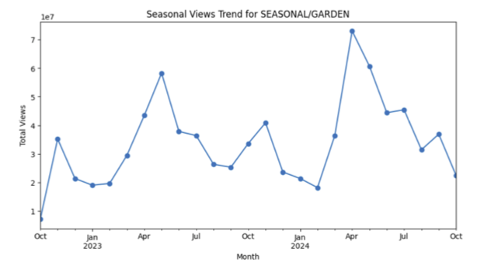
seasonal views Trend for Seasonal/Garden
Multivariate Analysis – Seasonal Views Trend for ‘Seasonal/Garden’ (high traffic department)
Summary of Findings:
A steep decline in views occurs during the winter and summer months
A steep surge in views occurs in the spring months for seasonal/garden products
The lowest engagement occurs on October 2022 and the highest engagement occurs in April 2024
Insights/Assumptions:
Seasonality is of prime importance in gardening. Springtime has an influx while too hot summer months and too cold winters has declines in views
Business Recommendations:
Ad campaigns centered around plants/flowers that grow/bloom well during summer and winter to increase sales during these periods. Consider promotional sales to generate momentum.
Continue complementing springtime sales with advertising campaigns.
Increase ad-space pricing in springtime on gardening pages
Figure 7

Slide 13
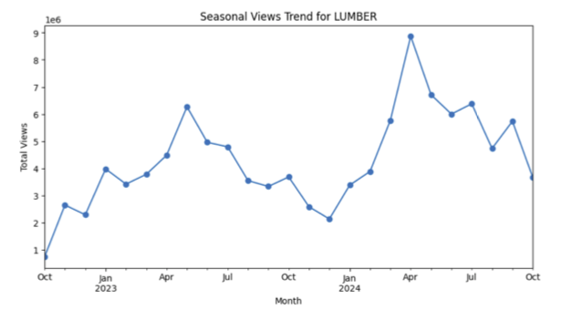
seasonal views Trend for Lumber
Multivariate Analysis – Seasonal Views Trend for ‘Lumber’ (low traffic department)
Summary of Findings:
Steady increase is displayed from January till around around April/May and then there is a steady drop from May till December.
Demand for lumber during the springtime has increased
The lowest engagement occurs on October 2022 and the highest engagement occurs on April 2024, likely driven by outdoor projects.
Insights/Assumptions:
Outdoor projects during the springtime require lumber
Summer and Winter may be difficult times of year to build outdoor products requiring lumber
Business Recommendations:
Structure marketing campaigns around indoor projects (e.g. wall paneling) during summer and winter months to increase purchasing
Figure 8

Slide 14
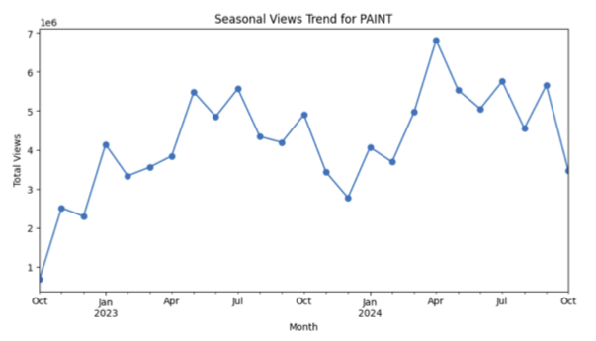
seasonal views Trend For Paint
Multivariate Analysis – Seasonal Views Trend for ‘Paint’ (low traffic department)
Summary of Findings:
According to Figure 9, a sharp increase in views occurs from February 2024-April2024; A sharp increase occurs from February 2023 to May 2023
A sharp increase in views occurs from December to January in both years
The lowest engagement occurs on October 2022 and the highest engagement occurs on April 2024, likely driven by springtime and outdoor projects.
Insights/Assumptions:
New Years and Christmas may have an impact on the sharp increase in views from December to January
Paint products are higher in demand during the spring time potentially because of the pleasant weather conditions
Business Recommendations:
Create Ad campaigns in the month of December to amplify ROAS during that period of high demand for paint products
Advertising workshops on how to paint interiors
Figure 9

Slide 15
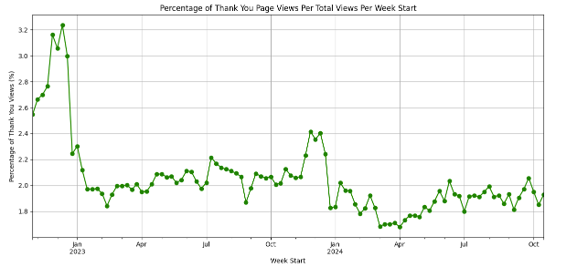
Conversion Rate Trend over Time
Bivariate Analysis – Conversion Rate Trend Over Week Start
Figure 11displays the conversion rate per week start based on the Thank You Page Views
Summary of Findings:
Top 5 ‘week starts’ conversion rates: Conversions are at their highest during the Christmas holiday season in 2022
12-12-2022 (3.23%)
11-28-2022 (3.16%)
12-5-2022 (3.06%)
12-19-2022 (3.00%)
11-21-2022 (2.76%)
Conversion rates remain high in 2023 during the Holiday season
The lowest conversion rate occurs on 4-1-2024 (1.68%).
Insights/Assumptions:
Average expenditures increased in 2022 likely due to increased savings for upper-middle class families post Covid¹
Macroeconomic trends including increased inflation and economic concerns during 2024 may have dampened spending²
Figure 10
Notes:
1. https://www.bls.gov/opub/reports/consumer-expenditures/2022/#BLStable_2023_12_13_12_31_footnotes
2. https://www.mckinsey.com/industries/consumer-packaged-goods/our-insights/the-state-of-the-us-consumer
Moreover, there is a huge spike in conversions in preparation for Thanksgiving (in the month of November for both years)
After the mid-week of December, there is a significant decline in conversions, potentially due to the end of gift buying for the year

Slide 16
Top 10 Taxonomies for the Top 3 Merchandising Departments (Descending Order)
Online
Homepage
Thank You
Homepage Pro
Seasonal/Garden
Outdoors>patio furniture
outdoors>garden center
holiday decorations>halloween decorations
outdoors>outdoor power equipment
storage & organization > outdoor storage>sheds
holiday decorations>Christmas decorations>Christmas greenery
holiday decorations>christmas decorations>outdoor Christmas decorations
holiday decorations>Christmas decorations
Outdoors
outdoors>garden center>landscaping supplies>mulch
Kitchen and Bath
Appliance> refrigerators,
Appliances
bath>bathroom vanities
bath>bathroom vanities>bathroom vanities with tops
appliances>refrigerators>french door refrigerators
kitchen>kitchen cabinets
appliances>washers&dryers
appliances>dishwashers
bath
appliances>washers&dryers>washing machines

Slide 17
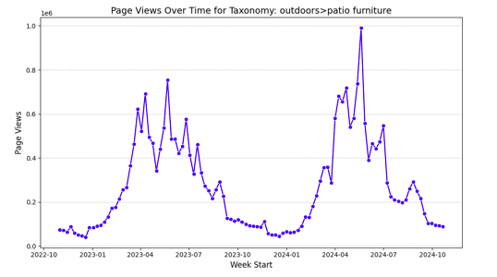
Page Views over time for Taxonomy: outdoors>Patio furniture
Multivariate Analysis –
Summary of Findings:
According to Figure 11, a sharp increase in views occurs in the spring and summer
Views plateau during the fall and winter months
Insights:
Since the taxonomy is patio furniture, views will likely increase during optimal weather conditions
No one wants to buy patio furniture during the winter and fall months
Business Recommendations:
Certain taxonomies will have higher or lower viewership according to seasonal demand
Figure 11

Slide 18
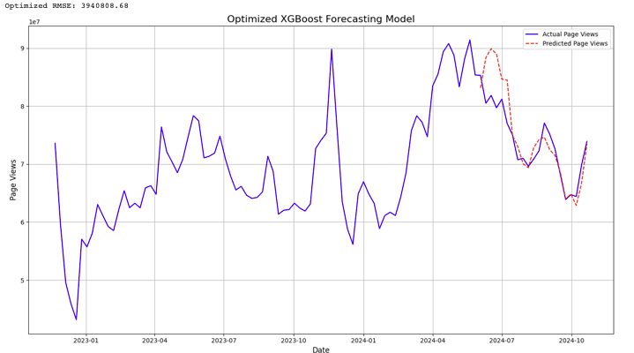
Forecasting Model Summary
Built an XGBoost Forecasting model with an RMSE (Root Mean Squared Error) of 3,940,808.68
Dividing RMSE by the weekly average returns 5.4%; overall this model is accurate at making predictions on the test data since the error is near 5% (an indication of an excellent forecasting model)
Figure 12

Slide 19
Business Recommendations
Season-based marketing campaigns to support strong sources of revenue and prop up areas for growth
Kitchen and Bath
Winter and Summer are strong. Complement with ad campaigns
”Getting ready for the holidays” as a campaign to increase sales during the Fall season
Seasonal/Garden
Springtime page views are strong. Complement with ad campaigns
Promotions for winter and summer-hardy fruits, vegetables, flowers, and shrubbery
Lumber
Structure marketing campaigns around indoor projects (e.g. wall paneling) during summer and winter months to increase purchasing
Paint
Create Ad campaigns in the month of December and spring time to amplify ROAS during that period of high demand for paint products
Price ad-spaces based on historic views per page during seasonal peaks/troughs based on Merchandising Department and Taxonomies
Improve User website experience while shopping to lead to higher conversion rates (Thank You Page views)
Simplify the checkout process and provide clear payment options

